Slide 1
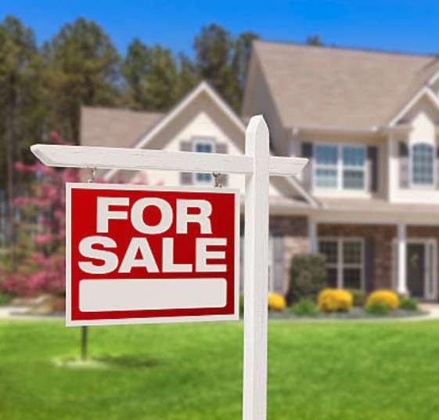
Statistical Analysis on Home Sale Prices
Alison Inglis

Slide 2
Distribution of Home Sale Prices
Notes:
Normal distribution as shown with bell curve
Right skewed
Probability distribution that’s symmetric about the mean
Data near the mean occurs more frequently than data far from the mean

Slide 3
Hypothesis 1: Year Build
Ho: there is no significant difference in the means of the two groups – houses built after 1970 and houses built before 1970.
Ha: there is significant difference in the means of the two groups – houses built after 1970 and houses built before 1970.

Slide 4
Hypothesis 1: Year Build
Reject the null that there is no difference between the means of homes built after 1970 and homes built before 1970.
This difference is significant at the p < a (0.05) level. And with 95% confidence, the difference is between $69,856.17 and $83,793.75.
Notes:
If p value is below 0.05, reject null hypothesis
Threshold of 95% is a confidence interval

Slide 5
Hypothesis 2: Fireplaces
Ho: there is no significant difference in the means of the two groups – houses with no fireplaces and houses with 1 fireplace.
Ha: there is significant difference in the means of the two groups – houses with no fireplaces and houses with 1 fireplace.

Slide 6
Hypothesis 2: Fireplaces
Reject the null that there is no difference between the means of no fireplaces and 1 fireplace homes.
This difference is significant at the p < a (0.05) level. And with 95% confidence, the difference is between $63,687.32 and $77,626.02.

Slide 7
Hypothesis 3: Central Air
Ho: there is no significant difference in the means of two groups – houses with no central air and houses with central air.
Ha: there is significant difference in the means of the two groups – houses with no central air and houses with central air.

Slide 8
Hypothesis 3: Central Air
Reject the null that there is no difference between the means of no central air and central air homes.
This difference is significant at the p < a (0.05) level. And with 95% confidence, the difference is between $71,206.63 and $89,823.71.

Slide 9
Hypothesis 4: Garages
Ho: there is no significant difference in the means of two groups – houses with a 1-car garage and houses with a 2-car garage.
Ha: there is significant difference in the means of the two groups – houses with a 1-car garage and houses with a 2-car garage.

Slide 10
Hypothesis 4: Garages
Reject the null that there is no difference between the means of 1-car garage and 2-car garage homes.
This difference is significant at the p < a (0.05) level. And with 95% confidence, the difference is between $50,757.95 and $67,622.97.

Slide 11
Results
Tested 4 factors that affect real estate prices
Ran t-tests to test hypotheses
Each factor is statistically significant so reject null hypotheses

Slide 12
Recommendations
Built after 1970
Fireplace (1)
Central Air
2-Car Garage
Notes:
Maximize investment

