Slide 1

Understanding Wine Quality
Alison Lanski
Spring 2019

Slide 2
The Dataset
6497 observations with
12 variables about
acidity (x2)
citric acid
sugar
chlorides
sulfur dioxide (x2)
density
pH
sulphates
alcohol
type (red or white)
1 reponse: quality
2384 low quality (score 0-5)
4113 are high quality (score 6-10)
No missing data

Slide 3
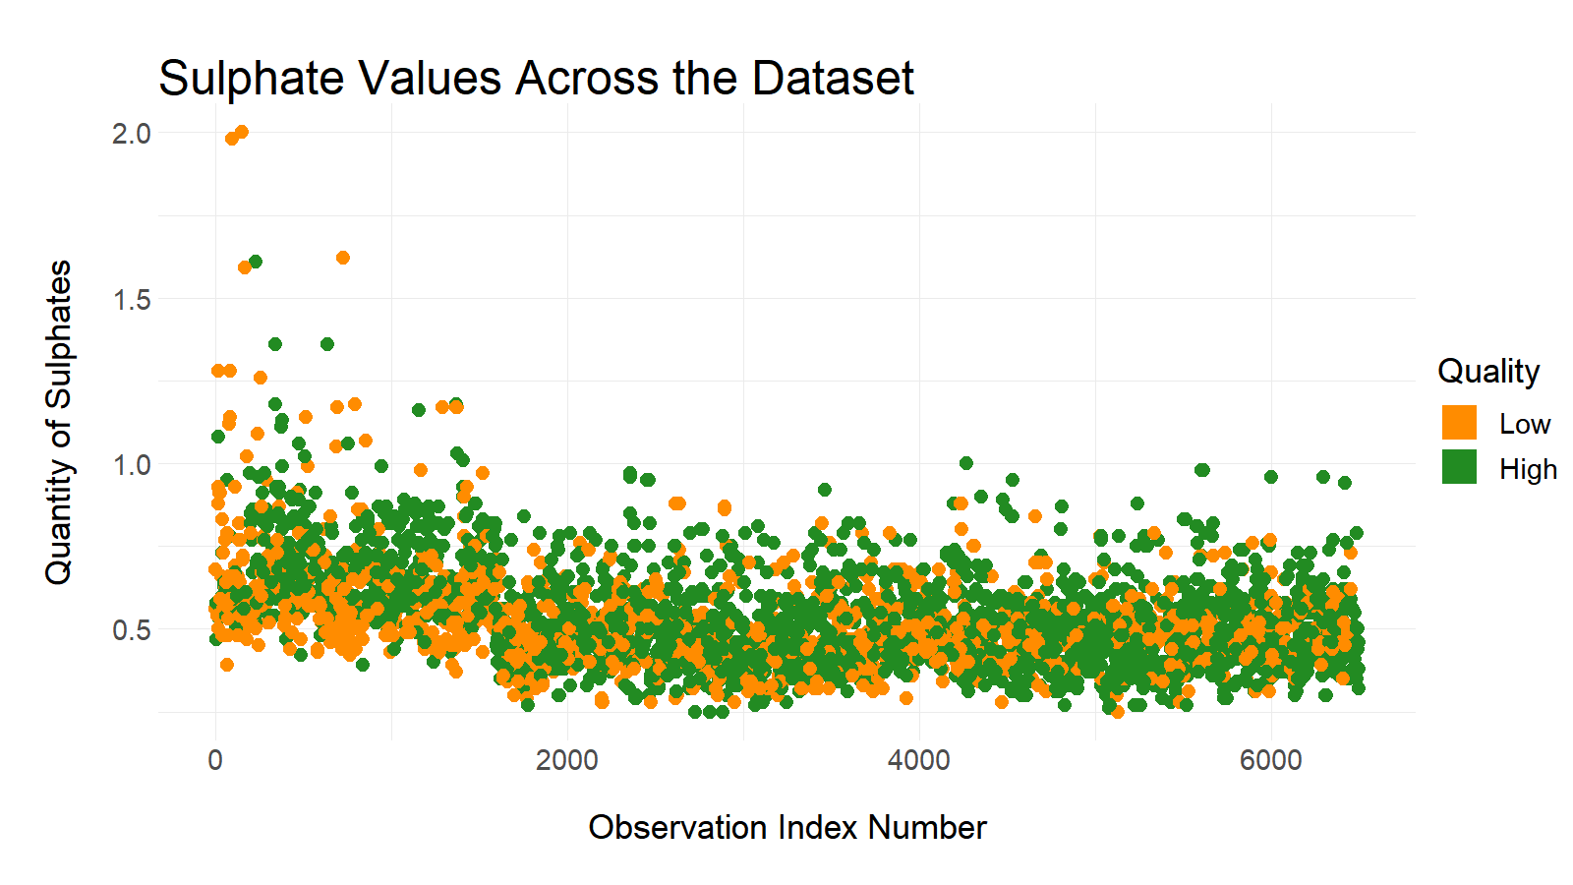

Slide 4
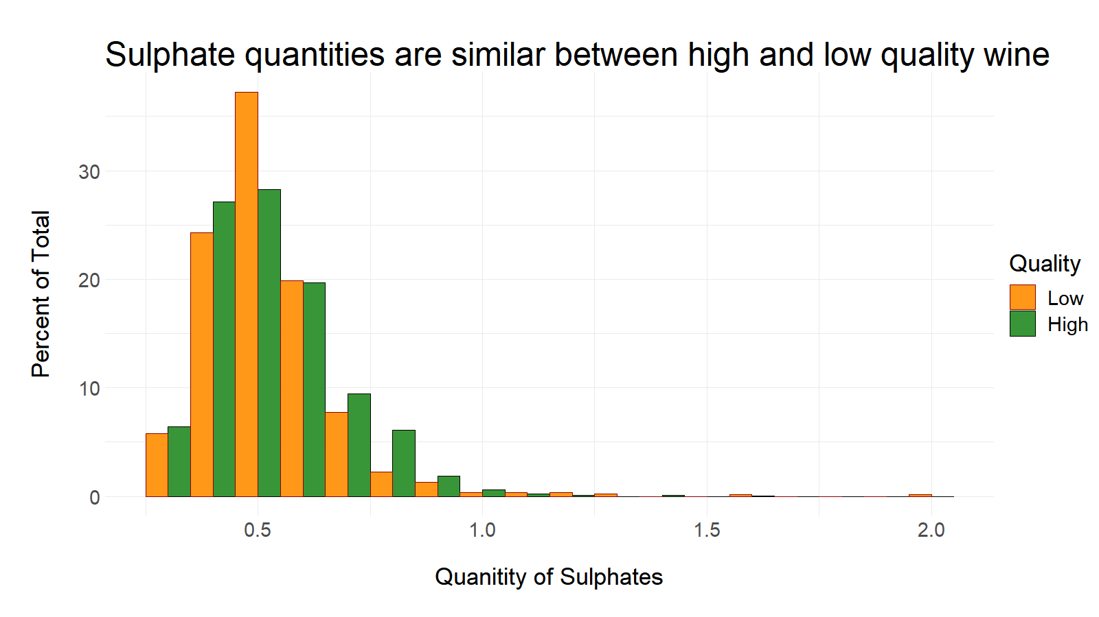

Slide 5
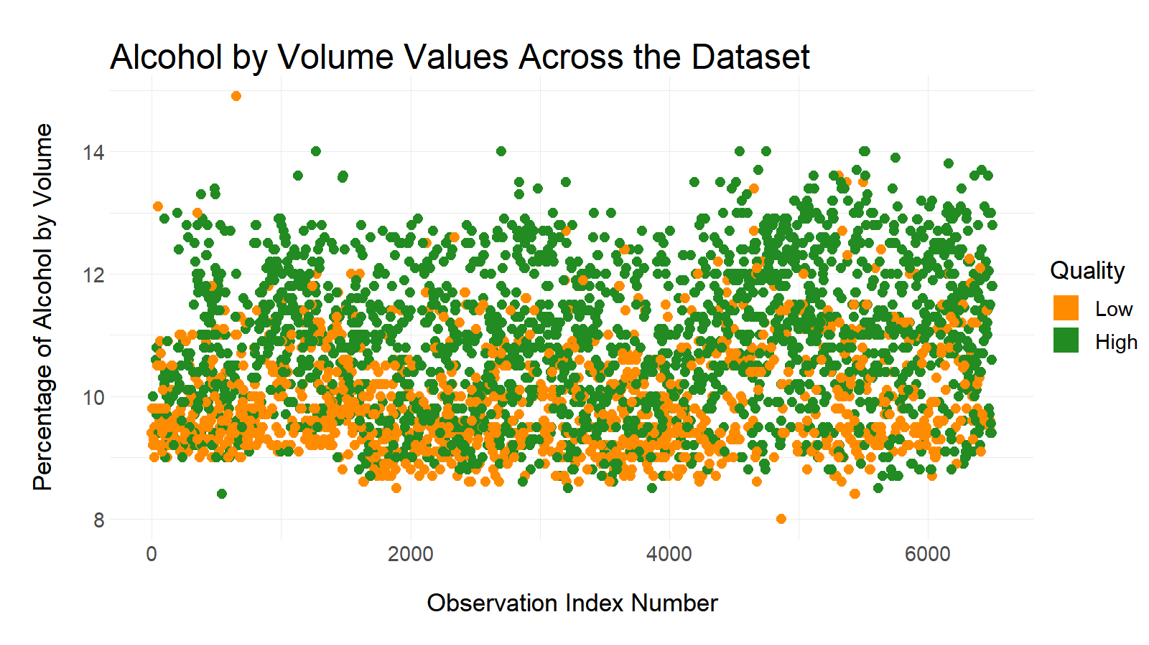

Slide 6
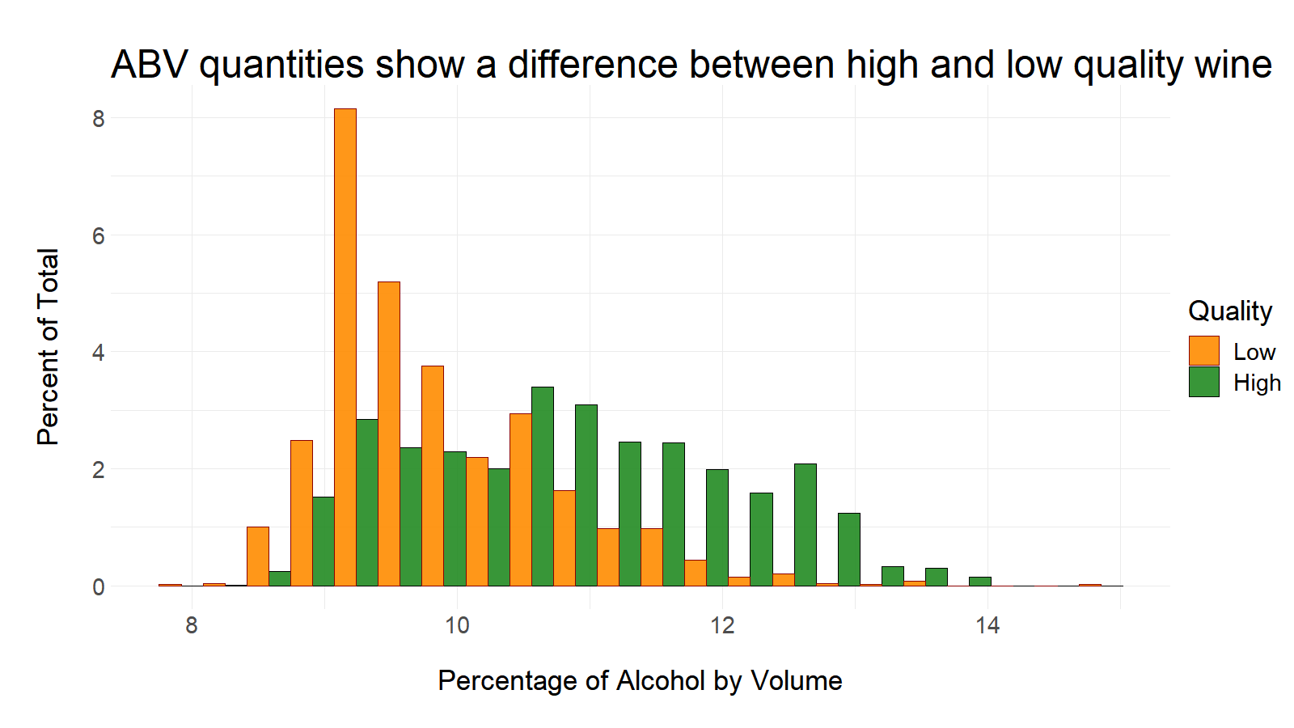

Slide 7
Modeling Phase 1: Start with everything
The Full Model:
glm(quality ~ ., data = dat_train, family = "binomial")
AIC top results:
Akike Information Criteria test
Fixed Acidity and chlorides removed -- still a complex model, unstable estimates?
Look for correlations
Remove items to eliminate strong correlation: sulfur dioxide and density
Rerun AIC
Model Version | AIC | Deviance | Notes
1: Full model | 4091.5 | 4065.5 | starting point
2: Full model without citric acid | 4089.6 | 4065.6 | selected by AIC
3: Full model without citric acid or chlorides | 4089.6 | 4067.6 | simpler and preferred

Slide 8
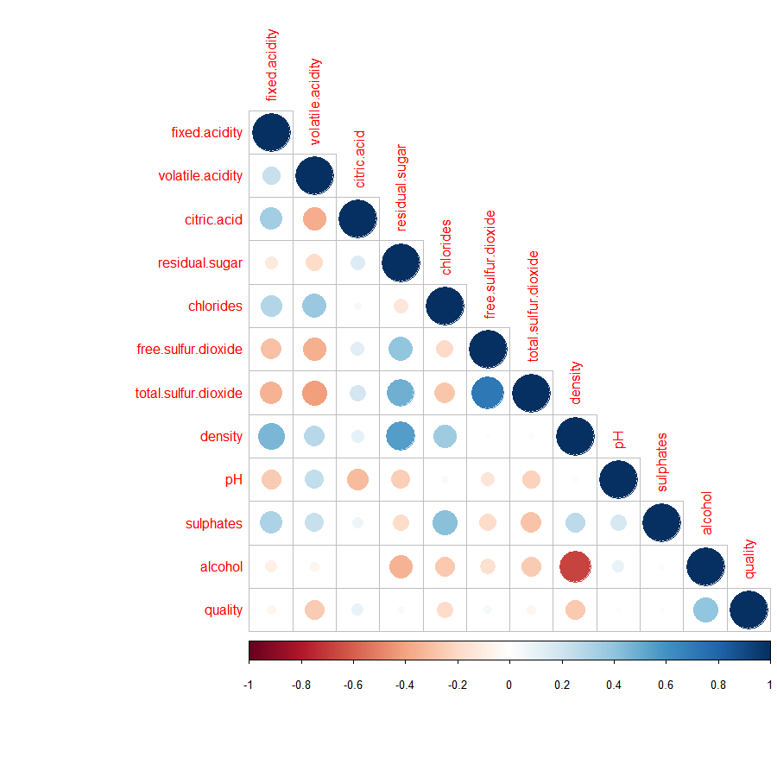
Removing total sulfur dioxide and density may improve the model by reducing multicollinearity

Slide 9
Modeling Phase 2: Simplify, simplify, simplify
Removed after AIC:
citric.acid, chlorides (Model 3)
Removed additionally after multicollinearity check:
total.sulfur.dioxide, density (Model 4)
glm(quality ~ fixed.acidity + volatile.acidity + residual.sugar + free.sulfur.dioxide + pH + sulphates + alcohol + type, data = dat_train, family = 'binomial')
Rerun AIC to produce Model 5....

Slide 10
Final Model
Model 5: glm(quality ~ volatile.acidity + residual.sugar + free.sulfur.dioxide + pH + sulphates + alcohol + type,
data = dat_train,
family = 'binomial')
Model Version | AIC | Deviance | Notes
3: Full model without citric acid or chlorides | 4089.6 | 4067.6 | selected previously
4: Model without citric acid, chlorides, total sulfur dioxide, or density | 4116.9 | 4098.9 | with reduced multicollinearity
5: Same as model 4 with fixed acidity also removed | 4115.7 | 4099.7 | selected by AIC from model 4: simplest so far

Slide 11
Assess Model Fit: Hypothesis Testing
Hosmer-Lemeshow Goodness of Fit Test on the Final Model (5):
hoslem.test(finalmod$y, finalmod$fitted.values, 10) test stat is 8.2116 with 8 degrees of freedom
p = 0.4131 > alpha = 0.05, so we fail to reject the null hypothesis:
The fit of our final model is adequate

Slide 12
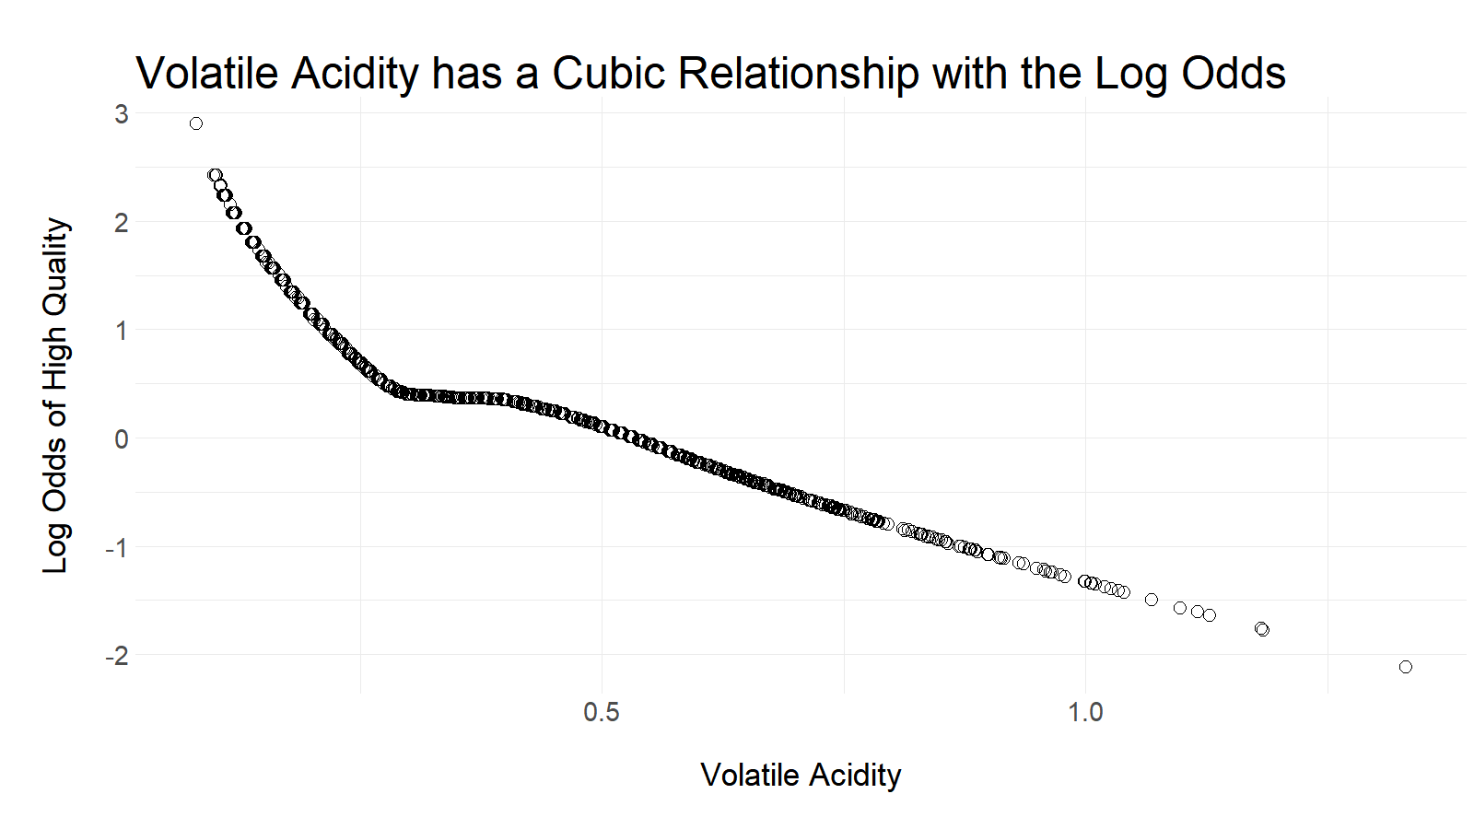

Slide 13
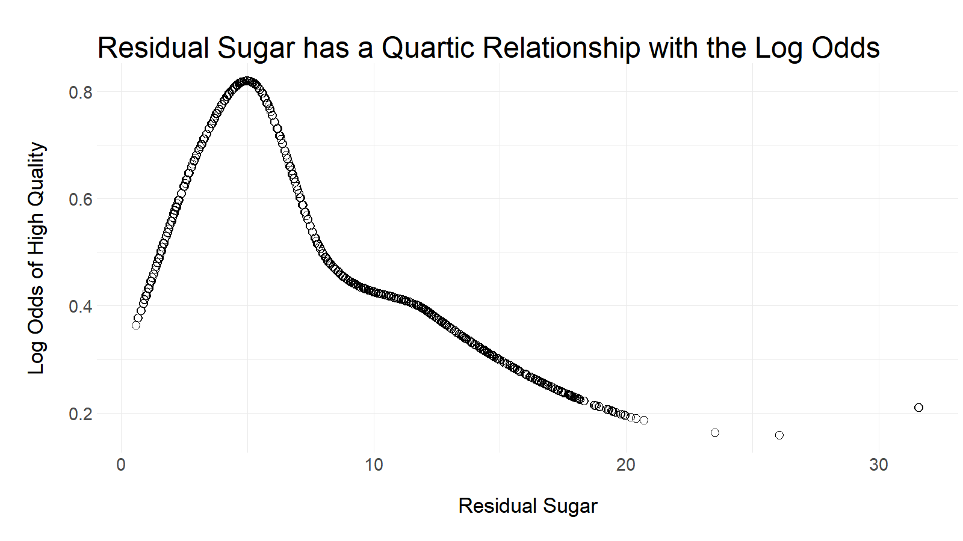

Slide 14
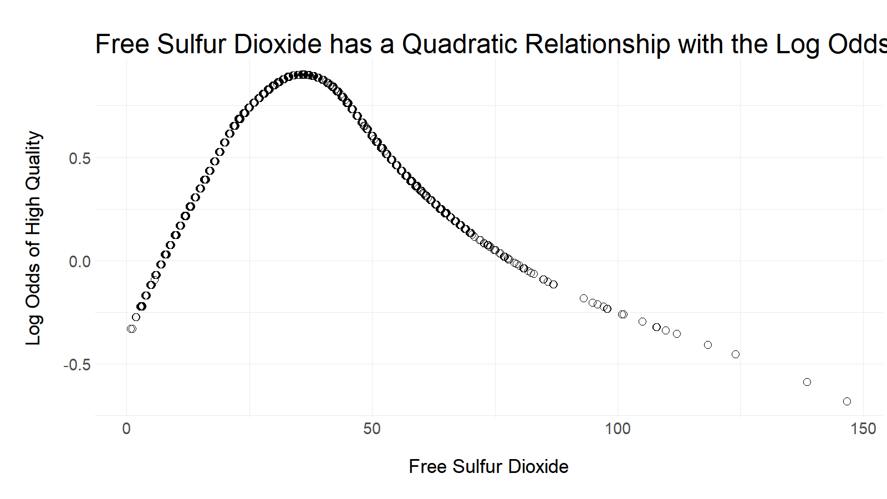

Slide 15
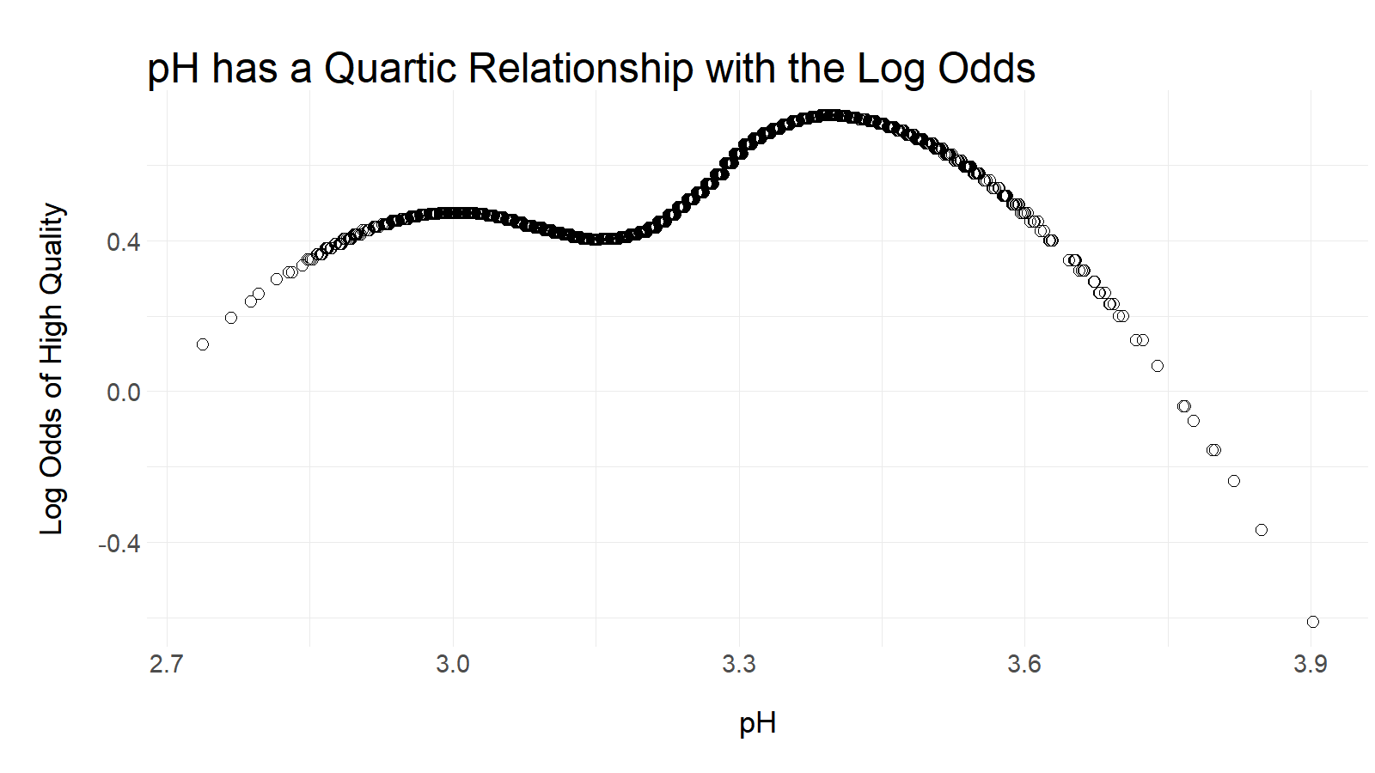

Slide 16
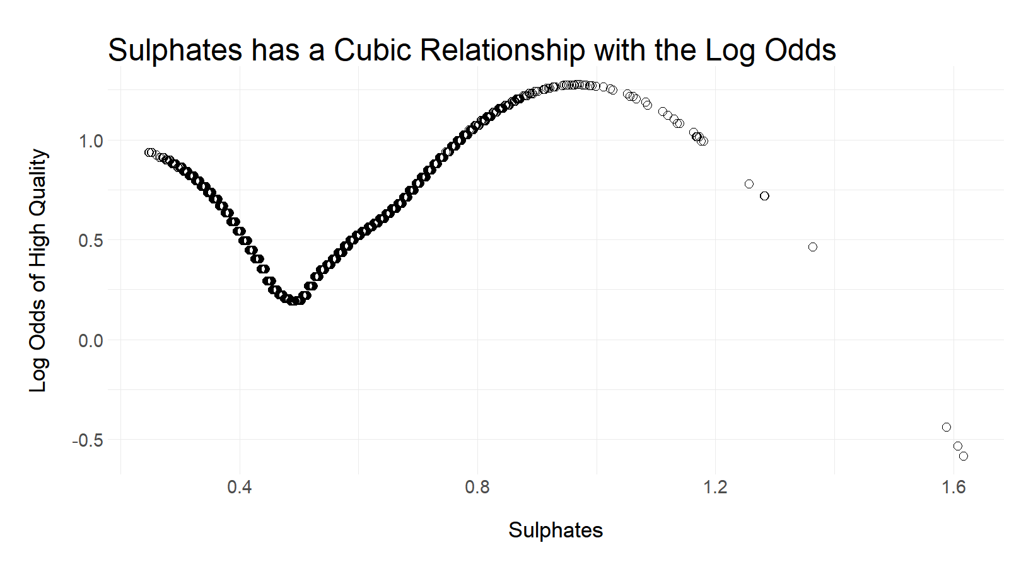

Slide 17
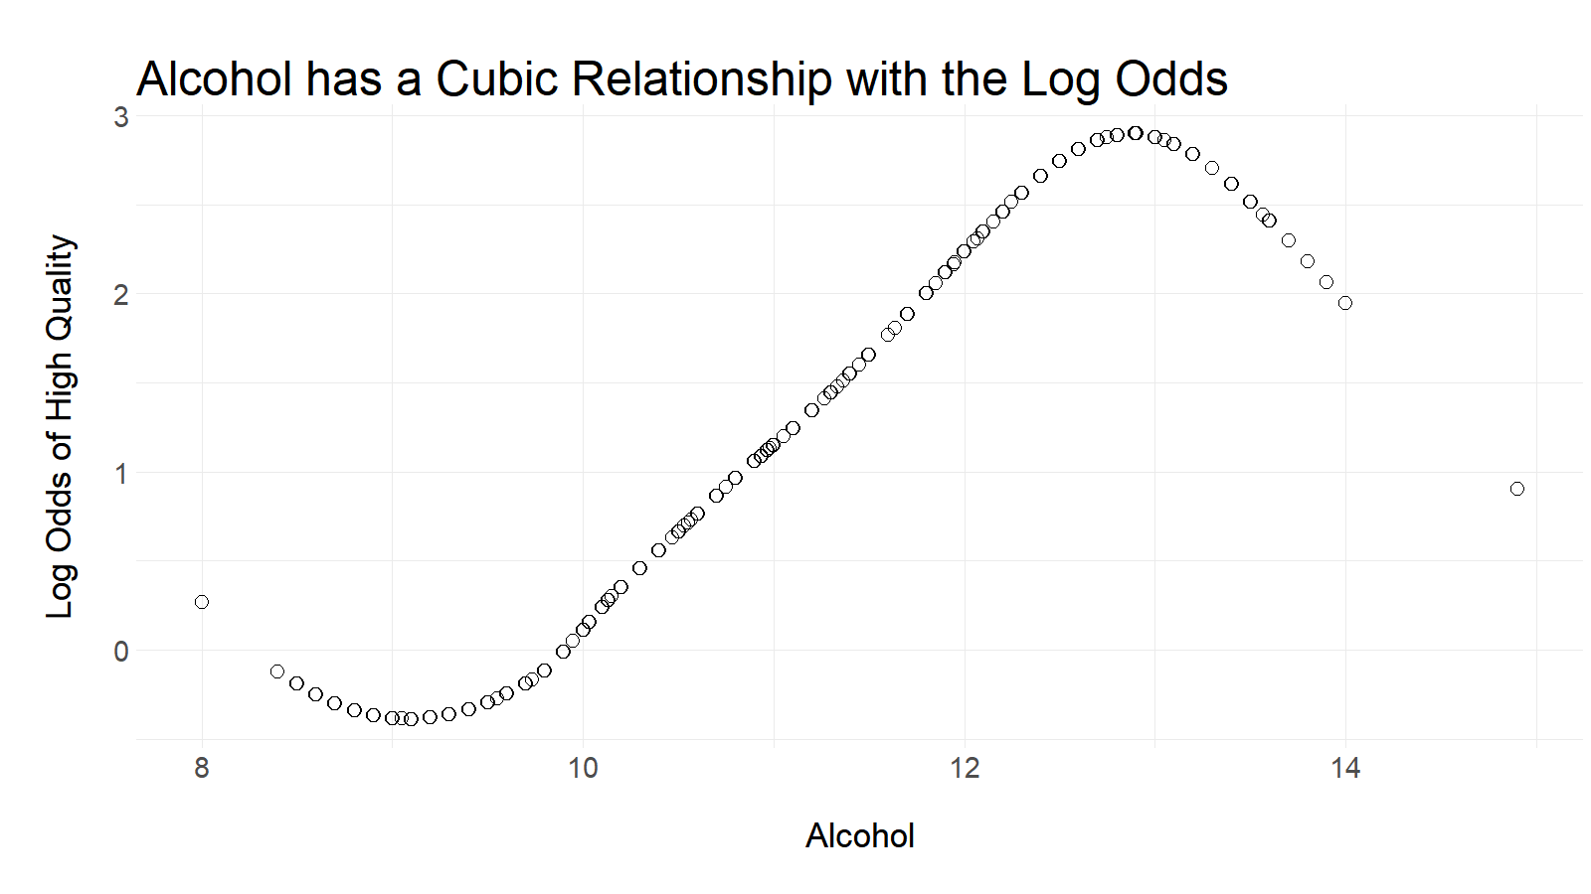

Slide 18
Assess Model Fit: Hypothesis Testing
Hosmer-Lemeshow Goodness of Fit Tests:
The Final Model (5) gives p = 0.4131
The Splined Final Model (6) gives p = 0.5091
The fit of our splined model is still adequate --- hooray!

Slide 19
Highly Significant Variables, by p-value
Parameter | p-value |  | Parameter | p-value
volatile acidity (1) | 0.00000000000132 |  | alcohol (1) | 0.024242
volatile acidity (2) | 0.00000794865404 |  | alcohol (2) | < 0.0000000000000002
volatile acidity (3) | 0.00000000004057 |  | alcohol (3) | < 0.0000000000000002
free sulfur dioxide (1) | 0.00000000223668 |  | type (white) | 0.00000001090218
free sulfur dioxide (2) | 0.095235
Other parameters with larger p-values (many significant) are: intercept, residual sugar (1-4), pH (1-4), sulphates (1-3)

Slide 20
The data has no outliers that influence the model
Our data has all Cook's Distances within [0.000000049 , 0.068]
AKA: all are less than 1 (not outliers)

Slide 21
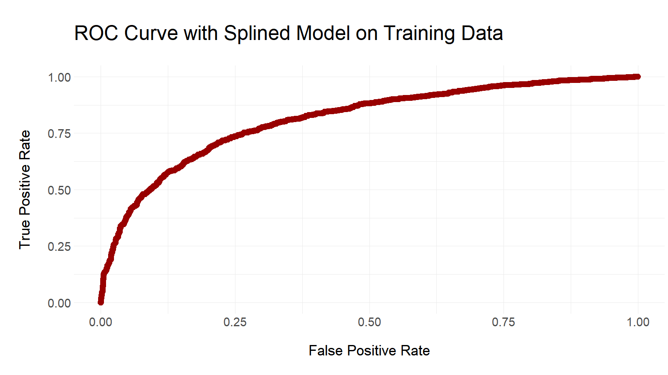
AUC = 0.811

Slide 22
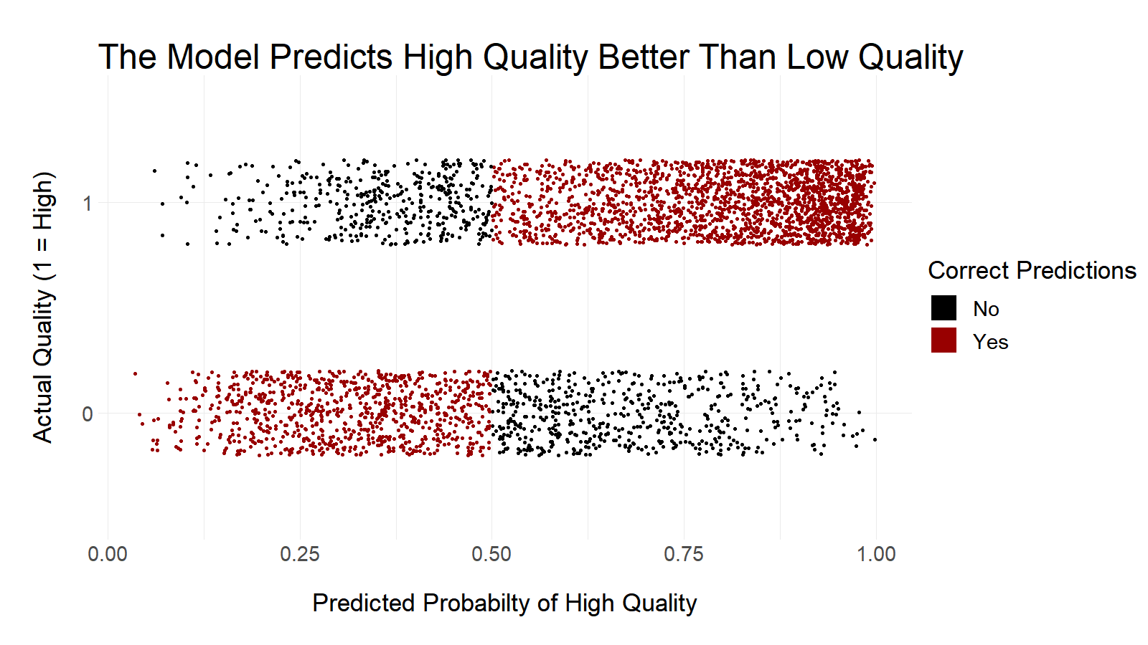

Slide 23
The Model is Acceptable on Test Data
Check fit with Hosmer-Lemeshow
p = 0.18 > alpha = 0.05, so we fail to reject the null hypothesis:
The fit is still adequate

Slide 24
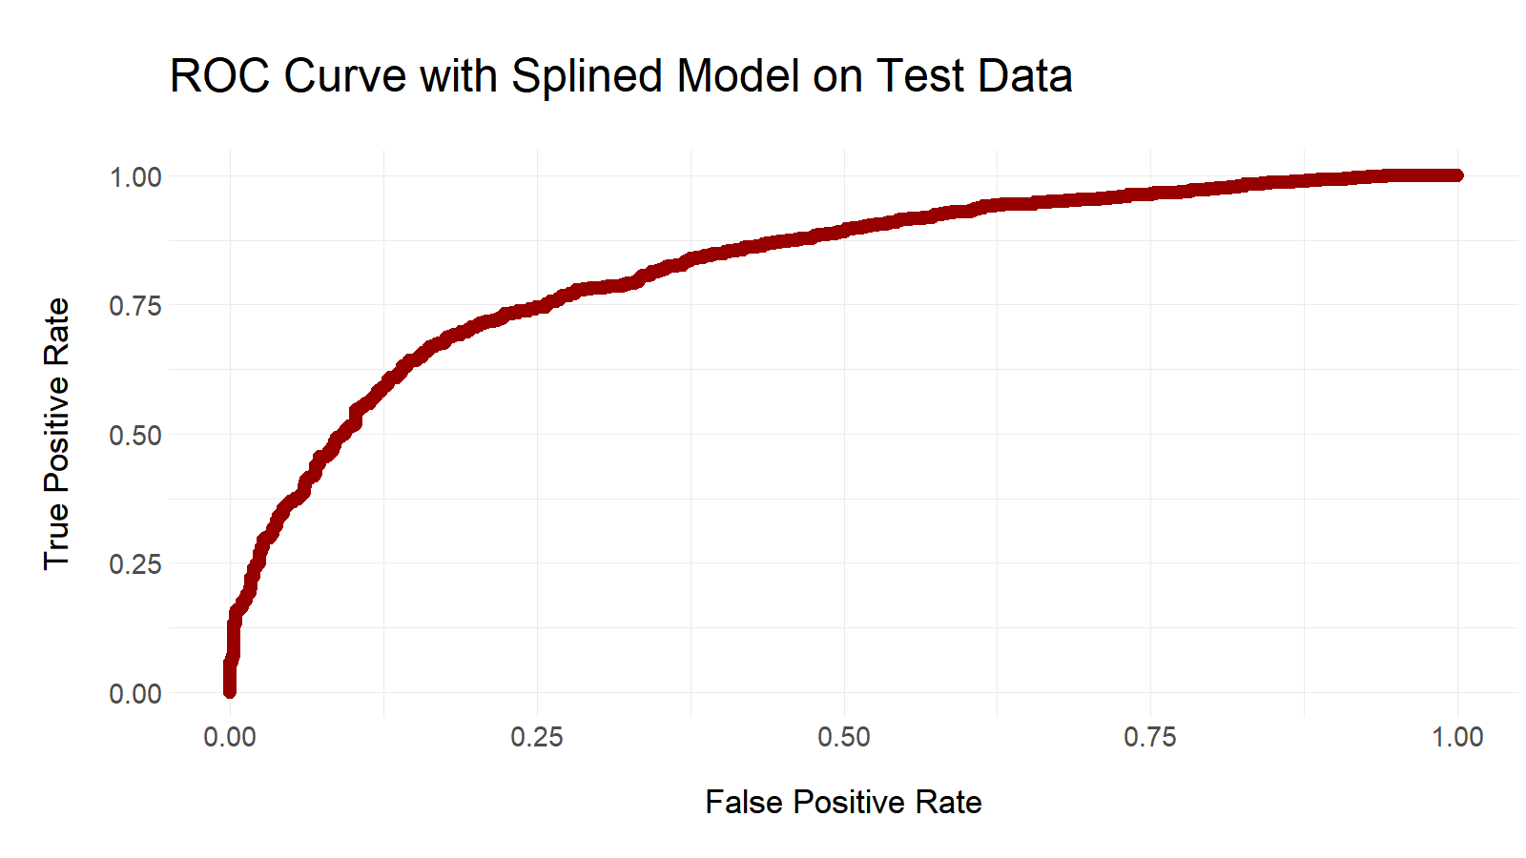
AUC = 0.822

Slide 25
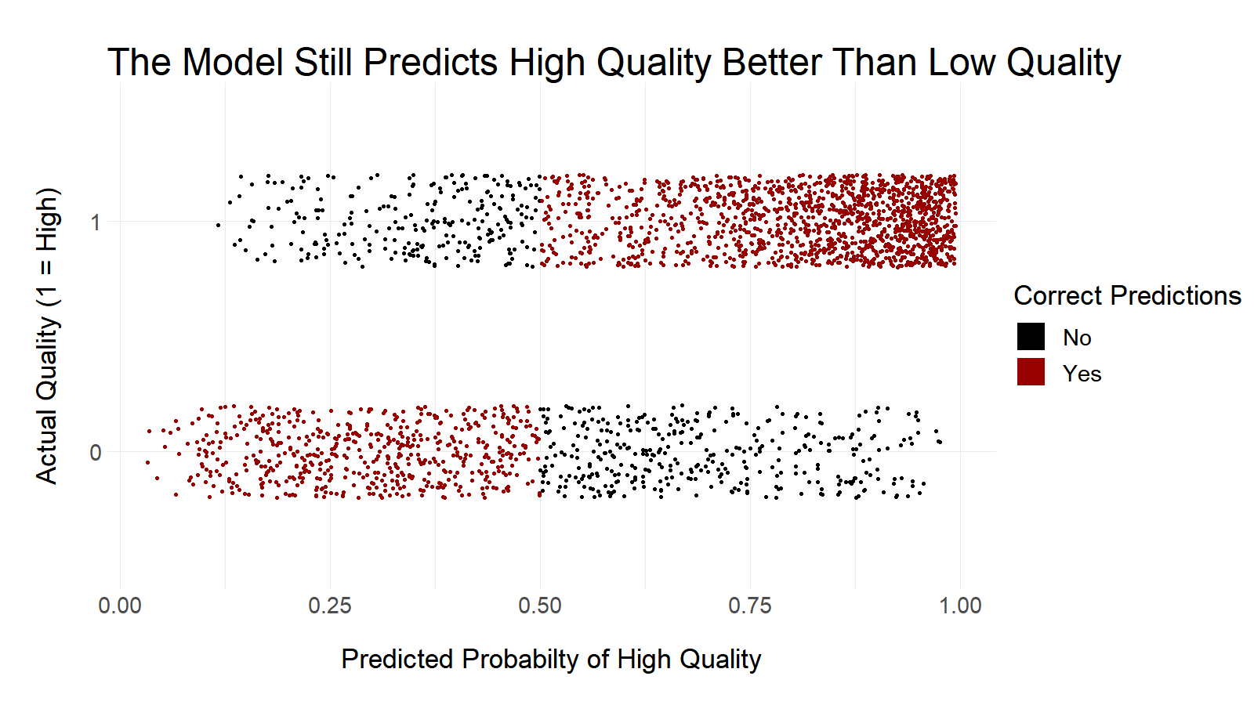

Slide 26
Be Careful!
The data is imbalanced
Too many white wines
Too many high quality wines
No very bad and few very good wines in the data
The model may not fit other kinds of wines
Data is 100% based on Portuguese "Vinho Verde"

Slide 27
Takeaways
The model is well-fit
HL test shows reasonable fit with training and test data
Accuracy is steady between training (75%) and test (76%) data
AUC for the ROC is excellent at 0.811 training and 0.822 test
A wine rated as high-quality tends to be a red wine with..
lower volatile acidity
higher residual sugar
higher free sulfur dioxide
lower PH (more acidic)
higher sulphates
higher ABV

