Slide 1
A Geometric Analysis of
Spectral Stability of Matrices
Shreemayee Bora and Rafikul Alam
Department of Mathematics
Indian Institute of Technology, Guwahati
INDIA

Slide 2
The Problem:
Characterization of the sensitivity of eigenvalues and
spectral decompositions of an n-by-n matrix A.
By a spectral decomposition of A we mean a pair of
matrices (X,D) where
X is invertible,
D is the block diagonal matrix D := diag(A ,A ,··,A )
such that X A X = D,
(iii) A is of size n with σ(A ) ∩ σ(Α ) = φ for i ≠ j.
Equivalently, a spectral decomposition of A is specified
by a partition of the spectrum σ (A) of A into
disjoint sets:
σ (A) = ∪ σ , σ ∩σ = φ, i ≠ j
-1
1
2
m
j
j
i
j
m
j
i
j
j=1

Slide 3
In practice we may be working with an n-by-n matrix A+E
where E is any random matrix such that ||E|| is less than
or equal to ε.
Thus A is indistinguishable from any other matrix in the
ball
n
Ball (A, ε) := {Á ∈ BL(C ) : || A – Á|| < ε}
|
m
We would like the spectral decomposition σ (A) = ∪ σ to
hold in some sense for all matrices in Ball (A, ε).
j=1
j

Slide 4
Definition: We say that the spectral decomposition
σ(Α)= ∪ σ , σ ∩ σ = φ, i ≠ j
is ε-stable if the eigenvalues in σ and σ do not
move and coalesce as A is continuously perturbed
with the magnitude of the perturbations gradually
increasing to ε.
m
j
i
j
j=1
i
j

Slide 5
We define the ε-spectrum of A to be the set
σ (Α):= ∪ σ(A+E) = { z ∈ C : sep (z,A) < ε }
|
__
ε
||E|| < ε
_
where
sep(z,A) := min{||E|| : z ∈σ (A+E)}
If the norm is an operator norm we have,
σ (Α) ={z ∈ C : ||R(A, z)|| ≥ 1/ε}
|
ε
where R(A,z) := (A-z I) , z ∈ρ(Α)
and ||R(A,z)|| = ∝, z∈σ(A)
-1
Proposition: The ε–spectrum for the spectral and Frobenius norms coincide.

Slide 6
For an operator norm the ε-spectrum of A has the
following properties
.
σ (Α) is the closure of {z ∈ C : || R(A,z)|| > 1/ε}
|
ε
.
∂σ (Α) ⊆ {z ∈ρ(Α) : || R(A,z)|| = 1/ε}
ε
.
Each component of σ (Α) contains at least one
eigenvalue of A in its interior.
ε
.
If ||diag(A , A )|| = max { ||A ||,||A || }
1
2
1
2
σ (diag (A , A ) ) = σ (A ) ∪σ (A )
ε
1
2
ε
1
ε
2

Slide 7
The dissociation of the subset σ⊂σ(A) from the rest of σ(A), is the minimum magnitude of perturbation for which an eigenvalue from σ and an eigenvalue from σ(Α)\σ move and coalesce.
diss(σ)
diss(σ ,σ ,··,σ ,A) = min(diss(σ)), j=1,2,..,m.
1
2
m
j
Theorem (Demmel): The spectral decomposition
σ(Α)=∪ σ is ε-stable if and only if
ε < diss(σ ,σ ,··,σ ,A)
m
j
j=1
1
2
m
Drawback: Dissociation is a highly implicit concept and its value depends upon the structure of the underlying normed linear space as well as on the form of the matrix.

Slide 8
The geometric separation of the subset σ⊂σ(A)
from the rest of σ(A), is the minimum value of ε for
which a component of σ (A) containing an eigenvalue
from σ coalesces with a component containing an
eigenvalue from σ(Α)\σ.
gsep(σ)
ε
gsep(σ ,σ , ···,σ ,A) = min(gsep (σ )), j=1,2,..,m.
1
2
m
j

Slide 9
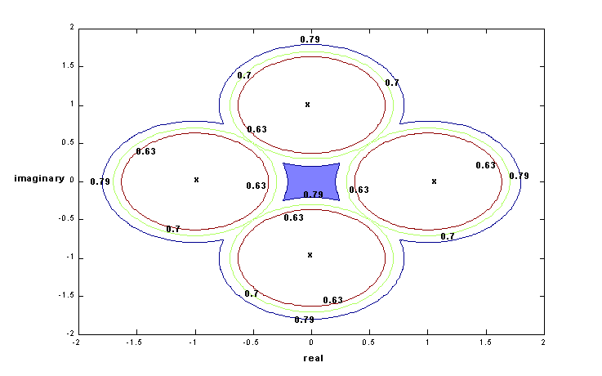
For the diagonal matrix A= diag(1,-1, i, -i), the following figure
illustrates that gsep(1) = gsep(-1) = gsep(i) = gsep(-i) = 0.7

Slide 10
Evidently we have,
diss(σ)≥ gsep(σ).
Thus gsep provides a sufficient condition for the
stability of spectral decompositions.
The lower bound of diss provided by Demmel and
in fact all other lower bounds obtained from
localisation theorems are lower bounds of gsep.

Slide 11
Problem: Does gsep characterize the
stability of spectral decompositions?
In other words is gsep(σ) = diss(σ) ?
Ans:
(i) For an operator norm satisfying the maximum property the answer is yes if
A is in block diagonal form.
(ii) For the spectral norm, the answer is yes
for any n-by-n matrix A.
Conjecture: For operator norms and the
Frobenius norm, we have gsep(σ) =diss(σ).

Slide 12
Theorem: For the spectral norm a
m
spectral decomposition σ(Α) = ∪ σ is
ε-stable if and only if ε < gsep (σ , σ ,···, σ )
In particular if σ(Α) = { λ , λ ,…, λ } then
each B ∈ Ball(A, ε) has exactly k eigenvalues if and only if ε < min gsep (λ )
j=1
j
1
2
m
1
2
k
j
1< j < k
-
-
If A is simple and B is indistinguishable
from A up to an accuracy ε, then B is
simple if and only if σ (Α) has n components.
ε

Slide 13
Consequence:
Let A be a simple matrix with σ(Α)={λ , λ , ···, λ }.
1
2
n
Define
dist(A) := min{||E|| :A+E has a multiple eigenvalue}
Wilkinson considered the following problem:
How does one determine dist(A)?
For the spectral norm we have,
dist(A) = gsep ( λ , λ , ···, λ )
1
2
n

