Slide 1
Clipped double Q
DDPG
Multi-step

Slide 2
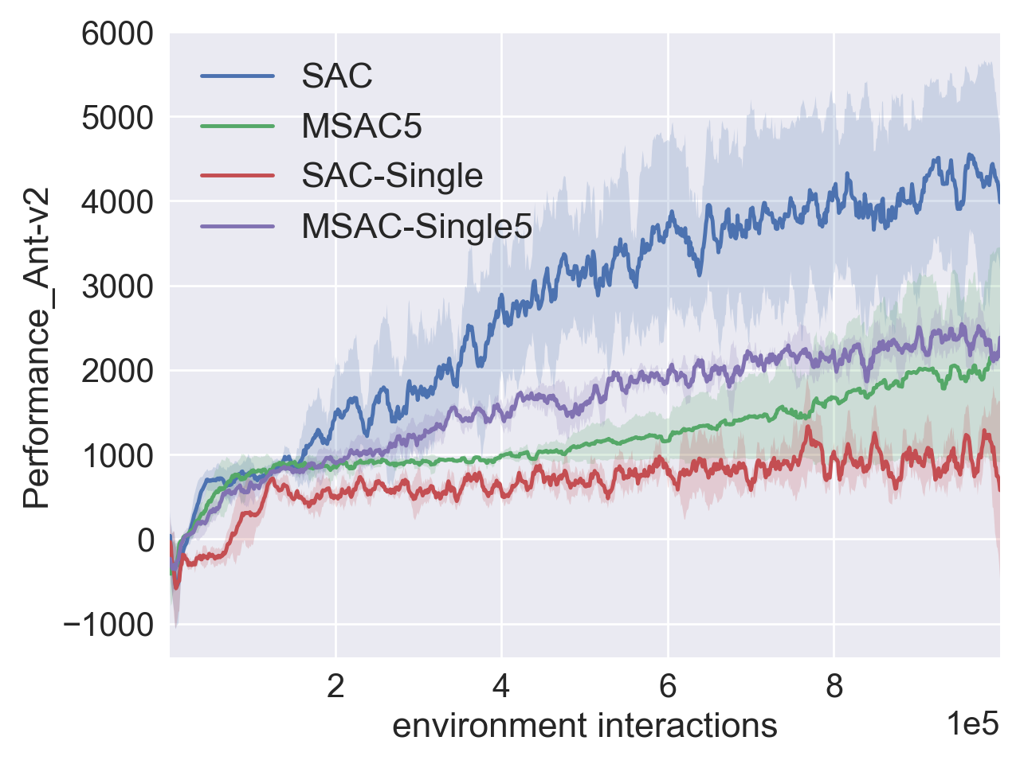
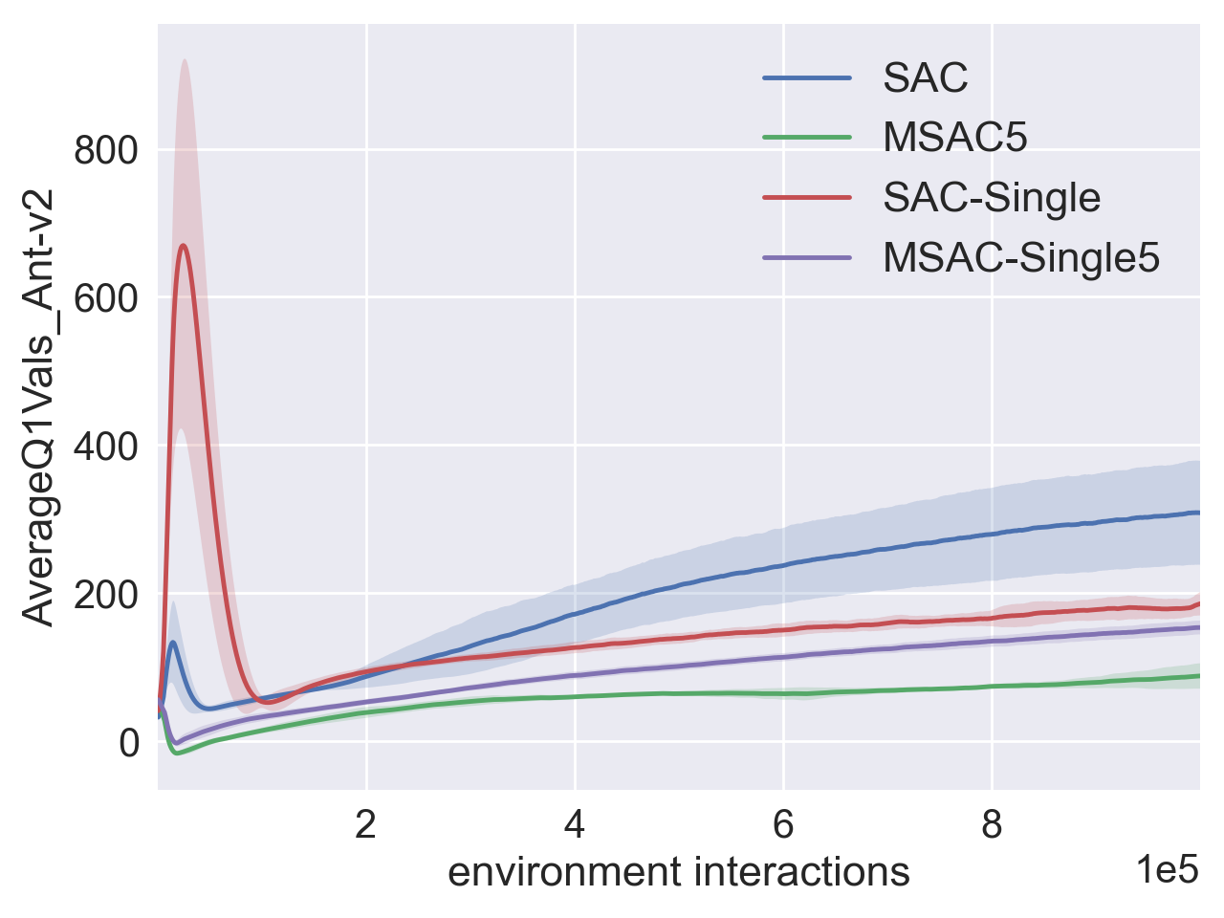
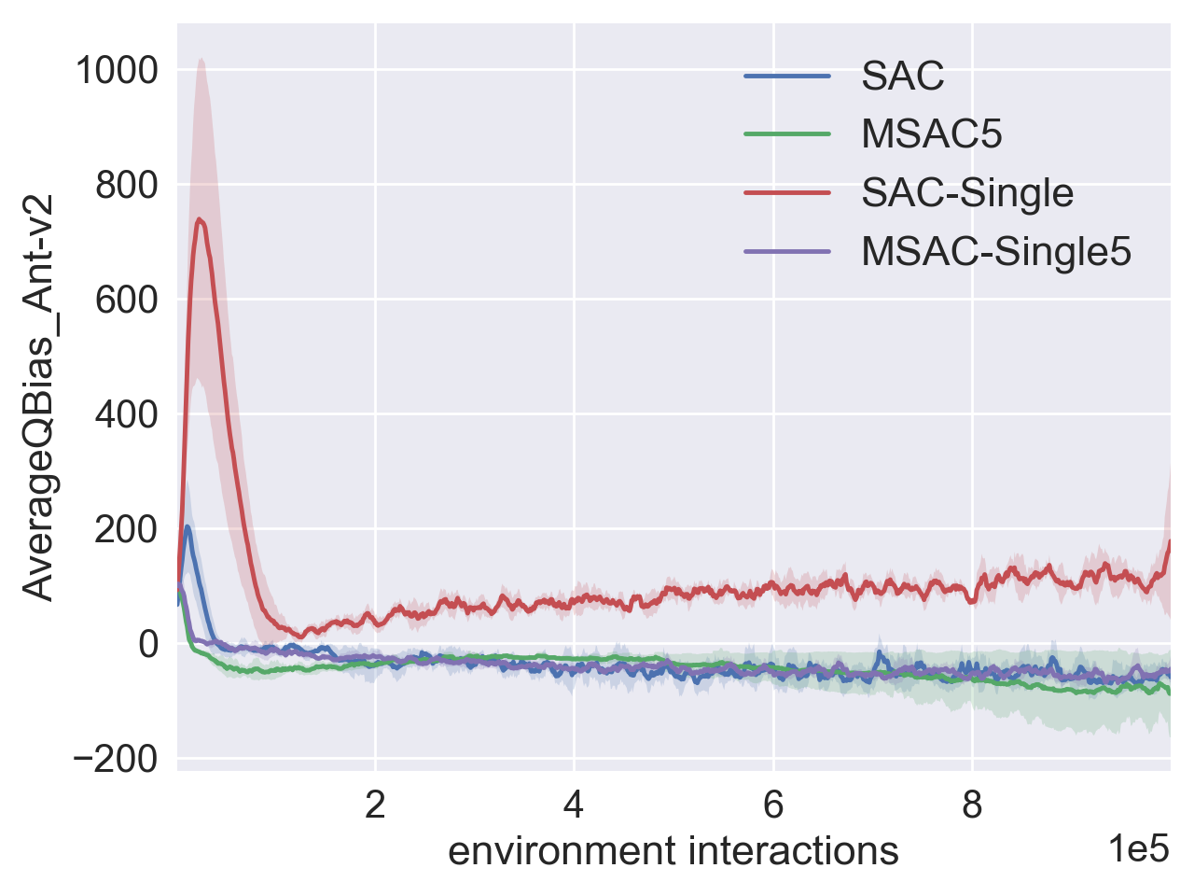
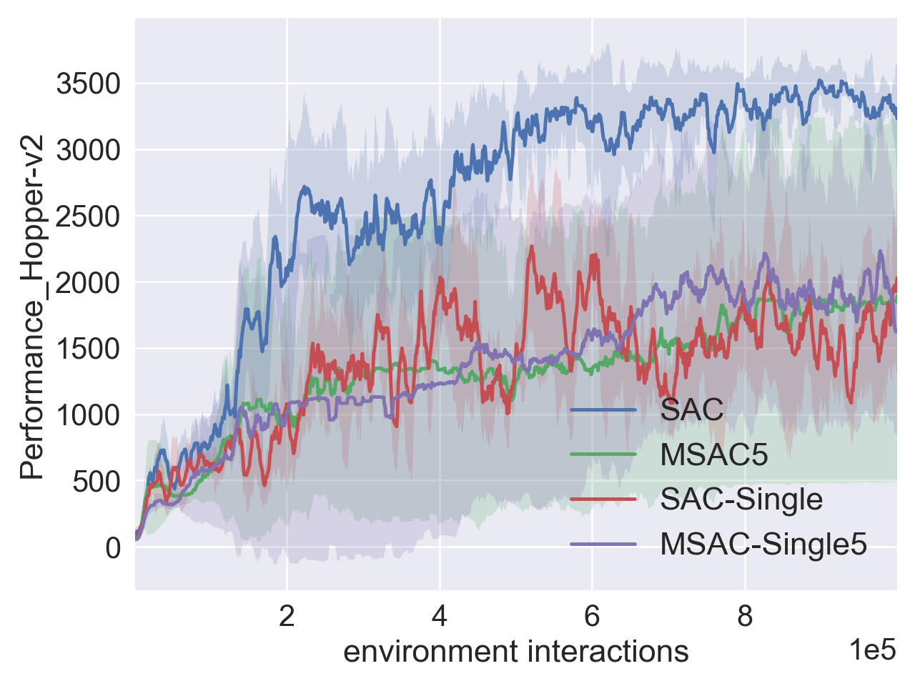
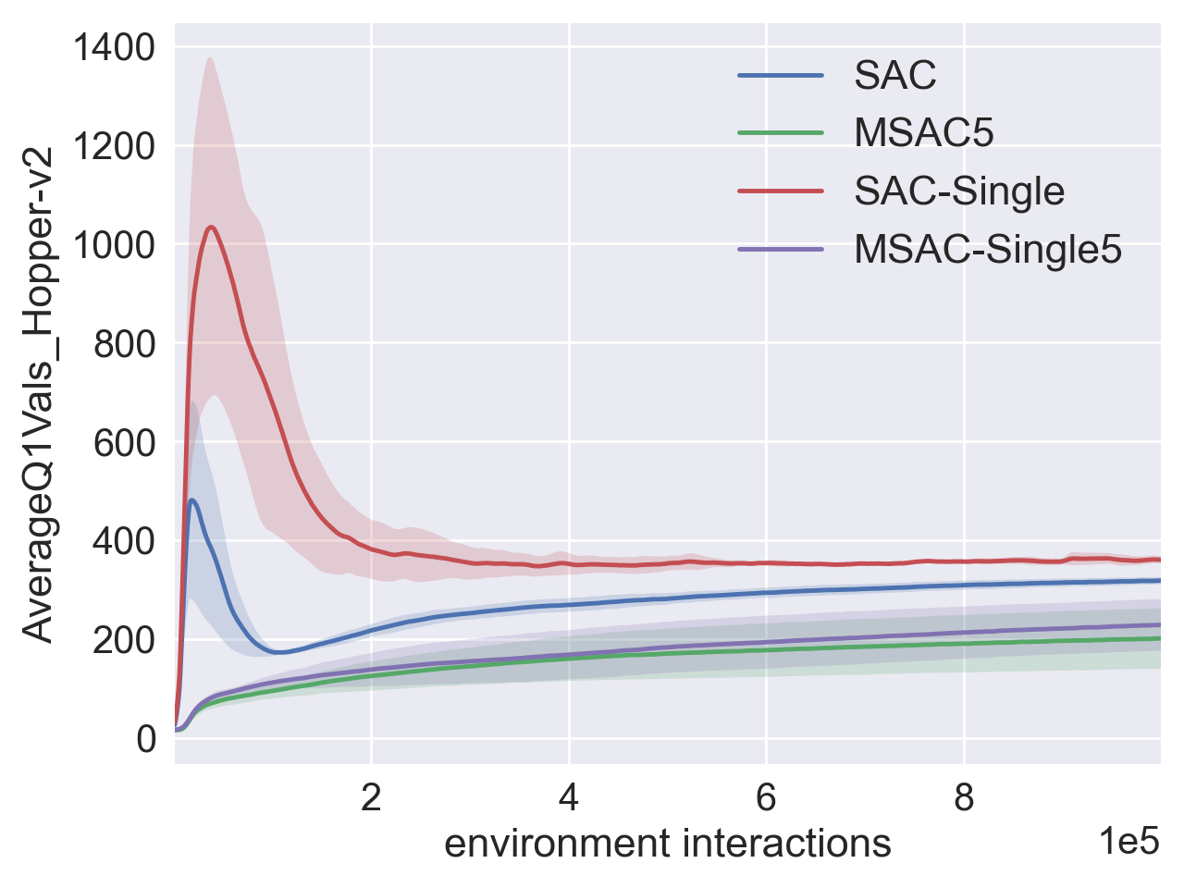
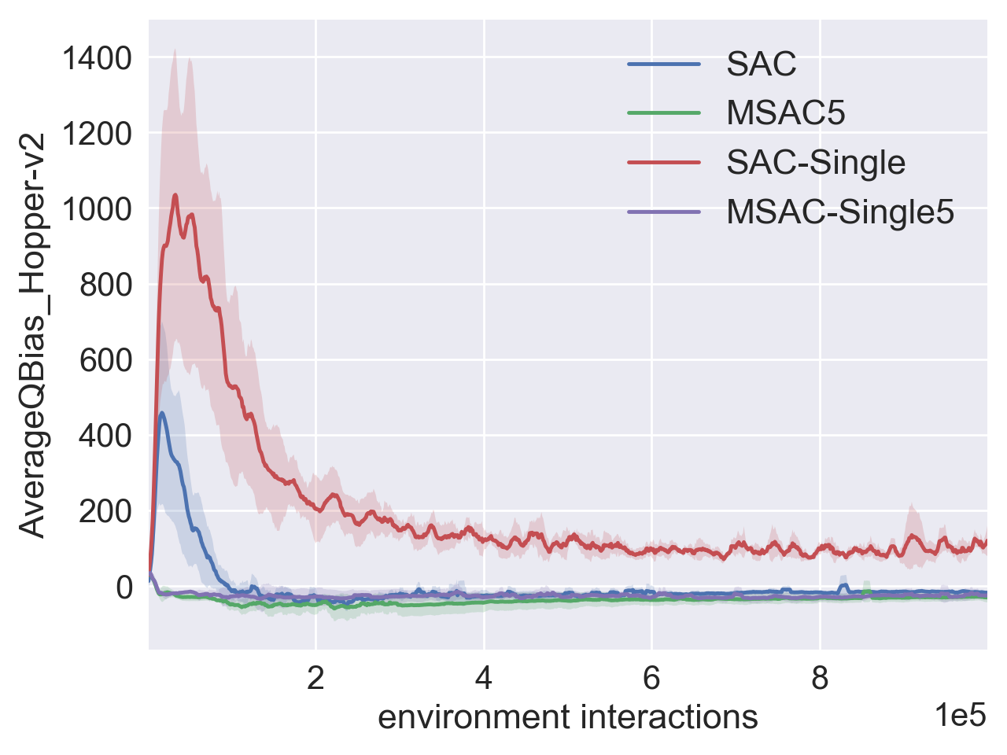
Avg Test Return
Avg Q Values
Avg Q Bias
(a) Ant-v2 Environment
Avg Test Return
Avg Q Values
Avg Q Bias
(b) Hopper-v2

Slide 3
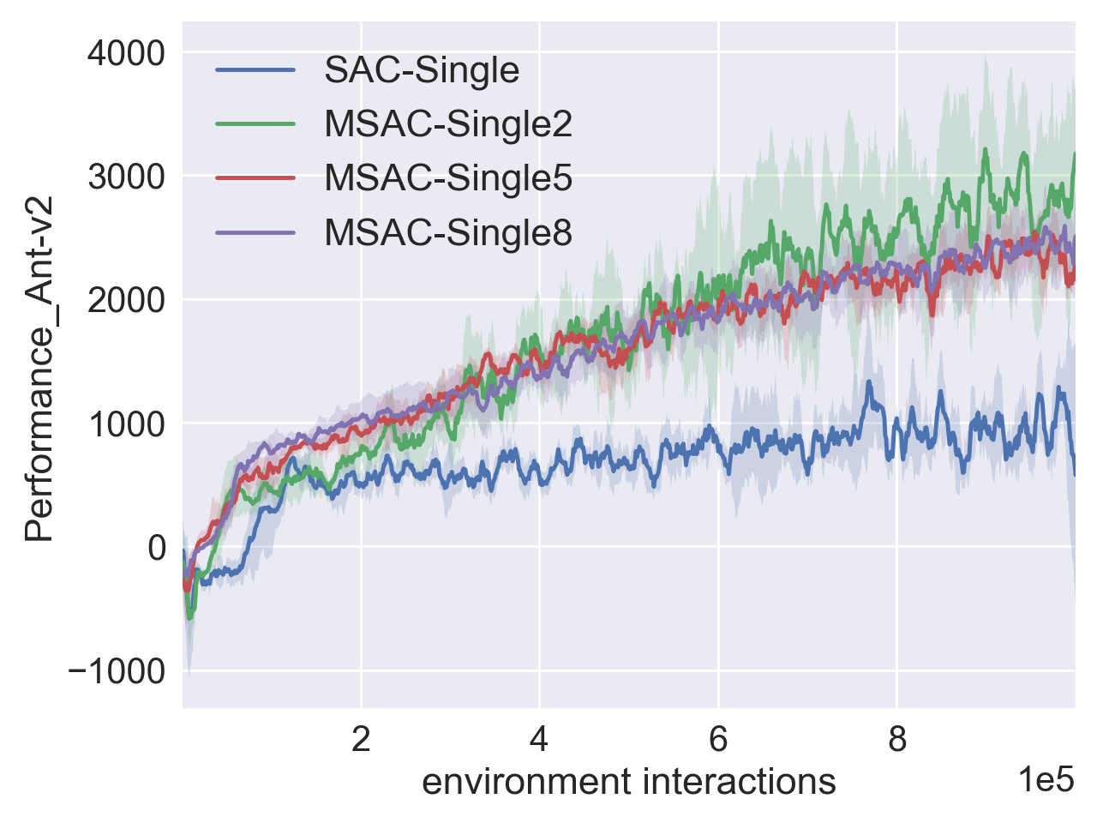
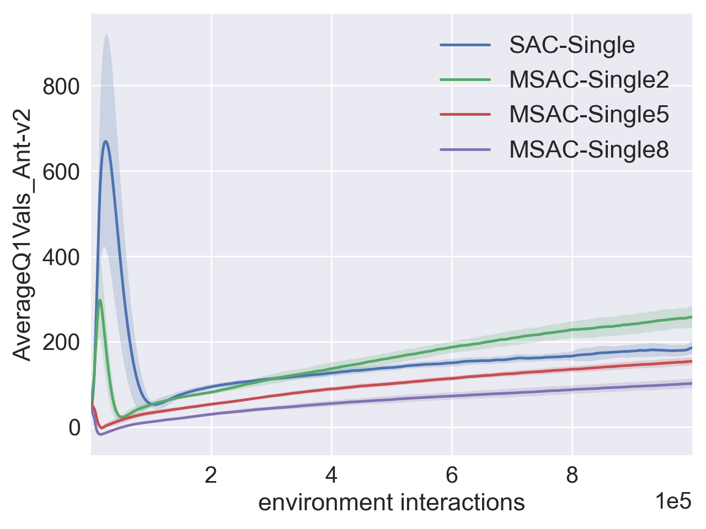
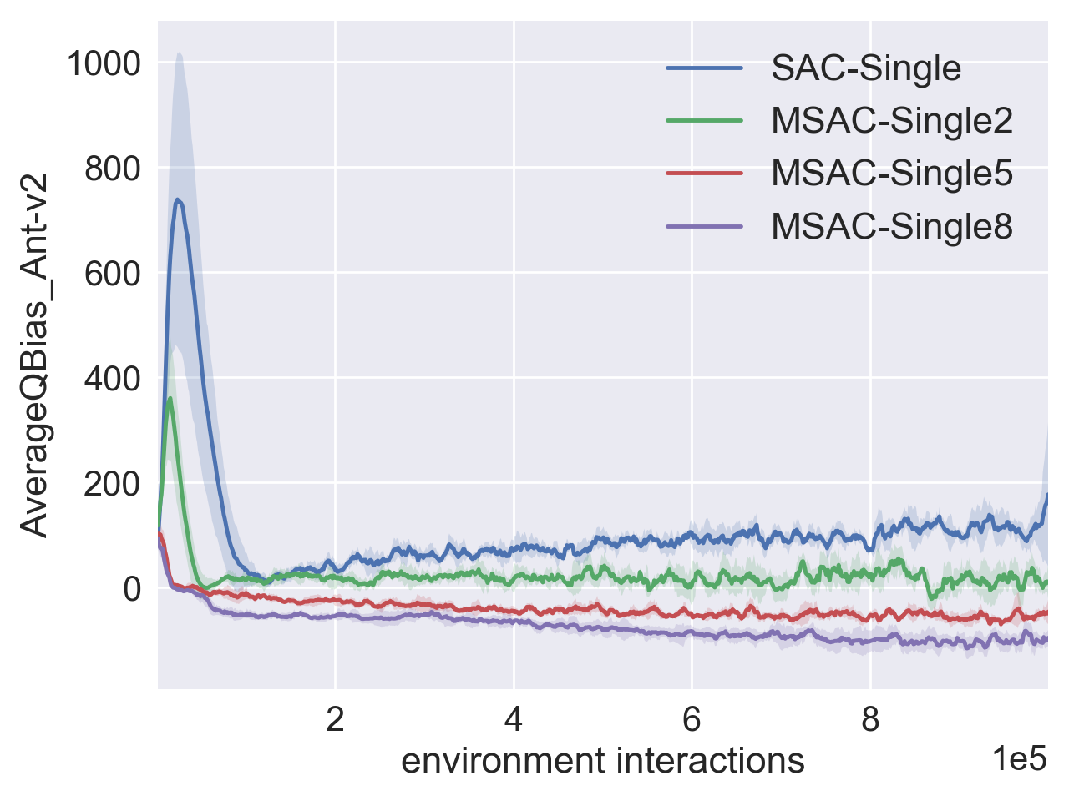
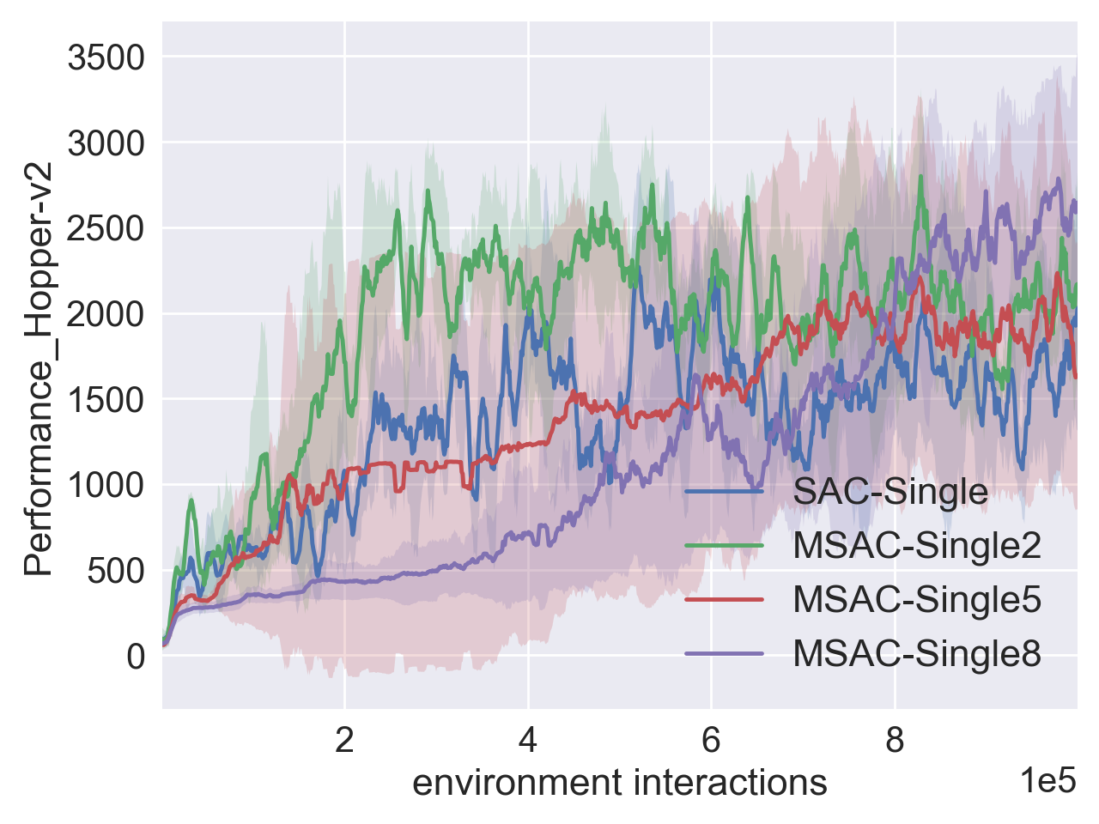
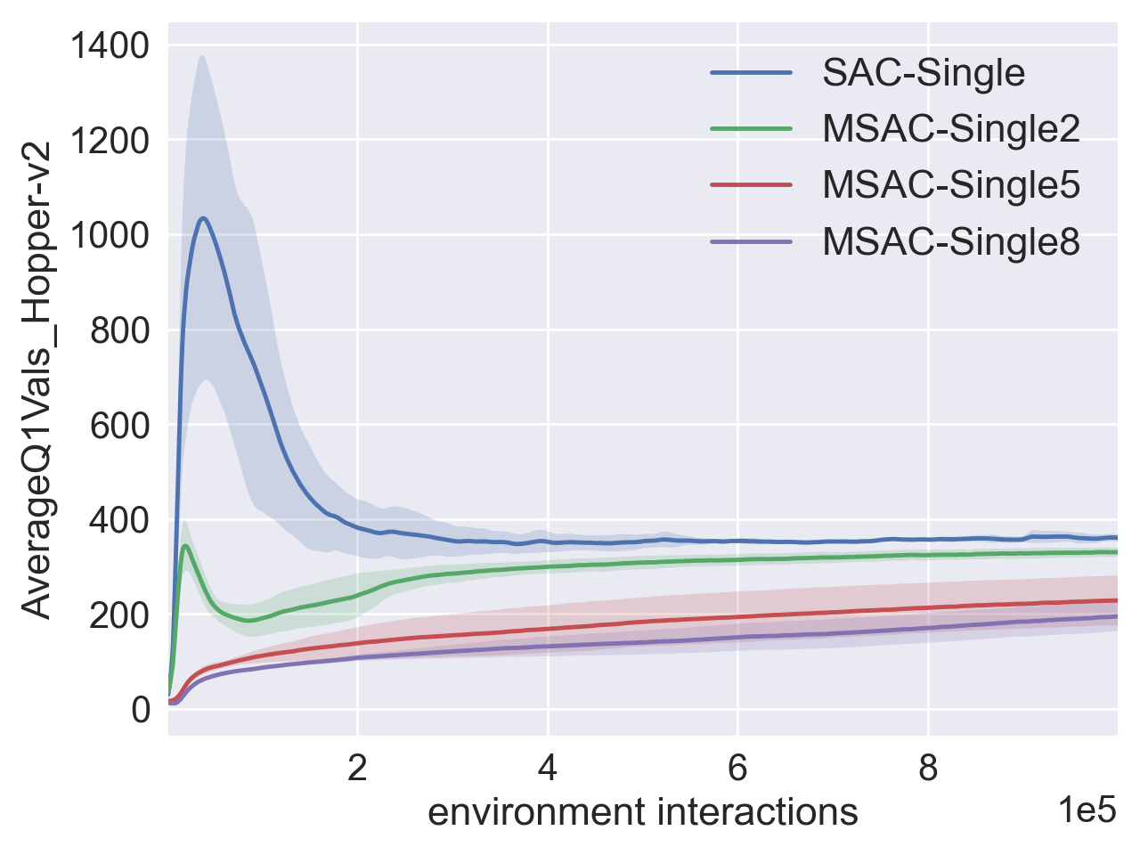
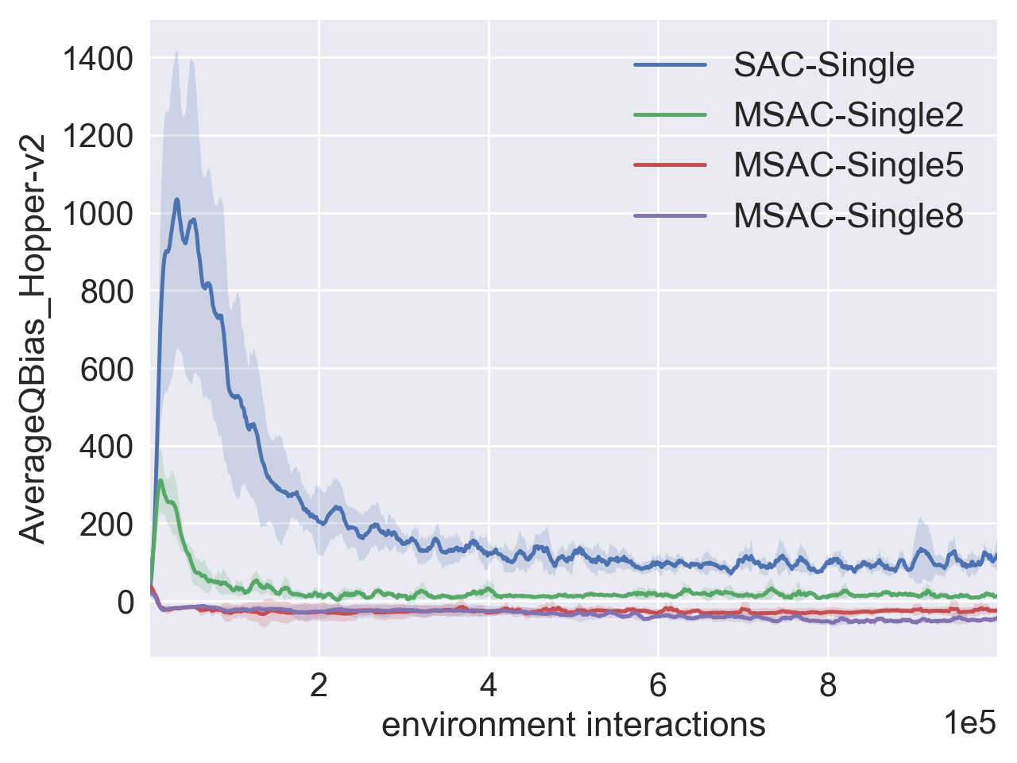
Avg Test Return
Avg Q Values
Avg Q Bias
(a) Ant-v2 Environment
Avg Test Return
Avg Q Values
Avg Q Bias
(b) Hopper-v2

