Slide 1
Homework #7

Slide 2
Goals
Word Sense Disambiguation
Gain better understanding of word embeddings
Compare global and contextual word embeddings
Apply embeddings to word sense disambiguation
Compare different WSD strategies

Slide 3
HW #7 Data: SemCor
SemCor
Semantic Concordance: corpus in which each open class word (e.g. noun, verb,adjective, adverb) in each sentence is labeled with a word sense from a particular resource, such as WordNet
SemCor is a subset of the Brown Corpus with 226,036 words that were manuallytagged with WordNet senses
The SemCor-based WSD task is to choose the correct sense from the possible sensesin WordNet

Slide 4
HW #7 Data: SemCor Example
SemCor Example
“You will find that avocado is unlike other fruit you have ever tasted.”
Goal: for every open class word (words in bold), choose the most likely sense among WordNet senses
Let’s look in WordNet…
find = wn.synsets(‘find’)
avocado = wn.synsets(‘avocado’)
fruit = wn.synsets(‘fruit’)
Some words have many different senses.

Slide 5
HW #7 Data: SemCor Example
SemCor Example
“You will find that avocado is unlike other fruit you have ever tasted.”
Goal: for every open class word (words in bold), choose the most likely sense among WordNet senses
Tagged sentence example:
You will find⁹_{v} that avocado¹_{n} is unlike¹_{j} other¹_{j} fruit¹_{n} you have ever¹_{r} tasted²_{v}
The integers correspond to the index within the synset list
Recall that WordNet synsets are organized by frequency. Index 1 corresponds to the “most frequent sense” (mfs)

Slide 6
HW #7: Global Embeddings
GloVe (Pennington et al, 2014)
GloVe: Global Vectors
Static embedding model based on global corpus statistics
Uses ratios of probabilities from word-word co-occurrence matrix
Similar properties to word2vec
Relative distances between words in vector space correspond to meaningful traits of words
Can apply analogical reasoning using vector arithmetic
Can use cosine similarity as similarity metric between word vectors
More info here: https://nlp.stanford.edu/projects/glove/

Slide 7
“A new pair of GloVes”
(Carlson et al 2025)
Applies GloVe architecture to newer data & with better documentation
From the paper: “For example, ‘covid’ does not have a representation in the 2014 embeddings.” 🙃
https://arxiv.org/abs/2507.18103

Slide 8
HW #7: Contextual Embeddings
DistilRoBERTa
Distilled version of RoBERTa model
“Robustly optimized BERT pretraining Approach” (Liu et al 2019)
Improves upon BERT training procedure, while retaining masked-language model objective
“Distilled”: A procedure for shrinking model size while retaining performance and improving speed (Sanh et al 2019)
Model card here: https://huggingface.co/distilbert/distilroberta-base

Slide 9
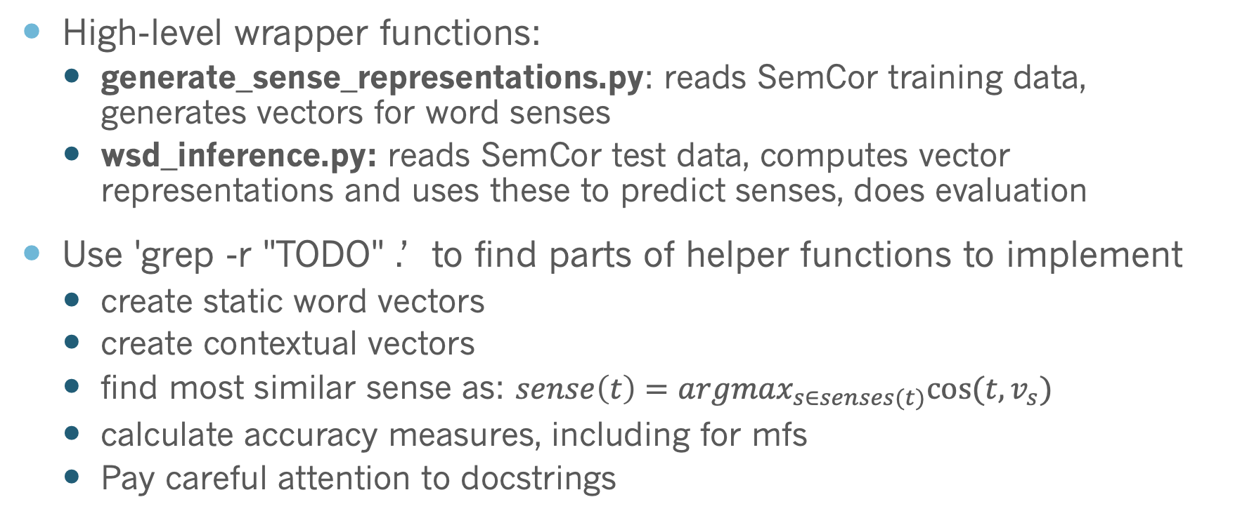
Implementation
High-level wrapper functions:
generate_sense_representations.py: reads SemCor training data, generates vectors for word senses
wsd_inference.py: reads SemCor test data, computes vector representations and uses these to predict senses, does evaluation
Use 'grep -r "TODO" .’ to find parts of helper functions to implement
create static word vectors
create contextual vectors
find most similar sense as: $sense\left(t\right)={argmax}_{s∈senses(t)}cos⁡(t,v_{s})$
calculate accuracy measures, including for mfs
Pay careful attention to docstrings

Slide 10
In 'contextual_vectors.py', last_layer has dimensions (batch_size, sequence_length, hidden_size)
Since batch_size is just 1, we want to index into last_layer to grab the representation of the first (and only) sentence in the batch, i.e. last_layer[0]
last_layer[0] has dimensions (sequence_length, hidden_size)

