Slide 1
Which types of buildings in Montgomery County are Energy – Efficient?
Alissa Ouspenskaia
DATA 110
Montgomery College, Fall 2026

Slide 2
Source Dataset:
2023 Energy Benchmarking All Sites
https://data.montgomerycountymd.gov

Slide 3
What is Benchmarking?
Notes:
Measuring and comparing a building’s energy use to similar buildings, past consumption,
or a reference performance level.

Slide 4
Exploratory Analysis
1846 rows, 27 columns
Numerical and Categorical data
25 duplicate entries
1821 remaining
Missing ID numbers and addresses
Electricity (kWh) had the most unique entries: 1716
Reported Property Gross Floor Area unique: 1672
Total GHG Emissions (Metric Tons CO2e) unique: 1619
Notes:
Entries had missing ID numbers and addresses, but most had electricity use,
floor area, and Total GHG Emissions

Slide 5
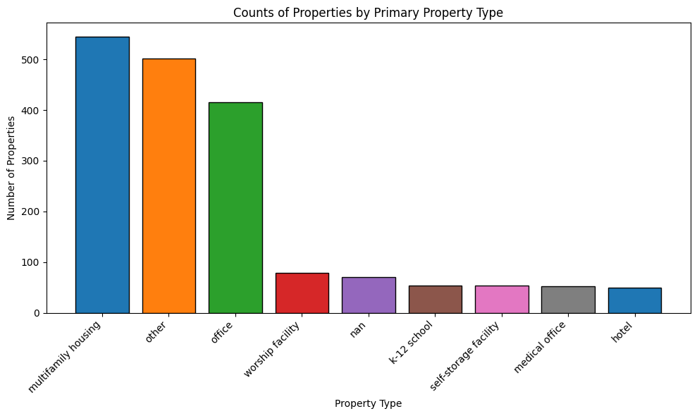
Histogram
Notes:
Note NaN
Other: supermarket or grocery store, retail store, senior living community,
car dealership, mixed use property, laboratory, strip mall

Slide 6
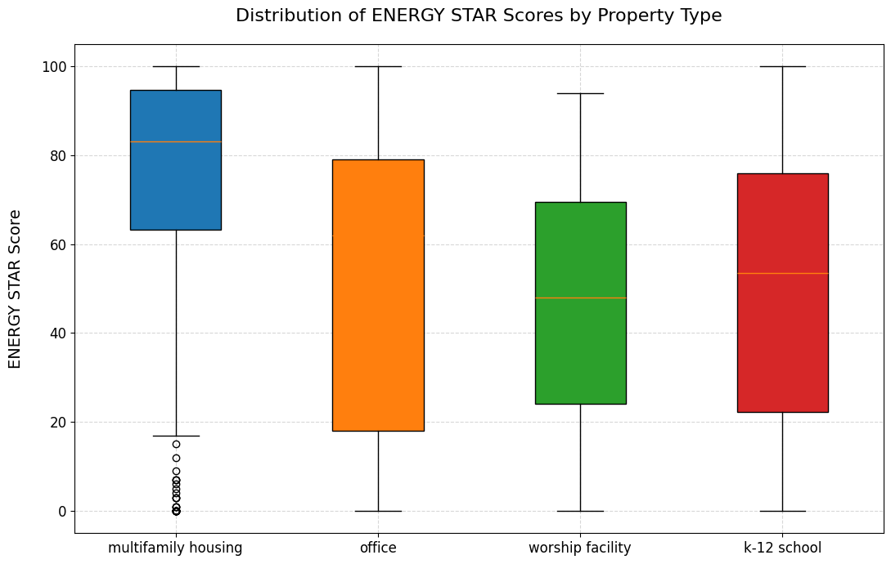
Energy Star Scores
Notes:
Energy Star: 1–100 score, which rates energy performance in comparison to
similar buildings across the country

Slide 7
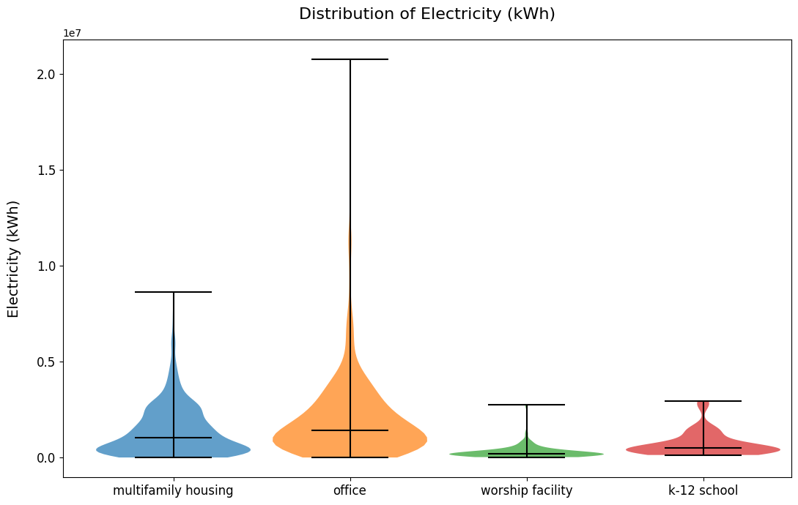
Violin Electricity
Notes:
Top 4 not counting “other” and NaN

Slide 8
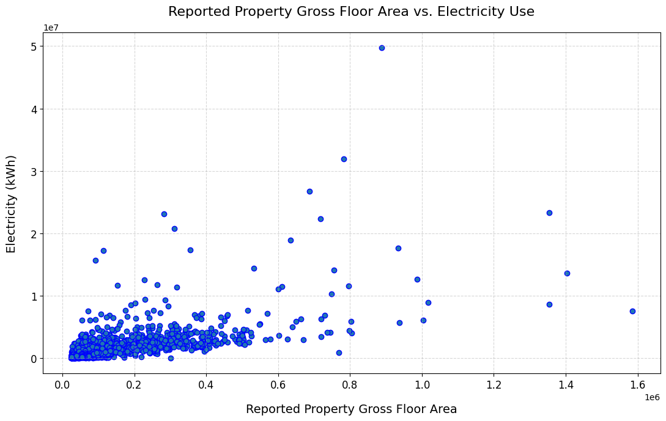
Scatter electricity full
Notes:
Note that we need to add 6 or 7 zeros to the numbers.
Now will zoom in on the bottom– left corner for a better look.

Slide 9
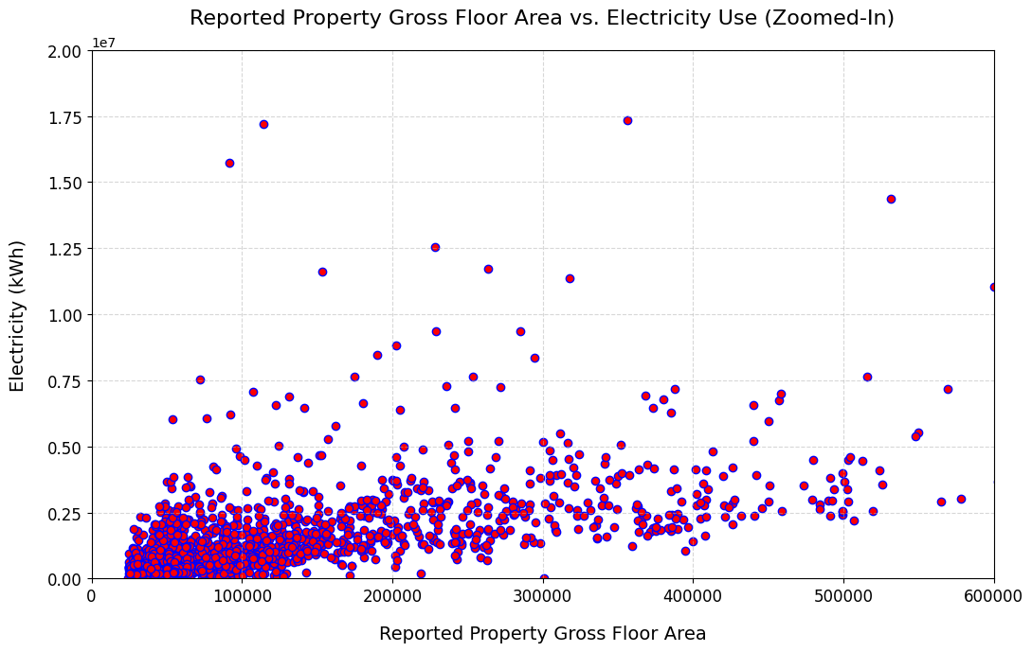
Electricity use by floor area, zoomed
Notes:
Electricity use by floor area, zoomed – in bottom left corner

Slide 10
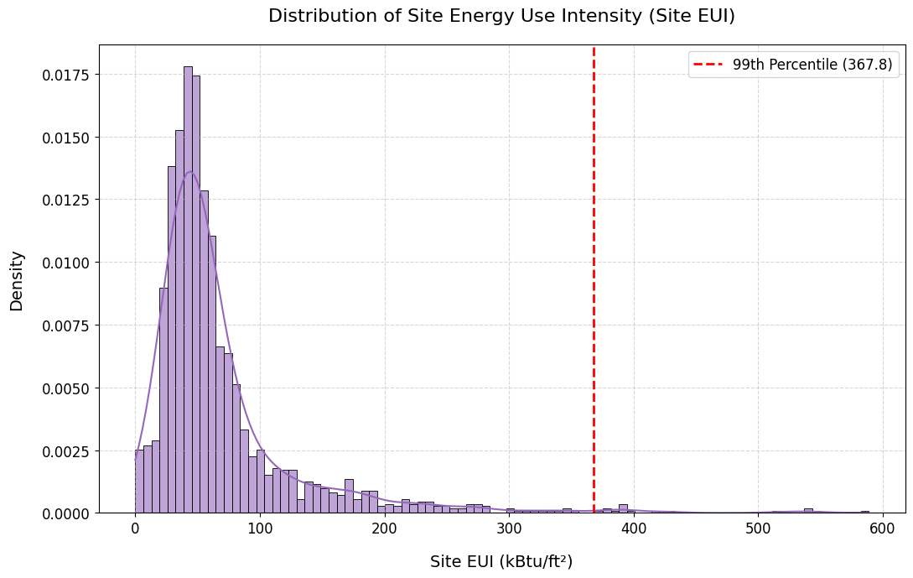
Distribution of Energy Use Intensity
Notes:
The British thermal unit (Btu) is a unit of measure of heat.

Slide 11
Surprising findings:
Building age vs. Total GHG emissions
Building age vs. ENERGY STAR score
ENERGY STAR score vs. Total GHG emissions
Notes:
Surprising finding (or lack thereof):

Slide 12
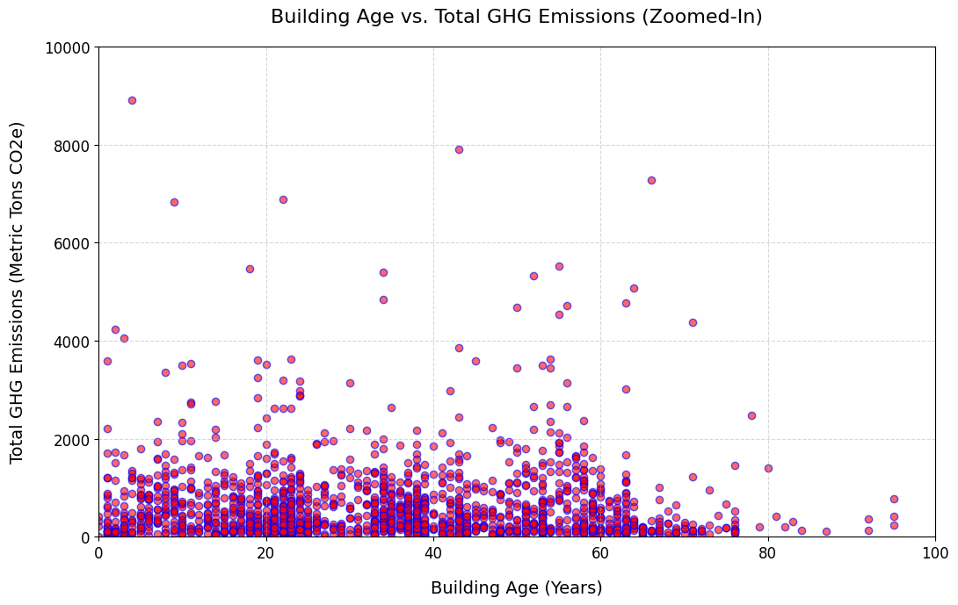
Building age vs. Total GHG emissions
Notes:
Building age vs. Total GHG emissions
Building age vs. ENERGY STAR score
ENERGY STAR score vs. Total GHG emissions

Slide 13
Further study
Explore more variables that may contribute to ENERGY STAR scores and try to find some stronger relationships.
Compare 2022 data with this 2023 data.
Notes:
Hopefully, 2024 data will be published soon.

Slide 14
Sources and Notes
2023 Energy Benchmarking All Sites
The Energy Benchmarking Law requires the County to make annually reported energy benchmarking information readily available to the public. This dataset reflects data received by the publish date and does not include individually attributable benchmarking data for buildings in Group 5, as CY 2023 was the first year that these buildings were required to report to DEP.
September 23, 2025
Dataset Owner: Kathy Luh
27 columns 1846 rows
https://data.montgomerycountymd.gov/Environment/2023-Energy-Benchmarking-All-Sites/ensr-8pr2/about_data
https://www.energystar.gov/buildings/benchmark
https://www.energystar.gov/buildings/about-us

Slide 15
Notes
Btu: the British thermal unit (Btu) is a unit of measure of heat.
It’s the amount of heat required to raise the temperature of one
pound of water by one degree Fahrenheit.
One Btu equals about 1,055 joules.
Energy Star: 1–100 score, which rates energy performance in comparison to similar buildings across the country

