Slide 1
Storytelling with Data: ​
a Data Visualization Guide for Business Professionals​
Cole Nussbaumer Knaflic
Published 2015 by John Wiley & Sons, Inc.
Chapter 5: Think Like a Designer
Recap compiled by Alissa Ouspenskaia
DATA110 Montgomery College Fall 2026

Slide 2
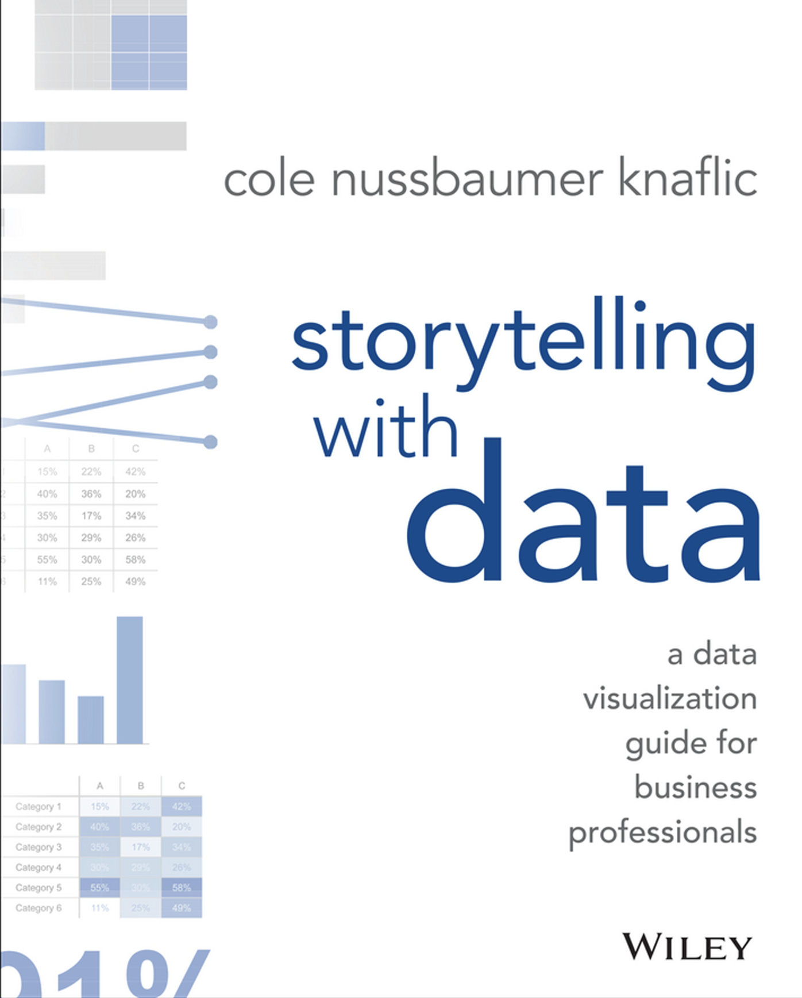
Chapter 5 Overview
Affordances
Accessibility
Aesthetics
Acceptance

Slide 3
Affordances
Accessibility
Aesthetics
Acceptance
Cole Chapter 5
/13
Affordance definition
- the quality or property of an object that defines its possible uses or makes clear how it can or should be used
— Merriam-Webster Dictionary
- aspects inherent to the design that make it obvious how the product is to be used
— Cole Knaflic
Examples
“We sit or stand on a chair because those affordances are fairly obvious.” — Scott Lafee
“A knob affords turning, a button affords pushing, and a cord affords pulling.”
— Cole Knaflic

Slide 4
Affordances
Accessibility
Aesthetics
Acceptance
Cole Chapter 5
/13
Highlight what’s important
  - details can go in footnotes or on the last few slides as additional references
  Eliminate distractions
- font / typeface arial sans serif
- italics, and underlining are only for titles and captions.
- 2 font sizes preferred. 3 if absolutely necessary.
- no blinking or flashing.
Visual hierarchy of information
  - use color, bold, and ALL CAPS sparingly
  - supporting details can be pushed to the background

Slide 5
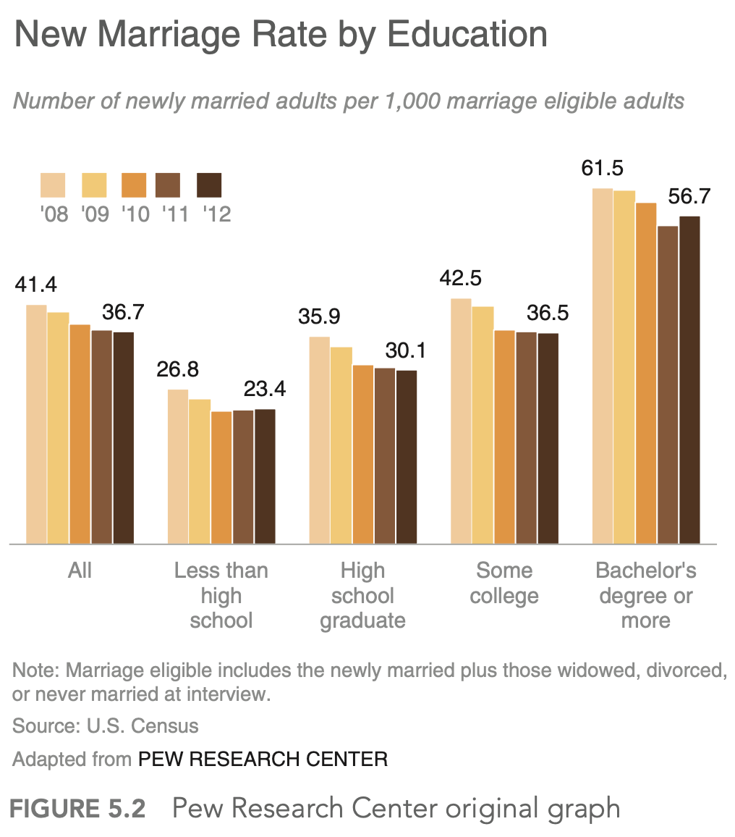
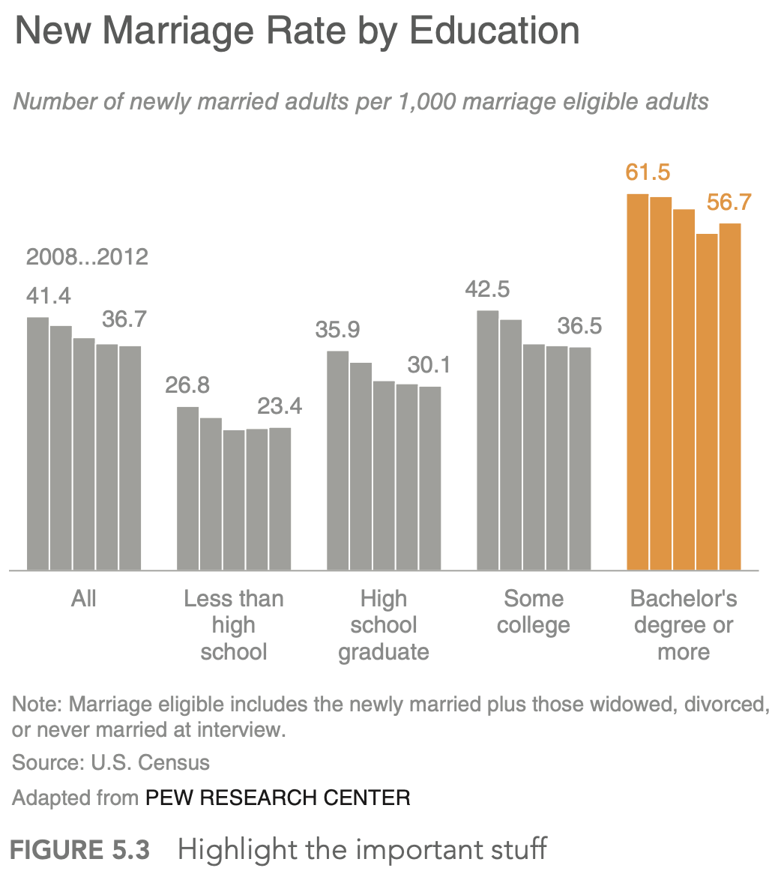
Affordances
Accessibility
Aesthetics
Acceptance
Cole Chapter 5
/13

Slide 6
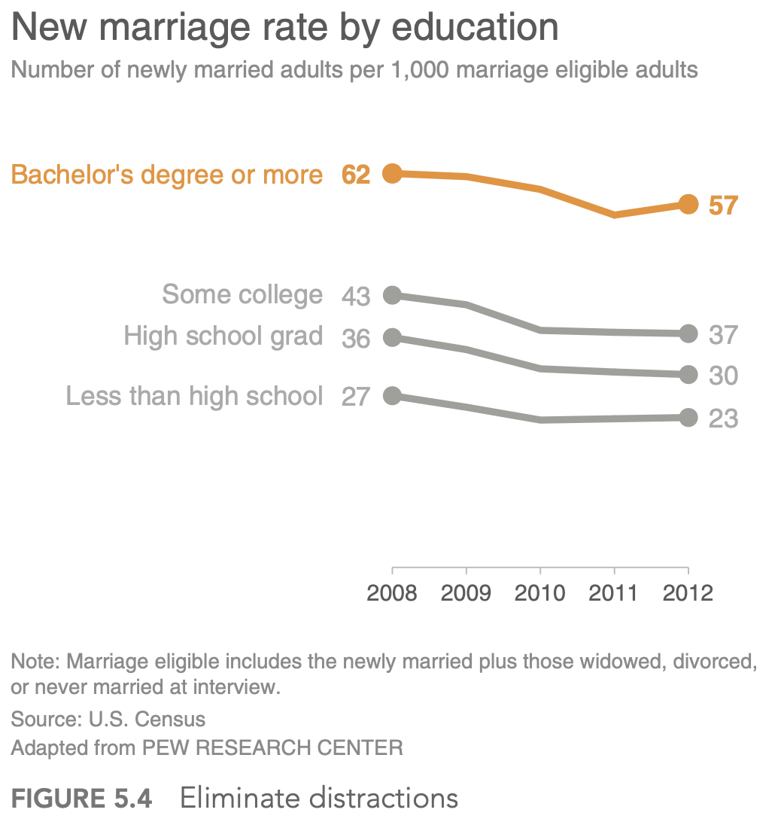
Affordances
Accessibility
Aesthetics
Acceptance
Cole Chapter 5
/13

Slide 7
Affordances
Accessibility
Aesthetics
Acceptance
Cole Chapter 5
/13
Diverse abilities
Different educational backgrounds and technical skills
Audience
Take into account the needs of the user
Don’t overcomplicate
Use text to label, introduce, explain, reinforce, highlight, recommend, tell a story.
“ Don’t assume that two different people looking at the same data visualization will draw the same conclusion. If there is a conclusion you want your audience to reach, state it in words.”
— Cole Knaflic
Notes:
Technical skills: group of microbiologists studying the cells in mouse lungs? Mixed team of scientists, mathematicians, computer scientists?
Audience: internal department? Mixed teams? Outside public?
Overcomplication: metro design with above-ground features

Slide 8
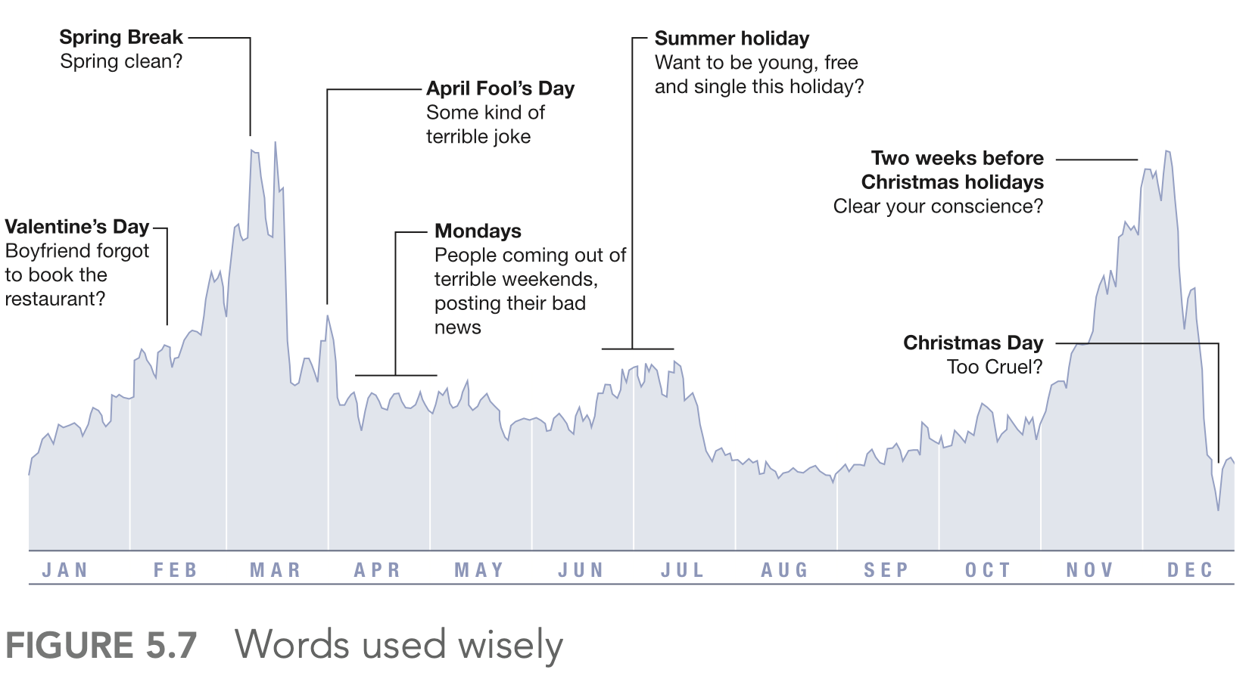
Affordances
Accessibility
Aesthetics
Acceptance
Cole Chapter 5
/13

Slide 9
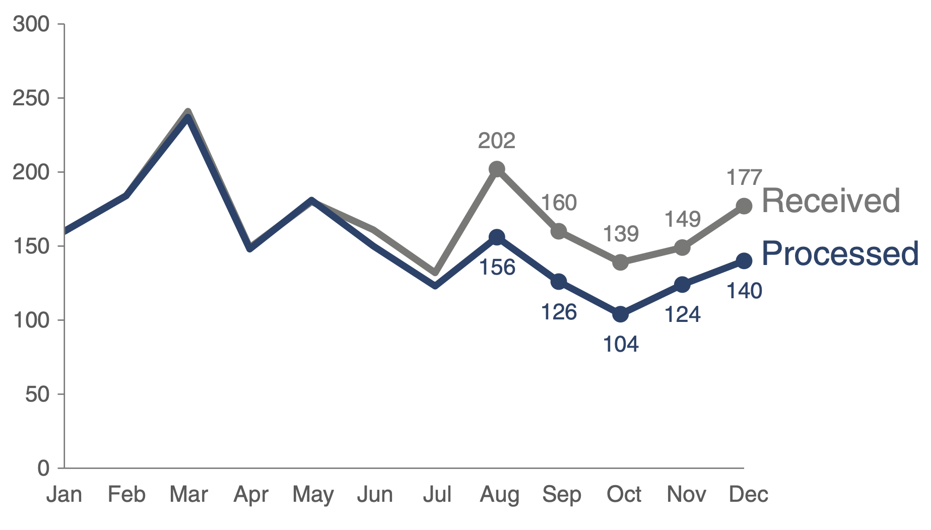
Affordances
Accessibility
Aesthetics
Acceptance
Cole Chapter 5
/13

Slide 10
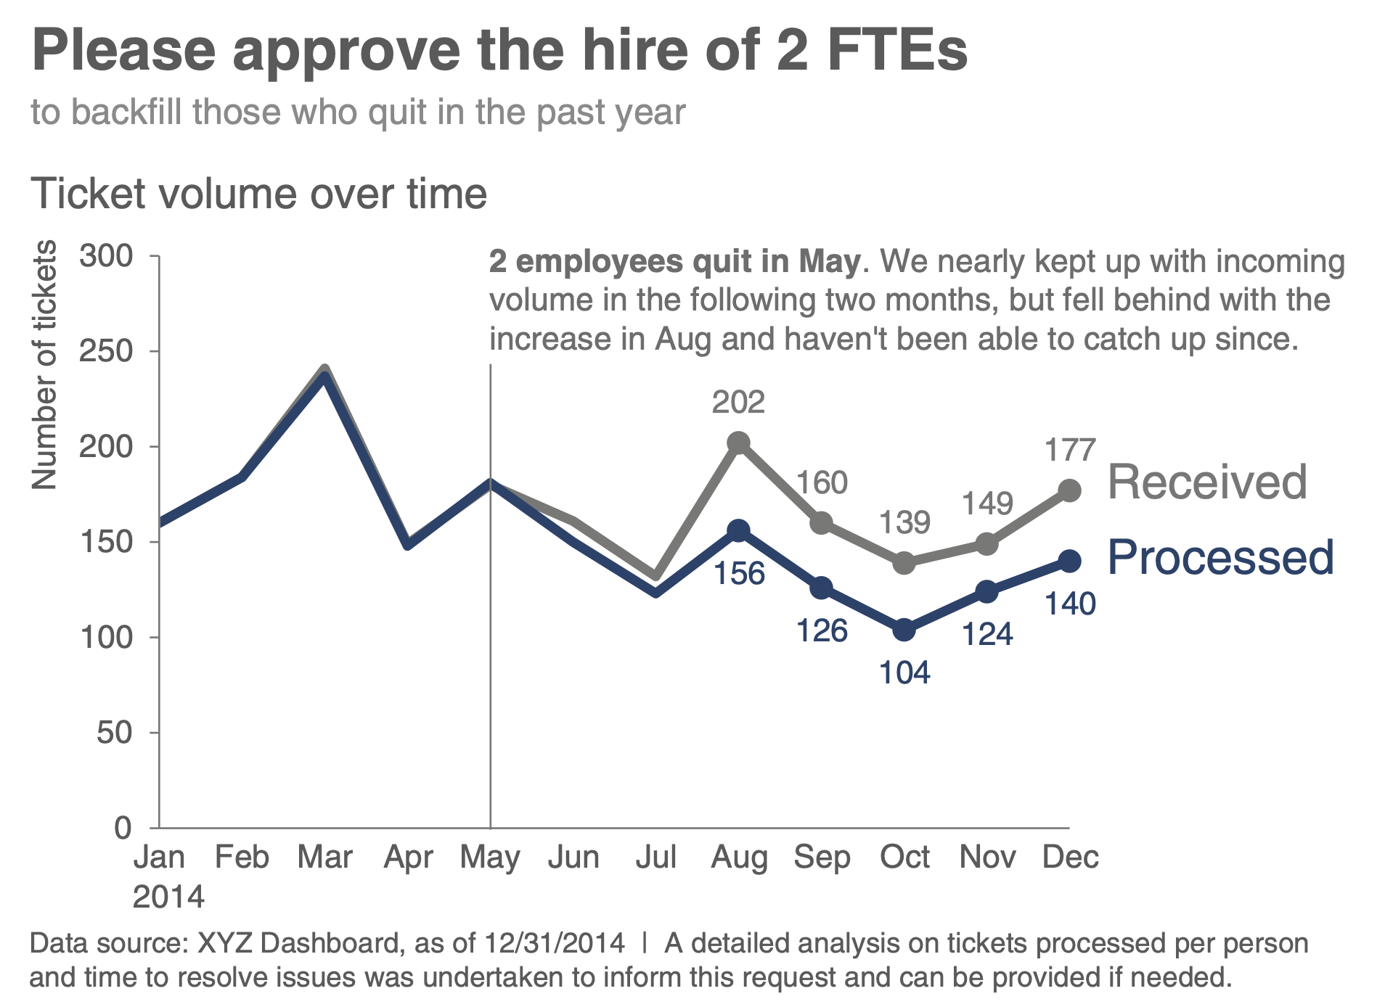
Affordances
Accessibility
Aesthetics
Acceptance
Cole Chapter 5
/13

Slide 11
Affordances
Accessibility
Aesthetics
Acceptance
Cole Chapter 5
/13
Make it pretty
“Studies have shown that more aesthetic designs are not only perceived as easier to use, but also more readily accepted and used over time, promote creative thinking and problem solving, and foster positive relationships, making people more tolerant of problems with designs.”
— Cole Knaflic
Use color sparingly and strategically to highlight
Alignment
Leverage white space
Notes:
Leverage white space. Preserve margins; don’t stretch your
graphics to fill the space, or add things simply because you have
extra space.

Slide 12
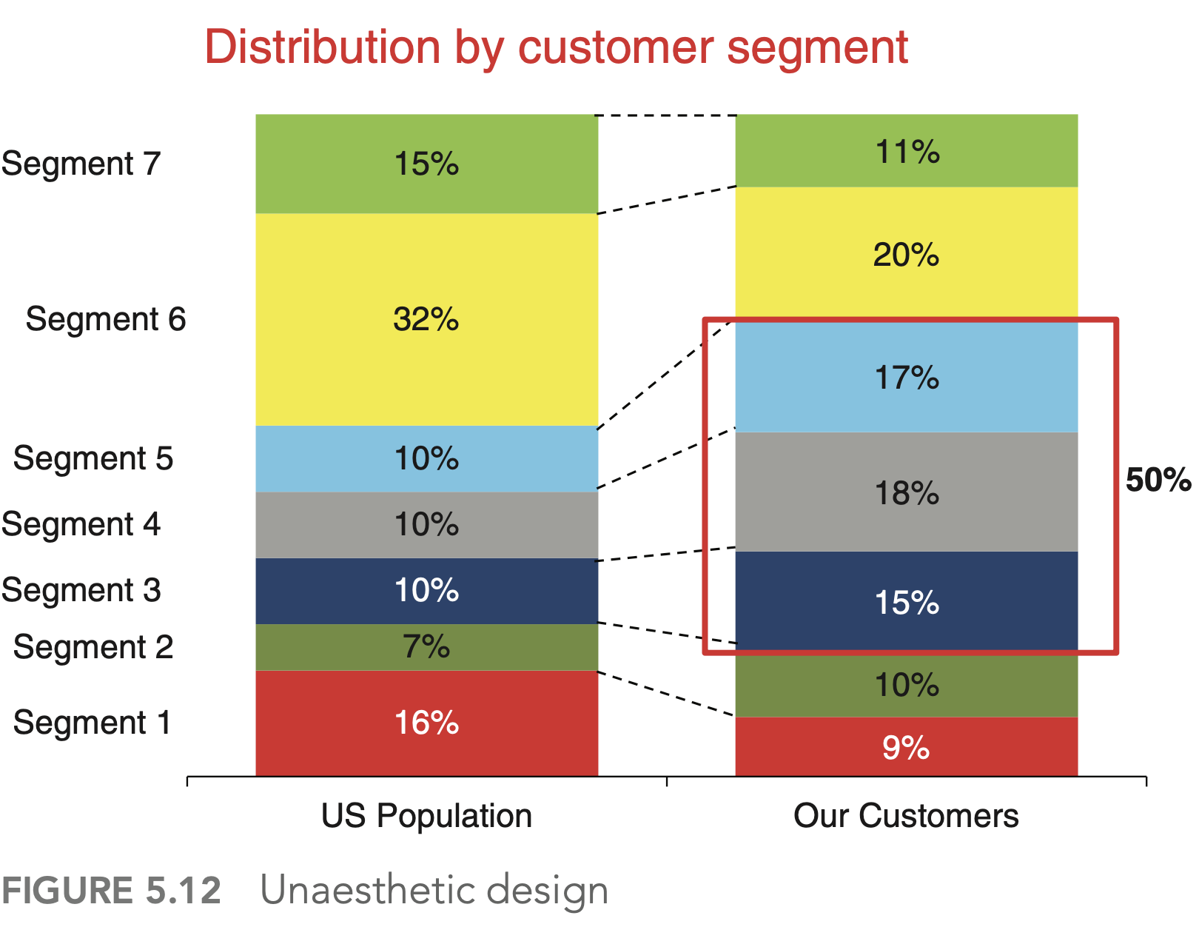
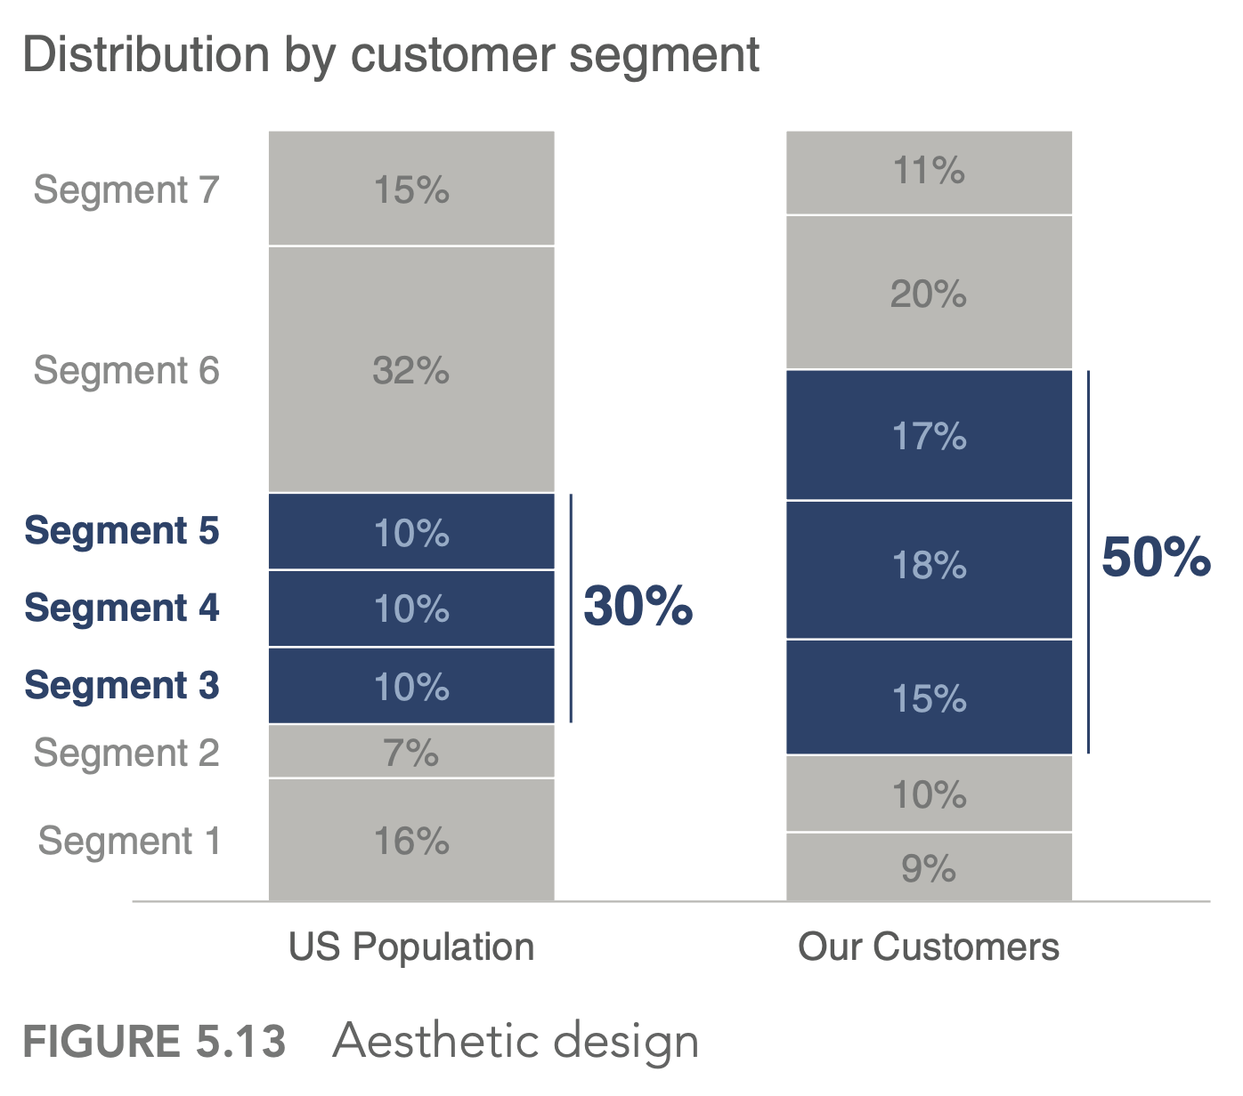
Affordances
Accessibility
Aesthetics
Acceptance
Cole Chapter 5
/13

Slide 13
Affordances
Accessibility
Aesthetics
Acceptance
Cole Chapter 5
/13
What if your audience is not accepting your design?
Articulate the benefits
Side-by-side
Provide options and seek input
Get a vocal member of the audience to back you up
Find the root of the problem:
    real issue or resistance to change?
Notes:
Articulate the benefits of the new or different approach.
Show the side‐by‐side comparison
Provide several options and seek input

