Slide 1
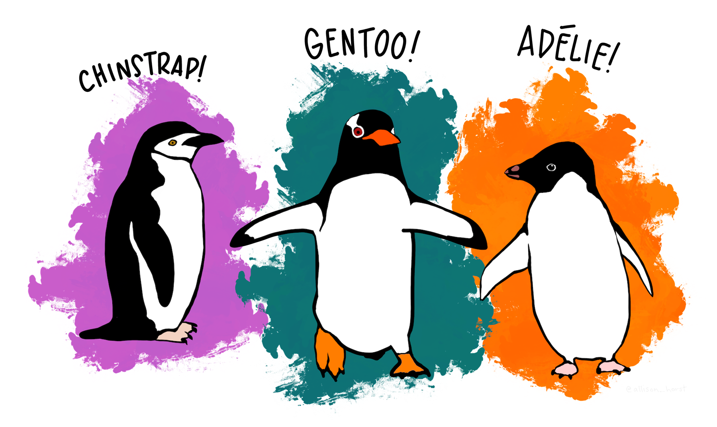
Palmer Penguins
Alissa Ouspenskaia
DATA 201
Montgomery College Spring 2026
Artwork by @allison_horst
https://allisonhorst.com/allison-horst
Notes:
physical characteristics of three penguin species from the Palmer Archipelago in Antarctica.
Group of islands: Torgersen, Biscoe, Dream

Slide 2
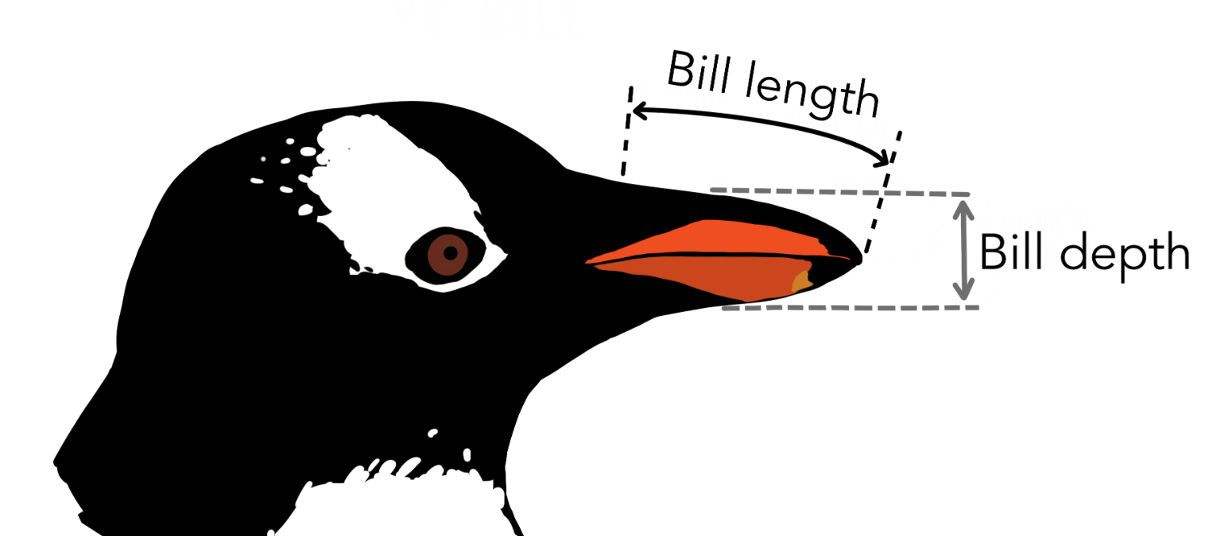
Artwork by @allison_horst
https://allisonhorst.com/allison-horst

Slide 3
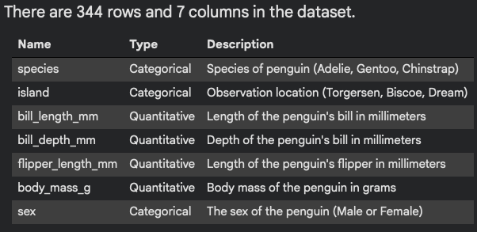

Slide 4
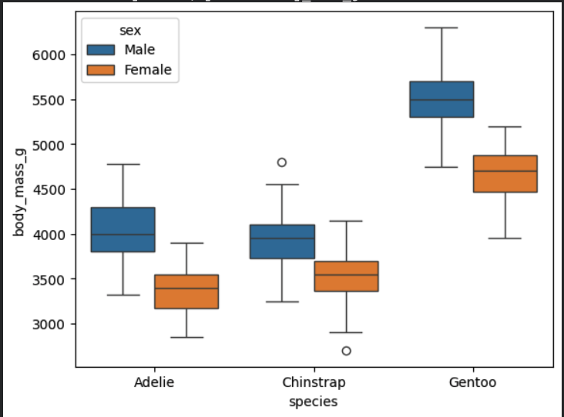

Slide 5
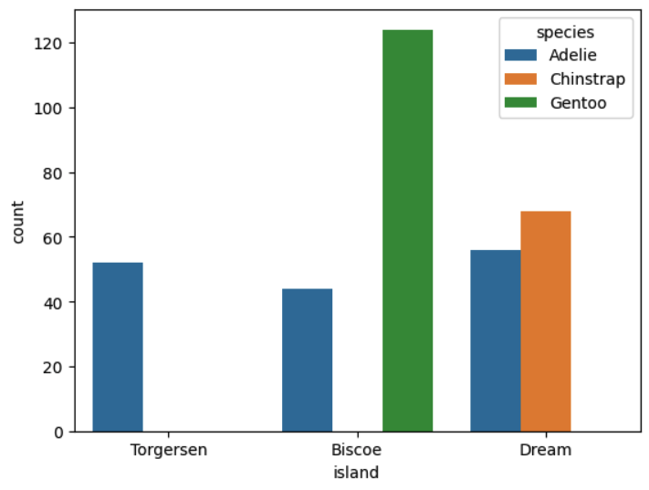
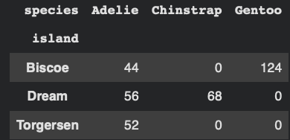

Slide 6
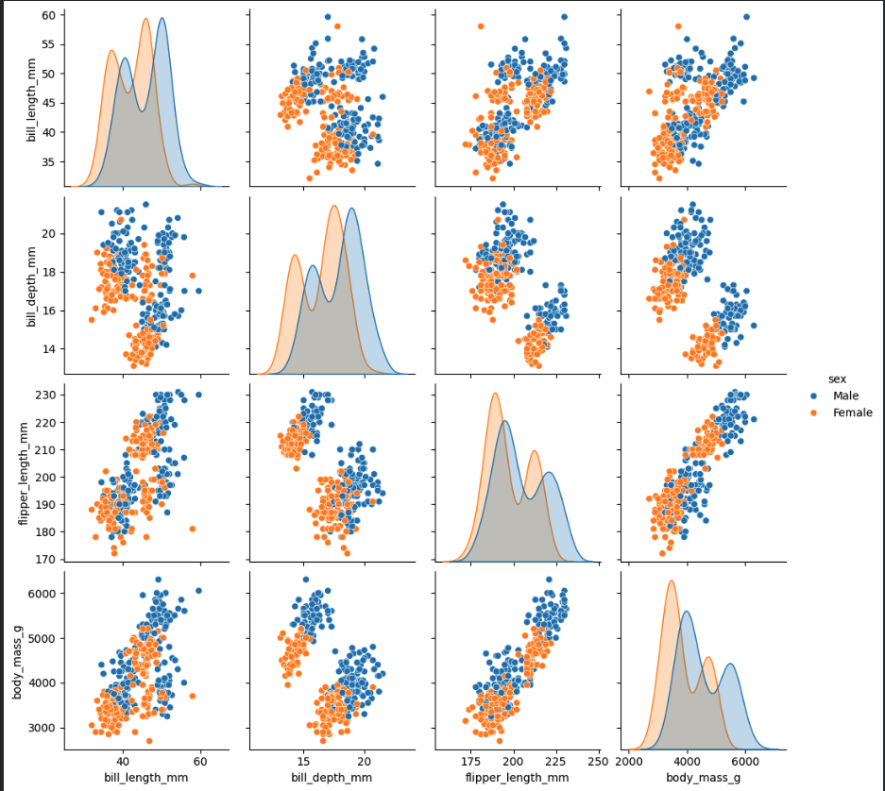
Pairwise plots grouped by sex

Slide 7
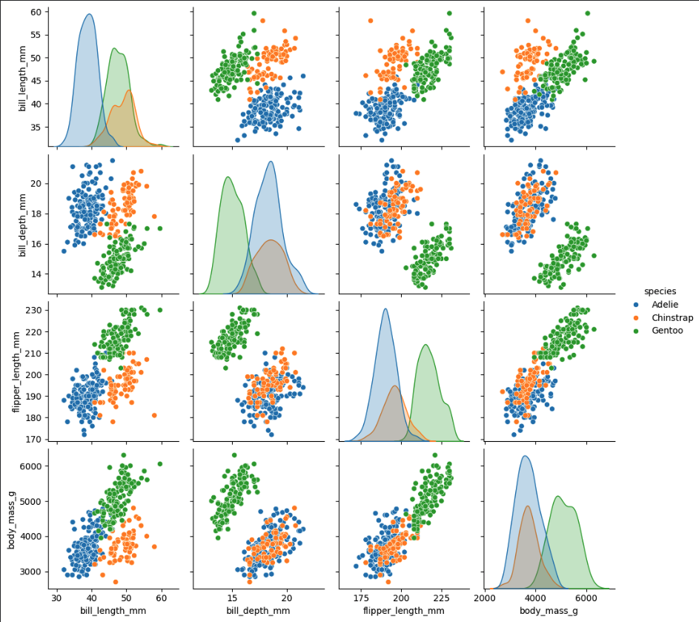
Pairwise plots grouped by species

Slide 8
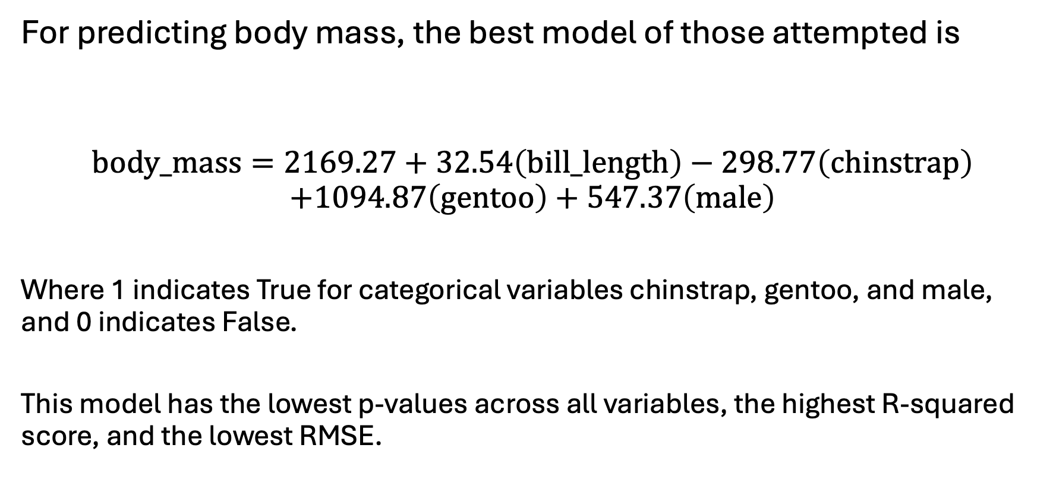
body_mass=2169.27+32.54(bill_length)−298.77(chinstrap)+1094.87(gentoo)+547.37(male)
body_mass=2169.27+32.54(bill_length)−298.77(chinstrap)+1094.87(gentoo)+547.37(male)
𝑅2
𝑅2
𝑅2
For predicting body mass, the best model of those attempted is
$$\text{body}\text{_}\text{mass}=2169.27+32.54\left(\text{bill}\text{_}\text{length}\right)−298.77\left(\text{chinstrap}\right)$$
$$+1094.87\left(\text{gentoo}\right)+547.37\left(\text{male}\right)$$
Where 1 indicates True for categorical variables chinstrap, gentoo, and male, and 0 indicates False.
This model has the lowest p-values across all variables, the highest R-squared score, and the lowest RMSE.

Slide 9
References:
Horst AM, Hill AP, Gorman KB (2020). palmerpenguins: Palmer
Archipelago (Antarctica) penguin data. R package version 0.1.0.
https://allisonhorst.github.io/palmerpenguins/. doi: 10.5281/zenodo.3960218.
https://allisonhorst.github.io/palmerpenguins/reference/penguins_raw.html
https://journals.plos.org/plosone/article?id=10.1371/journal.pone.0090081
https://allisonhorst.github.io/palmerpenguins/
https://www.uaf.edu/cfos/people/faculty/detail/kristen-gorman.php
https://deepwiki.com/mwaskom/seaborn-data/5.3-palmer-penguins

