Slide 1
Tile38

Slide 2
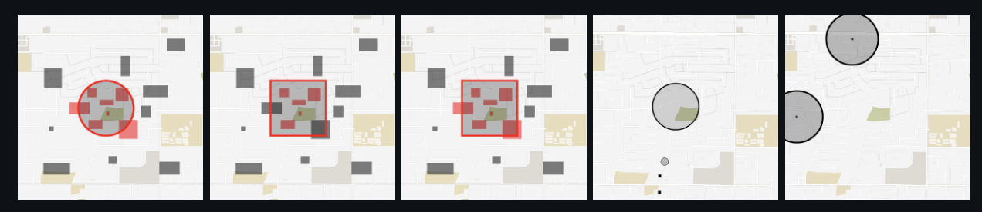
intro
Tile38 is an open source (MIT licensed), in-memory geolocation data store, spatial index, and realtime geofencing server. It supports a variety of object types including lat/lon points, bounding boxes, XYZ tiles, Geohashes, and GeoJSON.
Develop with Go, Operate through Lua

Slide 3
Start….
docker pull tile38/tile38
docker run -p 9851:9851 tile38/tile38
brew install tile38
tile38-server
tile38-server --metrics-addr=127.0.0.1:4321

Slide 4
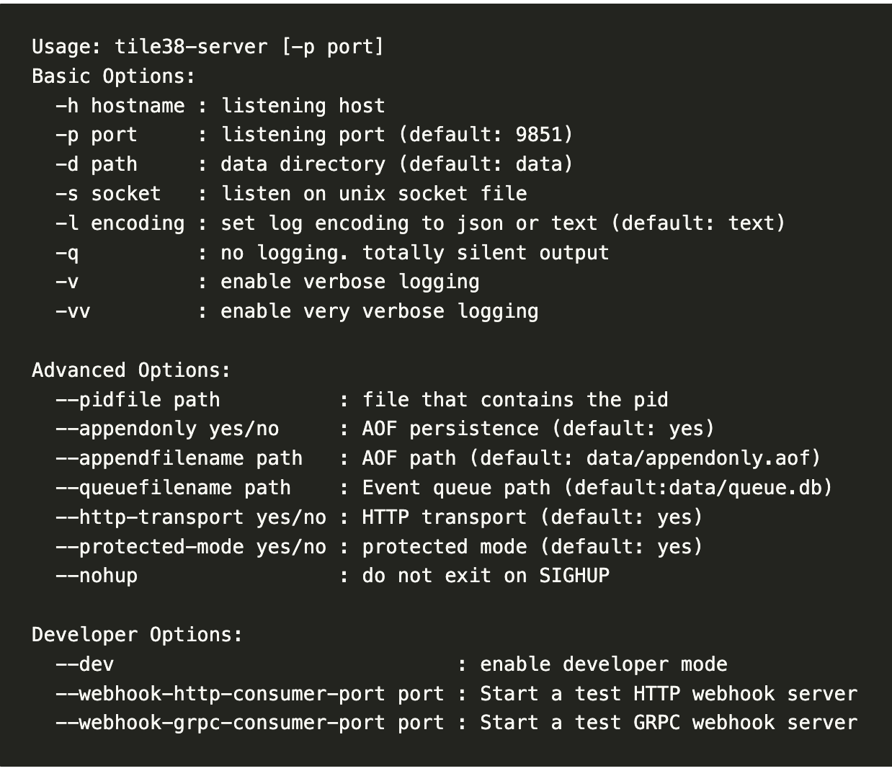
config
Notes:
AOF stands for Append Only File. It's the change-log style persistent format.
RDB is for Redis Database File. It's the snapshot style persistence format.

Slide 5
Object type
Lat/lon Point 119.19 21.58
Bounding Box (Minimum bounding rectangle) 121.614983 24.593883 121.889204 24.842419
XYZ Tile (only support search)：An XYZ tile is rectangle bounding area on earth that is represented by an X, Y coordinate and a Z (zoom) level. Check out maptiler.org for an interactive example.
QuadKey (only support search):A QuadKey used the same coordinate system as an XYZ tile except that the string representation is a string characters composed of 0, 1, 2, or 3. For a detailed explanation checkout The Bing Maps Tile System.

Slide 6
command
# add a couple of points named 'truck1' and 'truck2' to a collection named 'fleet'.
> set fleet truck1 point 33.5123 -112.2693
> set fleet truck2 ex 10 point 33.4626 -112.1695
#Set the value of an id. If a value is already associated to that key/id, it'll be overwritten.
# search the 'fleet' collection.
> scan fleet # returns both trucks in 'fleet'
> nearby fleet point 33.462 -112.268 6000 # search 6 kilometers around a point. returns one truck.
# key value operations
> get fleet truck1 # returns 'truck1'
> del fleet truck2 # deletes 'truck2'
> drop fleet # removes all

Slide 7
Searching
command: Within, Intersects, Nearby
WITHIN fleet BOUNDS 33.462 -112.268 33.491 -112.245
(BOUNDS minlat minlon maxlat maxlon)|(OBJECT geojson)|(CIRCLE lat lon meters)|(TILE x y z)|(QUADKEY quadkey)|(HASH geohash)|(SECTOR lat lon meters bearing1 bearing2)

Slide 8
DEMO
set ad_set 宜蘭 BOUNDS 121.614983 24.593883 121.889204 24.842419
set ad_set 台北 BOUNDS 121.481153 24.979926 121.618943 25.097378
set ad_set 東區商圈 BOUNDS 121.540086 25.035019 121.5522 25.044461
set ad_set 北台灣 BOUNDS 120.7276 24.5667 122.0636 25.3943
set ad_set 基隆 BOUNDS 121.6358 25.0544 121.7994 25.1704
set ad_set 台中 BOUNDS 120.4767 23.9994 120.8422 24.3323
set ad_set 台灣 BOUNDS 119.19 21.58 122.44 25.33
INTERSECTS ad_set IDS point 121.5544 22.0503
INTERSECTS ad_set 121.564558 25.03746

Slide 9
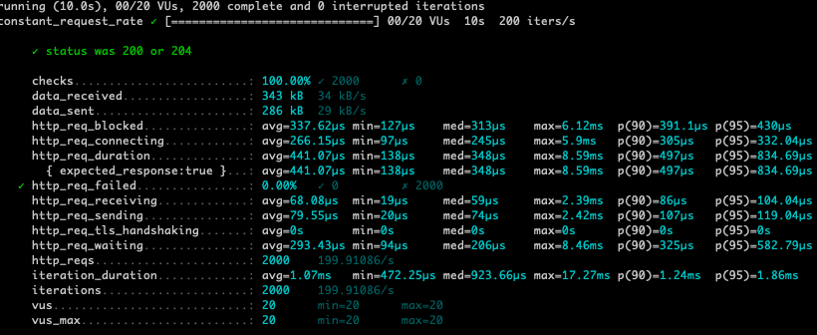
K6壓測: 7筆資料 (key： ad_set)

Slide 10
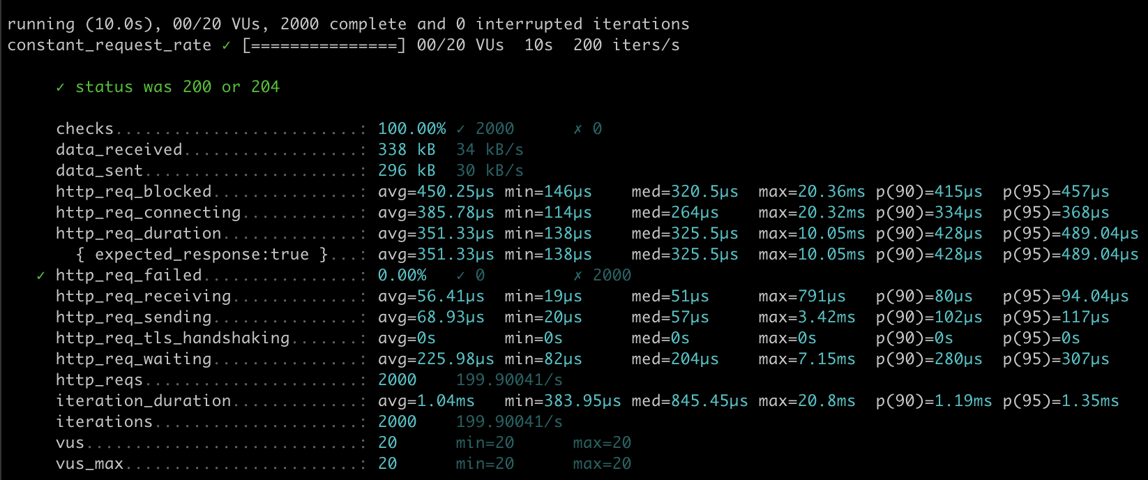
K6壓測: 200000筆資料(initData.sh 20~30m)

Slide 11
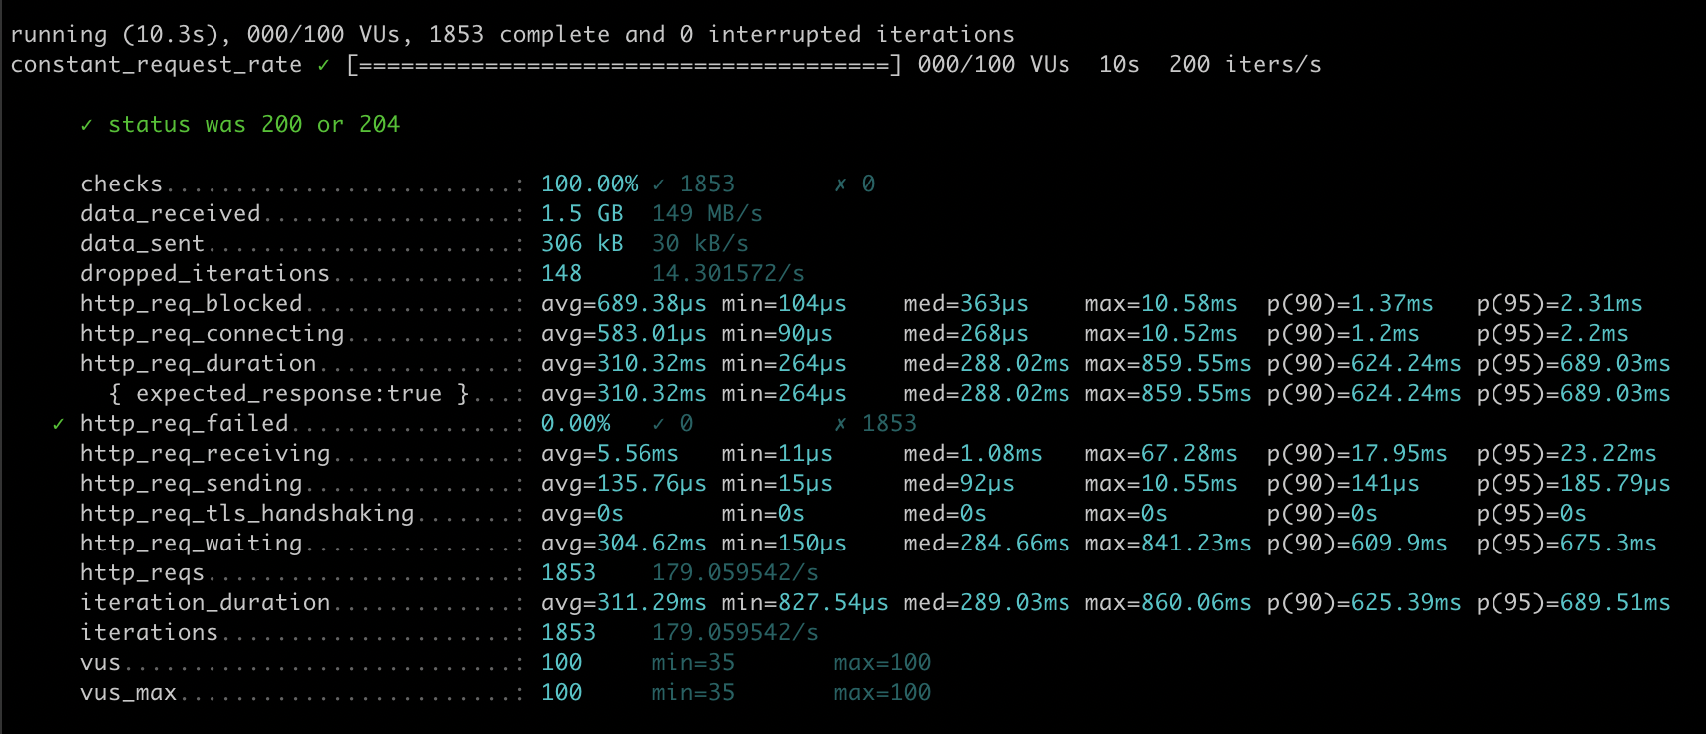
20萬筆資料都是全世界

Slide 12
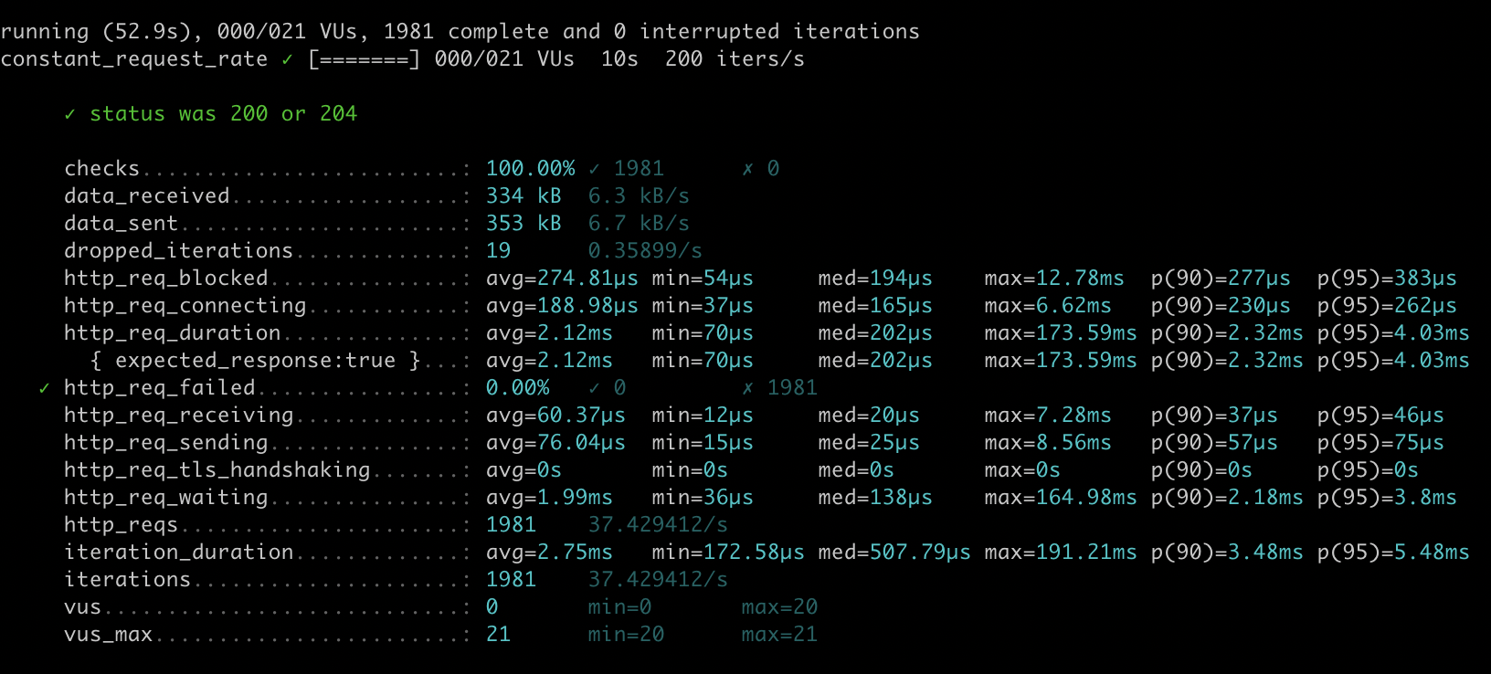
geoJson: 465 area and app_log point test

Slide 13
problem
ad relation many area
set 重複的id會被覆蓋
search 一次只能對一組key(name) 操作

Slide 14
maybe?
revers tile38Id & ad_id:
add ad_id into FIELD:
process field not 0 name
user location
find areaId
ad_id list
Tile38
someDB

Slide 15
link:
boundingBox: https://boundingbox.klokantech.com/
commands: https://tile38.com/commands/#
git: https://github.com/tidwall/tile38

