Slide 1


Assessing Credit Risk of Bank Customers Using
Machine Learning Algorithms
Team Member:
Alistair Biswas (20200104046)
Syed Mohtasib Mashruk (20200104029)
Rafeed Mahbub Rafi (20200104041)
Md.Fahim Faisal (20200104032)
Presented To
Faisal Muhammad Shah & Md.Zahid Hossain
Notes:
https://pixabay.com/en/achievement-agreement-business-3481967/

Slide 2


Introduction
Objectives
Automate the credit risk classification process using machine learning techniques.
A dataset from Kaggle that contains information about 1,000 credit card clients and their default status were used.
A machine learning model was proposed that can predict the default status of a client.
Contributions
We have compared the performance of different machine learning algorithms.
The developed predictive models can be applied to enhance real-time decision-making in banks.
We have used feature selection models to enhance the accuracy.
Notes:
https://pixabay.com/en/open-book-library-education-read-1428428/

Slide 3
Dataset
Source
Features
Dataset was collected from Kaggle which contains information about the credit risk of customers from a leading bank.
The dataset contains information about 1,000 bank customers.
The output variable has two classes: good customers and bad customers.
The dataset has 21 columns, of which 20 are
input variables and one is the output variable (class). Some of them are,
Age
Income
Purpose
Employment Status
Credit Amount

Slide 4
Models
Logistic Regression
k-Nearest Neighbors
SVM
Random Forest Regressor
Decision Tree
XGBoost

Slide 5
Data Pre-processing
Correlation coefficient
Forward selection
Backward elimination
Chi-square
Linear Discriminant Analysis
Principal Component Analysis
Regularization
Bi-directional elimination

Slide 6
Methodology
Scenario 1
Scenario 2
Scenario 3
We used the raw data without feature selection or extraction.
We trained and tested the models on the original 20 input variables.
We have applied forward selection to select the most relevant features.
We used the F1-score as the criterion to add one feature.
We applied PCA to reduce the dimensionality of the data and extract the principal components.
We used the scree plot to determine the optimal number of components .

Slide 7
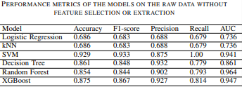
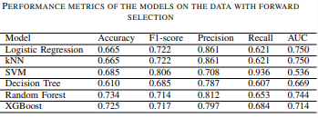
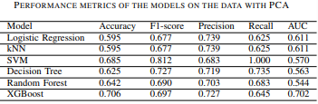
Results
From the tables below we can see that the Support Vector Machines (SVM) has performed really well without any feature selection or extraction. The accuracy is 92.9%.

Slide 8
Limitations and Future Work
Limitations
Future Work
we have used a relatively small and imbalanced dataset.
It may not reflect the real-world scenario of credit risk assessment.
Feature selection and extraction model did not perform well.
This approach can be applied to a larger and balanced dataset.
Other feature selection and extraction method can be used for better result.

Slide 9

Thank You!
Notes:
https://pixabay.com/en/question-mark-labyrinth-lost-maze-2648236/

