Slide 1

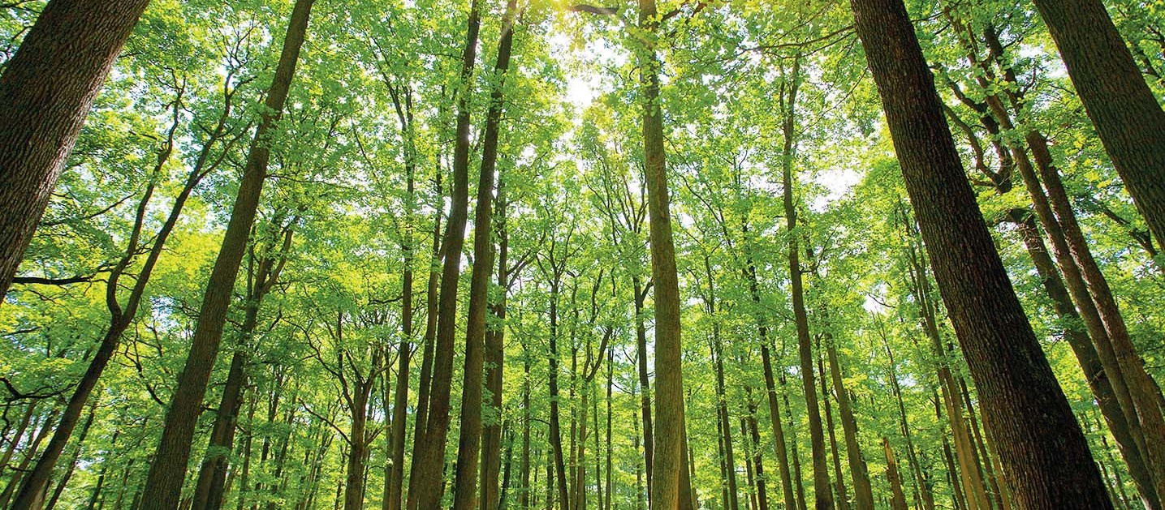
Classification of Forest Cover-type Based on Soil Characteristics Using
Machine Learning
Team Member:
Zakia Sultana(20200104005)
Syed Mohtasib Mashruk(20200104029)
Alistair Biswas(20200104046)
Rafeed Mahbub Rafi(20200104041)
Guided by Prof. Dr. Md. Shamim Akhter
Mr. Md. Zahid Hossain
Mr. Md Rasheduzzaman
Notes:
https://pixabay.com/en/achievement-agreement-business-3481967/

Slide 2

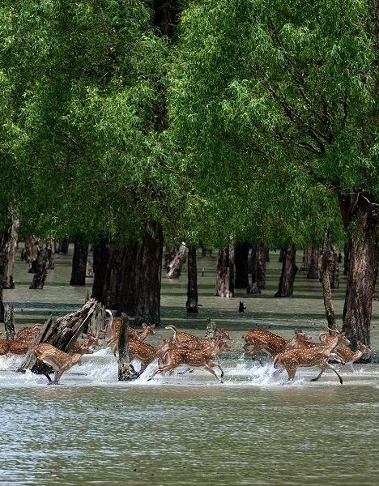
Introduction
Objectives
Accurate Classification: Use soil attributes data and machine learning to accurately identify forest cover types.
Machine Learning: Apply algorithms like decision trees, random forest, logistic regression etc to improve classification accuracy.
Conservation Tool: Develop a model for natural resource monitoring to aid conservation decisions and detect ecosystem changes.
Support for Forestry: Provide a model for forestry professionals to optimize resource use, schedule harvests, and measure biodiversity.
Notes:
https://pixabay.com/en/open-book-library-education-read-1428428/

Slide 3
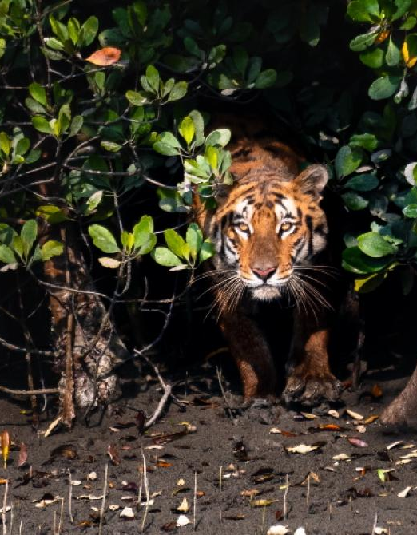
Introduction
Sustainability and Impact in Bangladesh
Biodiversity: Crucial for conserving biodiversity and regulating climate.
Forest Management: Enhances monitoring and management, mitigating deforestation.
Landscape Planning: Improves land use practices and sustainable management.
Climate Change: Helps analyze climate impacts on ecosystems.
Economic Benefits: Supports agriculture and logging, balancing resource use.
Sustainable Development: Aids in biodiversity preservation and ecosystem services.
Notes:
https://pixabay.com/en/open-book-library-education-read-1428428/

Slide 4
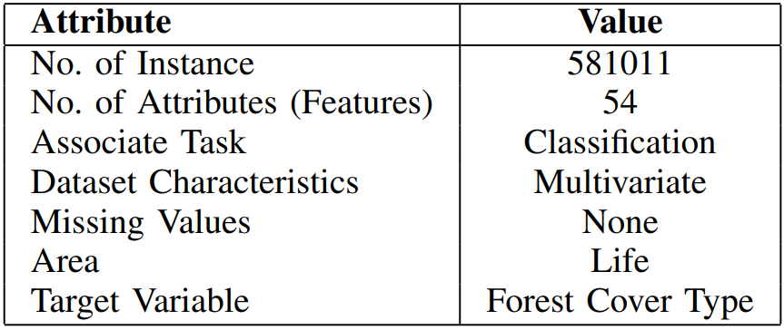
Dataset
Source
Dataset Info
This dataset is part of the UCI Machine Learning Repository.
The original database owners are Jock A. Blackard, Dr. Denis J. Dean, and Dr. Charles, W. Anderson of the Remote Sensing and GIS Program at Colorado State University.
It contains tree observations from four areas of the Roosevelt National Forest in Colorado.
Fig: Dataset Information

Slide 5
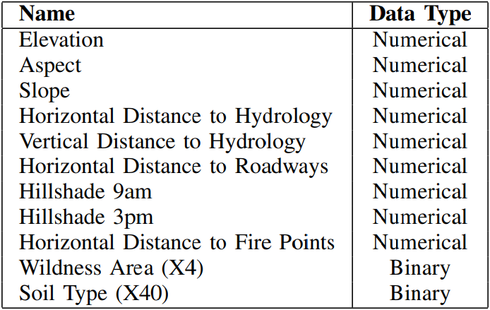
Dataset
Datatype
Classes
The study included ten quantitative variables, 4 binary variables (Wilderness Area), and 40 binary variables (Soil Type).
The target variable contains 7 different classes which is represented with integer values from 1 to 7.
Spruce/Fir
Lodgepole Pine
Ponderosa Pine
Cottonwood/Willow
Aspen
Douglas-fir
Krummholz
So, an observation with ’5’ value in a Forest Cover Type column, it means that observation has Aspen Forest Cover Type for that observation.
Fig: Data Types of Each Feature

Slide 6
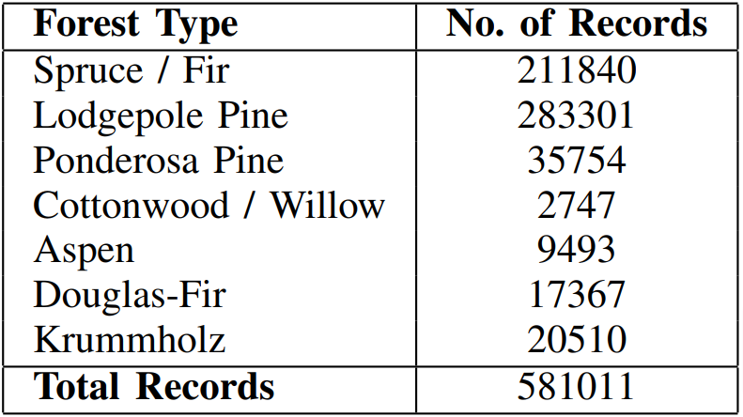
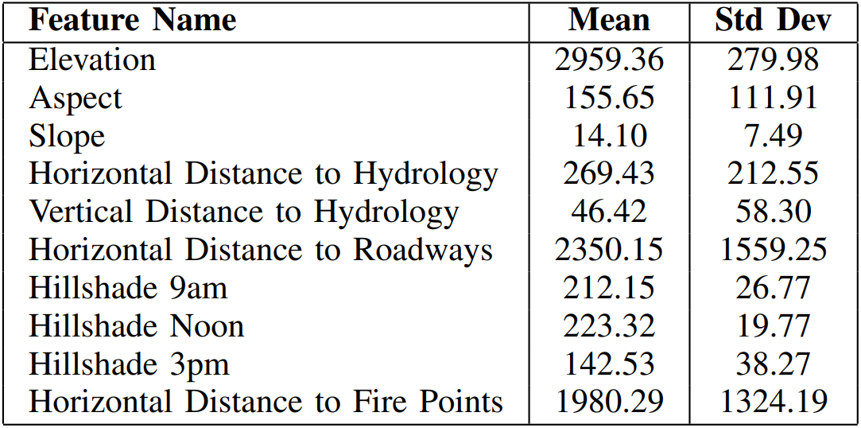
Dataset
Number of Records
Mean & Standard Deviation
There are 581,011 examples in the data set.
By analyzing the statistics for the specified features:
Fig: Number of Records for Each Forest Type
Fig: Mean and Standard Deviation of Each Feature

Slide 7
Data Preprocessing
StringIndexer: categorical features like soil type and wilderness area were indexed using PySpark's StringIndexer, which assigns numerical labels to categorical variables.
OneHotEncoder: To prevent ordinal relationships, OneHotEncoder converted indexed features into binary vectors.
VectorAssembler: Combined all features (numerical and encoded categorical) into a single vector to prepare the dataset for machine learning models.
Data Split: The dataset was split using randomSplit() into 80% training and 20% testing sets, ensuring balanced representation of all classes.
7

Slide 8
Methodology
Model Comparison: compared the optimal logistic regression and decision tree models to identify the best one.
Confusion Matrix: Used PySpark to compute confusion matrices for each model to analyze true positives, false positives, true negatives, and false negatives for each forest cover type.
Precision and Recall: Calculated precision and recall for each forest cover type to evaluate the model's ability to correctly classify without overclassification.
Final Model Selection: Choose the best-performing model for forest type classification based on accuracy, precision, and recall.

Slide 9
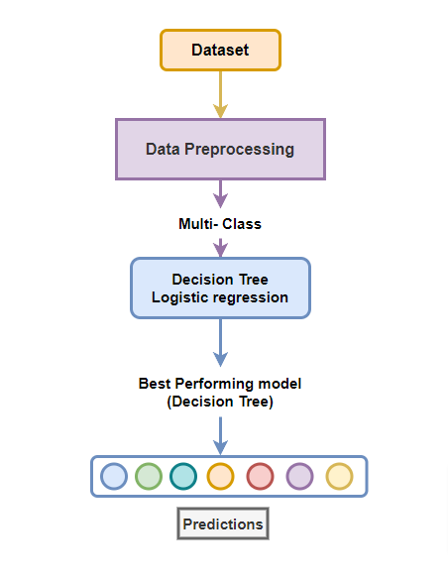
Methodology

Slide 10
Result Analysis
Logistic Regression
Decision Tree
Optimal model: Alpha = 0.0, Lambda = 1e-05.
5-fold cross-validation score: 0.6741 (67.4% accuracy on training data).
Despite tuning, the model's performance remained suboptimal compared to the Decision Tree model.
Optimal model: Max depth = 16, Minimum instances per node = 1.
Cross-validation score: 0.7775 (77.8% accuracy on training data).
Outperformed Logistic Regression due to deeper structure and non-linear decision boundaries, capturing complex data relationships.
10

Slide 11
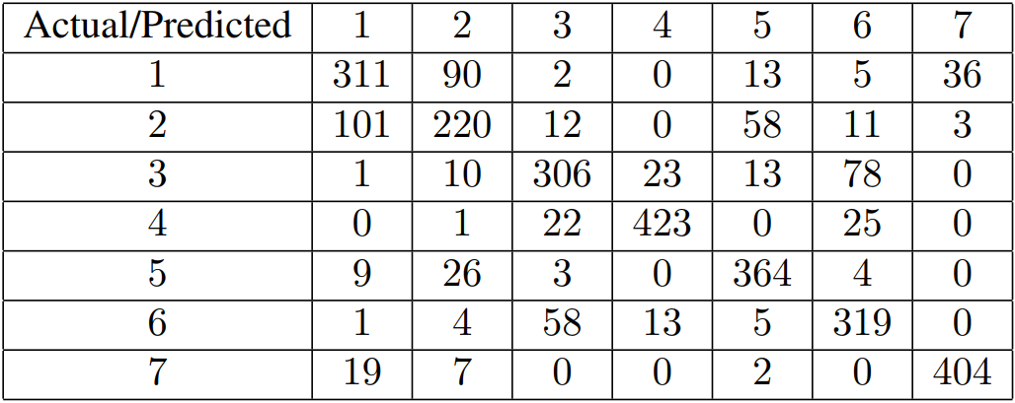
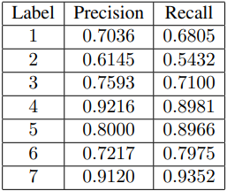
Result Analysis
Test Set Evaluation:
Decision Tree was evaluated on the test set due to superior training performance.
Test set accuracy: 0.7818 (78.2%), indicating good generalization to unseen data.
Confusion Matrix
Precision & Recall
11

Slide 12
Future Work
01
Ensemble Methods: Implement advanced techniques like Random Forest or Gradient Boosting to reduce misclassification and improve accuracy.
02
Feature Engineering: Perform additional domain-specific feature engineering to better capture relationships between land traits and forest cover types.
03
Handling Imbalanced Data: Use techniques such as oversampling, undersampling, or class-weight adjustments to address class imbalances, improving precision and recall for underrepresented cover types.
04
Model Deployment: Deploy the Decision Tree model for practical use in forest management and monitoring, supporting conservation efforts.
12

Slide 13
Contributions
01
Data Preprocessing: Syed Mohtasib Mashruk
02
Data Visualization: Zakia Sultana
03
Model Preparation: Alistair Biswas, Rafeed Mahbub Rafi
04
Result Evaluation: Alistair Biswas, Rafeed Mahbub Rafi
05
Paper Writing & Slide Creation: Alistair Biswas, Rafeed Mahbub Rafi, Syed Mohtasib Mashruk, Zakia Sultana
13

Slide 14

Thank You!
Notes:
https://pixabay.com/en/question-mark-labyrinth-lost-maze-2648236/

