Slide 1

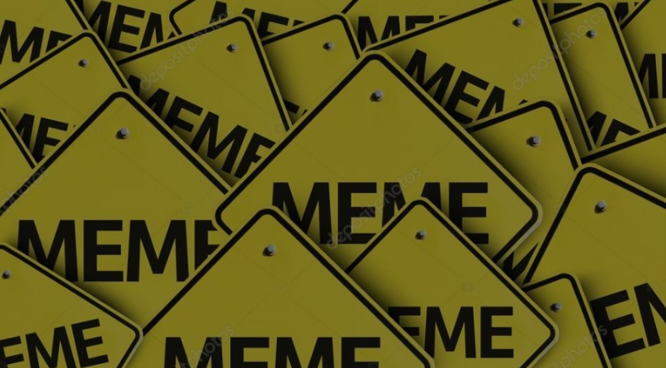
Beyond the Laughter: Detecting Hateful Memes with Deep Learning
Team Member:
Alistair Biswas (20200104046)
Syed Mohtasib Mashruk (20200104029)
Rafeed Mahbub Rafi (20200104041)
Md.Fahim Faisal (20200104032)
Nusrat Islam(20200104027)
Presented To
Md. Tanvir Rouf Shawon & Raihan Tanvir
Notes:
https://pixabay.com/en/achievement-agreement-business-3481967/

Slide 2

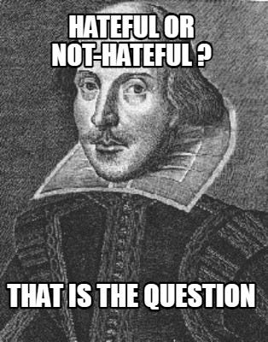
Introduction
Objectives
Develop a hateful meme detection system using deep learning techniques
Improve understanding of the complex interactions between images and text in hateful memes.
Enhance transparency and interpretability in detecting and explaining the presence of hate speech in memes.
Contributions
We Implement and evaluate of various machine learning models, encompassing both unimodal and multimodal approaches.
We investigate different evaluation metrics (Accuracy, Precision, Recall, F1 Score) to gauge the performance of detection models.
Notes:
https://pixabay.com/en/open-book-library-education-read-1428428/

Slide 3
Dataset
Data Collection
Data Annotation
We collected dataset from MUTE Dataset.
It is a multimodal dataset consisting of 4,369 images.
Annotated with ’hate’ and ’not-hate’.
The train set (80%), the test set (10%), and the validation set (10%).
The dataset has a little imbalance, with the ’Not-Hate’ class comprising approximately 60% of the data.
Dataset | Hate | Not-Hate
Train | 1275 | 2090
Validation | 152 | 223
Test | 159 | 257
Tota | 1586 | 2570

Slide 4
Models
VGG16
VGG19
ResNet50
BiLSTM
+
CNN
BanglaBERT
M-BERT

Slide 5
Methodology
Data Pre-Processing
Classification
We focused on a systematic and comprehensive pre-processing of the data to prepare it for subsequent analysis
We sourced the dataset and Label column of the datasets are transformed into numerical values.
‘Hate’ is encoded as 1, while ’not-hate’ is encoded as 0.
We used VGG-19, VGG-16, and ResNet50 for image based Model.
For Textual analysis, we use BanglaBERT,BiLSTM with CNN & M-BERT.
For multimodal approach, we employed a combination of VGG16 and BanglaBERT & VGG19 and BanglaBERT

Slide 6
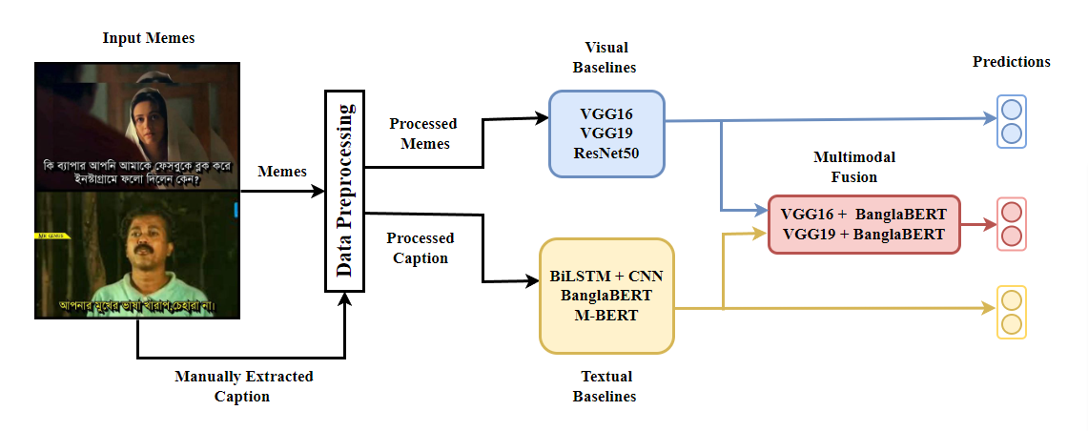
Methodology

Slide 7
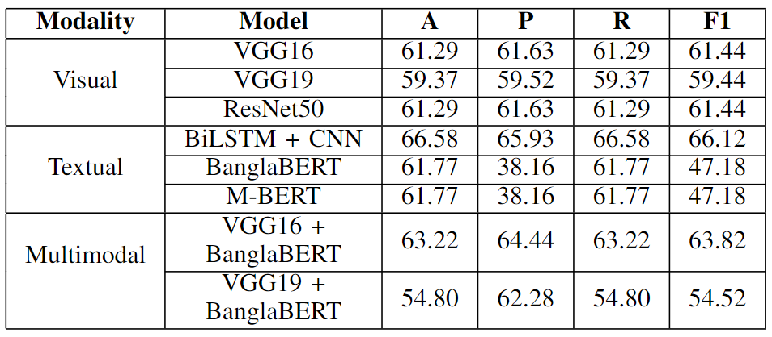
Results
Here we can see that the BiLSTM + CNN and VGG16 + BanglaBERT has given the best accuracy respectively 66.58% and 63.22%.

Slide 8
Limitations and Future Work
Limitations
Future Work
we have used a relatively small and imbalanced dataset, may bias the models towards predicting
the ‘Not-Hate’ class.
No advanced word embedding techniques were applied.
Enough multi-modal models were not implied.
More varied and representative dataset.
More advanced word embedding techniques like Word2Vec or GloVe.
More ambitious studies like effective meme generator.

Slide 9

Thank You!
Notes:
https://pixabay.com/en/question-mark-labyrinth-lost-maze-2648236/

