Slide 1
TELECOM CUSTOMER CHURN
N a m e : Alistair Dsilva, Pooja Mathur, Shagun Choudhary
ANALYSIS

Slide 2
PROBLEM STATEMENT
In the telecom industry, customers are able to choose from multiple service providers and actively switch from one operator to another. In this highly competitive market, the telecommunications industry experiences an average of 15-25% annual churn rate. Given the fact that it costs 5-10 times more to acquire a new customer than to retain an existing one, customer retention has now become even more important than customer acquisition.
For many incumbent operators, retaining high profitable customers is the number one business goal.
To reduce customer churn, telecom companies need to predict which customers are at high risk of churn.
In this project, you will analyse customer-level data of a leading telecom firm, build predictive models to identify customers at high risk of churn and identify the main indicators of churn.
Understanding and defining churn
There are two main models of payment in the telecom industry - postpaid (customers pay a monthly/annual bill after using the services) and prepaid (customers pay/recharge with a certain amount in advance and then use the services).
In the postpaid model, when customers want to switch to another operator, they usually inform the existing operator to terminate the services, and you directly know that this is an instance of churn.
However, in the prepaid model, customers who want to switch to another network can simply stop using the services without any notice, and it is hard to know whether someone has actually churned or is simply not using the services temporarily (e.g. someone may be on a trip abroad for a month or two and then intend to resume using the services again).
Thus, churn prediction is usually more critical (and non-trivial) for prepaid customers, and the term ‘churn’ should be defined carefully. Also, prepaid is the most common model in India and Southeast Asia, while postpaid is more common in Europe in North America.
This project is based on the Indian and Southeast Asian market.
Definitions of churn
There are various ways to define churn, such as:
Revenue-based churn: Customers who have not utilised any revenue-generating facilities such as mobile internet, outgoing calls, SMS etc. over a given period of time. One could also use aggregate metrics such as ‘customers who have generated less than INR 4 per month in total/average/median revenue.
The main shortcoming of this definition is that there are customers who only receive calls/SMSes from their wage-earning counterparts, i.e. they don’t generate revenue but use the services. For example, many users in rural areas only receive calls from their wage-earning siblings in urban areas.
Usage-based churn: Customers who have not done any usage, either incoming or outgoing - in terms of calls, internet etc. over a period of time.
A potential shortcoming of this definition is that when the customer has stopped using the services for a while, it may be too late to take any corrective actions to retain them. For e.g., if you define churn based on a ‘two-months zero usage’ period, predicting churn could be useless since by that time the customer would have already switched to another operator.
In this project, you will use the usage-based definition to define churn.
High-value churn
In the Indian and Southeast Asian markets, approximately 80% of revenue comes from the top 20% of customers (called high-value customers). Thus, if we can reduce the churn of high-value customers, we will be able to reduce significant revenue leakage.
In this project, you will define high-value customers based on a certain metric predict churn only on high-value customers.

Slide 3
Reading and Cleaning data
Imported csv file
Handle missing values in rows and columns
Removed unwanted columns
Imputed missing values
Deleted unwanted records
Tagged the churned customers (churn=1, else 0) based on the fourth month as follows: Those who have not made any calls (either incoming or outgoing) AND have not used mobile internet even once in the churn phase.
Deleted all the attributes corresponding to the churn phase
Treated outliers
Derived new columns.

Slide 4
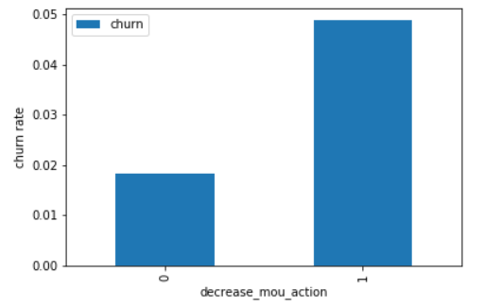
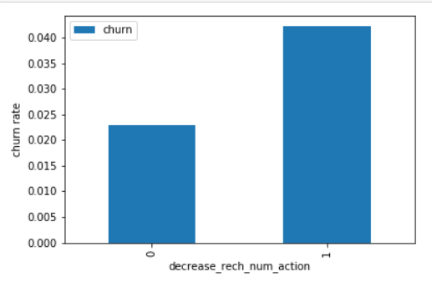
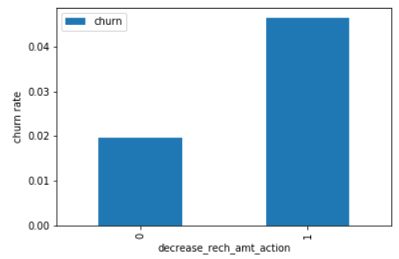
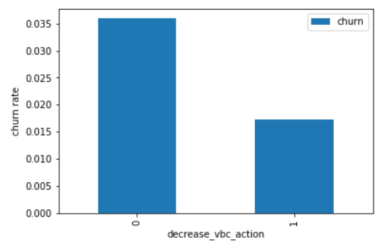
EDA
Churn rate on the basis whether the customer decreased her/his MOU in action month
Churn rate on the basis whether the customer decreased her/his number of recharge in action month
Churn rate on the basis whether the customer decreased her/his amount of recharge in action month
Churn rate on the basis whether the customer decreased her/his volume based cost in action month

Slide 5
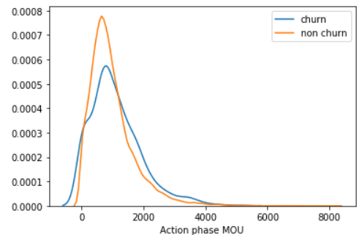
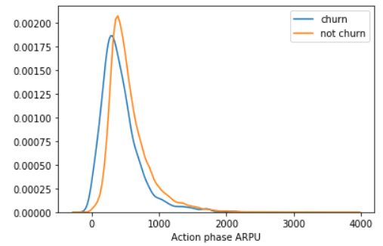
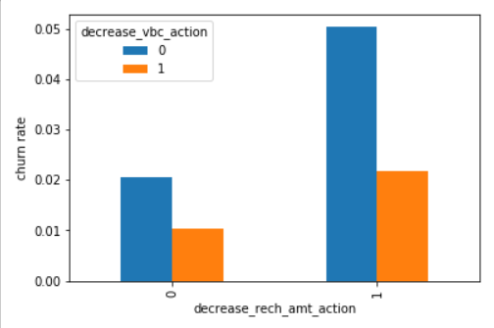
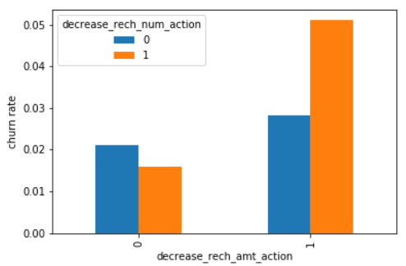
EDA
Analysis of the average revenue per customer (churn and not churn) in the action phase
Analysis of the minutes of usage MOU (churn and not churn) in the action phase
Analysis of churn rate by the decreasing recharge amount and volume based cost in the action phase
Analysis of churn rate by the decreasing recharge amount and number of recharge in the action phase

Slide 6
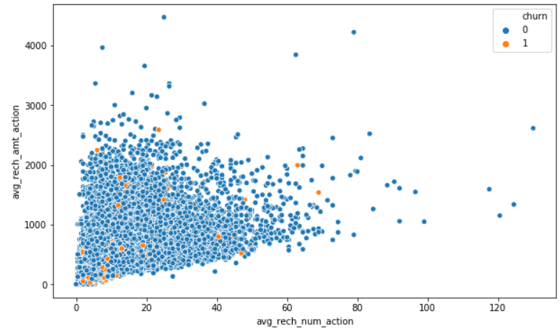
EDA
Analysis of recharge amount and number of recharge in action month

Slide 7
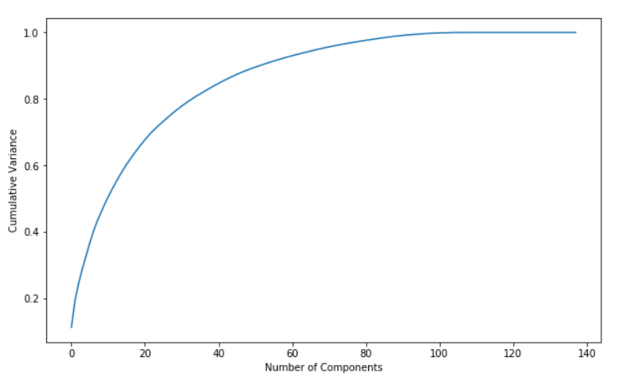
Building model
Performed Train-Test Split
Dealing with data imbalance
Feature Scaling
Model with PCA - 60 components explain more than 90% variance of the data. So, we will perform PCA with 60 components.
Performing PCA with 60 components
Applying transformation on the test set
Emphasize Sensitivity/Recall than Accuracy

Slide 8
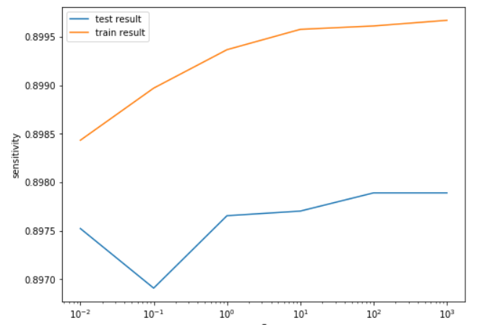
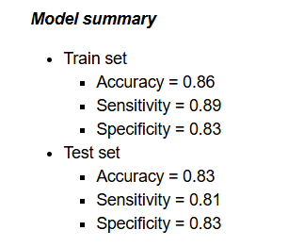
Logistic regression with PCA
Tuning hyperparameter C
plot of C versus train and validation scores
Logistic regression with optimal C
Prediction on the train set
Confusion matrix
Accuracy
Sensitivity
Specificity
Prediction on the test set
Confusion matrix
Accuracy
Sensitivity
Specificity

Slide 9
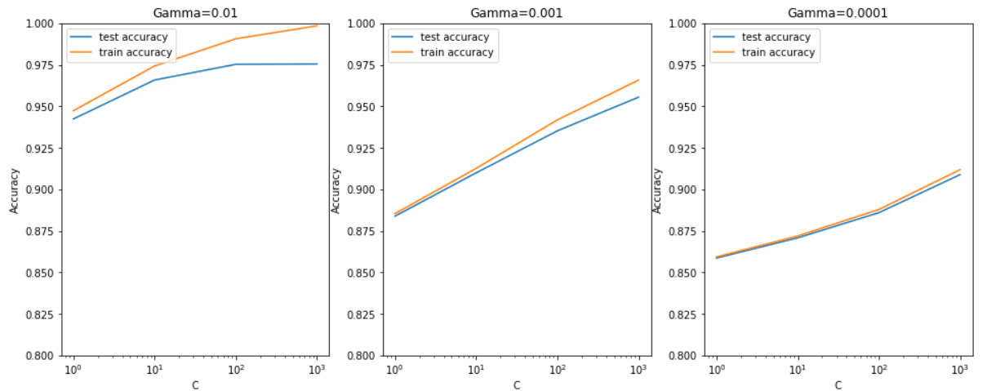
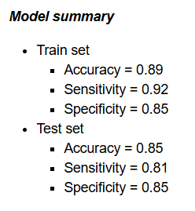
Support Vector Machine(SVM) with PCA
Hyperparameter tuning
Plotting the accuracy with various C and gamma values
From the plot, we can see that higher value of gamma leads to overfitting the model. With the lowest value of gamma (0.0001) we have train and test accuracy almost same.
Also, at C=100 we have a good accuracy and the train and test scores are comparable.
Though sklearn suggests the optimal scores mentioned above (gamma=0.01, C=1000), one could argue that it is better to choose a simpler, more non-linear model with gamma=0.0001. This is because the optimal values mentioned here are calculated based on the average test accuracy (but not considering subjective parameters such as model complexity).
We can achieve comparable average test accuracy (~90%) with gamma=0.0001 as well, though we'll have to increase the cost C for that. So to achieve high accuracy, there's a tradeoff between:
High gamma (i.e. high non-linearity) and average value of C
Low gamma (i.e. less non-linearity) and high value of C
We argue that the model will be simpler if it has as less non-linearity as possible, so we choose gamma=0.0001 and a high C=100.
Build the model with optimal hyperparameters
Prediction on the train set
Prediction on the test set

Slide 10
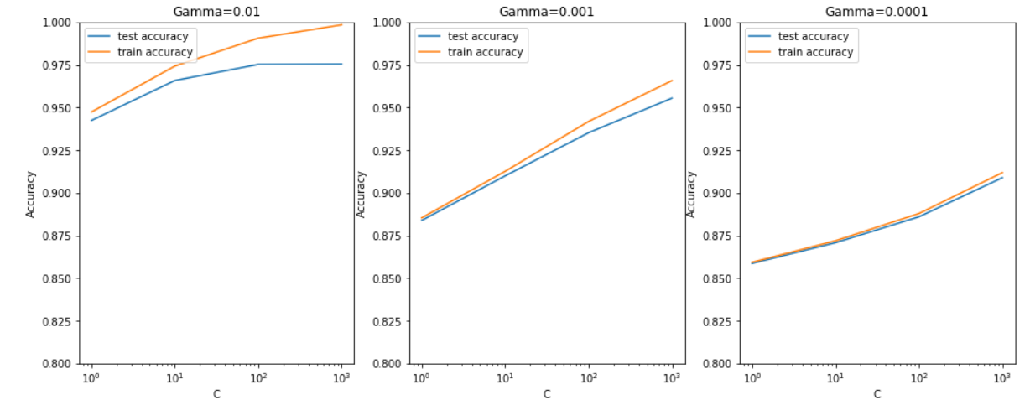
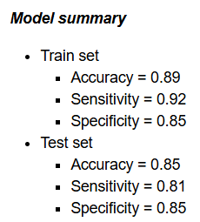
Decision tree with PCA
Hyperparameter tuning
Plotting the accuracy with various C and gamma values
From the above plot, we can see that higher value of gamma leads to overfitting the model. With the lowest value of gamma (0.0001) we have train and test accuracy almost same.
Also, at C=100 we have a good accuracy and the train and test scores are comparable.
Though sklearn suggests the optimal scores mentioned above (gamma=0.01, C=1000), one could argue that it is better to choose a simpler, more non-linear model with gamma=0.0001. This is because the optimal values mentioned here are calculated based on the average test accuracy (but not considering subjective parameters such as model complexity).
We can achieve comparable average test accuracy (~90%) with gamma=0.0001 as well, though we'll have to increase the cost C for that. So to achieve high accuracy, there's a tradeoff between:
High gamma (i.e. high non-linearity) and average value of C
Low gamma (i.e. less non-linearity) and high value of C
We argue that the model will be simpler if it has as less non-linearity as possible, so we choose gamma=0.0001 and a high C=100.
Build the model with optimal hyperparameters
Prediction on the train set
Prediction on the test set

Slide 11
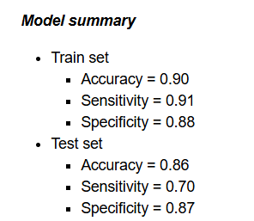
Decision tree with PCA
Hyperparameter tuning
Model with optimal hyperparameters
Prediction on the train set
Prediction on the test set

Slide 12
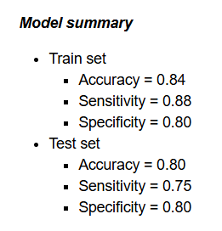
Random forest with PCA
Hyperparameter tuning
Model with optimal hyperparameters
Prediction on the train set
Prediction on the test set
Final conclusion with PCA
After trying several models we can see that for acheiving the best sensitivity, which was our ultimate goal, the classic Logistic regression or the SVM models preforms well. For both the models the sensitivity was approx 81%. Also we have good accuracy of apporx 85%.

Slide 13
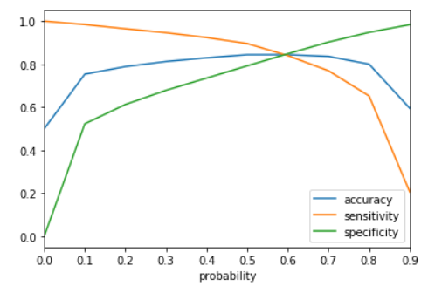
without PCA Logistic regression with No PCA
Model analysis
Coarse tuning (Auto+Manual)
Feature Selection Using RFE
Model with RFE selected columns
Checking VIFs
Removing unnecessary columns
Model performance on the train set
Analysis of the curve
Accuracy - Becomes stable around 0.6
Sensitivity - Decreases with the increased probablity.
Specificity - Increases with the increasing probablity.
At point 0.6 where the three parameters cut each other, we can see that there is a balance between sensitivity and specificity with a good accuracy

Slide 14
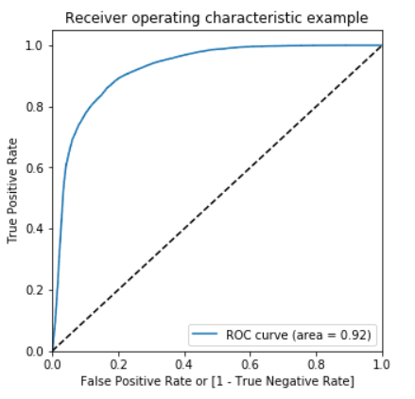
ROC Curve

Slide 15
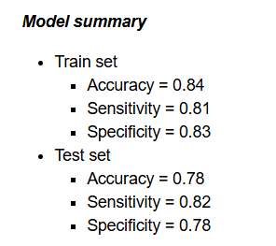
without PCA Logistic regression with No PCA
Final conclusion with no PCA
We can see that the logistic model with no PCA has good sensitivity and accuracy, which are comparable to the models with PCA. So, we can go for the more simplistic model such as logistic regression with PCA as it expliains the important predictor variables as well as the significance of each variable. The model also hels us to identify the variables which should be act upon for making the decision of the to be churned customers. Hence, the model is more relevant in terms of explaining to the business.

Slide 16
Business recommendation
Target the customers, whose minutes of usage of the incoming local calls and outgoing ISD calls are less in the action phase (mostly in the month of August).
Target the customers, whose outgoing others charge in July and incoming others on August are less.
Also, the customers having value based cost in the action phase increased are more likely to churn than the other customers. Hence, these customers may be a good target to provide offer.
Customers, whose monthly 3G recharge in August is more, are likely to be churned.
Customers having decreasing STD incoming minutes of usage for operators T to fixed lines of T for the month of August are more likely to churn.
Customers decreasing monthly 2g usage for August are most probable to churn.
Customers having decreasing incoming minutes of usage for operators T to fixed lines of T for August are more likely to churn.
roam_og_mou_8 variables have positive coefficients (0.7135). That means for the customers, whose roaming outgoing minutes of usage is increasing are more likely to churn.

Slide 17
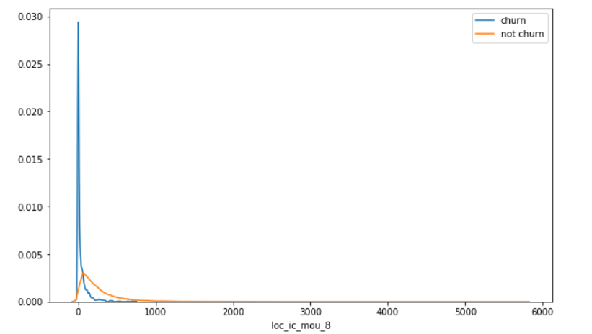
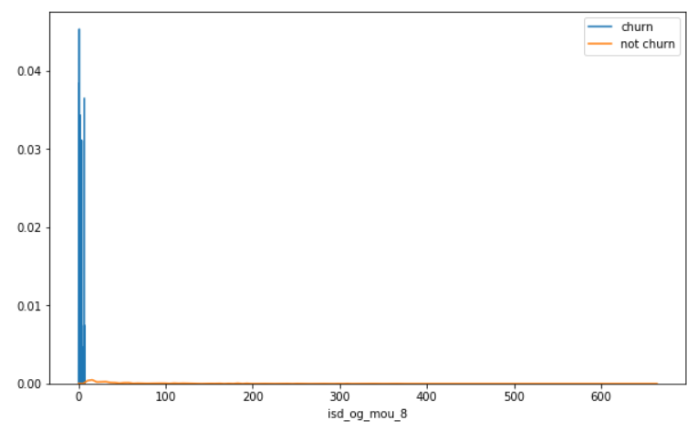
Plots of important predictors for churn and non churn customers
We can see that for the churn customers the minutes of usage for the month of August is mostly populated on the lower side than the non churn customers.
We can see that the ISD outgoing minutes of usage for the month of August for churn customers is dense approximately to zero. On the other hand for the non churn customers it is little more than the churn customers.

Slide 18
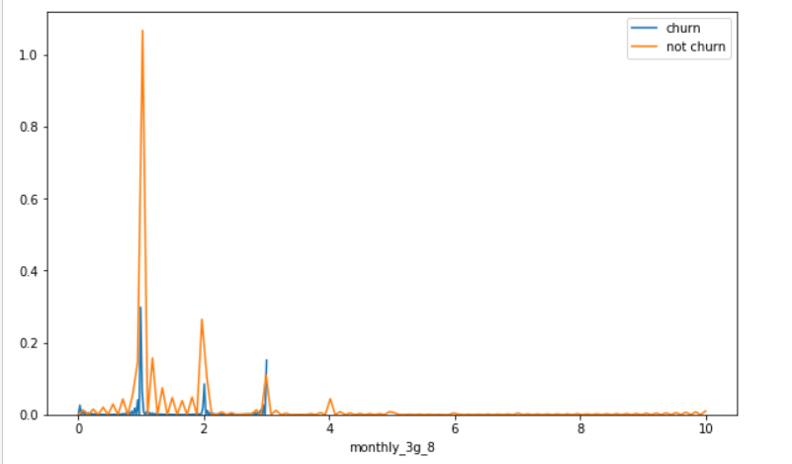
Plots of important predictors for churn and non churn customers
The number of monthly 3g data for August for the churn customers are very much populated around 1, whereas of non churn customers it spread across various numbers.

