Slide 1

Presentation to Tyre Industry Stakeholders 18th July 2017
Brian White, Maria Douglas, Eastern-Midlands Waste Enforcement Regional Lead Authority

Slide 2

Outline of Presentation
Introduction - WERLA Overview;
National Priorities 2017;
Local Authority Enforcement
Enforcement current Regulations
Next steps – New Regulations
Reporting non-compliant activity

Slide 3
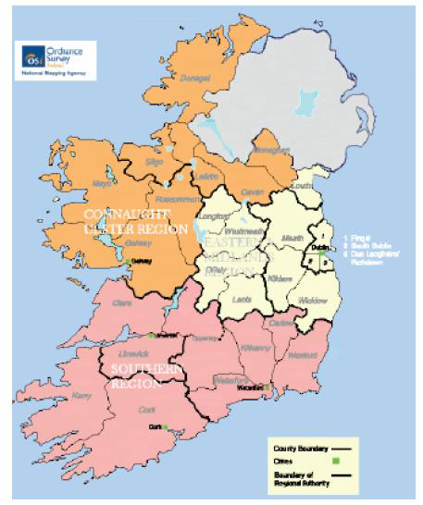


Waste Management Regions

Slide 4












EMR Local Authorities
Dublin City Council
Fingal County Council
South Dublin County Council
Dun Laoghaire Rathdown
Kildare County Council
Meath County Council
Louth County Council
Wicklow County Council
Westmeath County Council
Offaly County Council
Longford County Council
Laois County Council

Slide 5
Waste Enforcement Regional Lead Authority Main Functions
Business case for establishment of WERLAs
Established 2015 / 2016. EMR March 2016;
Coordinated approach to enforcement of waste legislation ;
Develop a strong regional enforcement network ;
Deal with strategic national waste enforcement priorities and serious criminal offenders;
To drive improved levels of compliance.

Slide 6
National Priorities 2017
Circular WP08/16 identified the national waste priorities for 2017
1. Illegal Dumping including construction and demolition waste
2. Household Waste Management Compliance including Brown Bin
3. End- of-Life Vehicles
4. Tyres
5. Packaging Pilot

Slide 7
Local Authority Enforcement
Each local authority is responsible for waste enforcement in their own functional area
Authorised persons under S14 of the Waste Management Act
Responsible for the enforcement of the provisions of Parts III to VIII of Regulations
Compliance assistance enforcement including inspection, warning letters, re-inspection, statutory Notice under WMA, prosecution.
Penalties in accordance with section 10 of the WMA and prosecuted in accordance with section 11, 12 and 13 of the WMA.

Slide 8
Local Authority Enforcement Continued
Penalties available under the Waste Management Act 1996 (as amended) are:
a) on summary conviction, a fine not exceeding €5,000, or imprisonment for any term not exceeding 12 months, or both fine and imprisonment, or
b) on conviction on indictment, a fine not exceeding €15,000,000, or imprisonment for a term not exceeding ten years, or both fine and imprisonment.

Slide 9
Enforcement Current Regulations
Awareness – Information pack to unregistered Economic Operator’s (EOs) in 2016 & 2017
Coordinated national inspections
Warning letters issued to non compliant EOs
Enforcement notices
Prosecutions initiated

Slide 10
Next Steps – New Regulations
A coordinated national approach to compliance with new Regulations including:
awareness
inspections
Multi-local authority operations
Multi-agency operations

Slide 11
Reporting Non-compliant Activity
Please report any non-complaint activity:
EPA Hotline – 1850 365121
Individual Local Authority Confidential Complaint Lines

