Slide 1


Repak ELT Road Show July 2017
End of Life Tyres

Slide 2
Outline of Roadshow
Purpose.
To brief industry (producers and retailers) on the main elements of the PRI scheme commencing on 1 October 2017.
To inform key tyre stakeholders on their compliance obligations, with the main focus on the legal and reporting obligations for producers and retailers.
Advise on preparations required to ensure a smooth transition to the full PRI scheme. in the tyre industry.
Format
Information brief, a series of short presentations followed by questions and answers.
End of Life Tyres

Slide 3
Agenda
 | Topic | Lead
a. | Introduction & Roadshow Overview | Repak ELT
b. | Retailer Obligations | Repak ELT
c. | Enforcement | WERLA
d. | Producer Obligations | PRL
e. | Enforcement | EPA
f. | Q & A
End of Life Tyres

Slide 4







Repak ELT Company Limited by Guarantee
Incorporated in July 2015, Repak ELT is a not for profit producer responsibility compliance scheme.
Repak ELT Mission: to provide legal compliance for our members under the Waste Management (Tyres And Waste Tyres) Regulations 2017
Repak ELT focus:
to provide a cost effective solution
to deliver responsible and environmentally-sound recovery methods (waste hierarchy, proximity principle applied)
End of Life Tyres

Slide 5
Repak ELT Organisation Structure
General Manager
(Tony O Sullivan)
Admin, IT, Communications
Finance
Operations/Collections
End Markets, Auditing
(Mark Gillick)
Membership, Compliance
Enforcement, Auditing
(John Coleman)
Support from Repak. Shared services, service level agreement.
End of Life Tyres

Slide 6
Repak ELT Road Show Presentation - July 2017
John Coleman,
Membership Manager.
End of Life Tyres

Slide 7
Presentation Content
Repak ELT
ELT PRI Model
Compliance Obligations
vEMCs
Registration Process
Reporting Process
Collections Overview
Data Validation
Q&A.
End of Life Tyres

Slide 8
Overview of system / structure
RepakELT
Producers
Retailers
ATFs
Collectors
Farmers
12no Staff, Membership
Collections
Auditing & Reporting
Producer Register Ltd
Producer Registration
Invoicing Information to Scheme
Auditing of Producers
Reporting to EPA
DCCAE
Regulation
Enforcement
EPA,LA’s,WERLAs
Multi Agency Task Force
EPA
WERLA
LA’s
PRL
Repak ELT
Members
ENFORCEMENT

Slide 9

ELT PRI Model
Tyre Producers
(Manufacturer/ Importer)
Repak ELT
Reporting
DCCAE
EPA
PRL
Black Box
Tyre Wholesaler
Consumer
Retailer
Collection
Recovery / Recycling
Tyres
ELT
vEMC / Invoicing
Data
Note: vEMC is a separate line item on each sales invoice throughout the supply chain (producer/importer, wholesaler, retailer, consumer)
End of Life Tyres

Slide 10
Retailer Legal Compliance Obligations
Become a member of the ELT compliance scheme - Repak ELT - and display Membership Certificate on premises.
Purchase tyres only from registered suppliers.
Charge the vEMC on all tyres sold (separate line item on invoice).
Report data to Repak ELT by the 15th of each month to avail of free collection.
Only give waste tyres to an authorised Repak ELT waste collector.
Advise customers who retain their own waste tyres to dispose of them in an environmentally sound manner.
Abide by Repak ELT Member Scheme Rules.
End of Life Tyres

Slide 11
Visible Environmental Management Costs (vEMC) Fees
vEMC finances the cost of managing waste tyres in an environmentally sound manner
Cost neutral for industry as consumer pays the vEMC at point of purchase.
Category | vEMC (ex VAT)
Passenger Car / 4x4 / Van | €2.80
Motorcycle | €1.50
Truck / Bus – Light Commercial | €6.70
Truck / Bus – Heavy Commercial | €11.00
Agricultural | €0.00*
Construction | €0.00*
Industrial | €0.00*
Minister to confirm vEMC outlook for Agri / Construction / Industrial.
End of Life Tyres

Slide 12
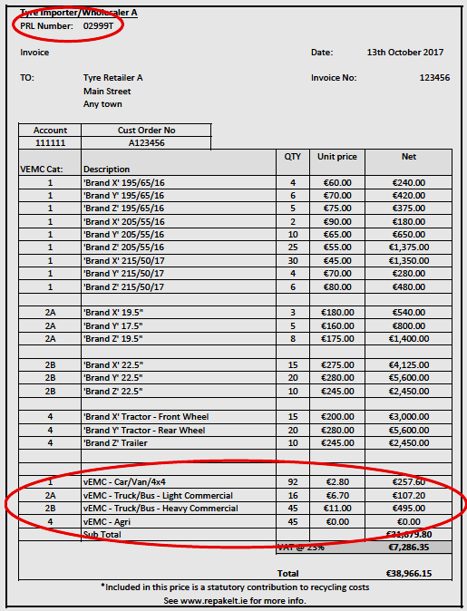
vEMCs to be displayed on Invoices
Financing the cost of managing tyres in an environmentally sound manner
42. (1) On and from the commencement of these Regulations (from October 1st 2017), producers shall impose an environmental management cost for all tyres placed by them on the market in the State.
(2) Where a cost under paragraph (1) is imposed that cost shall be itemised as a separate line item on any invoice, receipt, credit note, dispatch and delivery docket containing the retail price of a tyre issued to his or her customer.
End of Life Tyres

Slide 13
vEMCs to be displayed on Invoices
End of Life Tyres

Slide 14
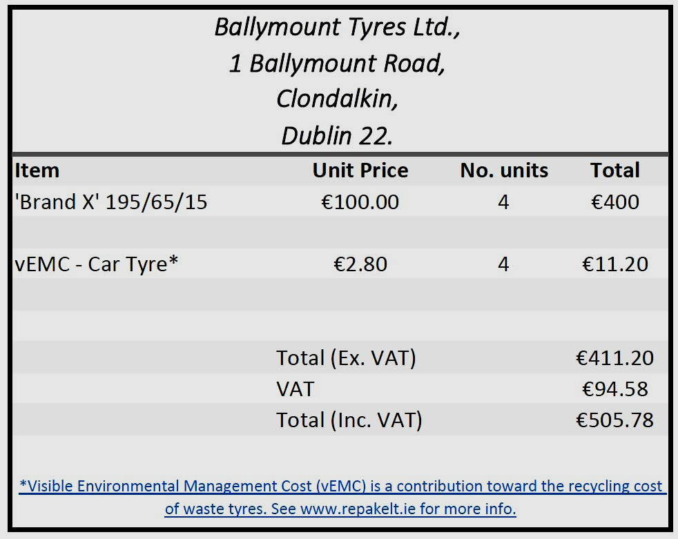
vEMCs to be displayed on Receipts
End of Life Tyres

Slide 15
Repak ELT Registration Process
Log-on to www.repakelt.ie.
Click on “Join Today” at the top of the page.
Complete the Membership Application Form (4-5mins).
Once completed, click on “Send” at the bottom of the form. Your application has now been submitted to Repak ELT.
Once fully reviewed and successfully registered with Repak ELT, your Certificate of Membership will be posted to you.
When you receive your Certificate be sure to display it on your premises
End of Life Tyres

Slide 16
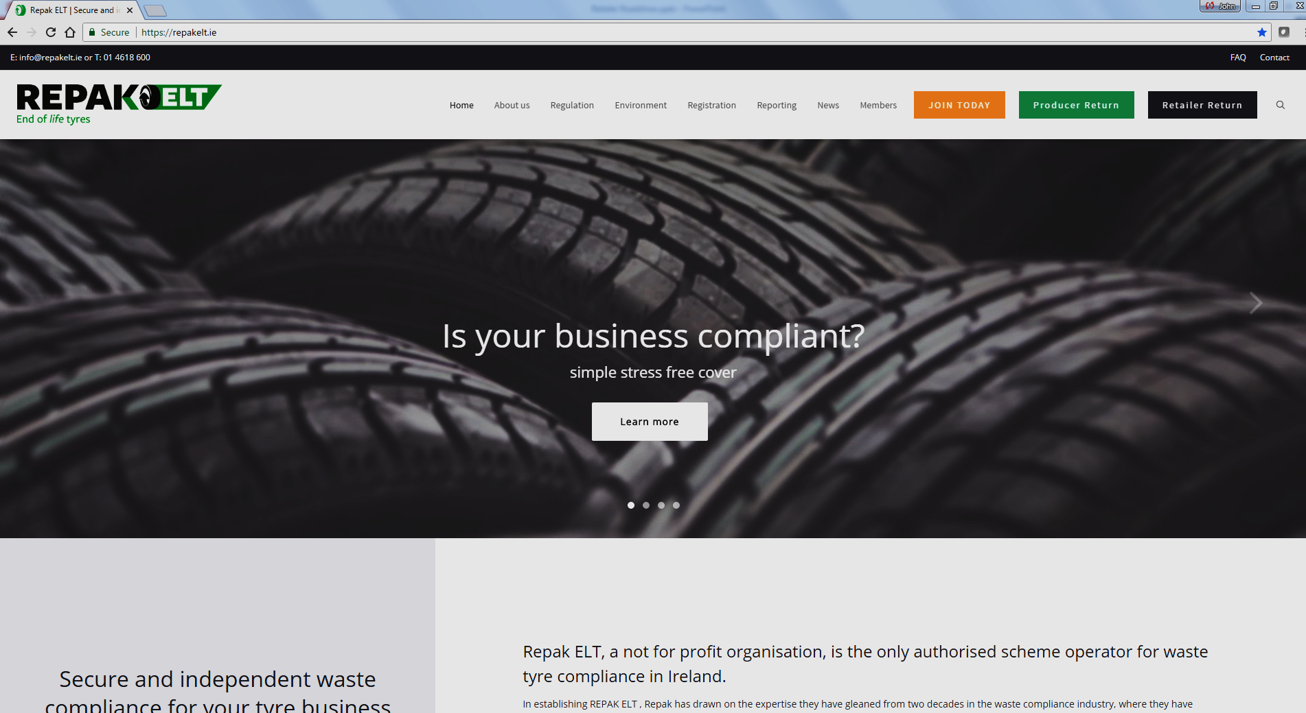

Slide 17
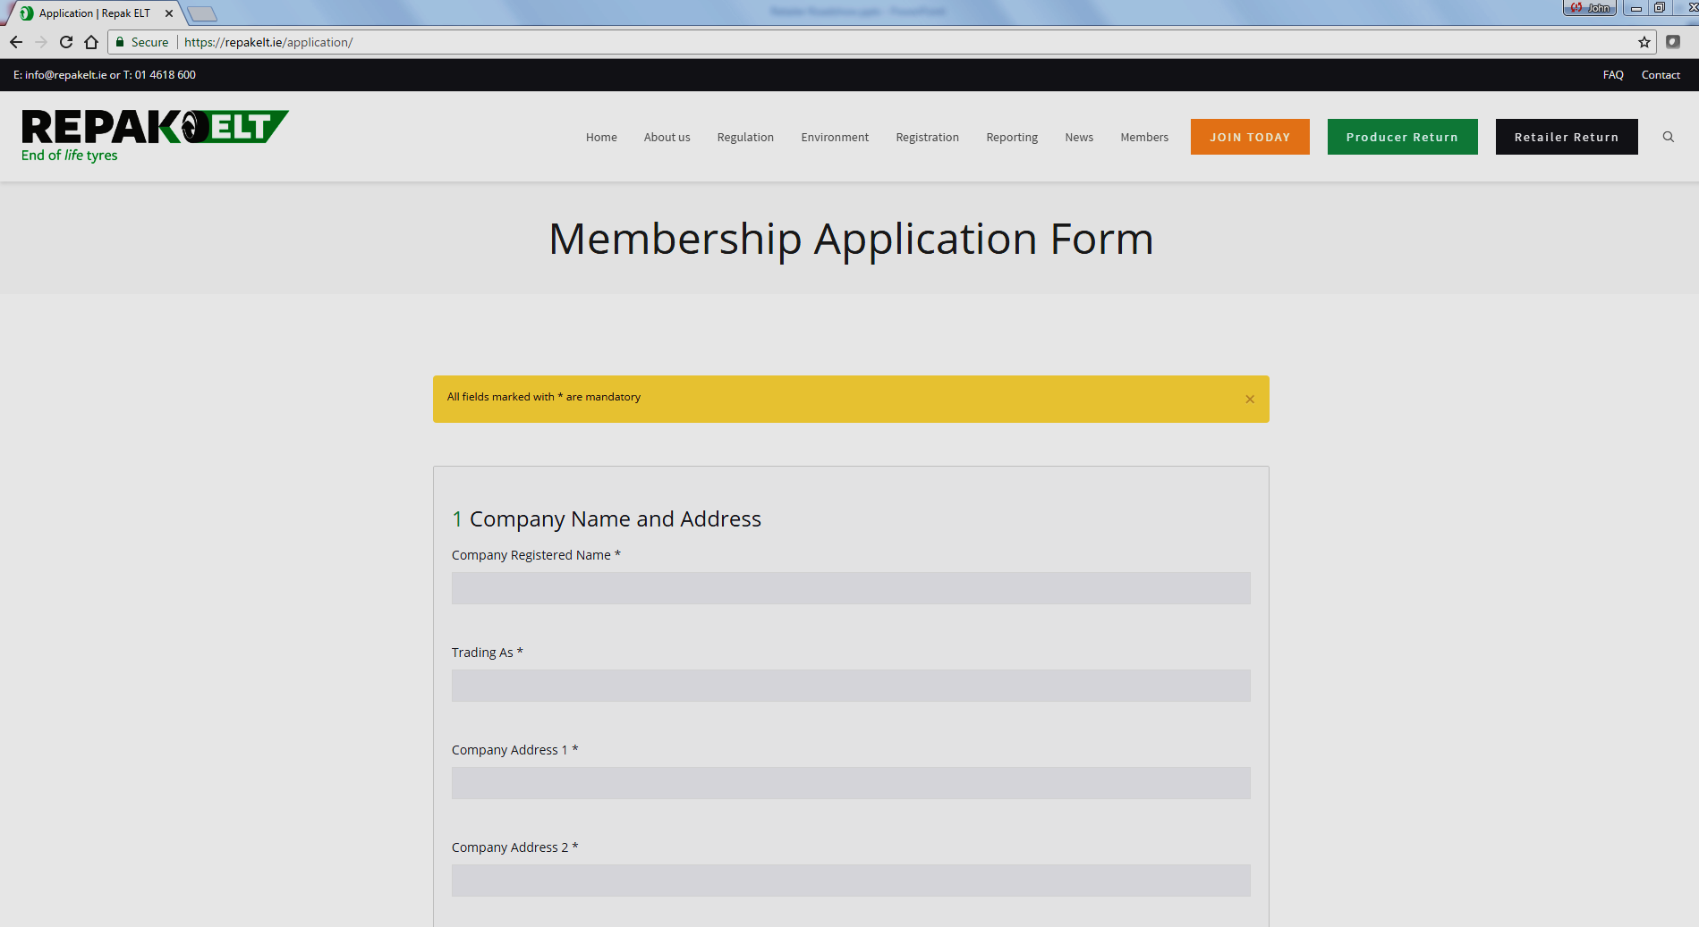

Slide 18
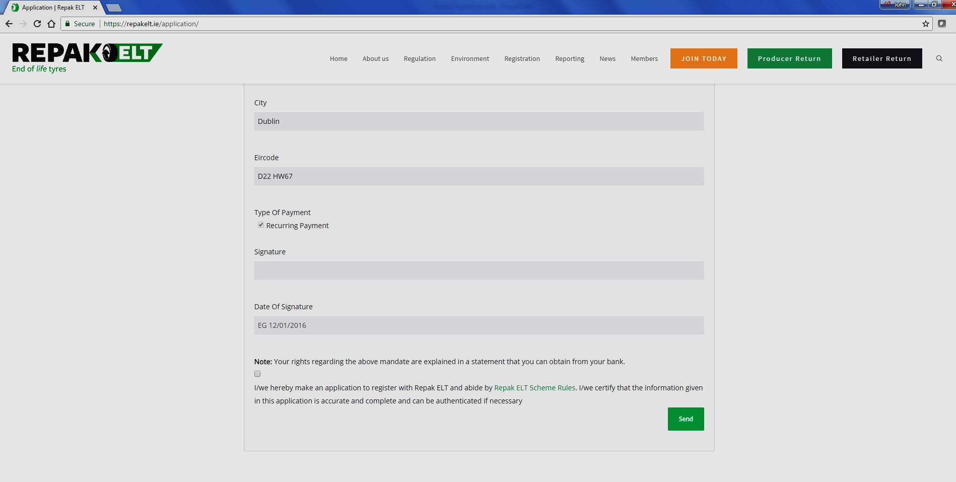

Slide 19
How to Report Monthly to Repak ELT
Report to be complete by the 15th day of every month.
All reporting will be online.
Reporting will include tyres : Purchased, Sold & Collected by category and sub-category.
First month’s reporting will require opening stock to be declared.
PRL ‘Opt-in’ option – More efficient reporting!
End of Life Tyres

Slide 20
Retailer – Opening Stock Declarations for 1 October 2017
Retailers declare the following on October 1st:
Number of units, by category, of waste tyres on site.
Number of units, by category, of new tyres in stock.
Retailers to run down their stock of waste tyres in advance of scheme launch, as they will have to pay €2.80 (+VAT) after the launch date.
Retailers must use Repak ELT approved waste collectors.

Slide 21
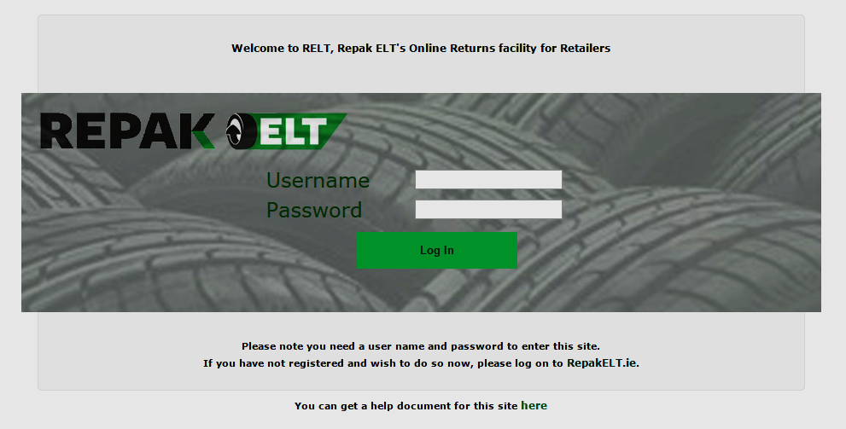
Repak ELT Retailer Reporting Process

Slide 22
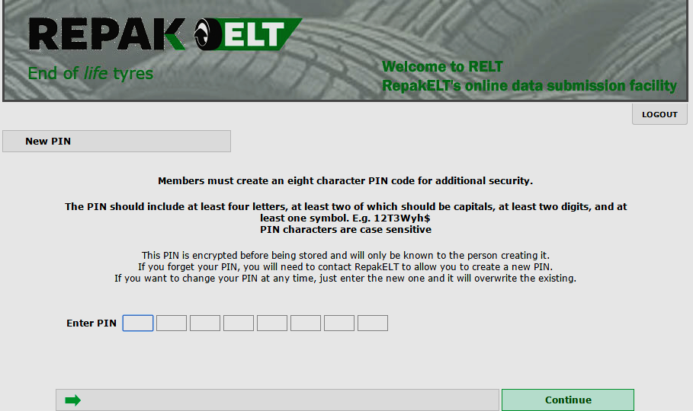

Slide 23
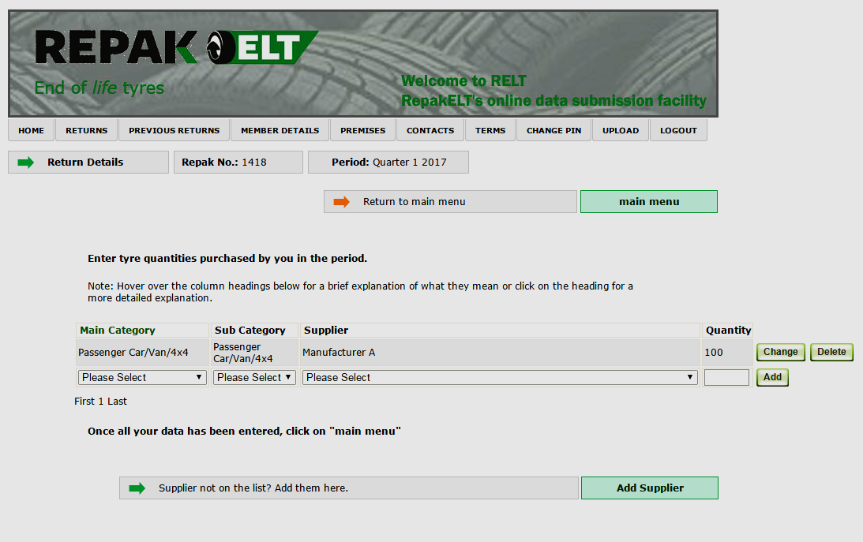

Slide 24
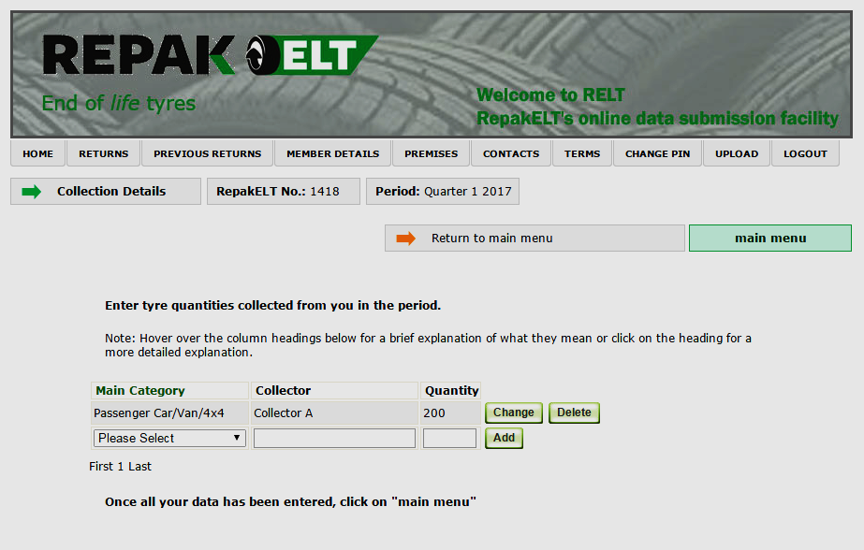

Slide 25
Collection Overview
Waste Tyre Collection is FREE only where a vEMC has been paid.
All reporting will be in electronic format and all tyres collected must be recorded in units by category and sub-category
End of Life Tyres

Slide 26
Waste Collector Compliance
Register through www.repakelt.ie
Report waste collected for previous periods from Retailers
Report destination of waste (facilities used in Ireland or abroad)
Report waste tyres supplied to farmers (Farmers will register with Repak ELT through an online form on www.repakelt.ie )
Supply supporting documentation (e.g. Recycling Certs,Recovery Certs, Annex VII Forms, TFS: TransFrontier Shipments)
End of Life Tyres

Slide 27
Data Validation/Auditing
Data Validation / Reconciliation:
Producer tyres versus tyres purchased by retailers
Retailer sales (B to B)
Retailer waste tyres versus waste tyres collected by collectors
Collector end of life documentation
Auditing:
Retailer audit programme
Collector audit programme
End of Life Tyres

Slide 28
Summary
Solution to an environmental problem; waste tyres to be managed in an environmentally friendly manner.
Opportunity for economic operators to participate in the scheme; fair and equitable scheme, sharing burden.
Free collections of waste tyres where an applicable vEMC has been paid.
Effective enforcement, minimise unfair competition, no hiding place for non compliant operators.
Growth and employment opportunities for compliant industry.
Clean, positive image for industry.
End of Life Tyres

Slide 29
Next Steps…
Now:
Register with Repak ELT (and PRL if a Producer) immediately.
Report data to Repak ELT.
Minimise your waste tyres on site.
By October 1st:
Declare opening stock to Repak ELT for:
New Tyres in stock
Waste Tyres on site
By 15th of each month:
Report Retailer data to Repak ELT.
End of Life Tyres

Slide 30
Contact Details
Repak ELT(01) 4618 600
info@repakelt.ie
www.repakelt.ie
End of Life Tyres

