Slide 1

Producer Register Ltd

Slide 2

Producer Register & Producers
Our primary relationship is with producers and it is two fold:
Producer Registration
and
Producer Reporting

Slide 3
What is a Producer?
The person or company who places tyres on the market in Ireland for the first time.
A producer can be a manufacturer, tyre importer or car importer. An importer of tyres for the purpose of retreading or remoulding those tyres is a producer..
Anybody who places tyres on the market on behalf of a producer who is not registered will be deemed to be the producer.

Slide 4
Producers
Producer Obligations

Slide 5
Producer Obligations
Each producer must display the registration number issued to him by PRL on all invoices, receipts, credit notes, dispatch and delivery dockets issued by him.
A producer must display the vEMC on all invoices, credit notes etc
A producer must notify the registration body of any changes to the information provided in the application form within 10 working days.

Slide 6
Producer Obligations
If a producer wishes to de-register (he no longer places tyres on the market) he must de-register by informing PRL in writing that he has ceased to be a producer. PRL will then commence the de-registration process and inform the producer when it is complete.
Each producer is responsible for retaining for a period of 7 years after the end of a reporting period such records as are necessary to verify the information submitted to the Blackbox.

Slide 7
Producer Obligations
A producer is not deemed to be registered until he receives a registration number and a certificate of registration from PRL
A producer who fails to register or is refused a renewal of registration is deemed not to be registered and is prohibited from placing tyres on the market
Any producer who is not in possession of a valid certificate of registration from PRL shall be prohibited from displaying any registration number on any invoice, receipt, credit note etc

Slide 8
Producer Obligations - Pricing
Website: at each point where a price is quoted the producer must show the retail price of the tyre and separately the vEMC.
Producer must include the wording “Included in this price is a statutory contribution to recycling costs”
Catalogue, Brochures etc: in any such communication the following wording must be included in letters not less than 2 mm high “Included in these prices is a statutory contribution to recycling costs”
Advertising: any advertisement indicating the price of a tyre the producer must include the following words not less than 2 mm high “Included in these prices is a statutory contribution to recycling costs”

Slide 9
Producer Obligations
Producer Registration

Slide 10
Producer Registration
Producers are obliged to register annually with PRL
Producers are obliged to join the compliance scheme (www.repakelt.ie)
Producers are obliged to report monthly to PRL via the WEEE Blackbox

Slide 11
Producer Registration
Registration is by online or postal application directly to PRL no later than 31st January each year.
The following items are needed along with the annual application form
Annual Registration Fee if applicable
Copy of Compliance Scheme Membership Certificate

Slide 12
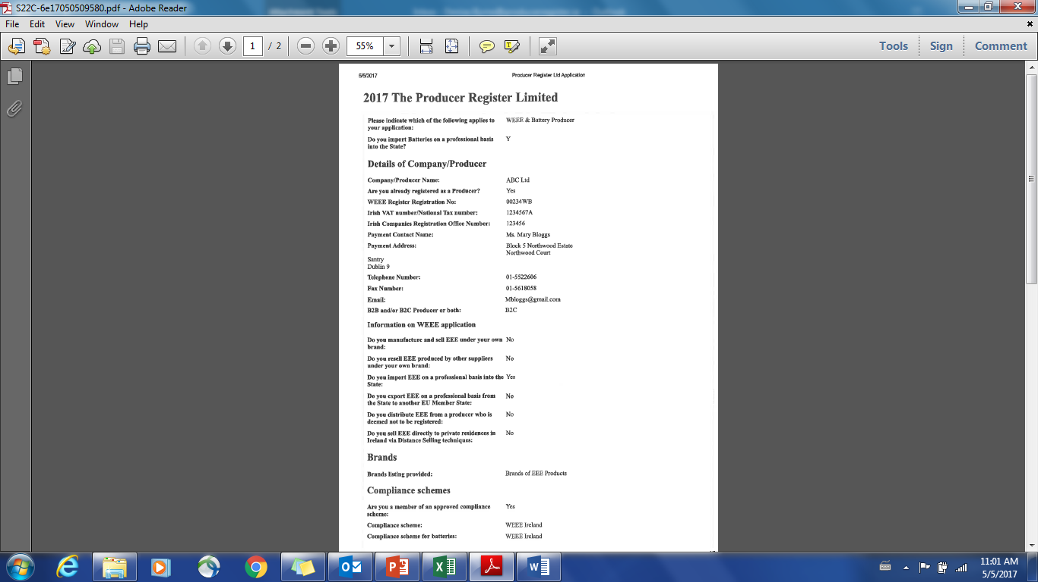

Producer Registration
Online
Postal

Slide 13
The Application Form
Producer Name & Producer Register Number (from 2018)
Type of Producer : Tyre only, Battery & Tyre, WEEE & Tyre ( from 2018)
CRO Number, VAT Number or National Tax Number.
Contact details of the registered office of the producer.
Contact details of the premises at or from which tyres are or will be placed on the market by the producer
Contact details of the individual reporting the weights or as appropriate the number of tyres placed on the market to the WEEE Blackbox
Selling Technique used

Slide 14
The Application Form
Type of producer
Categories of Tyres as indicated in the First Schedule
Information in relation to the approved body of which the producer is a member
The quantities by weight or, as appropriate, by number of units of tyres that were placed on the market in the calendar year prior to the date of the first application in each of the categories specified in the First Schedule
Registration Fee & PO details ( from 1st January 2018)
Indication if the producer is willing to have information supplied to the registration body shared with an approved body
Declaration & Signature

Slide 15
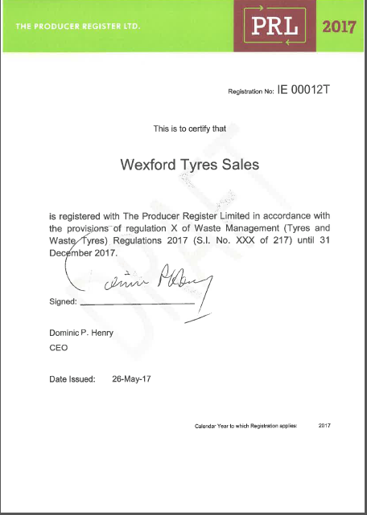
Producer Registration

Slide 16
Reporting
Producer Reporting

Slide 17
Producer Reporting
Producers will be obliged to report to the WEEE Blackbox
Online reporting tool to allow producers submit details of the tyres they placed on the market in the previous month.
It is very important to note that all categories of tyres must be reported to the WEE Blackbox including those without a visible environmental management cost (vEMC)

Slide 18
WEEE Blackbox Hallmark Features
Convenient and user friendly system.
Appointed Deloitte to operate WBB AS an independent third party to ensure producer confidentiality
Security assurance provided. No system failures or security breaches.
Producer service and query handling helpdesk available from 9:00am – 5:00 pm Monday to Friday
Provides monthly tracking on the compliance of producers
Reports provided on monthly producer submissions

Slide 19
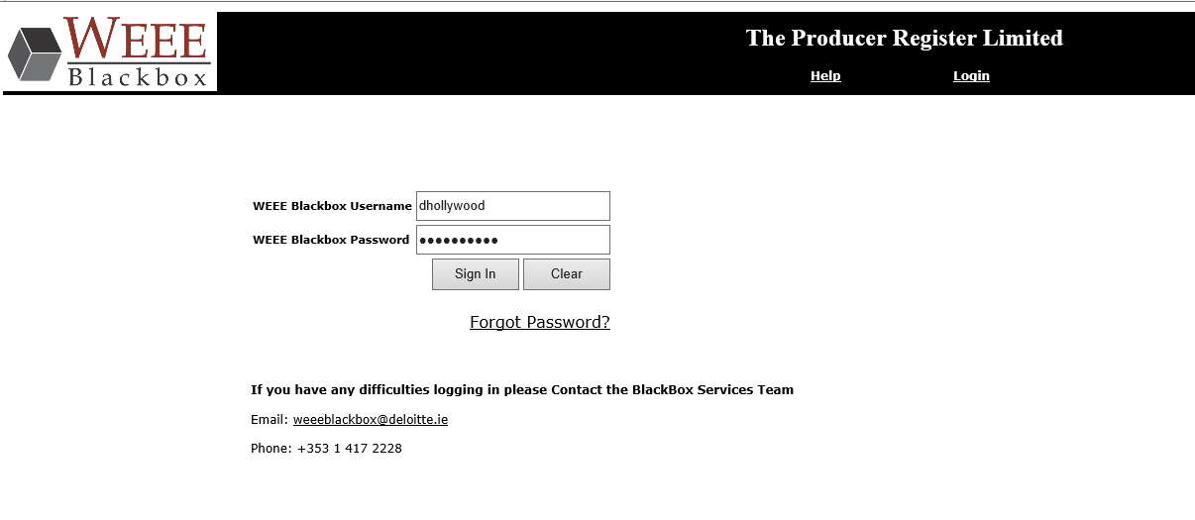
Login Screen
Enter Username and password
Click Sign in

Slide 20
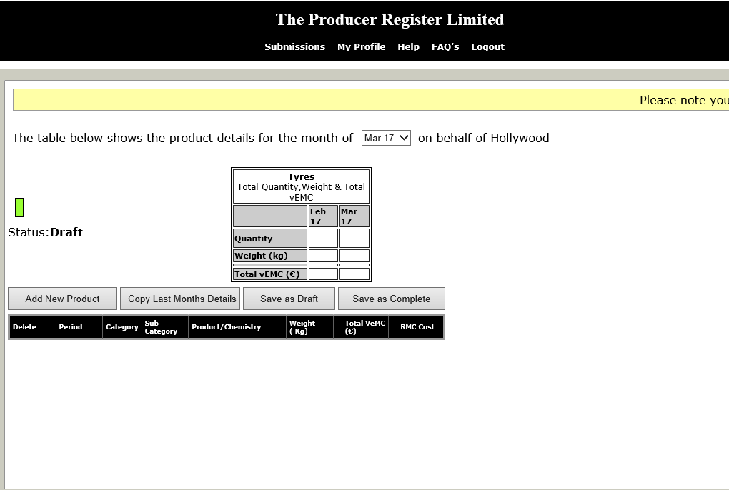
Main Submission Page
Background information
Reporting Obligations
Helpdesk contact details
How to make a submission
Reporting Month
Producers details
Reset password
Click “Add new product” to open the submission panel

Slide 21
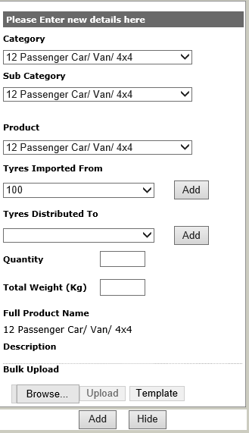
Submission Panel
Select category/ subcategory/ product from the dropdown according to what product the company is selling
Select existing Tyres Customers from the dropdown “Tyres distributed to”
Click on add “Tyres distributed to” to log a new customer

Slide 22
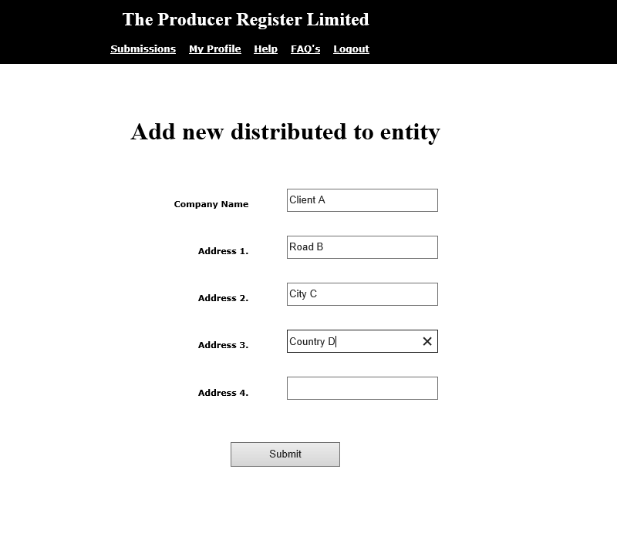
Add Tyres Distributed To
Enter all the necessary customer’s details
Click submit to store the customer on the system

Slide 23
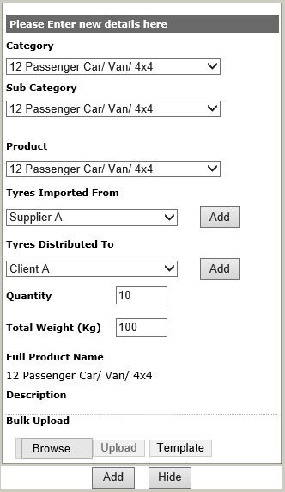
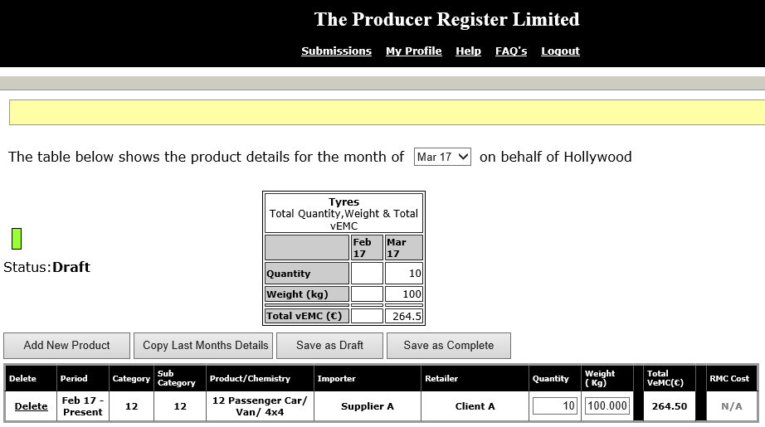
Manual Entry
Click “Add” once the details are entered to enter the data

Slide 24
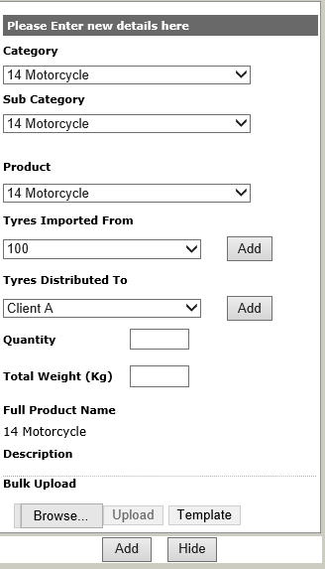
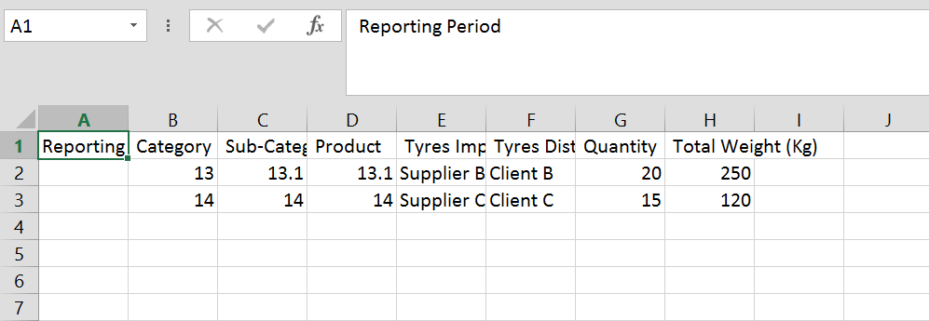
Bulk Upload
If the producer has already submitted previously and the necessary suppliers/ customers are stored on the system, the bulk upload can be used.
For the first bulk upload, click “Template”
As per the template displayed above, the producer will have to manually enter the category, subcategory and product details related to their tyre sales. They will also need to enter the name of the customer they sold to the tyres to. Finally, the producer will enter the quantity sold and has the option of entering relevant total weights.
Once this file has been prepared it can be saved to the user’s desktop.
Click browse and find the path to the file.
Double click on the file to unlock the upload functionality and click upload.

Slide 25
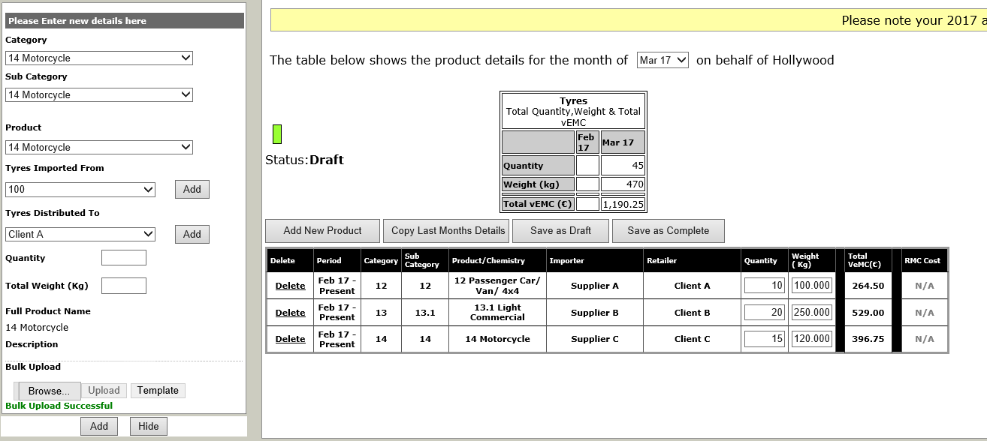
Bulk Upload
Once the producer clicks on “upload” the message “Bulk Upload Successful” appears on the control panel and the data is fed into the submission summary table with the exact details that have been typed in the Excel sheet shown previously
The producer can now click “Save As Complete” to submit his data for the month

Slide 26
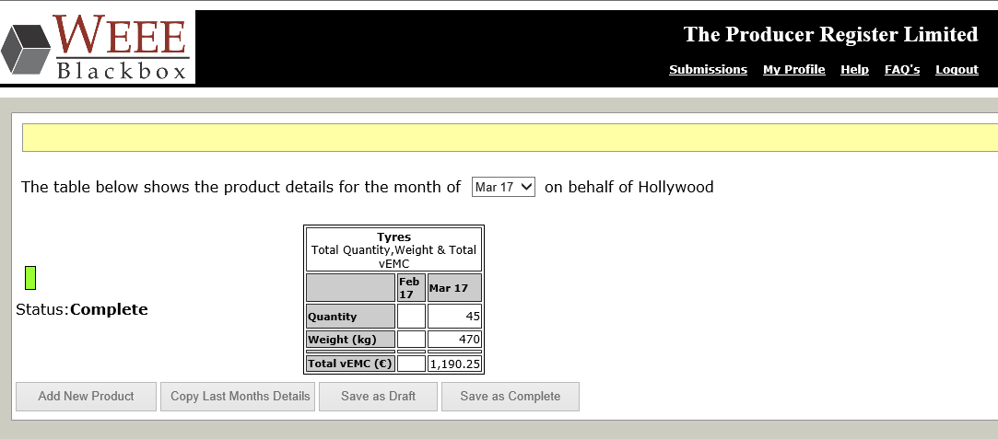
Submission Complete
This table summarises the total quantity/ weight submitted for the month as well as the vEMC associated with the submission
The table shows the same information for the previous month
Producer submission functionalities are disabled once their submission has been “saved as complete” to avoid further changes. However, the admin can reopen a producer submission in case a mistake has been spotted before the month close

Slide 27
Thank You!
DOMINIC HENRY
The Producer Register Ltd
01-5522606
Dominic.Henry@producerregister.ie

