Slide 1

Customer behavior is strong, but subscription value is underdeveloped
A quantitative portfolio review across 3,900 purchases to connect transaction behavior to operating choices.
Customer Shopping Behavior Analysis · Client Decision Brief
Dataset scope: 3,900 customer purchases across demographics, product categories, and transaction terms.
Notes:
Open the executive review: customer activity demonstrates solid core retention and baseline transaction volume, yet subscription mechanics and basket expansion remain largely untapped levers.

Slide 2
A 3,900-purchase dataset connects behavior to business choices
01
Exhibit Analysis pipeline and methodology validation
GOVERNANCE
Audit trail
3,900 purchases across 18 dimensional fields.
Statistically representative. 3,900 balanced records yield sufficient sample power across age, gender, and category groupings.
1
Comprehensive attribute logging covering demographics, product categories, discount usage, shipping selection, review ratings, and subscription status.
Three-stage analytical pipeline.
2
Python execution for data sanitation and feature engineering, structured PostgreSQL schema queries for cohort logic, and Power BI visualization models.
Normalized values. Zero-variance fields purged; continuous spending scaled to isolate pricing outliers.
Medians applied for 37 missing ratings.
3
Review ratings contained 37 null entries, imputed cleanly via respective product category medians to maintain rigorous distribution validity.
Decision-ready schemas. Relational views ready for recurring operational dashboards and automated testing cycles.
Source: Customer Shopping Behavior transactional database (3,900 records, 18 fields). Cleaned via Python, validated in PostgreSQL.
Notes:
Walk through the rigorous three-stage methodology. Emphasize that all records were sanitized systematically, category median imputation resolved nulls, and data architecture is set up for repeatable decision cycles.

Slide 3
The headline metric is healthy demand with a modest basket
Exhibit Core customer behavior metrics
Metric | Value
Customers | 3,900
Average purchase amount | $59.76
Average review rating | 3.75 out of 5
So what
The business has a broad demand base, with room to lift basket size and satisfaction.
Clothing leads the dashboard in revenue and sales, ahead of accessories, footwear, and outerwear.
Notes:
Point out the healthy demand base, modest average purchase amount, and average review rating, then connect the clothing lead to the dashboard.

Slide 4
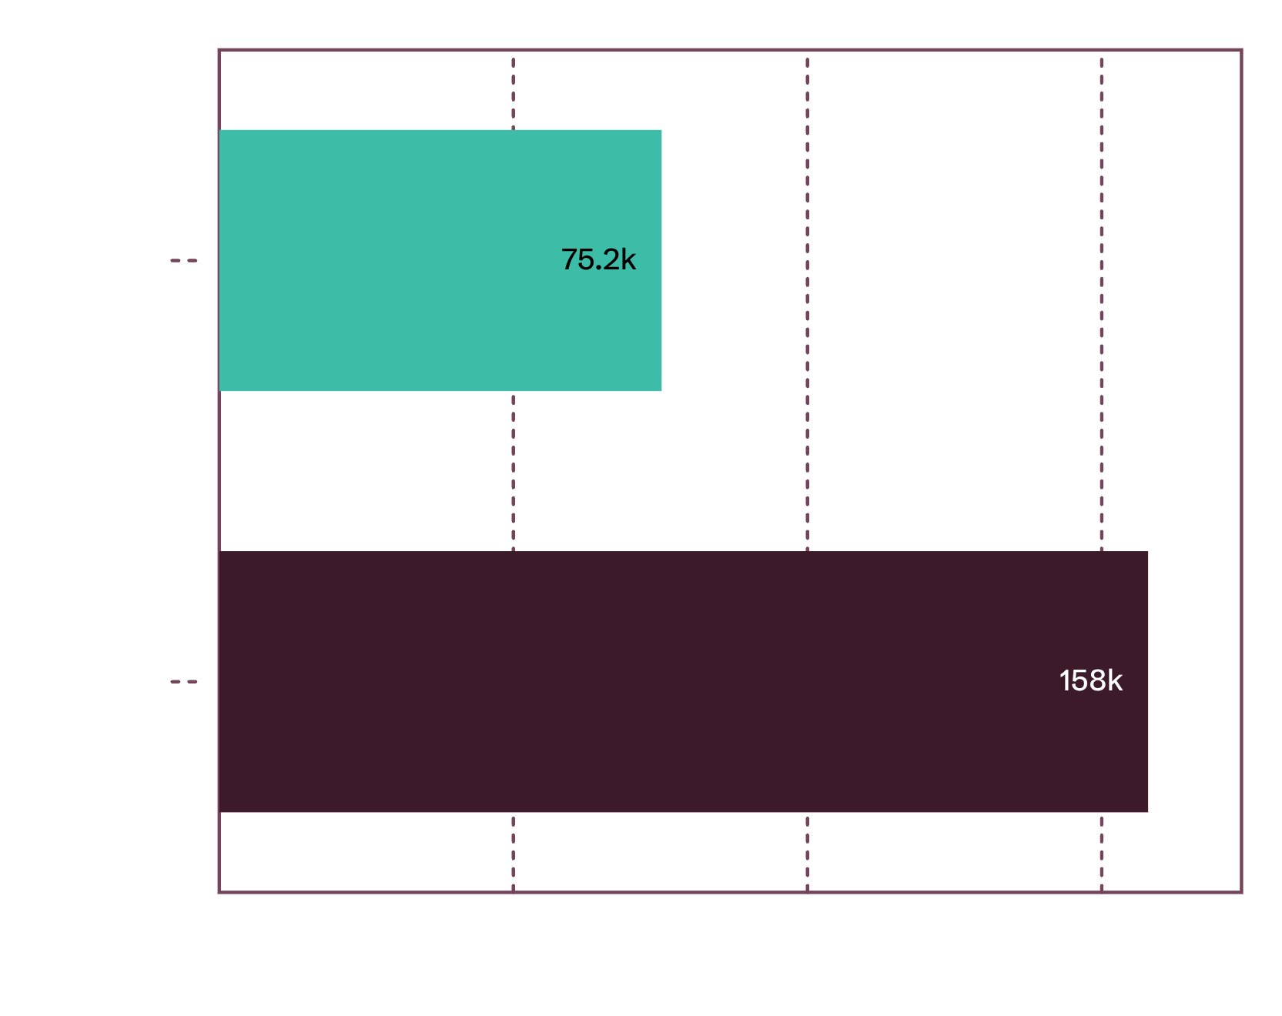
Revenue is concentrated in the male customer base
Exhibit Revenue by gender
So what
Male customers generated $157,890 in revenue versus $75,191 from female customers
The gap is a segmentation signal, not a reason to ignore female customers
Decision: tailor acquisition and merchandising plans by audience economics, not one-size-fits-all reach
Notes:
Clarify that the 2:1 revenue skew toward male shoppers is an operational signal of past ad focus, not a limitation. Female customers represent a proven $75K baseline that can be unlocked with targeted merchandising.

Slide 5
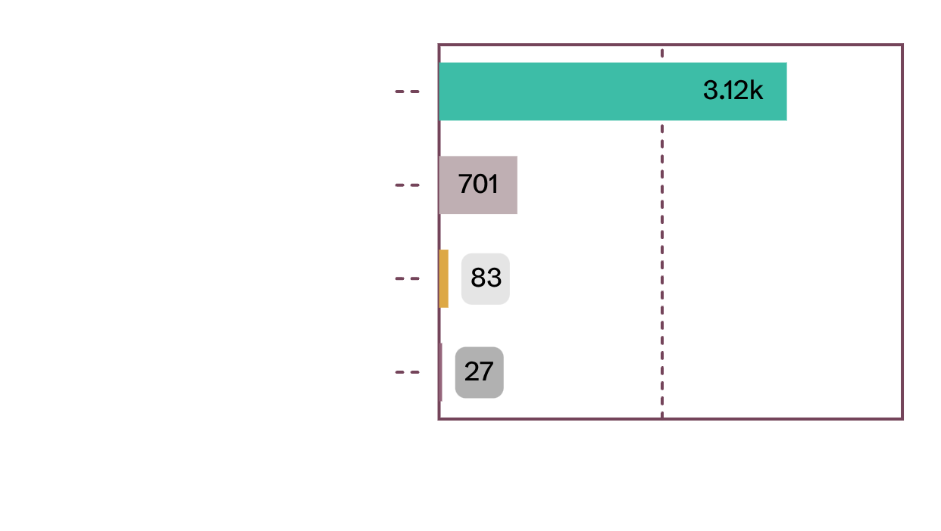
Loyal customers dominate the base, but subscription is not keeping pace
04
KEY VULNERABILITY
Exhibit Retention segments versus subscription penetration
So what
3,116 Loyal buyers. An overwhelming 80% of buyers show established retention behavior.
Retention without monetization. Customers return reliably, but membership fails to extract added lifetime value.
27% Subscriber rate. 73% of customers remain unsubscribed despite high purchase loyalty.
Zero spend incentive. Subscribing does not currently confer perceived basket value or higher ticket volume.
Flat spend delta. Subscribers average $59.49 versus $59.87 for non-subscribers—a $0.38 gap with zero premium.
Reposition the program. Introduce tiered benefits, early drops, and bundle pricing to elevate subscriber spend above $60.
Source: Customer segmentation and subscription analysis. Retention cohort sizes: 3,116 Loyal, 701 Returning, 83 New; Subscriber rate: 27%.
Notes:
Highlight the stark contrast: with 3,116 loyal customers, brand retention is exceptional, yet subscription penetration is only 27% and subscribers spend no more ($59.49 vs $59.87) than casual buyers.

Slide 6
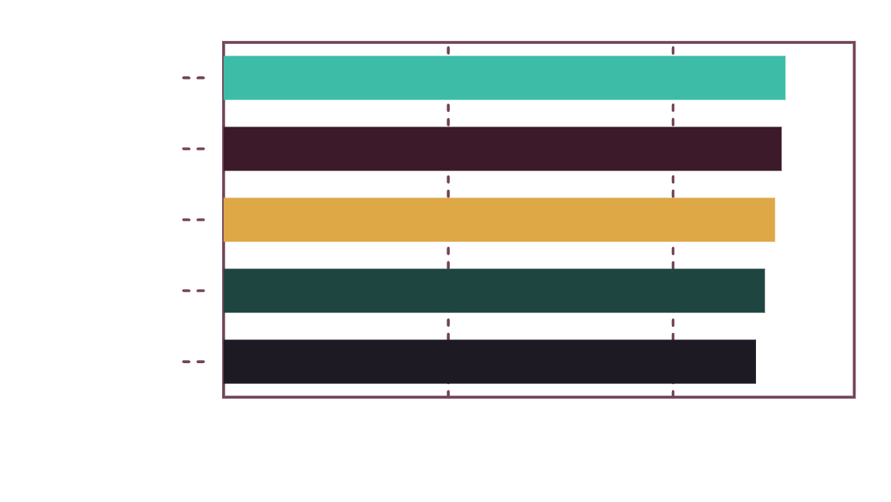
Discounts can drive conversion without defining the whole business
05
Exhibit Top products by discounted purchase penetration rate (%)
POLICY SHIFT
So what
839 customers used discounts while spending above the average purchase amount.
Hats, sneakers, coats, sweaters, and pants have the highest discounted-purchase rates, ranging from 47.37% to 50.00%.
Decision: test targeted offers and monitor margin by product instead of broad discounting.
Notes:
839 customers used discounts while spending above the average purchase amount. Hats, sneakers, coats, sweaters, and pants have the highest discounted-purchase rates, ranging from 47.37% to 50.00%. Decision: test targeted offers and monitor margin by product instead of broad discounting.

Slide 7
Product and service signals point to practical growth levers
Product / service | Rating / spend
gloves | 3.86
sandals | 3.84
boots | 3.82
hat | 3.80
skirt | 3.78
Express shipping | $60.48
Standard shipping | $58.46
Decision
Feature trusted products and use speed as a value proposition where the economics support it.

Slide 8
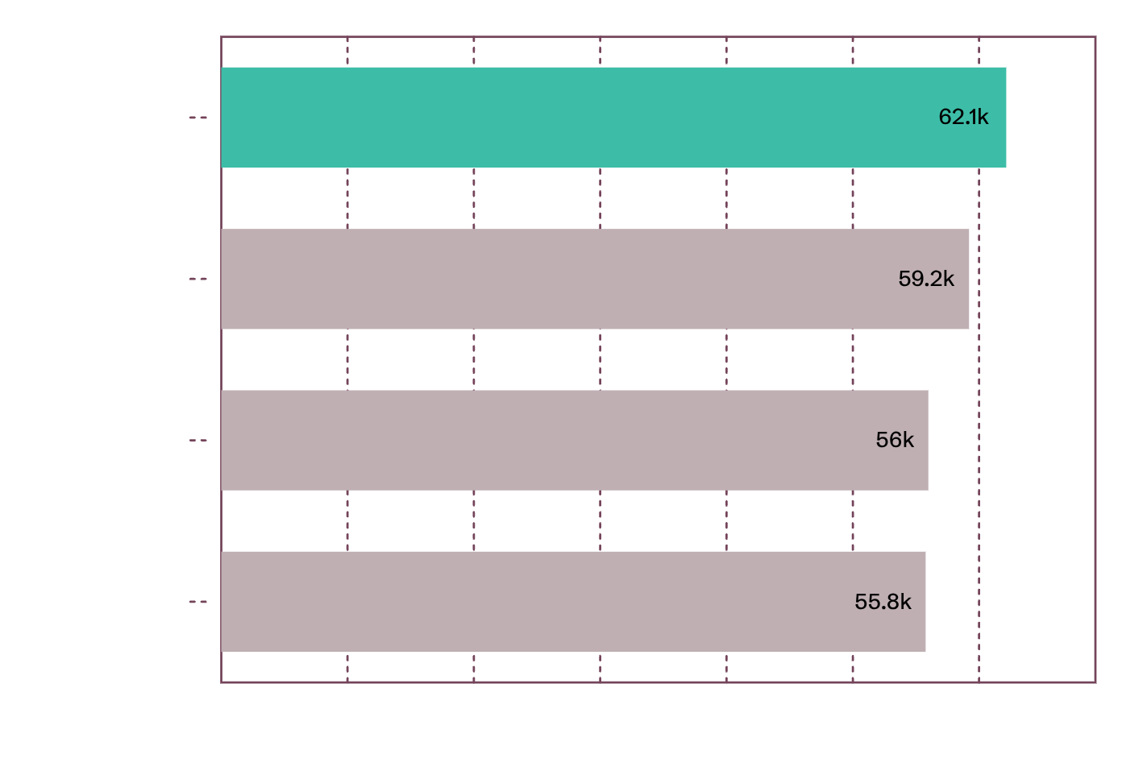
Young adults are the largest revenue opportunity by age group
07
Exhibit Total revenue contribution by age demographic tier ($)
TARGETING PRIORITY
So what
Young adults contribute $62,143, followed by middle-aged customers at $59,197.
Adults contribute $55,978 and seniors $55,763.
Decision: prioritize the highest-revenue segment while tailoring offers and creative to each age group.
Source: Customer demographic revenue distribution. Young Adult: $62,143; Middle-aged: $59,197; Adult: $55,978; Senior: $55,763.
Notes:
Young adults contribute $62,143, followed by middle-aged customers at $59,197. Adults contribute $55,978 and seniors $55,763. Decision: prioritize the highest-revenue segment while tailoring offers and creative to each age group.

Slide 9
Five decisions can turn the analysis into a growth plan
Boost subscriptions with exclusive, measurable benefits
Reward repeat buyers and move more customers into the Loyal segment
Review discount policy to balance conversion with margin control
Position top-rated and best-selling products more prominently
Target high-revenue age groups and test express-shipping messaging
Notes:
Synthesize the five business decisions approved in the brief. Show how each connects directly back to an analytical finding: subscription mechanics, retention transitions, targeted discounting, product highlights, and demographic focus.

Slide 10
Start with three tests, then scale what moves the metrics
1
Subscription test
3 Tests
Compare benefit-led offers against the current proposition.
2
Discount test
Target the five discount-dependent products and track margin, conversion, and repeat purchase.
3
Merchandising test
Feature top-rated products with age- and gender-relevant creative.
Use the dashboard as the operating view for the next decision cycle.

