Slide 1
A BRIEF OVERVIEW OF AI
A sector by sector analysis
Giovanni Novati 68642A
Simone Alessandro Casciaro 76678A

Slide 2
ECONOMY

Slide 3
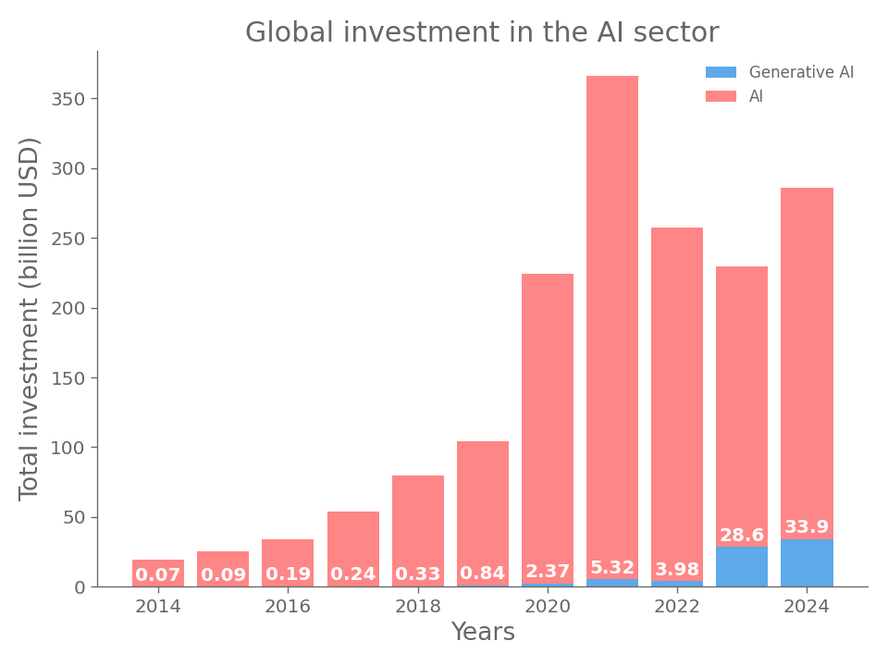

Slide 4
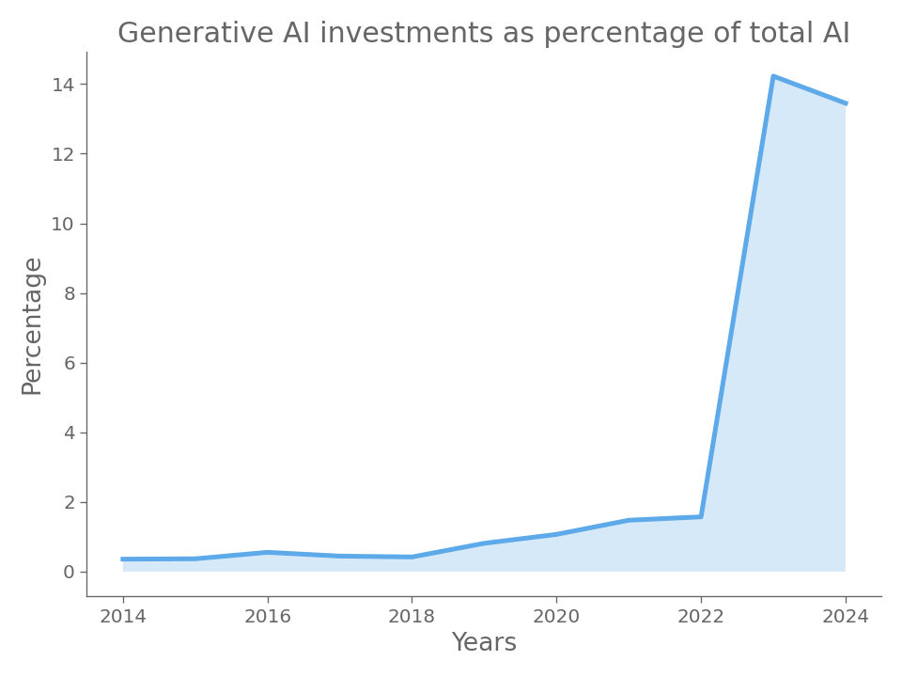

Slide 5
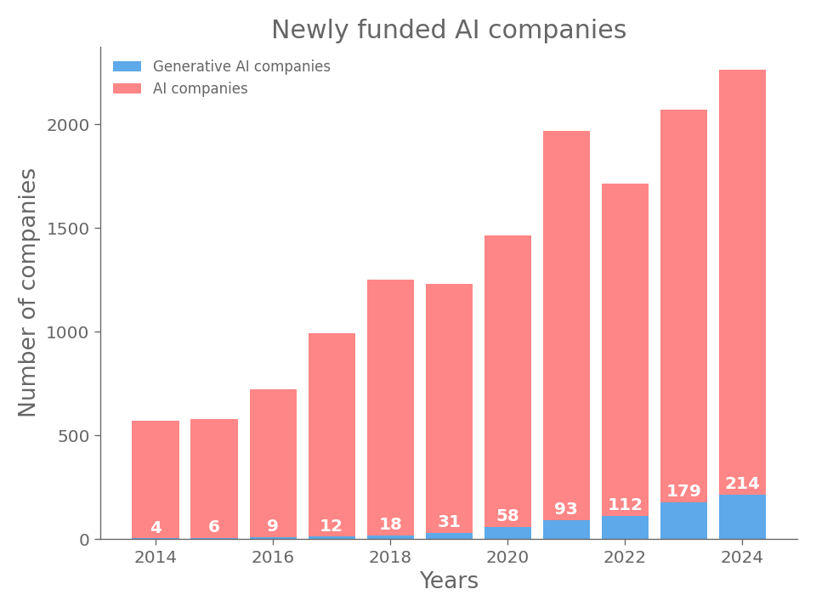

Slide 6
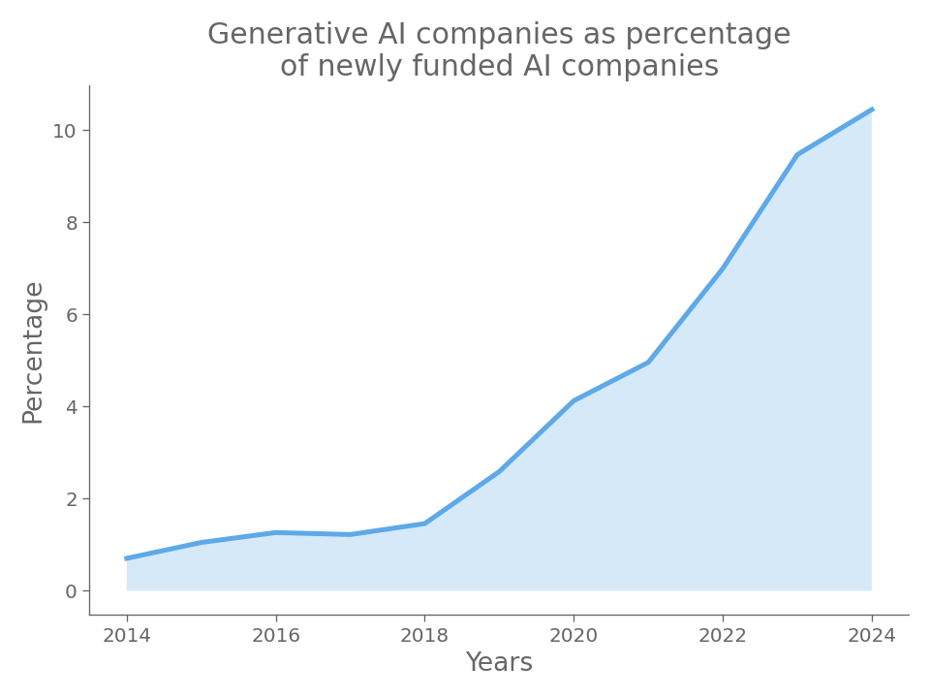

Slide 7
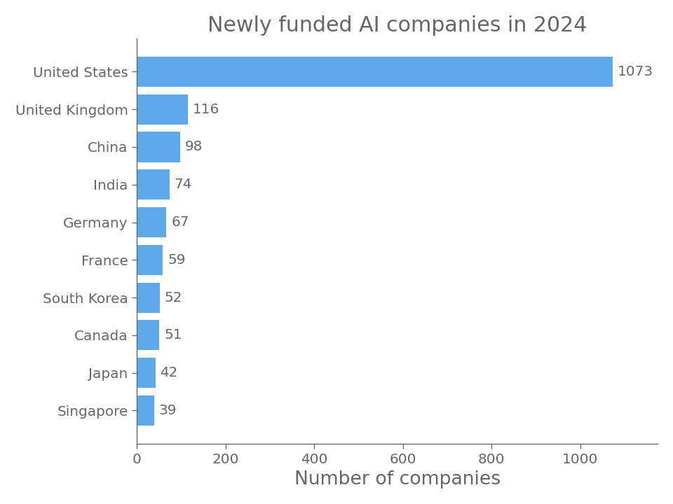

Slide 8
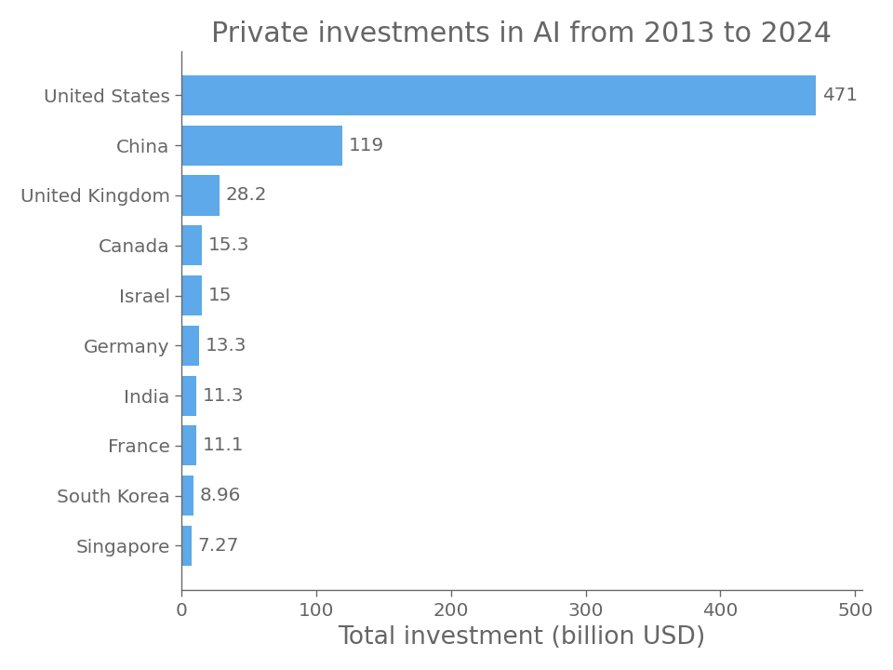

Slide 9
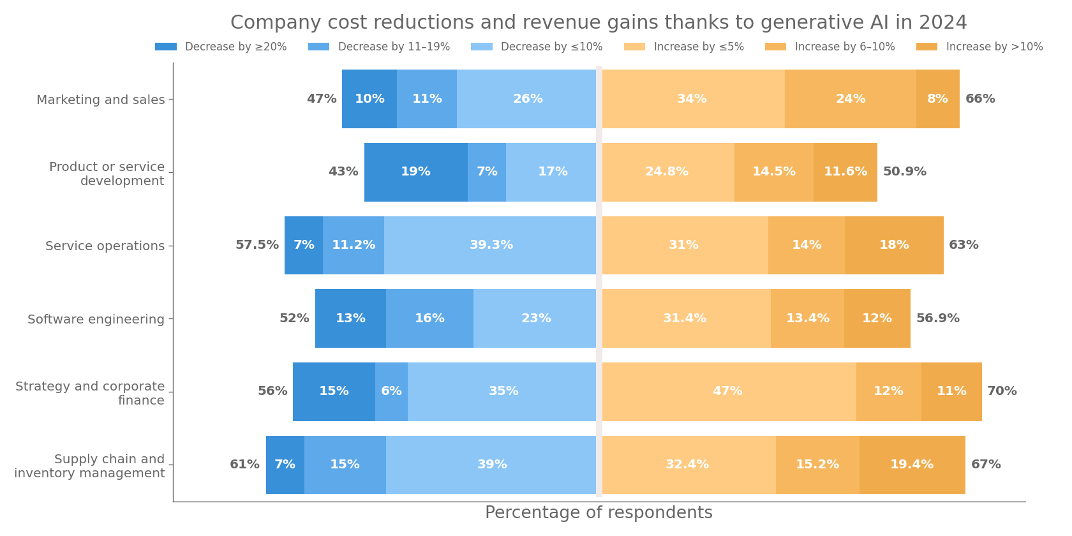

Slide 10
POLICY AND GOVERNANCE

Slide 11
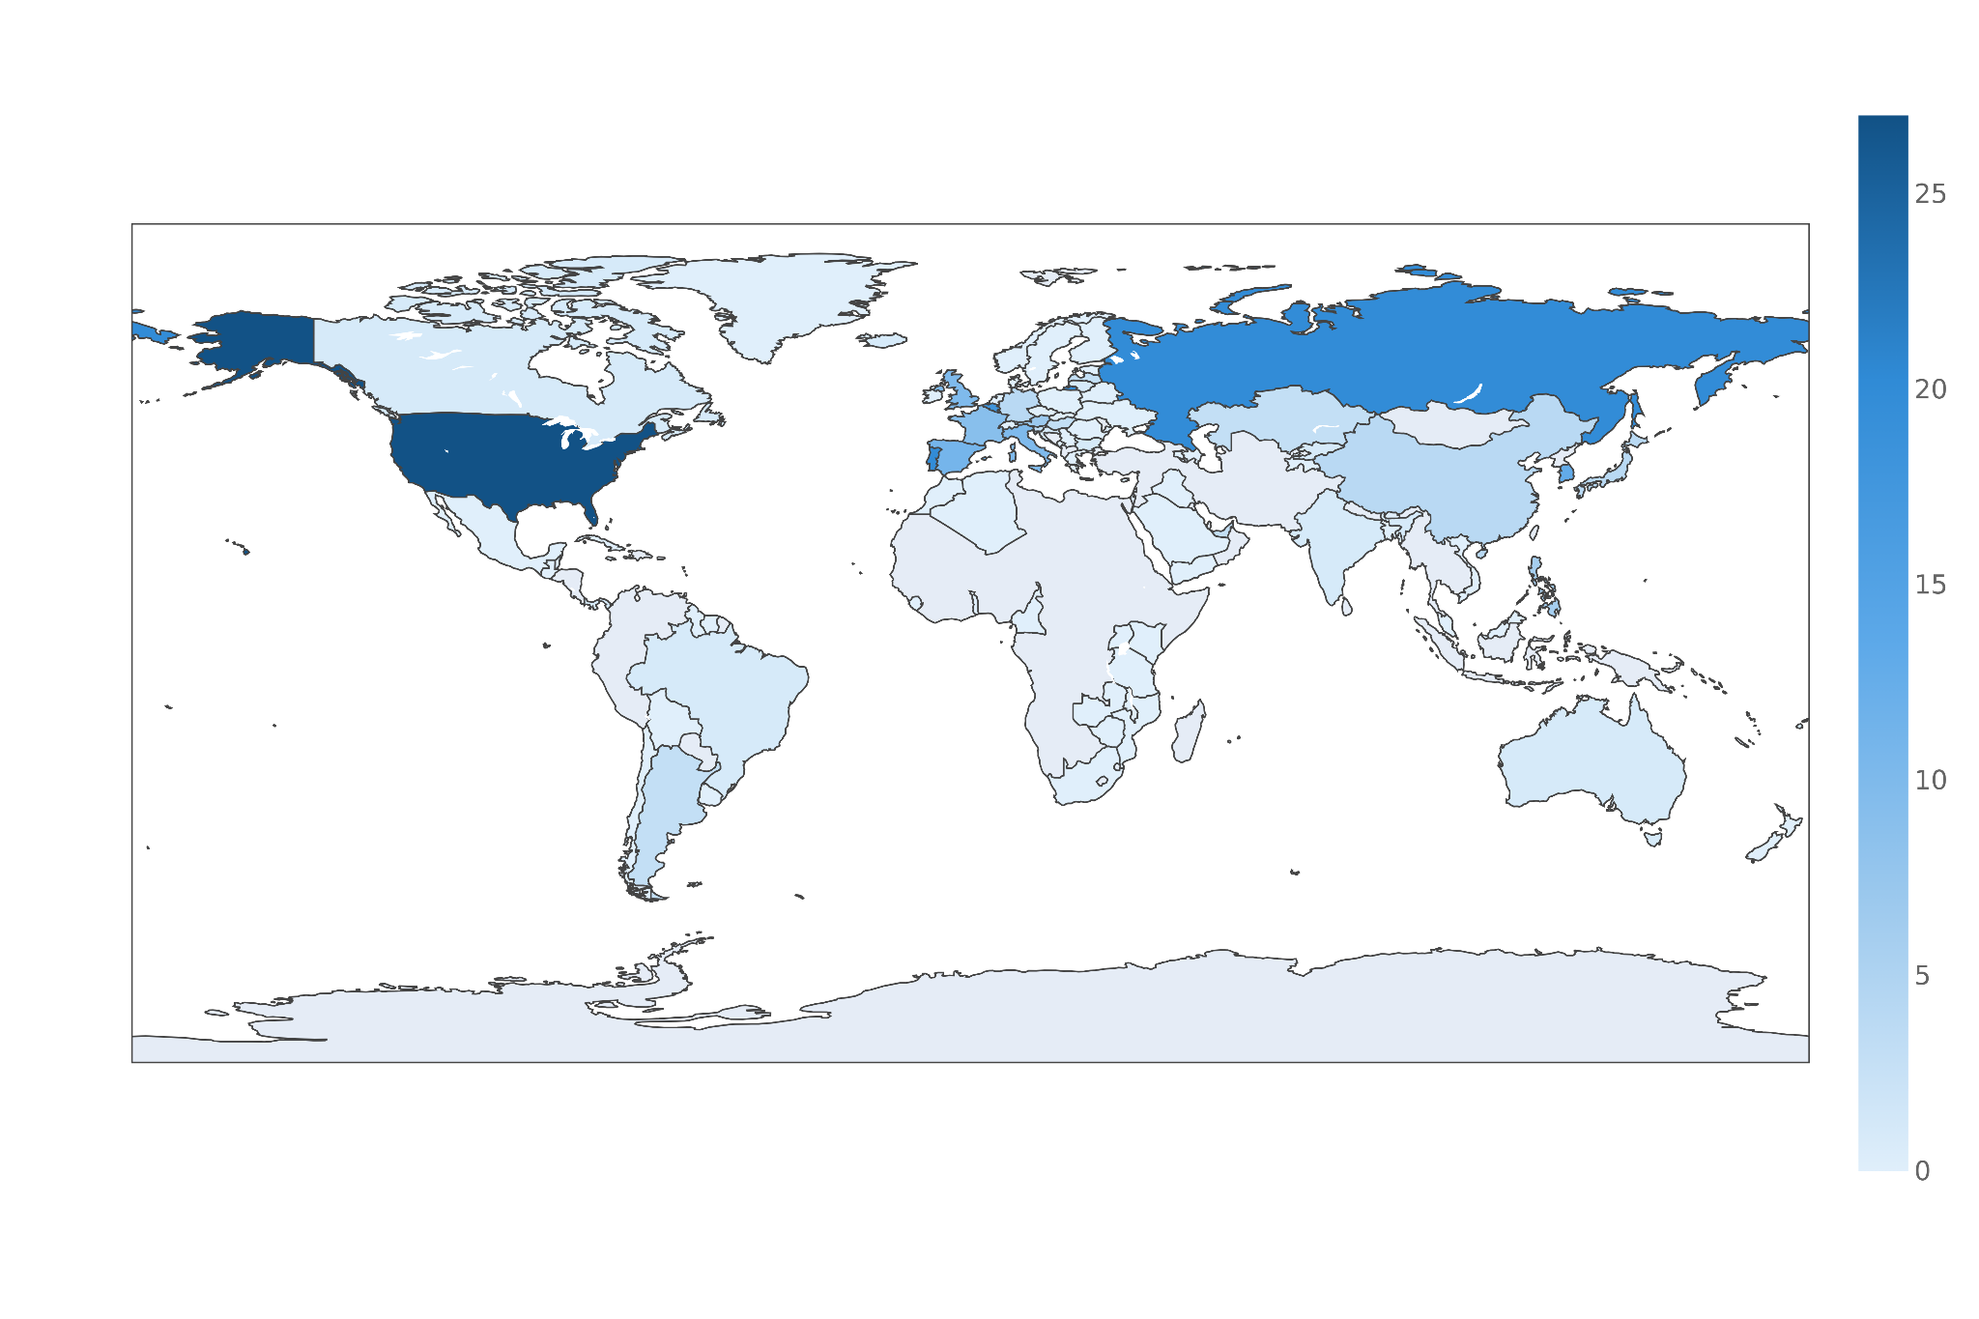
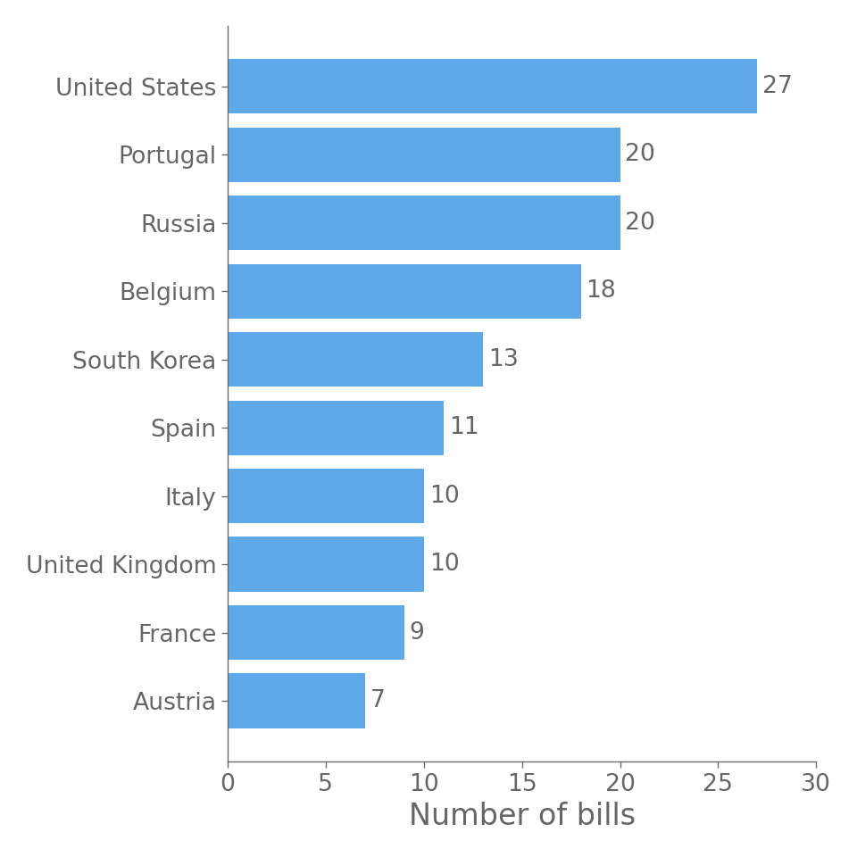
Number of AI-related bills passed into law from 2016 to 2024

Slide 12
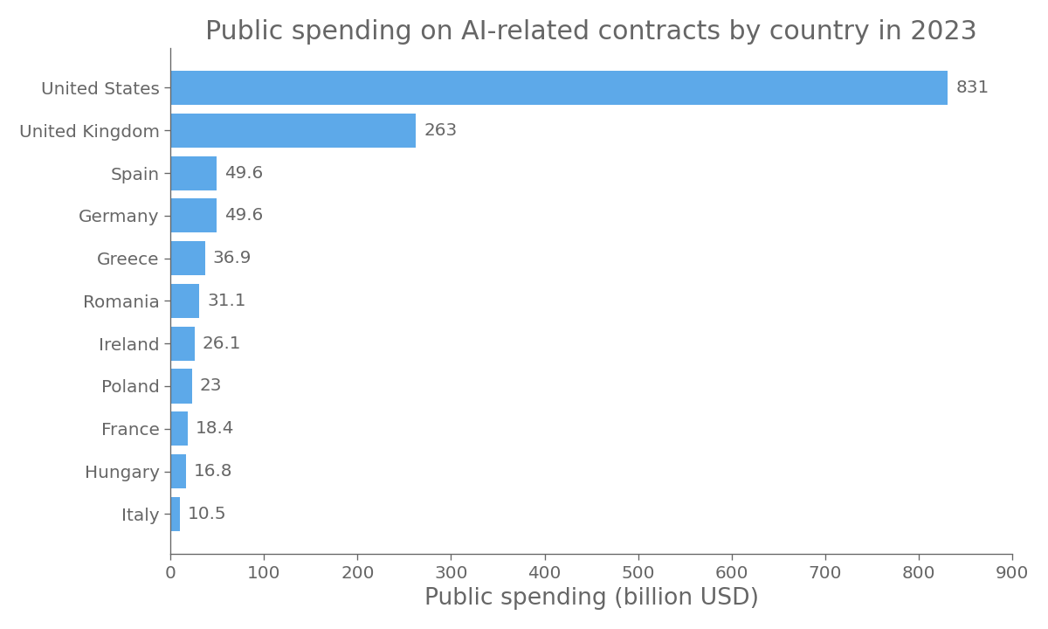

Slide 13
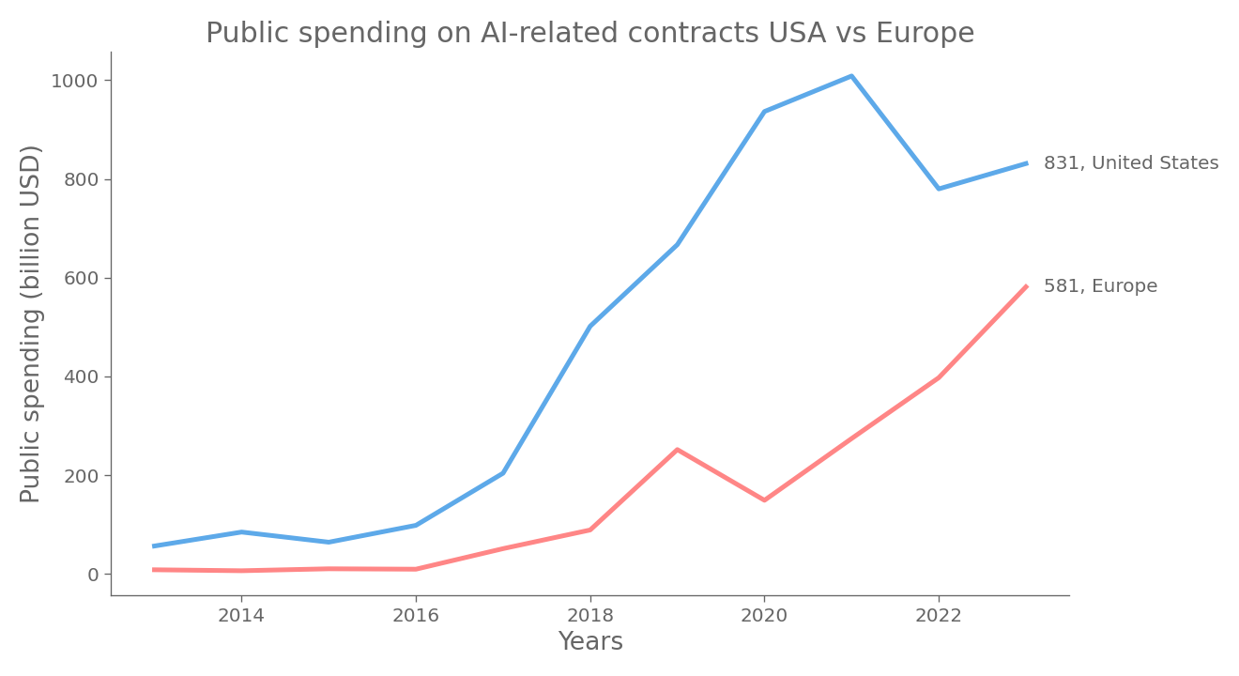

Slide 14
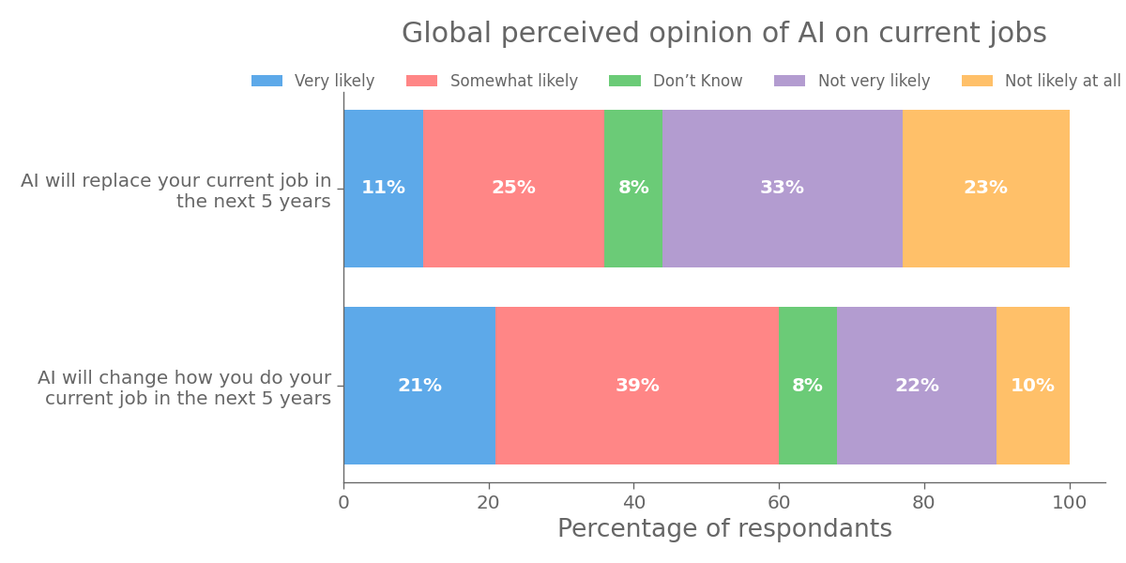

Slide 15
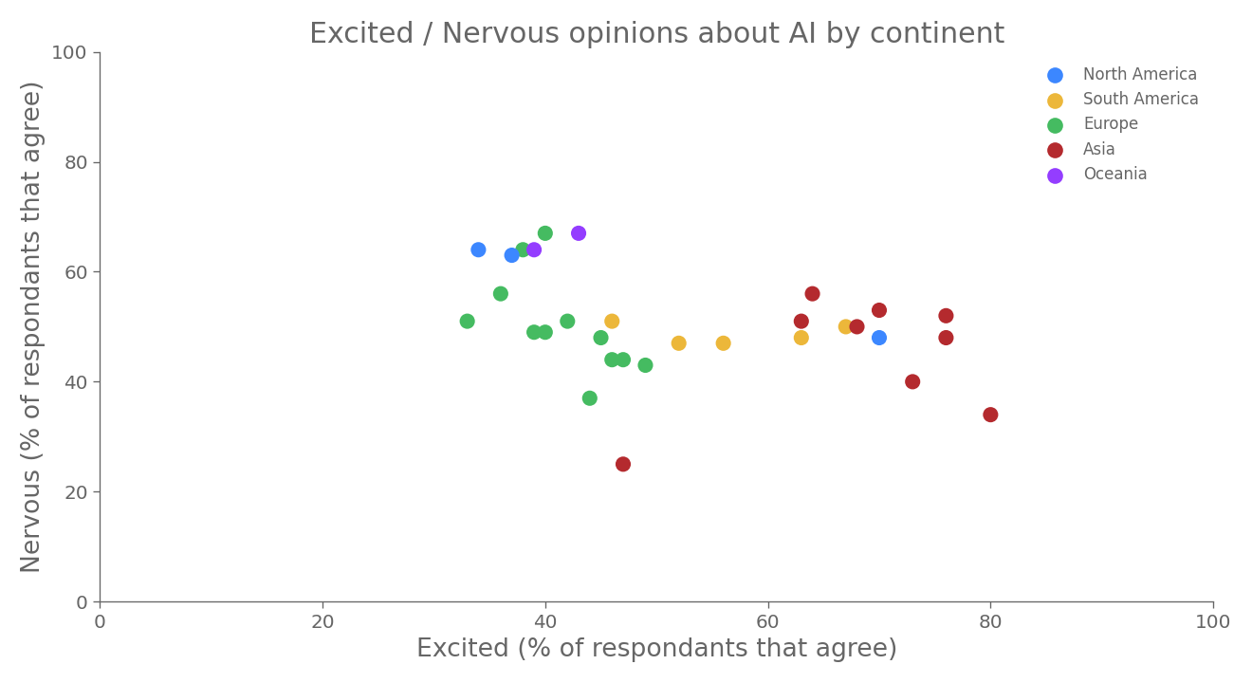

Slide 16
RESEARCH AND DEVELOPMENT

Slide 17
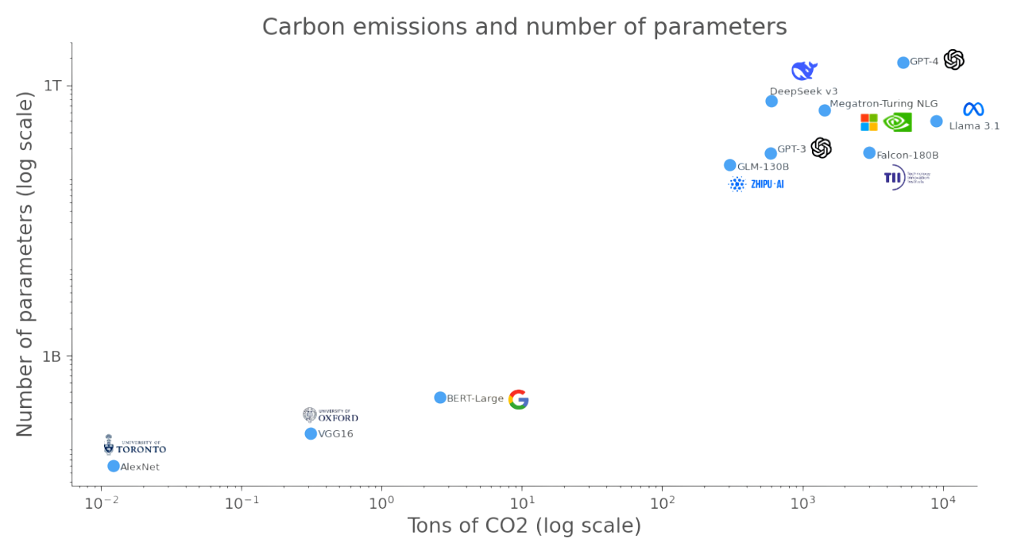

Slide 18
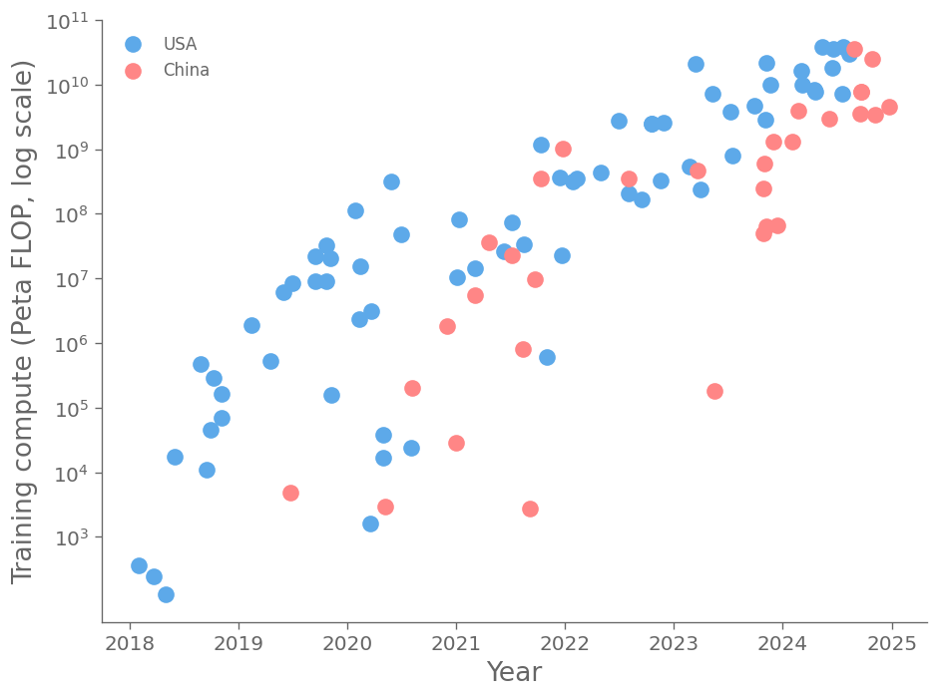
Training compute of select notable AI models in the United States and China

Slide 19
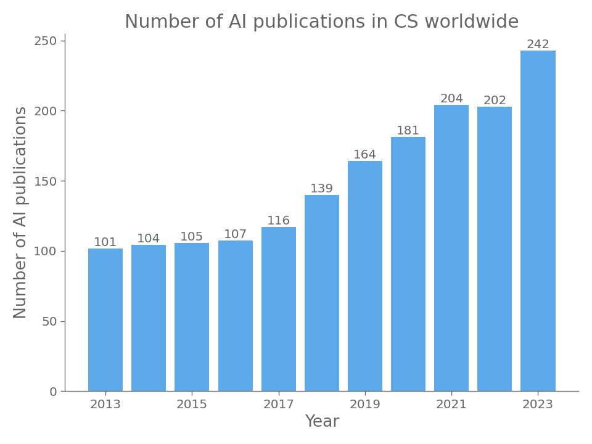

Slide 20
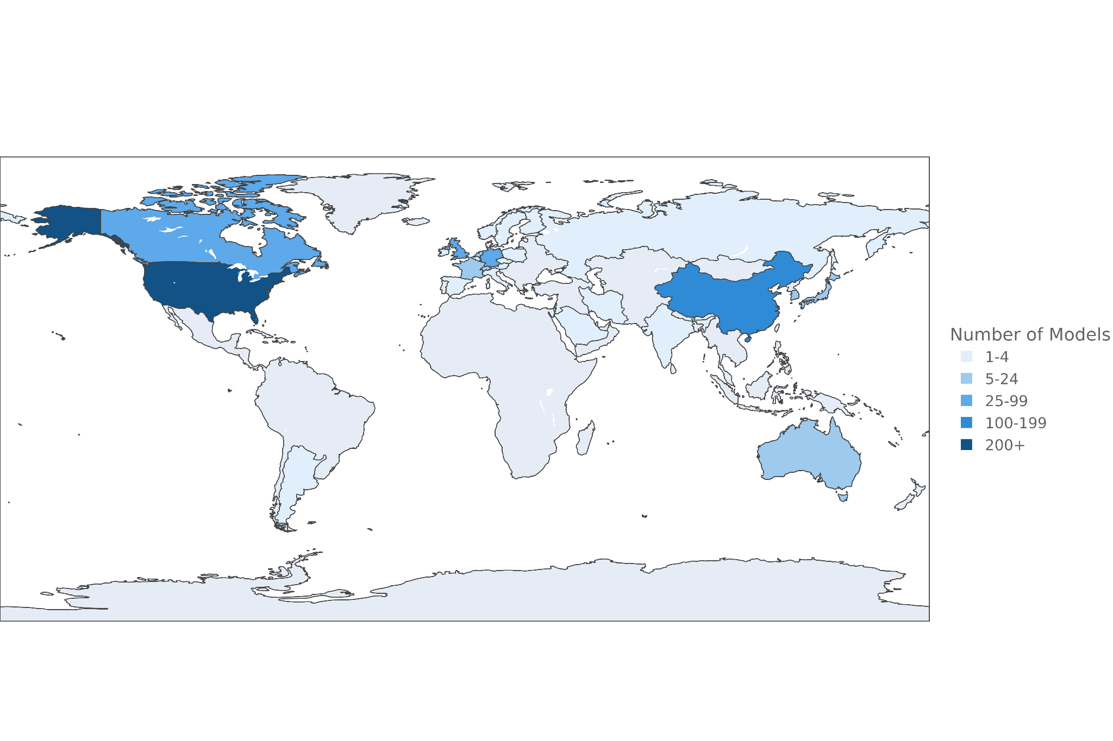
Number of Notable AI models from 2003 to 2024

Slide 21
RESPONSIBLE AI

Slide 22
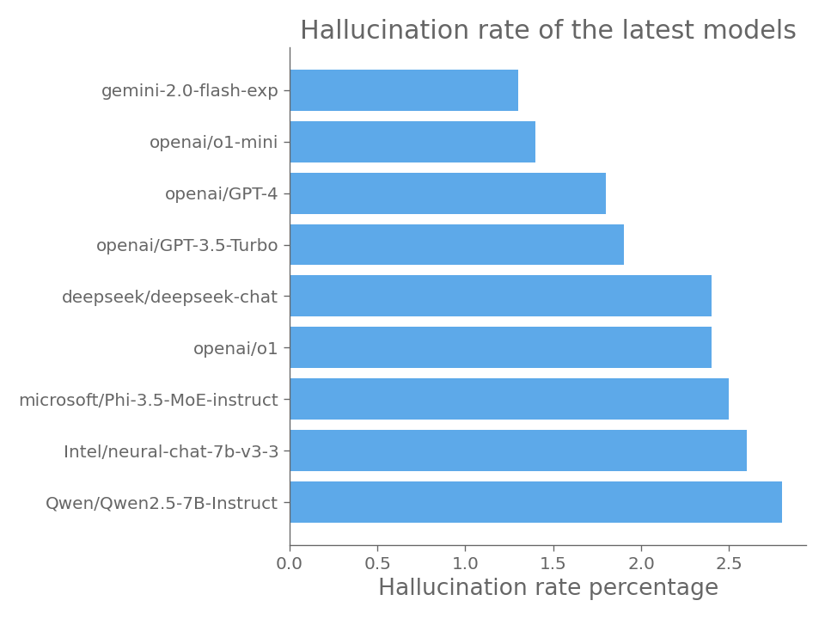

Slide 23
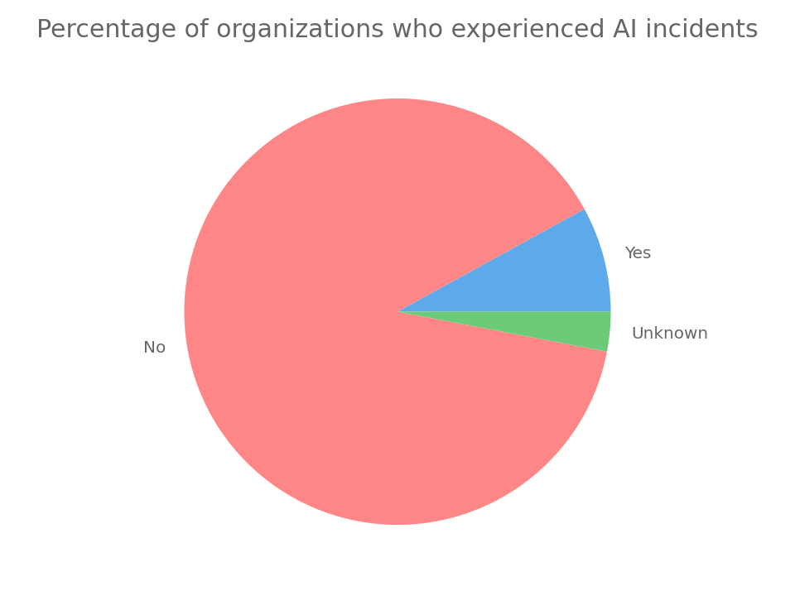

Slide 24
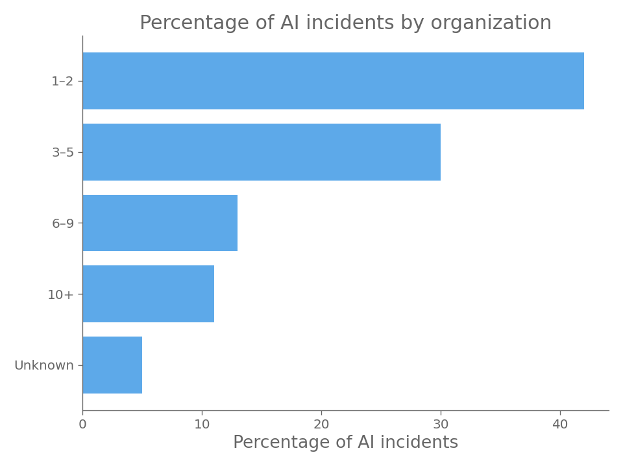

Slide 25
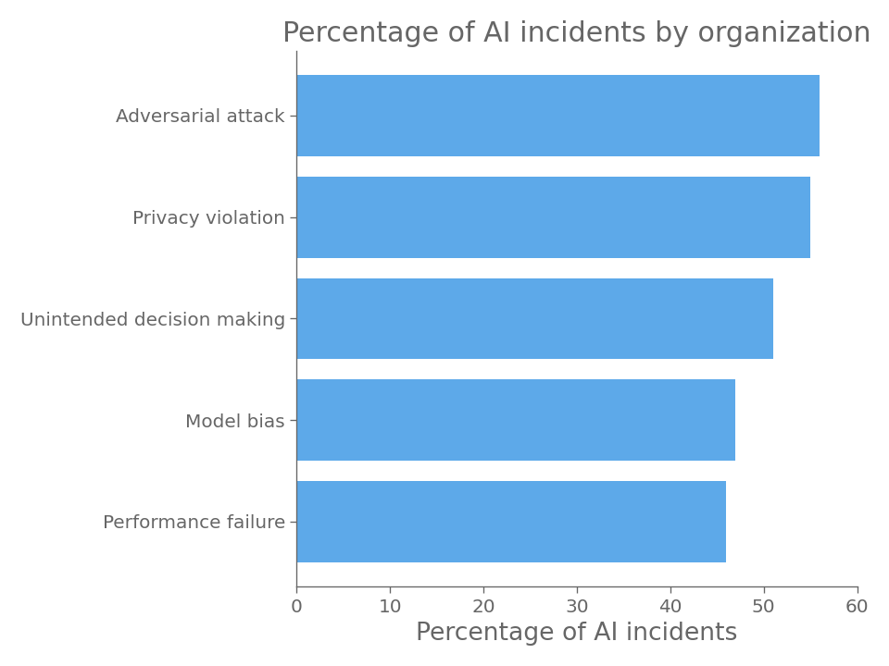

Slide 26
SCIENCE AND MEDICINE

Slide 27
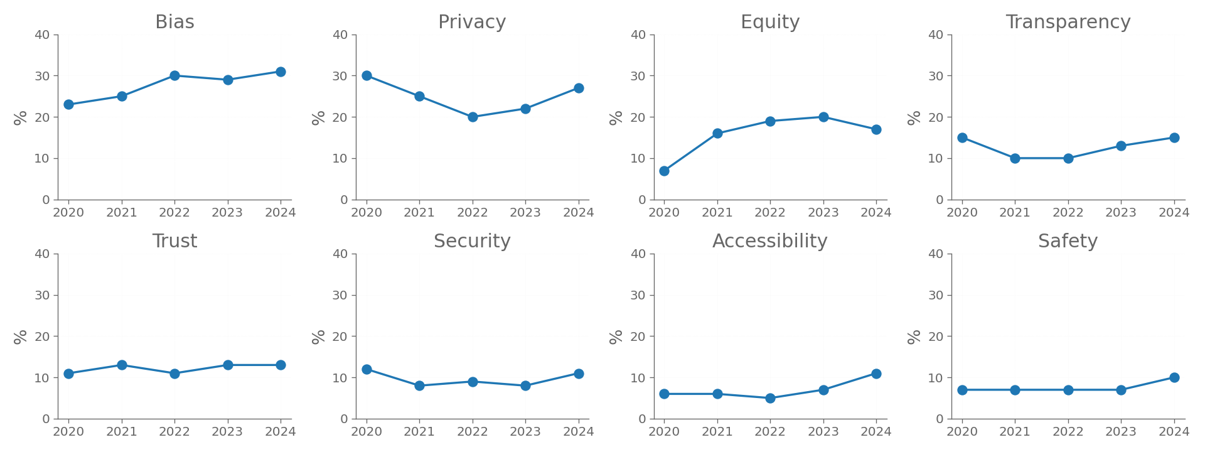
Top 8 ethical concerns discussed in medical AI ethics publications

Slide 28
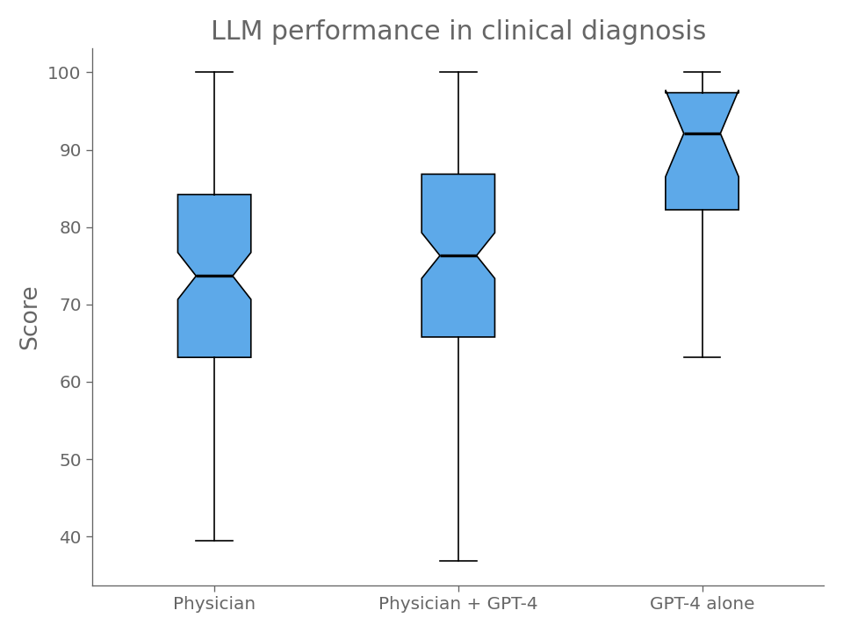

Slide 29
TECHNICAL PERFORMANCE

Slide 30
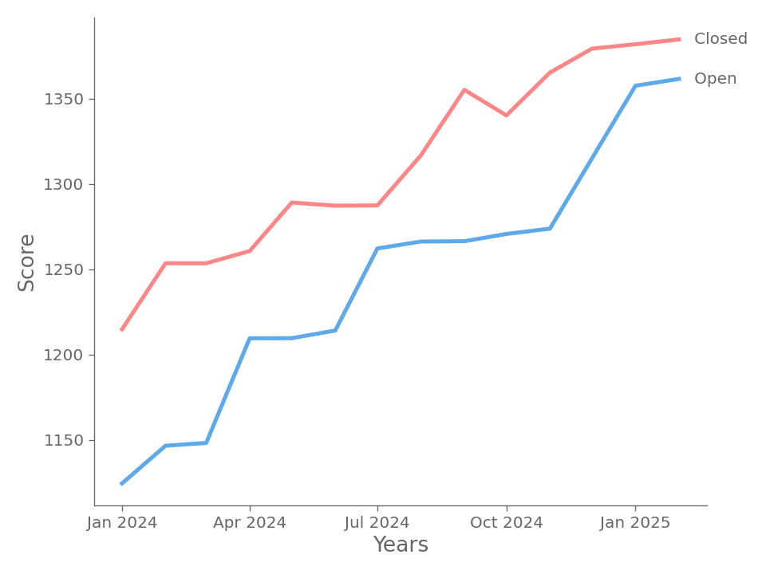
Performance of top closed/open models over years

Slide 31
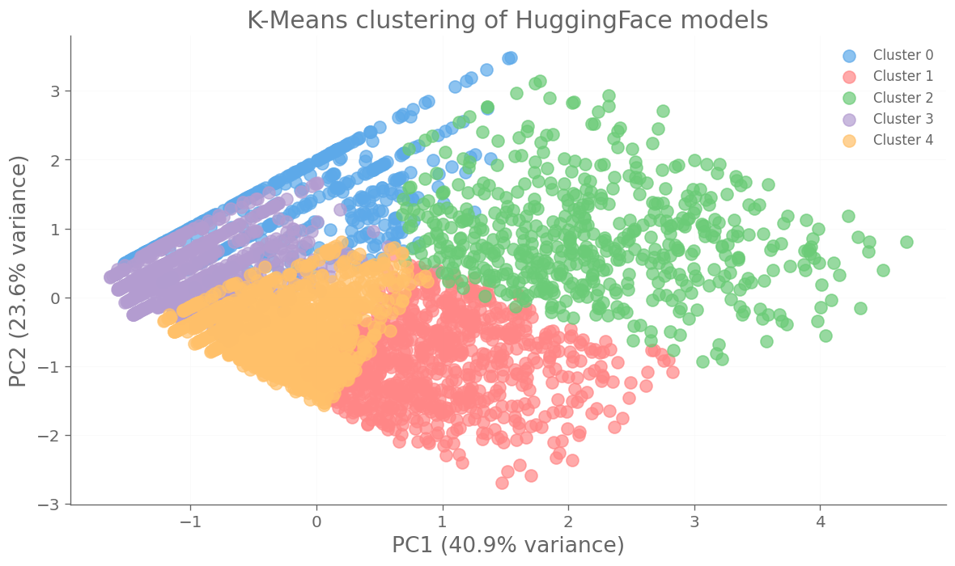

Slide 32
Cluster | Size | Avg. Downloads | Avg. Likes | Top Architecture | Top Task
0 ( ) | 481 | 6590 | 2 | timm | image classification
1 ( ) | 863 | 3012 | 52 | transformers | text generation
2 ( ) | 555 | 53766 | 30 | transformers | text generation
3 ( ) | 1418 | 1655 | 1 | transformers | text generation
4 ( ) | 1569 | 1604 | 7 | transformers | text generation

Slide 33
FONTI
https://hai.stanford.edu/ai-index/2025-ai-index-report
https://www.quid.com/2024-stanford-ai-index-report
https://www.mckinsey.com/capabilities/quantumblack/our-insights/the-state-of-ai-2024
https://ifr.org/img/worldrobotics/Press_Conference_2024.pdf
https://www.ipsos.com/en/global-trends-2024
https://www.fda.gov/medical-devices/software-medical-device-samd
https://med.stanford.edu/raisehealth.html
https://epoch.ai/data/machine-learning-hardware
https://www.ipsos.com/en/global-trends-2024
https://zenodo.org/records/14801921

Slide 34
GRAZIE PER L’ATTENZIONE

