Slide 1

Big Data Applied Algorithms
Lecture 4
Rong-Hua Li
School of Computer Science & Technology
Beijing Institute of Technology

Slide 2

Course Information
Grade: 50% final exam (or Project), 50% Homework
Recommended Books (PDF available: http://dimacs.rutgers.edu/~graham/ssbd.html)

Slide 3
Mining and Learning from graphs (I)
Graph datasets: Where graph data comes from and characteristics
Mining graphs: Which properties we mine and why
Computation and algorithm design goals for massive graphs
Deep dive: Techniques + algorithms for mining large graphs:
MinHash sketches of reachability sets (centrality, similarity, influence)
All-Distances sketches

Slide 4
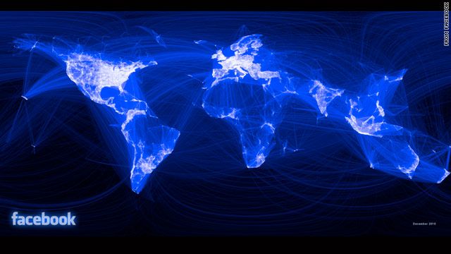
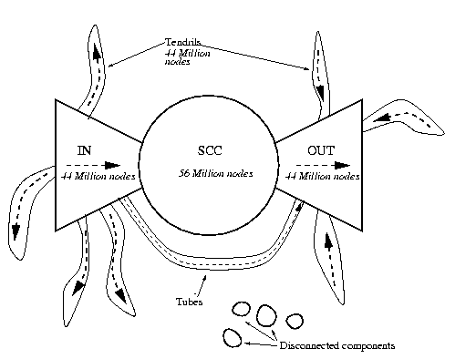
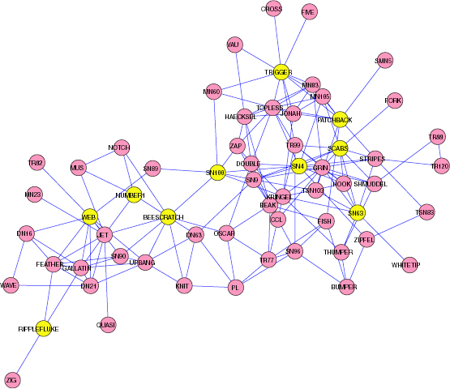
Graph Datasets: Represent relations between “entities”
Bowtie structure of the Web Broder et. al. 2001
Dolphin interactions

Slide 5
Graph Datasets
Hyperlinks (Web, linked documents)
Social interactions (Facebook, Twitter, LinkedIn,… friends) Email, phone call detail, messages
Commercial transactions (purchases, Reviews, Likes, Ratings)
Road networks
Communication networks
Protein interactions
Knowledge graph: Many types of entities (nodes) and relations (edges)
Graphs generated from metric data/embeddings: (nearest neighbors/neighborhoods): Images, search queries
Notes:
Embedings: Sometimes graph tools are so useful that it is worth while to convert non-graph data to graph form

Slide 6
Properties
Directed/Undirected
Snapshot or with time dimension (dynamic)
One or more types of entities (people, pages, products)
Features (Meta data) associated with nodes
Some graphs are really large: Hyperlinks, social, images

Slide 7
Computation on Very Large Graphs
Design algorithms for Streamed / Distributed / Parallel computation
General guidelines :
keep total computation/ communication/ storage “sub/linear” in the size of the data
Trade off computation and approximation quality
Parallelize (minimize chains of dependencies)
Localize dependencies (nodes that share edges are stored closer to each other)

Slide 8
Centrality
Importance measures of nodes in a network
… depends on what we want to capture:
Degree (in/out): largest number of followers, friends. Easy to compute locally. Spammable. Local.
Cut-based
Eigenvector (PageRank/Bonacich): Your importance/ reputation recursively depend on that of your friends.
Distance/reach-based
Betweenness: Your value as a “hub” – located on the shortest path between many pairs
Closeness: Centrally located, able to quickly reach/infect many nodes.
Notes:
Monitin=Reputation

Slide 9
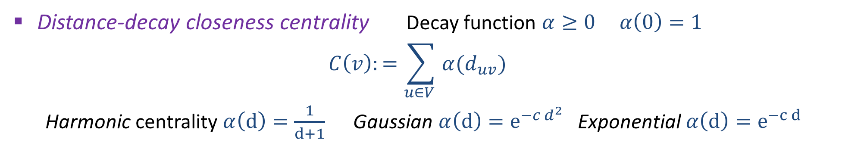
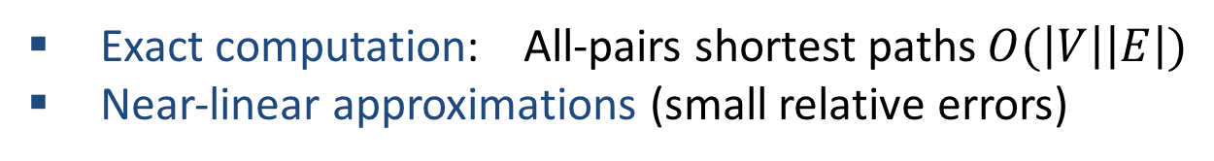
Closeness Centrality (distance based)
“Classic” closeness centrality $C\left(v\right):= \frac{1}{\sum_{u∈V }{d_{uv} }}$ [Bavelas 1950]
!! Not defined well when graph is not (strongly) connected
Reach centrality $C\left(v\right):=\sum_{u∈V }{I_{v↝u}}$ #nodes $v$ can reach
Distance-decay closeness centrality Decay function $α≥0$ $α\left(0\right)=1$
$$C\left(v\right):=\sum_{u∈V }{α(d_{uv}) }$$
Harmonic centrality $α\left(d\right)=\frac{1}{d+1}$ Gaussian $α\left(d\right)=e^{−{c d}^{2}}$ Exponential $α\left(d\right)=e^{−c d}$
Exact computation: All-pairs shortest paths $O(\left|V\right|\left|E\right|)$
Near-linear approximations (small relative errors)

Slide 10
Node sketches for distance/reachability based measures
MinHash sketches of reachability sets
All-distances sketches (ADS)
Sketching:
Compute a sketch for each node, efficiently
From sketch(es) can estimate properties that are “hard” to compute exactly (e.g., centrality of all nodes)

Slide 11













Reachability Sets

Slide 12




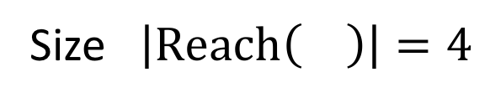
Reachability Set of
Reach$\left( \right)=\{ \}$
Size $\left|Reach\left( \right)\right|=4$

Slide 13
Reachability Set of
Size 13

Slide 14
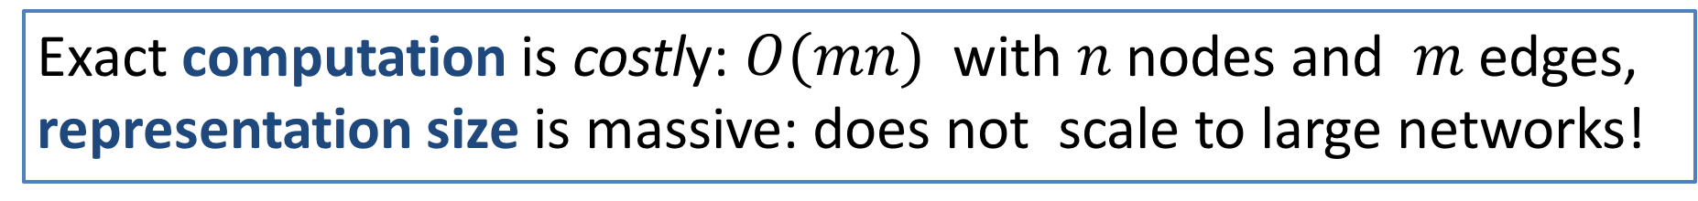
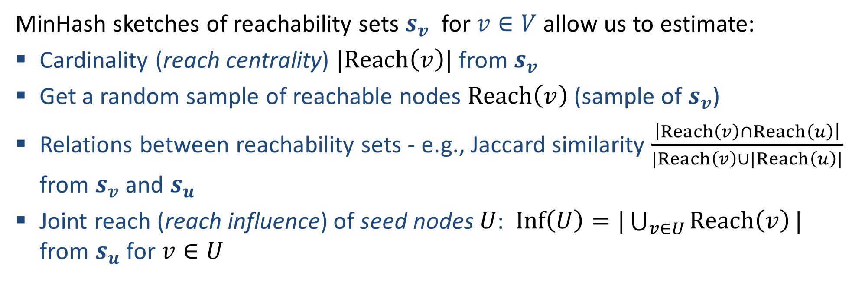
Why sketch reachability sets ?
Exact computation is costly: $O(mn)$ with $n$ nodes and $m$ edges, representation size is massive: does not scale to large networks!
MinHash sketches of reachability sets $s_{v}$ for $v∈V$ allow us to estimate:
Cardinality (reach centrality) $|Reach\left(v\right)|$ from $s_{v}$
Get a random sample of reachable nodes $Reach\left(v\right)$ (sample of $s_{v}$)
Relations between reachability sets - e.g., Jaccard similarity $\frac{\left|Reach\left(v\right)∩Reach\left(u\right)\right|}{|Reach\left(v\right)∪|Reach\left(u\right)|}$ from $s_{v}$ and $s_{u}$
Joint reach (reach influence) of seed nodes $U$: $Inf\left(U\right)=|\bigcup_{v∈U}{Reach\left(v\right)}|$ from $s_{u}$ for $v∈U$

Slide 15

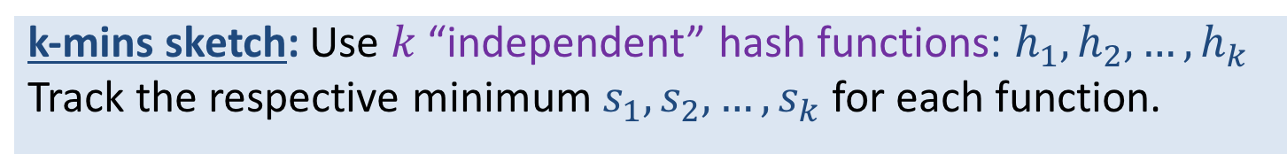
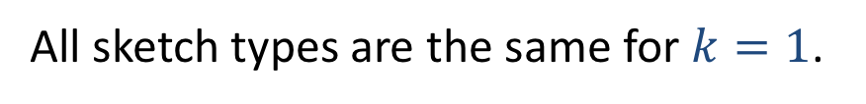

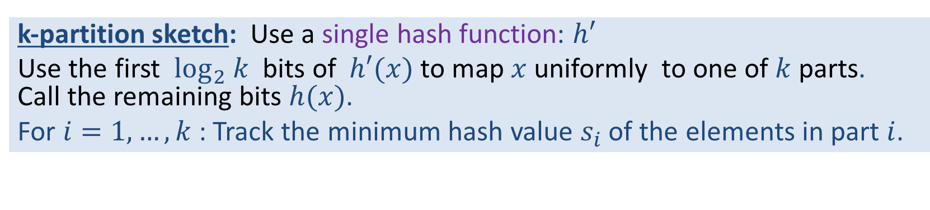
Review (lecture2): MinHash Sketch Variety
Sketch maintains $k$ hash values $s_{1},s_{2},…,s_{k}$
k-mins sketch: Use $k$ “independent” hash functions: $h_{1},h_{2},…,h_{k}$
Track the respective minimum $s_{1},s_{2},…,s_{k}$ for each function.
Bottom-k sketch: One hash function: $h$
Track the $k$ smallest values $s_{1},s_{2},…,s_{k}$
k-partition sketch: Use a single hash function: $h′$
Use the first $\log_{2} k$ bits of $h′(x)$ to map $x$uniformly to one of $k$ parts. Call the remaining bits $h(x)$.
For $i=1,…,k$: Track the minimum hash value $s_{i}$ of the elements in part $i$.
All sketch types are the same for $k=1$.

Slide 16

MinHash sketches of Reachability sets of nodes
0.37
0.12
0.28
0.45
0.34
0.23
0.85
0.93
0.77
0.06
0.69
0.32
hash values $h(v)∼U[0,1]$
0.95

Slide 17

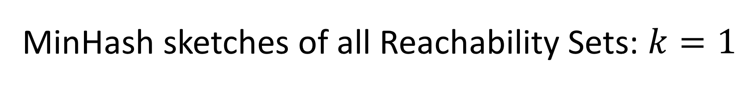
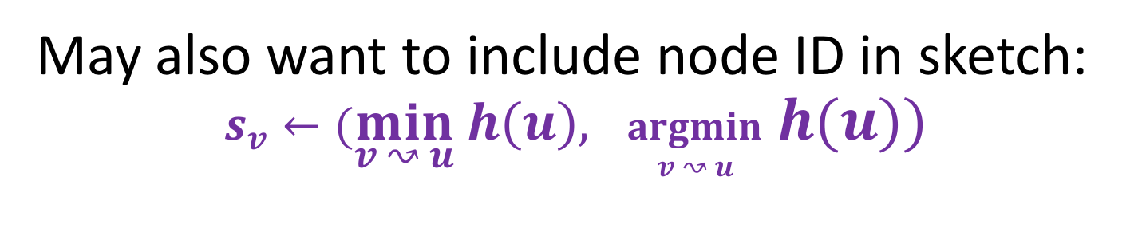
MinHash sketches of all Reachability Sets: $k=1$
For each $v$: $s_{v}←\min_{v ↝ u}$ $h(u)$
May also want to include node ID in sketch:
$s_{v}←(\min_{v ↝ u} h\left(u\right), \underset{v ↝ u}{argmin}$ $h(u))$

Slide 18
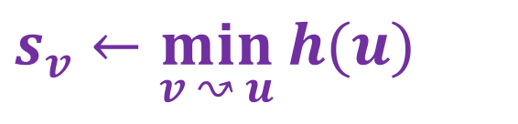
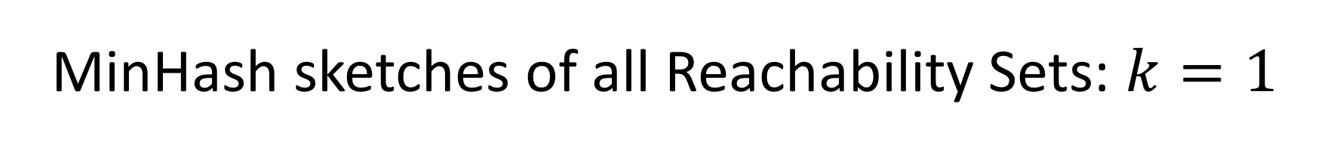
MinHash sketches of all Reachability Sets: $k=1$
0.37
{0.23}
0.12
0.28
0.45
{0.12}
{0.23}
{0.12}
{0.23}
0.34
{0.12}
{0.23}
0.23
{0.12}
0.85
0.93
{0.06}
{0.12}
{0.06}
0.77
0.06
0.69
$s_{v}←\min_{v ↝ u}$ $h(u)$
{0.06}
{0.06}
0.95
0.32

Slide 19
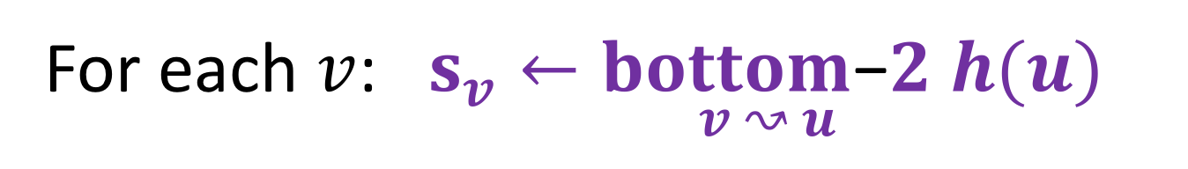
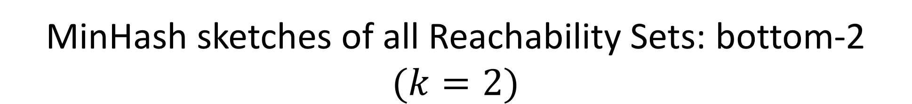
MinHash sketches of all Reachability Sets: bottom-2 $(k=2)$
For each $v$: $s_{v}←\underset{v ↝ u}{bottom\text{−}2}$ $h(u)$

Slide 20
MinHash sketches of Reachability Sets: bottom-2
0.37
0.12
0.28
0.45
{0.23,0.37}
0.34
{0.12,0.23}
0.23
0.85
0.93
{0.06,0.12}
0.77
0.06
0.69
0.95
0.32

Slide 21

Next: Computing MinHash sketches of reachability sets efficiently
Sketch size for a node: $O(k)$
Total computation $≈O(km)$
Algorithms/methods:
Graphs searches (say BFS)
Dynamic programming/ Distributed

Slide 22
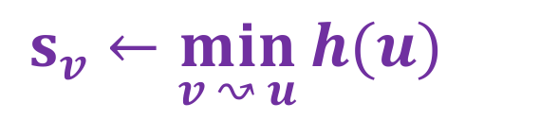

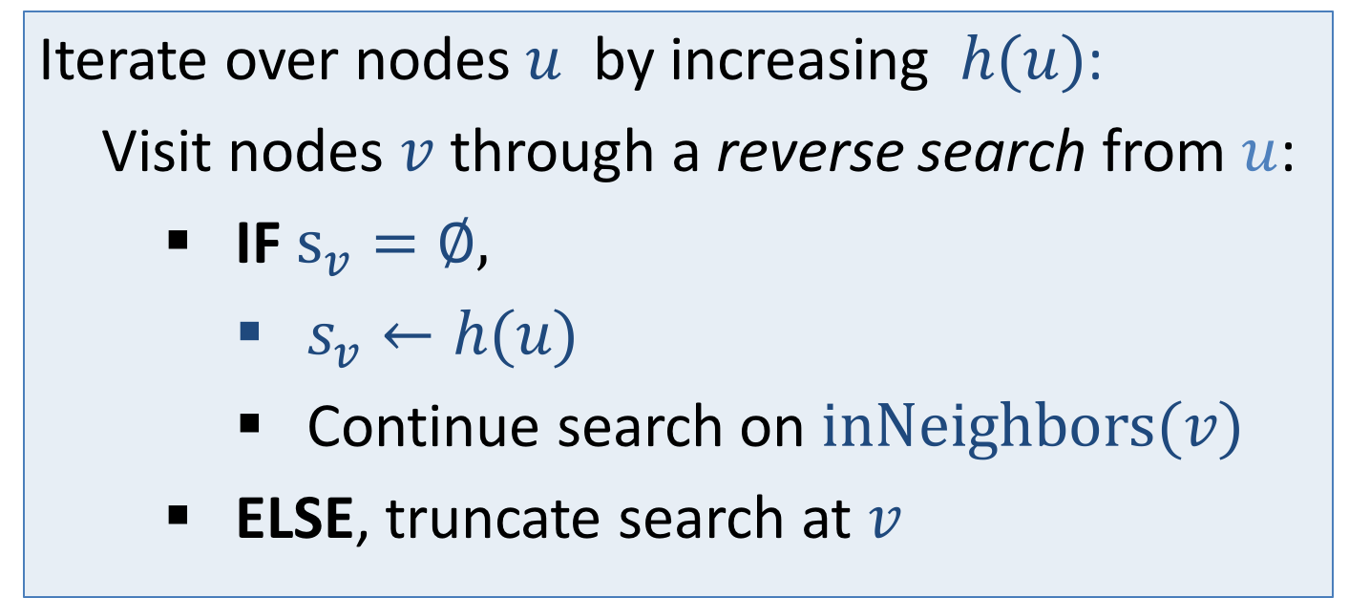
Computing MinHash Sketches of all Reachability Sets: $k=1$ BFS method
$s_{v}←\min_{v ↝ u}$ $h(u)$
Iterate over nodes $u$ by increasing $h(u)$:
Visit nodes $v$ through a reverse search from $u$:
IF $s_{v}=∅,$
$s_{v}←h(u)$
Continue search on $inNeighbors(v)$
ELSE, truncate search at $v$

Slide 23
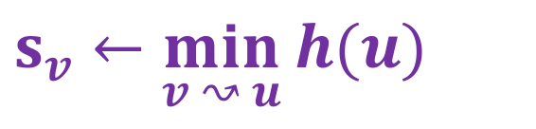

Computing MinHash sketches of all Reachability Sets: $k=1$, BFS
0.37
{0.23}
0.12
0.28
0.45
{0.12}
{0.23}
{0.12}
{0.23}
0.34
{0.12}
{0.23}
0.23
{0.12}
0.85
0.93
{0.06}
{0.12}
{0.06}
0.77
0.06
0.69
{0.06}
{0.06}
$s_{v}←\min_{v ↝ u}$ $h(u)$
0.95
0.32

Slide 24
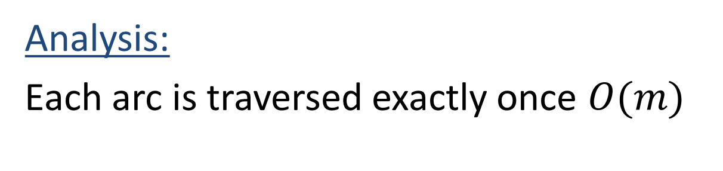

Computing MinHash sketches of all reachability sets: $k=1$ BFS method
Analysis:
Each arc is traversed exactly once $O(m)$

Slide 25
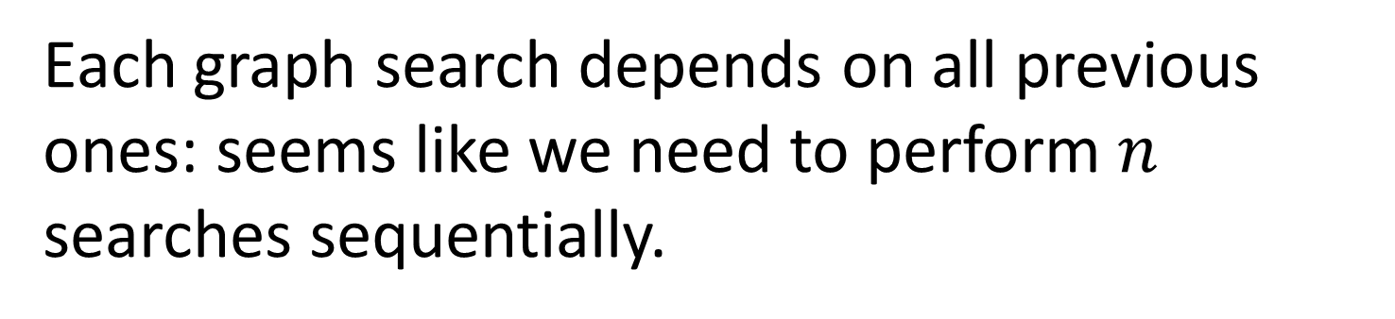
Parallelizing BFS-based MinHash computation
Each graph search depends on all previous ones: seems like we need to perform $n$ searches sequentially.
How can we reduce dependencies ?

Slide 26
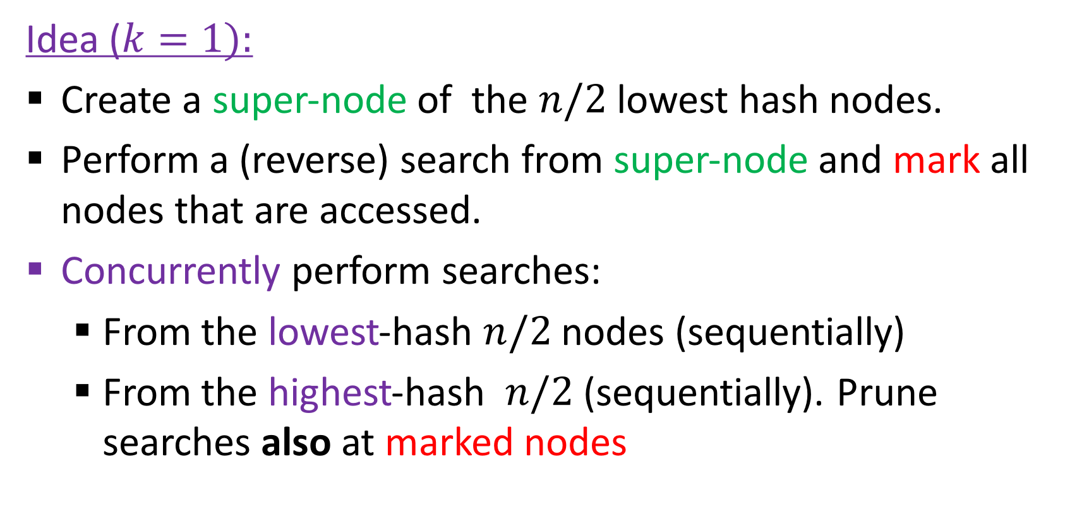
Parallelizing BFS-based MinHash computation
Idea ($k=1):$
Create a super-node of the $n/2$ lowest hash nodes.
Perform a (reverse) search from super-node and mark all nodes that are accessed.
Concurrently perform searches:
From the lowest-hash $n/2$ nodes (sequentially)
From the highest-hash $n/2$ (sequentially). Prune searches also at marked nodes

Slide 27
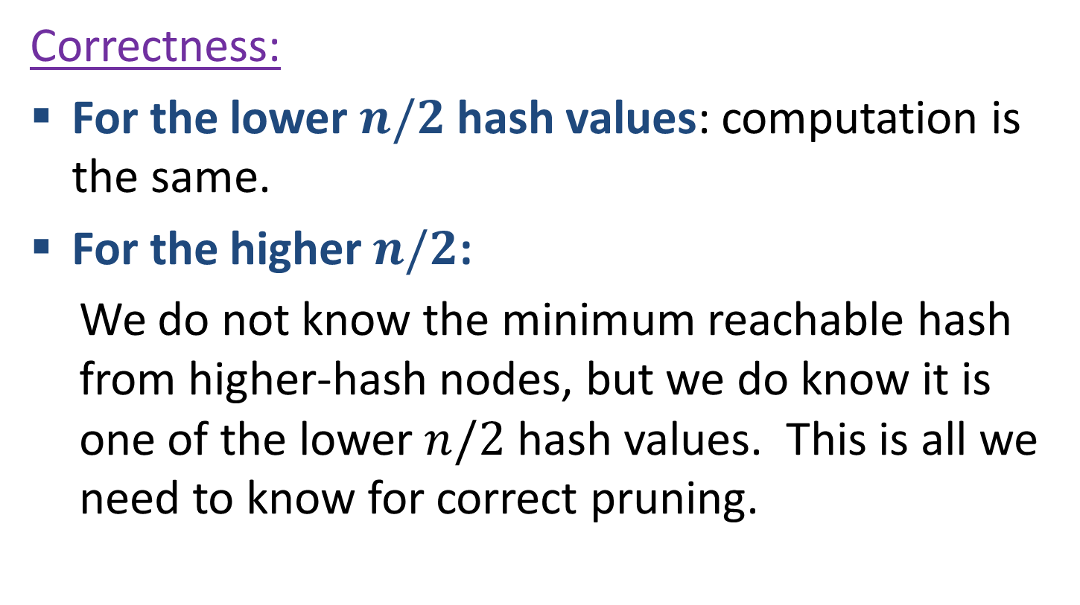
Parallelizing BFS-based MinHash computation
Correctness:
For the lower $n/2$ hash values: computation is the same.
For the higher $n/2$:
We do not know the minimum reachable hash from higher-hash nodes, but we do know it is one of the lower $n/2$ hash values. This is all we need to know for correct pruning.

Slide 28
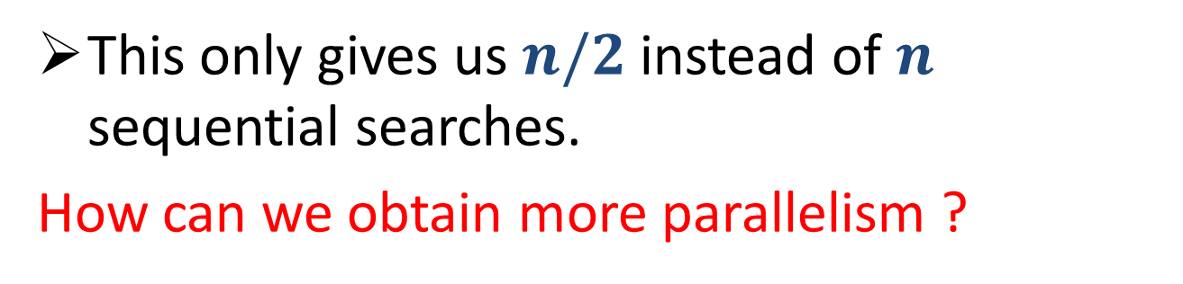
Parallelizing BFS-based MinHash computation
This only gives us $n/2$ instead of $n$ sequential searches.
How can we obtain more parallelism ?
We recursively apply this to each of the lower/higher sets:

Slide 29
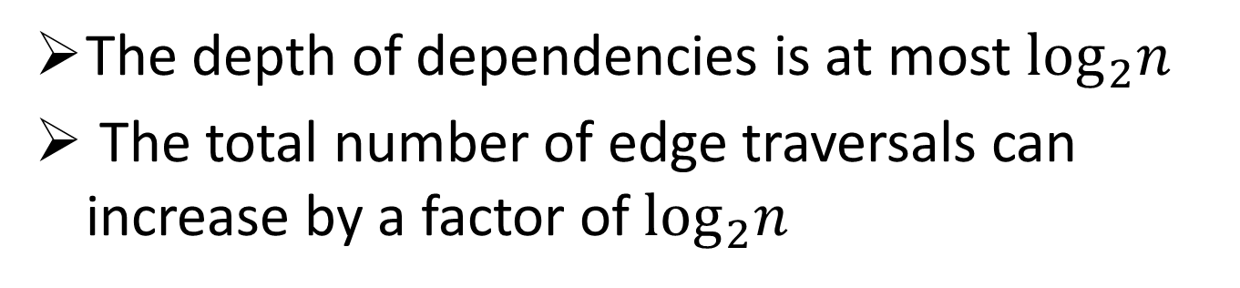
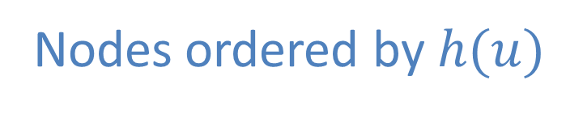
Parallelizing BFS-based MinHash computation
Nodes ordered by $h(u)$
Super-nodes created in recursion
The depth of dependencies is at most $\log_{2}n$
The total number of edge traversals can increase by a factor of $\log_{2}n$

Slide 30
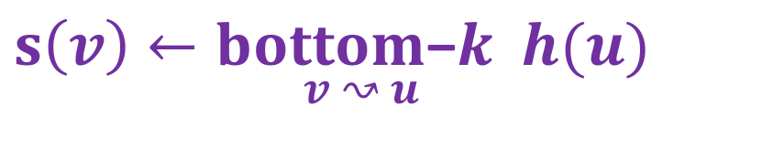

Computing MinHash Sketches of all Reachability Sets: bottom-$k$, BFS method
Next: Computing sketches using the BFS method for k>1
$s\left(v\right)←\underset{v ↝ u}{bottom\text{−}k}$ $h(u)$

Slide 31
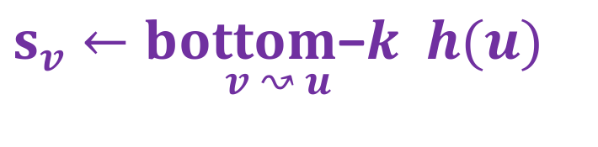
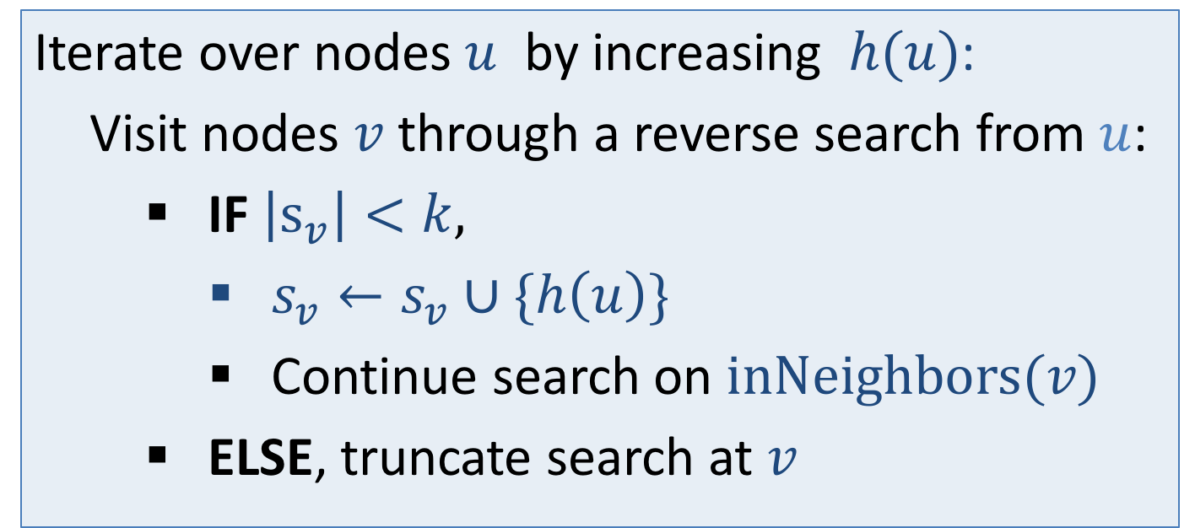
Computing MinHash Sketches of all Reachability Sets: bottom-$k$, BFS method
$s_{v}←\underset{v ↝ u}{bottom\text{−}k}$ $h(u)$
Iterate over nodes $u$ by increasing $h(u)$:
Visit nodes $v$ through a reverse search from $u$:
IF $\left|s_{v}\right|<k,$
$s_{v}←s_{v}∪\{h\left(u\right)\}$
Continue search on $inNeighbors(v)$
ELSE, truncate search at $v$

Slide 32
MinHash sketches of all Reachability Sets: bottom-2
0.37
0.12
0.28
0.45
{0.23, }
0.37
0.34
{0.12, }
0.23
0.23
0.85
0.93
{0.06, }
0.77
0.12
0.06
0.69
0.95
0.32

Slide 33
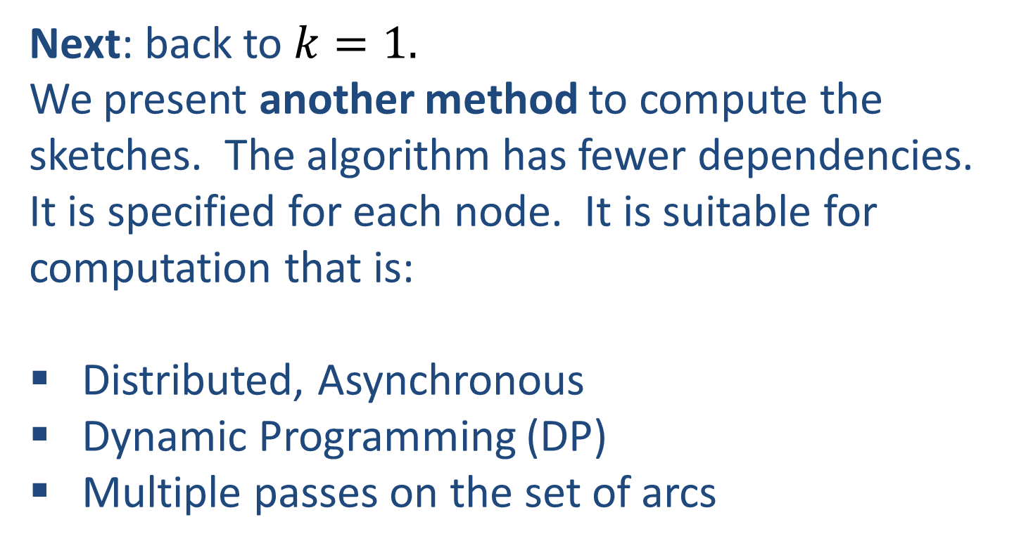

Computing MinHash Sketches of all Reachability Sets: $k=1$ Distributed (DP)
Next: back to $k=1.$
We present another method to compute the sketches. The algorithm has fewer dependencies. It is specified for each node. It is suitable for computation that is:
Distributed, Asynchronous
Dynamic Programming (DP)
Multiple passes on the set of arcs

Slide 34
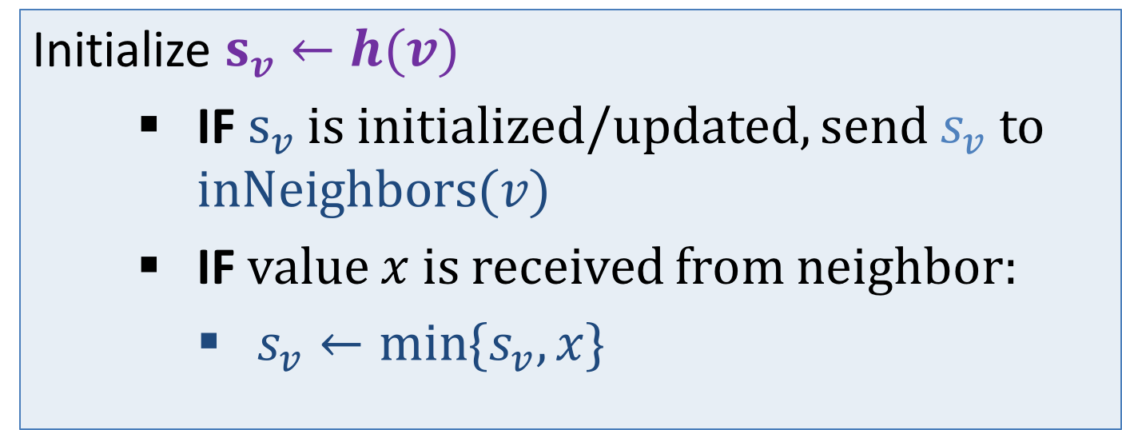
Computing MinHash Sketches of all Reachability Sets: $k=1$ Distributed (DP)
$s_{v}←\min_{v ↝ u}$ $h(u)$
Initialize $s_{v}←h(v)$
IF $s_{v}$ is initialized/updated, send $s_{v}$ to $inNeighbors(v)$
IF value $x$ is received from neighbor:
$s_{v}←\min{\{s_{v},x\}}$

Slide 35

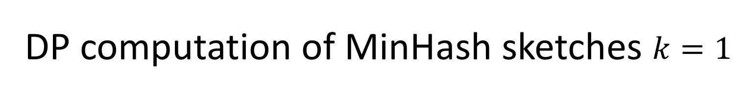
DP computation of MinHash sketches $k=1$
0.37
{0.37}
0.12
0.28
0.45
{0.12}
{0.45}
{0.28}
{0.23}
0.34
{0.34}
{0.85}
0.23
{0.93}
0.85
0.93
{0.06}
{0.77}
{0.69}
0.77
0.06
0.69
{0.95}
{0.32}
Initialize: $s_{v}←h(v)$
0.95
0.32

Slide 36
DP computation of MinHash sketches $k=1$
0.37
{0.37}
0.12
0.28
0.45
{0.12}
{0.45}
{0.28}
{0.23}
0.34
{0.34}
{0.85}
0.23
{0.93}
0.85
0.93
{0.06}
{0.77}
{0.69}
0.77
0.06
0.69
{0.95}
{0.32}
Send to inNeighbors
0.95
0.32

Slide 37
DP computation of MinHash sketches $k=1$
0.37
{0.37}
0.12
0.28
0.45
{0.12}
{0.45}
{0.12}
{0.23}
0.34
{0.12}
{0.23}
0.23
{0.28}
0.85
0.93
{0.06}
{0.12}
{0.06}
0.77
0.06
0.69
{0.32}
{0.32}
Update
0.95
0.32

Slide 38
DP computation of MinHash sketches $k=1$
0.37
{0.37}
0.12
0.28
0.45
{0.12}
{0.45}
{0.12}
{0.23}
0.34
{0.12}
{0.23}
0.23
{0.28}
0.85
0.93
{0.06}
{0.12}
{0.06}
0.77
0.06
0.69
{0.32}
{0.32}
If updated, send to inNeighbors
0.95
0.32

Slide 39
DP computation of MinHash sketches $k=1$
0.37
{0.37}
0.12
0.28
0.45
{0.12}
{0.45}
{0.12}
{0.23}
0.34
{0.12}
{0.23}
0.23
{0.28}
0.85
0.93
{0.06}
{0.12}
{0.06}
0.77
0.06
0.69
{0.32}
{0.32}
Update
0.95
0.32

Slide 40
DP computation of MinHash sketches $k=1$
0.37
{0.23}
0.12
0.28
0.45
{0.12}
{0.23}
{0.12}
{0.23}
0.34
{0.12}
{0.23}
0.23
{0.12}
0.85
0.93
{0.06}
{0.12}
{0.06}
0.77
0.06
0.69
{0.06}
{0.06}
If updated, send to inNeighbors. Done.
0.95
0.32

Slide 41

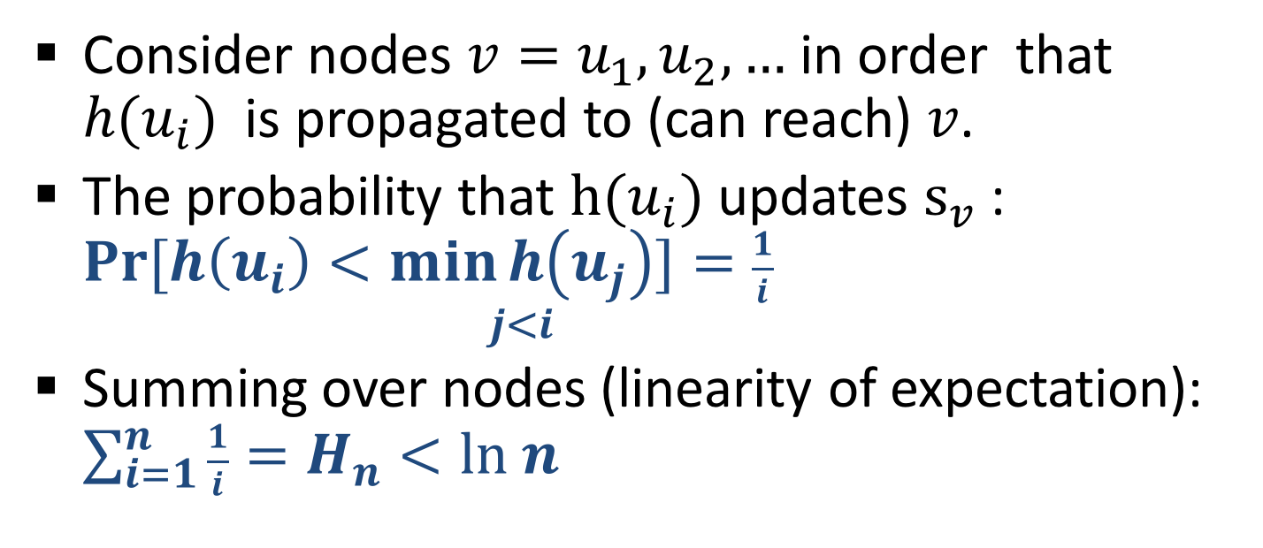
Analysis of DP: Edge traversals
Lemma: Each arc is used in expectation $< ln n$ times.
Proof: We bound the expected number of updates of $s_{v}$. (similar to lecture2)
Consider nodes $v=u_{1},u_{2},…$ in order that ${h(u}_{i})$ is propagated to (can reach) $v$.
The probability that $h(u_{i})$ updates $s_{v}$: $Pr⁡[h\left(u_{i}\right)<\underset{j<i}{\min{h\left(u_{j}\right)}}]=\frac{1}{i}$
Summing over nodes (linearity of expectation): $\sum_{i=1}^{n}{\frac{1}{i}=H_{n}<ln n}$

Slide 42
Analysis of DP: dependencies
The longest chain of dependencies is at most the longest shortest path (the diameter of the graph)

Slide 43
Next: All-Distances Sketches (ADS)
Sketch for distance (generalize reachability):
Sketch supports distance-based queries:
Centrality, similarity, influence, approximate distances

Slide 44
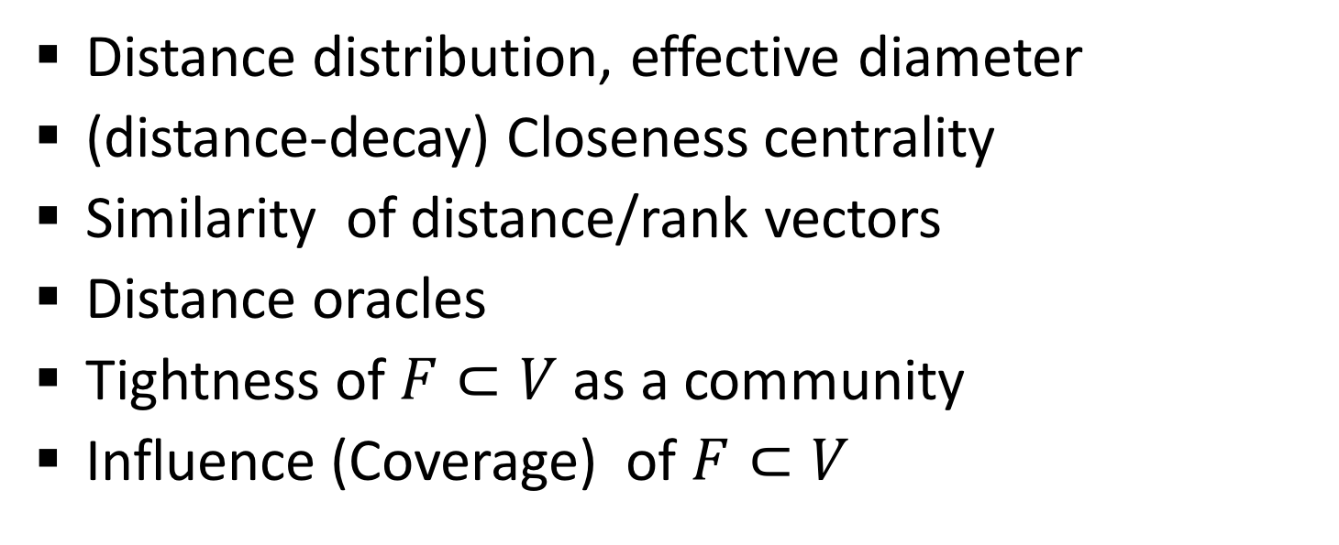
Applications of ADSs
Estimate node/subset/network level properties that are costly to compute exactly:
Distance distribution, effective diameter
(distance-decay) Closeness centrality
Similarity of distance/rank vectors
Distance oracles
Tightness of $F⊂V$ as a community
Influence (Coverage) of $F⊂V$

Slide 45
Bibliography
Recommended reading on social networks analysis:
Book: “Networks, Crowds, and Markets: Reasoning About a Highly Connected World” By David Easley and Jon Kleinberg.
http://www.cs.cornell.edu/home/kleinber/networks-book/
Course/Lectures by Lada Adamic: https://www.coursera.org/course/sna
http://open.umich.edu/education/si/si508/fall2008
Page Rank: Brin, S.; Page, L. (1998). "The anatomy of a large-scale hypertextual Web search engine".

Slide 46
Bibliography
Reachability MinHash sketches, All-Distances sketches:
E. Cohen “Size-Estimation Framework with Applications to Transitive Closure and Reachability” JCSS 1997
E. Cohen H. Kaplan “Spatially-decaying aggregation over a network” JCSS 2007
E. Cohen H. Kaplan “Summarizing data using bottom-k sketches” PODC 2007
E. Cohen: “All-Distances Sketches, Revisited: HIP Estimators for Massive Graphs Analysis” TKDE 2015

