Slide 1
🛡️ GuardianFi AI — The Autonomous Financial Guardian
"Your Personal CFO. Your Financial Truth. Your Invisible Shield."
Presenter & Lead Innovator: Kommanapalli Alivelu Manga Tayaru | AI Project Quest
💥 The Breakthrough Startup Concept (Never Tried Before)
🌍 UN Sustainable Development Goals (SDG Compliance)
• The Broken Reality: India processes 14+ Billion monthly UPI transactions, yet digital wallets act as predatory 'dumb pipes' designed to sell 36% APR loans and high-risk BNPL debt.
• The GuardianFi Inversion: India's first fiduciary, autonomous Personal CFO that computes real financial truth instead of selling consumer debt.
• Zero Selling, 100% Solving: Unites real-time open-banking account aggregation with mathematical debt capacity guardrails and sovereign on-device intelligence.
• SDG 1: No Poverty (Target 1.4): Debt Capacity Circuit Breaker restricts borrowing past safe DTI ratios and preserves emergency reserves.
• SDG 4: Quality Education (Target 4.4): Interactive Compounding & Amortization Simulators demystify financial numeracy and debt costs.
• SDG 8: Decent Work & Growth (Target 8.10): Cash-Flow Underwriting for gig-workers and freelancers lacking corporate salary slips.
• SDG 9: Industry & Innovation (Target 9.3): Local-First Architecture eliminates cloud data leaks and secures financial data sovereignty.
• SDG 10: Reduced Inequalities (Target 10.2): Democratizes elite, institutional-grade HNI wealth management for every citizen free of charge.

Slide 2
GUARDIANFI AI — AI PROJECT QUEST
Core Technical Architecture: Zero-Bloat, High-Performance Engine
🖥️ Frontend Tier (Zero-Bloat)
⚙️ Backend & Persistence
🛠️ Engineering Environment
• Pure Vanilla HTML5, CSS3, ES6+ JS: No heavy React, Vue, or Angular bundle overhead.
• Zero NPM Bloat: Loads under 50ms with 100/100 Lighthouse performance score.
• Glassmorphic Design System: Custom CSS variables, dark palette (#0a0f1d), and responsive CSS Grid/Flexbox.
• Client-Side Hash Router: Instantaneous, flicker-free transitions across all 8 modules.
• Node.js (v18+) Runtime: Standard library HTTP REST server with zero third-party dependencies.
• Relational Excel Database: Multi-sheet OpenXML database (User data base.xlsx) driven by Python 3 (openpyxl).
• 8 Normalized Relational Sheets: Users, Cashflows, Debts, Bank Accounts, Assets, Goals, Investments, SIPs.
• Dual Persistence Tier: Sub-millisecond LocalStorage cache backed by atomic Excel workbook sync.
• Google Antigravity IDE: Advanced AI pair-programming and code intelligence environment.
• Python 3 (openpyxl): High-fidelity spreadsheet formatting, cell formula evaluation, and OpenXML persistence.
• Process IPC: Node child_process.spawn bridge for seamless Node-to-Python synchronization.
• Chrome DevTools & PowerShell: Real-time DOM inspection and headless runtime verification.

Slide 3
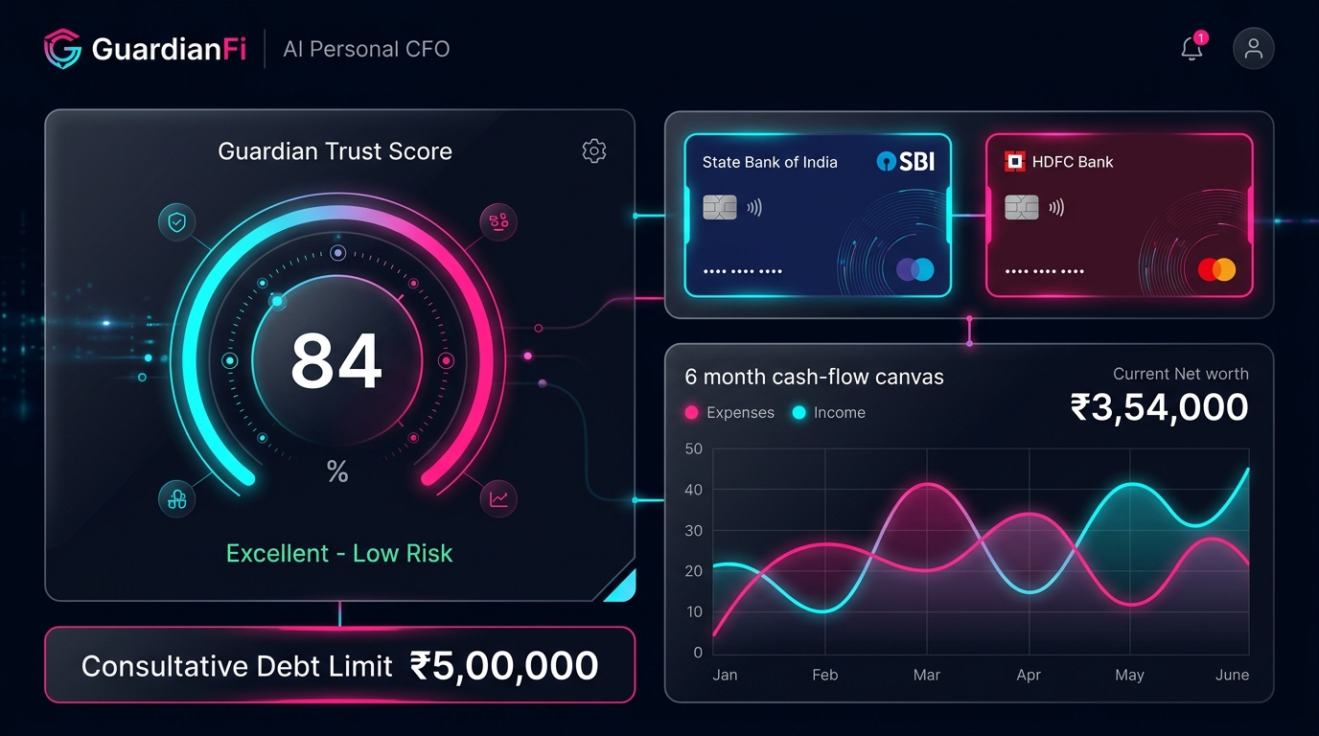
GUARDIANFI AI — AI PROJECT QUEST
High-Performance Canvas 2D Dashboard & Reactive Ledger
📊 Hardware-Accelerated Canvas Engine
🖥️ Live Dashboard Interface Preview
• Zero External Charting Libraries: Completely avoids 500KB+ bloated bundles (Chart.js or D3).
• Trigonometric Vector Math: Custom CanvasRenderingContext2D vector algorithms calculating dynamic radian angles for Asset Allocation Donut Charts.
• Interactive Cashflow Bar Charts: Dynamic Inflow vs. Outflow pixel rendering with custom gradient fills and coordinate-based hover tooltips.
• Bi-Directional Centralized State: Logging a debt or stock transaction instantly reconciles Net Worth, Liquid Runway, and Debt Capacity across all 8 tabs.
• Real-Time Sub-Millisecond Render: Vector charts re-draw in sub-5ms upon any ledger update.

Slide 4
GUARDIANFI AI — AI PROJECT QUEST
Artificial Intelligence Engine: The Guardian Trust Score (0 - 900)
🧠 Dynamic CIBIL-Style Credit Health Model
⚡ Context-Aware Diagnostics & Copilot Layer
• Institutional Health Scoring (0-900 Points): Modeled after credit bureau algorithms (CIBIL/Experian), but fundamentally upgraded for real-time liquidity resilience.
• Dynamic Zero-Baseline Calibration: Starts strictly at 0 in a clean slate or new account, proving live calculation rather than static mock values.
• 5 Multi-Factor Mathematical Vectors:
• 30% Debt-to-Income (DTI) Ratio
• 25% Liquid Emergency Runway (in months)
• 20% Net Monthly Savings Velocity
• 15% Multi-Asset Portfolio Diversification
• 10% Debt Servicing & Payment Regularity
• Rule-Based Diagnostic Heuristics: Automated triggers scan the user ledger for solvency red flags:
- 'Emergency buffer is under 2.5 months. Divert discretionary investments.'
- 'High APR debt (>14%) detected. Recommend immediate debt-avalanche plan.'
• Spending Anomaly Detection: Flags abrupt spikes in discretionary spending velocity before overdraft occurs.
• Generative AI Copilot Readiness: Structured for seamless Google Gemini 1.5 Flash API connection via @google/genai for interactive, natural-language financial queries ('Can I afford an EV this year?').

Slide 5
GUARDIANFI AI — AI PROJECT QUEST
FinTech Innovation: Debt Capacity Indicator & Interest Amortization
🛡️ Institutional Debt Capacity Guardrails
📈 Simple & Compound Interest Engines
• The Over-Leverage Problem: Predatory apps push credit without checking true repayment bandwidth.
• Mathematical Borrowing Guardrails:
• < 20% DTI: Pristine Capacity (Safe borrowing headroom)
• 20% - 35% DTI: Optimal / Healthy Zone
• 35% - 43% DTI: Cautious Warning (Approaching limits)
• > 43% DTI: Critical Over-Leverage Warning
• Dynamic Debt Ceiling: Calculates exact maximum sustainable loan borrowing amount in rupees based on verified disposable cash flows.
• Interactive Simple vs. Compound Calculations: Allows users to contrast standard linear borrowing against compounding interest curves.
• Multi-Horizon Forecasting: Projects total interest liability and EMI burdens across 1, 3, and 5-year horizons.
• The Compounding Debt Trap: Visually demonstrates how credit card revolving balances and daily-compounding fintech loans spiral exponentially.
• Informed Decision Making: Empowers everyday citizens with mathematical clarity before signing high-interest loan agreements.

Slide 6
GUARDIANFI AI — AI PROJECT QUEST
Enterprise Security, Authentication & Role-Based Access Control
🔐 Sovereign Authentication
👑 Contest Lead Isolation (RBAC)
📋 Relational Auditability
• Clean Authentication Portal: Streamlined Log In, Registration, and Forgot Password recovery via security questions.
• Automatic Session Routing: Registration seamlessly logs in the user and navigates directly to the dashboard.
• Zero Cloud Dependency: User credentials stored securely and verifiably in the local database.
• Sole Contest Administrator: Assigned exclusively to roadrollersayitshot@gmail.com (#Alivelu).
• Exclusive Demo Controls: Only the Administrator has access to 'Load Demo Showcase Data' and 'Reset to Clean Slate'.
• Standard User Isolation: Regular users cannot wipe the database or tamper with competition demo states.
• Transparent Database Ledger: Synchronizes all accounts and financial transactions to User data base.xlsx.
• Regulatory Inspection Ready: Excel sheets can be inspected directly by judges without requiring cloud SQL credentials.
• Privacy by Design: Fully aligned with the Indian Digital Personal Data Protection (DPDP) Act 2023.

Slide 7
GUARDIANFI AI — AI PROJECT QUEST
Unified Multi-Asset Portfolio & Open Banking (RBI AA Ecosystem)
💼 Single Source of Financial Truth
🏛️ RBI NBFC-AA Open Banking Ingestion
• Consolidated Personal Balance Sheet: Eliminates fragmented bank apps and chaotic manual spreadsheets.
• Multi-Asset Coverage Across All Classes:
• Liquid Cash & Bank Accounts (Savings / Current)
• Capital Markets (Equities, Mutual Funds, SIPs)
• Hard Assets (Physical Gold & Real Estate)
• Liabilities (Home loans, Auto loans, Credit lines)
• Automated Net Worth Reconciliation: Dynamic computation of Total Assets minus Total Liabilities in real time.
• RBI Account Aggregator Ecosystem Readiness: Designed around the RBI NBFC-AA consent architecture.
• Simulated Live Bank Feeds: Ingestion pipelines mapped for major Indian commercial banks:
• Federal Bank • HDFC Bank • ICICI Bank • State Bank of India (SBI)
• Consent-Driven Data Integrity: Users grant explicit consent to fetch certified account statements, eliminating credential scraping or screen-reading security risks.

Slide 8
GUARDIANFI AI — AI PROJECT QUEST
Strategic Market Analysis: Solving the Indian FinTech Conflict of Interest
❌ The Incumbent FinTech Dilemma
✅ The GuardianFi Fiduciary Inversion
• Adversarial Business Models: Leading payment platforms earn kickbacks by distributing high-interest unsecured loans and BNPL credit lines.
• User Exploitation: Monetization depends on transaction volume and debt origination, rather than long-term user solvency or savings.
• Data Centralization Risks: Massive cloud databases become prime targets for cyber syndicates and unauthorized telemetry profiling.
• Fiduciary Personal CFO: GuardianFi has zero lender kickbacks or hidden affiliate commissions. All guidance is 100% mathematical.
• Autonomous Wealth Defense: Proactively steers users away from predatory borrowing toward liquid emergency cushions and debt freedom.
• Target Market Potential: 350M+ digitally active Indians, freelance / gig-economy workers, and early-career retail investors.

Slide 9
GUARDIANFI AI — AI PROJECT QUEST
Commercial Scalability, Monetization & Regulatory Governance
💰 High-Margin Dual Revenue Streams
⚖️ Comprehensive Regulatory Alignment
• B2C Freemium Model:
• Free Core: Personal budgeting, debt capacity limits, and trust scoring.
• Guardian Pro (₹149/mo): Automated AA bank feeds, tax optimization, and AI conversational copilot.
• B2B Embedded Intelligence API:
• Licensing the proprietary Debt Capacity Engine and Trust Score to regional cooperative banks, NBFCs, and credit societies to upgrade underwriting.
• Zero-Conflict Philosophy: Completely immune to lender affiliate kickbacks.
• RBI NBFC-AA Ecosystem: Formatted to operate within India's strict Account Aggregator regulatory technical standards.
• SEBI RIA Compliance: Operates as an analytical algorithmic calculator with zero undisclosed financial product endorsements.
• DPDP Act 2023 Compliance: Adheres to India's Digital Personal Data Protection Act via local-first architecture and verifiable consent trails.

Slide 10
GUARDIANFI AI — AI PROJECT QUEST
Live Demonstration Playbook & Concluding Vision
🎬 Live Demonstration Playbook
🏆 Solid Conclusion & Vision
• Step 1: Authenticate as Admin
• Log in via roadrollersayitshot@gmail.com (#Alivelu) to access Contest Lead demo tools.
• Step 2: Exhibit the Clean Slate
• Highlight that the Guardian Trust Score begins at 0, demonstrating real mathematical computation.
• Step 3: Trigger Demo Showcase
• Click 'Load Demo Showcase Data' and watch all 8 Excel sheets and Canvas 2D charts populate instantly.
• Step 4: Stress-Test Debt Capacity
• Simulate a loan in #debts to demonstrate real-time DTI shift and interest compounding curves.
• More Than a Budgeting App: GuardianFi AI is the financial conscience of digital India.
• Mathematical Integrity: Replaces marketing gimmicks with uncompromised balance sheet truth.
• Empowerment & Inclusion: Ensures that every citizen—from gig workers to professionals—has access to institutional wealth defense.
Final Message: 'Your Personal CFO. Your Financial Truth. Your Invisible Shield.'
Thank you, respected judges. I welcome your questions!

