Slide 1
🏆 GuardianFi — The Autonomous Personal CFO
"Your Personal CFO. Your Financial Truth. Your Invisible Shield."
BIZIGNITE Part 1: Strategic Foundation & Business Model Canvas | Presenter: Kommanapalli Alivelu Manga Tayaru
💥 The Unprecedented Startup Concept
📉 The Documented Problem (Regulatory Proof)
• The Market Paradox: India processes over 14 Billion monthly UPI payments, yet payment apps operate as predatory 'dumb pipes' designed to sell 36% APR loans and BNPL debt traps.
• The GuardianFi Inversion: India's first fiduciary, autonomous Personal CFO. Instead of monetizing by pushing consumer debt, it computes absolute financial truth, enforces debt capacity guardrails, and defends household solvency.
• Zero Selling. 100% Solving: High-trust category creation in Indian FinTech.
• NCFE & RBI Literacy Audit: Only 27% of Indian adults are financially literate; 82% fail basic compound interest calculations, taking micro-loans with 300%+ effective APR.
• RBI Financial Stability Report: Unsecured consumer credit and BNPL micro-debt surged past ₹1.5 Lakh Crore at an alarming >28% CAGR via frictionless 1-click checkouts.
• SEBI Retail Loss Study: 93% of individual F&O traders lost capital, evaporating ₹1.81 Lakh Crore of household savings over FY22–FY24.
• The Cause: Incumbent apps monetize via loan bounties. GuardianFi intervenes with mathematical balance sheet protection.

Slide 2
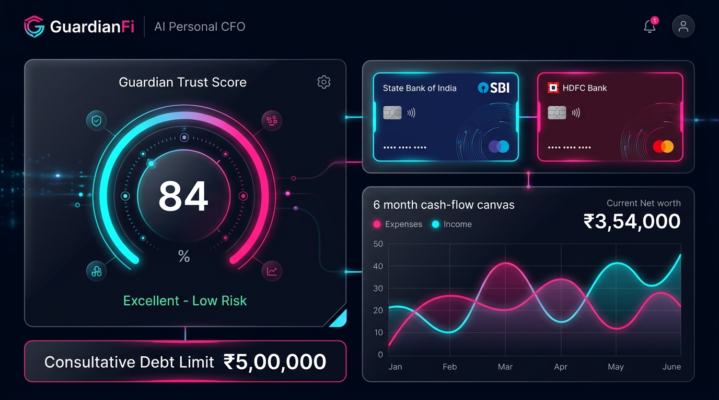
PART 1: STRATEGIC FOUNDATION (SLIDE 2 OF 5)
Proposed Solution: Fiduciary Personal CFO & Wealth Defense Engine
🛡️ 4 Core Financial Defense Pillars
🖥️ Live Balance Sheet Interface Preview
• 1. Consolidated Household Balance Sheet: Pulls verified data across bank accounts, mutual funds, equities, gold, real estate, and liabilities via the RBI Account Aggregator into one live Net Worth metric.
• 2. Guardian Trust Score (0-900): Real-time creditworthiness & liquidity health index evaluating DTI ratio, emergency runway, savings rate, and payment regularity.
• 3. Debt Capacity Circuit Breaker: Mathematical borrowing ceiling based on institutional lending norms that stops dangerous over-leverage before default occurs.
• 4. Simple & Compound Amortization Engine: Visually reveals exponential compounding debt traps before signing loan contracts.
• 5. 100% Fiduciary Independence: Zero affiliate kickbacks from predatory lenders. Recommendations are 100% mathematical.

Slide 3
PART 1: BUSINESS MODEL CANVAS — RIGHT SIDE
Business Model Canvas (Market & Customer Facing Half)
👥 Customer Segments
💎 Value Propositions
• Mass Affluent & Urban Salaried: 45M+ professionals with multiple cards and fragmented bank accounts.
• Retail Capital Market Investors: 120M+ demat account holders lacking risk guardrails.
• Gig Workers & Freelancers: 15M+ informal earners needing cash-flow based underwriting.
• Enterprise B2B: Regional cooperative banks and NBFCs requiring automated debt capacity APIs.
• 100% Fiduciary Protection: Zero commissions from lenders; uncompromised consumer defense.
• Unified Financial Truth: Instant consolidation of multi-bank accounts, equities, gold, and debt.
• Active Debt Circuit Breakers: Mathematical borrowing ceiling preventing toxic over-leverage.
• Autonomous Wealth Optimization: Actionable tax-loss harvesting and liquidity buffer planning.
📢 Channels & Customer Relationships
💰 Revenue Streams
• Channels: Direct web application, Account Aggregator consent flows, B2B partner bank portals, and organic viral referral loops via financial health calculators.
• Customer Relationships: Automated algorithmic self-service, real-time proactive risk alerts, transparent fee-only trust, and dedicated financial mastery community.
• Guardian Pro Subscriptions: ₹149/month for automated tax-harvesting and AI copilot.
• Merchant Services: MDR on Credit Cards & Wallets for merchant checkouts.
• Financial Product Distribution: Fiduciary zero-kickback direct tier fees from AMCs.
• B2B Embedded Risk API: Per-query credit scoring and debt capacity licensing to banks.

Slide 4
PART 1: BUSINESS MODEL CANVAS — LEFT SIDE
Business Model Canvas (Internal Operations & Infrastructure Half)
🤝 Key Partnerships
⚙️ Key Activities
• Banking Partners: Ingestion mapping for HDFC, ICICI, SBI, Federal Bank via escrow rails.
• Licensed Account Aggregators: Sahamati-certified AAs (Anumati, OneMoney, Finvu).
• Asset Management Companies (AMCs) & Depositories: CDSL / NSDL ecosystem integration.
• Regulatory & Legal Advisors: SEBI RIA and RBI compliance audit partners.
• Algorithmic Financial Modeling: Continuous optimization of the 0-900 Trust Score model.
• Real-Time Multi-Bank Reconciliation: Ingesting and sanitizing multi-bank statements.
• Debt Circuit Breaker Risk Analytics: Calculating safe DTI borrowing limits in real time.
• Regulatory Compliance Management: Adhering to RBI Data Localization and DPDP Act 2023.
🧠 Key Resources
📊 Cost Structure
• Proprietary Mathematical IP: Algorithmic Debt Capacity & Credit Scoring algorithms.
• Sovereign Database Architecture: Local-first persistence engine ensuring 100% data sovereignty.
• Institutional Banking Connectors: Direct API bridges with Account Aggregator gateways.
• Experienced Interdisciplinary Team: Deep expertise in FinTech, algorithmic finance, and law.
• Fixed Costs: Core engineering talent, SEBI/RBI licensing, legal audits, sovereign servers.
• Variable Costs: Account Aggregator per-pull verification fees (₹2–₹5 per statement pull).
• Cybersecurity & Audits: Regular CERT-In compliance penetration testing and ISO audits.
• Go-To-Market & Acquisition: Targeted educational campaigns and B2B partner integration.

Slide 5
PART 1: BUSINESS MODEL CANVAS — UNIFIED MATRIX
The Complete Business Model Canvas: 9 Strategic Building Blocks
Key Partners
Key Activities
Value Propositions
Customer Rel.
Customer Segments
• HDFC, ICICI, SBI, Federal Bank
• Sahamati AAs (Anumati, Finvu)
• AMCs & CDSL/NSDL
• SEBI & RBI Auditors
• Algorithmic Modeling
• Real-Time AA Reconciliation
• Debt Circuit Breakers
• 100% Fiduciary Truth
• Zero Lender Kickbacks
• Consolidated Balance Sheet
• Active Debt Ceiling Alerts
• Simple/Compound Simulators
• Automated Self-Service
• Proactive Risk Alerts
• High-Trust Fiduciary Bond
• 45M+ Urban Salaried
• 120M+ Retail Demat Holders
• 15M+ Gig Earners
• Regional Banks & NBFCs
Key Resources
Channels
• Proprietary Math IP
• Sovereign Local DB
• RBI Banking Gateways
• Direct Web Application
• RBI Account Aggregator
• B2B Bank Portals & APIs
Cost Structure (Left Side Drivers)
Revenue Streams (Right Side Monetization)
• Fixed: Core development, SEBI RIA/RBI legal licensing, ISO/CERT-In audits.
• Variable: Account Aggregator per-statement pull fees (₹2–₹5), server infrastructure, and strategic B2B acquisition.
• B2C: Guardian Pro Subscriptions (₹149/mo), Utility Convenience Fees (₹2-₹5), and Broking.
• B2B: Merchant MDR, direct mutual fund platform fees, and Debt Capacity API licensing to banks.

Slide 6
PART 2: 5-MINUTE INVESTOR PITCH (SLIDE 1 OF 5)
The Investor Pitch Hook: Solving India's FinTech Conflict of Interest
❌ The Incumbent Conflict of Interest
✅ The GuardianFi Market Inversion
• The Core Problem: PhonePe, Google Pay, and CRED are transactional 'dumb pipes' that monetize by selling consumer attention to 36% APR predatory lenders.
• Incentives are Inverted: Payment platforms profit when consumers borrow and over-leverage, not when they save or build wealth.
• Empirical Evidence: Over 82% of Indians fail basic compounding debt math; unsecured retail loans spiked past ₹1.5 Lakh Crore; retail traders burned ₹1.81 Lakh Crore in F&O.
• 100% Fiduciary Alignment: We take zero kickbacks from lenders. Trust is our primary product and customer acquisition moat.
• Autonomous Balance Sheet Defense: Aggregates liquid cash, equities, mutual funds, gold, and debt into one live net worth ledger via RBI Account Aggregator.
• Active Debt Circuit Breakers: Mathematical borrowing limits prevent toxic loan stacking before execution.
• Massive Untapped Market: 350M+ digitally transacting Indians are seeking an unbiased financial guardian.

Slide 7
PART 2: 5-MINUTE INVESTOR PITCH (SLIDE 2 OF 5)
The Product Moat: Mathematical Fiduciary Intelligence
🛡️ Why GuardianFi Cannot Be Displaced
🖥️ Functional Balance Sheet Interface
• 1. Dynamic Guardian Trust Score (0-900): CIBIL-style credit & solvency index evaluating DTI, liquidity runway, and savings velocity in real time.
• 2. Debt Capacity Indicator: Enforces institutional borrowing zones (<20% Pristine, 20-35% Optimal, 35-43% Caution, >43% Critical).
• 3. Simple & Compound Amortization Simulators: Exposes the compounding interest trap of credit cards and instant loans.
• 4. Sovereign Privacy: User financial data resides locally with relational auditability. Zero cloud honeypots.

Slide 8
PART 2: 5-MINUTE INVESTOR PITCH (SLIDE 3 OF 5)
Market Sizing: Capturing India's $2.1 Trillion FinTech Surge
📊 TAM / SAM / SOM Metrics
🚀 Macro Industry Tailwinds
• TAM ($2.1 Trillion): Projected Indian FinTech ecosystem size by 2030 (EY/BCG reports) with 900M+ internet users and 14B+ monthly UPI transactions.
• SAM (120 Million Users): Active credit-card holders, salaried middle-income earners, and retail demat account holders across Tier-1/2 cities.
• SOM (12 Million Users): Tech-savvy young professionals and retail investors targeted in Years 1–3 ($24 Million ARR potential at 5% paid conversion).
• Demat Account Surge: Surged from 40M in 2020 to 160M+ today, but retail investors lack automated portfolio risk defense.
• RBI Account Aggregator Rollout: Mandates open banking statement pulling, eliminating scraping risks.
• Regulatory Clampdown on Digital Lending: Strict RBI rules against predatory loan stacking create an enormous vacuum for an uncompromised fiduciary guardian.

Slide 9
PART 2: 5-MINUTE INVESTOR PITCH (SLIDE 4 OF 5)
Revenue Model & Unit Economics: Solving the Free UPI Paradox
Segment | Service Provided | Monetization Mechanism | Who Pays?
Merchant Services | Payment Gateway & QR Codes | MDR on Credit Cards / Wallets | Merchants
Financial Products | Certified Direct Mutual Funds & Insurance | Distribution & Platform Fees | Financial Institutions
Consumer Platform | Utility Bill Payments & Mobile Recharges | Platform / Convenience Fees (₹2-₹5) | Consumers
Curated Advertising | Non-Predatory In-App Brand Placements | Cost-per-Impression (CPM) / Click | Brands & Advertisers
Wealth Management | Equity Broking (Share.Market) & Pro Sub | Broking Charges & ₹149/mo Subscription | Investors / Traders

Slide 10
PART 2: 5-MINUTE INVESTOR PITCH (SLIDE 5 OF 5)
Execution Roadmap, Funding Ask & Concluding Investor Pitch
💼 The Ask: ₹5.00 Crore ($600K)
🏆 The BIZIGNITE Concluding Pitch
• Seed Round Ask: ₹5.00 Crore ($600,000 USD) at ₹25.00 Crore post-money valuation.
• Capital Allocation:
• 40% (₹2.0 Cr): Product & Algorithmic Financial Engine
• 25% (₹1.25 Cr): Regulatory Licensing, SEBI/RBI Legal
• 20% (₹1.0 Cr): Sovereign Infrastructure & Audits
• 15% (₹0.75 Cr): Strategic GTM & Bank Partnerships
• 18-Month Runway to Operational Profitability:
• Month 6: 100k Active Users; AA certified
• Month 12: 500k Users; ₹3.5 Cr ARR; B2B API pilot
• Month 18: 2M Users; Unit-Economic Profitability; Series A ready
GuardianFi is not merely another personal finance app—it is the financial conscience of digital India.
In the coming decade, Indian consumers will reject platforms that profit by trapping them in debt. They will place their wealth in software that tells them the mathematical truth, defends their disposable income, and accelerates their net worth.
"Your Personal CFO. Your Financial Truth. Your Invisible Shield."
Presented by: Kommanapalli Alivelu Manga Tayaru
BIZIGNITE Venture Pitch | Thank you, respected jury!

