Slide 1
Pervasive Idea: Abstraction and Layering
Abstraction: only way of dealing with complex systems
Divide world into objects, each with an…
Interface: knobs, behaviors, knobs → behaviors
Implementation: “black box” (ignorance+apathy)
Only specialists deal with implementation, rest of us with interface
Example: only mechanics know how cars work
Layering: abstraction discipline makes life even simpler
Divide objects in system into layers, layer n objects…
Implemented using interfaces of layer n – 1
(mostly) Don’t need to know interfaces of layer n – 2
Inertia: a dark side of layering
Layer interfaces become entrenched over time (“standards”)
Very difficult to change even if benefit is clear
Opacity: hard to reason about performance across layers
Notes:
Feb 17, 2009: digital TV conversion date, was postponed to June 12th, even after significant government subsidy

Slide 2
Abstraction, Layering, and Computers
App
App
App
Software
System software
ISA
Mem
CPU
I/O
Hardware
Transistors
Computers are complex, built in layers
Several software layers: assembler, compiler, OS, applications
Instruction set architecture (ISA)
Several hardware layers: transistors, gates, CPU/Memory/IO
99% of users don’t know hardware layers implementation
90% of users don’t know implementation of any layer
That’s okay, world still works just fine
But sometimes it is helpful to understand what’s “under the hood”

Slide 3
Why Study Hardware?
Understand where computers are going
Future capabilities drive the (computing) world
Real world-impact: no computer architecture → no computers!
Understand high-level design concepts
The best system designers understand all the levels
Hardware, compiler, operating system, applications
Understand computer performance
Writing well-tuned (fast) software requires knowledge of hardware
Write better software
The best software designers also understand hardware
Understand the underlying hardware and its limitations
Design hardware
Intel, AMD, IBM, ARM, Qualcomm, Apple, Oracle, NVIDIA, Samsung, …
Notes:
Some of you will actually be designing chips and systems and working with things at this level
All of you will be writing code and if you know how the system works you will be able to take better advantage of things that the system does well and avoid things that the computer does poorly.
This understanding can have profound effects of code performance.

Slide 4
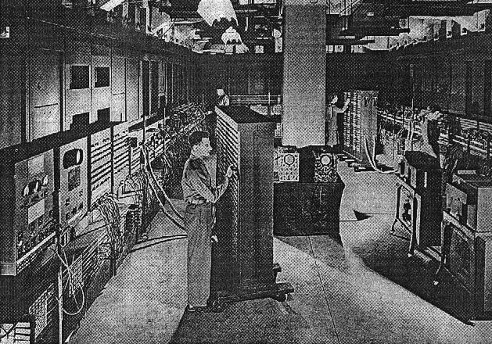
Penn Legacy
ENIAC: electronic numerical integrator and calculator
First operational general-purpose stored-program computer
Designed and built here by Eckert and Mauchly
See it in Moore 100!
First seminars on computer design
Moore School Lectures, 1946
“Theory and Techniques for Design of Electronic Digital Computers”

Slide 5
What is Computer Architecture?

Slide 6
Computer Architecture
Computer architecture
Definition of ISA to facilitate implementation of software layers
The hardware/software interface
Computer micro-architecture
Design processor, memory, I/O to implement ISA
Efficiently implementing the interface
CIS 371/501 is mostly about processor micro-architecture
“architecture” is also a vacuous term for “the design of things”
software architect, network architecture, …

Slide 7
Application Specific Designs
This class is about general-purpose CPUs
Processor that can do anything, run a full OS, etc.
E.g., Intel Atom/Core/Xeon, AMD Ryzen/EPYC, ARM M/A series
In contrast to application-specific chips
Or ASICs (Application specific integrated circuits)
Also application-domain specific processors
Implement critical domain-specific functionality in hardware
Examples: video encoding, 3D graphics, machine learning
General rules
Hardware is less flexible than software
Hardware more effective (speed, power, cost) than software
Domain specific more “parallel” than general purpose
But mainstream processors are quite parallel as well

Slide 8
Technology Trends

Slide 9
“Technology”
gate
Basic element
Solid-state transistor (i.e., electrical switch)
Building block of integrated circuits (ICs)
What’s so great about ICs? Everything
High performance, high reliability, low cost, low power
Lever of mass production
Several kinds of integrated circuit families
SRAM/logic: optimized for speed (used for processors)
DRAM: optimized for density, cost, power (used for memory)
Flash: optimized for density, cost (used for storage)
Increasing opportunities for integrating multiple technologies
Non-transistor storage and inter-connection technologies
Magnetic disks, optical storage, ethernet, fiber optics, wireless
source
drain
channel

Slide 10
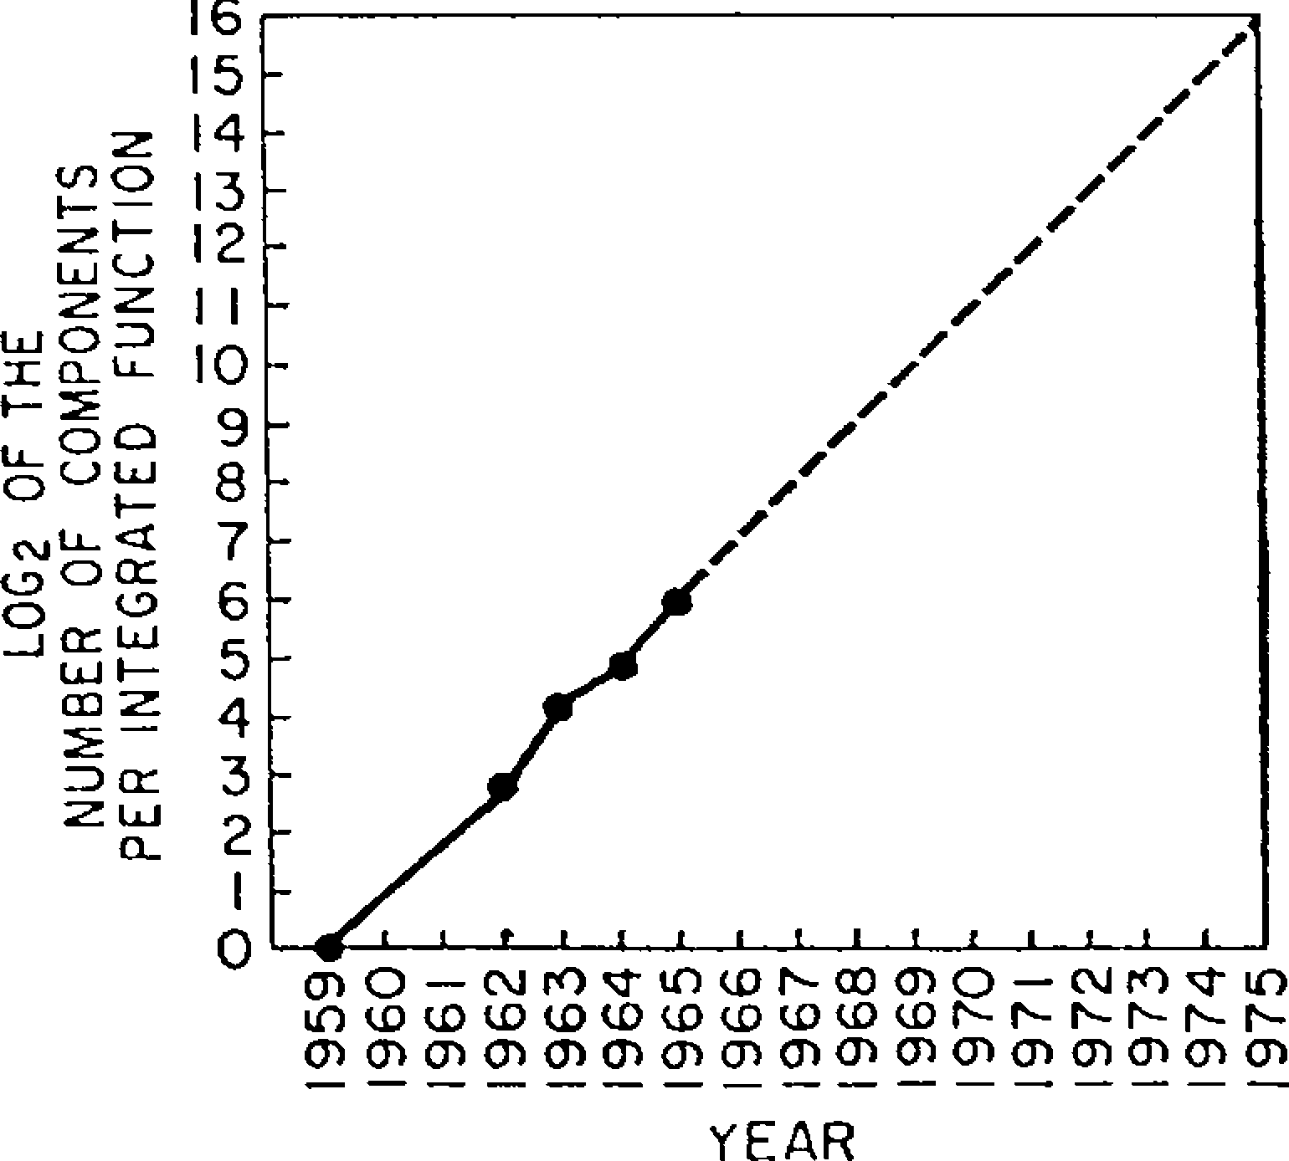
Moore’s Law - 1965
Today: 2³³ transistors

Slide 11
Moore’s Law today
data c/o WikiChip
Notes:
gray line is Moore’s Law, doubling density every ~2.5 years
TSMC 7nm was used for Apple A12 processor, in iPhone XS/XR

Slide 12
Moore’s Law today
data c/o WikiChip
Notes:
gray line is Moore’s Law, doubling density every ~2.5 years
TSMC 7nm was used for Apple A12 processor, in iPhone XS/XR

Slide 13
Revolution I: The Microprocessor
Microprocessor revolution
One significant technology threshold was crossed in 1970s
Enough transistors (~25K) to put a 16-bit processor on one chip
Huge performance advantages: fewer slow chip-crossings
Even bigger cost advantages: one “stamped-out” component
Microprocessors have allowed new market segments
Desktops, CD/DVD players, laptops, game consoles, set-top boxes, mobile phones, digital camera, mp3 players, GPS, automotive
And replaced incumbents in existing segments
Microprocessor-based system replaced supercomputers, “mainframes”, “minicomputers”, “desktops”, etc.

Slide 14
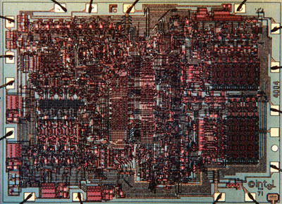
First Microprocessor
Intel 4004 (1971)
Application: calculators
Technology: 10,000 nm
2300 transistors
13 mm²
108 KHz
12 Volts
4-bit data
Single-cycle datapath
Notes:
10um

Slide 15
Revolution II: Implicit Parallelism
Then to extract implicit instruction-level parallelism
Hardware provides parallel resources, figures out how to use them
Software is oblivious
Initially using pipelining …
Which also enabled increased clock frequency
… caches …
Which became necessary as processor clock frequency increased
… and integrated floating-point
Then deeper pipelines and branch speculation
Then multiple instructions per cycle (superscalar)
Then dynamic scheduling (out-of-order execution)
We will talk about these things

Slide 16
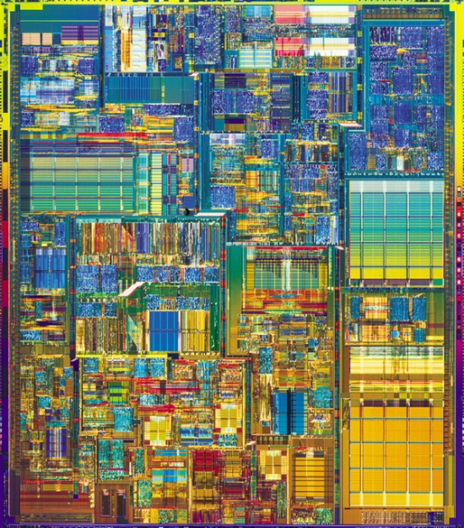
Pinnacle of Single-Core Microprocessors
Intel Pentium4 (2003)
Application: desktop/server
Technology: 90nm (1/100x)
55M transistors (20,000x)
101 mm² (10x)
3.4 GHz (10,000x)
1.2 Volts (1/10x)
32/64-bit data (16x)
22-stage pipelined datapath
3 instructions per cycle (superscalar)
Two levels of on-chip cache
data-parallel vector (SIMD) instructions, hyperthreading

Slide 17
Revolution III: Explicit Parallelism
Then to support explicit data & thread level parallelism
Hardware provides parallel resources, software specifies usage
Why? diminishing returns on instruction-level-parallelism
First using (subword) vector instructions…, Intel’s SSE
One instruction does four parallel multiplies
… and general support for multi-threaded programs
Coherent caches, hardware synchronization primitives
Then using support for multiple concurrent threads on chip
First with single-core multi-threading, now with multi-core
Graphics processing units (GPUs) are highly parallel
Converging with general-purpose processors (CPUs)?

Slide 18
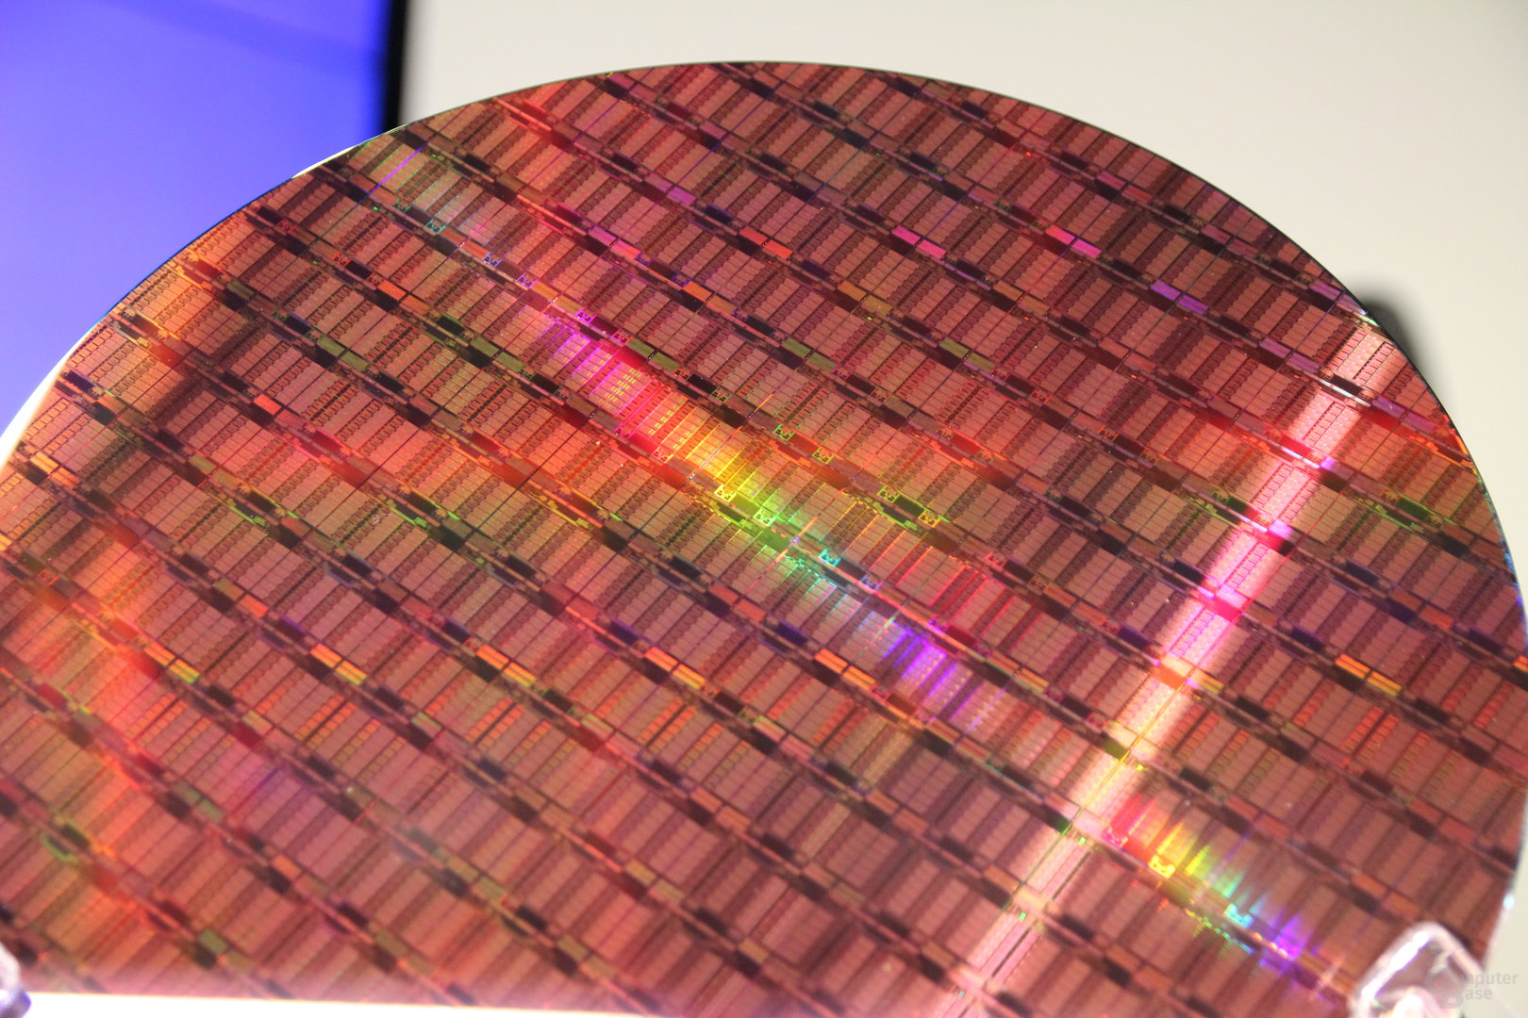
Modern Multicore Processor
Intel Xeon E5-2699 V4 (2016)
Application: server
Technology: 14nm (16% of P4)
7.2B transistors (130x)
456 mm² (4.5x)
2.4 to 3.6 Ghz (~1x)
1.8 Volts (~1x)
256-bit data (2x)
14-stage pipelined datapath (0.5x)
4 instructions per cycle (1x)
Three levels of on-chip cache
data-parallel vector (SIMD) instructions, hyperthreading
22-core multicore (22x)

Slide 19
Revolution IV: Heterogeneous Processing
Combining multiple kinds of compute engines in one die
not just homogenous collection of cores
System-on-Chip (SoC) is one common example in mobile space
Lots of stuff on the chip beyond just CPUs
Graphics Processing Units (GPUs)
throughput-oriented specialized multicore processors
good for gaming, machine learning, computer vision, …
Special-purpose logic
media codecs, radios, encryption, compression, machine learning
Excellent energy efficiency and performance
extremely complicated to program!

Slide 20
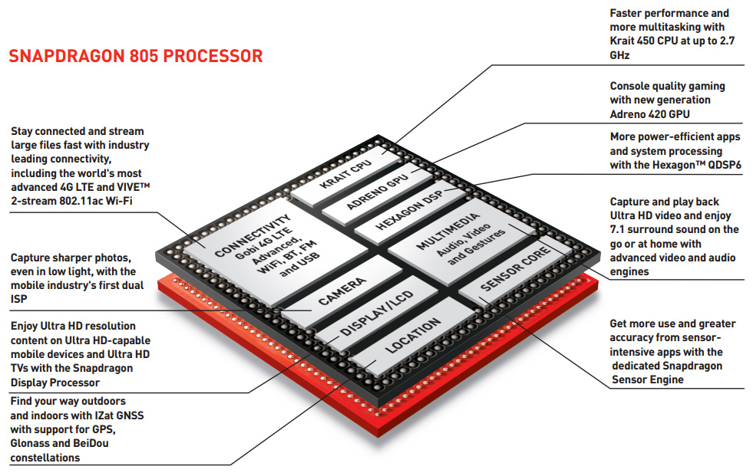
c/o Qualcomm

Slide 21
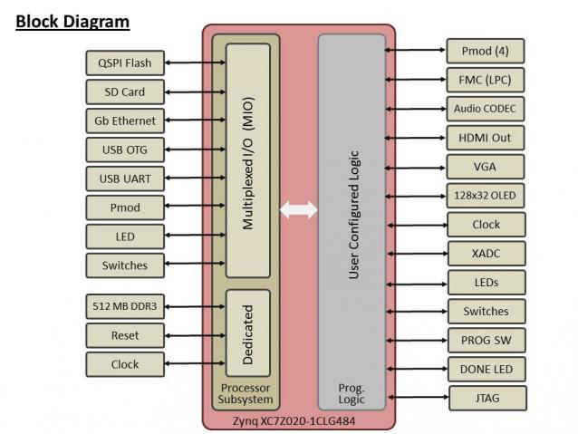
Our lowly Zedboard FPGA

Slide 22
Cerebras: Wafer-Scale Engine
giant 8.5” square chip!
full of deep learning accelerators
18GB on-chip memory
9 PB/sec on-chip memory bandwidth
TSMC 16nm transistors

Slide 23
Technology Disruptions
Classic examples:
The transistor
Microprocessor
More recent examples:
Flash-based solid-state storage
Accelerators
Nascent disruptive technologies:
non-volatile memory (“disks” as fast as DRAM)
Chip stacking (also called 3D die stacking)
Disruptive “end-of-scaling”
“If something can’t go on forever, it must stop eventually”
Transistor speed/energy efficiency not improving like before

Slide 24
Themes
Parallelism
How do we enhance system performance by doing multiple things at once.
This happens at multiple levels: Instruction Level Parallelism, multicore, GPU
How do we accelerate access to data
Exploiting locality of reference, building storage hierarchies and caches
Try to provide the illusion of a single large, fast memory

