Slide 1
Transistors & Fabrication

Slide 2
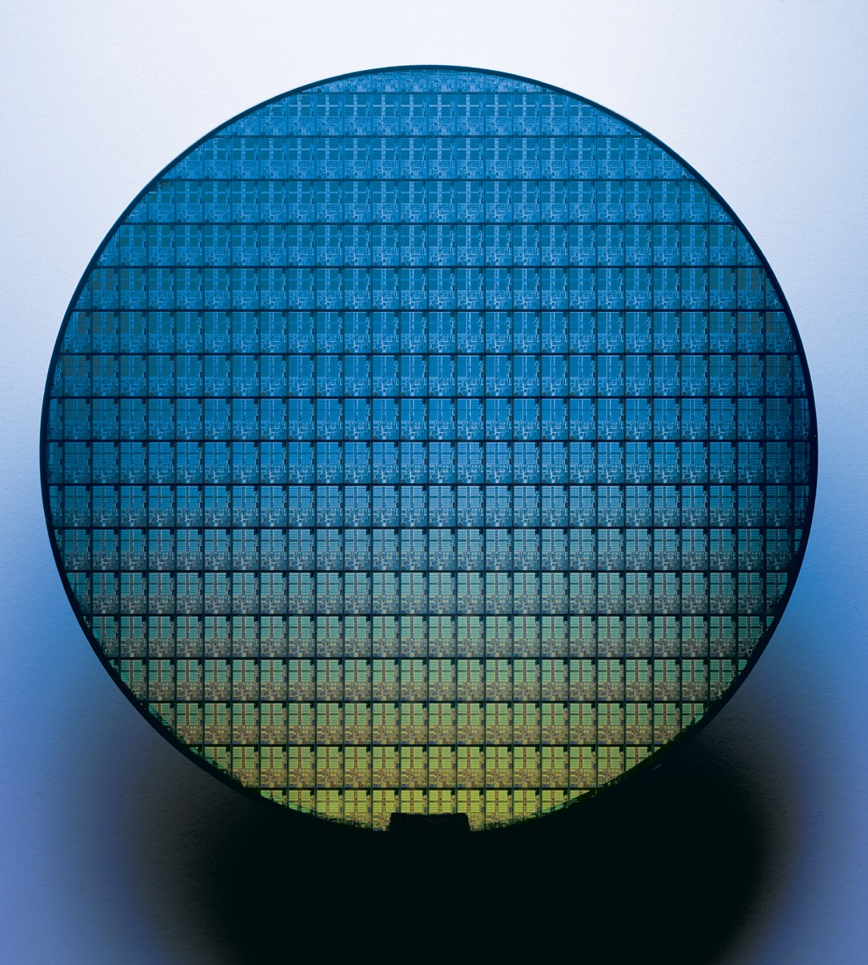
Intel Pentium M Wafer

Slide 3
Semiconductor Technology
gate
gate
insulator
channel
source
drain
source
drain
Substrate
channel
Basic technology element: MOSFET
Solid-state component acts like electrical switch
MOS: metal-oxide-semiconductor
Conductor, insulator, semi-conductor
FET: field-effect transistor
Channel conducts source→drain only when voltage applied to gate
Channel length: characteristic parameter (short → fast)
Aka “feature size” or “technology”
Currently: 0.007 micron (μm), 7 nanometers (nm)
Continued miniaturization (scaling) known as “Moore’s Law”
Won’t last forever, physical limits approaching (or are they?)

Slide 4
Complementary MOS (CMOS)
Voltages as values
Power (V_{DD}) = “1”, Ground = “0”
Two kinds of MOSFETs
N-transistors
Conduct when gate voltage is 1
Good at passing 0s
P-transistors
Conduct when gate voltage is 0
Good at passing 1s
CMOS
Complementary n-/p- networks form boolean logic (i.e., gates)
And some non-gate elements too (important example: RAMs)
power (1)
p-transistor
input
output
(“node”)
n-transistor
ground (0)

Slide 5
Basic CMOS Logic Gate
Inverter: NOT gate
One p-transistor, one n-transistor
Basic operation
Input = 0
P-transistor closed, n-transistor open
Power charges output (1)
Input = 1
P-transistor open, n-transistor closed
Output discharges to ground (0)
0
1
1
0

Slide 6
Another CMOS Gate Example
What is this? Look at truth table
0, 0 → 1
0, 1 → 1
1, 0 → 1
1, 1 → 0
Result: NAND (NOT AND)
NAND is “universal”
What function is this?
A
B
output
A
B
A
B
output
A
B
Notes:
NOR – Not Or

Slide 7
Digital Building Blocks: Logic Gates
Logic gates: implement Boolean functions
Basic gates: NOT, NAND, NOR
Underlying CMOS transistors are naturally inverting ( = NOT)
NAND, NOR are “Boolean complete”
NOT (Inverter)
NAND
NOR
A’
A
A
A
(AB)’
(A+B)’
B
B
BUF
AND
OR
A
A
A+B
A
A
AB
B
B
AND3
ANDNOT
XOR
A
A
A
B
AB’
AB’+A’B
(A^B)
B
B
C

Slide 8
Digital Logic Review

Slide 9
Boolean Functions and Truth Tables
Any Boolean function can be represented as a truth table
Truth table: point-wise input → output mapping
Function is disjunction of all rows in which “Out” is 1
A,B,C → Out
0,0,0 → 0
0,0,1 → 0
0,1,0 → 0
0,1,1 → 0
1,0,0 → 0
1,0,1 → 1
1,1,0 → 1
1,1,1 → 1
Example above: Out = AB’C + ABC’ + ABC
Notes:
We will return to this when we talk about CLBs in FPGAs

Slide 10
Truth Tables and PLAs
Implement Boolean function by implementing its truth table
Takes two levels of logic
Assumes inputs and inverses of inputs are available (usually are)
First level: ANDs (product terms)
Second level: ORs (sums of product terms)
PLA (programmable logic array)
Flexible circuit for doing this

Slide 11
PLA Example
PLA with 3 inputs, 2 outputs, and 4 product terms
Out0 = AB’C + ABC’ + ABC
A
Permanent connections
B
C
Programmable connections (unconnected)
Out0
Out1
Notes:
One implementation with a programmable interconnect.

Slide 12
Boolean Algebra
Boolean Algebra: rules for rewriting Boolean functions
Useful for simplifying Boolean functions
Simplifying = reducing gate count, reducing gate “levels”
Rules: similar to logic (0/1 = F/T)
Identity: A1 = A, A+0 = A
0/1: A0 = 0, A+1 = 1
Inverses: (A’)’ = A
Idempotency: AA = A, A+A = A
Tautology: AA’ = 0, A+A’ = 1
Commutativity: AB = BA, A+B = B+A
Associativity: A(BC) = (AB)C, A+(B+C) = (A+B)+C
Distributivity: A(B+C) = AB+AC, A+(BC) = (A+B)(A+C)
DeMorgan’s: (AB)’ = A’+B’, (A+B)’ = A’B’

Slide 13
Logic Minimization
Logic minimization
Iterative application of rules to reduce function to simplest form
Design tools do this automatically
Out = AB’C + ABC’ + ABC
Out = A(B’C + BC’ + BC) // distributivity
Out = A(B’C + (BC’ + BC)) // associativity
Out = A(B’C + B(C’+C)) // distributivity (on B)
Out = A(B’C + B1) // tautology
Out = A(B’C + B) // 0/1
Out = A((B’+B)(C+B)) // distributivity (on +B)
Out = A(1(B+C)) // tautology
Out = A(B+C) // 0/1

Slide 14
Non-Arbitrary Boolean Functions
PLAs implement Boolean functions point-wise
E.g., represent f(X) = X+5 as [0→5, 1→6, 2→7, 3→8, …]
Mainly useful for “arbitrary” functions, no compact representation
Many useful Boolean functions are not arbitrary
Have a compact implementation
Examples
Multiplexer
Adder

Slide 15
Multiplexer (Mux)
Multiplexer (mux): selects output from N inputs
Example: 1-bit 4-to-1 mux
Not shown: N-bit 4-to-1 mux = N 1-bit 4-to-1 muxes + 1 decoder
S (binary)
S (1-hot)
S (binary)
A
A
B
O
B
O
C
D
C
D

Slide 16
Adder
Adder: adds/subtracts two binary integers in two’s complement format
Half adder: adds two 1-bit “integers”, no carry-in
Full adder: adds three 1-bit “integers”, includes carry-in
Ripple-carry adder: N chained full adders add 2 N-bit integers
To subtract: negate B input, set bit 0 carry-in to 1

Slide 17
Full Adder
What is the logic for a full adder?
Look at truth table
CI A B → C0 S
0 0 0 → 0 0
0 0 1 → 0 1
0 1 0 → 0 1
0 1 1 → 1 0
1 0 0 → 0 1
1 0 1 → 1 0
1 1 0 → 1 0
1 1 1 → 1 1
S = C’A’B + C’AB’ + CA’B’ + CAB = C ^ A ^ B
CO = C’AB + CA’B + CAB’ + CAB = CA + CB + AB
CI
S
CI
A
A
S
B
FA
B
CO
CO

Slide 18
N-bit Adder/Subtracter
0
1
A₀
FA
S₀
B₀
A₁
FA
S₁
A
+/-
S
B₁
B
+/–
…
A_{N-1}
FA
S_{N-1}
B_{N-1}
+/–
More later when we cover arithmetic

Slide 19
FPGAs

Slide 20
Alternative to Fabrication: FPGA
We’ll use FPGAs (Field Programmable Gate Array)
Also called Programmable Logic Devices (PLDs)
An FPGA is a special type of programmable chip
Conceptually, contains a grid of gates
The wiring connecting them can be reconfigured electrically
Using more transistors as switches
Once configured, the FPGA can emulate any digital logic design
Tool converts gate-level design to configuration
Uses
Hardware prototyping (what “we” are doing)
Low-volume special-purpose hardware
Network processing. FPGAs in AWS, Azure Clouds

Slide 21
FPGA
A Field Programmable Gate Array contains a collection of configurable logic elements and a programmable interconnect that can be set up to perform the desired logical operations.

Slide 22
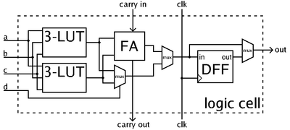
Configurable Logic Blocks
Each of the configurable logic blocks (or logic cells) contains some lookup tables and one or more flip-flops.
By setting the entries in the lookup tables (LUTs) these units can be programmed to implement arbitrary logical functions on their inputs.
http://en.wikipedia.org/wiki/Field-programmable_gate_array
ZedBoard has 85K logic cells
Notes:
walkthrough LUT-as-gate

Slide 23
Configuring FPGAs
By configuring the CLBs and the interconnect the FPGA can be ‘programmed’ to implement the desired operation.

Slide 24
Hardware Design Methods

Slide 25
Hardware Design Methodologies
Fabricating a chip requires a detailed layout
All transistors & wires
How does a hardware designer describe such design?
(Bad) Option #1: draw all the masks “by hand”
All 1 billion transistors? Umm…
Option #2: use computer-aided design (CAD) tools to help
Layout done by engineers with CAD tools or automatically
Design levels – uses abstraction
Transistor-level design – designer specifies transistors (not layout)
Gate-level design – designer specifics gates, wires (not transistors)
Higher-level design – designer uses higher-level building blocks
Adders, memories, etc.
Or logic in terms of and/or/not, and tools translates into gates

Slide 26
Describing Hardware
Two general options
Schematics
Pictures of gates & wires
Hardware description languages
Use textual descriptions to specify hardware
Translation process called “synthesis”
Textual description -> gates -> full layout
Tries to minimizes the delay and/or number of gates
Much like process of compilation of software
Much slower!

Slide 27
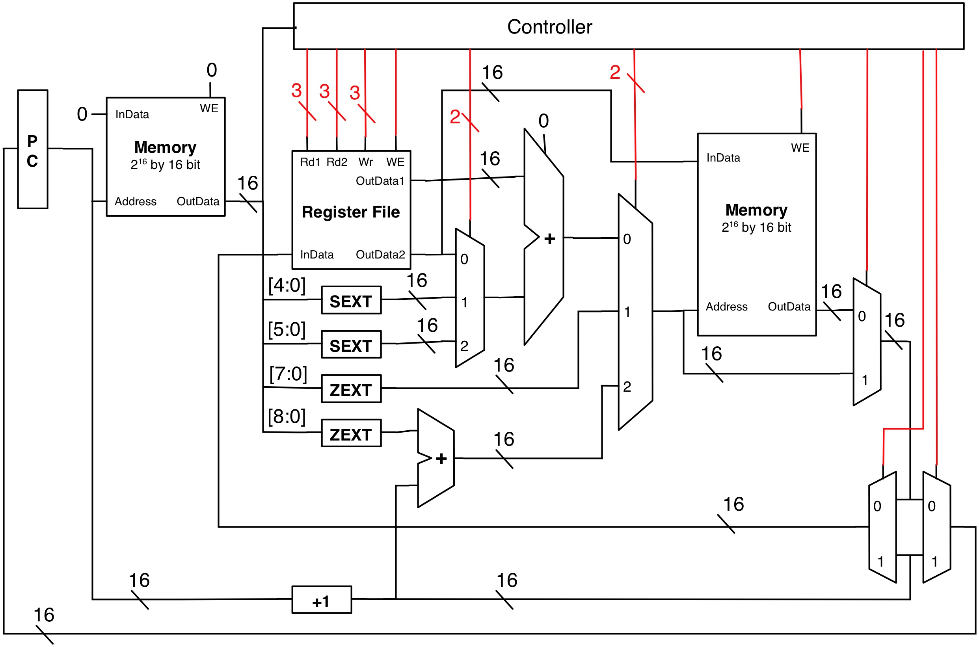
Schematics
S
A
O
B
Draw pictures
Use a schematic entry program to draw wires, logic blocks, gates
Support hierarchical design (arbitrary nesting)
Good match for hardware which is inherently spatial
Time consuming, “non-scalable” (large designs are unreadable)
Rarely used in practice (“real-world” designs are too big)

Slide 28
Hardware Description Languages (HDLs)
Write “code” to describe hardware
HDL vs. SDL
Specify wires, gates, modules (also hierarchical)
Easier to create, edit, modify, scales well
Misleading “sequential” representation: must still “think” spatially (gets easier with practice)
module mux2to1(S, A, B, Out);
input S, A, B;
output Out;
wire S_, AnS_, BnS;
not (S_, S);
and (AnS_, A, S_);
and (BnS, B, S);
or (Out, AnS_, BnS);
endmodule
S
A
Out
B

Slide 29
(Hierarchical) HDL Example
Build up more complex modules using simpler modules
Example: 4-bit wide mux from four 1-bit muxes
S
4
module mux2to1_4(S, A, B, Out);
input [3:0] A;
input [3:0] B;
input S;
output [3:0] Out;
mux2to1 mux0 (S, A[0], B[0], Out[0]);
mux2to1 mux1 (S, A[1], B[1], Out[1]);
mux2to1 mux2 (S, A[2], B[2], Out[2]);
mux2to1 mux3 (S, A[3], B[3], Out[3]);
endmodule
4
A
4
Out
B
Notes:
Key point – abstraction of designs.

Slide 30
Verilog HDL
Verilog: HDL we will be using
Syntactically similar to C (by design)
Ease of syntax hides fact that this isn’t C (or any software lang)
We will use a few lectures to learn Verilog
module mux2to1_4(S, A, B, Out);
input [3:0] A;
input [3:0] B;
input S;
output [3:0] Out;
mux2to1 mux0 (S, A[0], B[0], Out[0]);
mux2to1 mux1 (S, A[1], B[1], Out[1]);
mux2to1 mux2 (S, A[2], B[2], Out[2]);
mux2to1 mux3 (S, A[3], B[3], Out[3]);
endmodule
These aren’t variables
These aren’t function calls

Slide 31
HDLs are not “SDLs”
SDL == Software Description Language (e.g., Java, C)
Similar in some (intentional) ways …
Syntax
Named entities, constants, scoping, etc.
Tool chain: synthesis tool analogous to compiler
Multiple levels of representation
“Optimization”
Multiple targets (portability)
“Software” engineering
Modular structure and parameterization
Libraries and code repositories
… but different in many others
One of the most difficult conceptual leaps of this course

Slide 32
Hardware is not Software
Just two different beasts (or two parts of the same beast)
Things that make sense in hardware, don’t in software, vice versa
One of the main themes of this course
Software is sequential
Hardware is inherently parallel and “always on”
Have to work to get hardware to not do things in parallel
Software atoms are purely functional (“digital”)
Hardware atoms have quantitative (“analog”) properties too
Including correctness properties!
Software mostly about quality (“functionality”)
Hardware mostly about quantity: performance, area, power, etc.
One reason that HDLs are not SDLs
Notes:
Tip write Verilog but think in terms of schematics.

Slide 33
HDL: Behavioral Constructs
HDLs have low-level structural constructs
Specify hardware structures directly
Transistors, gates (and, not) and wires, hierarchy via modules
Also have mid-level behavioral constructs
Specify operations, not hardware to perform them
Low-to-medium-level: &, ~, +, *
Also higher-level behavioral constructs
High-level: if-then-else, for loops
Some of these are synthesizable (some are not)
Tools try to guess what you want, often highly inefficient
Higher-level → more difficult to know what it will synthesize to!
HDLs are both high- and low-level languages in one!
And the boundary is not clear!

Slide 34
HDL: Simulation
Another use of HDL: simulating & testing a hardware design
Cheaper & faster turnaround (no need to fabricate)
More visibility into design (“debugger” interface)
HDLs have features just for simulation
Higher level data types: integers, FP-numbers, timestamps
Routines for I/O: error messages, file operations
Obviously, these cannot be synthesized into circuits
Also another reason for HDL/SDL confusion
HDLs have “SDL” features for simulation
Notes:
Verilog actually designed to support simulation more than synthesis – idea was you would come up with a design and then in the same language write code for testing the design hence a lot of constructs for doing looping and input output that are not related to hardware layout cannot be synthesized.

Slide 35
FPGA “Design Flow”
netlist (wires, gates, FFs)
implementation (place & route)
HDL source code
bitstream
synthesis
simulation
Hardware compilers are generally much slower than their software counterparts
solving hard problems: many more choices, optimizing for area, power, picosecond-level timing

Slide 36
Side note: High-Level Synthesis
Translate “C to gates”
write hardware at a higher level of abstraction than conventional HDLs
greater programmer productivity
need to write stylized C that will synthesize well
tools are still slow
take ESE 532 to learn (much!) more

