Slide 1
CIS 501: Computer Architecture
Unit 5: Performance & Benchmarking
Slides developed by Joe Devietti, Milo Martin & Amir Roth at Upenn
with sources that included University of Wisconsin slides by Mark Hill, Guri Sohi, Jim Smith, and David Wood

Slide 2
This Unit
Metrics
CPU Performance
Comparing Performance
Benchmarks
Performance Laws

Slide 3
Performance Metrics

Slide 4
Performance: Latency vs. Throughput
Latency (execution time): time to finish a fixed task
Throughput (bandwidth): number of tasks per unit time
Different: exploit parallelism for throughput, not latency (e.g., bread)
Often contradictory (latency vs. throughput)
Will see many examples of this
Choose definition of performance that matches your goals
Scientific program? latency. web server? throughput.
Example: move people 10 miles
Car: capacity = 5, speed = 60 miles/hour
Bus: capacity = 60, speed = 20 miles/hour
Latency: car = 10 min, bus = 30 min
Throughput: car = 15 PPH (count return trip), bus = 60 PPH
Fastest way to send 10TB of data? (1+ gbits/second)
Notes:
Answer: Used FedEx overnight to deliver the drive. 10 TB in, say, 15 hours is 1,300 mbits/second of bandwidth (600 GB/hour)

Slide 5
CPU Performance

Slide 6
Frequency as a performance metric
1 Hertz = 1 cycle per second 1 Ghz is 1 cycle per nanosecond, 1 Ghz = 1000 Mhz
(Micro-)architects often ignore dynamic instruction count…
… but general public (mostly) also ignores CPI
and instead equate clock frequency with performance!
Which processor would you buy?
Processor A: CPI = 2, clock = 5 GHz
Processor B: CPI = 1, clock = 3 GHz
Probably A, but B is faster (assuming same ISA/compiler)
Classic example
Core i7 faster clock-per-clock than Core 2
Same ISA and compiler!
partial performance metrics are dangerous!

Slide 7
MIPS (performance metric, not the ISA)
(Micro) architects often ignore dynamic instruction count
Typically work in one ISA/one compiler → treat it as fixed
CPU performance equation becomes
Latency: seconds / insn = (cycles / insn) * (seconds / cycle)
Throughput: insn / second = (insn / cycle) * (cycles / second)
MIPS (millions of instructions per second)
Cycles / second: clock frequency (in MHz)
Example: CPI = 2, clock = 500 MHz → 0.5 * 500 MHz = 250 MIPS
Pitfall: may vary inversely with actual performance
Compiler removes insns, program gets faster, MIPS goes down
Work per instruction varies (e.g., multiply vs. add, FP vs. integer)
Notes:
- Ie RISC vs CISC ins

Slide 8
Cycles per Instruction (CPI)
CPI: Cycle/instruction on average
IPC = 1/CPI
Used more frequently than CPI
Favored because “bigger is better”, but harder to compute with
Different instructions have different cycle costs
E.g., “add” typically takes 1 cycle, “divide” takes >10 cycles
Depends on relative instruction frequencies
CPI example
A program executes equal: integer, floating point (FP), memory ops
Cycles per instruction type: integer = 1, memory = 2, FP = 3
What is the CPI? (33% * 1) + (33% * 2) + (33% * 3) = 2
Caveat: this sort of calculation ignores many effects
Back-of-the-envelope arguments only
Notes:
Q: what’s something that this CPI calc ignores?

Slide 9
CPI Example
Assume a processor with instruction frequencies and costs
Integer ALU: 50%, 1 cycle
Load: 20%, 5 cycle
Store: 10%, 1 cycle
Branch: 20%, 2 cycle
Which change would improve performance more?
A. “Branch prediction” to reduce branch cost to 1 cycle?
B. Faster data memory to reduce load cost to 3 cycles?
Compute CPI
Base = 0.5*1 + 0.2*5 + 0.1*1 + 0.2*2 = 2 CPI
Notes:
A = 0.5*1 + 0.2*5 + 0.1*1+ 0.2*1 = 1.8 CPI
B = 0.5*1 + 0.2*3 + 0.1*1 + 0.2*2 = 1.6 CPI
A is 1.11x faster than base
B is 1.25x faster than base

Slide 10
Measuring CPI
How are CPI and execution-time actually measured?
Execution time? stopwatch timer (Unix “time” command)
CPI = (CPU time * clock frequency) / dynamic insn count
How is dynamic instruction count measured?
More useful is CPI breakdown (CPI_{CPU}, CPI_{MEM}, etc.)
So we know what performance problems are and what to fix
Hardware event counters
Available in most processors today
One way to measure dynamic instruction count
Calculate CPI using counter frequencies / known event costs
Cycle-level micro-architecture simulation
Measure exactly what you want … and impact of potential fixes!
Method of choice for many micro-architects

Slide 11
Comparing Performance

Slide 12
Comparing Performance - Speedup
Speedup of A over B
X = Latency(B)/Latency(A) (divide by the faster)
X = Throughput(A)/Throughput(B) (divide by the slower)
A is X% faster than B if
X = ((Latency(B)/Latency(A)) – 1) * 100
X = ((Throughput(A)/Throughput(B)) – 1) * 100
Latency(A) = Latency(B) / (1+(X/100))
Throughput(A) = Throughput(B) * (1+(X/100))
Car/bus example
Latency? Car is 3 times (and 200%) faster than bus
Throughput? Bus is 4 times (and 300%) faster than car

Slide 13
Speedup and % Increase and Decrease
Program A runs for 200 cycles
Program B runs for 350 cycles
Percent increase and decrease are not the same.
% increase: ((350 – 200)/200) * 100 = 75%
% decrease: ((350 - 200)/350) * 100 = 42.3%
Speedup:
350/200 = 1.75 – Program A is 1.75x faster than program B
As a percentage: (1.75 – 1) * 100 = 75%
If program C is 1x faster than A, how many cycles does C run for? – 200 (the same as A)
What if C is 1.5x faster? 133 cycles (50% faster than A)

Slide 14
Mean (Average) Performance Numbers
Arithmetic: (1/N) * ∑_{P=1..N} P_latency
For units that are proportional to time (e.g., latency)
Harmonic: N / ∑_{P=1..N} 1/P_throughput
For units that are inversely proportional to time (e.g., throughput)
You can add latencies, but not throughputs
Latency(P1+P2,A) = Latency(P1,A) + Latency(P2,A)
Throughput(P1+P2,A) != Throughput(P1,A) + Throughput(P2,A)
1 mile @ 30 miles/hour + 1 mile @ 90 miles/hour
Average is not 60 miles/hour
Geometric: ^{N}√∏_{P=1..N} P_speedup
For unitless quantities (e.g., speedup ratios)

Slide 15
For Example…
You drive two miles
30 miles per hour for the first mile
90 miles per hour for the second mile
Question: what was your average speed?
Hint: the answer is not 60 miles per hour
Why?

Slide 16
Answer
You drive two miles
30 miles per hour for the first mile
90 miles per hour for the second mile
Question: what was your average speed?
Hint: the answer is not 60 miles per hour
0.03333 hours per mile for 1 mile
0.01111 hours per mile for 1 mile
0.02222 hours per mile on average
= 45 miles per hour
Notes:
Q: avg if we drove 30mph for 1 hour and 60mph for 1 hour?

Slide 17
Measurement Challenges

Slide 18
Measurement Challenges
Are –O3 compiler optimizations really faster than –O0?
Why might they not be?
other processes running
not enough runs
not using a high-resolution timer
cold-start effects
managed languages: JIT/GC/VM startup
solution: experiment design + statistics

Slide 19
Experiment Design
Two kinds of errors: systematic and random
removing systematic error
aka “measurement bias” or “not measuring what you think you are”
Run on an unloaded system
Measure something that runs for at least several seconds
Understand the system being measured
simple empty-for-loop test => compiler optimizes it away
Vary experimental setup
Use appropriate statistics
removing random error
Perform many runs: how many is enough?
Notes:
what problems does HW2 data collection have?

Slide 20
Determining performance differences
Program runs in 20s on machine A, 20.1s on machine B
Is this a meaningful difference?
the distribution matters!
count
execution time
Notes:
We can ask about average perf, 90% perf, etc.

Slide 21
Confidence Intervals
Compute mean and confidence interval (CI)
Meaning of the 95% confidence interval x ± 1.3
collected 1 sample with n experiments
given repeated sampling, x will be within 1.3 of the true mean 95% of the time
If CIs overlap, differences not statistically significant
t = critical value from t-distribution
s = sample standard error
n = # experiments in sample
Notes:
t depends on CI level

Slide 22
CI example
setup
130 experiments, mean = 45.4s, stderr = 10.1s
What’s the 95% CI?
t = 1.962 (depends on %CI and # experiments)
look it up in a stats textbook or online
at 95% CI, performance is 45.4 ±1.74 seconds
What if we want a smaller CI?

Slide 23
Benchmarking
Notes:
metrics, stats, now need workloads

Slide 24
Processor Performance and Workloads
Q: what does performance of a chip mean?
A: nothing, there must be some associated workload
Workload: set of tasks someone (you) cares about
Benchmarks: standard workloads
Used to compare performance across machines
Either are, or highly representative of, actual programs people run
Micro-benchmarks: non-standard non-workloads
Tiny programs used to isolate certain aspects of performance
Not representative of complex behaviors of real applications
Examples: binary tree search, towers-of-hanoi, 8-queens, etc.
Notes:
-mention different workloads used for different purposes

Slide 25
Example: SPECmark 2006/2017
performance wrt reference machine
Latency SPECmark
For each benchmark
Take odd number of samples
Choose median
Take speedup (reference machine / your machine)
Take “average” (Geometric mean) of speedups over all benchmarks
Throughput SPECmark
Run multiple benchmarks in parallel on multiple-processor system
Notes:
Q: how does this account for run-to-run variability?

Slide 26
Example: GeekBench
Set of cross-platform multicore benchmarks
Can run on iPhone, Android, laptop, desktop, etc
Tests integer, floating point, memory bandwidth performance
GeekBench stores all results online
Easy to check scores for many different systems, processors
Pitfall: Workloads are simple, may not be a completely accurate representation of performance
We know they evaluate compared to a baseline benchmark
Notes:
geekbench workloads: GEMM, FFT, encryption, file/image (de)compress

Slide 27
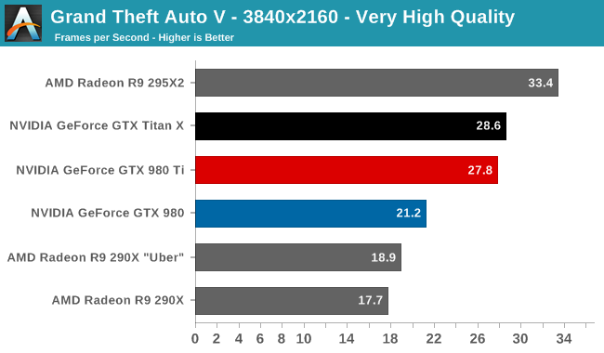
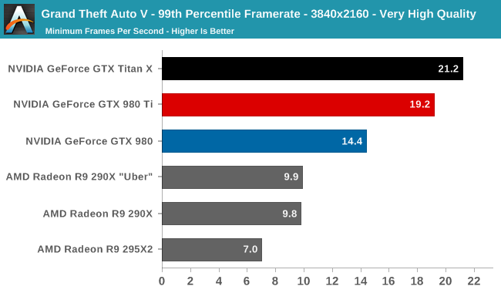
Example: GTA V
http://www.anandtech.com/show/9306/the-nvidia-geforce-gtx-980-ti-review
Notes:
GTA V measures latency percentiles internally
sometimes, worst-case latency matters
google experiment: increase latency by 0.5s, 20% reduction in traffic/revenue
http://glinden.blogspot.com/2006/11/marissa-mayer-at-web-20.html

Slide 28
Performance Laws

Slide 29
Amdahl’s Law
How much will an optimization improve performance?
P = proportion of running time affected by optimization
S = speedup
What if I speedup 25% of a program’s execution by 2x?
1.14x speedup
What if I speedup 25% of a program’s execution by ∞?
1.33x speedup
Notes:
1-P is the runtime of unoptimized part
P/S is runtime of optimized part

Slide 30
Amdahl’s Law for the US Budget
https://www.whitehouse.gov/omb/historical-tables/
scrapping Dept of Education ($111B) cuts budget by 2.7%
Notes:
HHS includes Medicare/Medicaid
even Defense is ~13.5%

Slide 31
Amdahl’s Law for Parallelization
How much will parallelization improve performance?
P = proportion of parallel code
N = threads
What is the max speedup for a program that’s 10% serial?
What about 1% serial?
Notes:
10% serial – 10x
1% serial – 100x

Slide 32
Increasing proportion of parallel code
Amdahl’s Law requires extremely parallel code to take advantage of large multiprocessors
two approaches:
strong scaling: shrink the serial component
same problem runs faster
becomes harder and harder to do
weak scaling: increase the problem size
natural in many problem domains: internet systems, scientific computing, video games
doesn’t work in other domains

Slide 33

Use Little’s Law!
How long am I going to be in this line?

Slide 34
Little’s Law
L = λW
L = items in the system
λ = average arrival rate
W = average wait time
Assumption:
system is in steady state, i.e., average arrival rate = average departure rate
No assumptions about:
arrival/departure/wait time distribution or service order (FIFO, LIFO, etc.)
Works on any queuing system
Works on systems of systems

Slide 35
Little’s Law for Computing Systems
Only need to measure two of L, λ and W
often difficult to measure L directly
Describes how to meet performance requirements
e.g., to get high throughput (λ), we need either:
low latency per request (small W)
service requests in parallel (large L)
Addresses many computer performance questions
sizing queue of L1, L2, L3 misses
sizing queue of outstanding network requests for 1 machine
or the whole datacenter
calculating average latency for a design

Slide 36
Performance Rules of Thumb
Design for actual performance, not peak performance
Peak performance: “Performance you are guaranteed not to exceed”
Greater than “actual” or “average” or “sustained” performance
Why? Caches misses, branch mispredictions, limited ILP, etc.
For actual performance X, machine capability must be > X
Easier to “buy” bandwidth than latency
say we want to transport more cargo via train:
(1) build another track or (2) make a train that goes twice as fast?
Use bandwidth to reduce latency
Build a balanced system
Don’t over-optimize 1% to the detriment of other 99%
System performance often determined by slowest component
Notes:
System performance determined by “worst mistake” not by making everything perfect
- Build another track

Slide 37
Measuring LC-4 Processor Performance
Notes:
- Possibly move benchmarks before

Slide 38
Benchmarking the LC-4 processors
Fixed workload: wireframe trace
Focus on improving frequency with pipelining
measure frequency with Vivado timing reports
Focus on improving IPC with superscalar
see how many cycles the wireframe trace takes
Notes:
show results from Vivado timing report

Slide 39
Summary
Latency = seconds / program =
(instructions / program) * (cycles / instruction) * (seconds / cycle)
Instructions / program: dynamic instruction count
Function of program, compiler, instruction set architecture (ISA)
Cycles / instruction: CPI
Function of program, compiler, ISA, micro-architecture
Seconds / cycle: clock period
Function of micro-architecture, technology parameters
Optimize each component
this class focuses mostly on CPI (caches, parallelism)
…but some on dynamic instruction count (compiler, ISA)
…and some on clock frequency (pipelining, technology)

