Slide 1
17. Cache organization: The basics

Slide 2
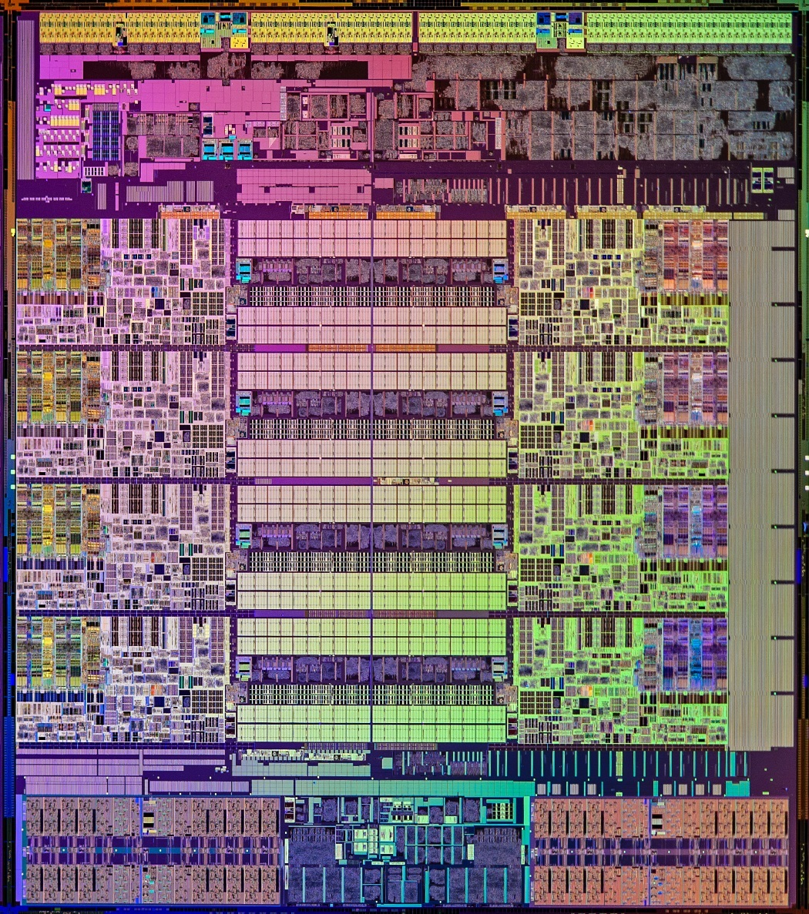
Today’s Lecture: Cache Organization Basics
Caches consume most of a processor’s die area
Cache

Slide 3
Cache Aware vs Non-Aware Code
Notes:
Time: 2.7 seconds vs 16.4 seconds

Slide 4
Memory
So far, we have discussed two structures that hold data:
Register file (little array of words)
Memory (bigger array of words)
We have discussed several methods of implementing storage devices:
Static memory (made with logic gates)
Dynamic memory (transistor and capacitor)
ROM, and other ROM-like storage, e.g., flash (floating gate transistors)
4

Slide 5
Memory Hierarchy
We want a lot of memory
LC2 can handle 2¹⁸ bytes of memory
MIPS can handle 2³² bytes of memory
Athlon-64 or EM64T can handle 2⁶⁴ bytes of memory
What are our choices?
SRAM, DRAM, ROM, Flash, disk, tape, optical disk?

Slide 6
Option 1: SRAM
Fast: ~2ns access time or faster
Decoders are big
Array is big
Why?
Expensive, high area requirement
SRAM: ~$5.0 per megabyte
$0.13 for LC2
$20,000 for MIPS
$88,000,000,000,000 for Athlon-64

Slide 7
Option 2: DRAM
Slower: ~60ns access time
Must stall for dozens of cycles on each memory load
Less expensive than SRAM.
DRAM costs ~$0.004 per megabyte
$0.00 for LC2
$16for MIPS/Pentium-IV/Athlon-XP
$70,000,000,000 for Alpha/G5/x86_64

Slide 8
Option 3: Disks
Obnoxiously slow: 3,000,000ns access time
We could have stopped with the Intel 4004
Cheap
Disk storage costs $0.000043 per megabyte
$0.00 LC2
$0.18 for MIPS
$760,000,000 for Athlon-64
Non-volatile

Slide 9
Memory Hierarchy Goals
Fast: Ideally run at processor clock speed
1 ns access
Cheap: Ideally free
Not more expensive than rest of system
Options DRAM, flash, disks are too slow
Option SRAM is too expensive
How to get best properties of multiple memory technologies?

Slide 10
Memory Hierarchy Goals
move what you use here
fast
small
With good locality of reference, memory appears as fast as
and as large as
faster per byte
cheaper per byte
backup
everything
here
big but slow

Slide 11
Memory Hierarchy
Use a small array of SRAM
Small so fast and cheap
For the cache (hopefully covers most loads and stores)
Use a larger amount of DRAM
Cheaper than SRAM, faster than flash/disk
For the main memory
Use a lot of flash and/or disk
Non-volatile. Cheap. Big
For Virtual memory
Don’t try to buy 2⁶⁴ bytes of anything
Use “virtual memory” to make it look like the entire address range is available
A few TB is enough for most desktop machines today, or a smartphone in a few years

Slide 12
Memory hierarchy
Cache
(SRAM)
Cost
Latency
Main memory
(DRAM)
Disk
(magnetic or floating gate)
12

Slide 13
Function of the Cache
The cache will hold the data that we think is most likely to be referenced
Because we want to maximize the number of references that are serviced by the cache to minimize the average memory access latency
How do we decide what the most likely accessed memory locations are?

Slide 14
Hardware Background
Content Addressable Memory（内容寻址存储器）
Unlike regular memory, where we insert an index (or address) and it gives us data…
For a CAM, we insert data and get an index (or a bit saying it's not in there)

Slide 15
CAM example
101101101
101101000
111101101
100101111
111101101
Found location 3
110001101
5 storage element CAM array of 9 bits each

Slide 16
Operations on CAMs
Search: the primary way to access a CAM
Send data to CAM memory
Return “found” or “not found”
If found, return location of where it was found or associated value
Write:
Send data for CAM to remember
Where should it be stored if CAM is full?
Replacement policy
Replace oldest data in the CAM
Replace least recently searched data

Slide 17
Previous use of CAMs
You have seen a simple CAM used before. When?

Slide 18
Fetch Stage with Branch Prediction
Direction predictor (2-bit counters)
taken?
PC + inst size
Next Fetch
Address
Program
Counter
hit?
Address of the
current branch
target address
Cache of Target Addresses (BTB: Branch Target Buffer)

Slide 19
Basic Cache Design
Cache memory can copy data from any part of main memory. It has 2 parts:
The TAG (CAM) holds the memory address
The BLOCK (SRAM) holds the memory data
Accessing the cache: compare reference address and tag
Match? Get the data from the cache block
No Match? Get the data from main memory
addr
data
addr
data
TAG BLOCK

Slide 20
Cache Organization
addr
data
addr
data
TAG BLOCK
A cache memory consists of multiple tag/block pairs (called cache lines)
Searches can be done in parallel (within reason)
At most one tag will match
If there is a tag match, it is a cache HIT
If there is no tag match, it is a cache MISS
Our goal is to keep the data we think will be accessed in the near future in the cache

Slide 21
Caches: the hardware view
TAG BLOCK
A hit in the cache
A miss in the cache
0x8060c000
0x0040a0c0
0x0345b480
0x04563900
150
0
-355
450
0
search result
01
0x0040a0c0
From the µp
To the µp
CAM SRAM
TAG BLOCK
0x8060c000
0x0040a0c0
0x0345b480
0x04563900
150
0
-355
450
0x0050a0c0
search result
Not found
0x0050a0c0
From the µp
To the main memory
CAM SRAM

Slide 22
Cache Operation
Every cache miss will get the data from memory and ALLOCATE a cache line to put the data in
Just like any CAM write
Which line should be allocated?
Random? OK, but hard to grade test questions
Better than random? How?

Slide 23
Something To Think About
Does an optimal replacement policy exist?
That is, given a choice of cache lines to replace, which one will result in the fewest total misses during program execution
Hint: a crystal ball will come in handy in solving this problem…
Why would we care?

Slide 24
Picking the Most Likely Addresses
What is the probability of accessing a random memory location?
With no information, it is just as likely as any other address
But programs are not random
They tend to use the same memory locations over and over
We can use this to pick the most referenced locations to put into the cache

Slide 25
Temporal Locality
The principle of temporal locality in program references says that if you access a memory location (e.g., 1000) you will be more likely to re-access that location than you will be to reference some other random location
Temporal locality says any miss data should be placed into the cache
It is the most recent reference location
Temporal locality says that the least recently referenced (or least recently used – LRU ) cache line should be evicted to make room for the new line
Because the re-access probability falls over time as a cache line isn’t referenced, the LRU line is least likely to be re-referenced

Slide 26
A Very Simple Memory System
Processor
Cache
Memory
2 cache lines
4 bit tag field
1 byte block
0
1
2
3
4
5
6
7
8
9
10
11
12
13
14
15
74
110
120
Ld R1 ← M[ 1 ]
Ld R2 ← M[ 5 ]
Ld R3 ← M[ 1 ]
Ld R3 ← M[ 7 ]
Ld R2 ← M[ 7 ]
130
140
V
150
V
160
tag data
170
180
190
200
R0
R1
R2
R3
210
220
230
240
250

Slide 27
A Very Simple Memory System
Processor
Cache
Memory
0
1
2
3
4
5
6
7
8
9
10
11
12
13
14
15
74
Is it in the cache?
110
No valid tags
120
Ld R1 ← M[ 1 ]
Ld R2 ← M[ 5 ]
Ld R3 ← M[ 1 ]
Ld R3 ← M[ 7 ]
Ld R2 ← M[ 7 ]
130
140
0
1
1
110
150
0
160
tag data
170
180
This is a
Cache miss
190
200
R0
R1
R2
R3
210
Allocate: address → tag
Mem[1] → block
220
230
240
250

Slide 28
A Very Simple Memory System
Processor
Cache
Memory
0
1
2
3
4
5
6
7
8
9
10
11
12
13
14
15
100
74
110
120
Ld R1 ← M[ 1 ]
Ld R2 ← M[ 5 ]
Ld R3 ← M[ 1 ]
Ld R3 ← M[ 7 ]
Ld R2 ← M[ 7 ]
130
140
1
1
110
150
lru
0
160
tag data
170
180
190
200
R0
R1
R2
R3
210
110
Misses: 1
Hits: 0
220
230
240
250

Slide 29
A Very Simple Memory System
Processor
Cache
Memory
0
1
2
3
4
5
6
7
8
9
10
11
12
13
14
15
100
74
Check tags: 5 ≠ 1
110
120
Cache Miss
Ld R1 ← M[ 1 ]
Ld R2 ← M[ 5 ]
Ld R3 ← M[ 1 ]
Ld R3 ← M[ 7 ]
Ld R2 ← M[ 7 ]
130
140
1
1
110
150
lru
0
1
5
150
160
tag data
170
180
190
200
R0
R1
R2
R3
210
110
Misses: 1
Hits: 0
220
230
240
250

Slide 30
A Very Simple Memory System
Processor
Cache
Memory
0
1
2
3
4
5
6
7
8
9
10
11
12
13
14
15
100
74
110
120
Ld R1 ← M[ 1 ]
Ld R2 ← M[ 5 ]
Ld R3 ← M[ 1 ]
Ld R3 ← M[ 7 ]
Ld R2 ← M[ 7 ]
130
140
lru
1
1
110
150
1
5
150
160
tag data
170
180
190
200
R0
R1
R2
R3
210
110
Misses: 2
Hits: 0
220
150
230
240
250

Slide 31
A Very Simple Memory System
Processor
Cache
Memory
0
1
2
3
4
5
6
7
8
9
10
11
12
13
14
15
100
74
Check tags: 1 ≠ 5,
but 1 = 1 (HIT!)
110
120
Ld R1 ← M[ 1 ]
Ld R2 ← M[ 5 ]
Ld R3 ← M[ 1 ]
Ld R3 ← M[ 7 ]
Ld R2 ← M[ 7 ]
130
140
lru
1
1
110
150
1
5
150
160
tag data
170
180
190
200
R0
R1
R2
R3
210
110
Misses: 2
Hits: 0
220
150
230
240
250

Slide 32
A Very Simple Memory System
Processor
Cache
Memory
0
1
2
3
4
5
6
7
8
9
10
11
12
13
14
15
100
74
110
120
Ld R1 ← M[ 1 ]
Ld R2 ← M[ 5 ]
Ld R3 ← M[ 1 ]
Ld R3 ← M[ 7 ]
Ld R2 ← M[ 7 ]
130
140
1
1
110
150
lru
1
5
150
160
tag data
170
180
190
200
R0
R1
R2
R3
210
110
Misses: 2
Hits: 1
220
150
230
110
240
250

Slide 33
A Very Simple Memory System
Processor
Cache
Memory
0
1
2
3
4
5
6
7
8
9
10
11
12
13
14
15
100
74
110
120
Ld R1 ← M[ 1 ]
Ld R2 ← M[ 5 ]
Ld R3 ← M[ 1 ]
Ld R3 ← M[ 7 ]
Ld R2 ← M[ 7 ]
130
140
1
1
110
150
lru
1
5
150
160
tag data
170
180
190
200
R0
R1
R2
R3
210
110
Misses: 2
Hits: 1
220
150
230
110
240
250

Slide 34
A Very Simple Memory System
Processor
Cache
Memory
0
1
2
3
4
5
6
7
8
9
10
11
12
13
14
15
100
74
7 ≠ 5 and 7 ≠ 1
(MISS!)
110
120
Ld R1 ← M[ 1 ]
Ld R2 ← M[ 5 ]
Ld R3 ← M[ 1 ]
Ld R3 ← M[ 7 ]
Ld R2 ← M[ 7 ]
130
140
1
1
110
150
lru
1
5
7
150
170
160
tag data
170
180
190
200
R0
R1
R2
R3
210
110
Misses: 2
Hits: 1
220
150
230
110
170
240
250

Slide 35
A Very Simple Memory System
Processor
Cache
Memory
0
1
2
3
4
5
6
7
8
9
10
11
12
13
14
15
100
74
110
120
Ld R1 ← M[ 1 ]
Ld R2 ← M[ 5 ]
Ld R3 ← M[ 1 ]
Ld R3 ← M[ 7 ]
Ld R2 ← M[ 7 ]
130
140
lru
1
1
110
150
1
7
170
160
tag data
170
180
190
200
R0
R1
R2
R3
210
110
Misses: 3
Hits: 1
220
150
230
170
240
250

Slide 36
A Very Simple Memory System
Processor
Cache
Memory
0
1
2
3
4
5
6
7
8
9
10
11
12
13
14
15
100
74
7 ≠ 1 and 7 = 7
(HIT!)
110
120
Ld R1 ← M[ 1 ]
Ld R2 ← M[ 5 ]
Ld R3 ← M[ 1 ]
Ld R3 ← M[ 7 ]
Ld R2 ← M[ 7 ]
130
140
lru
1
1
110
150
1
7
170
160
tag data
170
180
190
200
R0
R1
R2
R3
210
110
Misses: 3
Hits: 1
220
150
170
230
170
240
250

Slide 37
A Very Simple Memory System
Processor
Cache
Memory
0
1
2
3
4
5
6
7
8
9
10
11
12
13
14
15
100
74
110
120
Ld R1 ← M[ 1 ]
Ld R2 ← M[ 5 ]
Ld R3 ← M[ 1 ]
Ld R3 ← M[ 7 ]
Ld R2 ← M[ 7 ]
130
140
lru
1
1
110
150
1
7
170
160
tag data
170
180
190
200
R0
R1
R2
R3
210
110
Misses: 3
Hits: 2
220
170
230
170
240
250

Slide 38
Calculating Average Access Latency
Avg latency = cache latency × hit rate + memory latency × miss rate
Avg latency for our example cache = 1 cycle × (2/5) + 15 × (3/5) = 9.4 cycles per reference
To improve average latency:
Improve memory access latency, or
Improve cache access latency, or
Improve cache hit rate

Slide 39
Calculating Cost
How much does our example cache cost (in bits)?
Calculate storage requirements
2 bytes of SRAM
Calculate overhead to support access (tags)
2 4-bit tags
The cost of the tags is often forgotten for caches, but this cost drives the design of real caches
2 valid bits
What is the cost if a 32 bit address is used?

Slide 40
How can we reduce the overhead?
Have a small address.
Impractical, and caches are supposed to be micro-architectural
Cache bigger units than bytes
Each block has a single tag, and blocks can be whatever size we choose.
To Be Continued…

