Slide 1
21. Cache Organization: Wrapup & Practice Problems

Slide 2
This slide just here to remind Jon to record

Slide 3
ANNOUNCEMENTS
Discussion pods today
HW 5 is due next Tuesday
Project 4 release later today

Slide 4
Poll
Poll: A direct-mapped cache can be though of as a set-associative cache with 1 ______?
block
tag
set
way

Slide 5
Review: Set-associative cache
Poll: How many tag bits are required? What are the overheads?
Memory
Each memory location maps to a specific "set" (color)
Within a "set", a piece of data can be stored in any "way"
0
1
2
3
4
5
6
7
8
9
10
11
12
13
14
15
78
29
120
tag data
123
Set 0
Set 1
71
Way0
150
162
Way1
173
18
21
33
28
Address:
19
200
tag
set index
block offset
210
2 bit
1 bits
1 bit
225

Slide 6
Review: The 3C’s of Cache Misses
First reference to an address
Compulsory miss
Also sometimes called a “cold start” miss
First reference to any block will always miss
Cache is too small to hold all the data
Capacity miss
Would have had a hit with a large enough cache
Replaced it from a busy set
Conflict miss
Would have had a hit with a fully associative cache

Slide 7
Review: Classifying Cache Misses
Can you classify all cache misses?
Compulsory miss?
Capacity miss?
Conflict miss?
Yes! (with a cache simulator)
Simulate with a cache of unlimited size (cache size = memory size) – Any misses must be compulsory misses
Simulate again with a fully associative cache of the intended size - Any new misses must be capacity misses
Simulate a third time, with the actual intended cache - Any new misses must be conflict misses

Slide 8
Review: Fixing cache misses
Compulsory misses
First reference to a address
No way to completely avoid these
Reduce by increasing block size
This reduces the total number of blocks
Capacity misses
Would have a hit with a large enough cache
Reduce by building a bigger cache
Conflict misses
Would have had a hit with a fully associative cache
Cache does not have enough associativity
Reduce by increasing associativity

Slide 9
3 C’s Sample Problem
Consider a cache with the following configuraion: write-allocate, total size is 64 bytes, block size is 16 bytes, and 2-way associative. The memory address size is 16 bits and byte-addressable. The replacement policy is LRU. The cache is empty at the start.
For the following memory accesses, indicate whether the reference is a hit or miss, and the type of a miss (compulsory, conflict, capacity)

Slide 10
Cache Parameters vs. Miss Rate
Cache Size
Block Size
Associativity
Replacement policy

Slide 11
3 C’s Sample Problem
Total size is 64 bytes, block size is 16 bytes, and 2-way associative:

Slide 12
3 C’s Practice Problem – 3 C’s
Address | Infinite | FA | SA | 3Cs
0x00
0x14
0x27
0x08
0x38
0x4A
0x18
0x27
0x0F
0x40

Slide 13
3 C’s Practice Problem – 3 C’s
Address | Infinite | FA | SA | 3Cs
0x00 | M | M | M
0x14 | M | M | M
0x27 | M | M | M
0x08 | H | H | H
0x38
0x4A
0x18
0x27
0x0F
0x40

Slide 14
3 C’s Practice Problem – 3 C’s
Address | Infinite | FA | SA | 3Cs
0x00 | M | M | M | Compulsory
0x14 | M | M | M | Compulsory
0x27 | M | M | M | Compulsory
0x08 | H | H | H | ---
0x38
0x4A
0x18
0x27
0x0F
0x40

Slide 15
3 C’s Practice Problem – 3 C’s
Address | Infinite | FA | SA | 3Cs
0x00 | M | M | M | Compulsory
0x14 | M | M | M | Compulsory
0x27 | M | M | M | Compulsory
0x08 | H | H | H | ---
0x38 | M | M | M | Compulsory
0x4A | M | M | M | Compulsory
0x18 | H | M | H | ---
0x27 | H | M | M | Capacity
0x0F
0x40

Slide 16
3 C’s Practice Problem – 3 C’s
Address | Infinite | FA | SA | 3Cs
0x00 | M | M | M | Compulsory
0x14 | M | M | M | Compulsory
0x27 | M | M | M | Compulsory
0x08 | H | H | H | ---
0x38 | M | M | M | Compulsory
0x4A | M | M | M | Compulsory
0x18 | H | M | H | ---
0x27 | H | M | M | Capacity
0x0F | H | M | M | Capacity
0x40 | H | H | M | Conflict

Slide 17
Cache Size
Cache size in the total data (not including tag) capacity
bigger can exploit temporal locality better
not ALWAYS better
Too large a cache adversely affects hit & miss latency
smaller is faster => bigger is slower
access time may degrade critical path
Too small a cache
doesn’t exploit temporal locality well
useful data replaced often
Working set: the whole set of data executing application references
Within a time interval
hit rate
“working set”
size
cache size

Slide 18
Block size (also called Line size)
Block size is the data that is associated with an address tag
Sub-blocking: A block divided into multiple pieces (each with V bit)
Can improve “write” performance
Too small blocks
don’t exploit spatial locality well
have larger tag overhead
Too large blocks
too few total # of blocks
likely-useless data transferred
Extra bandwidth/energy consumed
hit rate
Block size

Slide 19
Associativity
How many blocks can map to the same index (or set)?
Larger associativity
lower miss rate, less variation among programs
diminishing returns
Smaller associativity
lower cost
faster hit time
Especially important for L1 caches
Power of 2 associativity?
hit rate
associativity

Slide 20
Review: Fully-associative caches
Memory
0
1
2
3
4
5
6
7
8
9
10
11
12
13
14
15
100
110
tag data
120
A block can go
to any location
130
140
150
160
170
180
190
200
Address:
210
220
tag
block offset
230
3 bits
1 bit
240
250

Slide 21
Review: Direct-mapped caches
Memory
Cache
0
1
2
3
4
5
6
7
8
9
10
11
12
13
14
15
78
29
tag data
120
A block can go
to one location
0
1
2
3
123
71
150
162
173
18
21
33
Address:
28
19
tag
line index
block offset
200
1 bit
2 bits
1 bit
210
225

Slide 22
Review: Set-associative cache
Memory
0
1
2
3
4
5
6
7
8
9
10
11
12
13
14
15
78
29
120
tag data
123
Set 0
Set 1
71
Way0
150
162
Way1
173
18
21
33
28
Address:
19
200
tag
set index
block offset
210
2 bit
1 bits
1 bit
225

Slide 23
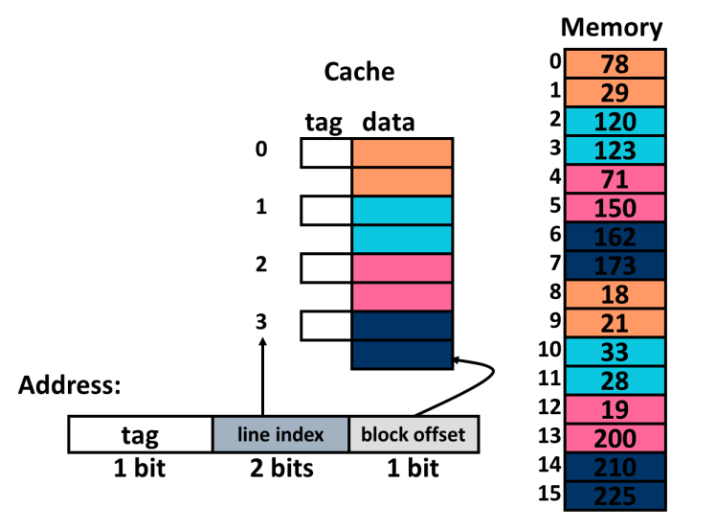
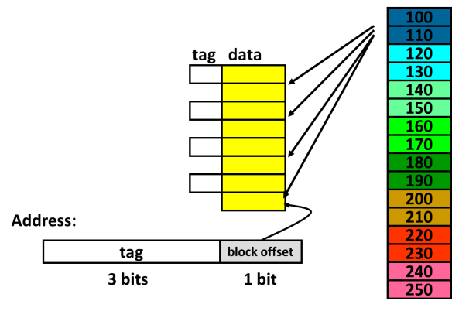
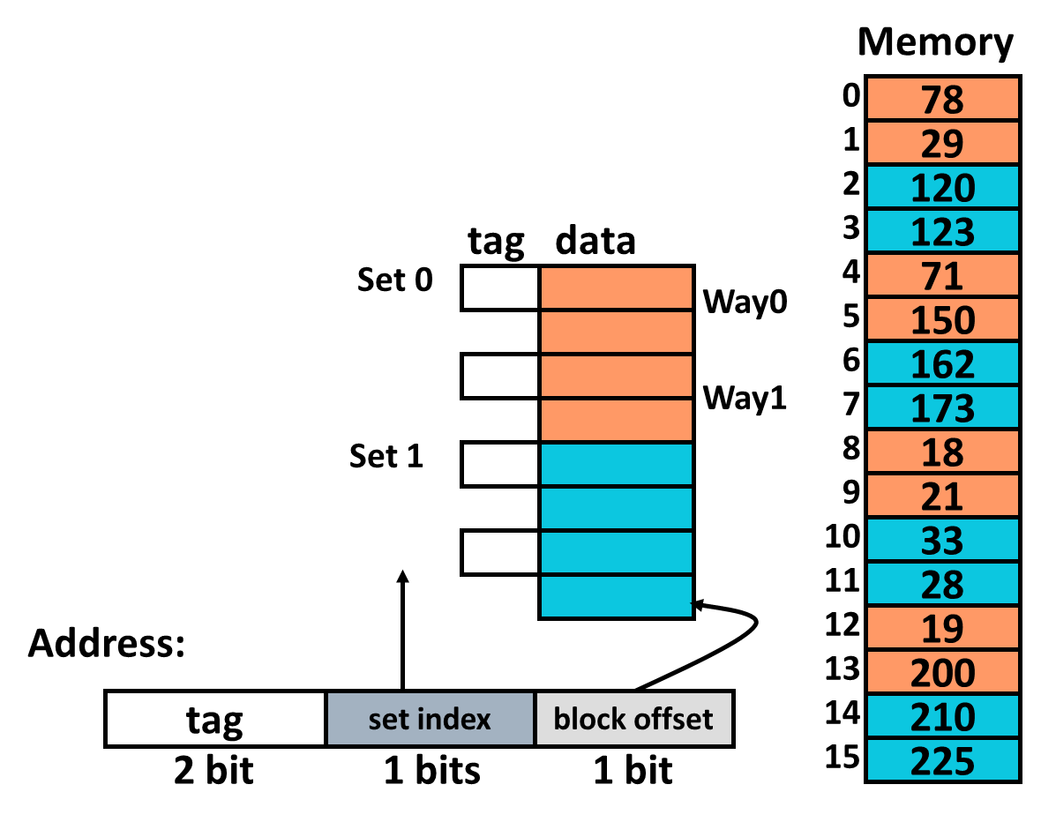
All together
Fully associative
Direct mapped
Set associative

Slide 24
Practice Problem 1: CPI with caches
The grinder application run on the LC2k with full data forwarding and all branches predicted not-taken has the following instruction frequencies:
45% R-type 20% Branches 15% Loads 20% Stores
In grinder, 40% of branches are taken and 50% of LWs are followed by an immediate use.
The I-cache has a miss rate of 3% and the D-cache has a miss rate of 6% (no overlapping of misses). On a miss, the main memory is accessed and has a latency of 100 ns. The clock frequency is 500 MHz.
What is the CPI of grinder on the LC2k?

Slide 25
Practice Problem 1: Solution
The grinder application run on the LC2k with full data forwarding and all branches predicted not-taken has the following instruction frequencies:
45% R-type 20% Branches 15% Loads 20% Stores
In grinder, 40% of branches are taken and 50% of LWs are followed by an immediate use.
The I-cache has a miss rate of 3% and the D-cache has a miss rate of 6% (no overlapping of misses). On a miss, the main memory is accessed and has a latency of 100 ns. The clock frequency is 500 MHz.
What is the CPI of grinder on the LC2k?
Stalls per cache miss = 100 ns / 2ns = 50 cycles (500 Mhz ➜ 2ns cycle time)
CPI = 1 + data hazard stalls + control hazard stalls + icache stalls + dcache stalls
CPI = 1 + 0.15*0.50*1 + 0.20*0.40*3 + 1*0.03*50 + 0.35*0.06*50

Slide 26
Practice Problem 2: Memory Usage
Say you have the following:
A program that generates 2 Billion loads and 1 Billion stores, each 4 bytes in size.
A cache with a 32-byte block which gets a 95% hit rate on that program.
How many bytes of memory would be read and written if:
We had a write-though cache with a no-write allocate policy?
We had a write-back cache with a write-allocate policy? (Assume 25% of all misses result in a dirty eviction)
We had no cache?

Slide 27
Practice Problem 2: Solution (1/3)
Let’s start with the no-cache case.
All stores go to memory and are 4 bytes each
Writes: 1 billion stores* 4 bytes = 4 billion bytes
All loads go to memory and are 4 bytes each.
Reads: 2 billion loads* 4 bytes = 8 billion bytes
Write-though, no allocate.
All stores still go to memory and are still 4 bytes each.
Writes: 1 billion stores* 4 bytes = 4 billion bytes
Only loads that miss in the cache go to memory. But they read the full cache block.
Reads: 2 billion loads* 0.05* 32 bytes = 3.2 billion bytes

Slide 28
Practice Problem 2: Solution (2/3)
Write-back, write-allocate (data reads)
Store misses result in a cache block being read.
Reads: 1 billion stores* 0.05* 32 bytes = 1.6 billion bytes
Load misses result in a cache block being read.
Reads: 2 billion loads* 0.05* 32 bytes = 3.2 billion bytes
So that is 4.8 billion bytes of data read.

Slide 29
Practice Problem 2: Solution (3/3)
When do we write to memory?
Only on dirty evictions. Can be done by both loads and stores.
Recall we are assuming 25% of all evictions are of dirty data.
Write-back, write-allocate (data writes)
Store misses result in dirty eviction 1/4 of the time.
Reads: 1 billion stores* 0.05* 32 bytes*(.25) = 0.4 billion bytes
Load misses result in a cache block being read.
Reads: 2 billion loads* 0.05* 32 bytes*(.25) = 0.8 billion bytes
Note: could have just taken the read numbers and multiplied by 25%.

Slide 30
Practice Problem 3: CPI w/ Caches 2
Given a 200 MHz processor with 8KB instruction and data caches and a with memory access latency of 20 cycles. Both caches are 2-way associative. A program running on this processor has a 95% icache hit rate and a 90% dcache hit rate. On average, 30% of the instructions are loads or stores. The CPI of this system, if caches were ideal would be 1.
Suppose you have 2 options for the next generation processor, which do you pick?
Option 1: Double the clock frequency—assume this will increase your memory latency to 40 cycles. Also assume a base CPI of 1 can still be achieved after this change.
Option 2: Double the size of your caches, this will increase the instruction cache hit rate to 98% and the data cache hit rate to 95%. Assume the hit latency is still 1 cycle.

Slide 31
Practice Problem 3: Solution
Option 1: (double clock freq, base cycle time is 5 ns, so new cycle time is 2.5 ns)
CPI = baseCPI + IcacheStallCPI + DcacheStallCPI CPI = 1.0 + 0.05*40 + 0.3*0.1*40 = 4.2
Execution time = 4.2 * Ninstrs * 2.5ns = 10.5ns * Ninstrs
Option 2 (icache/dcache miss rates lowered to 2% and 5%)
CPI = baseCPI + IcacheStallCPI + DcacheStallCPI CPI = 1.0 + 0.02*20 + 0.3*0.05*20 = 1.7
Execution time = 1.7 * Ninstrs * 5ns = 8.5ns * Ninstrs
Therefore, Option 2 is the better choice

Slide 32
Practice Problem 4: Guess that cache!
Here is the series of address references (in hex) to a cache of size 512 bytes. You are asked to determine the configuration of the cache. Assume 12-bit addresses
0x310 – Miss
0x30f – Miss
0x510 – Miss
0x31f – Hit
0x72d – Miss
0x72f – Hit
0x320 – Miss
0x520 – Miss
0x720 - Miss
Block size: ?
Associativity: ?
Number of sets: ?

Slide 33
Practice Problem 4: Solution
Here is the series of address references (in hex) to a cache of size 512 bytes. You are asked to determine the configuration of the cache. Assume 12-bit addresses
0x310 – Miss
0x30f – Miss
0x510 – Miss
0x31f – Hit
0x72d – Miss
0x72f – Hit
0x320 – Miss
0x520 – Miss
0x720 - Miss
Determine block size
First hit must be brought in by another miss
Take closest address: 0x310, so know block size must be at least 16 bytes so 0x31f brought in when 0x310 miss occurs
Now, is the block size larger? Know that 0x30f was a miss, thus 0x310 and 0x30f not in the same block. Thus, block size must be <= 16 bytes
Thus Block Size = 16 bytes

Slide 34
Practice Problem 4 : Solution (2)
Here is the series of address references (in hex) to a cache of size 512 bytes. You are asked to determine the configuration of the cache. Assume 12-bit addresses
0x310 – Miss
0x30f – Miss
0x510 – Miss
0x31f – Hit
0x72d – Miss
0x72f – Hit
0x320 – Miss
0x520 – Miss
0x720 - Miss
Determine associativity
Assume direct mapped: 3-bit tag, 5-bit index, 4-bit offset.
If direct mapped 0x310 and 0x510 would both map to index 9,
Thus 0x31f could not be a hit. So, not direct mapped.
Assume 2-way associative: 4-bit tag, 4-bit index, 4-bit offset
This fixes the green accesses, and allows 0x31f to be a hit.
What about > 2-way associative?
Now we also know that 0x720 is a miss even though 3 accesses
earlier 0x72f was a hit, and thus it is in the cache. The intervening 2 accesses must kick it out, 0x320 and 0x520. Both go to set 2. If the associativity was > 2, then 0x720 would be a hit. So, must conclude that cache is 2-way associative.
Lastly, number of sets = 512 / (2 * 16) = 16

