Slide 1
双极型晶体管

Slide 2
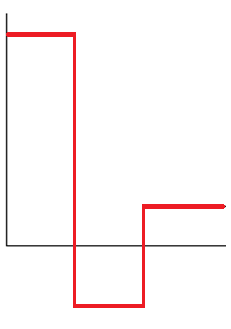








双结三层结构
发射极，用E或e表示（Emitter）
(Je)
$${10}^{19}$$
$${cm}^{−3}$$
$$N$$
集电极，用C或c表示（Collector）(Jc)
$$e$$
基极，用B或b表示（Base）(J_{b})
$${10}^{15}$$
$$c$$
集电结：集电极与基极之间的结
$$b$$
发射结：发射极与基极之间的结
$${10}^{17}$$

Slide 3
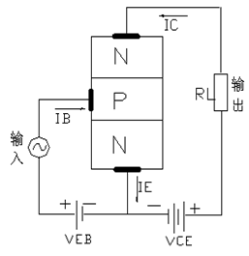
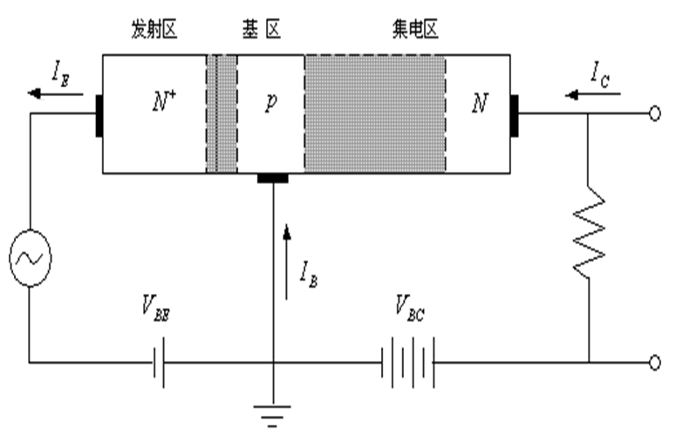
共基极接法
（电流跟随器）
共发射极接法
（小信号放大）

Slide 4
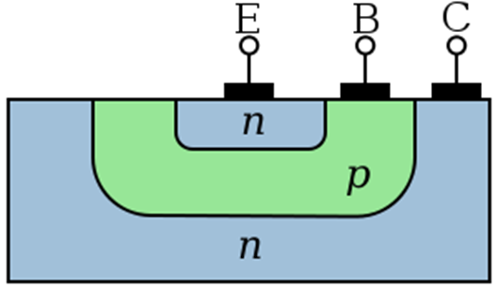
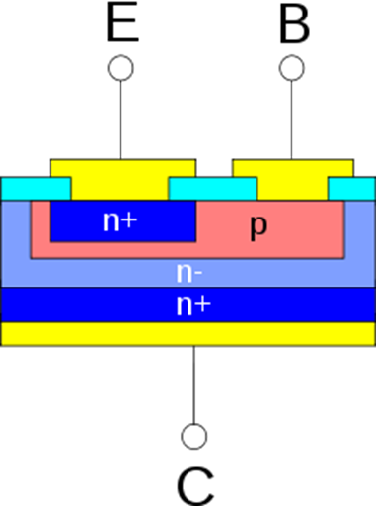
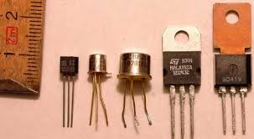
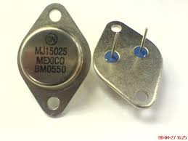
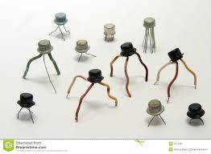

Slide 5
晶体管
三端器件（或四端）：用二端间的电压控制第三端的电流
电流放大、电压放大、小信号功率放大
分类：
双极晶体管：电子和空穴都参加电流传输
JFET
单极晶体管：
MOSFET

Slide 6
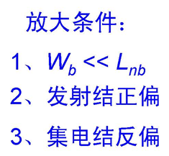
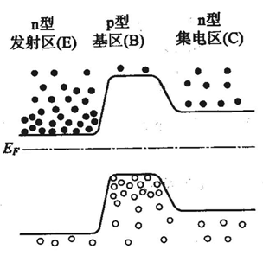
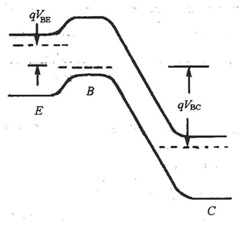
放大原理

Slide 7
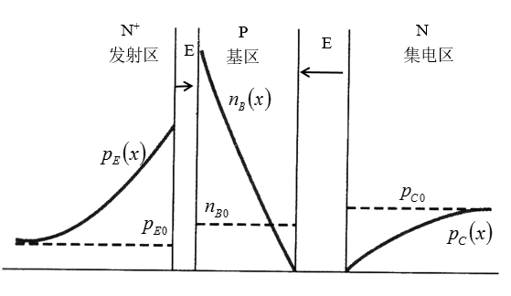

Slide 8
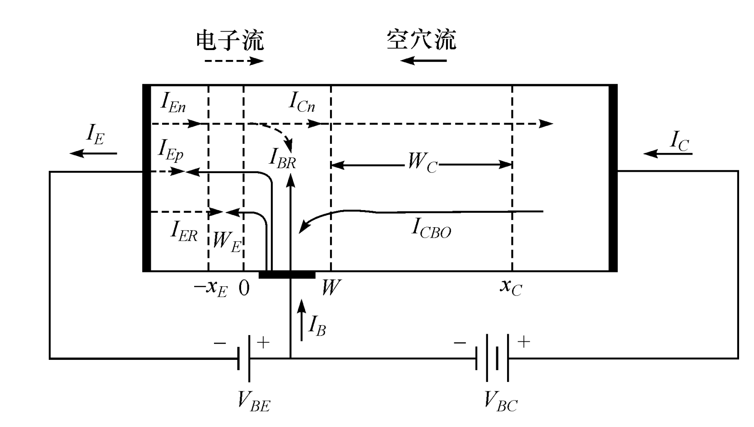


$$I_{E}=I_{nE}+I_{pE}+I_{ER}$$
$$I_{C}=I_{Cn}+I_{CBO}$$
$$I_{B}=I_{Ep}+I_{ER}+\left(I_{En}−I_{Cn}\right)−I_{CBO}$$

Slide 9

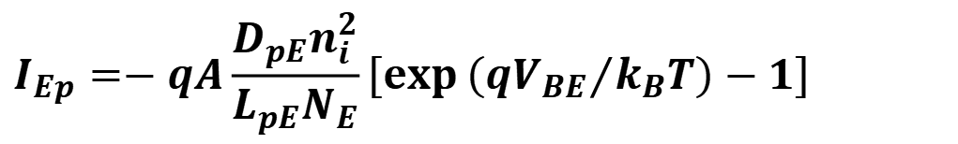
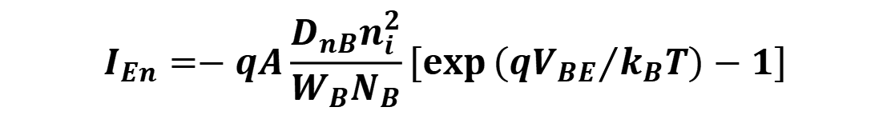
$$I_{En}=−qA\frac{D_{nB}n_{i}^{2}}{W_{B}N_{B}}\left[\exp\left({qV_{BE}}/{k_{B}T}\right)−1\right]$$
$$I_{Ep}=−qA\frac{D_{pE}n_{i}^{2}}{L_{pE}N_{E}}\left[\exp\left({qV_{BE}}/{k_{B}T}\right)−1\right]$$
$$β=\frac{I_{En}}{I_{Ep}}≈\frac{N_{E}}{N_{B}}$$

Slide 10
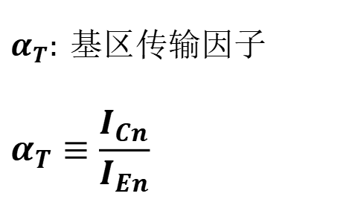
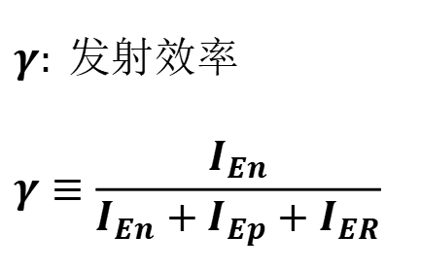
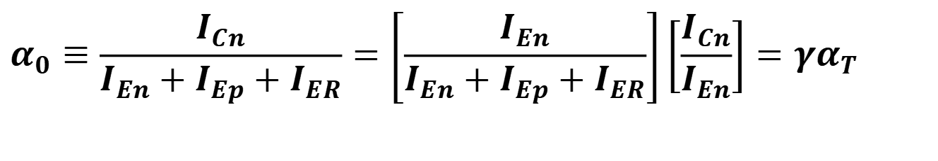
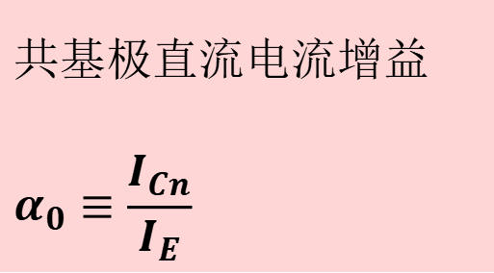
$$共基极直流电流增益 \\ α_{0}≡\frac{I_{Cn}}{I_{E}}$$
$$α_{0}≡\frac{I_{Cn}}{I_{En}+I_{Ep}+I_{ER}}=\left[\frac{I_{En}}{I_{En}+I_{Ep}+I_{ER}}\right]\left[\frac{I_{Cn}}{I_{En}}\right]=γα_{T}$$
$$γ: 发射效率 \\ γ≡\frac{I_{En}}{I_{En}+I_{Ep}+I_{ER}}$$
$$α_{T}: 基区传输因子 \\ α_{T}≡\frac{I_{Cn}}{I_{En}}$$

Slide 11
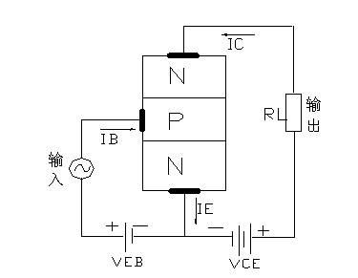
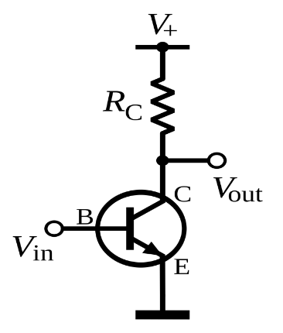

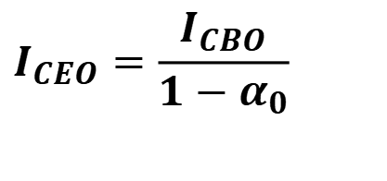
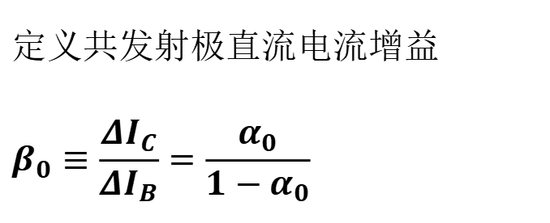
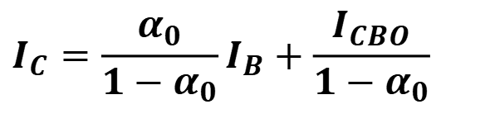

共发射极接法电流增益
发射极开路的基极－集电极电流
$$集电极电流可表示为:I_{C}=α_{0}I_{E}+I_{CBO}$$
$$I_{C}=α_{0}\left(I_{C}+I_{B}\right)+I_{CBO}$$
$$I_{C}=\frac{α_{0}}{1−α_{0}}I_{B}+\frac{I_{CBO}}{1−α_{0}}$$
$$I_{C}=β_{0}I_{B}+I_{CEO}$$
$$定义共发射极直流电流增益 \\ β_{0}≡\frac{ΔI_{C}}{ΔI_{B}}=\frac{α_{0}}{1−α_{0}}$$
$$I_{CEO}=\frac{I_{CBO}}{1−α_{0}}$$
基极开路的发射极－集电极反向饱和电流

Slide 13
理想晶体管的电流-电压关系

Slide 14
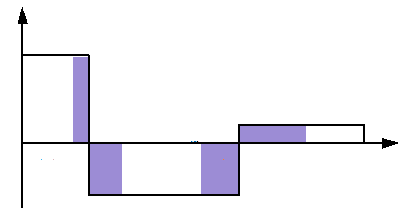
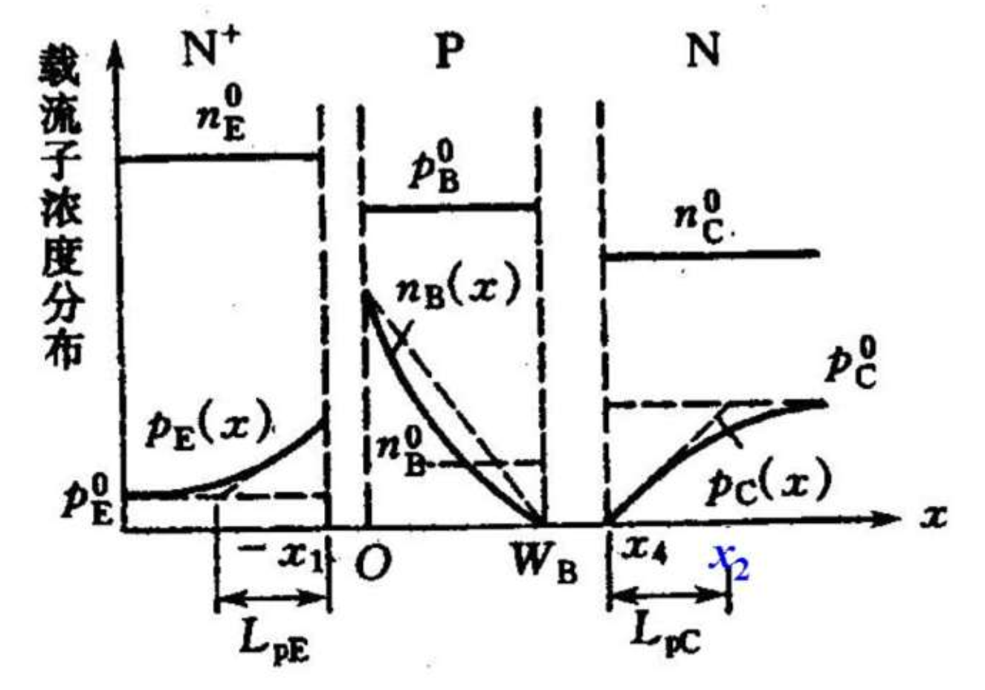




理想晶体管：
掺杂均匀;外加电压都在结上；
空间电荷区内没有产生/复合电流；
无串联电阻；小注入
少子分布
$$发射区 基区 集电区$$
N_{E}
N_{C}
0
$$W_{B}$$
$${−W}_{E}$$
-x_{E}
x_{C}
$$W_{C}$$
N_{B}

Slide 15
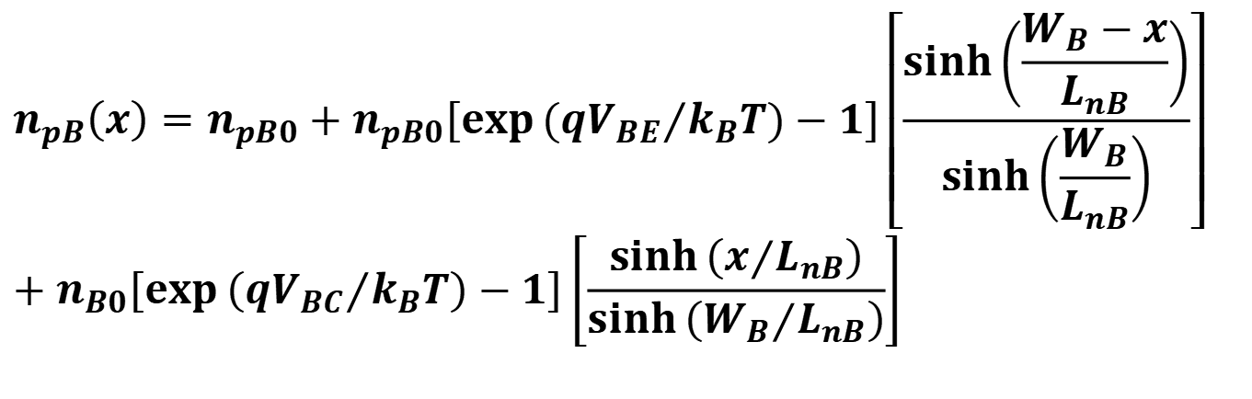
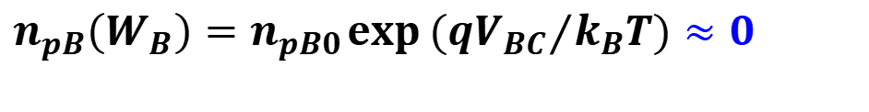
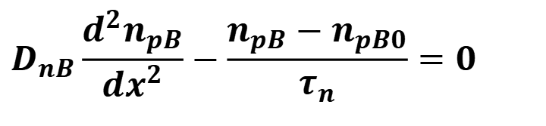
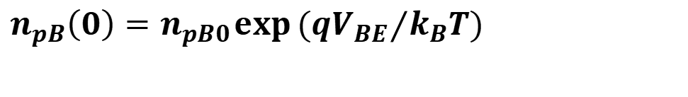

基区
$$\left(0≤x≤W_{B}\right)：$$
$$D_{nB}\frac{d^{2}n_{pB}}{dx^{2}}−\frac{n_{pB}−n_{pB0}}{τ_{n}}=0$$
$$n_{pB}\left(0\right)=n_{pB0}\exp\left({qV_{BE}}/{k_{B}T}\right)$$
边界条件：
$$n_{pB}\left(W_{B}\right)=n_{pB0}\exp\left({qV_{BC}}/{k_{B}T}\right)≈0$$
$$n_{pB}\left(x\right)=n_{pB0}+n_{pB0}\left[\exp\left({qV_{BE}}/{k_{B}T}\right)−1\right]\left[\frac{\sinh\left(\frac{W_{B}−x}{L_{nB}}\right)}{\sinh\left(\frac{W_{B}}{L_{nB}}\right)}\right] \\ +n_{B0}\left[\exp\left({qV_{BC}}/{k_{B}T}\right)−1\right]\left[\frac{\sinh\left(x/{L_{nB}}\right)}{\sinh\left({W_{B}}/{L_{nB}}\right)}\right]$$

Slide 16


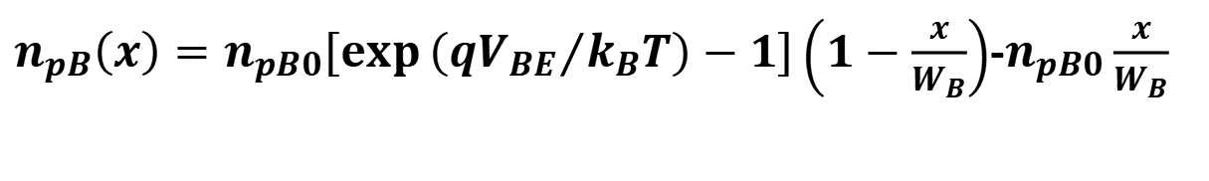
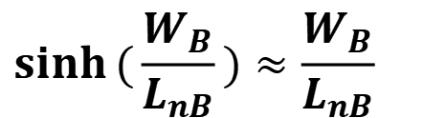


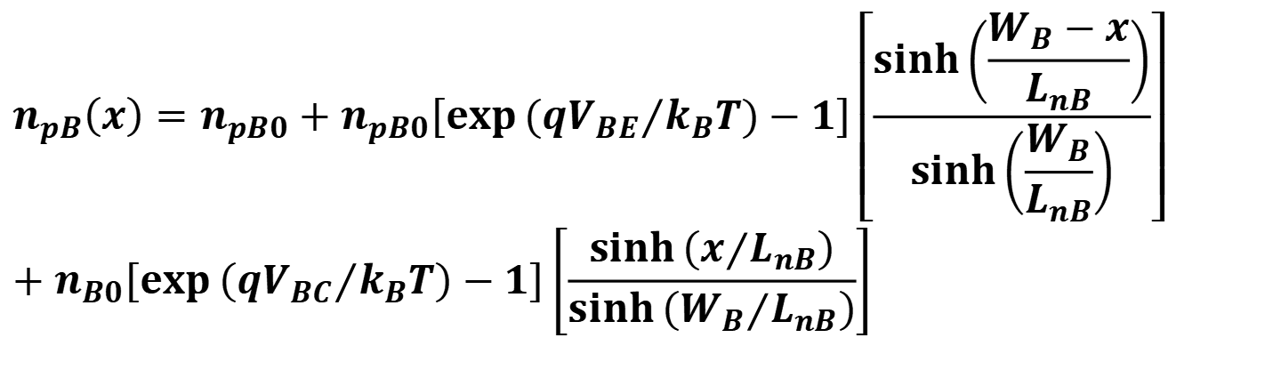
$$∆n_{pB}(0)$$
$$n_{pB}\left(x\right)=n_{pB0}+n_{pB0}\left[\exp\left({qV_{BE}}/{k_{B}T}\right)−1\right]\left[\frac{\sinh\left(\frac{W_{B}−x}{L_{nB}}\right)}{\sinh\left(\frac{W_{B}}{L_{nB}}\right)}\right] \\ +n_{B0}\left[\exp\left({qV_{BC}}/{k_{B}T}\right)−1\right]\left[\frac{\sinh\left(x/{L_{nB}}\right)}{\sinh\left({W_{B}}/{L_{nB}}\right)}\right]$$
$$∆n_{pB}(W_{B})$$
$$\sinh{(}\frac{W_{B}}{L_{nB}})≈\frac{W_{B}}{L_{nB}}$$
$$x<<1,$$
$$\sinh{(}x)≈x$$
即
$n_{pB}\left(x\right)=n_{pB0}\left[\exp\left({qV_{BE}}/{k_{B}T}\right)−1\right]\left(1−\frac{x}{W_{B}}\right)$-$n_{pB0}\frac{x}{W_{B}}$

Slide 17
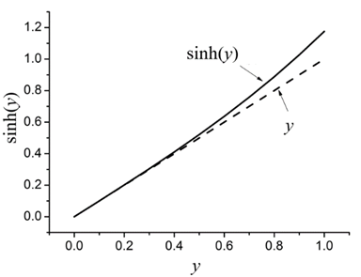
$$\sqrt{25{cm}^{2}/s×{10}^{−6}s }=5×{10}^{−3}cm=50μm$$

Slide 18

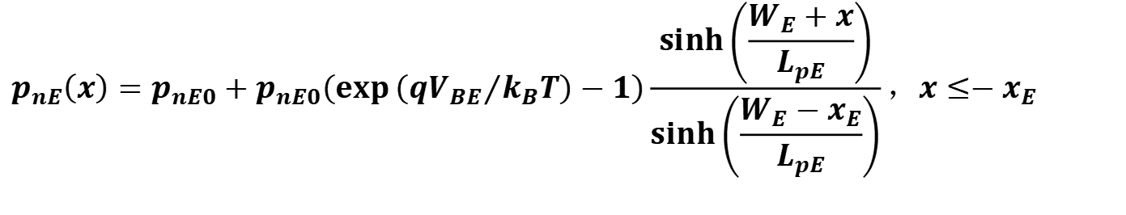
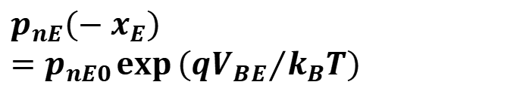
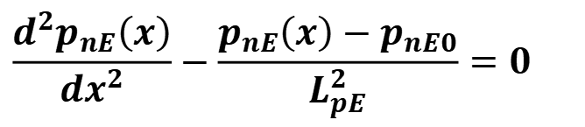
发射区少子分布的解析表达式
$$p_{nE}\left(−x_{E}\right)=p_{nE0}\exp\left({qV_{BE}}/{k_{B}T}\right)$$
$$\frac{d^{2}p_{nE}\left(x\right)}{dx^{2}}−\frac{p_{nE}\left(x\right)−p_{nE0}}{L_{pE}^{2}}=0$$
$$p_{nE}\left(x\right)=p_{nE0}+p_{nE0}\left(\exp\left({qV_{BE}}/{k_{B}T}\right)−1\right)\frac{\sinh\left(\frac{W_{E}+x}{L_{pE}}\right)}{\sinh\left(\frac{W_{E}−x_{E}}{L_{pE}}\right)}，x≤−x_{E}$$
$$W_{E}−x_{E}>>L_{pE}$$
$$p_{nE}\left(x\right)=p_{nE0}+p_{nE0}\left[\exp\left({qV_{BE}}/{k_{B}T}\right)−1\right]\exp\left[{\left(x+x_{E}\right)}/{L_{pE}}\right]$$

Slide 19

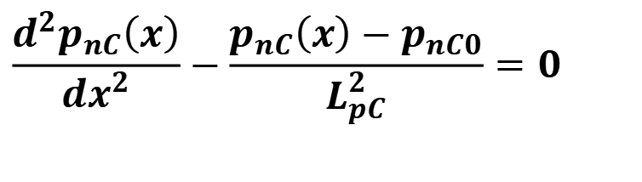
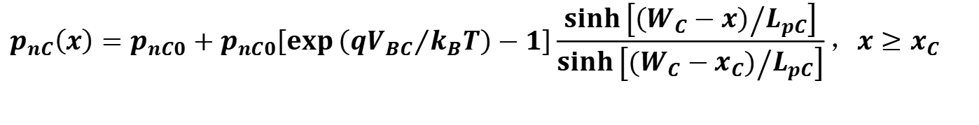
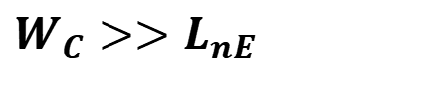
集电区少子分布的解析表达式
$$\frac{d^{2}p_{nC}\left(x\right)}{dx^{2}}−\frac{p_{nC}\left(x\right)−p_{nC0}}{L_{pC}^{2}}=0$$
$$p_{nC}\left(x_{C}\right)=p_{nC0}\exp\left({qV_{BC}}/{k_{B}T}\right)$$
$$W_{C}>>L_{nE}$$
$$p_{nC}\left(x\right)=p_{nC0}+p_{nC0}\left[\exp\left({qV_{BC}}/{k_{B}T}\right)−1\right]\frac{\sinh\left[{\left(W_{C}−x\right)}/{L_{pC}}\right]}{\sinh\left[{\left(W_{C}−x_{C}\right)}/{L_{pC}}\right]}，x≥x_{C}$$
$$p_{nC}\left(x\right)=p_{nC0}+p_{nC0}\left[\exp\left({qV_{BC}}/{k_{B}T}\right)−1\right]\exp\left[{−\left(x−x_{C}\right)}/{L_{pC}}\right]$$

Slide 20
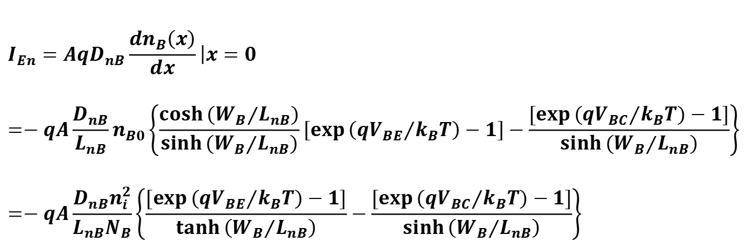
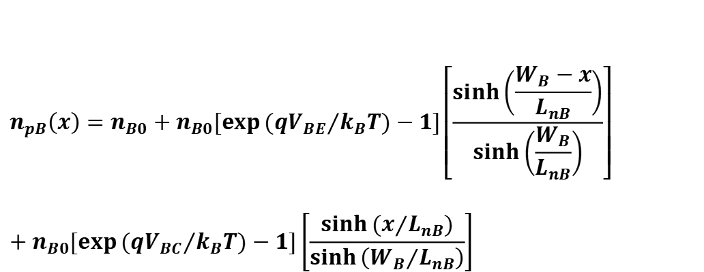
基区电场为零，只有扩散电流，流过发射极的电子电流：
$$n_{pB}\left(x\right)=n_{B0}+n_{B0}\left[\exp\left({qV_{BE}}/{k_{B}T}\right)−1\right]\left[\frac{\sinh\left(\frac{W_{B}−x}{L_{nB}}\right)}{\sinh\left(\frac{W_{B}}{L_{nB}}\right)}\right] \\ +n_{B0}\left[\exp\left({qV_{BC}}/{k_{B}T}\right)−1\right]\left[\frac{\sinh\left(x/{L_{nB}}\right)}{\sinh\left({W_{B}}/{L_{nB}}\right)}\right]$$
$$I_{En}=AqD_{nB}\frac{dn_{B}\left(x\right)}{dx}\left|x=0\right. \\ =−qA\frac{D_{nB}}{L_{nB}}n_{B0}\left\{\frac{\cosh\left({W_{B}}/{L_{nB}}\right)}{\sinh\left({W_{B}}/{L_{nB}}\right)}\left[\exp\left({qV_{BE}}/{k_{B}T}\right)−1\right]−\frac{\left[\exp\left({qV_{BC}}/{k_{B}T}\right)−1\right]}{\sinh\left({W_{B}}/{L_{nB}}\right)}\right\} \\ =−qA\frac{D_{nB}n_{i}^{2}}{L_{nB}N_{B}}\left\{\frac{\left[\exp\left({qV_{BE}}/{k_{B}T}\right)−1\right]}{\tanh\left({W_{B}}/{L_{nB}}\right)}−\frac{\left[\exp\left({qV_{BC}}/{k_{B}T}\right)−1\right]}{\sinh\left({W_{B}}/{L_{nB}}\right)}\right\}$$

Slide 21
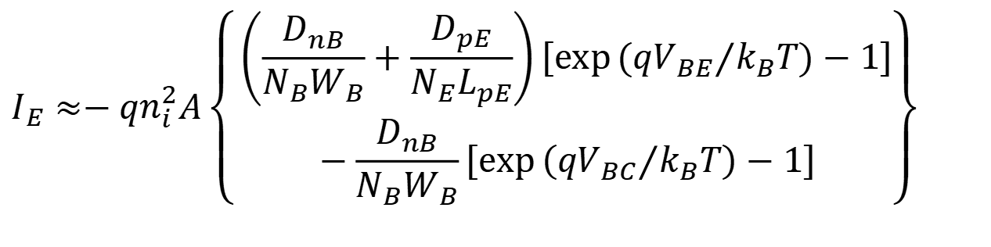
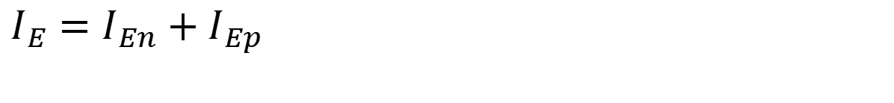
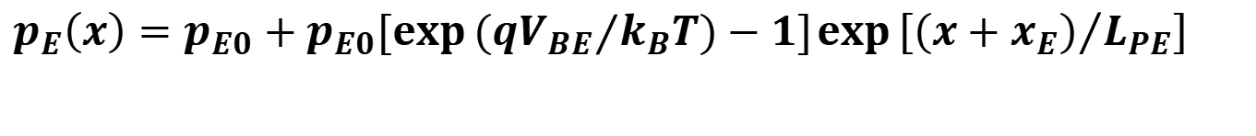
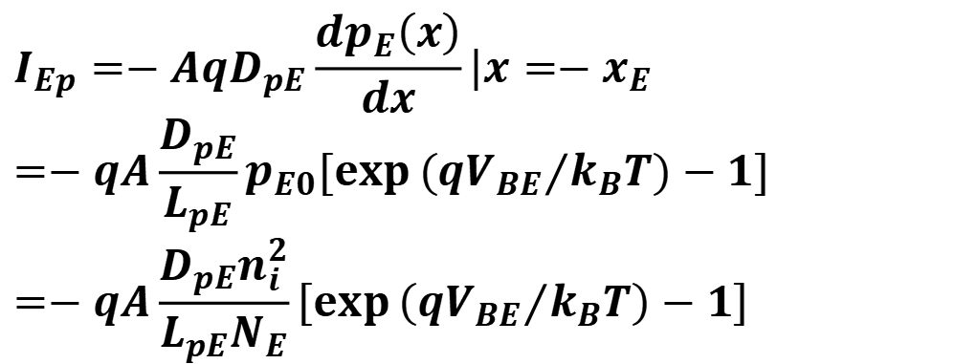
$$p_{E}\left(x\right)=p_{E0}+p_{E0}\left[\exp\left({qV_{BE}}/{k_{B}T}\right)−1\right]\exp\left[{\left(x+x_{E}\right)}/{L_{PE}}\right]$$
$$I_{Ep}=−AqD_{pE}\frac{dp_{E}\left(x\right)}{dx}\left|x=−x_{E}\right.=−qA\frac{D_{pE}}{L_{pE}}p_{E0}\left[\exp\left({qV_{BE}}/{k_{B}T}\right)−1\right]=−qA\frac{D_{pE}n_{i}^{2}}{L_{pE}N_{E}}\left[\exp\left({qV_{BE}}/{k_{B}T}\right)−1\right]$$
$$I_{E}=I_{En}+I_{Ep}$$
$$I_{E}≈−qn_{i}^{2}A\left\{\begin{aligned}&\left(\frac{D_{nB}}{N_{B}W_{B}}+\frac{D_{pE}}{N_{E}L_{pE}}\right)\left[\exp\left({qV_{BE}}/{k_{B}T}\right)−1\right] \\ &−\frac{D_{nB}}{N_{B}W_{B}}\left[\exp\left({qV_{BC}}/{k_{B}T}\right)−1\right]\end{aligned}\right\}$$

Slide 22
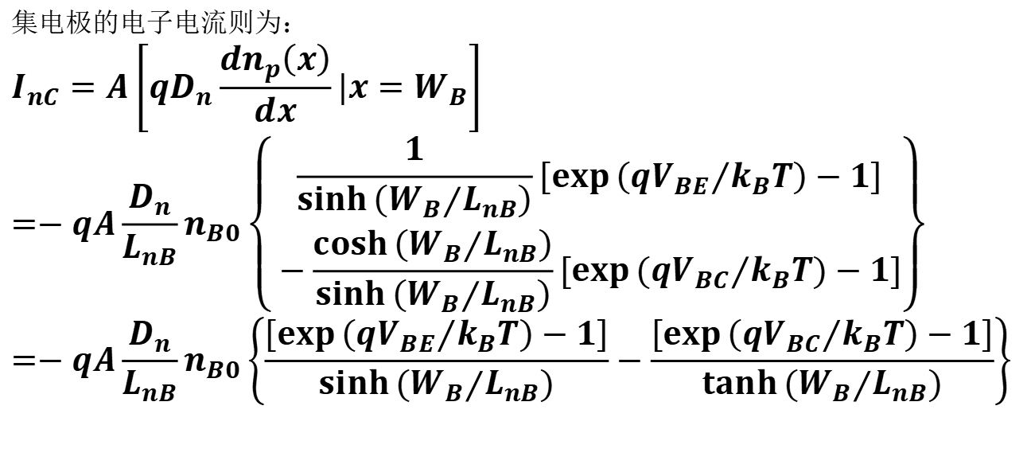
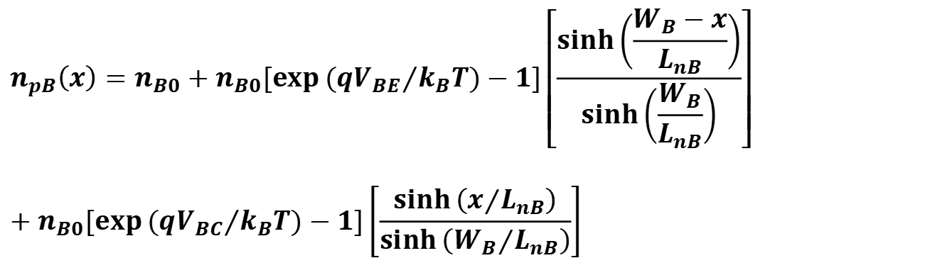
$$n_{pB}\left(x\right)=n_{B0}+n_{B0}\left[\exp\left({qV_{BE}}/{k_{B}T}\right)−1\right]\left[\frac{\sinh\left(\frac{W_{B}−x}{L_{nB}}\right)}{\sinh\left(\frac{W_{B}}{L_{nB}}\right)}\right]$$
$$+n_{B0}\left[\exp\left({qV_{BC}}/{k_{B}T}\right)−1\right]\left[\frac{\sinh\left(x/{L_{nB}}\right)}{\sinh\left({W_{B}}/{L_{nB}}\right)}\right]$$
$$集电极的电子电流则为： \\ I_{nC}=A\left[qD_{n}\frac{dn_{p}\left(x\right)}{dx}\left|x=W_{B}\right.\right]=−qA\frac{D_{n}}{L_{nB}}n_{B0}\left\{\begin{aligned}&\frac{1}{\sinh\left({W_{B}}/{L_{nB}}\right)}\left[\exp\left({qV_{BE}}/{k_{B}T}\right)−1\right] \\ &−\frac{\cosh\left({W_{B}}/{L_{nB}}\right)}{\sinh\left({W_{B}}/{L_{nB}}\right)}\left[\exp\left({qV_{BC}}/{k_{B}T}\right)−1\right]\end{aligned}\right\} \\ =−qA\frac{D_{n}}{L_{nB}}n_{B0}\left\{\frac{\left[\exp\left({qV_{BE}}/{k_{B}T}\right)−1\right]}{\sinh\left({W_{B}}/{L_{nB}}\right)}−\frac{\left[\exp\left({qV_{BC}}/{k_{B}T}\right)−1\right]}{\tanh\left({W_{B}}/{L_{nB}}\right)}\right\}$$

Slide 23
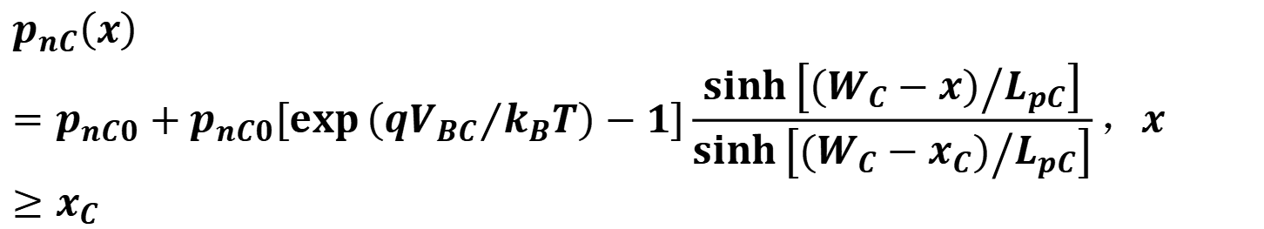

$$p_{nC}\left(x\right)=p_{nC0}+p_{nC0}\left[\exp\left({qV_{BC}}/{k_{B}T}\right)−1\right]\frac{\sinh\left[{\left(W_{C}−x\right)}/{L_{pC}}\right]}{\sinh\left[{\left(W_{C}−x_{C}\right)}/{L_{pC}}\right]}，x≥x_{C}$$
$$p_{nC}\left(x\right)=p_{nC0}+p_{nC0}\left[\exp\left({qV_{BC}}/{k_{B}T}\right)−1\right]\exp\left[{−\left(x−x_{C}\right)}/{L_{pC}}\right]$$
$$I_{Cp}=−AqD_{pC}\frac{dp_{C}\left(x\right)}{dx}\left|x=x_{C}\right.=qAn_{i}^{2}\frac{D_{pC}}{L_{pC}N_{C}}\left[\exp\left({qV_{BC}}/{k_{B}}T\right)−1\right]$$

Slide 24







$$I_{C}=I_{Cn}+I_{Cp} \\ =−qAn_{i}^{2}\left\{\begin{aligned}&\frac{D_{nB}}{L_{nB}N_{B}\sinh\left(W/{L_{nb}}\right)}\left[\exp\left({qV_{BE}}/{k_{B}T}\right)−1\right] \\ &−\left(\frac{D_{nB}}{L_{nB}N_{B}\tanh\left(W/{L_{nB}}\right)}+\frac{D_{pC}}{L_{pC}N_{C}}\right)\left[\exp\left({qV_{BC}}/{k_{B}T}\right)−1\right]\end{aligned}\right\}$$
$$y<<1$$
$$\sinh{(}y)≈y$$
$$\text{tanh}(y)≈y$$
$${W_{B}}/{L_{nB}}<<1$$
$$I_{C}≈−qAn_{i}^{2}\left\{\frac{D_{nB}}{N_{B}W_{B}}\left[{\exp{(}qV_{BE}}/{k_{B}T})−1\right]−\left(\frac{D_{nB}}{N_{B}W_{B}}+\frac{D_{pC}}{N_{C}L_{pC}}\right)\left[\exp\left({qV_{BC}}/{k_{B}T}\right)−1\right]\right\}$$
$$基极电流I_{B}的表达式可以通过I_{B}=I_{E}−I_{C}$$

Slide 25










正向有源放大模式下电流增益——发射效率$γ$
发射结耗尽区内的复合电流
$$I_{ER}$$
比较小可以忽略不计
$$V_{BE}>0$$
$$V_{BC}<0$$
$$I_{Ep}=−qA\frac{D_{pE}n_{i}^{2}}{L_{pE}N_{E}}\exp\left({qV_{BE}}/{k_{B}T}\right)$$
$${W_{B}}/{L_{nB}}<<1$$
$$I_{En}≈−qA\frac{D_{nB}n_{i}^{2}}{W_{B}N_{B}}\exp\left({qV_{BE}}/{k_{B}T}\right)$$
$$γ≡\frac{I_{En}}{I_{En}+I_{Ep}}=\frac{1}{1+\frac{I_{Ep}}{I_{En}}}$$
$W_{B}$ 小
$\frac{N_{B}}{N_{E}}$ 低
$$γ=\frac{1}{1+\frac{D_{pE}}{D_{nB}}\frac{W_{B}}{{L_{p}}_{E}}\frac{N_{B}}{N_{E}}}$$
$N_{E}$ 较高 禁带变窄及俄歇复合效应
$N_{B}$ 小 基区电阻增加

Slide 26



$$γ=\frac{1}{1+\frac{D_{pE}}{D_{nB}}\frac{W_{B}}{{L_{p}}_{E}}\frac{N_{B}}{N_{E}}}$$
$γ=\frac{1}{1+\frac{D_{pE}}{D_{nB}}\frac{N_{B}}{N_{E}}\frac{W_{B}}{{L_{p}}_{E}}}≈$ $\frac{1}{1+\frac{μ_{pB}}{μ_{nE}}\frac{N_{B}}{N_{E}}\frac{W_{B}}{{L_{p}}_{E}}}={\left(1+\frac{ρ_{E}}{ρ_{B}}\frac{W_{B}}{{L_{p}}_{E}}\right)}^{−1}$

Slide 27


Slide 28




基区输运因子$α_{T}$
$$I_{\text{nC}}=−\text{qA}\frac{D_{nB}n_{i}^{2}}{L_{nB}N_{B}}\left\{\frac{\left[\text{exp}\left({\text{q}{\text{V}}_{\text{BE}}}/{k_{B}T}\right)−1\right]}{\text{sinh}\left({W_{B}}/{L_{\text{nB}}}\right)}−\frac{\left[\text{exp}\left({\text{q}{\text{V}}_{\text{BC}}}/{k_{B}T}\right)−1\right]}{\text{tanh}\left({W_{B}}/{L_{\text{nB}}}\right)}\right\}$$
$$I_{En}=−qA\frac{D_{nB}n_{i}^{2}}{L_{nB}N_{B}}\left\{\frac{\left[\exp\left({qV_{BE}}/{k_{B}T}\right)−1\right]}{\tanh\left({W_{B}}/{L_{nB}}\right)}−\frac{\left[\exp\left({qV_{BC}}/{k_{B}T}\right)−1\right]}{\sinh\left({W_{B}}/{L_{nB}}\right)}\right\}$$
$$α_{T}=\frac{I_{Cn}}{I_{En}}≈\frac{1}{\cosh\left(\frac{W_{B}}{L_{nB}}\right)}≈1−\frac{W_{B}^{2}}{2L_{nB}^{2}}$$
要想提高基区传输因子，降低基区的宽度非常重要，这也是基区宽度要远远小于电子扩散长度的原因之一。

Slide 29

四种工作模式下少子分布示意图

Slide 30

理想晶体管的工作曲线

Slide 31


Slide 32


$V_{CE}=V_{CB}+V_{BE}$
$$V_{BE}>0$$
$$V_{CE}<V_{BE}$$
$V_{CB}<0$，集电结正偏

Slide 33

作业：

