Slide 1
第三章双极晶体管

Slide 2
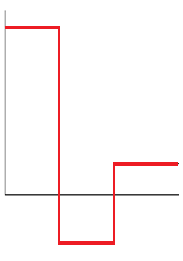
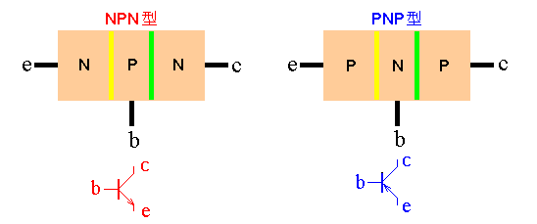
双结三层结构
cm⁻³
10¹⁹
10¹⁵
发射极，用E或e表示（Emitter）
(Je)
发射结：发射极与基
极之间的结
10¹⁷
集电极，用C或c表示（Collector）(Jc)
基 极，用B或b表示（Base） (J_{b})
；
集电结：集电极与基
极之间的结

Slide 3
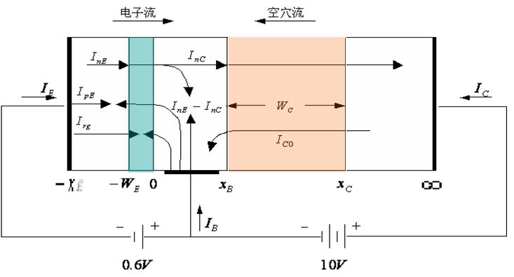
Describe the charge flow in an npn bipolar transistor biased in the forward-active mode. Is the current by drift or diffusion?

Slide 4
Define the current-limiting factors from the current components in the transistor

Slide 5
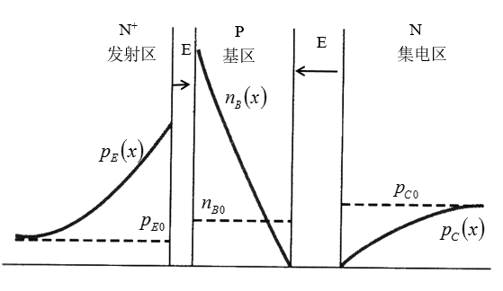
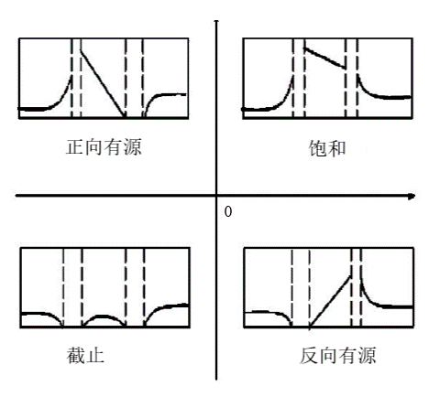
Sketch the minority carrier concentrations throughout the transistor under the various operating modes

Slide 6
提高NE, 但不能太大，以免重掺杂效应导致禁带变窄
降低NB，但不能太低，否则基区电阻太大
在不至降低击穿电压
的条件下，降低基区的宽度

Slide 7
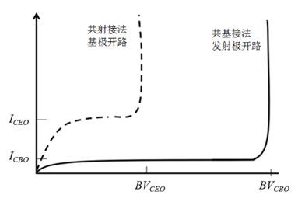
Describe the voltage breakdown mechanisms in a bipolar transistor

Slide 8
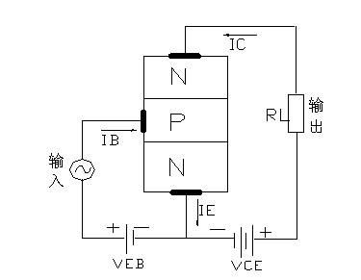
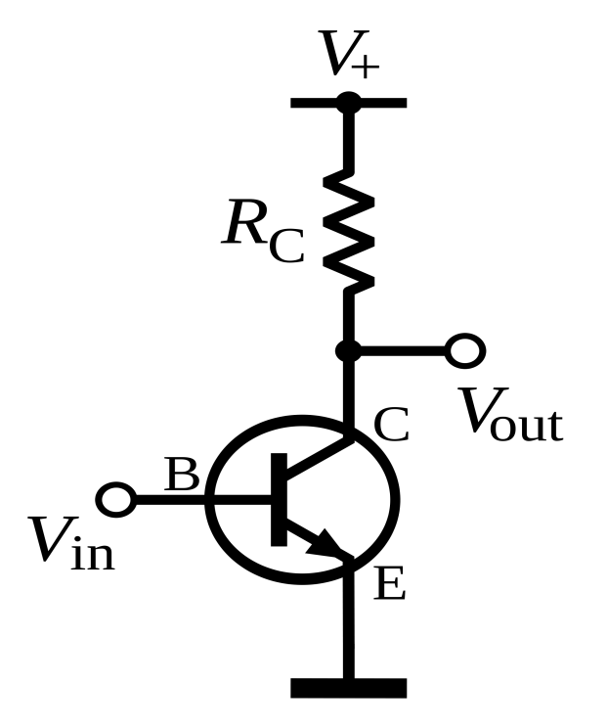
发射极开路的基极－集电极电流
基极开路的发射极－集电极电流

Slide 9
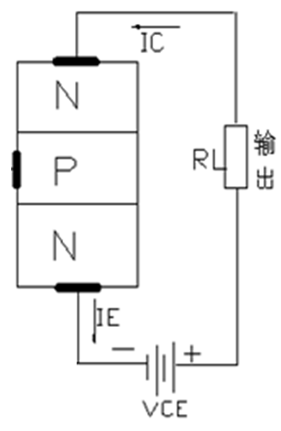
对共发射极接法

Slide 10
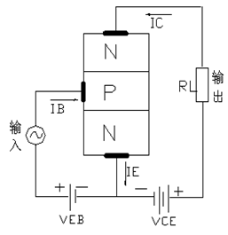
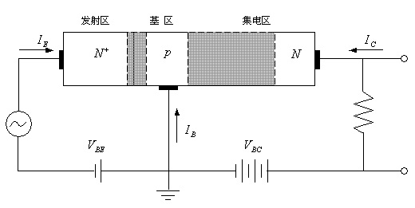




共基极接法
共发射极接法
输入特性曲线：
$$I_{B}\sim V_{BE}$$
输入特性曲线：
$$I_{E}\sim V_{BE}$$
输出特性曲线：
$$I_{C}\sim V_{CB}$$
输出特性曲线：
$$I_{C}\sim V_{CE}$$

Slide 11
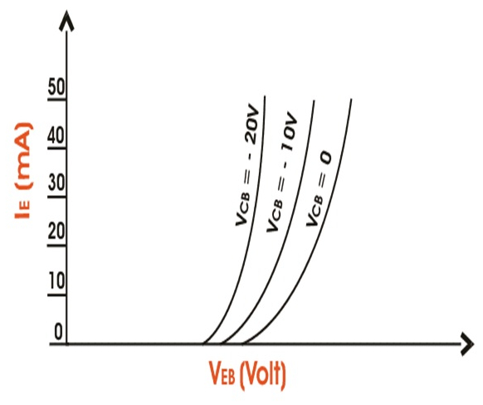
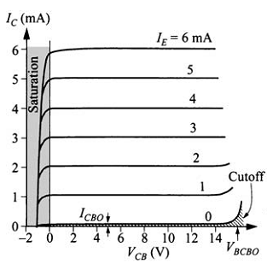
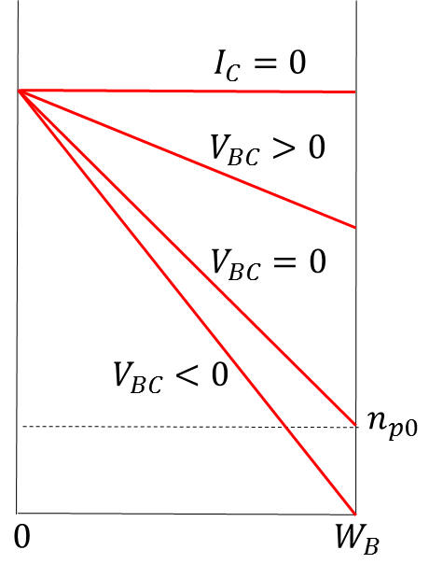



共基极接法
$$V_{CB1}$$
$$V_{CB2}$$
$$V_{CB3}$$

Slide 12
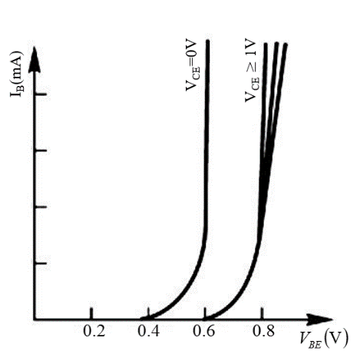
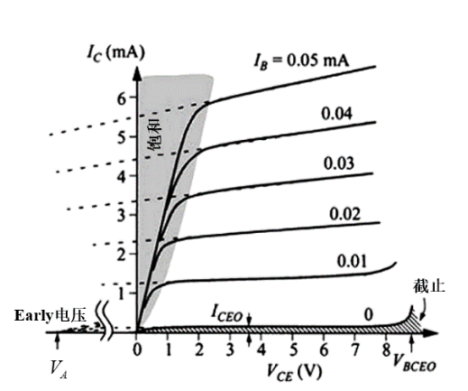











共发射极的工作曲线
$$n_{B}$$
$$I_{CEO}{(V}_{BE}>0)$$
$$I_{CBS}{(V}_{BE}=0)$$
$$n_{P0}$$
$$0$$
$$I_{CBO}{(I}_{E}=0)$$
$$W_{B}$$
共射
共基
$$I_{CEO}$$
$$I_{CBO}$$
$$BV_{CEO}$$
$$BV_{CBO}$$

Slide 13
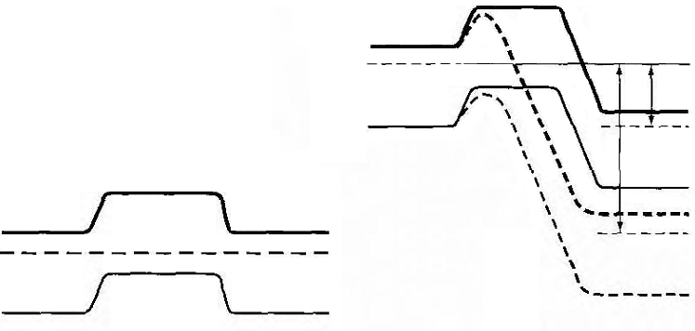
基区穿通
V_{R1}
V_{R2}

Slide 14
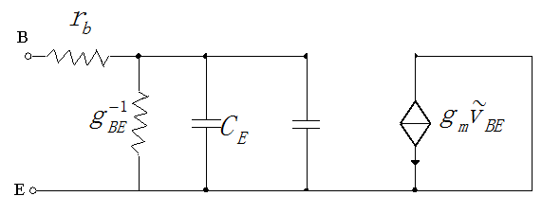
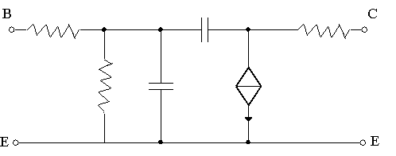
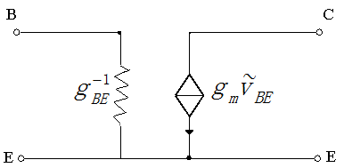
Sketch the simplified small-signal circuit of the transistor biased in the forward-active mode
高频小信号交流等效电路
低频小信号交流等效电路

Slide 15
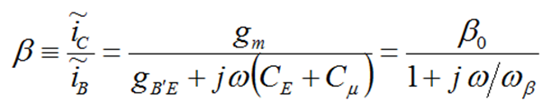
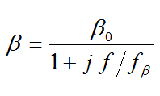
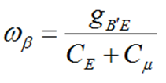

f_{β}：β截止频率
f= f_{β}
β= β₀/√2
f_{T}：特征频率
f= f_{T}＝ β₀ f_{β}
β= 1
输出端交流短路时双极晶体管的高频小信号交流等效电路

Slide 16
α随工作频率的变化
表示共基极交流短路电流增益，即输出端交流短路时交流电流之比
f= f_{α} α= α₀/√2
f_{α}：α截止频率

Slide 17
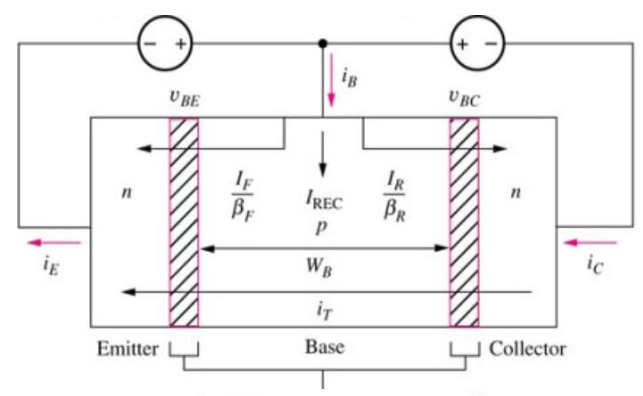
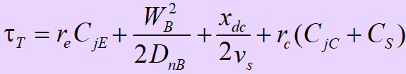
Describe qualitatively the four time-delay or time-constant components in the frequency response of the bipolar transistor or why the frequency response of the bipolar transistors is transit-time-dependent?

Slide 18
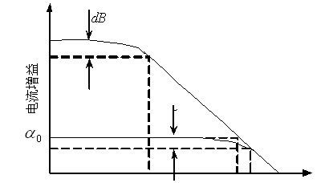
3
3dB

Slide 19
增益带宽乘积
当工作频率远大于截止频率时，则工作频率与此频率下放大倍数的乘积等于特征频率，因此特征频率又称为增益带宽乘积。
工作频率大于 时
频率每升高1倍，其放大倍数就是原值的二分之一

Slide 20
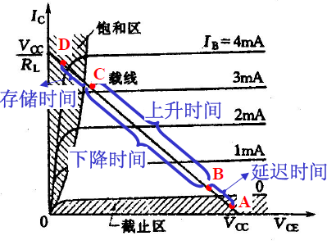
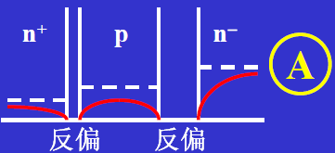
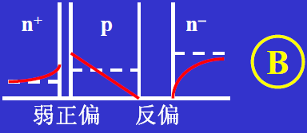
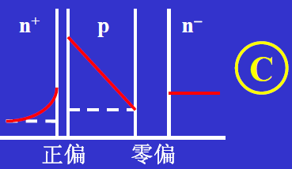
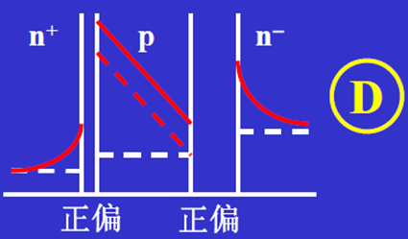
Describe the response of a bipolar transistor when it is switching between saturation and cutoff. 开关过程中的少子分布

Slide 21
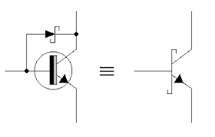
钳位二极管
提高开关速度的方法：
减小发射结和集电结势垒电容
增大基极抽取电流
减小基极驱动电流
缩短基区电子寿命和集电区空穴寿命
减小面积
Schotty钳位二极管及其电路符号
钳位二极管的作用：分流
降低V_{BC}: 从0.6-0.3V

Slide 22
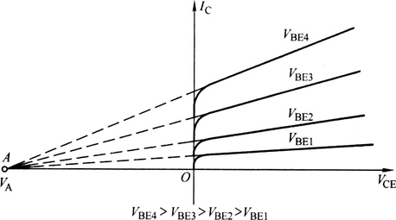




What is meant by base width modulation? What is another term used for this effect? 基区宽度调制效应——Early effect
$$n_{p}(0)$$
$$n_{p}(x)$$
$$n_{p0}$$
$$x_{B}$$

Slide 23
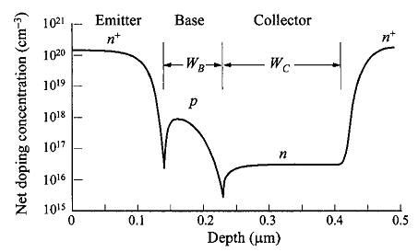
缓变基区晶体管
Q_{GB}称为Gummel数

Slide 24
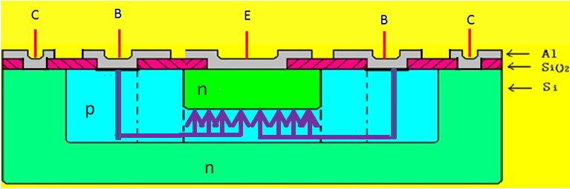
Explain emitter current crowding 基区扩展电阻及发射极电流集边效应
+
-
+
V_{BE}
V_{BE}

Slide 25
发射区重掺杂效应
$${10}^{17 }{ 10}^{18 }{ 10}^{19} { 10}^{20}$$

Slide 26
What is meant by high injection 大注入特性
准中性基区：

Slide 27
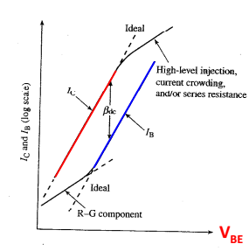
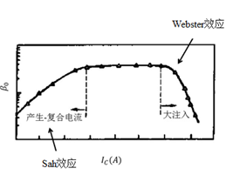
Sah效应和Webster效应

Slide 28
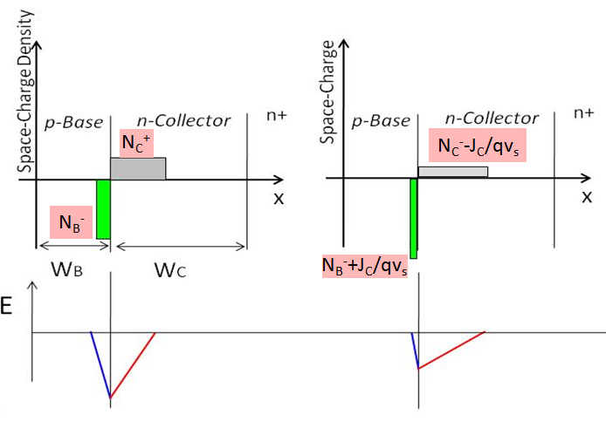
基区展宽效应——Kirk effect
+

Slide 29
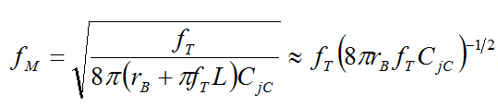
最高工作频率
双极晶体管功率增益为1时的频率
由于一般晶体管的输出阻抗大于输入阻抗，因此，即使β≤1，它仍可以获得功率放大。故为了说明晶体管工作频率上的限制，又专门定义功率增益等于1时的工作频率称为晶体管的最高振荡频率fm。
显然，当f=fm时，晶体管的功率放大倍数等于1。其输出端功率反馈到输入端时刚好可以维持振荡状态，如果频率再高一点，电路就会停止振荡。

Slide 30
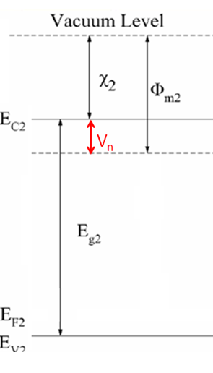

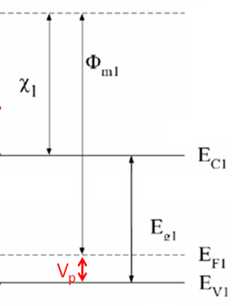
Heterojunction bipolar transistor 异质结晶体管

Slide 31
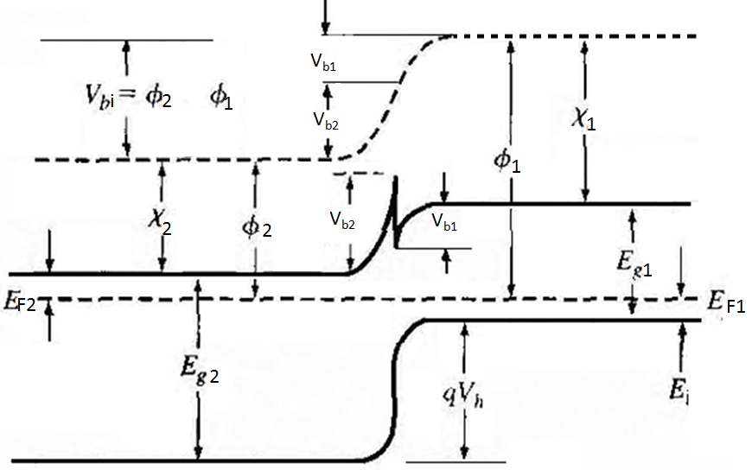

Vacuum level
$$∆E_{V}$$

Slide 32
N_{b}可提高至10²⁰/cm³
１、基区不容易穿通，从而厚度可以做小
２、R_{B}降低，f_{max}可提高
３、基区电导调制效应不明显，大注入效应不明显，改善大注入下的增益下降
４、基区电荷对输出电压不敏感，Early电压显著增大
N_{E}可降低到10¹⁷/cm³,
发射结耗尽层电容减少，电流放大截止频率f_{T}上升

Slide 33
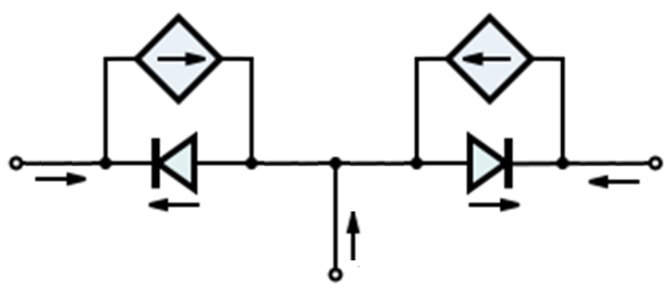
E-M模型
α_{R}I_{R}
α_{F}I_{F}
E
C
I_{E}
I_{C}
I_{F}
I_{B}
I_{R}
B

Slide 34
I_{EBO}（ I_{CBO} ）是集电极（发射极）开路的发射结（集电结）反射饱和电流

Slide 35
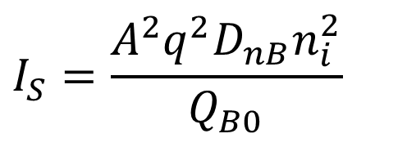
$$Q_{B0}=Aq\int_{0}^{W_{B}}{p_{B}\left(x\right)dx\left|\begin{aligned}&V_{BE}=0 \\ &V_{BC}=0\end{aligned}\right.}$$
$$I_{S}=\frac{A^{2}q^{2}D_{nB}n_{i}^{2}}{Q_{B0}}$$

Slide 36
$$I_{CC}=\frac{I_{S}Q_{BO}}{Q_{B}}\left\{\left[\exp\left({qV_{BE}}/{k_{B}T}\right)−1\right]−\left[\exp\left({qV_{BC}}/{k_{B}T}\right)−1\right]\right\} \\ ..........................发射极向集电极的传输电流 \\ I_{CE}=\frac{I_{S}Q_{BO}}{Q_{B}}\left[\exp\left({qV_{BE}}/{k_{B}T}\right)−1\right]...........正向传输电流 \\ I_{EC}=\frac{I_{S}Q_{BO}}{Q_{B}}\left[\exp\left({qV_{BC}}/{k_{B}T}\right)−1\right]...........反向传输电流 \\ I_{S}=−\frac{A^{2}q^{2}D_{nB}n_{i}^{2}}{Q_{B0}}.....................晶体管的饱和电流 \\ Q_{BO}=Q_{B0}=Aq\int_{0}^{W_{B}}{p_{B}\left(x\right)dx\left|\begin{aligned}&V_{BE}=0 \\ &V_{BC}=0\end{aligned}\right.}....热平衡时(V_{BE}=V_{BC}=0)基区的多子电荷总量 \\ Q_{B}=qA\int_{x_{E}}^{x_{C}}{p\left(x\right)dx}..........工作状态下基区多子电荷总量$$

Slide 38
新型高性能双极晶体管：
异质结晶体管（HBT——heterojunction-bipolar-transistor）
多晶硅发射极晶体管
锗硅基区晶体管

Slide 39
HBT——heterojunction bipolar transistor
Vacuum level

Slide 40
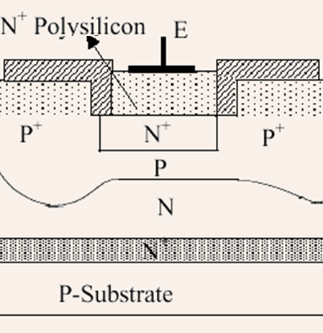
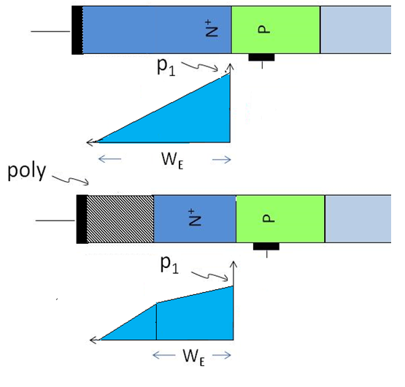
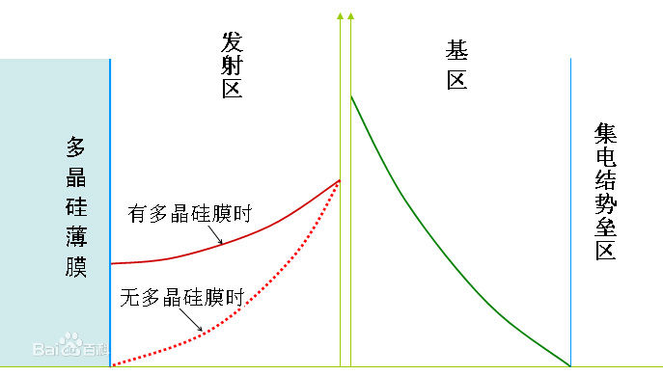
多晶硅发射极晶体管
多晶硅发射极晶体管示意图
多晶硅中载流子迁移率低，扩散系数小

Slide 41
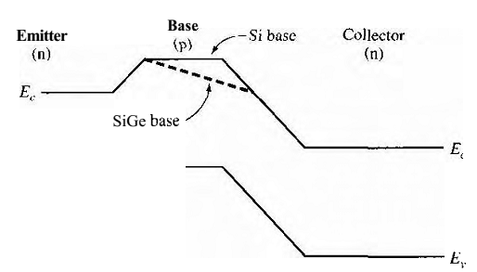
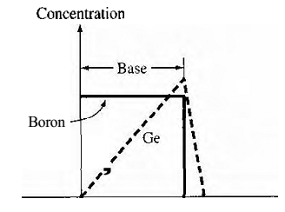
锗硅基极晶体管
E_{g}(Ge)=0.67eV
E_{g}(Si)=1.12eV
结构特点：将锗引进基区中它的分布特点是靠近发射
结处要尽量小，而靠近集电结处要尽可能 大。也就是说两个晶体管发射结是相同的，不同的是集电结。

Slide 42
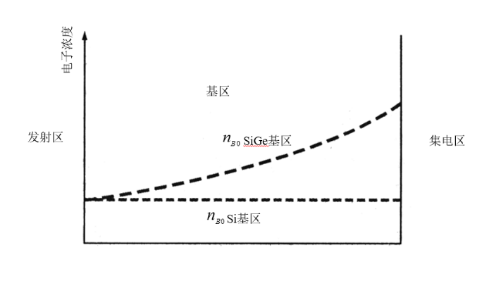
基区中平衡少子浓度随位置变化：
自建电场
自建电场的作用：
阻止少子扩散，维持基区准中性
加速注入少子的漂移运动，减小基区渡越时间

Slide 43
1. Describe the charge flow in an npn bipolar transistor biased in the forward-active mode. Is the current by drift or
diffusion? 2. Define the common-emitter current gain and explain why, to a first approximation, the current gain is a constant. 3. Explain the conditions of the cutoff, saturation, and inversed-active modes. 4. Sketch the minority carrier concentrations in a pnp bipolar transistor biased in the forward-active mode. 5. Define and describe the limiting factors in the common-base current gain. 6. What is meant by base width modulation? What is another term used for this effect? 7. What is meant by high injection? 8. Explain emitter current crowding. 9. Sketch simplified small-signal equivalent circuit for an npn bipolar transistor and explain when this equivalent circuit is used. 10. Describe the time-delay factors in the frequency limitation of the bipolar transistor. 11. What is the cutoff frequency of a bipolar transistor? 12. Describe the response of a bipolar transistor when it is switching between saturation and cutoff.
12. Deline I_{CBO} and I_{CEO}, and explain I_{CBO} < I_{CEO}
REVIEW QUESTIONS

Slide 44
CHECKPOINT
1. Describe the basic operation of the transistor. 2. Sketch the energy bands of the transistor in thermal equilibrium and when biased in the various operating modes. Calculate, to a good first approximation, the collector current as a function of base-emitter voltage. 3. Sketch the minority carrier concentrations throughout the transistor under the various operating modes. 4. Define the various diffusion and other current components in the transistor from the minority carrier distribution curves. 5. Explain the physical mechanisms of the current gain limiting factors. Define the current-limiting factors from the current components in the transistor. 6. Describe the physical mechanism of base width modulation and its effect on the current-voltage characteristics of the transistor 7. Describe the voltage breakdown mechanisms in a bipolar transistor 8.Describe qualitatively the four time-delay or time-constant components in the frequency response of the bipolar transistor.

