Slide 1
二极管交流小信号特性分析

Slide 2
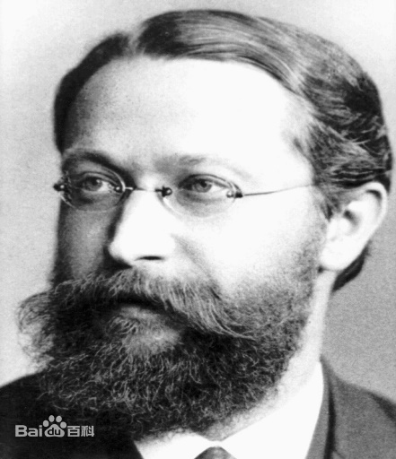
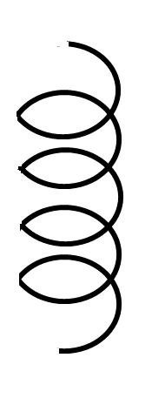
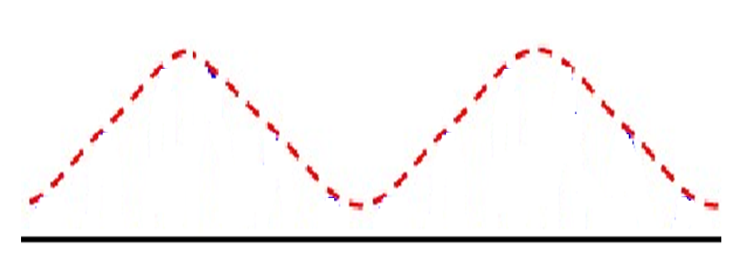
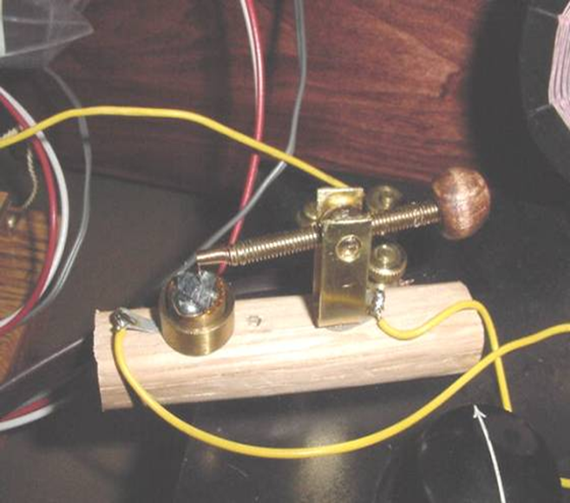

猫须探测器 cat whisker detector
斩波
卡尔·费迪南德·布劳恩
Karl Ferdinand Braun
▪ 发明阴极射线管
▪ 改进无线电通讯
▪ 无线电接收机
▪ 无线电发射机
1909年度诺贝尔物理学奖
调幅波
D
L
C
R_{L}
L:电感上产生射频电压
音频信号
C:高频滤波电容
PbS 猫须探测器
无线电接收器的简化电路
http://makearadio.com/misc-stuff/catswhisker.php
在古董和收藏家市场上可以看到
布劳恩与马可尼共获1909年度诺贝尔物理学奖
1904年弗莱明发明的真空管（整流，放大）
二战时真空管无限风光

Slide 3
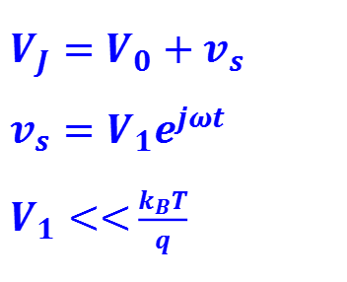
小信号交流分析
i_{s}:小信号响应
$$V_{J}=V_{0}+v_{s} \\ v_{s}=V_{1}e^{jωt}$$ $V_{1}<<$ $\frac{k_{B}T}{q}$
I₀
V₀
v_{s}:输入小信号

Slide 4



$$t_{1}$$
$$t_{0}$$
$$t_{2}$$

Slide 5

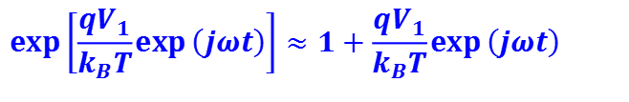


$$V(t)=V_{0}+V_{1}\exp{(}jωt)$$
$$p_{n}\left(x_{n},t\right)=p_{n0}\exp\left({qV_{J}}/{k_{B}T}\right)=p_{n0}\exp{[}\frac{qV_{0}}{k_{B}T}+\frac{qV_{1}}{k_{B}T}\exp{(}jωt)] \\ =p_{n0}\exp\left(\frac{qV_{0}}{k_{B}T}\right)\exp\left[\frac{qV_{1}}{k_{B}T}\exp\left(jωt\right)\right]$$
$${ =p}_{ns}\left(x_{n}\right)\exp\left[\frac{qV_{1}}{k_{B}T}\exp\left(jωt\right)\right]$$
$$V_{1}<<\frac{k_{B}T}{q}$$
$$\exp\left[\frac{qV_{1}}{k_{B}T}\exp\left(jωt\right)\right]≈1+\frac{qV_{1}}{k_{B}T}\exp\left(jωt\right)$$

Slide 6
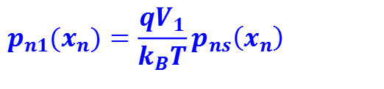

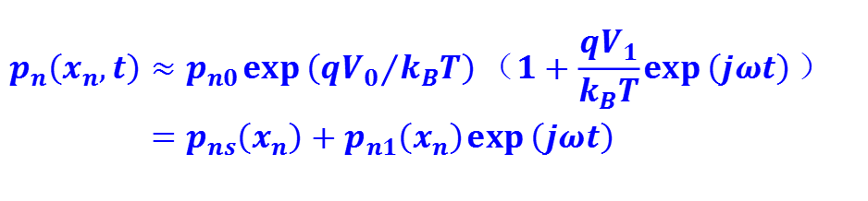
$$p_{n}\left(x_{n},t\right)≈p_{n0}\exp\left({qV_{0}}/{k_{B}T}\right)（1+\frac{qV_{1}}{k_{B}T}\exp\left(jωt\right)） \\ =p_{ns}\left(x_{n}\right)+p_{n1}\left(x_{n}\right)\exp\left(jωt\right)$$
$$p_{ns}\left(x_{n}\right)=p_{n0}\exp\left({qV_{0}}/{k_{B}T}\right)$$
$$p_{n1}(x_{n})=\frac{qV_{1}}{k_{B}T}p_{ns}\left(x_{n}\right)$$
$$p_{n}\left(x,t\right)=p_{ns}\left(x\right)+p_{n1}\left(x\right)\exp\left(jωt\right)$$

Slide 7
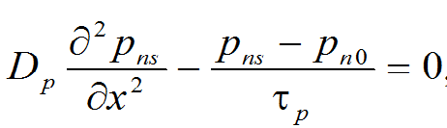
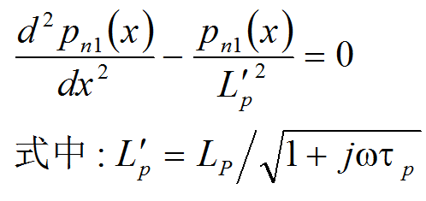

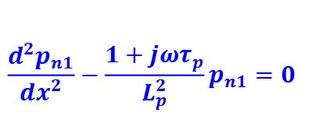

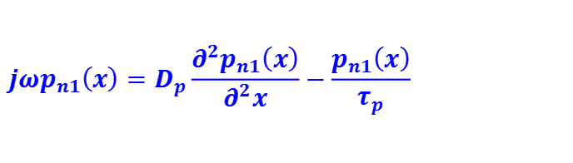
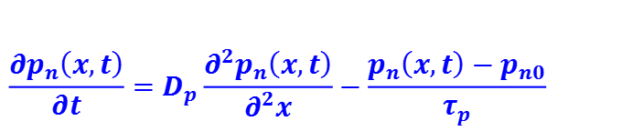
$$\frac{∂p_{n}\left(x,t\right)}{∂t}=D_{p}\frac{∂^{2}p_{n}\left(x,t\right)}{∂^{2}x}−\frac{p_{n}\left(x,t\right)−p_{n0}}{τ_{p}}$$
$$p_{n}\left(x,t\right)=p_{ns}\left(x\right)+p_{n1}\left(x\right)\exp\left(jωt\right)$$
$$\frac{∂p_{ns}\left(x\right)}{∂t}$$
$$jωp_{n1}\left(x\right)=D_{p}\frac{∂^{2}p_{n1}\left(x\right)}{∂^{2}x}−\frac{p_{n1}\left(x\right)}{τ_{p}}$$
$$\frac{d^{2}p_{n1}}{dx^{2}}−\frac{1+jωτ_{p}}{L_{p}^{2}}p_{n1}=0$$

Slide 8


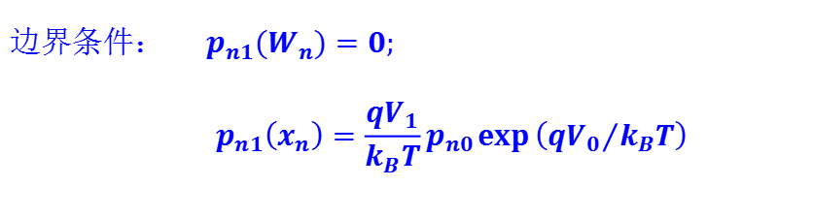
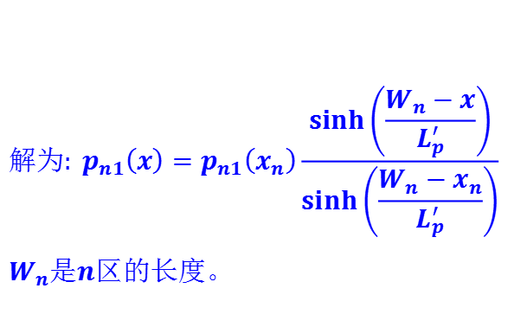
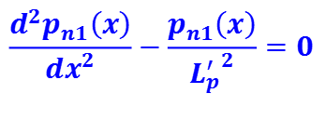
$$\frac{d^{2}p_{n1}\left(x\right)}{dx^{2}}−\frac{p_{n1}\left(x\right)}{{L_{p}^{′}}^{2}}=0$$
$$边界条件： p_{n1}(W_{n})=0; \\ p_{n1}\left(x_{n}\right)=\frac{qV_{1}}{k_{B}T}p_{n0}\exp\left({qV_{0}}/{k_{B}T}\right)$$
$$x_{n}$$
$$W_{n}$$
$$解为:{ p}_{n1}\left(x\right)=p_{n1}\left(x_{n}\right)\frac{\sinh\left(\frac{W_{n}−x}{L_{p}^{′}}\right)}{\sinh\left(\frac{W_{n}−x_{n}}{L_{p}^{′}}\right)} \\ W_{n}是n区的长度。$$
$$t_{1}$$
$$t_{0}$$
$$t_{2}$$

Slide 9
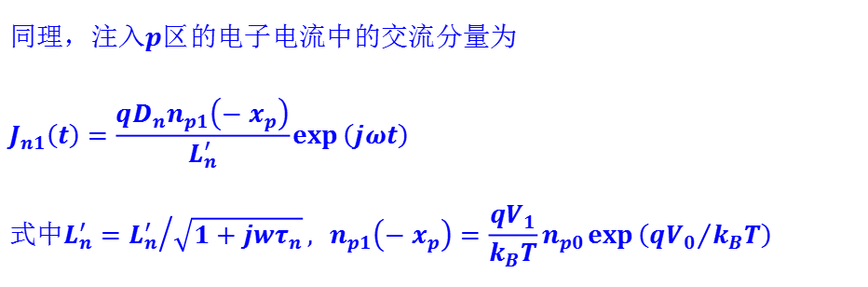
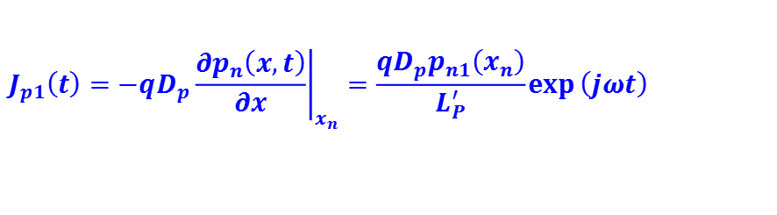
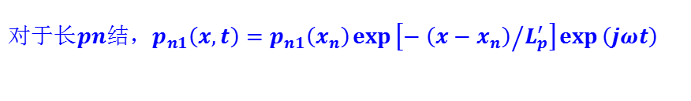
$$对于长pn结，p_{n1}\left(x,t\right)=p_{n1}\left(x_{n}\right)\exp\left[{−\left(x−x_{n}\right)}/{L_{p}^{′}}\right]\exp\left(jωt\right)$$
$$J_{p1}\left(t\right)={\left.−qD_{p}\frac{∂p_{n}\left(x,t\right)}{∂x}\right|}_{x_{n}}=\frac{qD_{p}p_{n1}\left(x_{n}\right)}{L_{P}^{′}}\exp\left(jωt\right)$$
$$同理，注入p区的电子电流中的交流分量为 \\ J_{n1}\left(t\right)=\frac{qD_{n}n_{p1}\left(−x_{p}\right)}{L_{n}^{′}}\exp\left(jωt\right) \\ 式中L_{n}^{′}={L_{n}^{′}}/{\sqrt{1+jwτ_{n}}}{, n}_{p1}\left(−x_{p}\right)=\frac{qV_{1}}{k_{B}T}n_{p0}\exp\left({qV_{0}}/{k_{B}T}\right)$$

Slide 10


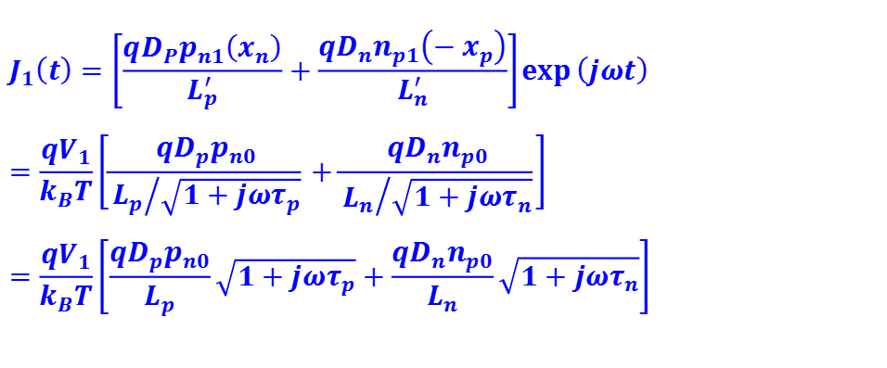
$$J_{1}\left(t\right)=\left[\frac{qD_{P}p_{n1}\left(x_{n}\right)}{L_{p}^{′}}+\frac{qD_{n}n_{p1}\left(−x_{p}\right)}{L_{n}^{′}}\right]\exp\left(jωt\right) \\ =\frac{qV_{1}}{k_{B}T}\left[\frac{qD_{p}p_{n0}}{{L_{p}}/{\sqrt{1+jωτ_{p}}}}+\frac{qD_{n}n_{p0}}{{L_{n}}/{\sqrt{1+jωτ_{n}}}}\right] \\ =\frac{qV_{1}}{k_{B}T}\left[\frac{qD_{p}p_{n0}}{L_{p}}\sqrt{1+jωτ_{p}}+\frac{qD_{n}n_{p0}}{L_{n}}\sqrt{1+jωτ_{n}}\right]$$
$$\exp\left({qV_{0}}/{k_{B}T}\right)$$
$$\exp\left(jωt\right)$$
$$J_{p1}+J_{n1}$$
$J_{p1}=I_{p1}e^{jωt}$ $I_{p1}=\frac{qV_{1}}{kT} (1+jωτ_{p})^{\frac{1}{2}}I_{p0} I_{p0}=\frac{qD_{p}p_{n}}{L_{P}}e^{qV_{0}/kT}$
$J_{n1}=I_{n1}e^{jωt} I_{n1}=\frac{qV_{1}}{kT}(1+jωτ_{n})^{1/2}I_{n0}$ $I_{n0}=\frac{qD_{n}n_{p}}{L_{n}}e^{qV_{0}/kT}$

Slide 11
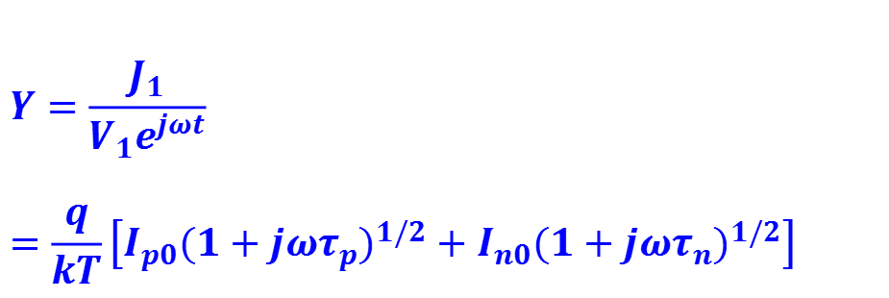
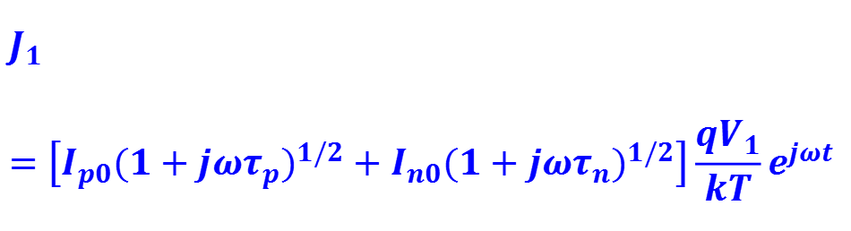
$$J_{1}=\left[I_{p0}(1+jωτ_{p})^{1/2}+I_{n0}(1+jωτ_{n})^{1/2}\right]\frac{qV_{1}}{kT}e^{jωt}$$
交流导纳：
$$Y=\frac{J_{1}}{V_{1}e^{jωt}} \\ =\frac{q}{kT}\left[I_{p0}(1+jωτ_{p})^{1/2}+I_{n0}(1+jωτ_{n})^{1/2}\right]$$

Slide 12

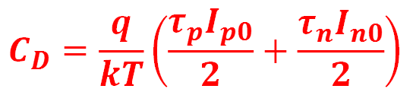
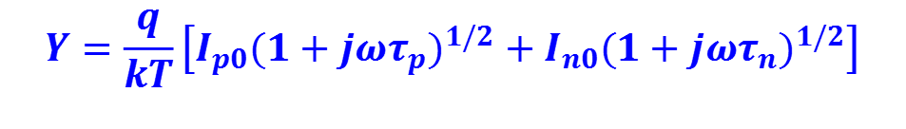
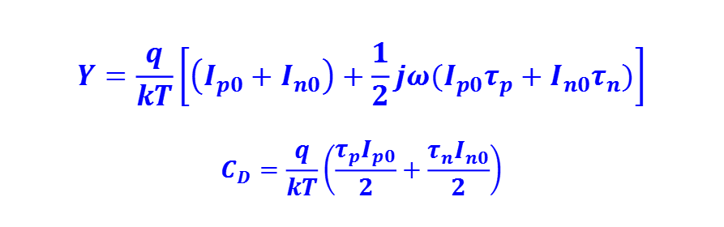
$$Y=\frac{q}{kT}\left[I_{p0}(1+jωτ_{p})^{1/2}+I_{n0}(1+jωτ_{n})^{1/2}\right]$$
$$ωτ_{p}<<1, ωτ_{n}<<1$$
$$Y=\frac{q}{kT}\left[\left(I_{p0}+I_{n0}\right)+\frac{1}{2}jω(I_{p0}τ_{p}+I_{n0}τ_{n})\right] \\ C_{D}=\frac{q}{kT}\left(\frac{τ_{p}I_{p0}}{2}+\frac{τ_{n}I_{n0}}{2}\right)$$
$G=\frac{q}{kT}\left(I_{p0}+I_{n0}\right)$ $=\frac{qI_{0}}{kT}$
$$C_{D}=\frac{q}{kT}\left(\frac{τ_{p}I_{p0}}{2}+\frac{τ_{n}I_{n0}}{2}\right)$$

Slide 13
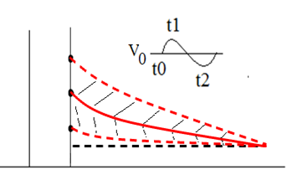
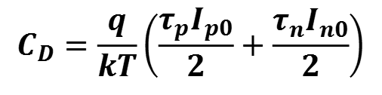
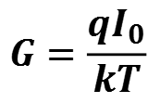
$$G=\frac{qI_{0}}{kT}$$
二极管直流电导也叫做扩散电导，其倒数叫做PN结扩散电阻。
$$C_{D}=\frac{q}{kT}\left(\frac{τ_{p}I_{p0}}{2}+\frac{τ_{n}I_{n0}}{2}\right)$$
称为P-N结扩散电容。是正偏压下PN结准中性区中存贮电荷随偏压变化引起的电容，随直流偏压的增加而增加。所以，在低频正向偏压下，扩散电容特别重要。

Slide 14
小提示
以上讨论，前提条件是交流信号的周期远大于载流子在准中性区中扩散所需要的时间。这样在扩散区中空穴随位置的变化函数可以认为是稳态分布的 。
在正向偏置下扩散电容要远大于势垒电容。
T=300K,N_{d}=5×10¹⁶,N_{a}= 5×10¹⁵,V_{R}=5V, 势垒电容C=0.366pF.

Slide 15
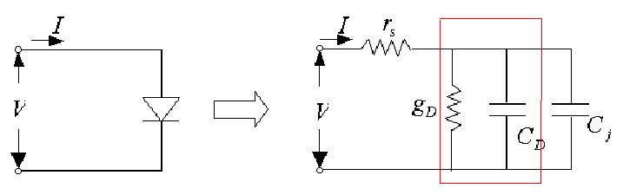
二极管小信号等效电路

Slide 16
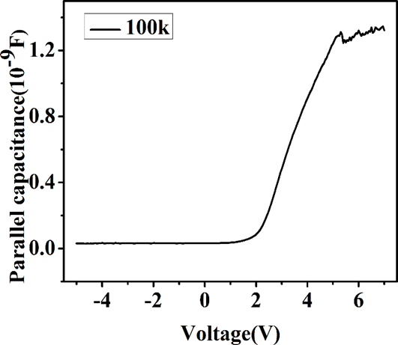
Au/n-SiC/Au
1.频率的关系
2.扩散电容远大于势垒电容

Slide 17
作业
Consider a P⁺N silicon diode at T=300K. The diode is forward biased at a current of 1 mA. The hole lifetime in the n region is 10⁻⁷ s. Neglecting the depletion capacitance calculate the diode impedance at frequencies of 10 kHz, 100 kHz, 1MHz and 10MHz.
Consider a P⁺N silicon diode at T=300K. The slope of the diffusion capacitance versus forward-bias current is 2.5×10⁻⁶ F/A. Determine the hole lifetime and the diffusion capacitance at a forward-bias current of 1mA.

