Slide 1
Week 04

Slide 2
Warm-up (10 minutes)
What does bash stand for and what is it used for? What bash command do we use to change directories? How do we print the working directory?
Open a jupyter notebook. Create a list = [1,2,3,4,5,6,7,8]. Iterate through the list and only return the even values.

Slide 3
Today's Activities
Warmup (15 mins)
Homework Answers/Q&A (30 mins)
Numpy practice (30 mins)
Break (15 mins)
Pandas Overview(45 mins)
Group Exercise (45 minutes)

Slide 4
Homework Answers (30 mins)
To save some time I will discuss a subset of answers.
Voluntarily slack answers to the #datascience channel
Don't be shy!

Slide 5
NumPy Overview
Arrays
Array Shaping and transposition
Array Math
Array Indexing and slicing
NumPy is all about arrays!

Slide 6
Shaping
a = np.array([1,2,3,4,5,6])
a = a.reshape(3,2)
a = a.reshape(2,-1)
a = a.ravel()
Total number of elements cannot change.
Use -1 to infer axis shape
Row-major by

Slide 7
Transposition
a = np.arange(10).reshape(5,2)
a = a.T
a = a.transpose((1,0))
np.transpose permutes axes.
a.T transposes the first two axes.

Slide 8
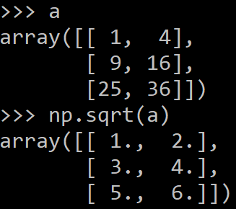
Math, universal functions
Also called ufuncs
Element-wise
Examples:
np.exp
np.sqrt
np.sin
np.cos
np.isnan

Slide 9
Indexing
a[0,0] # top-left element
a[0,-1] # first row, last column
a[0,:] # first row (many entries)
a[:,0] # first column (many entries)
Notes:
Zero-indexing

Slide 10
Python Slicing
Syntax: start:stop:step
a = list(range(10))
a[:3] # indices 0, 1, 2
a[-3:] # indices 7, 8, 9
a[3:8:2] # indices 3, 5, 7
a[4:1:-1] # indices 4, 3, 2 (this one is tricky)

Slide 11
Numpy Exercise (5 min)
Write a NumPy program to create a 3x3 matrix with values ranging from 2 to 10
Find the square root of all the values in this Numpy array

Slide 12
Break (15 Minutes)
Attendance word: TopTechnologist

Slide 13
Pandas
Python module used for data analysis and exploration
Two main useful data structures:
Series
DataFrames
Can import data files and turn them into DataFrames
CSV (comma-separated values)
If you get stuck, look at the documentation! It is pretty good.

Slide 14
Pandas exercise (10 minutes)
Import the Belize_Airbnb_listings csv
Create a new dataframe that take the original dataset and groups the data by neighborhood and finds the average price, number of reviews, and availability_365
In short, you’re looking for the average price, number of reviews, and availability per neighborhood.
Think about what you should Google for if you’re stuck!
Notes:
https://pandas.pydata.org/docs/reference/api/pandas.core.groupby.GroupBy.mean.html

Slide 15
Week 3 Group Exercise
If you are logged in to Zoom with your email you use to login to Canvas, you should be automatically put in the right room.

