Slide 1
Week 05

Slide 2
Warm-up (7 minutes)
Take the belize_Airbnb_listings.csv from last time and create a dataframe that shows the max price per neighborhood AND average price per neighborhood.
What does CSV stand for?
What is a delimiter?
If you have time, sort your resulting dataframe alphabetically from A-Z.

Slide 3
Today's Activities
Warmup (15 mins)
Homework Answers/Q&A (30 mins)
APIs practice (40 mins)
Break (15 mins)
Plotting Overview(20 mins)
Group Exercise (60 mins)

Slide 4
Class Requirements
You must have turned in at least 5 of the first 6 assignments by April 14th to continue in this course!
You need to have an average of 70% or above on those assignments.

Slide 5
Homework Answers (30 mins)
To save some time I will discuss a subset of answers.
Voluntarily slack answers to the #datascience channel
Don't be shy!

Slide 6
APIs
API = Application Programming Interface
Allows applications to talk to each other
Read https://restfulapi.net/http-methods/

Slide 7
OpenWeatherMap API
Free Weather API
https://openweathermap.org/
Create your account.
Generate API Key.
Create a file called api_keys.py
add a variable api_key = 'YOUR API KEY HERE'
Save API key.
Add .gitignore file
Open your terminal.
cd into your repo where you store this exercise.
touch .gitignore
open .gitignore
add a line api_keys.py to the file
this file will instruct git to ignore these files
You do not want API keys to be available to the public!

Slide 8
API Examples
APIs.ipynb

Slide 9
Break (15 Minutes)
Attendance word: GoogleGuru

Slide 10
Matplotlib plotting
Edward Tufte’s
Graphical Integrity Principles:
Representations of numbers should match their true proportions.
Labeling should be clear, detailed and thorough.
Designs should show only data variations, not design variation.
Standardized units are best when representing money.
The number of dimensions visualized should equal the number of dimensions in the data.
Representations should not imply a subjective or false context.

Slide 11
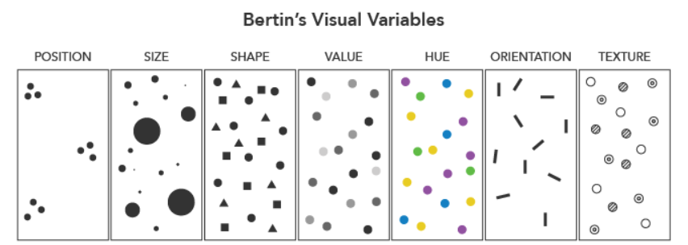
Visual Variables

Slide 12
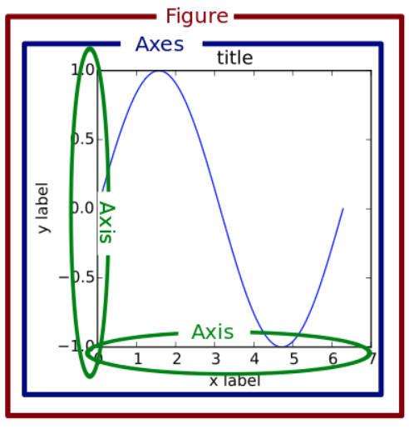
Components of a plot

Slide 13
Plotting exercise (10 minutes)
Import the Belize_Airbnb_listings csv
Create a new dataframe that take the original dataset and groups the data by neighborhood and finds the average price, number of reviews, OR availability_365
Create an appropriate chart to show one of these graphically
Notes:
https://pandas.pydata.org/docs/reference/api/pandas.core.groupby.GroupBy.mean.html

Slide 14
Week 3 Group Exercise
Once you finish and have submitted your exercise properly, please feel free to go back to any previous homeworks and ask questions you have about them OR start working on next week’s assignment!

