Slide 1
Week 02

Slide 2
Warm-up (5 minutes to complete)
#whats wrong with this code?
#what is it doing?
num = str(input("Enter a number: "))
if num % 2 = 0:
print("Even")
else
print("Odd)

Slide 3
Today's Activities
Lots of material to get through so we will be moving fast!
Warm-up (15 minutes)
Good struggle vs Bad struggle (15 minutes)
Our expectations
Creating your own repo and pushing your assignments to it (30 minutes)
Exercise
gitignore files (5 mins)
Review Homework and Any Questions (30 minutes)
Break (10 minutes)
Flow control (20 minutes)
Exercise
Survival Guide (15 minutes)
Group Exercise (40 minutes)

Slide 4
Week 2 Assignments
The Class Repo is the place to find assignments.
Each week you may have in class assignments that are due on Fridays at 8:00pm.
Usually finishing anything not done in class.
Homework assignments are due Wednesdays at 5:30pm
Ask Questions in Slack. Don't ask them in Canvas.
Start Early and ask questions!

Slide 5
Q & A
Ask us anything!
Don't ask questions in Canvas. It is not monitored closely.
Ask questions in Slack.
Ask anything. There are no silly questions.
Don't just read and watch videos.
Read. Then do!
Watch. Then do!
Close the readings and do it from memory.
Interact with each concept.
Use Office Hours!
Most important! Don't get discouraged. This is week 2. The pieces will start to fit together as you proceed.

Slide 6
Expectations
You should be spending about 15 hours on your homework and readings and DataCamp PER WEEK outside of class
If you don’t have much of a foundation in programming, it will likely take you more time in the beginning
We will be covering many data science topics at a higher level instead of digging into the intricacies of the math. Why?
We are learning tools to put in your toolbox for solving problems
Interviews for entry level jobs are not focused on the math intricacies but rather on knowing how models work and how to evaluate them
We care about you and your learning, but we are also busy. This is NOT our full-time job
Be growth minded:
Even if you struggle on some early assignments, you have the capacity to improve and become an amazing programmer

Slide 7
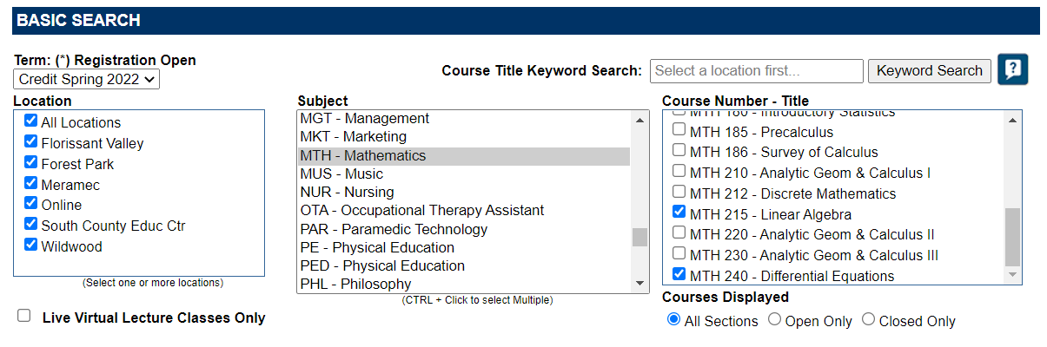
Some Classes to Take
https://applications.stlcc.edu/ClassSchedule/Term_Courses.asp
Linear algebra has prereq of Calc 1 and Diff EQ has a prereq of Calc 3

Slide 8
Good Struggle vs Bad Struggle
Good struggle is working a problem and solving it in a reasonable amount of time.
Exercising cognitive muscles. Challenging but progress is made.
Feeling of satisfaction when the problem is solved.
Important for growth and real learning.
Bad struggle is working on a problem and making little or no progress in a large amount of time.
Feelings of frustration. Anger.
Does nothing to foster learning.
Rule of thumb:
Stuck on a HW problem for more than 15 mins?
Consider skipping and returning to it later. You might find insight in other problems.
Stuck >30mins?
Post to Slack
Post sooner than later in the week.
Students should answer questions. Mentors will only step in when needed.
No Slack help?
Reply to your post with @mentors "Any insights?".
Give us 24hrs to respond.

Slide 9
Everything is hard before it is easy.

Slide 10
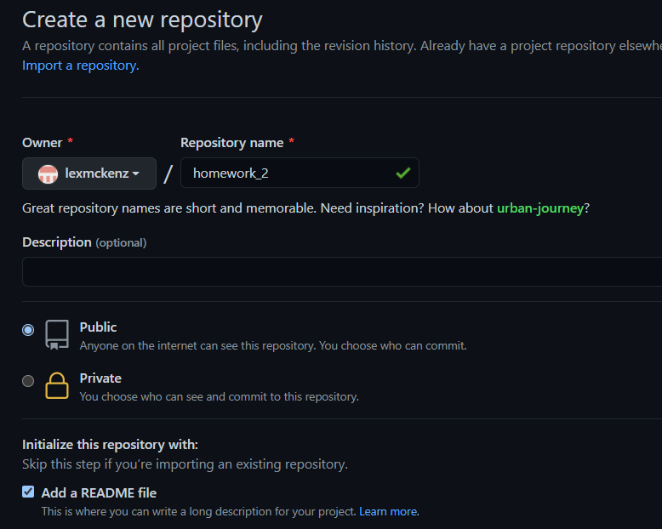
Creating Your own Repo
Create a repo inside your github account called homework_2
Open github and create a new repository
WARNING!!! These repos are public!
Private info, passwords API keys are NOT to be stored in repos!

Slide 11
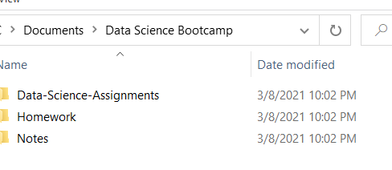
Where do you clone your HW repo?!?!?!
Do NOT put it in the repo for the course material (Data-Science-Assignments)
Make sure you store your notes and HW assignments in a different folder from the class repo (called Data-Science-Assignments)
It will get overwritten if you don’t!

Slide 12
Congrats! You have your first repo!
Clone your repo into a logical location!
Copy your homework2.ipynb file into homework_02 repo (or homework repo)
Cd into your homework_02 repo
git add .
Git add . is probably not best practice. Use the exact filename instead!
git commit –m 'adding homework'
git push
Homework will now be a link to your repo.
Make changes. Git add, git commit, git push!

Slide 13
Git practice (5 minutes)
Make a directory to store your homework 2 assignment in
Edit the readme.md file with your name, a title, and a description of what homework 2 is about (look in the class repo)
Push your changes to github
Git add .
Git commit –m “your message”
Git push

Slide 14
.gitignore
Untracked files . What is a dot file?

Slide 15
What is an interpreter?
What interpreter are we using for python thus far?
Notes:
A program that executes instructions written in a programming language. Parses the code, translates code into intermediate form and executes that, executed precompiled code. VS code is an editor that references installed interpreters. We have used ipython thus far (does more than just python interpreter)

Slide 16
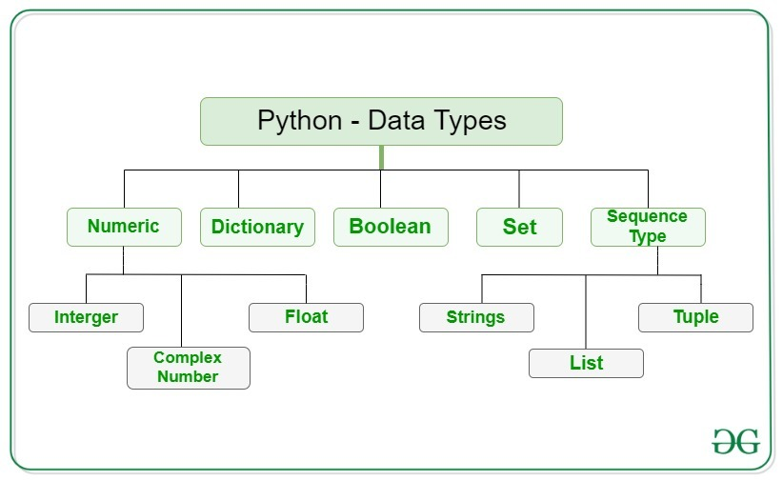
Python Data types
Notes:
https://www.geeksforgeeks.org/python-data-types/ yeah “integer” is spelled wrong

Slide 17
Python Flow control
If… elif… else
for
While
Range

Slide 18
Break (10 Minutes)
We will always have a break about midway through class. You need a breather, we need a breather, breaks are good.

Slide 19
Review Week 1 Homework

Slide 20
Installation Corrections
Everyone together (please do this with the class):
In a terminal: python --version
If you do not have python 3.X as a version let us know
In a terminal: pip --version
If you do not have pip3 let us know
Aliasing (not everyone had to do this last week)
When we did alias python='python3' it likely did not persist
Why? Some commands are set for the session only.
Set aliases in .bashrc or other .xxxrc file.
cd ~
ls –la
Find .bashrc or equivalent
If it does not exist that's ok!
touch .bashrc or equivalent
vim .bashrc or equivalent
Hit the 'i' key to toggle to insert mode
Type alias python='python3' and hit 'return'
Type alias pip='pip3'
Hit escape key followed by :wq and hit enter
Close terminal and open new terminal
See python and pip versions again and let us know if they are incorrect

Slide 21
Installation Corrections
Now that everyone has the correct python/pip we can correct some installs
Last week 'pip install jupyter lab'
Same as pip install package1 package2 package3
pip uninstall lab
pip uninstall jupyter
pip uninstall (anything else jupyter related you might have tried) (jupyter-lab)
pip install jupyterlab
Pip install notebook (this is the classic jupyter)
jupyter lab
Close terminal
jupyter notebook
Any issues let us know!

Slide 22
Survival Guide
Intro
Did anyone find value in this?
Comments, questions?
Learning How to Learn and Deep Work

Slide 23
Group Exercise
Clone the repo! The exercise is in week 2.

