Slide 1
Week 09

Slide 2
Warm-up (10 minutes)
Use the agg function to find the mean, median, and standard deviation of the price for the belize Airbnb data (in week 4). Describe what you’re seeing in as simple of terms as possible.
Use the documentation:
https://pandas.pydata.org/docs/reference/api/pandas.DataFrame.agg.html

Slide 3
Today's Activities
Warmup (10 mins)
Presentations (75 mins)
Break (15 mins)
Basic Probability in Python (30 mins)
Group Exercise (50 mins)

Slide 4
Class Memo
We will no longer accept in-class assignments that are more than a week late!
Any currently late ones can be turned in before April 30th for a max of 90% credit.

Slide 5
Presentations (75 mins)

Slide 6
Break (5 Minutes)
Attendance word: OutstandingOpsEngineer

Slide 7
What is probability?
Notes:
How frequently we expect an outcome to occur if we repeat an experiment over repeatedly.

Slide 8
Random Variables
A random variable, x, is a variable where the possible outcomes are a function of a random phenomena.
The probability for any event is between 0 and 1, inclusive
The summation of the probabilities of each outcome equals 1
We use a random seed to make sure our results are repeatable.

Slide 9
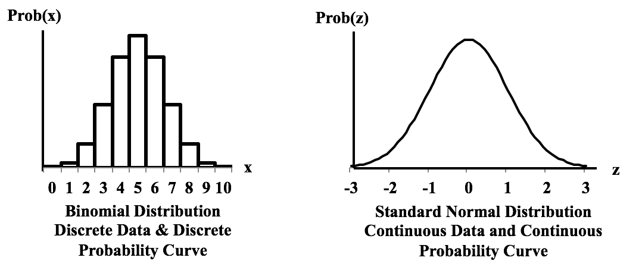
Discrete and Continuous
What is an example of something continuous? Discrete?
Notes:
statisticsfromatoz.com/blog/statistics-tip-of-the-week-different-distributions-can-have-discrete-or-continuous-probability-graphs-for-discrete-or-continuous-data

Slide 10
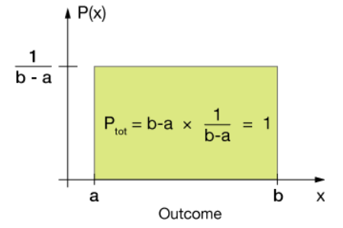
Uniform Distribution
Notes:
https://xaktly.com/UniformProbDistr.html

Slide 11
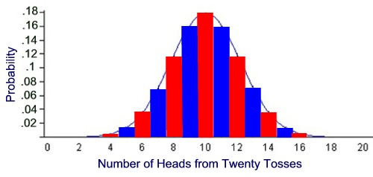
Binomial Distribution
Notes:
https://mathbitsnotebook.com/Algebra2/Probability/PBBinomialProbNormalCurve.html

Slide 12
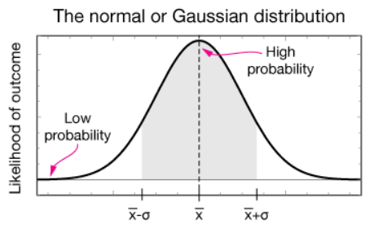
Normal Distribution

Slide 13
Expected Value
Law of large numbers – as the sample size increases the sample mean gets closer to the population mean
Uniform distribution – for a random variable, expected value is (a+b)/2, where a is the maximum possible value and b is the minimum
Binomial distribution – mean is the expected value, which is equal to n trials * p probability
Standard normal distribution – mean

Slide 14
Practice (5 mins)
What is the point of creating a random seed in probability?
What is the expected value for the number of heads in 50 trials of coin tosses?

Slide 15
Break (5 Minutes)
Attendance word: OutstandingOpsEngineer

Slide 16
Week 9 Group Exercise
Once you finish and have submitted your exercise in Canvas via a github link, use the remaining time to work on your homework.

