Slide 1
Week 23

Slide 2
Warm-up (10 minutes)

Slide 3
Today's Activities
Warmup (15 mins)
Review Homework (30 mins)
Document DB vs Relational reading (15 mins)
Mongo DB (30 mins)
Break (15 mins)
Final Project Breakout (30 mins)
Group Exercise (45 mins)

Slide 4
Review Homework

Slide 5
Questions from Reading
What is the shortcut to open dev tools and highlight the element you want to scrape? Try it! Does it work for you?
What do you do if an element you want to scrape takes time to load on the page?
Notes:
https://www.scrapingbee.com/blog/selenium-python/

Slide 6
Break (15 Minutes)
Attendance word:CSSConjurer

Slide 7
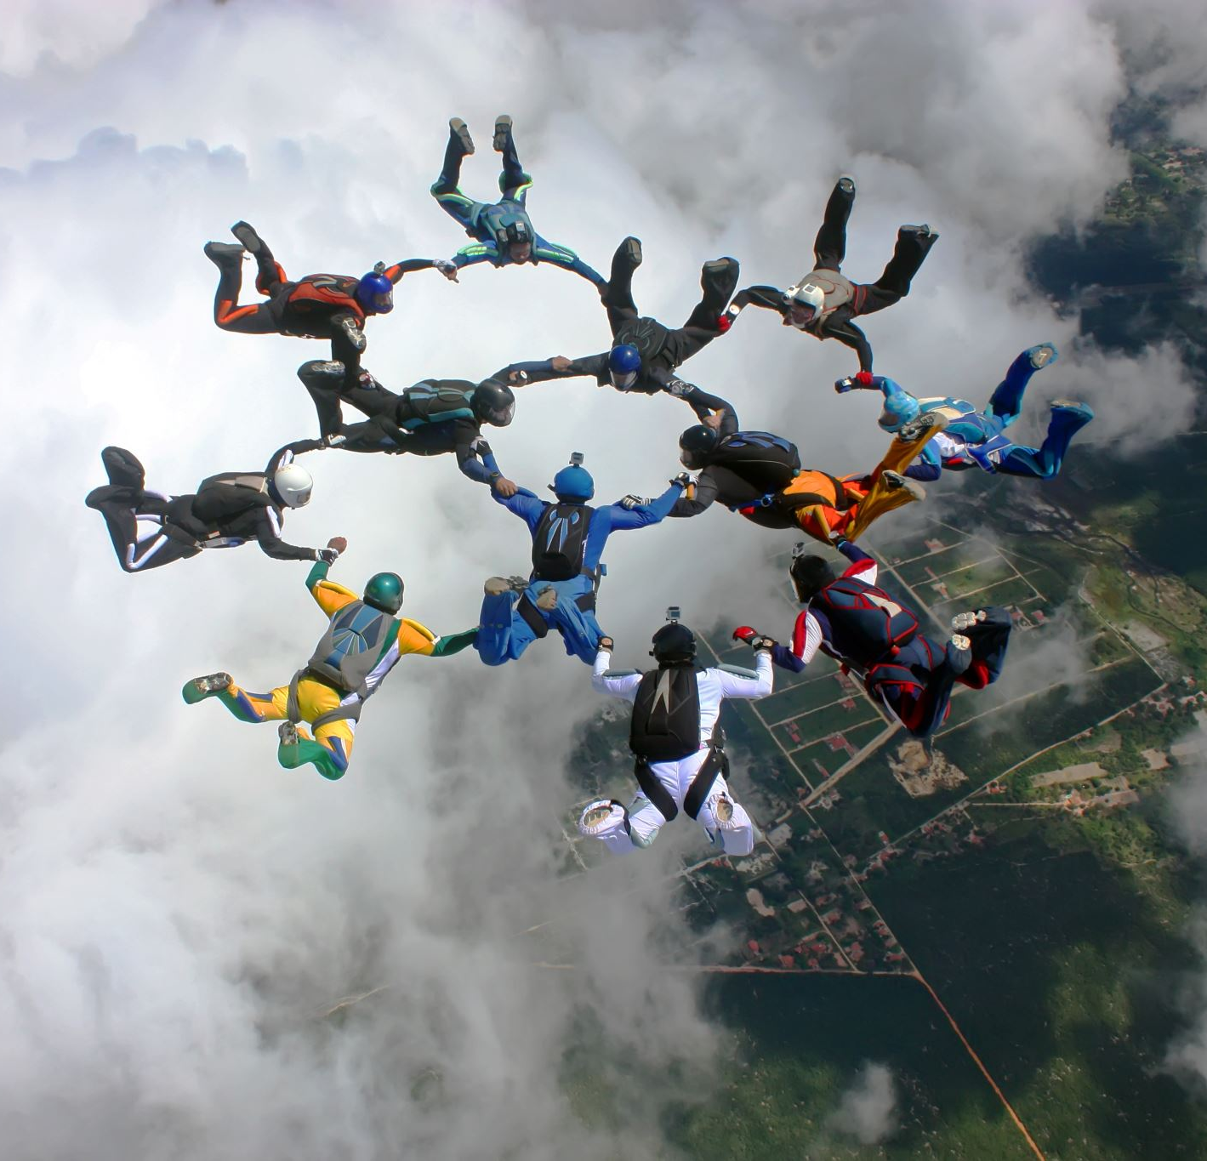
Group Project Work (30 mins)

Slide 8
Week 23 Group Exercise
Once you finish and have submitted your exercise in Canvas via a github link, use the remaining time to work on your homework.

