Slide 1

Auto Loan Modeling and Scoring
Alix Morales
Special thanks to Michael Flock for the opportunity

Slide 2
About Me
Rising sophomore at Emory
Applied Mathematics and Statistics
GA born and raised
Hobbies:
Music & playing my guitar
Skating & anything involving movement
Sports card collecting
Occasionally reading a book

Slide 3





Project Overview
Splitting Data
Initial Client Data
Data Cleaning & Prepping
Training
&
Validation
Data
Model 1
Valuation Matrix
Data Cleaning & Prepping
IRS Data
Model 2
Joining Data
JDP Reliability Data
*Data from Ritter
Craigslist Pricing Data

Slide 4
Incorporated Data Science Techniques
Binning
Modeling Methods
Statistical Testing
Raw Data Cleaning
Decision Making & Application
Notes:
Binning: Optimized binning (SEPARATION & MONOTONICITY)
Modeling: Tested various Models (LOG /binary/ VS LINEAR /continuous/)
Testing: ANOVA, SPEARMAN, T-TEST
Big Data: Techniques for working with big raw data
Decision Derivation: Deciding significance & assigning cutoffs

Slide 5
Model 1: Buyer Demographics
Can we determine liquidation ratios from buyers?
Most Significant Variables
time paying
capital sunk ratio
the state of Texas
account balance at closure
the state of Florida
origination balance
average tax returns
Formula:
Liquidation Ratio = 0.299 + (0.254)(capital sunk ratio every 25%) - (0.120)(account balance at closure every $5000) – (0.037)(Texas) + (0.003)(time paying every 100 days)
Is it any good?
83% Accuracy
WOW!
Notes:
Discuss estimates -> Discuss P-Values -> Jump to R-Squared… seems pretty strong
Jump to qq plot

Slide 6
Model 2: Vehicle Information
Can vehicle data be used to predict liquidation ratios?
Most Significant Variables
mileage
loan-to-value ratio
model age
reliability score
Hummer
luxury car
work vehicle
Dodge truck
Subaru
Fiat
value
Formula:
Liquidation Ratio = 1.006 + (0.067)(model age every 2 years) + (0.117)(work vehicle) + (0.061)(reliability score quartile) + (0.428)(Hummer) + (0.083)(Dodge truck) – (0.062)(loan-to-value deciles) – (0.00003)(mileage) –(0.0002)(value) – (0.096)(luxury car) – (0.282)(Subaru) – (0.443)(Fiat)
Is it any good?
8.5% Accuracy
Yikes
Notes:
Discuss estimates -> Discuss P-Values -> Jump to R-Squared… seems pretty strong
Jump to qq plot

Slide 7
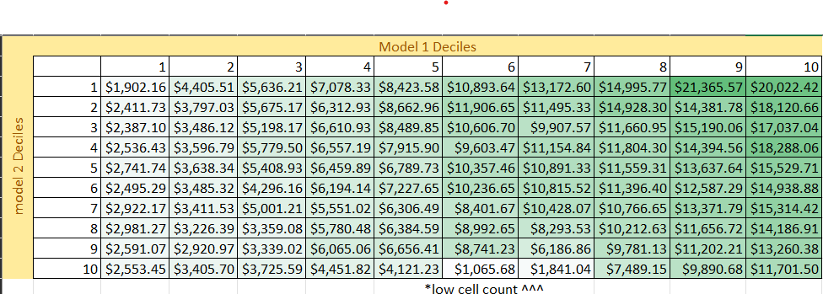
Matrix: Evaluating Portfolios
Can we value portfolios based on debtors' rankings?
Mapping Decile Rankings and Evaluating Cells
Average Predicted Debt Value for observations in decile 1 for both model 1 and model 2
Debt Value Formula:
Average(model 1 predictions*10 & model 2 predictions*1) * origination balance
Model Strength Visualized
Notes:
Explain how to get value for one cell then just say its rinse and repeat.
Discuss how I got these values what they mean and note the low cell count
Use: helps give a value to future debt observations and ultimately give the portfolio a value

Slide 8
Matrix Recap: Improved Modeling
What does this mean?
Revising Model 2 Shortcomings & Possible Improvements
Different Binning & Modeling Methods?
More Data?
Vehicle Data =/= Predictable
8
Notes:
Discuss Model 2 shortcomings, could use more data, optimal binning, different model type

Slide 9
Conclusion
Things I Have Learned:
The importance of binning
Methods for modeling
Applications of statistical concepts
Day-to-day processes and career outlook
Future Plans:
Study Math in Budapest
Get Into Sports Analytics
Special thanks to Michael Flock, William Bowers, and Dr. Priestley
And to the rest of the Flock team for welcoming me
Notes:
Give thanks, describe 4 things I learned, my future plans

