Slide 1
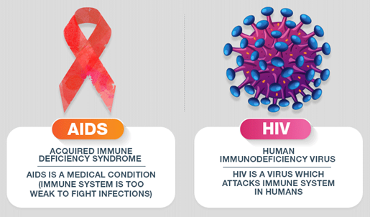
ACQUIRED IMMUNE DEFICIENCY SYNDROME (AIDS)
Dr Ayesha Fatima
Pharm D
Assistant Professor
Dept of Pharmacy Practice

Slide 2
INTRODUCTION
  AIDS was first described in 1981 as a new disease.
  In 1983, the causative agent was identified as Human Immunodeficiency Virus (HIV).
  HIV is a retrovirus. It is classified into:
      HIV-1 (most common and virulent)
      HIV-2 (less virulent, mainly in West Africa)
  HIV primarily attacks CD4+ helper T cells.
  Leads to: Progressive immune system destruction
  Increased susceptibility to: Opportunistic infections, Malignancies
  According to Joint United Nations Programme on HIV/AIDS: Approximately 34 million people are living with HIV/AIDS.
  High prevalence regions: Sub-Saharan Africa, Asia, South America
  High-Risk Groups
      Individuals with: Multiple sexual partners , STIs
      Intravenous drug users
      Healthcare workers (occupational exposure)
      Infants born to HIV-positive mothers

Slide 3
Modes of Transmission
HIV is transmitted through three main routes:
Sexual Transmission
Most common mode.
Includes: Receptive anal intercourse , Vaginal intercourse
Risk increases with: Existing sexually transmitted infections (STIs):
    Syphilis
    Gonorrhea
    Chlamydia
    Herpes simplex
    Trichomoniasis
    Chancroid
Condom use reduces risk by ~20-fold
Parenteral Transmission
  Through exposure to infected blood:
    Sharing needles (common in drug addicts)
    Blood transfusion with infected blood
  Healthcare workers:
    Risk via needle-stick injuries
Perinatal (Vertical) Transmission
  From mother to child
  Occurs: During pregnancy, At delivery, Through breastfeeding
  Risk without treatment: Approximately 40%
  Key factor: Maternal viral load at delivery

Slide 4
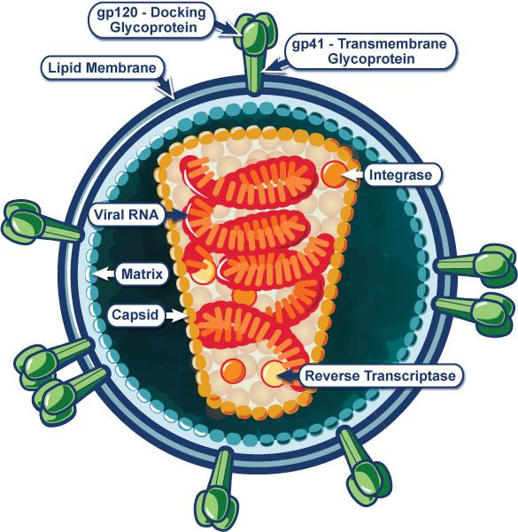
Morphologic Structure of HIV-1
Human Immunodeficiency Virus Type 1 belongs to the lentivirus subgroup of retroviruses.
Diameter: ~100 nm
Shape: Spherical, enveloped virus
Surrounded by a lipoprotein envelope derived from host cell membrane

Slide 5
1. Envelope (Outer Layer): Lipid bilayer obtained from host cell during budding Contains 72 glycoprotein spikes
Important proteins:
  gp120 (surface glycoprotein) : Responsible for attachment (adhesion) to CD4 receptors on host cells. Loosely attached → easily shed into serum & lymphatic tissues
  gp41 (transmembrane glycoprotein) : Anchors gp120 to viral envelope. Helps in fusion of virus with host cell membrane
  May incorporate host proteins: HLA class I & II
  Adhesion molecules like ICAM-1
2. Matrix Layer: Located just beneath the envelope, Composed of: p17 protein
  Functions:
    Maintains viral structure
    Anchors envelope to capsid
3. Capsid (Core)Cone-shaped central structure
Made of: p24 protein (core antigen): p24 is an important diagnostic marker in early HIV infection
4. Nucleocapsid: Inside the capsid
  Two copies of single-stranded RNA
  RNA is associated with: p7 nucleoprotein

Slide 6
5. Viral Genome: Contains 2 identical strands of RNA . Carries genetic information required for replication
6. Enzymes (Essential for Replication) HIV contains enzymes necessary for its life cycle:
  Reverse Transcriptase (p66) : Converts viral RNA → DNA
  Integrase (p32) : Integrates viral DNA into host genome
  Protease (p11) Cleaves viral proteins → maturation of virus
7. Additional Features
  During budding, virus may carry host cell components
  gp120 shedding contributes to:
    Immune evasion
    Circulating viral proteins in blood
gp120 → Attachment to CD4 cells
gp41 → Fusion with host membrane
p17 → Structural matrix protein
p24 → Core antigen (diagnostic marker)
p7 → RNA binding protein
RT, Integrase, Protease → Replication machinery

Slide 7
Pathophysiology
HIV Exposure
↓
Binding to CD4 T-cell (gp120 + CD4 receptor)
↓
Co-receptor Binding (CCR5 / CXCR4)
↓
Fusion with Host Cell (gp41 mediated)
↓
Release of Viral RNA + Enzymes into Cytoplasm
↓
Reverse Transcription
(RNA → Double-stranded DNA by Reverse Transcriptase)
↓
Integration into Host Genome
(by Integrase enzyme)
↓
Transcription & Translation
(using host cell machinery)
↓
Formation of Immature Viral Particles
↓
Budding from Host Cell
↓
Maturation of Virus (Protease action)
↓
New Infectious Virions Released
↓
Infection of New CD4 Cells

Slide 8
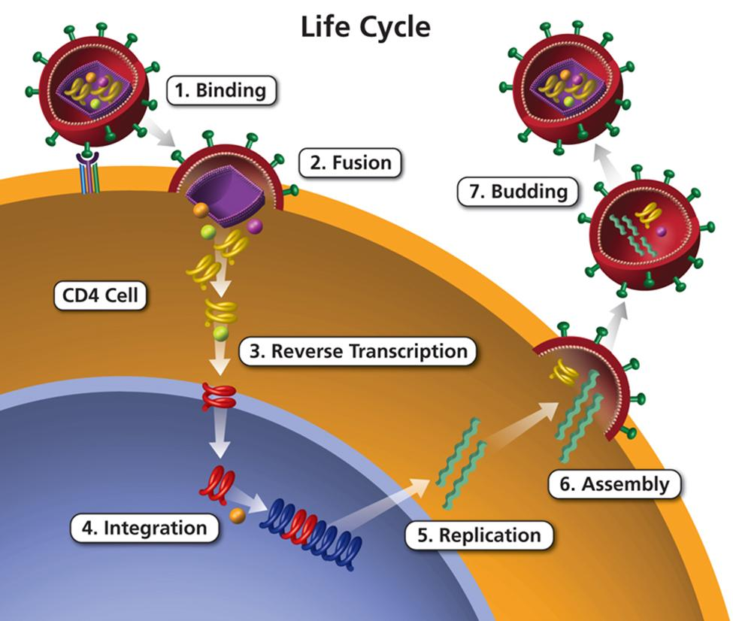

Slide 9
Cell may be destroyed due to: Direct viral damage (cytolysis) , Immune attack (cytotoxic T-cells) Natural cell death
Viral Distribution ~99% of HIV is present in: Lymph nodes, Immune-rich tissues
Acute Phase (Acute Retroviral Syndrome) : Often misdiagnosed or unnoticed
  Initial Infection
  ↓
  Rapid Viral Replication (High Viremia)
  ↓
  Drop in CD4 Cells
  ↓
  Immune Response Begins (Antibody Production)
  ↓
  Symptoms Appear:
  Fever
  Rash
  Lymphadenopathy
  Fatigue
  Night sweats

Slide 10
Viral Set Point Phase (Chronic Phase)
Immune System Partially Controls Virus
↓
Balance Achieved:
Virus Produced = Virus Destroyed
↓
Establishment of "Viral Set Point"
  Higher set point → Faster disease progression
  Lower set point → Slower progression

Slide 11
Clinical Presentation
1. Primary (Acute) HIV Infection
Common early symptoms (Acute Retroviral Syndrome):
  Fever
  Pharyngitis (sore throat)
  Lymphadenopathy (adenopathy)
Other associated features:
  Rash
  Fatigue
  Night sweats

Slide 12
Disease Progression : Progression to AIDS depends on: Viral RNA load
  Higher viral load → Faster progression to AIDS
Clinical Features in Children: Most HIV-infected children are asymptomatic initially
  Common physical findings:
  Lymphadenopathy
  Hepatomegaly
  Splenomegaly
  Failure to thrive
  Weight loss / low birth weight
  Fever of unknown origin

Slide 13
Diagnosis
ELISA Test (Screening) Detects: Antibodies against HIV-1 , Highly sensitive and specific
  False Positive may occur in: Multiparous women , Recent infections: Hepatitis B , Influenza and After rabies vaccination
  False Negative: Early infection (window period)
Western Blot Assay
Viral Load Testing: Measures: Amount of HIV RNA (viremia)
  Methods:
  RT-PCR (Reverse Transcriptase PCR)
  Branched DNA assay
  Nucleic acid sequence-based amplification
CD4 Count Normal range: 500 – 1600 cells/µL
    Important marker for:
      Disease progression
      Immune status

Slide 14
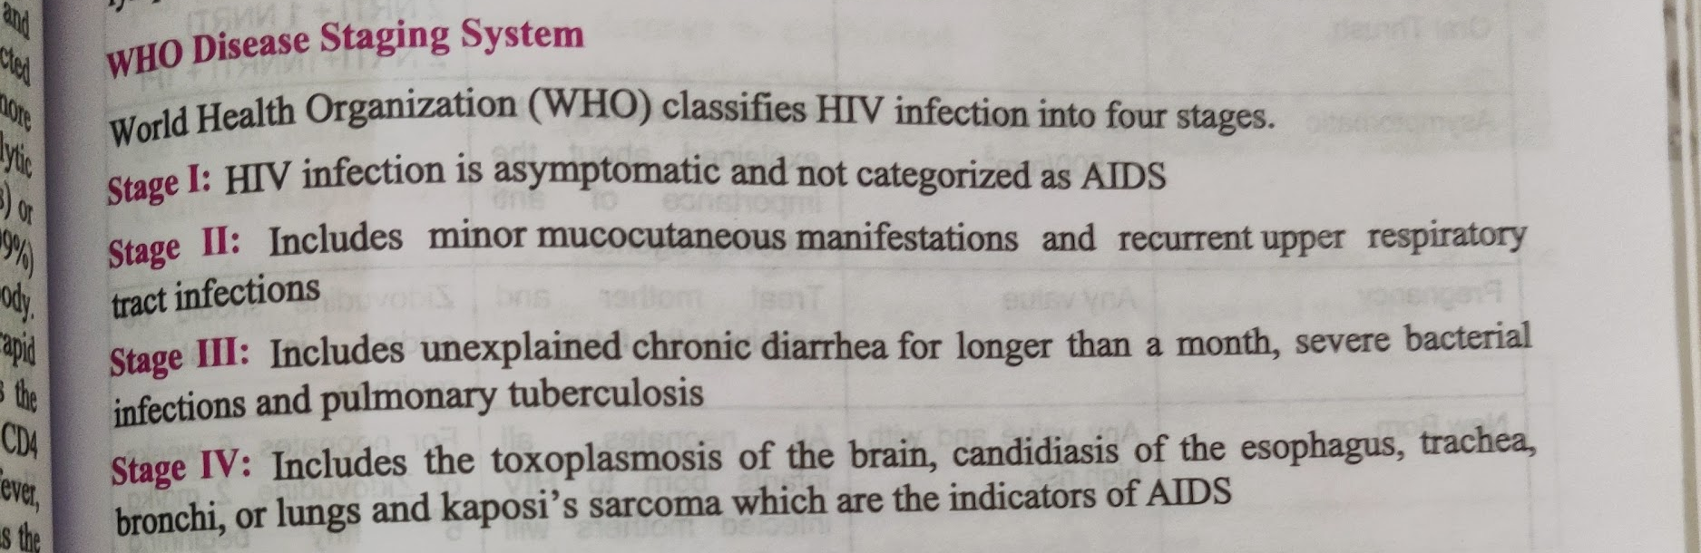
WHO Disease Staging System

Slide 15
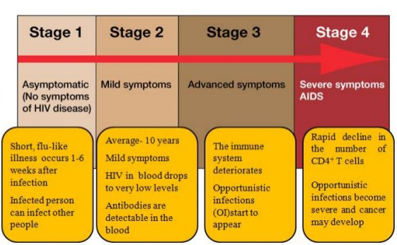

Slide 16
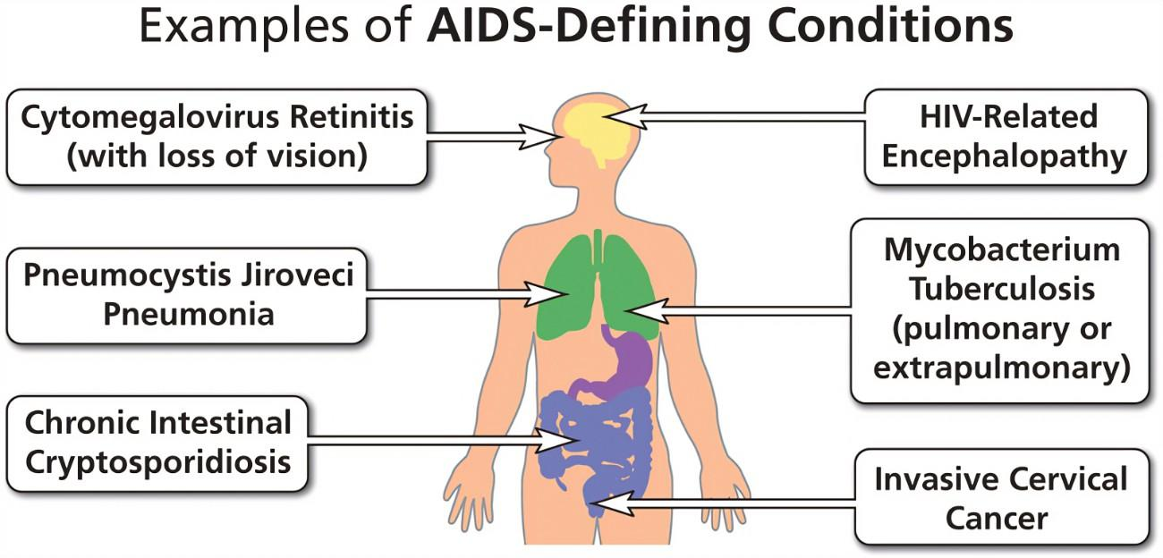

Slide 17
Treatment
Non-Pharmacological
1. General Principle HIV-infected individuals may remain asymptomatic when:
  CD4+ count is within normal range (500–1600 cells/µL)
Goal: Maintain immune strength , Delay disease progression
2. Lifestyle Modifications
  Practice safe sexual behavior: Limit to one sexual partner , Consistent condom use
  Avoid exposure to infection: Do not share blades, razors, needles, or sharps
  Maintain personal hygiene: Regular handwashing, Clean surroundings
3. Dietary Measures
  Consume a nutritious, balanced diet, Well-cooked foods . Properly washed fruits and vegetables
  Avoid: Contaminated or raw foods (to prevent infections)

Slide 18
4. Avoid Harmful Habits: Abstain from alcohol, Avoid smoking/tobacco , Avoid substance abuse
5. Infection Prevention Stay away from: Crowded or unhygienic environments and Situations increasing infection risk, Early management of minor infections
6. Overall Health Maintenance: Adequate rest and sleep, Regular physical activity (moderate), Stress management

Slide 19
Treatment
Pharmacological
1. Goal of Therapy Prevent viral replication
  Ultimate target:
    Undetectable viral load
  Benefits:
    Improves CD4+ count
    Reduces disease progression
    Prevents opportunistic infections
2. Guidelines
  Recommended by:
    International AIDS Society
    Centers for Disease Control and Prevention
    World Health Organization

Slide 20
Class | Full Form | Mechanism of Action | Examples
NRTIs | Nucleoside Reverse Transcriptase Inhibitors | Inhibit reverse transcriptase enzyme and block conversion of RNA → DNA | Zidovudine, Didanosine, Stavudine, Zalcitabine, Lamivudine, Abacavir
NNRTIs | Non-Nucleoside Reverse Transcriptase Inhibitors | Directly inhibit reverse transcriptase enzyme (non-competitive inhibition) | Nevirapine, Delavirdine, Efavirenz
PIs | Protease Inhibitors | Inhibit protease enzyme and prevent formation of mature viral particles | Saquinavir, Ritonavir, Indinavir, Nelfinavir, Amprenavir

Slide 21
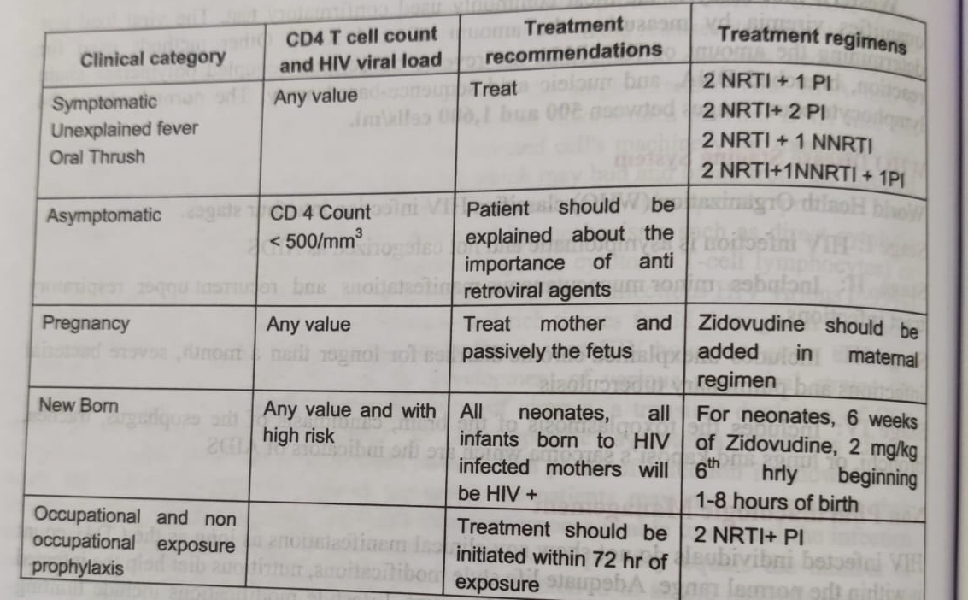

Slide 22
Patient Education
About the Disease
    HIV is a chronic manageable infection, not a death sentence
    Caused by Human Immunodeficiency Virus which weakens the immune system
    Progresses slowly if untreated → may lead to AIDS
    Transmission occurs via:
      Unprotected sexual contact
      Blood and needle sharing
      Mother-to-child transmission
    Patients may remain asymptomatic for years

Slide 23
About the Medication (ART)
    Antiretroviral therapy (ART):
      Controls viral replication
      Helps maintain/increase CD4 count
    Key counseling points:
      Strict adherence is essential (take medicines daily, same time)
      Missing doses → drug resistance & treatment failure
      Do not stop medication without consulting doctor
      Be aware of possible side effects and report them
    Goal:
      Achieve undetectable viral load

Slide 24
3. Lifestyle Modifications
C. Avoid Harmful Habits
  No alcohol
  No smoking/tobacco
  Avoid substance abuse
  A. Prevention of Transmission
    Use condoms consistently
    Maintain single sexual partner
    Do not share:
      Needles
      Razors/blades
  B. Healthy Living
    Eat nutritious, well-cooked food
    Maintain personal hygiene
    Regular exercise and adequate rest
D. Infection Prevention
  Avoid:
    Unhygienic environments
    Contaminated food/water
  Seek early treatment for infections
E. Psychosocial Support
  Maintain positive mental health
  Seek family and social support
  Avoid stigma and discrimination

Slide 25
Feature | HIV Infection | AIDS (Acquired Immunodeficiency Syndrome)
Definition | Infection caused by Human Immunodeficiency Virus | Advanced stage of HIV infection
Stage | Early to chronic phase | Final/advanced stage
Immune Status | CD4 count may be normal or mildly reduced | Severely reduced CD4 (<200 cells/mm³)
Symptoms | Often asymptomatic or mild (fever, rash, lymphadenopathy) | Severe symptoms due to opportunistic infections
Opportunistic Infections | Usually absent | Common (TB, candidiasis, toxoplasmosis, etc.)
Viral Load | Variable, can be controlled with ART | High if untreated
Diagnosis | HIV antibody/antigen tests (ELISA, etc.) | HIV positive + AIDS-defining conditions
Reversibility | Can be controlled with ART | Cannot be reversed, but can be managed
Prognosis | Good with treatment | Poor if untreated

