Slide 1
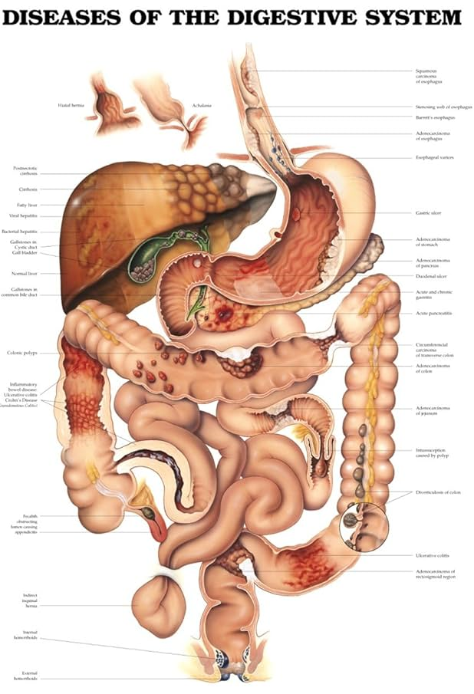
By
Dr. Ayesha Fatima
Pharm D
Assistant Professor
Dept. of Pharmacy Practice
DISORDERS OF DIGESTIVE SYSTEM

Slide 2
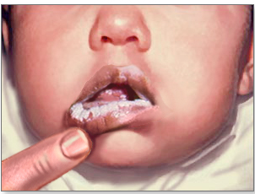
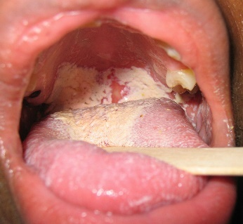
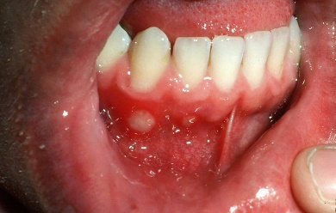
Thrush (oral candidiasis)
This acute fungal infection of the epithelium of the mouth is caused by the yeast Candida albicans, which grows in white patches on the tongue and oral mucosa.
In adults it causes opportunistic infection mainly in debilitated people and in those whose immunity is lowered by, e.g., steroids, antibiotics or cytotoxic drugs.
In babies it may be a severe infection, sometimes causing epidemics in nurseries by cross-infection. It occurs most commonly in bottle-fed babies.
Chronic thrush may develop, affecting the roof of the mouth in people who wear dentures. The fungus survives in fine grooves on the upper surface of the denture and repeatedly reinfects the oral mucosa.
Aphthous stomatitis (recurrent oral ulceration)
This common condition features extremely painful ulcers that occur singly or in crops inside the mouth. The cause is unknown.

Slide 3
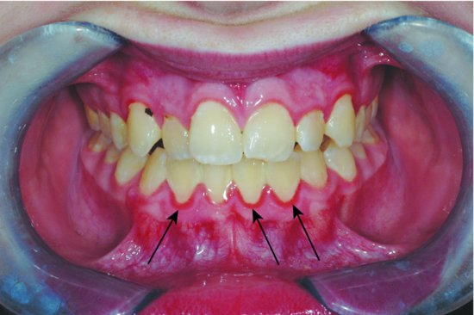
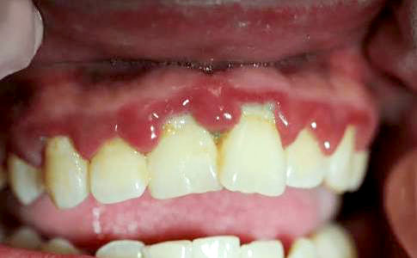
Gingivitis
This is inflammation of the gums, which may be acute or chronic.
Acute gingivitis
This is a rare condition previously known as Vincent’s infection, in which there is severe
inflammation that mainly affects the gums.
It is caused by two commensal organisms acting together, Borrelia vincenti and a fusiform bacillus.
Both organisms may be present in the mouth but only cause the condition in the presence of malnutrition, debilitating disease, poor oral hygiene or injury caused by previous infection.
Chronic gingivitis
This common inflammatory condition occurs in response to accumulation of bacterial plaque around the teeth.
It causes bleeding gums and gradually destroys the tissues that support the teeth, which eventually loosen and may fall out.

Slide 4
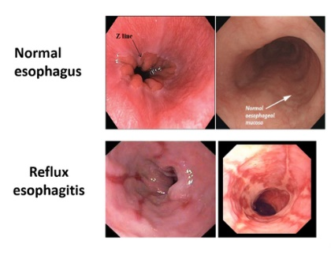
Acute oesophagitis
This arises after caustic materials are swallowed and also if immunocompromised people acquire severe fungal infections, typically candidiasis, or viral infections, e.g. Herpes simplex.
Dysphagia (difficulty in swallowing) is usually present. Following severe injury, healing causes fibrosis, and there is a risk of oesophageal stricture developing later, as the fibrous tissue shrinks.
Reflux oesophagitis
This condition, the commonest cause of indigestion (or ‘heartburn’), is caused by persistent regurgitation of acidic gastric juice into the oesophagus, causing irritation, inflammation and painful ulceration.
Haemorrhage occurs when blood vessels are eroded.
Persistent reflux leads to chronic inflammation and if damage is extensive, secondary healing with fibrosis occurs.
Shrinkage of mature fibrous tissue may cause stricture of the oesophagus.
This condition sometimes gives rise to Barrett’s oesophagus.
Reflux of gastric contents is associated with: increase in the intra-abdominal pressure, e.g. in pregnancy, constipation and obesity high acid content of gastric juice low levels of secretion of the hormone gastrin, leading to reduced sphincter action at the lower end of the oesophagus the presence of hiatus hernia

Slide 5
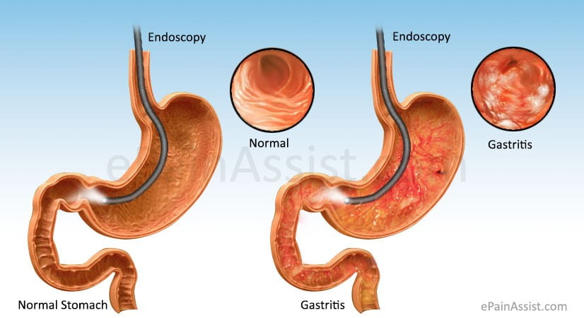
Gastritis
Inflammation of the stomach can be an acute or chronic condition.
Acute gastritis
This is usually a response to irritant drugs or alcohol.
The drugs most commonly implicated are nonsteroidal
anti-inflammatory drugs (NSAIDs) including aspirin,
even at low doses.
Other causes include the initial response to Helicobacter
pylori infection and severe physiological stress, e.g.
in extensive burns and multiple organ failure.
Mild cases can be asymptomatic or may present with nausea
and vomiting associated with inflammatory changes of the
gastric mucosa.
Erosions can also occur, which are characterized by tissue loss affecting the superficial layers of the gastric mucosa.
In more serious cases, there are multiple erosions, which may result in life-threatening haemorrhage causing haematemesis (vomiting of frank blood or black ‘coffee grounds’ when there has been time for digestion of blood to occur) and melaena (passing black tarry faeces), especially in elderly people. Where there has been extensive tissue damage, healing is by fibrosis causing reduced elasticity and peristalsis.

Slide 6
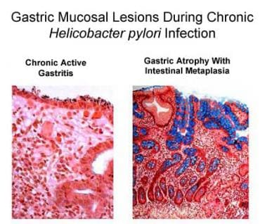
Chronic gastritis
Chronic gastritis is a milder longer-lasting condition. It is usually associated with Helicobacter
pylori but is sometimes due to autoimmune disease or chemical injury. It is more common in later life.
Helicobacter-associated gastritis
The microbe Helicobacter pylori can survive in the gastric mucosa and is commonly associated with gastric conditions, especially chronic gastritis and peptic ulcer disease.

Slide 7
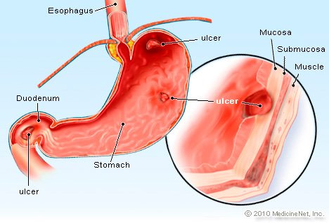
Peptic ulceration
Ulceration involves the full thickness of the gastrointestinal mucosa.
It is caused by disruption of the normal balance between the corrosive
effect of gastric juice and the protective effect of mucus on the gastric
epithelial cells.
The most common sites for ulcers are the stomach and the first few
centimetres of the duodenum.
More rarely they occur in the oesophagus and round the anastomosis of the stomach and small intestine, following gastrectomy.
The underlying causes are not known but, if gastric mucosal protection is impaired, the epithelium can be exposed to gastric acid causing the initial cell damage that leads to ulceration.
The main protective mechanisms are:
  good blood supply,
  adequate mucus secretion and
  efficient epithelial cell replacement.

Slide 8
Blood supply
Reduced blood flow and ischaemia may be caused by excessive cigarette smoking and severe stress, either physical or mental.
In stressful situations the accompanying sympathetic activity causes constriction of the blood vessels supplying the alimentary tract.
Secretion of mucus
The composition and the amount of mucus may be altered, e.g.: by regular and prolonged use of aspirin and other anti-inflammatory drugs by the reflux of bile acids and salts in chronic gastritis.
Epithelial cell replacement
There is normally a rapid turnover of gastric and intestinal epithelial cells.
This may be reduced: by raised levels of steroid hormones, e.g. in response to stress or when they are used as drugs in chronic gastritis by irradiation and the use of cytotoxic drugs.
In peptic ulcer disease, the alimentary tract is commonly colonised by the bacterium Helicobacter pylori, a causative agent in this disorder.

Slide 9
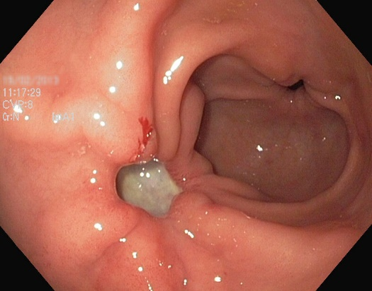
Acute peptic ulcers
These lesions involve tissue to the depth of the submucosa and may be single or multiple.
They are found in many sites in the stomach and in the first few centimetres of the duodenum.
Their development is often associated with acute gastritis, severe stress, e.g. severe illness, shock, burns, severe emotional disturbance and following surgery.
Healing without the formation of fibrous tissue usually occurs when the stressor is removed, although haemorrhage, which may be life-threatening, can be a complication.

Slide 10
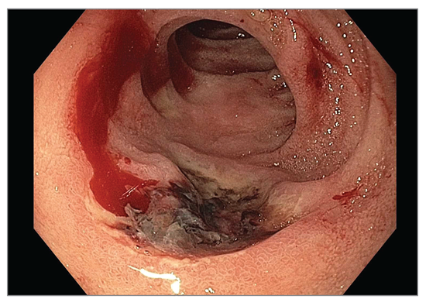
Chronic peptic ulcers
These ulcers penetrate through the epithelial and muscle layers of the stomach wall and may include the adjacent pancreas or liver.
In the majority of cases they occur singly in the pylorus of the stomach and in the duodenum. Occasionally there are two ulcers facing each other in the duodenum, called kissing ulcers. Helicobacter pylori is found in 90% of people with duodenal ulcers and 70% of those with gastric ulcers.
The remaining gastric ulcers are almost entirely due to non-steroidal anti-inflammatory drugs (NSAIDs). Smoking predisposes to peptic ulceration and delays healing.
Healing occurs with the formation of fibrous tissue and subsequent shrinkage may cause: stricture of the lumen of the stomach gastric outflow obstruction or stenosis of the pyloric sphincter adhesions to adjacent structures, e.g. pancreas, liver, transverse colon.

Slide 11
Complications of peptic ulcers
Haemorrhage
  When a major artery is eroded a serious and possibly life-threatening haemorrhage may occur, causing shock, haematemesis and/or melaena.
Anaemia
  Chronic persistent low level bleeding from an ulcer may lead to development of iron deficiency anaemia.
Perforation
When an ulcer erodes through the full thickness of the wall of the stomach or duodenum their contents enter the peritoneal cavity, causing acute peritonitis.
Infected inflammatory material may collect under the diaphragm, forming a subphrenic abscess and the infection may spread through the diaphragm to the pleural cavity.
Gastric outflow obstruction
  Also known as pyloric stenosis, fibrous tissue formed as an ulcer in the pyloric region heals, causes narrowing of the pylorus that obstructs outflow from the stomach and results in persistent vomiting.
Development of a malignant tumour
  This is frequently associated with chronic gastritis caused by Helicobacter pylori.

Slide 12
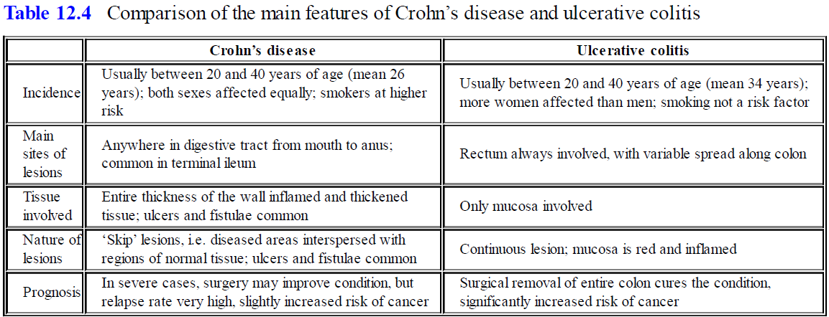
Inflammatory bowel disease (IBD)
This term includes Crohn’s disease and ulcerative colitis.
Their aetiology is unknown but is thought to involve environmental and immune factors in genetically susceptible individuals. Both conditions typically have a pattern of relapse and remission.

Slide 13
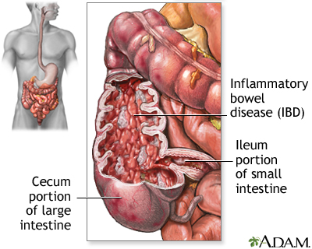
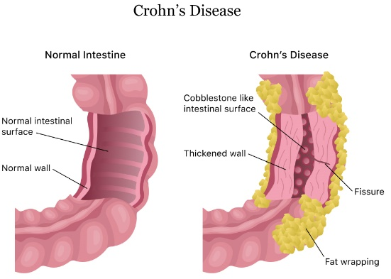
Crohn’s disease
This chronic inflammatory condition of the alimentary tract, also known as regional ileitis, usually occurs in young adults.
The terminal ileum and the rectum are most commonly affected but the disease may affect any part of the tract.
There is chronic patchy inflammation with oedema of the full thickness of the intestinal wall, causing partial obstruction of the lumen, sometimes described as skip lesions.
There are periods of remission of varying duration.
The main symptoms are diarrhoea, abdominal pain and weight loss.
Complications include:
  secondary infections, occurring when inflamed areas ulcerate fibrous adhesions and subsequent intestinal obstruction caused by the healing process fistulae between intestinal lesions and adjacent structures, e.g. loops of bowel,
  surface of the skin perianal fistulae,
  fissures and skin tags cancer of the small or large intestine.

Slide 14
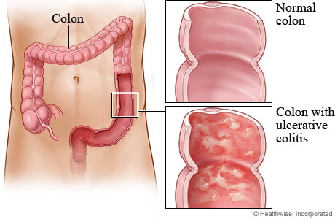
Ulcerative colitis
This is a chronic inflammatory disease of the mucosa of the colon and rectum, which may ulcerate and become infected.
It usually occurs in young adults and begins in the rectum and sigmoid colon.
From there it may spread proximally to involve a variable proportion of the colon and, sometimes, the entire colon.
The main symptom is bloody diarrhoea. There are periods of remission lasting weeks, months or years. Individuals may develop other systemic problems affecting, for example, the joints (ankylosing spondylitis, skin and liver.
In long-standing cases, cancer sometimes develops.
Toxic megacolon is an acute complication where the colon loses its muscle tone and dilates.
There is a high risk of electrolyte imbalance, perforation and hypovolaemic shock, which may be fatal if untreated.

Slide 15
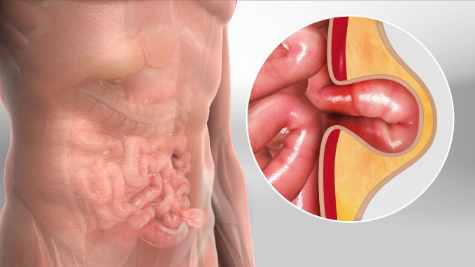
Hernias
A hernia is a protrusion of an organ or part of an organ through a weak point or aperture in the surrounding structures.
In those affecting the digestive system, a piece of bowel protrudes through a weak point in either the musculature of the anterior abdominal wall or an existing opening.
It occurs when there are intermittent increases in intra-abdominal pressure, most commonly in men who lift heavy loads at work.
The underlying causes of the abdominal wall weakness are unknown.
Outcomes include: spontaneous reduction, i.e. the loop of bowel slips back to its correct place when the intra-abdominal pressure returns to normal manual reduction, i.e. by applying gentle pressure over the abdominal swelling strangulation, when reduction is not possible and the venous drainage from the herniated loop of bowel is obstructed, causing congestion, ischaemia and gangrene.
In addition there is intestinal obstruction.

Slide 16
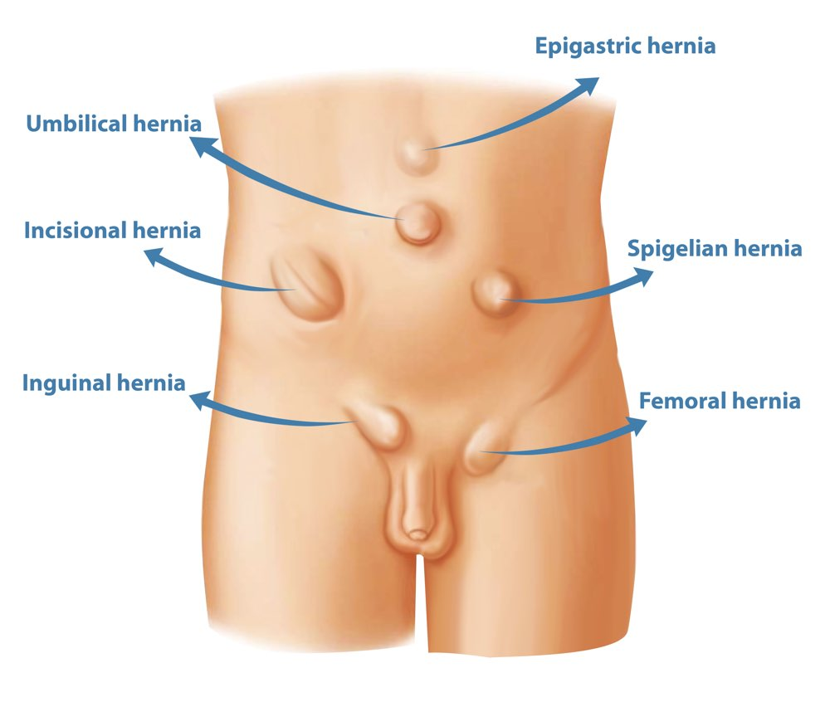
Sites of hernias
Inguinal hernia
  The weak point is the inguinal canal, which contains the spermatic cord in the male and the round ligament in the female.
  It occurs more commonly in males than in females.
Femoral hernia
  The weak point is the femoral canal through which the femoral artery, vein and lymph vessels pass from the pelvis to the thigh.
Umbilical hernia
  The weak point is the umbilicus where the umbilical blood vessels from the placenta entered the fetus before birth.
Incisional hernia
  This is caused by repeated stretching of fibrous tissue formed after previous abdominal surgery.

Slide 17
Hiatus hernia
  This is the protrusion of a part of the fundus of the stomach through the oesophageal opening in the diaphragm . Although often asymptomatic, irritation of the oesophagus only occurs when there is reflux of acid gastric juice, especially when the individual lies flat or bends down.
  The long term effects may be oesophagitis, fibrosis and narrowing of the oesophagus, causing dysphagia. Strangulation does not occur.
Rolling hiatus hernia
  An abnormally large opening in the diaphragm allows a pouch of stomach to ‘roll’ upwards into the thorax beside the oesophagus.
  This is associated with obesity and increased intra-abdominal pressure.
Sliding hiatus hernia
  Part of the stomach is pulled upwards into the thorax. The abnormality may be caused by shrinkage of fibrous tissue formed during healing of a previous oesophageal injury.
  The sliding movement of the stomach in the oesophageal opening is due to shortening of the oesophagus by muscular contraction during swallowing.

Slide 18
Peritoneal hernia
  A loop of bowel may herniate through the epiploic foramen, the opening in the lesser omentum that separates the greater and lesser peritoneal sacs.
Congenital diaphragmatic hernia
  Incomplete formation of the diaphragm, usually on the left side, allows abdominal organs such as the stomach and loops of intestine into the thoracic cavity, preventing normal development of the fetal lungs.

Slide 19
Acute pancreatitis
Proteolytic enzymes produced by the pancreas are secreted in inactive forms, which are not activated until they reach the intestine; this protects the pancreas from digestion by its own enzymes.
If these precursor enzymes are activated while still in the pancreas, pancreatitis results.
The severity of the disease is directly related to the amount of pancreatic tissue destroyed.
Mild forms are more common and damage only those cells near the ducts. Recovery is usually complete.
Severe forms cause widespread damage with necrosis and haemorrhage.
Common complications include infection, suppuration, and local venous thrombosis. Pancreatic enzymes, especially amylase, enter and circulate in the blood, causing similar damage to other structures. In severe cases there is a high mortality rate.
The causes of acute pancreatitis are not clear but known predisposing factors are gallstones and
alcoholism.
Other associated conditions include: cancer of the ampulla or head of pancreas viral infections, notably mumps kidney and liver transplantation hyperparathyroidism severe hypothermia drugs, e.g. corticosteroids, some cytotoxic agents.

Slide 20
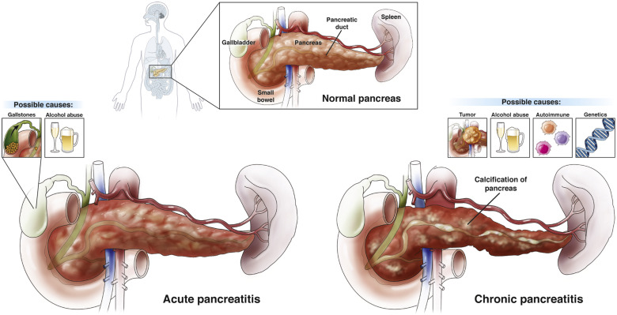
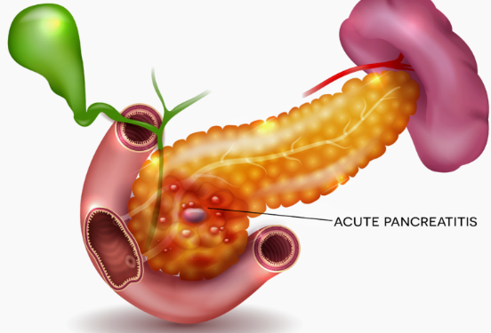
Chronic pancreatitis
This is either due to repeated attacks of acute pancreatitis or may arise gradually without evidence of pancreatic disease.
It is more common in men and is frequently associated with fibrosis and distortion of the main pancreatic duct.
There is intestinal malabsorption when pancreatic secretions are reduced and diabetes mellitus occurs when severe damage affects the β-islet cells.
Protein material secreted by the acinar cells blocks the tiny acinar ducts.
This eventually leads to the formation of encapsulated cysts which are a feature of acute and chronic pancreatitis.
The most common cause in the Western world is excessive chronic alcohol consumption.
In developing countries dietary factors and malnutrition have been implicated. It is also associated with cystic fibrosis.

Slide 21
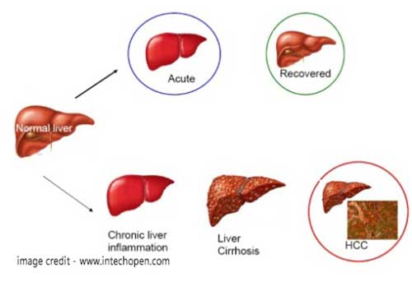
Acute hepatitis
Areas of necrosis develop as groups of hepatocytes die and the eventual outcome depends on the size and number of these areas.
Causes of the damage may be a variety of conditions, including: viral infections toxic substances circulatory disturbances.
Viral hepatitis
Viral infections are the commonest cause of acute liver injury and different types are recognised.
The types are distinguished serologically, i.e. by the antibodies produced to combat the infection.
The severity of the ensuing disease caused by the different virus types varies considerably, but the pattern is similar. The viruses enter the liver cells, causing degenerative changes.

Slide 22
An inflammatory reaction ensues, accompanied by production of an exudate containing lymphocytes, plasma cells and granulocytes.
There is reactive hyperplasia of the hepatic macrophages (Kupffer cells) in the walls of the sinusoids.
As groups of cells die, necrotic areas of varying sizes develop, phagocytes remove the necrotic material and the lobules collapse.
The basic lobule framework becomes distorted and blood vessels develop kinks. These changes interfere with the circulation of blood to the remaining hepatocytes and the resultant hypoxia causes further damage.
Fibrous tissue develops in the damaged area, and adjacent hepatocytes proliferate.
The effect of these changes on the overall functioning of the liver depends on the size of the necrotic areas, the amount of fibrous tissue formed and the extent to which the blood and bile channels are distorted.

Slide 23
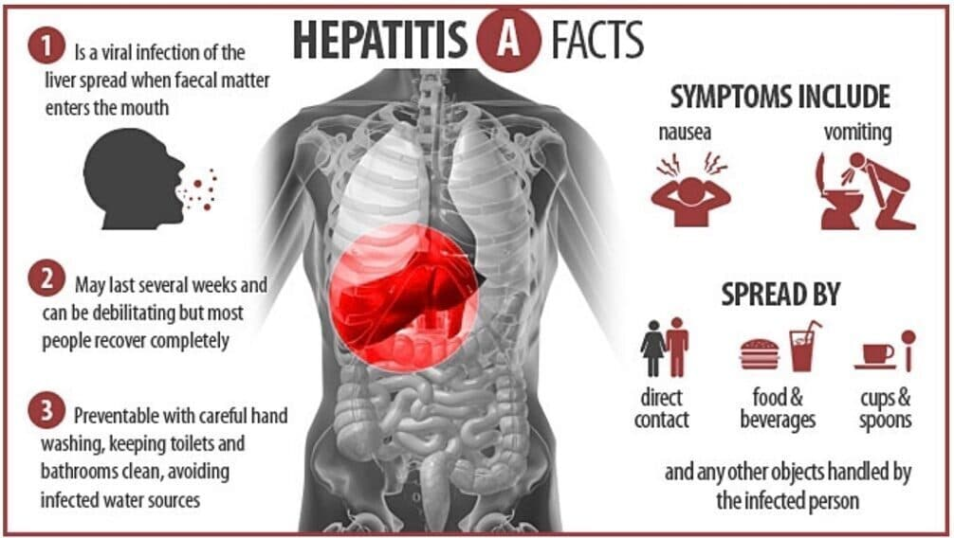
Hepatitis A
Previously known as ‘infectious hepatitis’, this type affects mainly children, causing a mild illness.
Infection is spread by hands, food, water and fomites contaminated by infected faeces.
The incubation period is 15 to 40 days and the viruses are excreted in the faeces for 7 to 14 days before clinical symptoms appear and for about 7 days after.
Symptoms may include general malaise followed by a period of jaundice , that is accompanied by passing of dark urine and pale faeces.
Antibodies develop and confer lifelong immunity after recovery. Subclinical disease may occur but not carriers.

Slide 24
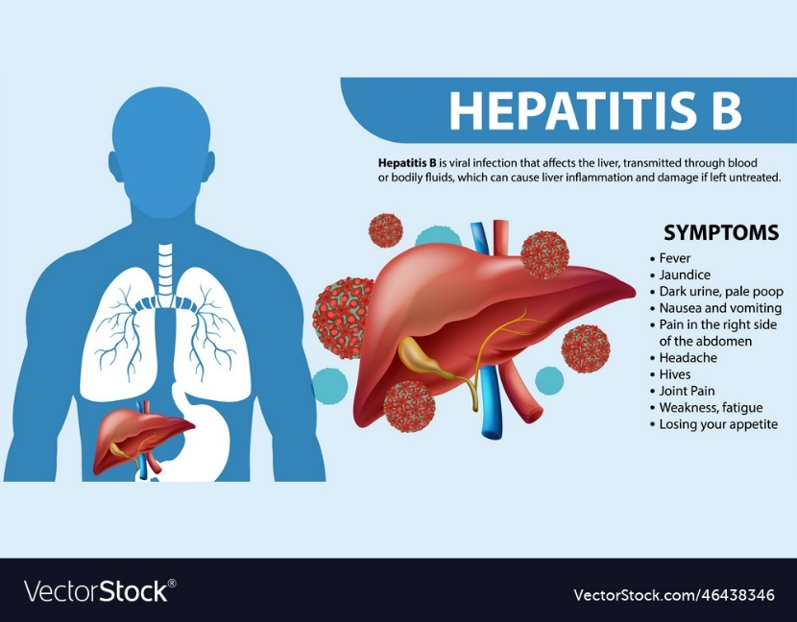
Hepatitis B
Previously known as ‘serum hepatitis’, infection occurs at any age, but mostly in adults.
The incubation period is 50 to 180 days.
The virus enters the blood and is spread by blood and blood products.
People at greatest risk of infection are those who come in contact with blood and blood products in the course of their work, e.g. health-care workers.
The virus is also spread by body fluids, i.e. saliva, semen, vaginal secretions, and from mother to fetus (vertical transmission).
Others at risk include IV drug users and men who have sex with men.

Slide 25
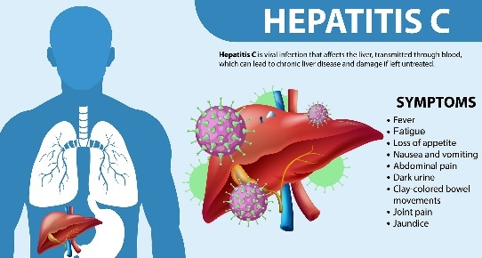
Antibodies are formed and immunity persists after recovery. Infection usually leads to severe illness lasting 2 to 6 weeks, often followed by a protracted convalescence.
Carriers may, or may not, have had clinical disease.
Type B virus may cause massive liver necrosis and death. In less severe cases recovery may be complete. In chronic hepatitis (see opposite) that may develop, live viruses continue to circulate in the blood and other body fluids.
The condition is thought to predispose to liver cancer.
Hepatitis C
This virus is spread by blood and blood products, which accounts for the infection of many people with haemophilia.
It is prevalent in IV drug users.
The infection is very frequently asymptomatic as a carrier state occurs.
Infection is usually diagnosed later in life when cirrhosis (see opposite) or chronic liver failure becomes evident.

Slide 26
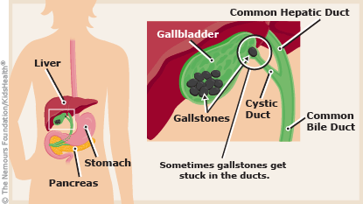
Gallstones (cholelithiasis)
Gallstones consist of deposits of the constituents
of bile, most commonly cholesterol. Many small
stones or one or more large stones may form but they
do not necessarily produce symptoms.
Predisposing factors include:
  changes in the composition of bile that affect the
  solubility of its constituents high blood cholesterol levels
  diabetes mellitus
  female gender
  obesity
  several pregnancies in young women, especially when accompanied by obesity.

Slide 27
Acute cholecystitis
This is acute inflammation of the gall bladder usually associated with gallstones, and occurs when a gallstone becomes impacted (stuck) in the cystic duct, often after a fatty meal.
Strong peristaltic contractions of the smooth muscle in the wall of the cystic duct that occur in an attempt to move the stone onwards result in biliary colic, severe acute pain in the right hypochondrium.
This does not cause jaundice because bile from the liver can still pass directly into the duodenum. Bile is unable to leave the gall bladder and an inflammatory reaction follows.
This may be complicated by bacterial infection and distension of the gall bladder, which carries the risk of perforation and peritonitis.

Slide 28
Chronic cholecystitis
The onset is usually insidious, sometimes following repeated acute attacks.
Gallstones are invariably present and there may be accompanying biliary colic.
Pain is due to the spasmodic contraction of muscle, causing ischaemia when the gall bladder is packed with gallstones.
There is usually secondary infection with suppuration.
Ulceration of the tissues between the gall bladder and the duodenum or colon may occur with fistula formation and, later, fibrous adhesions.

Slide 29
Jaundice
This is not a disease in itself, but yellowing of the skin and mucous membrane is a sign of abnormal bilirubin metabolism and excretion. Bilirubin, produced from the breakdown of haemoglobin, is normally conjugated in the liver and excreted in the bile.
Conjugation, the process of adding certain groups to the bilirubin molecule, makes it water-soluble and greatly enhances its removal from the blood, an essential step in excretion.
Unconjugated bilirubin, which is fat-soluble, has a toxic effect on brain cells. However, it is unable to cross the blood–brain barrier until the plasma level rises above 340 μmol/l, but when it does it may cause neurological damage, seizures (fits) and mental impairment.
Serum bilirubin may rise to 40 to 50 μmol/l before the yellow coloration of jaundice is evident in the skin and conjunctiva (normal 3 to 13 μmol/l). Jaundice is often accompanied by pruritus (itching) caused by the irritating effects of bile salts on the skin.
Jaundice develops when there is an abnormality of bilirubin processing.

Slide 30
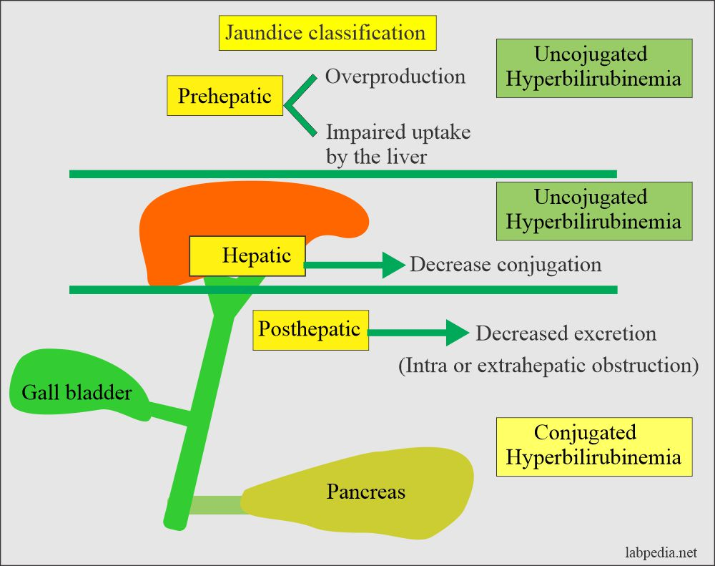
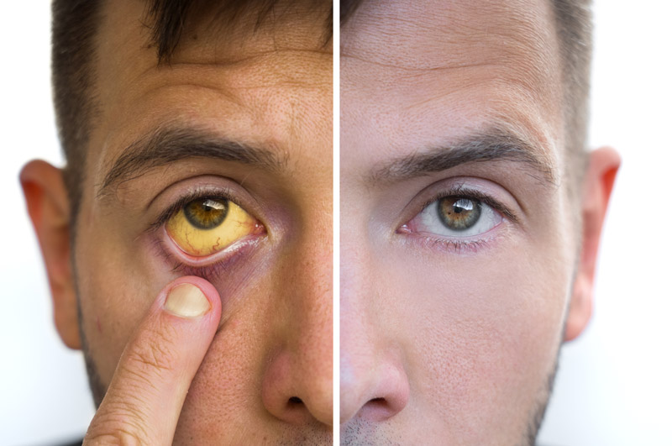

Slide 31
Types of jaundice
Whatever stage in bilirubin processing is affected, the end result is rising blood bilirubin levels.
1. Pre-hepatic jaundice
This is due to increased haemolysis of red blood cells that results in
production of excess bilirubin. Because the excess bilirubin is unconjugated it cannot be excreted in the urine, which therefore remains normal in colour.
Neonatal haemolytic jaundice occurs in many babies, especially in those born prematurely where the normal high haemolysis is coupled with shortage of conjugating enzymes in the hepatocytes of the still immature liver.

Slide 32
2. Intra-hepatic jaundice
This is the result of damage to the liver itself by, e.g.: viral hepatitis
toxic substances, such as drugs amoebiasis (amoebic dysentery) cirrhosis.
Excess bilirubin accumulates in the liver. Because it is mainly in the conjugated form, it is
water-soluble and excreted in the urine making it dark in colour.
3. Post-hepatic jaundice
Causes of obstruction to the flow of bile in the biliary tract include: gallstones in the common bile duct tumour of the head of the pancreas
fibrosis of the bile ducts, following cholangitis or injury by the passage of gallstones.
In this situation excess bilirubin is also conjugated and is therefore excreted in the urine.
The effects of raised serum bilirubin include: pruritus (itching) pale faeces due to absence of stercobilin dark urine due to the presence of increased amounts of bilirubin.

Slide 33
THANK YOU

