Slide 1
Insights from Stack Overflow Survey Analysis
Understanding the Evolving Tech Stack and Career Trends

Slide 2
Stack Overflow
Knowledge sharing platform
Largest, most trusted online community for developers to
  Learn
  Share​ ​their programming ​knowledge
  Build their careers

Slide 3
Understanding the Dataset
Scope: Survey Dataset of 2023
Number of Respondents: Around 90000
Demographics: Information about the respondents like age, country, education level.
Professional Information: Job roles, experience levels, industries.
Technology: Programming languages, tools, and technologies used.
Work Environment: Remote work trends,working hours.
Salary Information: Compensation trends across different regions and roles.

Slide 4
Key Areas of Interest
What are the most popular programming languages and technologies?
Who are the developers with the highest earnings?
Average Salary Across Countries
Average Salary Across Job Titles in UK
The relationship between education and compensation in tech.
Which Developers paid the most?
Highest Level of Education completed by Data Professionals
Trend in remote work vs in-person work in the tech industry?

Slide 5
2022 Vs 2023 Survey Dataset
#Respondents-2022 : 73268
#Respondents-2023 : 89184
There is a 22% rise in participants from 2022 to 2023

Slide 6
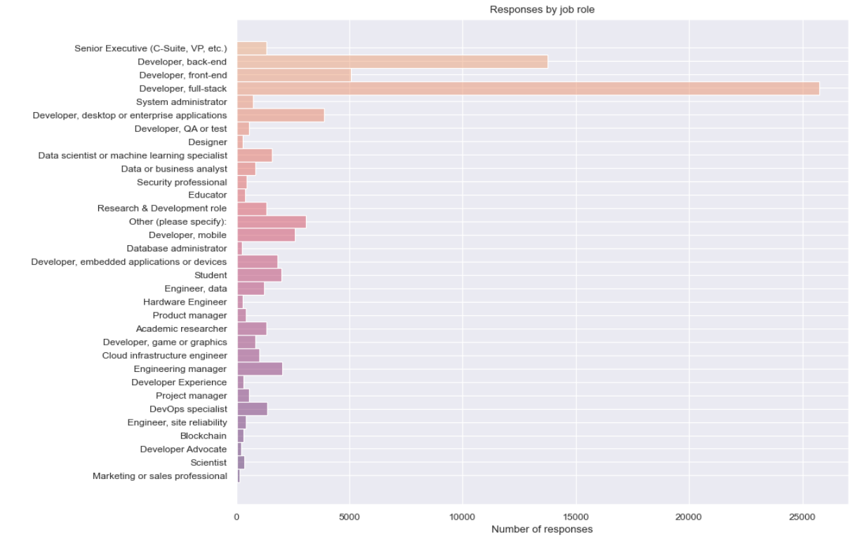
Who are the survey respondents?
The survey contains the response of developer, Analysts, IT leaders, reporters.
Majority of the respondents are Full Stack Developers followed by Frontend and Backend Developers.

Slide 7
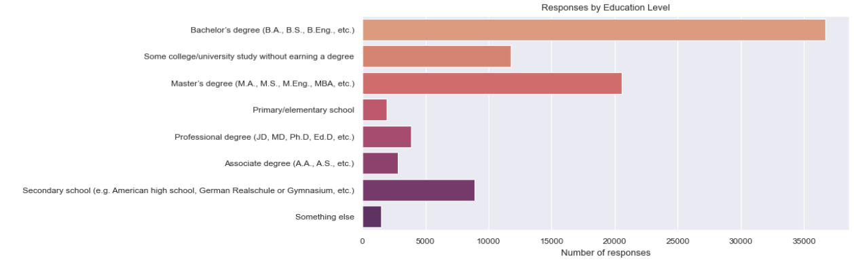
What is the highest Education Level of attained by Respondents?
Majority of respondents : Bachelor's degree (>40%)
Quarter of the professional developers have Master’s degree

Slide 8
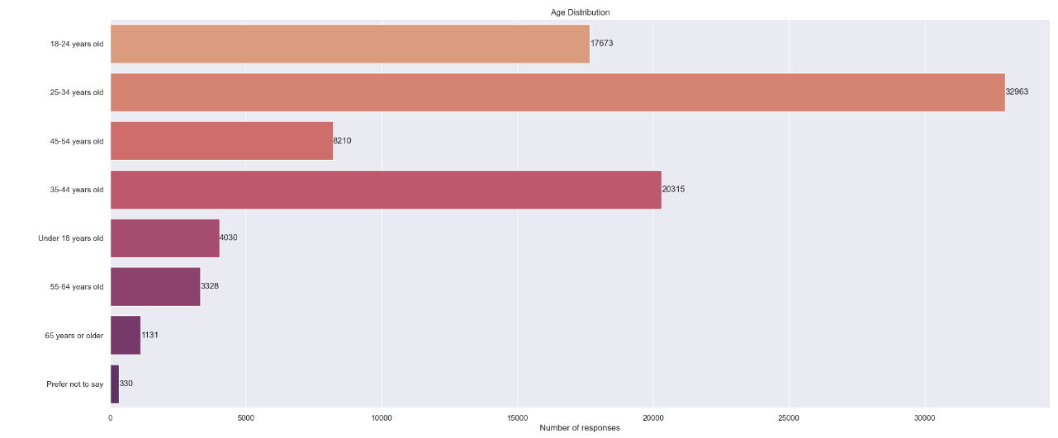
What Age Group does the respondents fall into?
Around 40% of professional developers fall within the age range of 25 to 34 years old.

Slide 9
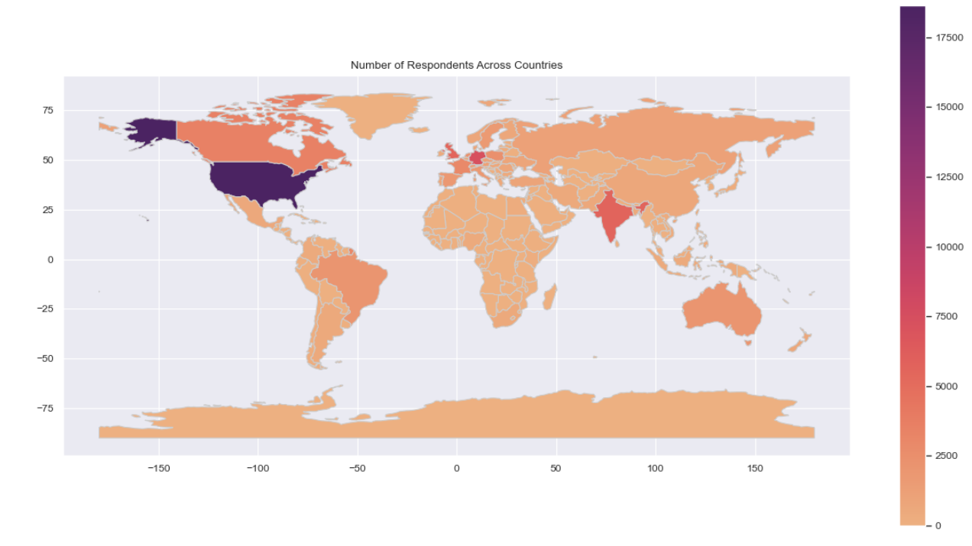
What regions are the survey respondents from?
The majority of respondents hail from the USA. Interestingly, there are fewer respondents from the UK compared to those from Germany and India.

Slide 10
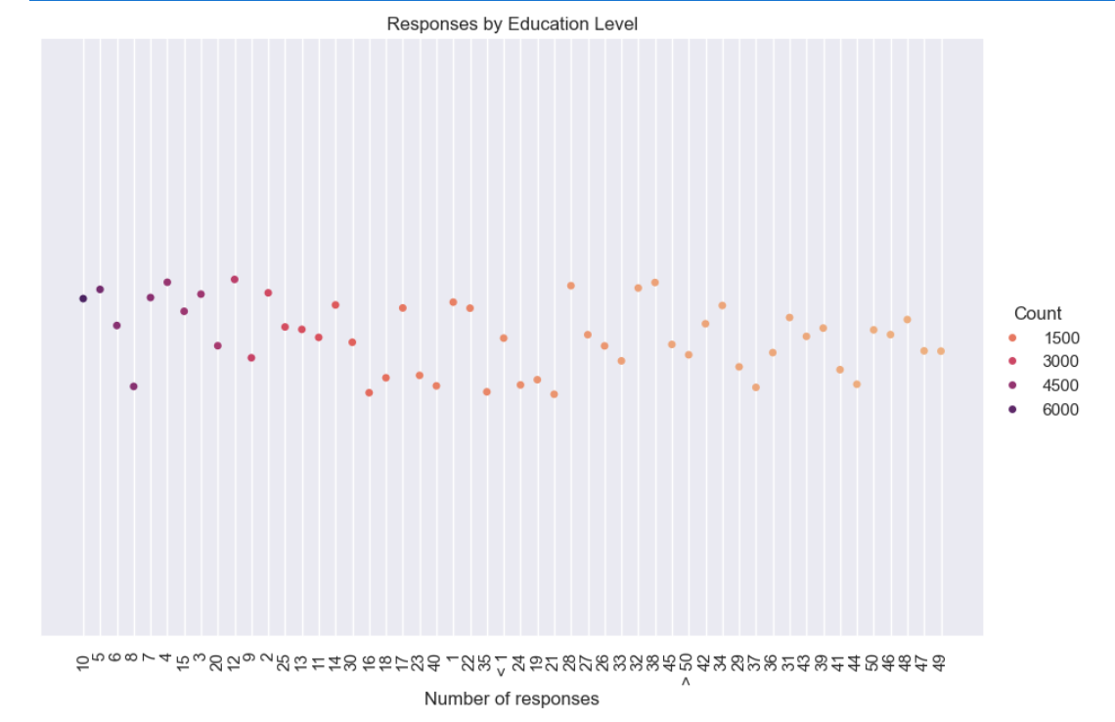
Work Experience
Most respondents are in the early to mid-career stage
49.71% of respondents have less than a decade of coding experience

Slide 11
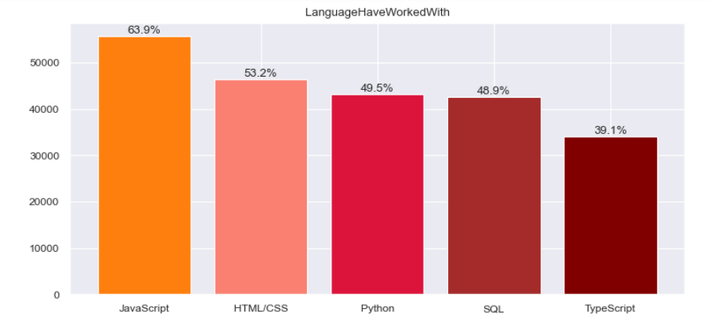
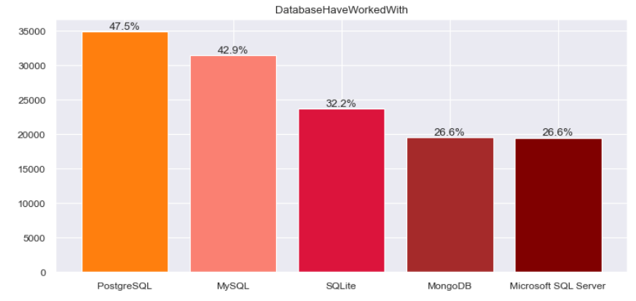
Popular Tools and Technologies
Languages that are popular with students: JavaScript, HTML/CSS, Python
Database
Professional developers are inclined to use PostgreSQL more frequently than those who are learning to code, whereas learners are more inclined to use MySQL.

Slide 12
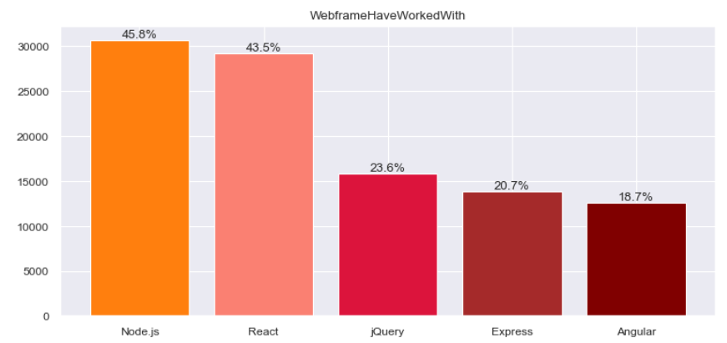
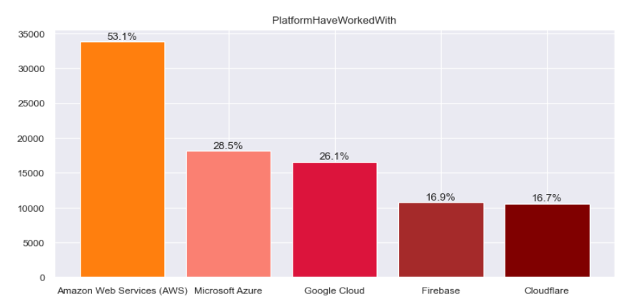
Web frameworks
Node.js and React.js are the two most common web technologies used by all respondents.
Cloud Platforms
Among all respondents, AWS continues to be the most utilized cloud platform, comfortably securing the leading position, with its usage nearly doubling that of the second most used cloud platform, Azure.

Slide 13
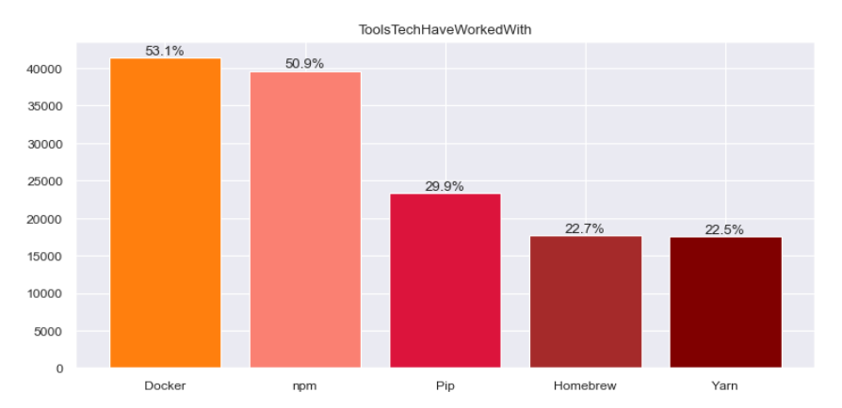
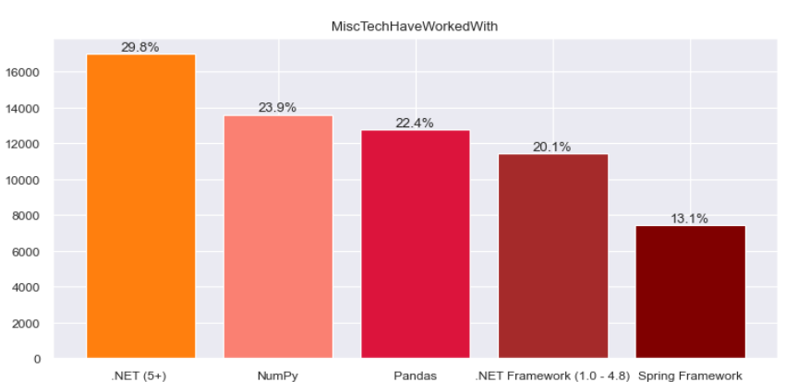
Other tools
Docker is the top-used other tool amongst all respondents followed by npm and pip
Other frameworks
.NET (5+) is top of the list
Those learning to code are using NumPy and Pandas more than .NET (5+)

Slide 14
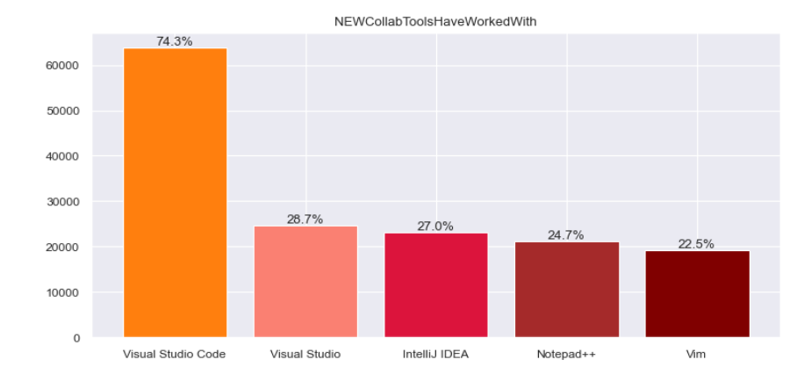
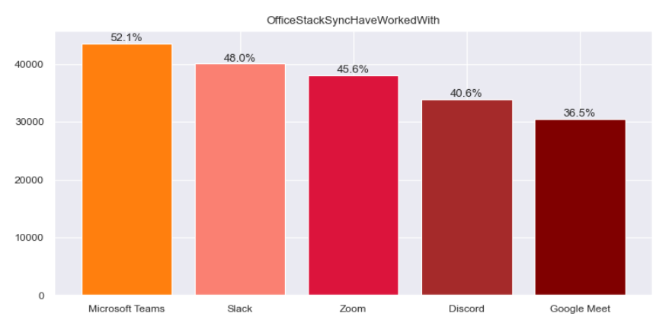
Collaboration Tools
Visual Studio Code remains the preferred IDE across all developers.
Synchronous Tools
The top three synchronous tools, Microsoft Teams, Slack, and Zoom, are universally favoured by all respondents.

Slide 15
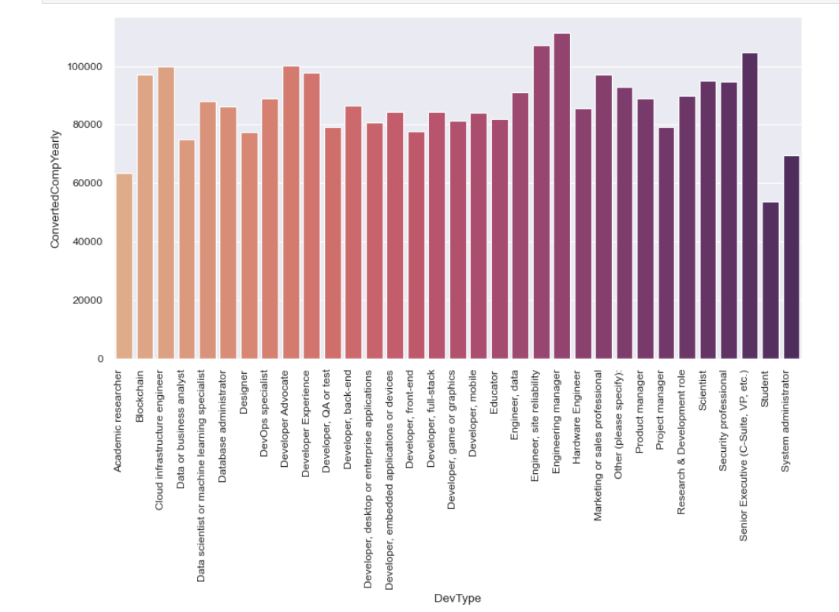
Who are the developers with the highest earnings?
Senior roles like c-suite executives and engineering managers tend to have the highest salaries.

Slide 16
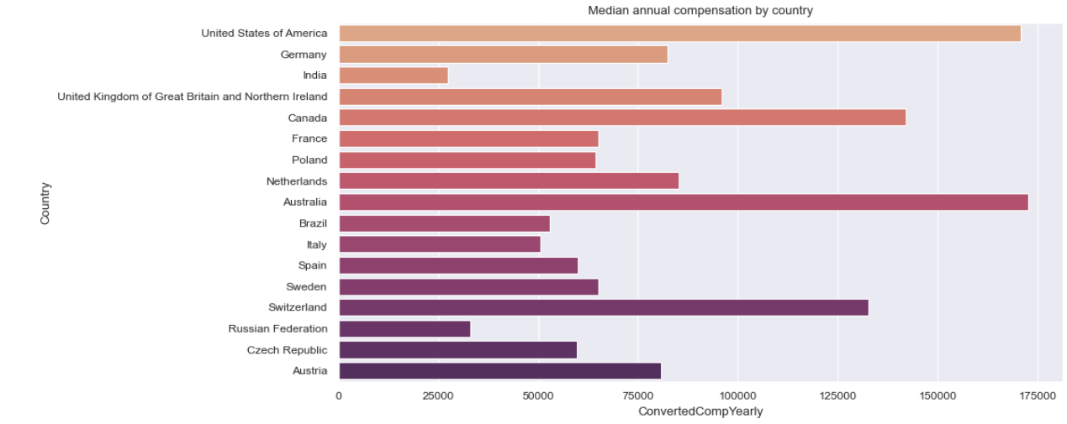
Average Salary Across Countries
Respondents from US earns more followed by Australia and Canada

Slide 17
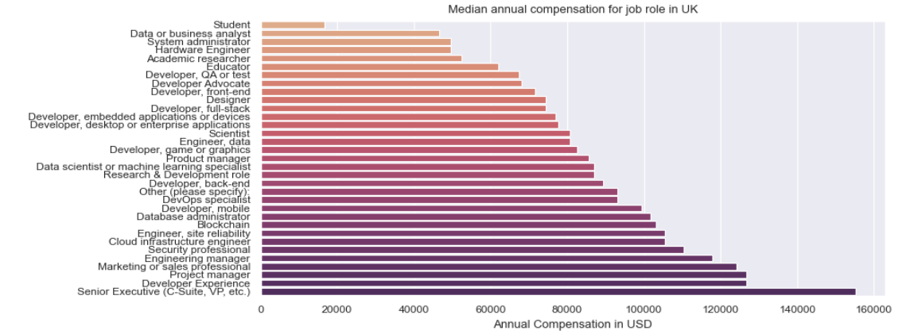
Average Salary Across Job Titles in UK
Just like across the globe, senior roles have highest salaries.
Data analyst roles have average salary of 45K
Full stack web developers have average salary of 75K

Slide 18
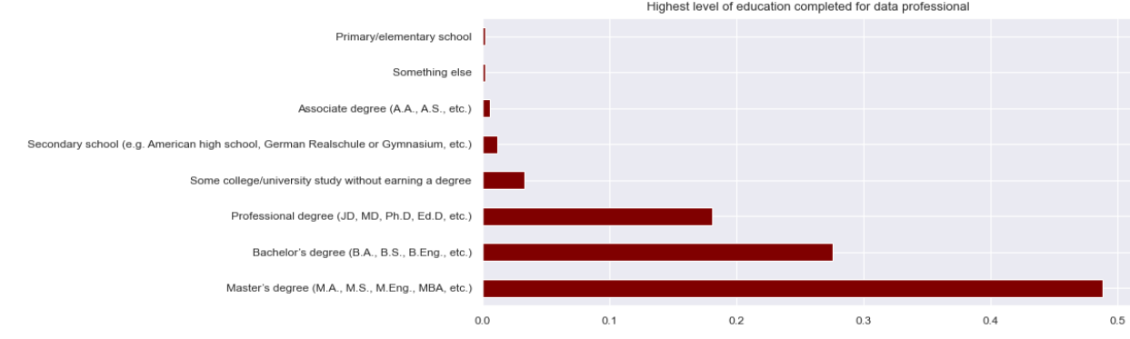
Highest Level of Education for Data Professional
Majority of respondents : Bachelor's degree (>40%)
Data specialists mostly attained Master's degree

Slide 19
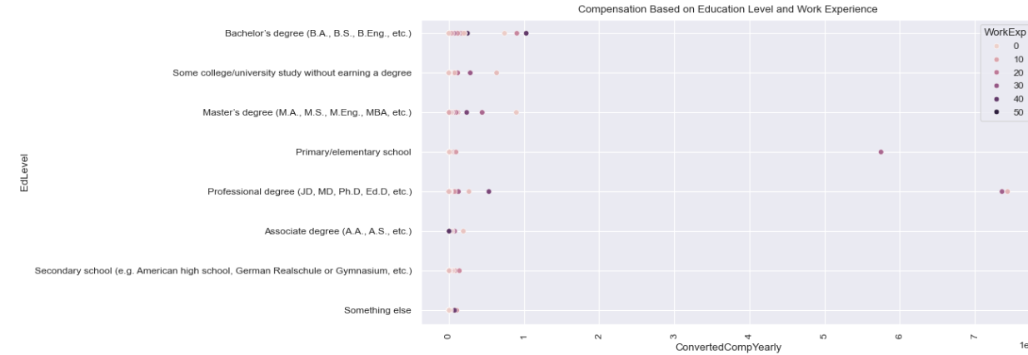
Compensation Based on Education Level with Work Experience
Respondents with Bachelor's degree and experience over 30 years tend to be paid more

Slide 20
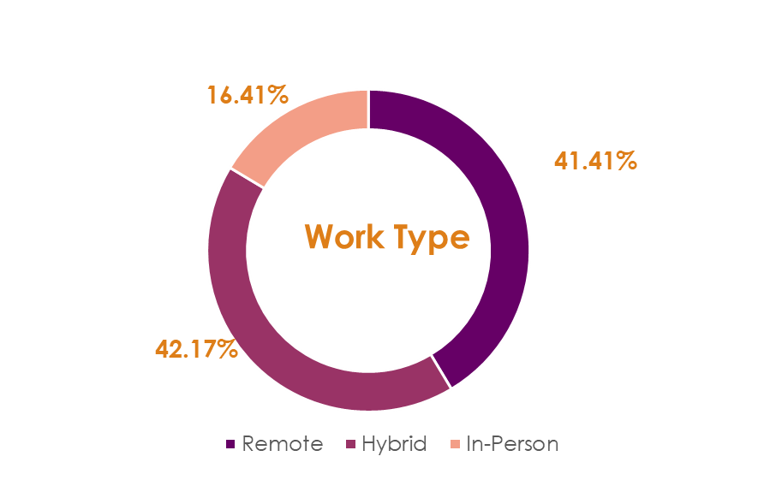
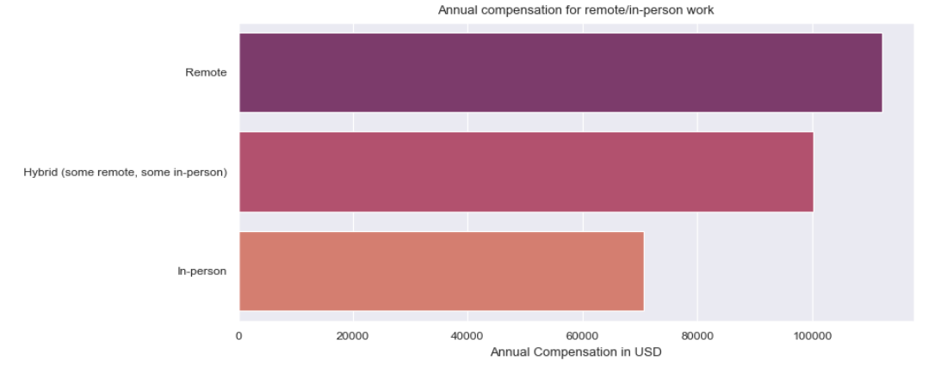
Work Type
Majority of people work remotely or in hybrid arrangements
In-person workers get less annual pay on average

Slide 21
Conclusion
Most represented among the responses were full-stack developers (>25K responses), from the USA (>18K respondents), aged 25-34 .
The most popular languages for data specialists are Python and SQL , while web development languages like JavaScript and HTML/CSS are opted by all respondents.
Majority of respondents hold Bachelor's degree, while data specialists tend to have more Master's degrees compared to all respondents
As expected, post pandemic majority of respondents work remotely to some extent, with only approx. 16% respondents working fully in-person. Surprisingly, there are stark differences in pay, with remote workers earning almost 70% more than those that work fully in-person.
Respondents from the USA earned the most, with respondents from Australia and Switzerland following after.

Slide 22
Thank You

