Slide 1

Exploring the Differences in Mental Rotation of Letters and Faces
Comparing Reaction time and Contralateral Delay Activity (CDA)
Group 5:
Guo Ran
Dang Qianqian
Shao Mingxin

Slide 2
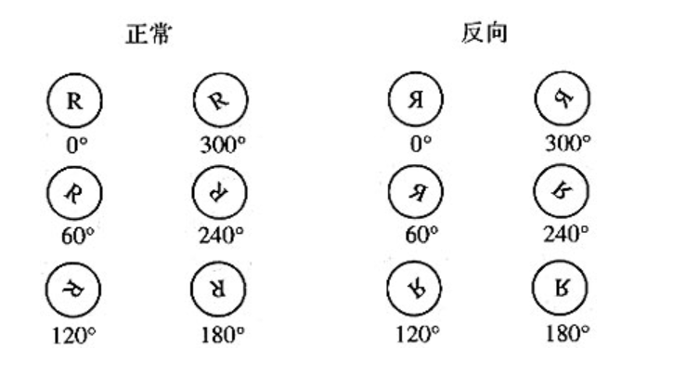
Mental rotation paradigm (Cooper & Shepard, 1973)
Mental Rotation (Upright/Inverted): Mental rotation involves rotating an object's image in the mind to match or compare orientations, highlighting spatial cognition and visual processing skills.
Result: The greater the degree of deviation of the sample from the orthostatic position, the more mental rotation is required and the longer it takes. Reverse R's response times were consistently larger than normal.

Slide 3
Neural study Mental rotation:
This study used EEG to explore contralateral delay activity (CDA) as one of the visual working memory (VWM) load indicators. Existing research has proven that it has higher sensitivity than traditional reaction time and can distinguish the two processes of image rotation (rotation angle and mirror image flip).
What is Contralateral Delay Activity (CDA)?
CDA is a crucial indicator of the load on visual working memory, manifesting as delayed activity in the brain's contralateral regions. It is considered a sensitive marker for assessing an individual's capacity to maintain and process visual information (Vogel & Machizawa, 2004).

Slide 4
Research purpose：
Exploring differences in the brain's processing of letters and faces. Whether or not processing mechanisms are different during mental rotation
RT: Used to assess the time it takes for an individual to respond to a stimulus.
CDA: When studying letter and face rotation tasks, CDA can be used to measure the amount of information carried by visual working memory during rotation.

Slide 5
Current research:
1. Association of CDA with Task Types: Studies have shown that different types of visual working memory tasks activate different regions of the brain.
For example, spatial tasks tend to activate more parietal and frontal areas, while face or object memory tasks rely more on the temporal lobes (Xu & Chun, 2005).
2. SPATIAL PROCESSING AND LETTER ROTATION: Letter rotation tasks rely heavily on spatial processing abilities, a process that takes place in the parietal and frontal regions of the brain (Corballis, 1997). These regions are thought to be critical for processing spatial information and performing mental rotation tasks.

Slide 6
3. Special Mechanisms for Face Recognition: Face rotation tasks involve more specialized visual processing mechanisms, mainly relying on face recognition-related brain regions such as the inferior temporal lobes and the fusiform gyrus (Haxby et al., 2000). These areas are specialized for processing face information, including identification and emotional interpretation.
4. Uniqueness of Face Processing: Face processing is believed to have a unique visual processing pathway, distinct from the pathways for objects or letters. It involves more activity in the temporal lobes, especially the inferior temporal lobes and the fusiform gyrus, crucial for processing face information (Kanwisher et al., 1997).

Slide 7

Hypothesis:
We hypothesize that under the different combinations of independent variables – material type (letters/faces), orientation (upright/mirror), and rotation angle (every 30° increment) – there will be significant differences in reaction time (RT) and visual working memory load (CDA).
1. The impact of material type on CDA and RT: We anticipate that the CDA for face rotation tasks will be lower than that for letter rotation tasks, as face recognition may activate specialized processing mechanisms in the brain, thereby reducing the load on visual working memory. Conversely, the RT for face rotation tasks may be higher than for letter rotations, due to the additional cognitive processing required to recognize rotated faces, despite the existence of specialized pathways for face processing.
Notes:
我们假设，在材料类型（字母/面孔）、性质（正立/镜像）、以及旋转角度（每30°一个水平）这些自变量的不同组合下，反应时间（RT）和视觉工作记忆负荷（CDA）会表现出明显的差异：
1、材料类型对CDA和RT的影响：我们预计面孔旋转任务的CDA会小于字母旋转任务的CDA，因为面孔识别可能激活了脑中专门化的处理机制，减轻了视觉工作记忆的负担。相反，面孔旋转任务的RT可能会高于字母旋转，因为旋转面孔的识别需要额外的认知加工，尽管面孔有专门的加工路径。

Slide 8
2. The impact of orientation (upright/mirror): It is anticipated that recognizing mirrored stimuli, especially mirrored faces, will require longer reaction times because processing the asymmetrical features of mirrored faces necessitates additional cognitive resources. Simultaneously, mirrored stimuli might also affect CDA. Previous research has shown that CDA maintains a high amplitude for rotations of mirrored images, indicating that the rotation of mirrored pictures imposes a significant working memory load on individuals. For mirrored faces, we predict that the CDA for mirrored faces will be lower than that for mirrored images of the letter R.
Notes:
性质（正立/镜像）的影响：预计镜像刺激的识别，尤其是镜像面孔，会需要更长的反应时间，因为处理镜像面孔的非对称特征需要额外的认知资源。同时，镜像刺激可能也会对CDA产生影响，在过去的研究中显示，CDA对于镜像的旋转，始终是保持在一个很高的波幅，说明镜像图片的旋转让人们产生了很大的工作记忆负荷。而对于镜像的面孔，我们可以预测镜像面孔的CDA是要小于字母R的镜像图片的。

Slide 9
3. The impact of rotation angle: We further predict that regardless of the material type and orientation, reaction times will increase with the increase in rotation angle, reflecting increasing difficulty of rotational tasks. For RT, the increase in rotation angle may lead to more significant changes in face rotation tasks, indicating an increased sensitivity to rotation in face recognition.
Notes:
旋转角度的影响：我们进一步预测，无论材料类型和性质如何，反应时间会随着旋转角度的增加而增加，反映出旋转任务的难度增加。对于RT而言，旋转角度的增加可能在面孔旋转任务中导致更显著的变化，这反映了面孔识别对旋转敏感性的增加。

Slide 10
4. Dissociation Effect
We believe that different types of visual tasks, such as face rotation versus letter rotation, exhibit differences in cognitive processing. These differences are manifested through various psychological measurement indicators, such as reaction time (RT) and visual working memory load (CDA).
RT is typically used to measure the time required to complete a task, reflecting processing speed. If the RT for face rotation tasks is longer, this may imply that the recognition and processing of rotated faces require more time, possibly due to more complex visual and cognitive transformations involved in recognizing faces after rotation.
CDA reflects the ability to maintain information in visual working memory, closely related to the visual working memory demand of the task. If the CDA amplitude caused by letter rotation tasks is greater than that for face rotation tasks, it may indicate that although face recognition is more efficient in visual working memory, letter rotation tasks demand more from visual working memory.
Therefore, we predict that face and letter rotation tasks may activate different processing mechanisms in the brain. Face recognition utilizes specialized facial processing pathways, which may make the recognition of rotated faces somewhat more efficient than the recognition of rotated letters, despite the additional time required to process the physical changes introduced by face rotation.
Notes:
分离效应
我们认为不同类型的视觉任务（如面孔旋转与字母旋转）在认知加工上存在差异。这些差异通过不同的心理测量指标（如反应时间RT和视觉工作记忆负荷CDA）得以显现。RT通常用来衡量任务完成所需的时间，反映了处理速度。如果面孔旋转任务的RT较长，这可能意味着面孔旋转的识别和加工需要更多时间，可能是因为旋转后的面孔识别涉及更复杂的视觉和认知转换。CDA反映了视觉工作记忆中维持信息的能力，与任务的视觉工作记忆需求密切相关。如果字母旋转任务导致的CDA振幅大于面孔旋转任务，这可能表明尽管面孔识别在视觉工作记忆中更为高效，但字母旋转任务对视觉工作记忆的需求更高。因此，我们预测面孔与字母旋转任务可能激活了大脑中不同的处理机制。面孔识别利用了专门的面孔处理路径，这可能使得旋转面孔的识别在某种程度上比旋转字母更为高效，尽管面孔旋转的物理变化处理需要更多时间。

Slide 11


Stimulate
A. Alphabet
Similar with classic paradigm of Cooper’s.
Apply some alphabets from different languages but are mirror-symmetric with each other.
E.g. R—Я , N—И
Including 12 revolve levels to capture more subtle changes.
R
R
R
R
R
R
R
R
R
R
R
R
Я
Я
Я
Я
Я
Я
Я
Я
Я
Я
Я
Я
B. Face
Similar faces generated from a generative adversarial network (GAN) (Karras et al., 2018), pretrained on the CelebA-HQ data set (Liu et al., 2015), but could be distinguished (De La Torre‐Ortiz et al., 2023)
Do same revolve as alphabets.

Slide 12
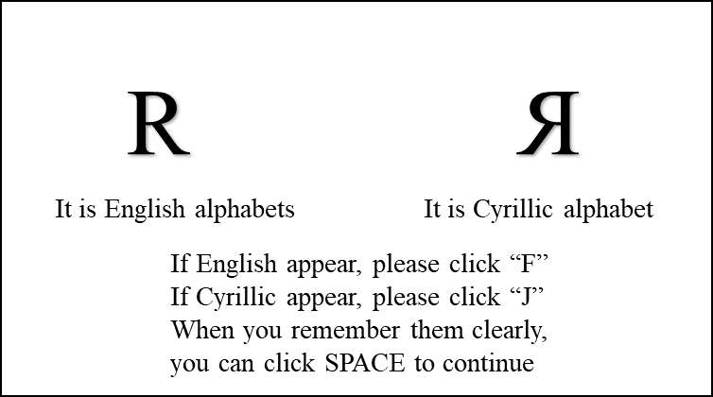
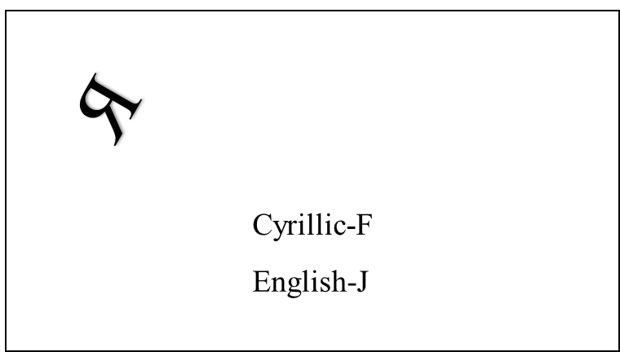
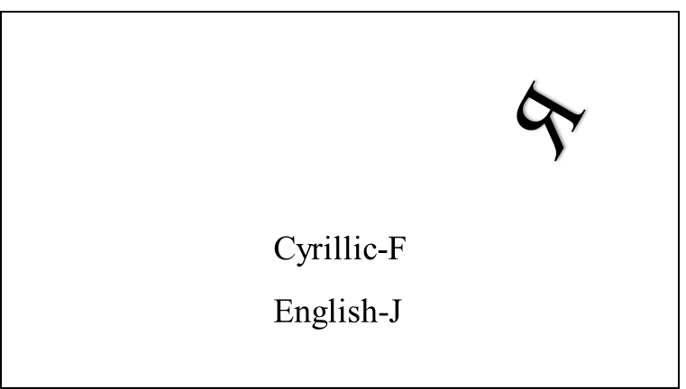
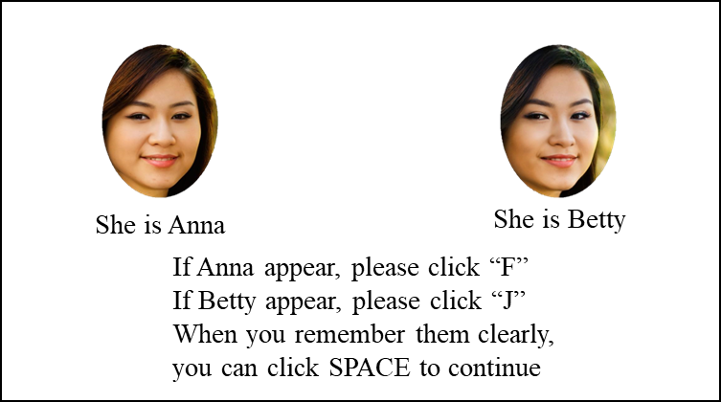


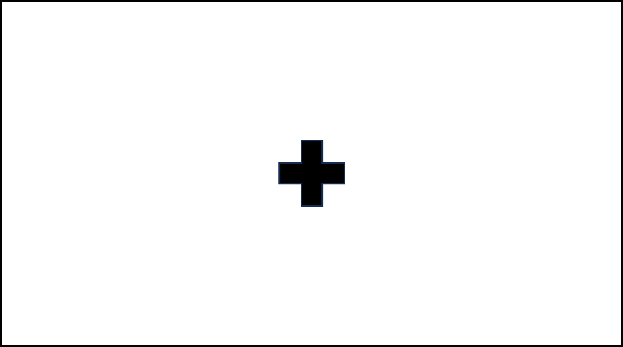
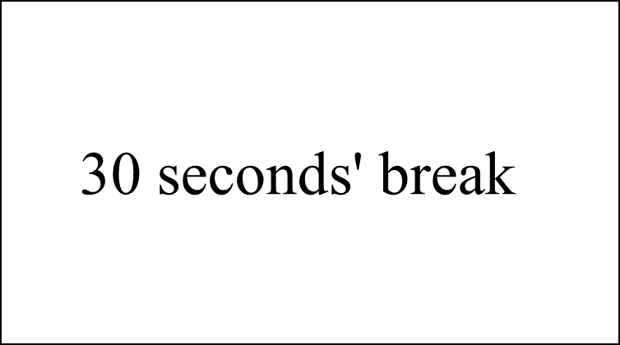

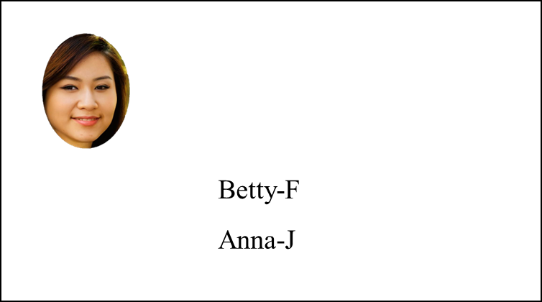
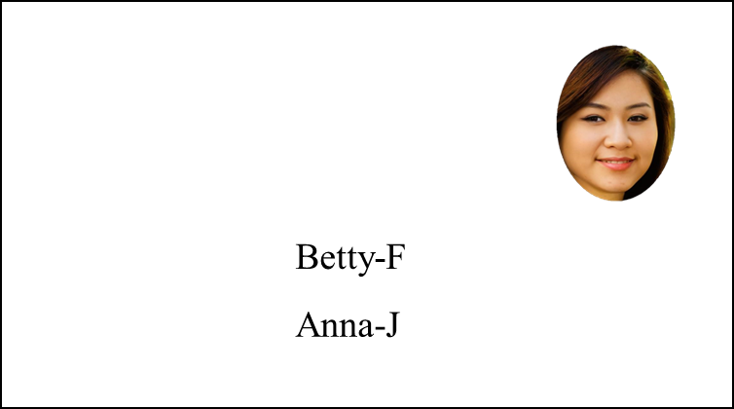
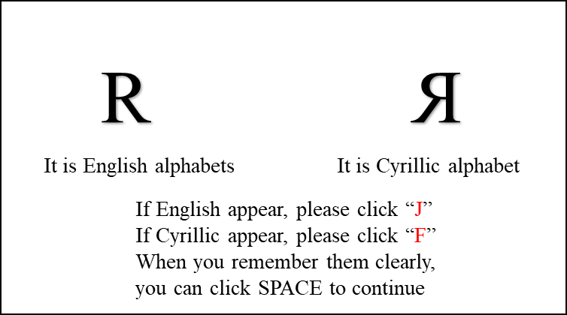
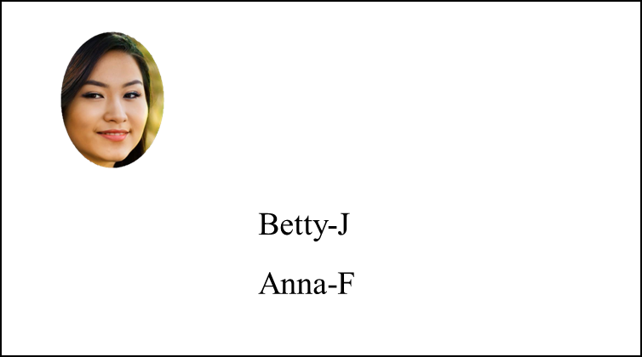
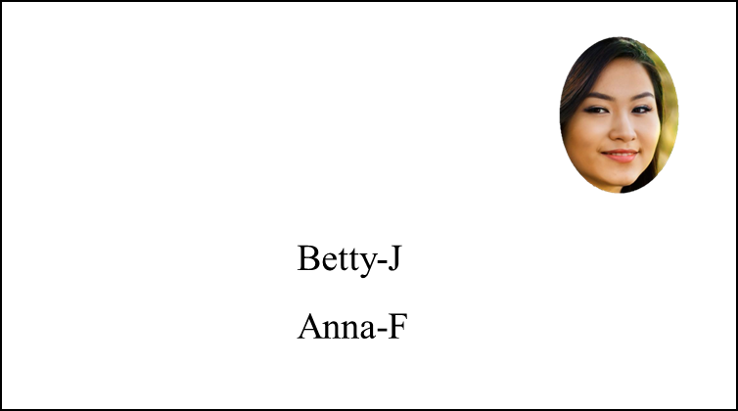
Task & Measure
Task
The Alphabets are used as target in Part1 and Part4
The faces are used as target in Part2 and Part3, to balance sequential effect
For every part, participants will be taught two alphabets are from different languages or there are two people firstly.
And then in paradigm, alphabets/faces will be shown until participant do a judge that alphabet/face they are showed is from certain language/certain person by click keyboard.
For CDA, the target will be showed in left and right equally and randomly.
In part1/part4 and part2/part3, the keys are exchanged to control the influence of the dominant hand
Click and other 2*12*4=96 trials
500ms

Slide 13
Task & Measure
A. Reaction time
Since the images showed, to the shoot that participant do a judgement
B. CDA（Contralateral Delay Activity）
The electrodes used for CDA analysis include P7, P8, PO3, PO4, PO7, and PO8, as well as two electrodes placed on the mastoids.
The method involves subtracting the ipsilateral amplitude from the contralateral amplitude, where the contralateral and ipsilateral amplitudes are defined relative to the position of the target on the screen.
eg. When target is in left, the left hemisphere of the brain is ipsilateral, while the right one is contralateral.

Slide 14
Reference:
Cooper, L. A., & Shepard, R. N. (1973). Chronometric studies of the rotation of Mental Images. Visual Information Processing, 75–176. https://doi.org/10.1016/b978-0-12-170150-5.50009-3
Corballis, M. C. (1997). Mental rotation and the right hemisphere. Brain and Language, 57(1), 100–121. https://doi.org/10.1006/brln.1997.1835
Haxby, J. V., Hoffman, E. A., & Gobbini, M. I. (2000). The distributed human neural system for face perception.
Trends in Cognitive Sciences, 4(6), 223–233. https://doi.org/10.1016/s1364-6613(00)01482-0
Kanwisher, N., McDermott, J., & Chun, M. M. (1997). The fusiform face area: A module in human extrastriate cortex specialized for face perception. The Journal of Neuroscience, 17(11), 4302–4311. https://doi.org/10.1523/jneurosci.17-11-04302.1997
Vogel, E. K., & Machizawa, M. G. (2004). Neural activity predicts individual differences in visual working memory capacity. Nature, 428(6984), 748–751. https://doi.org/10.1038/nature02447
Xu, Y., & Chun, M. M. (2005). Dissociable neural mechanisms supporting visual short-term memory for objects. Nature, 440(7080), 91–95. https://doi.org/10.1038/nature04262

Slide 15
The End
Thanks for listening

