Slide 2
Depreciation
Any equipment which is purchased today will not work for ever. This may be due to wear and tear of the equipment or obsolescence of technology.
Hence, it is to be replaced at the proper time for continuance of any business.
The replacement of the equipment at the end of its life involves money.
This must be internally generated from the earnings of the equipment.
The recovery of money from the earnings of an equipment for its replacement purpose is called depreciation fund since we make an assumption that the value of the equipment decreases with the passage of time.
Thus, the word “depreciation” means decrease in value of any physical asset with the passage of time.

Slide 3
METHODS OF DEPRECIATION
There are several methods of accounting depreciation fund. These are as follows:
Straight line method of depreciation
Declining balance method of depreciation
Sum of the years—digits method of depreciation
Sinking-fund method of depreciation
Service output method of depreciation

Slide 4
Straight Line Method of Depreciation
In this method of depreciation, a fixed sum is charged as the depreciation amount throughout the lifetime of an asset such that the accumulated sum at the end of the life of the asset is exactly equal to the purchase value of the asset.
Here, we make an important assumption that inflation is absent.

Slide 5
The formulae for depreciation and book value
are as follows:
Dt = (P – F)/n
Bt = Bt–1 – Dt = P – t X [(P – F)/n]
Let
P = first cost of the asset,
F = salvage value of the asset,
n = life of the asset,
Bt = book value of the asset at the end of the period t,
Dt = depreciation amount for the period t.

Slide 6
Example 1
A company has purchased an equipment whose first cost is Rs. 1,00,000 with an estimated life of eight years. The estimated salvage value of the equipment at the end of its lifetime is Rs. 20,000. Determine the depreciation charge and book value at the end of various years using the straight line method of depreciation.

Slide 7
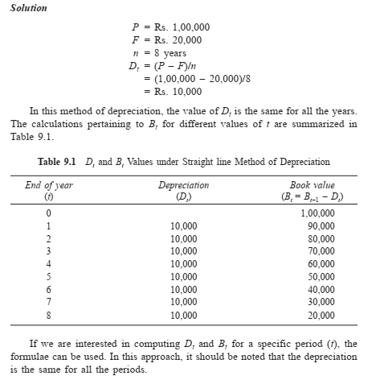

Slide 8
Example 2
A company has purchased an equipment whose first cost is Rs. 1,00,000 with an estimated life of eight years. The estimated salvage value of the equipment at the end of its lifetime is Rs. 20,000. Determine the depreciation charge and book value at the end of various years using the straight line method of depreciation.
Consider the Example and compute the depreciation and the book value for period 5.

Slide 9
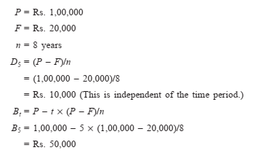

Slide 10
Declining Balance Method of Depreciation
In this method of depreciation, a constant percentage of the book value of the previous period of the asset will be charged as the depreciation amount for the current period.
This approach is a more realistic approach, since the depreciation charge decreases with the life of the asset which matches with the earning potential of the asset.
The book value at the end of the life of the asset may not be exactly equal to the salvage value of the asset. This is a major limitation of this approach.

Slide 11
The formulae for depreciation and book value are as follows:
Dt = K x Bt-1
Bt = Bt–1 – Dt = Bt–1 – K x Bt–1
= (1 – K) x Bt–1
Let
P = first cost of the asset,
F = salvage value of the asset,
n = life of the asset,
Bt = book value of the asset at the end of the period t,
K = a fixed percentage, and
Dt = depreciation amount at the end of the period t.

Slide 12
Example 3
A company has purchased an equipment whose first cost is Rs. 1,00,000 with an estimated life of eight years. The estimated salvage value of the equipment at the end of its lifetime is Rs. 20,000. Determine the depreciation charge and book value at the end of various years using the straight line method of depreciation.
Consider the Example and demonstrate the calculations of the declining balance method of depreciation by assuming 0.2 for K.

Slide 13
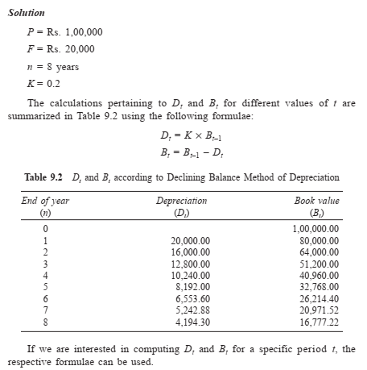

Slide 14
Example 4
A company has purchased an equipment whose first cost is Rs. 1,00,000 with an estimated life of eight years. The estimated salvage value of the equipment at the end of its lifetime is Rs. 20,000. Determine the depreciation charge and book value at the end of various years using the straight line method of depreciation.
Consider the Example and calculate the depreciation and the book value for period 5 using the declining balance method of depreciation by assuming 0.2 for K.

Slide 15
