Slide 1
Data Flow Diagrams
Examples

Slide 2
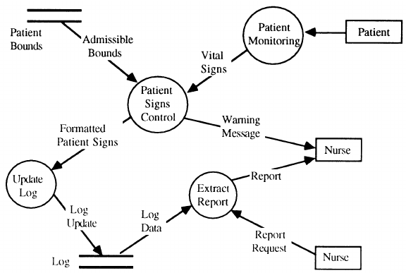
Patient Monitoring System

Slide 3








Rule of Data Flow
Wrong | Right | Description
 |  | An entity cannot provide data to another entity without some processing occurred.
 |  | Data cannot move directly from an entity to a data story without being processed.
 |  | Data cannot move directly from a data store without being processed.
 |  | Data cannot move directly from one data store to another without being processed.

Slide 4
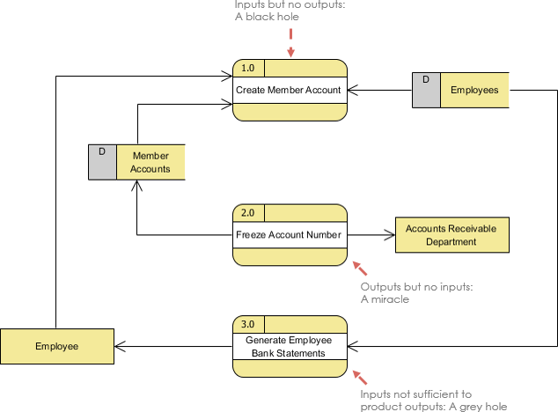
Black hole, Gray hole and Miracle process

