Slide 1
Data Flow Diagrams

Slide 2
Logical vs Physical DFD
Logical DFD depicts how the business operates.
The processes represent the business activities.
The data stores represent the collection of data regardless of how the data are stored.
It s how business controls.

Slide 3
Physical DFD
Physical DFD depicts how the system will be implemented (or how the current system operates).
The processes represent the programs, program modules, and manual procedures.
The data stores represent the physical files and databases, manual files.
It show controls for validating input data, for obtaining a record, for ensuring successful completion of a process, and for system security.

Slide 4
Benefits of Logical Data Flow Diagram
A physical data flow diagram shows how the system will be implemented, including the hardware, software, files, and people in the system. It is developed such that the processes described in the logical data flow diagrams are implemented correctly to achieve the goal of the business. Here is the benefits of the 2 type of DFDs:
Clarifying which processes are manual and which are automated: Manual processes require detailed documentation and automated process require computer programs to be developed.
Describing processes in more detail than do logical DFDs: Describes all steps for processing of data.
Sequencing processes that have to be done in a particular order: Sequence of activities that lead to a meaningful result are described. For example, update must be performed before a producing a summary report.
Identifying temporary data storage: Temporary storage such as a sales transaction file for a customer receipt (report) in a grocery store, are described.

Slide 5
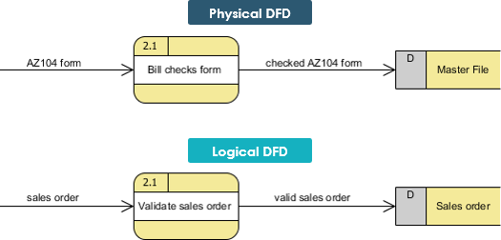

Slide 6
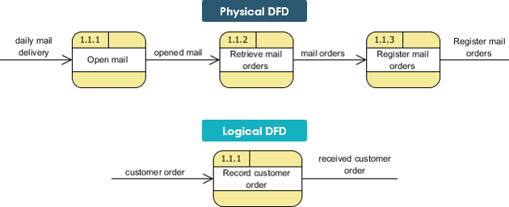

Slide 7
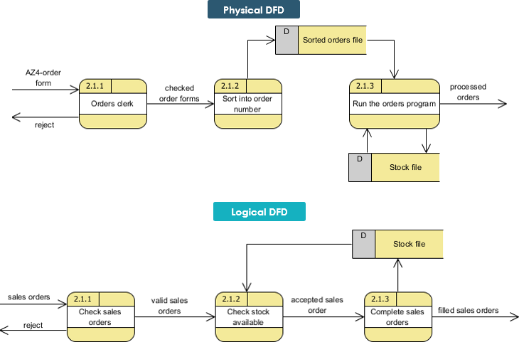

Slide 8
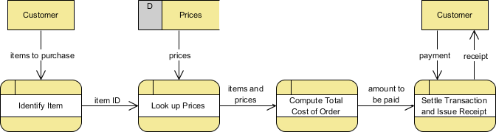
Logical DFD Example - Grocery Store

Slide 9
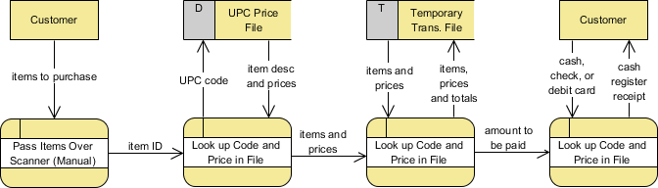
Physical DFD Example - Grocery Store

