Slide 1
Beyond Functionality – Software Quality Attributes
Lecture 8

Slide 2
Overview
Users expectations about “how well” the product will work, include how
easy it is to use,
how quickly it runs,
how often it fails,
and how it handles unexpected conditions.
Collectively known as software quality attributes or quality factors, (also called non-behavioral) requirements.

Slide 3
Overview
Quality attributes are difficult to define,
yet distinguish a product “what it's supposed to one that delights its customers”
If don't explore the customers' quality expectations during requirements elicitation,
Then its lucky if the product satisfies them, else disappointed users and frustrated developers are the more typical outcome.

Slide 4
Overview
Customers don't present their quality expectations explicitly,
although the information during elicitation supplies some clues.
Questions that explore the customers' implicit expectations can lead to quality goal statements.

Slide 5
Quality Attributes
Dozen product characteristics can be called quality attributes,
although most projects need only a handful of them.
If developers know most of crucial Quality attribute to his project success,
they can select architecture, design, and programming approaches to achieve quality goals

Slide 6
Quality Attributes
One way to classify attributes distinguishes those characteristics that are noticeable at run time.
Another approach is to separate qualities that are primarily significant to technical staff and primarily important to the users.
The latter indirectly contribute to customer satisfaction by making the product easier to change, correct, verify, and migrate to new platforms.

Slide 7
Quality Attributes
Lists several quality attributes in both categories that every project should consider.
Some attributes are critical to
embedded systems (efficiency and reliability),
others pertinent to Internet and mainframe applications (availability, integrity, and maintainability)
or to desktop systems (interoperability and usability).

Slide 8
Quality Attributes
Table 1: Software Quality Attributes
Important Primarily to Users | Important Primarily to Developers
Availability | Maintainability
Efficiency | Portability
Flexibility | Reusability
Integrity | Testability
Interoperability
Reliability
Robustness
Usability
Learn attributes from Table -1 are important to your project's success.

Slide 9
Quality Attributes
Different parts of the product need different combinations of quality attributes.
Efficiency might be critical for certain components, while usability is paramount for others.
So differentiate quality characteristics that apply to certain components, certain user classes, or particular usage situations.

Slide 10
Defining Quality Attributes
Most users won't know how to answer questions such as
"What are your interoperability requirements?" or
"How reliable does the software have to be?"
Analysts developed several prompting questions based on each attribute that they thought might be significant.

Slide 11
Defining Quality Attributes
For example, to explore integrity they asked,
"How important is it to prevent users from viewing orders they didn't place?" or
"Should everyone be able to search the stockroom inventory?"
Ask the user representatives to rank each attribute on a scale of 1 (don't give it another thought) to 5 (critically important).

Slide 12
Defining Quality Attributes
If you can't quantify quality attributes,
at least define their priorities and customer preferences.
Consider asking users what would constitute unacceptable performance, usability, integrity, or reliability.
That is, specify system properties that would violate the user's quality expectations
such as allowing an unauthorized user to delete files.
By defining unacceptable characteristics—a kind of inverse requirement

Slide 13
Attributes Important to Users
Availability:
Availability is a measure of the planned up time during which the system is actually available for use and fully operational.
Certain tasks are more time-critical, users become frustrated, when need essential work done and the system isn't available.
Ask users what percentage of up time is really needed and whether there are any times for which availability is essential to meet business or safety objectives.

Slide 14
Availability
Availability is more important for Web sites or global applications with worldwide users.
AV-1. The system shall be at least 99.5 percent available on weekdays between 6:00 a.m. and midnight local time, and at least 99.95 percent available on weekdays between 4:00 p.m. and 6:00 p.m. local time.

Slide 15
Attributes Important to Users
Efficiency:
Efficiency is a measure of how well the system utilizes processor capacity, disk space, memory, or communication bandwidth
Poor performance is an irritant to the user who is waiting for a database query to display results.
Consider minimum hardware configurations when defining efficiency, capacity, and performance goals.

Slide 16
Efficiency
EF-1. At least 25 percent of the processor capacity and RAM available to the application shall be unused at the planned peak load conditions.
Users won't state efficiency in such technical terms.
Think primarily in terms of response times or disk space consumption.

Slide 17
Attributes Important to Users
Flexibility:
Also known as extensibility, augment-ability, extend-ability, and expandability, flexibility measures how easy it is to add new capabilities to the product.
If developers expect making many enhancements,
they can choose design approaches that maximize the software's flexibility. Such as encapsulations.

Slide 18
Flexibility
FL-1. A maintenance programmer who has at least six months of experience supporting this product shall be able to make a new hardcopy output device available to the product, including code modifications and testing, with no more than one hour of labor.
This attribute is essential for products that are developed in an incremental or iterative fashion

Slide 19
Attributes Important to Users
Integrity :
Integrity—which encompasses security,
deals with blocking unauthorized access, preventing information loss, ensuring protected from virus infection, and protecting the privacy and safety of data entered into the system.
Integrity is a major issue with Internet software.
Users of e-commerce systems want their credit card information to be secure.

Slide 20
Integrity
Integrity requirements have no tolerance for error, State in unambiguous terms:
user identity verification, user privilege levels, access restrictions, or the precise data that must be protected.
IN-1. Only users who have Auditor access privileges shall be able to view customer transaction histories.

Slide 21
Attributes Important to Users
Interoperability:
Interoperability indicates how easily the system can exchange data or services with other systems.
To assess interoperability, need to know
which other applications the users will employ in conjunction with your product and what data they expect to exchange.

Slide 22
Interoperability
IO-1. The Chemical Tracking System shall be able to import any valid chemical structure from the ChemiDraw (version 2.3 or earlier) and Chem-Struct (version 5 or earlier) tools.
State this requirement as an external interface requirement

Slide 23
Attributes Important to Users
Reliability:
The probability of the software executing without failure for a specific period of time is known as reliability.
Ways to measure software reliability include
the percentage of operations that are completed correctly and the average length of time the system runs before failing.

Slide 24
Reliability
Systems that require high reliability should also be designed for high testability.
RE-1. No more than five experimental runs out of 1000 can be lost because of software failures.

Slide 25
Attributes Important to Users
Usability:
Also referred to as ease of use and human engineering, usability addresses the countless factors that constitute what users often describe as user-friendliness.
Analysts and developers shouldn't talk about friendly software
but about software that's designed for effective and unobtrusive usage.

Slide 26
Usability
US-1. A trained user shall be able to submit a complete request for a chemical selected from a vendor catalog in an average of four and a maximum of six minutes.
Inquire whether the new system must conform to any user interface standards or conventions,

Slide 27
Attributes Important to Developers
Maintainability:
Maintainability indicates how easy it is to correct a defect or modify the software.
Maintainability depends on how easily the software can be understood, changed, and tested.
Related to flexibility and testability.
Critical for products that will undergo frequent revision and for products that are being built quickly

Slide 28
Maintainability
MA-1. A maintenance programmer shall be able to modify existing reports to conform to revised chemical-reporting regulations from the federal government with 20 labor hours or less of development effort.
MA-2. Function calls shall not be nested more than two levels deep.

Slide 29
Attributes Important to Developers
Reusability:
A long-sought goal of software development, reusability indicates the relative effort involved to convert a software component for use in other applications.
Developing reusable software costs considerably more than creating a component that you intend to use in just one application, reusable software must be
modular, well documented, independent of a specific application and operating environment, and somewhat generic in capability.

Slide 30
Reusability
RU-1. The chemical structure input functions shall be designed to be reusable at the object code level in other applications that use the international standard chemical structure representations.

Slide 31
Attributes Important to Developers
Testability:
Also known as verifiability, testability refers to the ease with which software components or the integrated product can be tested to look for defects.
Designing for testability is critical if the product has complex algorithms and logic,
TE-1. The maximum cyclomatic complexity of a module shall not exceed 20.

Slide 32
Attribute Trade-Offs
Certain attribute combinations have inescapable trade-offs.
Users and developers must decide which attributes are important,
and they must respect those priorities consistently when they make decisions.

Slide 33
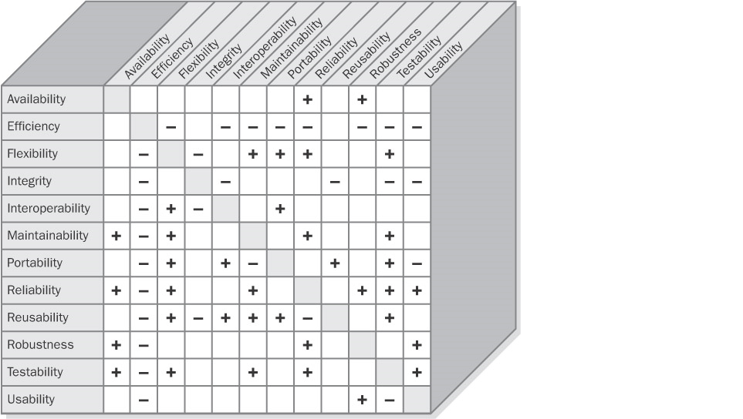
Attribute Trade-Offs

Slide 34
Attribute Trade-Offs
A minus sign(-) in a cell means that increasing the attribute in that row adversely affects the attribute in the column.
A blank cell indicates that the attribute in the row has little impact on the attribute in the column.
Efficiency has a negative impact on most other attributes.
If you write the tightest, fastest code you can, using coding tricks and relying on execution side effects, it's likely to be hard to maintain and enhance; in addition, it won't be easy to port to other platforms.

Slide 35
Attribute Trade-Offs
To reach the optimum balance of product characteristics,
you must identify, specify, and prioritize the applicable quality attributes during requirements elicitation.
Following are some examples:
Don't expect to maximize usability if the software must run on multiple platforms (portability).
Highly robust code will be less efficient because of the data validations and error checking that it performs.

