Slide 1
Chapter 4
DC Biasing–BJTs

Slide 2
Biasing
Biasing: The DC voltages applied to a transistor in order to turn it on so that it can amplify the AC signal.

Slide 3
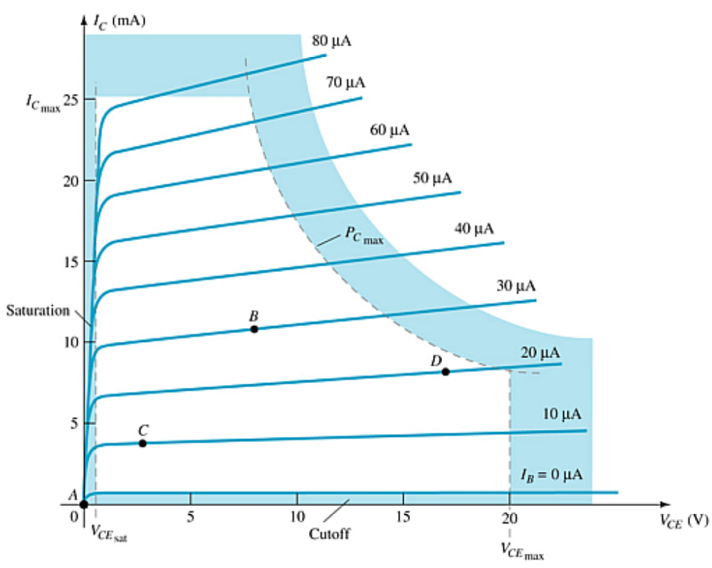
Operating Point
The DC input establishes an operating or quiescent point
called the Q-point.

Slide 4
The Three States of Operation
    Active or Linear Region Operation
    Base–Emitter junction is forward biased
        Base–Collector junction is reverse biased
    Cutoff Region Operation
    Base–Emitter junction is reverse biased
    Saturation Region Operation
    Base–Emitter junction is forward biased
    Base–Collector junction is forward biased

Slide 5
DC Biasing Circuits
Fixed-bias circuit
Emitter-stabilized bias circuit
Collector-emitter loop
Voltage divider bias circuit
DC bias with voltage feedback

Slide 6
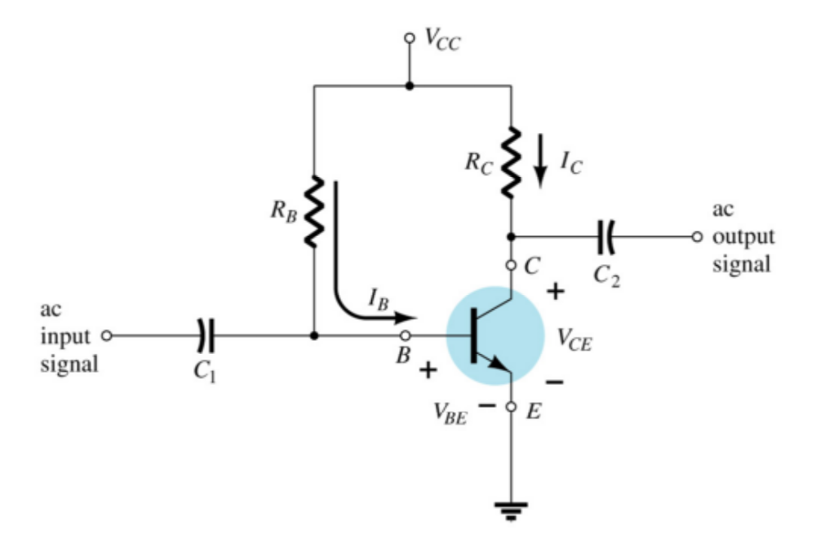
Fixed Bias

Slide 7
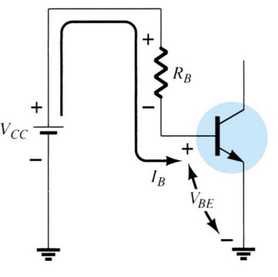
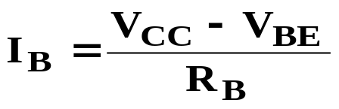
The Base-Emitter Loop
From Kirchhoff’s voltage law:
+V_{CC} – I_{B}R_{B} – V_{BE} = 0
Solving for base current:

Slide 8
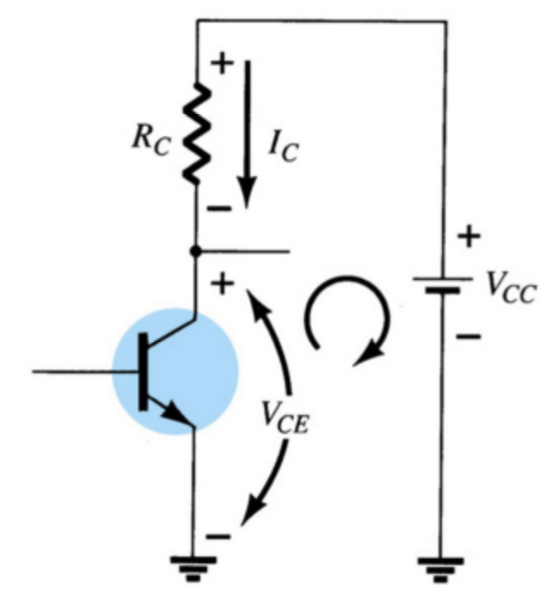


Collector-Emitter Loop
Collector current:
From Kirchhoff’s voltage law:

Slide 9
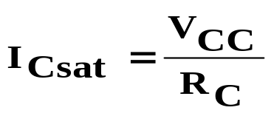

Saturation
When the transistor is operating in saturation, current through the transistor is at its maximum possible value.

Slide 10
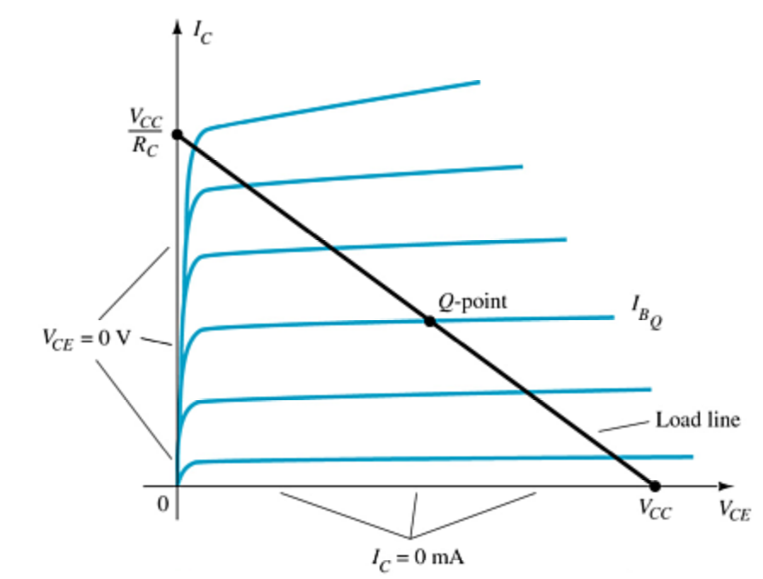
Load Line Analysis
The end points of the load line are:
I_{Csat}
  I_{C} = V_{CC} / R_{C}
  V_{CE} = 0 V
V_{CEcutoff}
  V_{CE} = V_{CC}
  I_{C} = 0 mA
The Q-point is the operating point:
where the value of R_{B} sets the value of I_{B}
that sets the values of V_{CE} and I_{C}

Slide 11
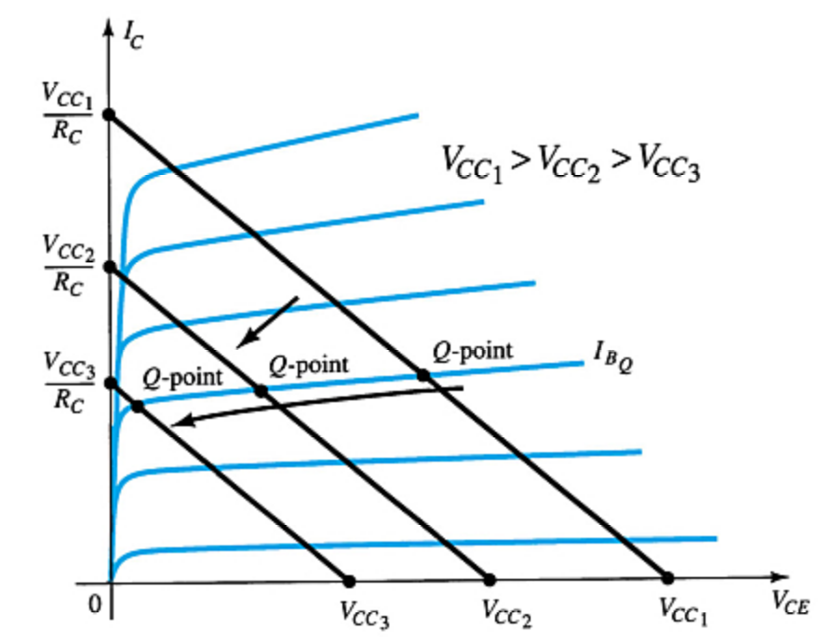
Circuit Values Affect the Q-Point
more …

Slide 12
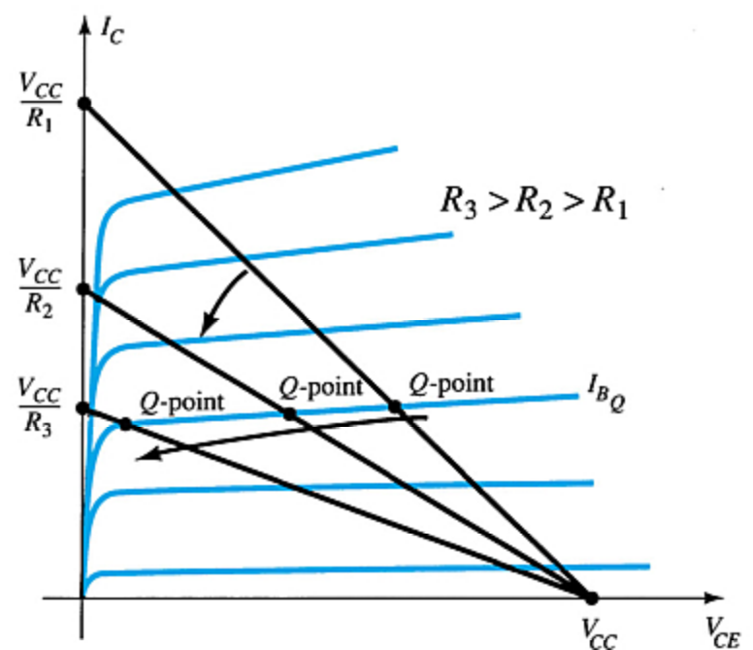
Circuit Values Affect the Q-Point
more …

Slide 13
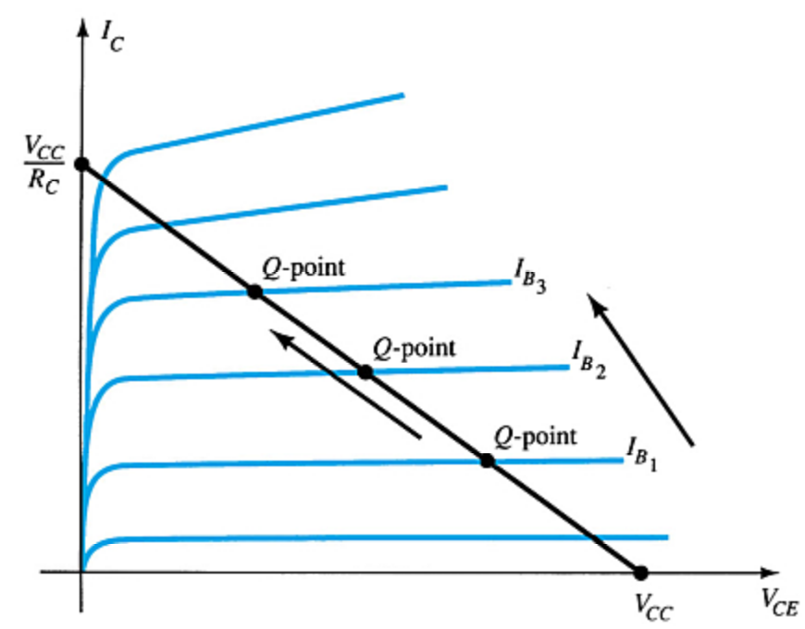
Circuit Values Affect the Q-Point

Slide 14
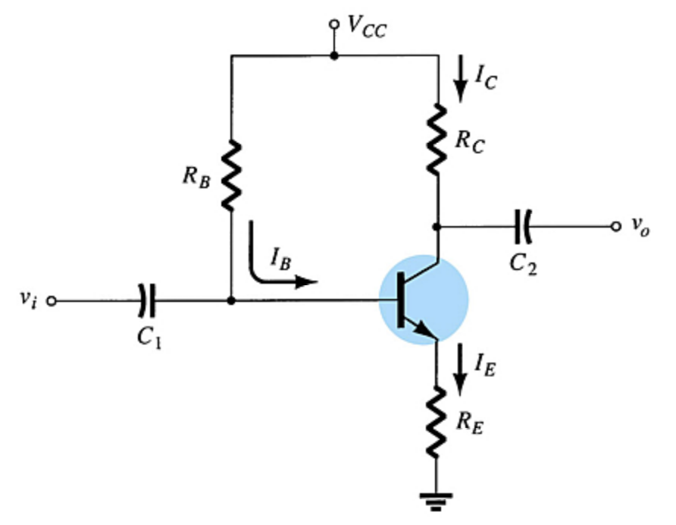
Emitter-Stabilized Bias Circuit
Adding a resistor (R_{E}) to the emitter circuit stabilizes the bias circuit.

Slide 15
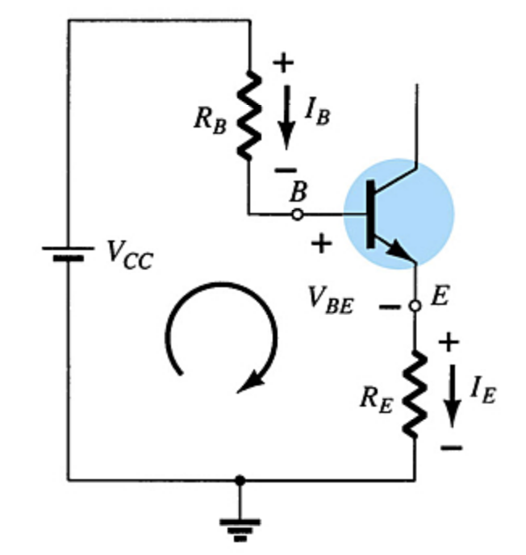


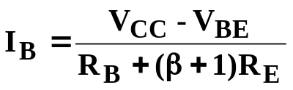
Base-Emitter Loop
From Kirchhoff’s voltage law:
Since I_{E} = (β + 1)I_{B}:
Solving for I_{B}:

Slide 16
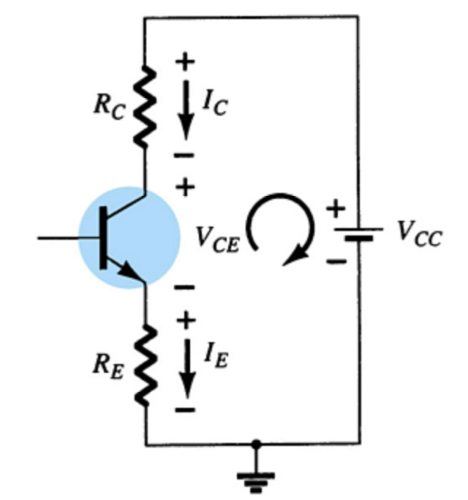


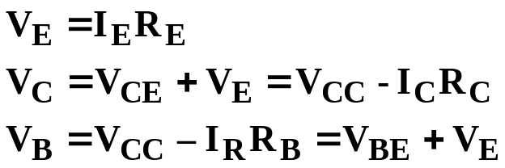
Collector-Emitter Loop
From Kirchhoff’s voltage law:
Since I_{E} ≅ I_{C}:
Also:

Slide 17
Improved Biased Stability
Stability refers to a circuit condition in which the currents and voltages will remain fairly constant over a wide range of temperatures and transistor Beta (β) values.
Adding RE to the emitter improves the stability of a transistor.

Slide 18
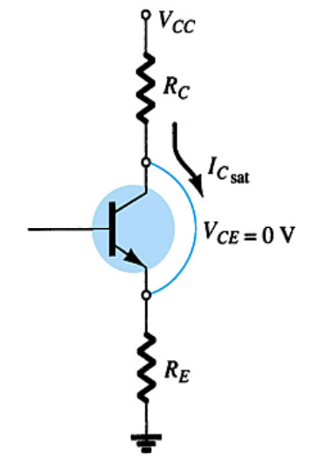
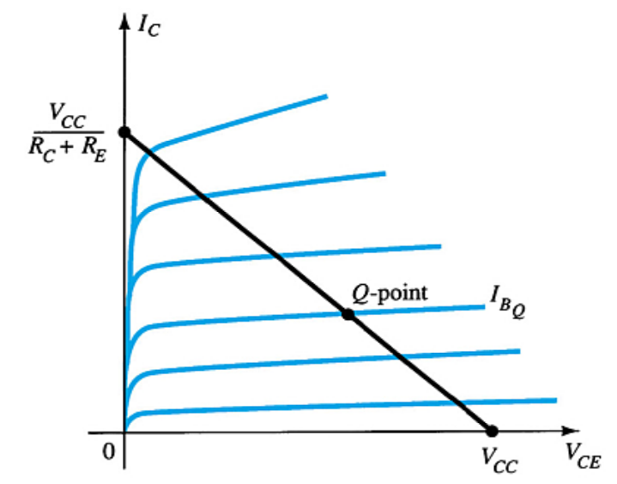
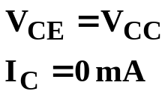
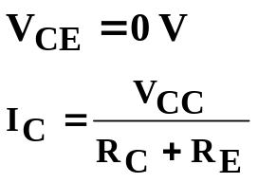
Saturation Level
The endpoints can be determined from the load line.
V_{CEcutoff}:
I_{Csat}:

Slide 19
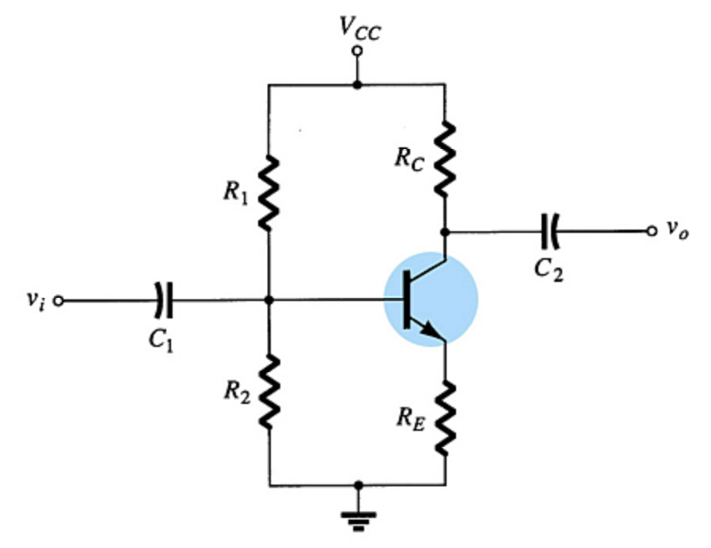
Voltage Divider Bias
This is a very stable bias circuit.
The currents and voltages are nearly independent of any variations in β.

Slide 20
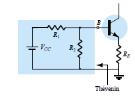

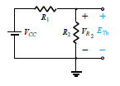

Exact Analysis

Slide 21

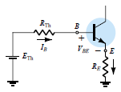

Slide 22
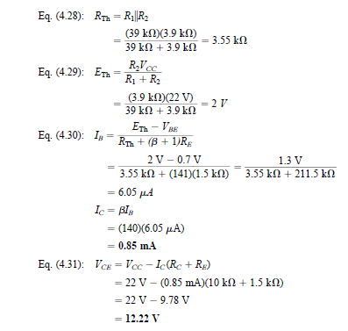
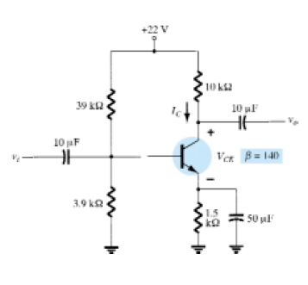

Slide 23
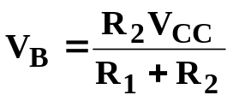
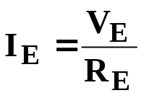


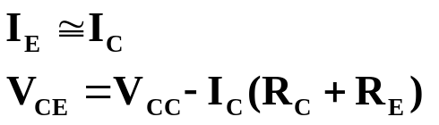
Approximate Analysis
Where I_{B} << I₁ and I₁ ≅ I₂ :
Where βR_{E} > 10R₂:
From Kirchhoff’s voltage law:

Slide 24
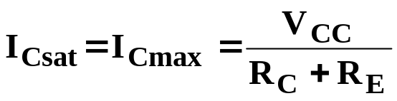
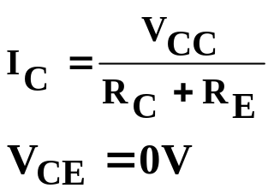
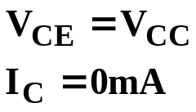
Voltage Divider Bias Analysis
Transistor Saturation Level
Load Line Analysis
  Cutoff: Saturation:

Slide 25
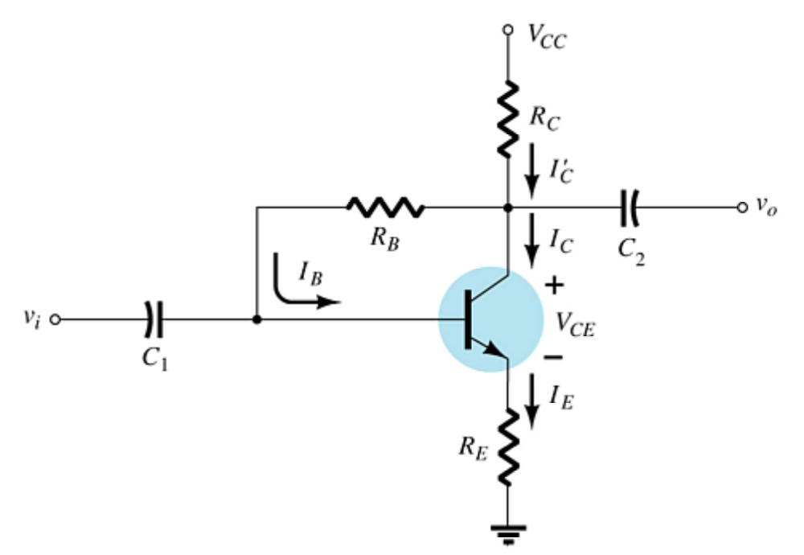
DC Bias with Voltage Feedback
Another way to improve the stability of a bias circuit is to add a feedback path from collector to base.
In this bias circuit the Q-point is only slightly dependent on the transistor beta, β.

Slide 26
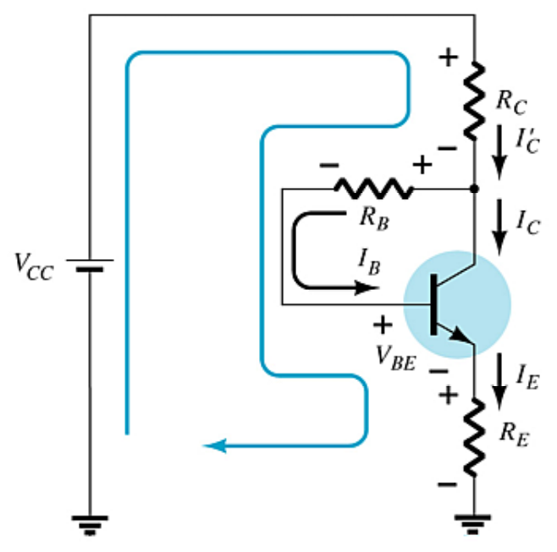

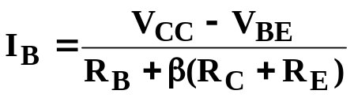
Base-Emitter Loop
From Kirchhoff’s voltage law:
Where I_{B} << I_{C}:
Knowing I_{C} = βI_{B} and I_{E} ≅ I_{C}, the loop equation becomes:
Solving for I_{B}:

Slide 27
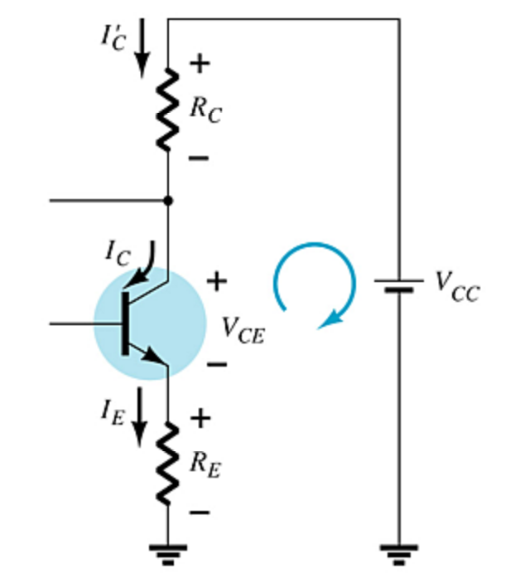
Collector-Emitter Loop
Applying Kirchoff’s voltage law:
R_{E}I_{E} + V_{CE} + I’_{C}R_{C} – V_{CC} = 0
Since I′_{C} ≅ I_{C} and I_{C} = βI_{B}:
I_{C}(R_{C} + R_{E}) + V_{CE} – V_{CC} =0
Solving for V_{CE}:
V_{CE} = V_{CC} – I_{C}(R_{C} + R_{E})

Slide 28
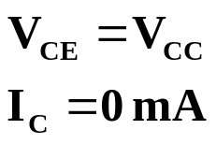
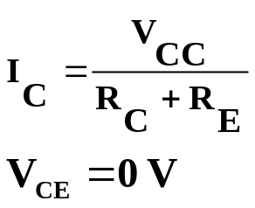
Base-Emitter Bias Analysis
Transistor Saturation Level
Load Line Analysis
  Cutoff: Saturation:

Slide 29
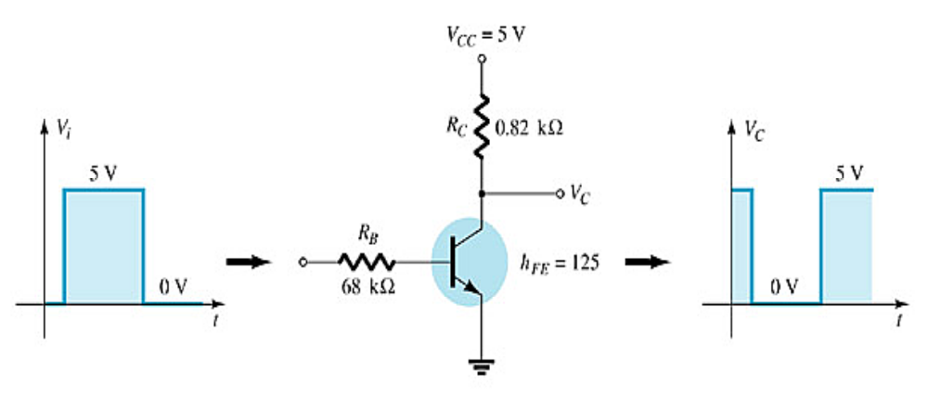
Transistor Switching Networks
Transistors with only the DC source applied can be used as electronic switches.

Slide 30
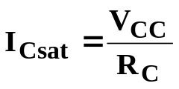
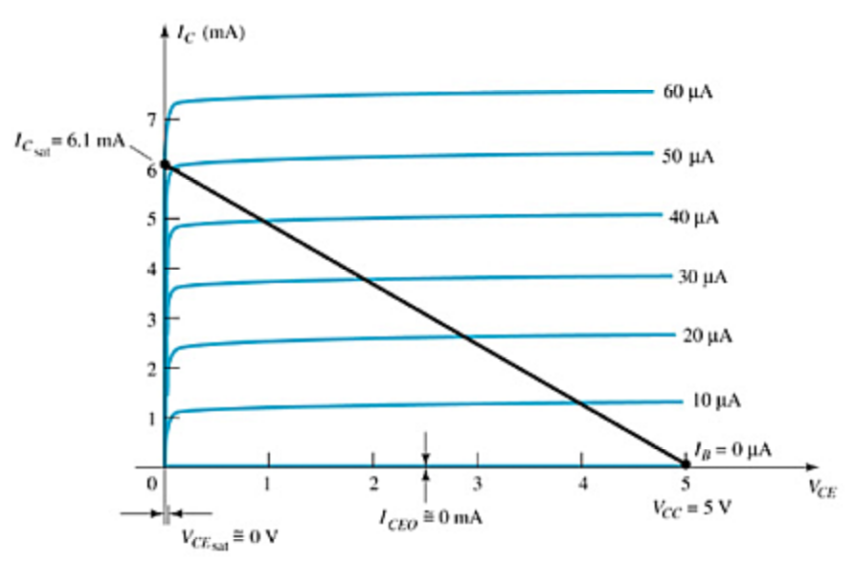
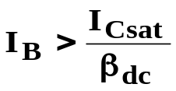
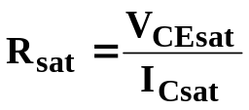
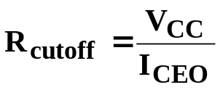
Switching Circuit Calculations
Saturation current:
To ensure saturation:
Emitter-collector resistance at saturation and cutoff:

Slide 31
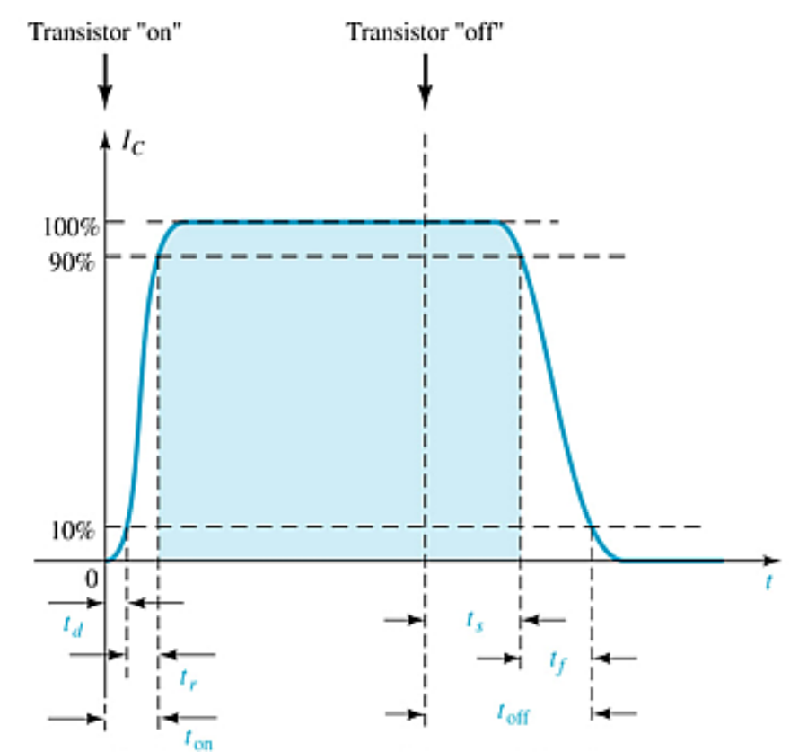


Switching Time
Transistor switching times:

Slide 32
Troubleshooting Hints
Approximate voltages
  V_{BE} ≅ .7 V for silicon transistors
  V_{CE} ≅ 25% to 75% of V_{CC}
Test for opens and shorts with an ohmmeter.
Test the solder joints.
Test the transistor with a transistor tester or a curve tracer.
Note that the load or the next stage affects the transistor operation.

Slide 33
PNP Transistors
The analysis for pnp transistor biasing circuits is the same as that for npn transistor circuits. The only difference is that the currents are flowing in the opposite direction.

