Slide 1
Chapter 8:
FET Amplifiers

Slide 2
Introduction
FETs provide:
  Excellent voltage gain
  High input impedance
  Low-power consumption
  Good frequency range

Slide 3
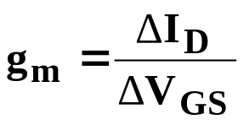
    FET Small-Signal Model
Transconductance
  The relationship of a change in I_{D} to the corresponding change in V_{GS} is called transconductance
  Transconductance is denoted g_{m} and given by:

Slide 4
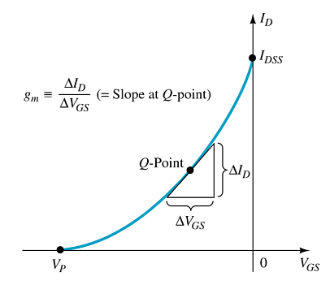
    Graphical Determination of g_{m}

Slide 5
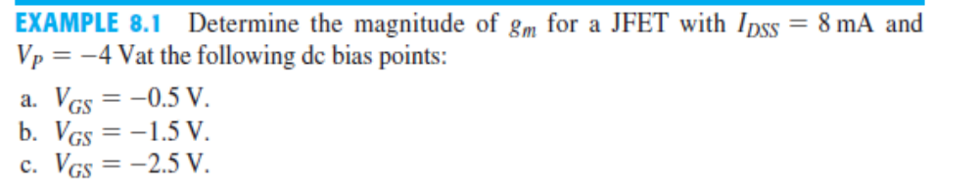

Slide 6
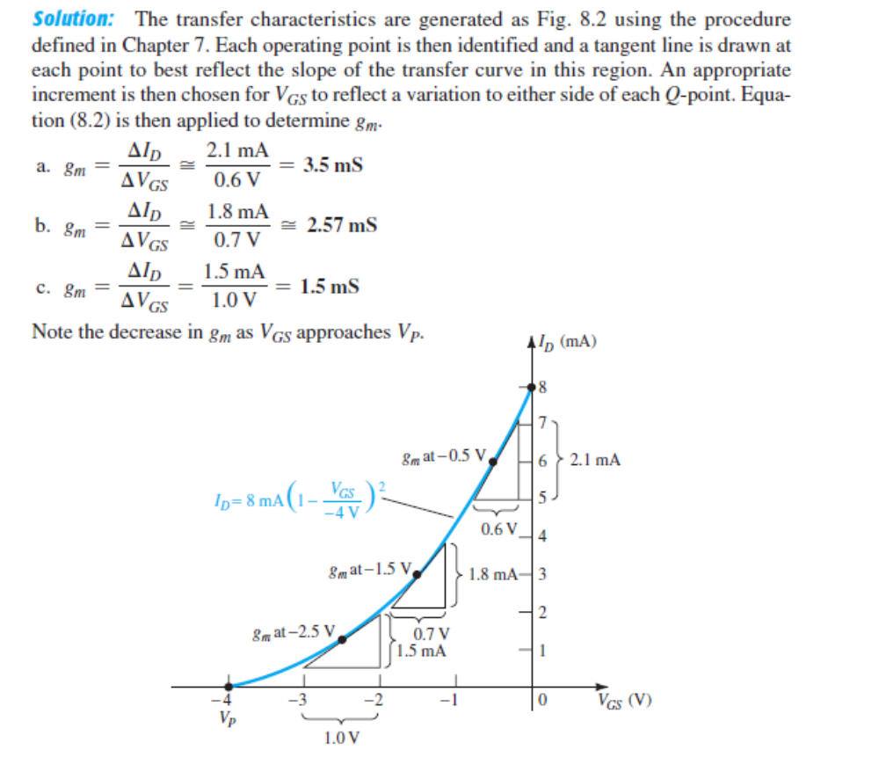

Slide 7
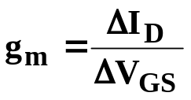
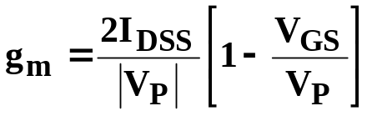
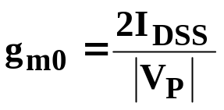
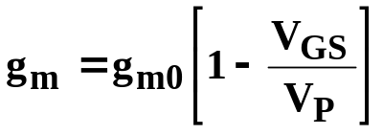
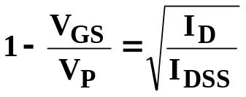
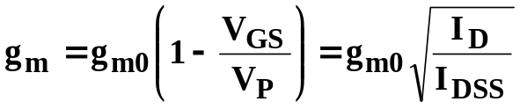
Mathematical Definitions of g_{m}
Where V_{GS} =0V
Where

Slide 8

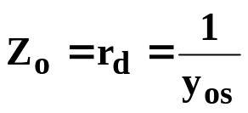
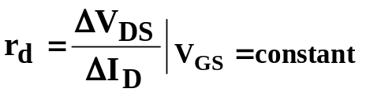
FET Impedance
Input impedance:
Output Impedance:
where:
y_{os}= admittance parameter listed on FET specification sheets.

Slide 9
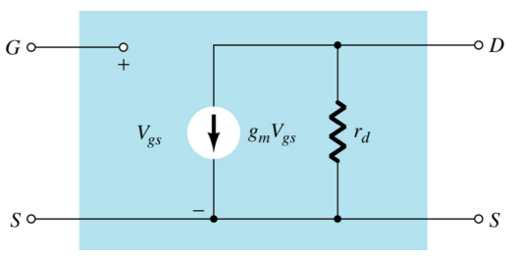
FET AC Equivalent Circuit

Slide 10
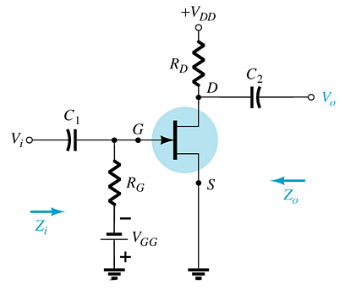
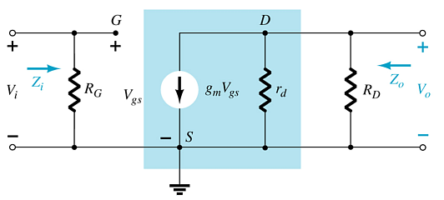
Common-Source (CS) Fixed-Bias Circuit
The input is on the gate and the output is on the drain
There is a 180° phase shift between input and output

Slide 11

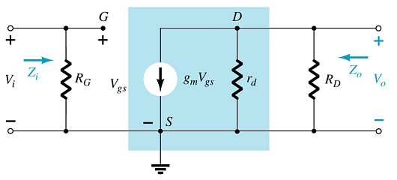

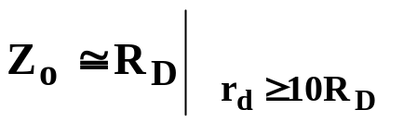
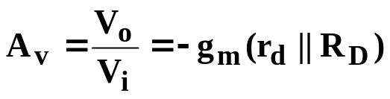
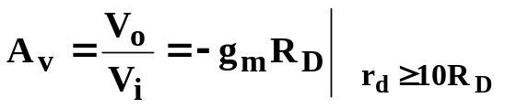
Calculations
Input impedance:
Output impedance:
Voltage gain:

Slide 12
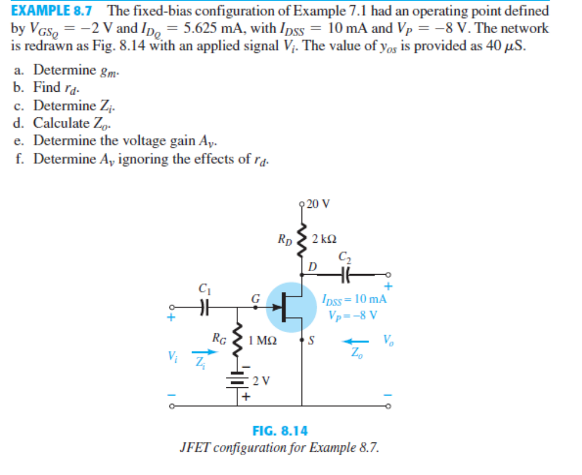

Slide 13
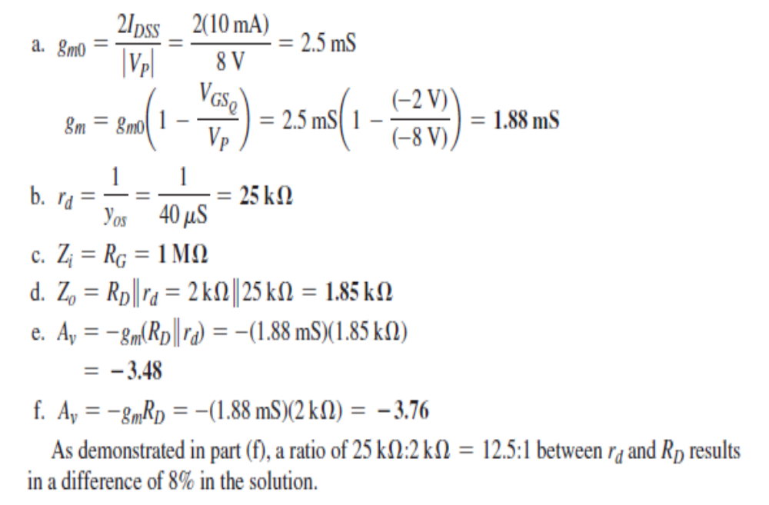

Slide 14
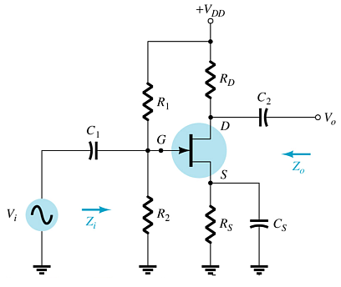
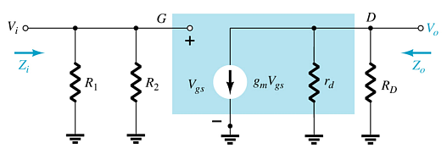
Common-Source (CS) Voltage-Divider Bias
This is a common-source amplifier configuration, so the input is on the gate and the output is on the drain.

Slide 15



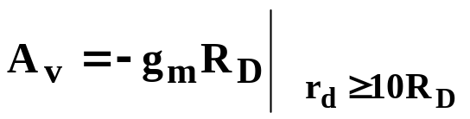
Impedances
Input impedance:
Output impedance:
Voltage gain:

Slide 16
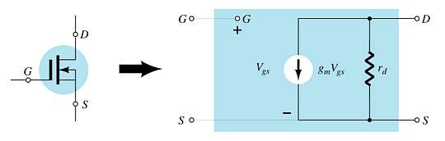
D-Type MOSFET AC Equivalent

Slide 17
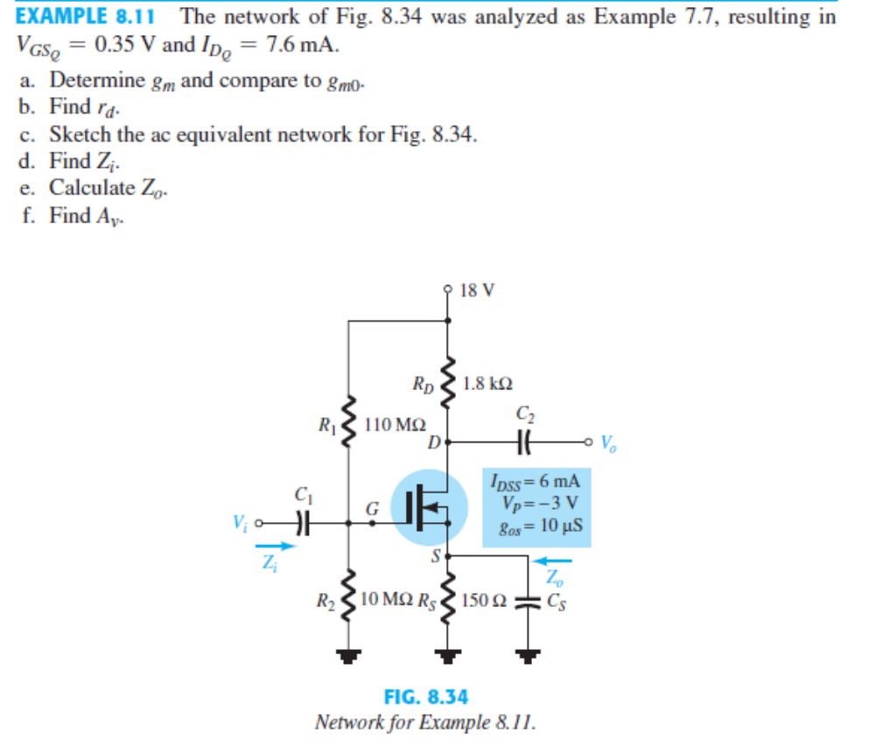

Slide 18
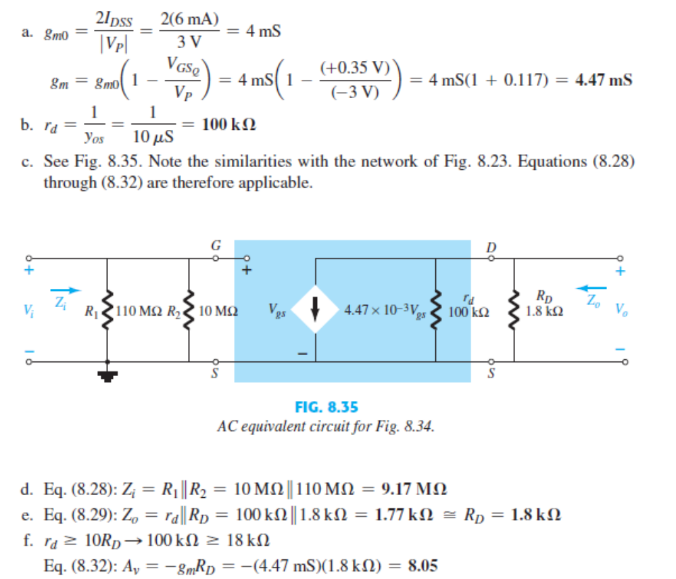

Slide 19
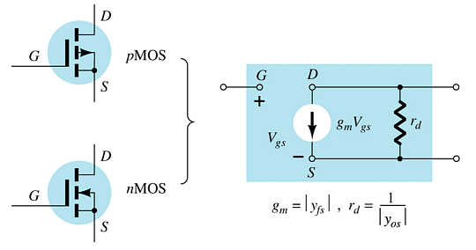

E-Type MOSFET AC Equivalent
g_{m} and r_{d} can be found in the specification sheet for the FET.

Slide 20
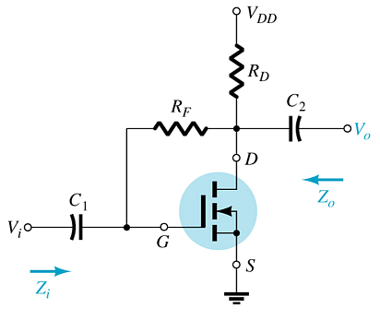
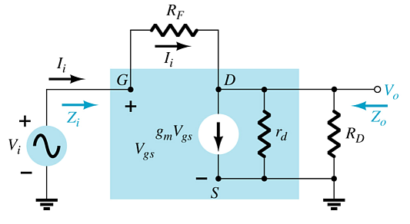
Common-Source Drain-Feedback
There is a 180° phase shift between input and output.

Slide 21
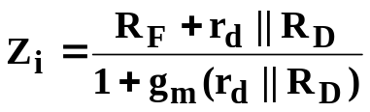
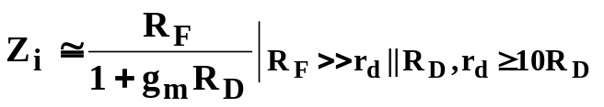




Calculations
Input impedance:
Output impedance:
Voltage gain:

Slide 22
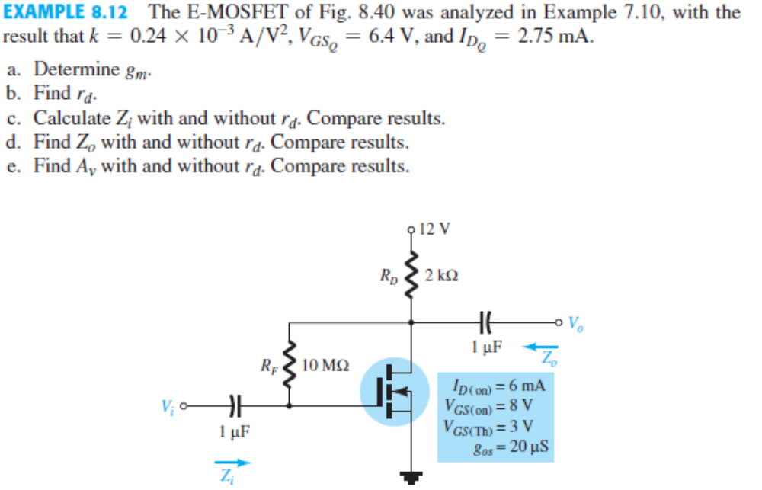

Slide 23
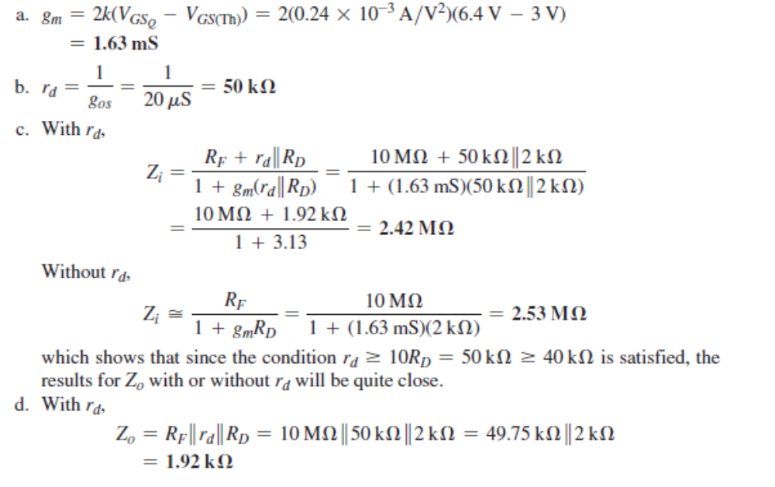

Slide 24
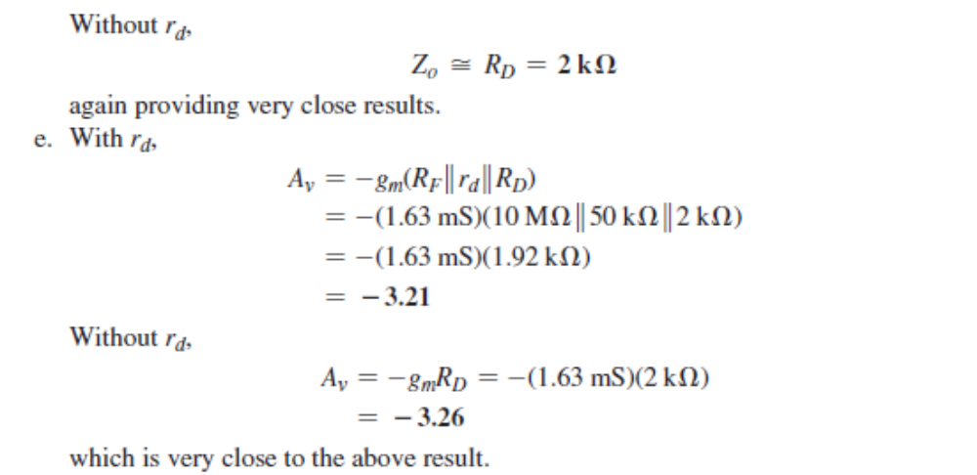

Slide 25
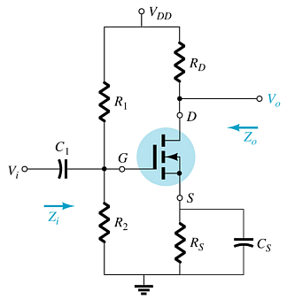
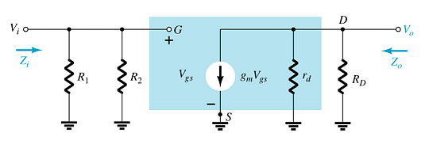
Common-Source Voltage-Divider Bias

Slide 26





Calculations
Input impedance:
Output impedance:
Voltage gain:

Slide 27
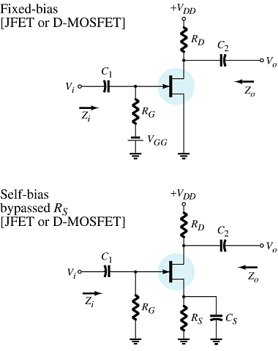
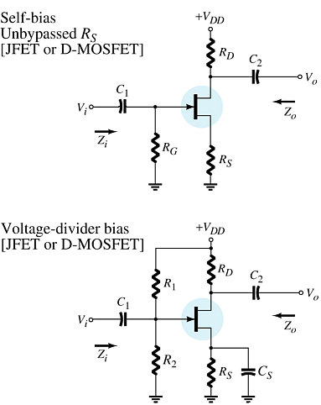
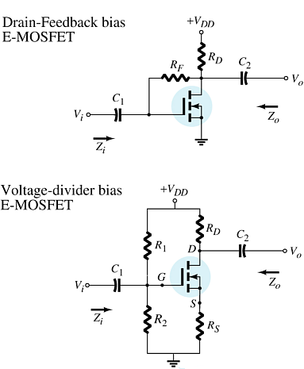
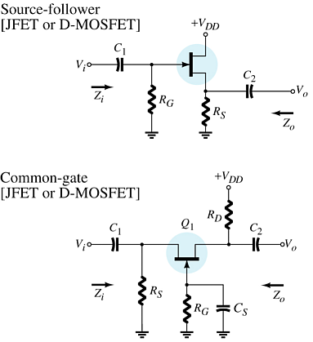
Summary Table
more…

Slide 28
Summary Table

Slide 29
Troubleshooting
Check the DC bias voltages:
  If not correct check power supply, resistors, FET. Also check to ensure that the coupling capacitor between amplifier stages is OK.
Check the AC voltages:
  If not correct check FET, capacitors and the loading effect of the next stage
.

Slide 30
    Practical Applications
Three-Channel Audio Mixer
Silent Switching
Phase Shift Networks
Motion Detection System

