Slide 1
Loan Prediction
April, 2022
Oleksandra Aliyeva

Slide 2
Objective of the Project: IDENTIFY the MOST EFFICIENT classification model that can predict loan approval or disapproval.

Slide 3
Table of content
Loan_ID | Unique loan ID
Gender | Male/Female
Married | Marriage status (TRUE/FALSE)
Dependent_No | Number of dependent/s
Education | Education status (Graduate/Not Graduate)
Self_Employed | Employment status (TRUE/FALSE)
Applicant_Income | Amount of applicant's income
CoApplicant_Income | Amount of co-applicant's income
Loan_Amount | Amount of loan requested
LoanAmountTerm | Term of loan in months
Credit_History | Applicant's credit history (0 for no /1 for yes)
Property_District | Applicant's district of property owned
Loan_Status | Loan approval status (0 for no /1 for yes)

Slide 4
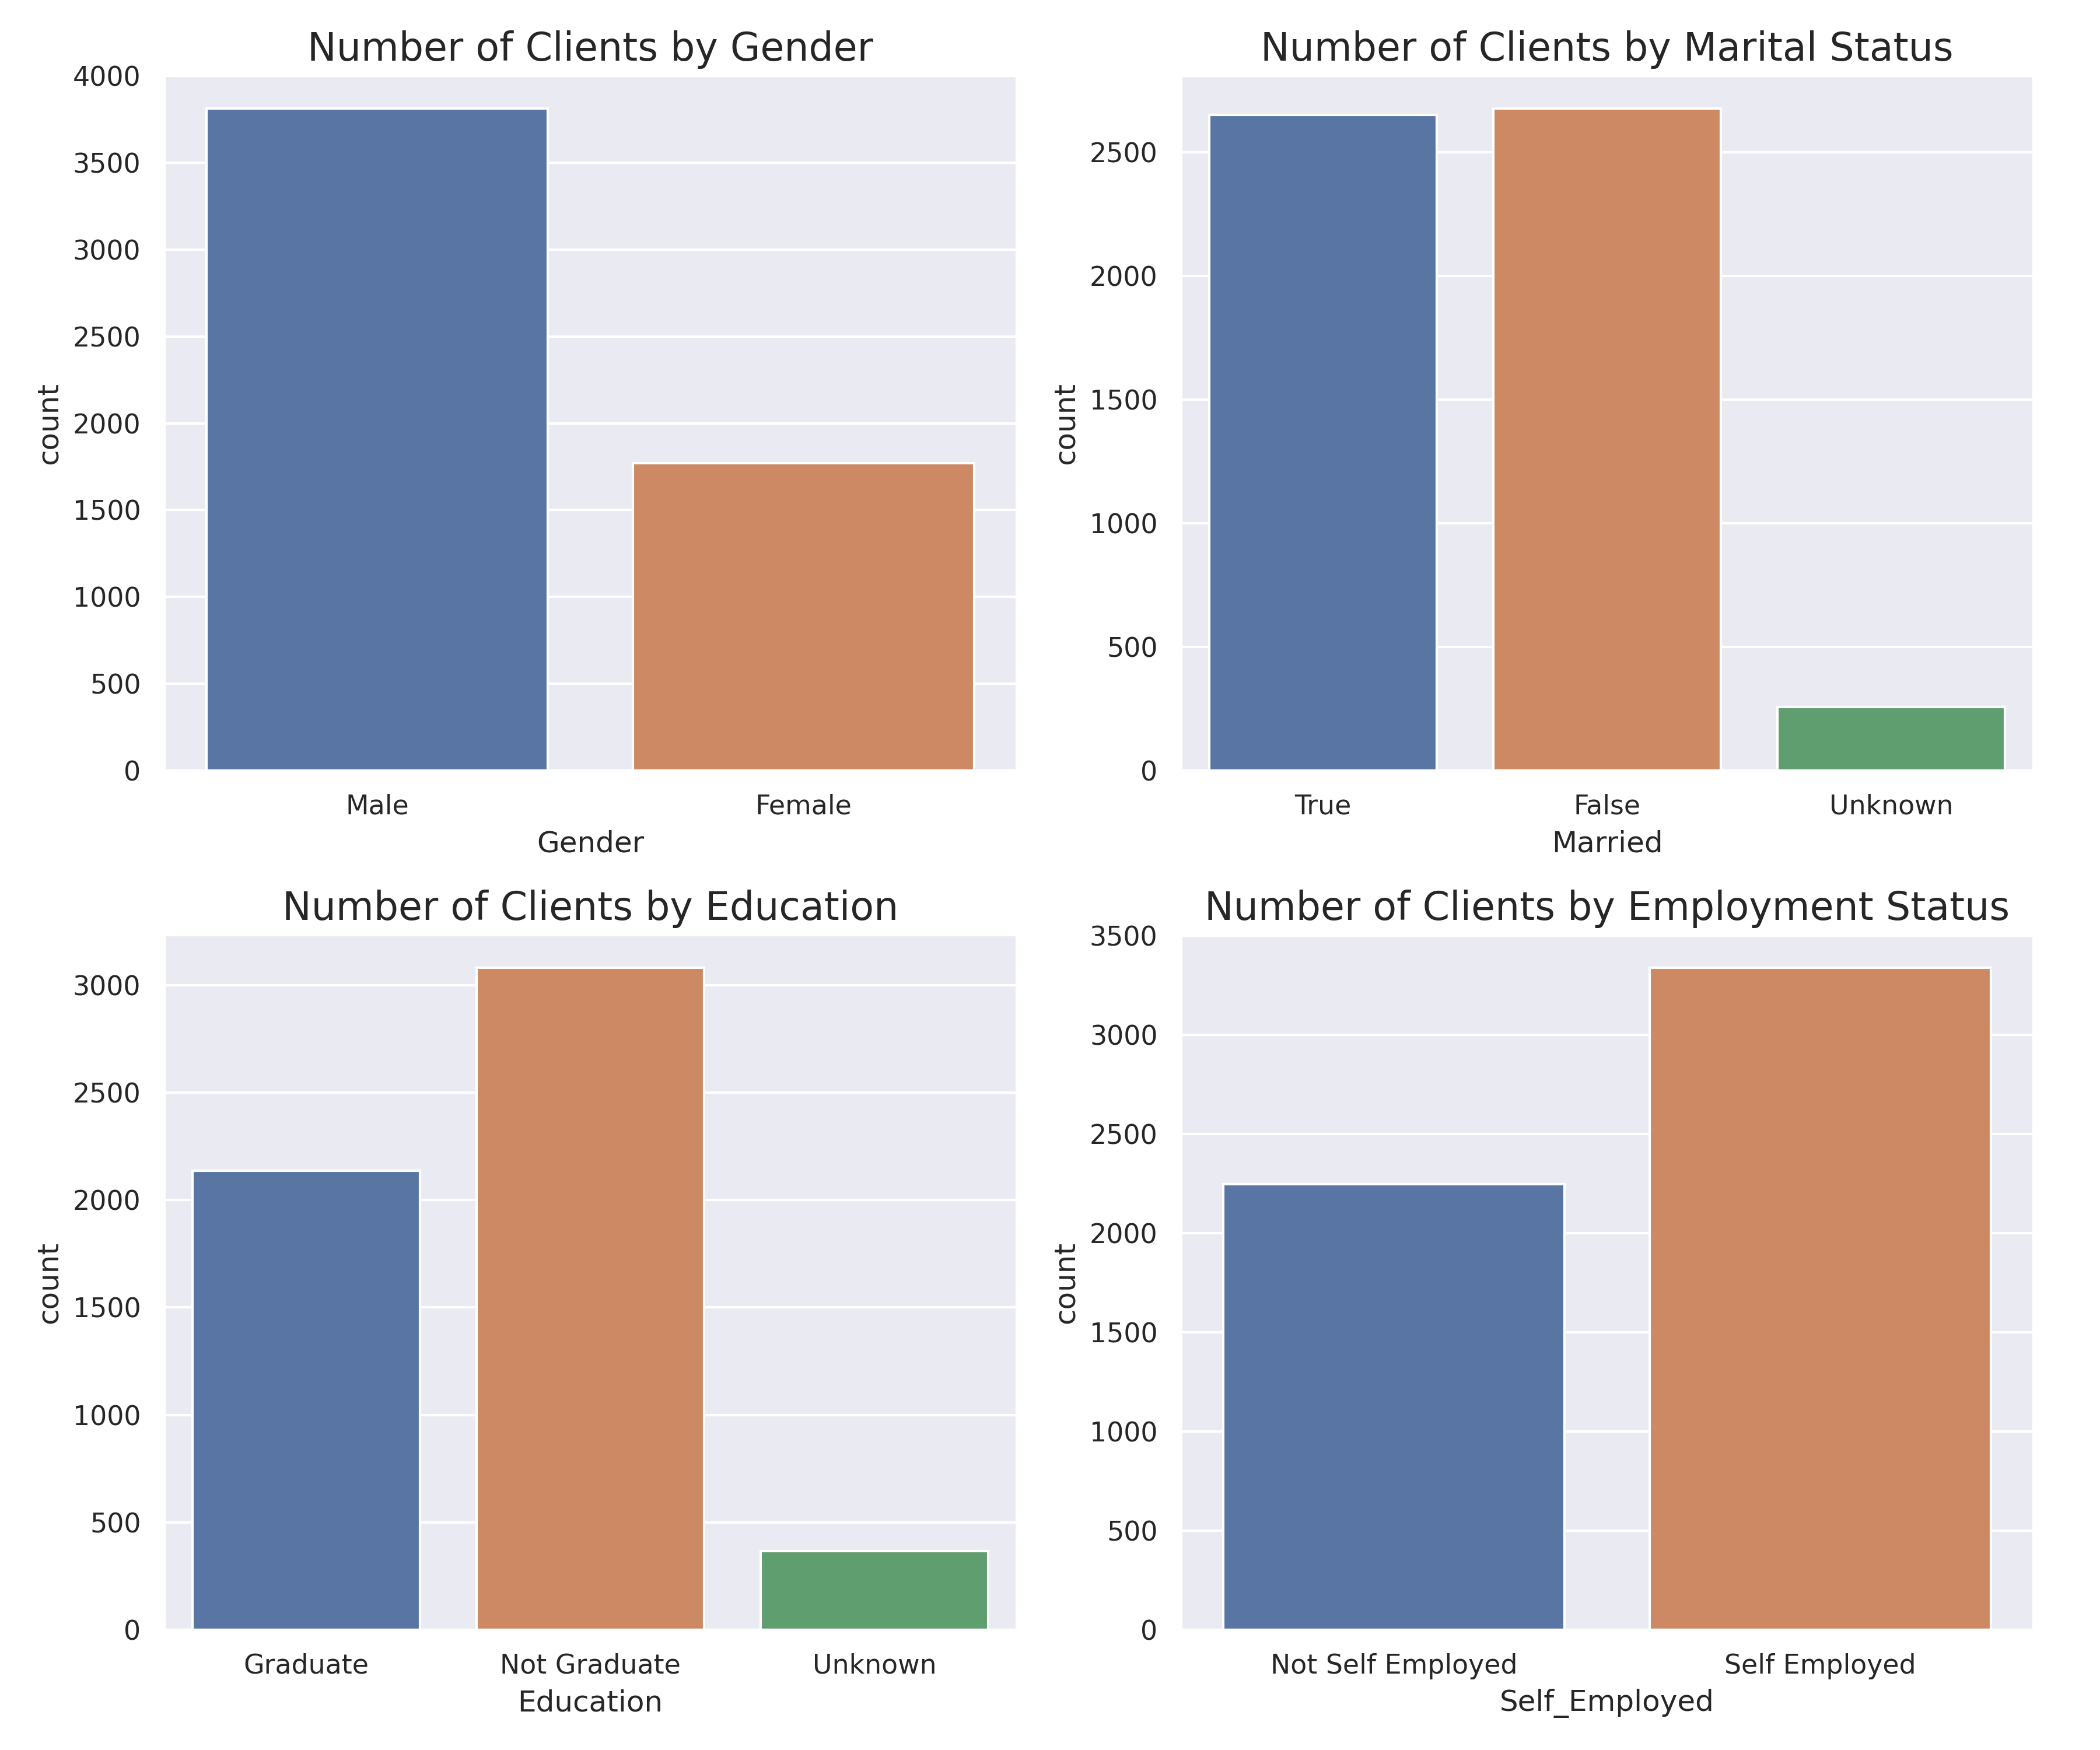
Information about clients
70% of clients are male
Clients split almost evenly between two main categories in Marital Status
38,3% of clients have Graduate level of education
65% of clients are Self Employed

Slide 5
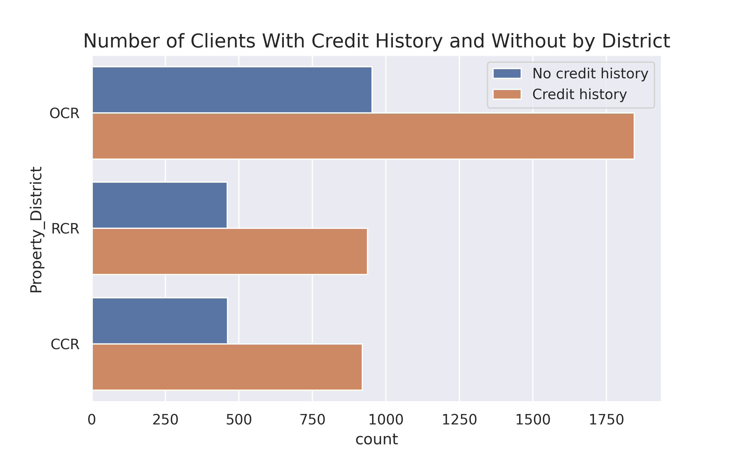
Credit history and number of clients by district
Clients in OCR:
Total: 2798 (50%)
Credit history: 1845 (66%)
No credit history: 953 (34%)
RCR:
Total: 1397 (25%)
Credit history: 920 (67%)
No credit history: 461 (33%)
CCR:
Total: 1381 (25%)
Credit history: 937 (67%)
No credit history: 460 (33%)

Slide 6
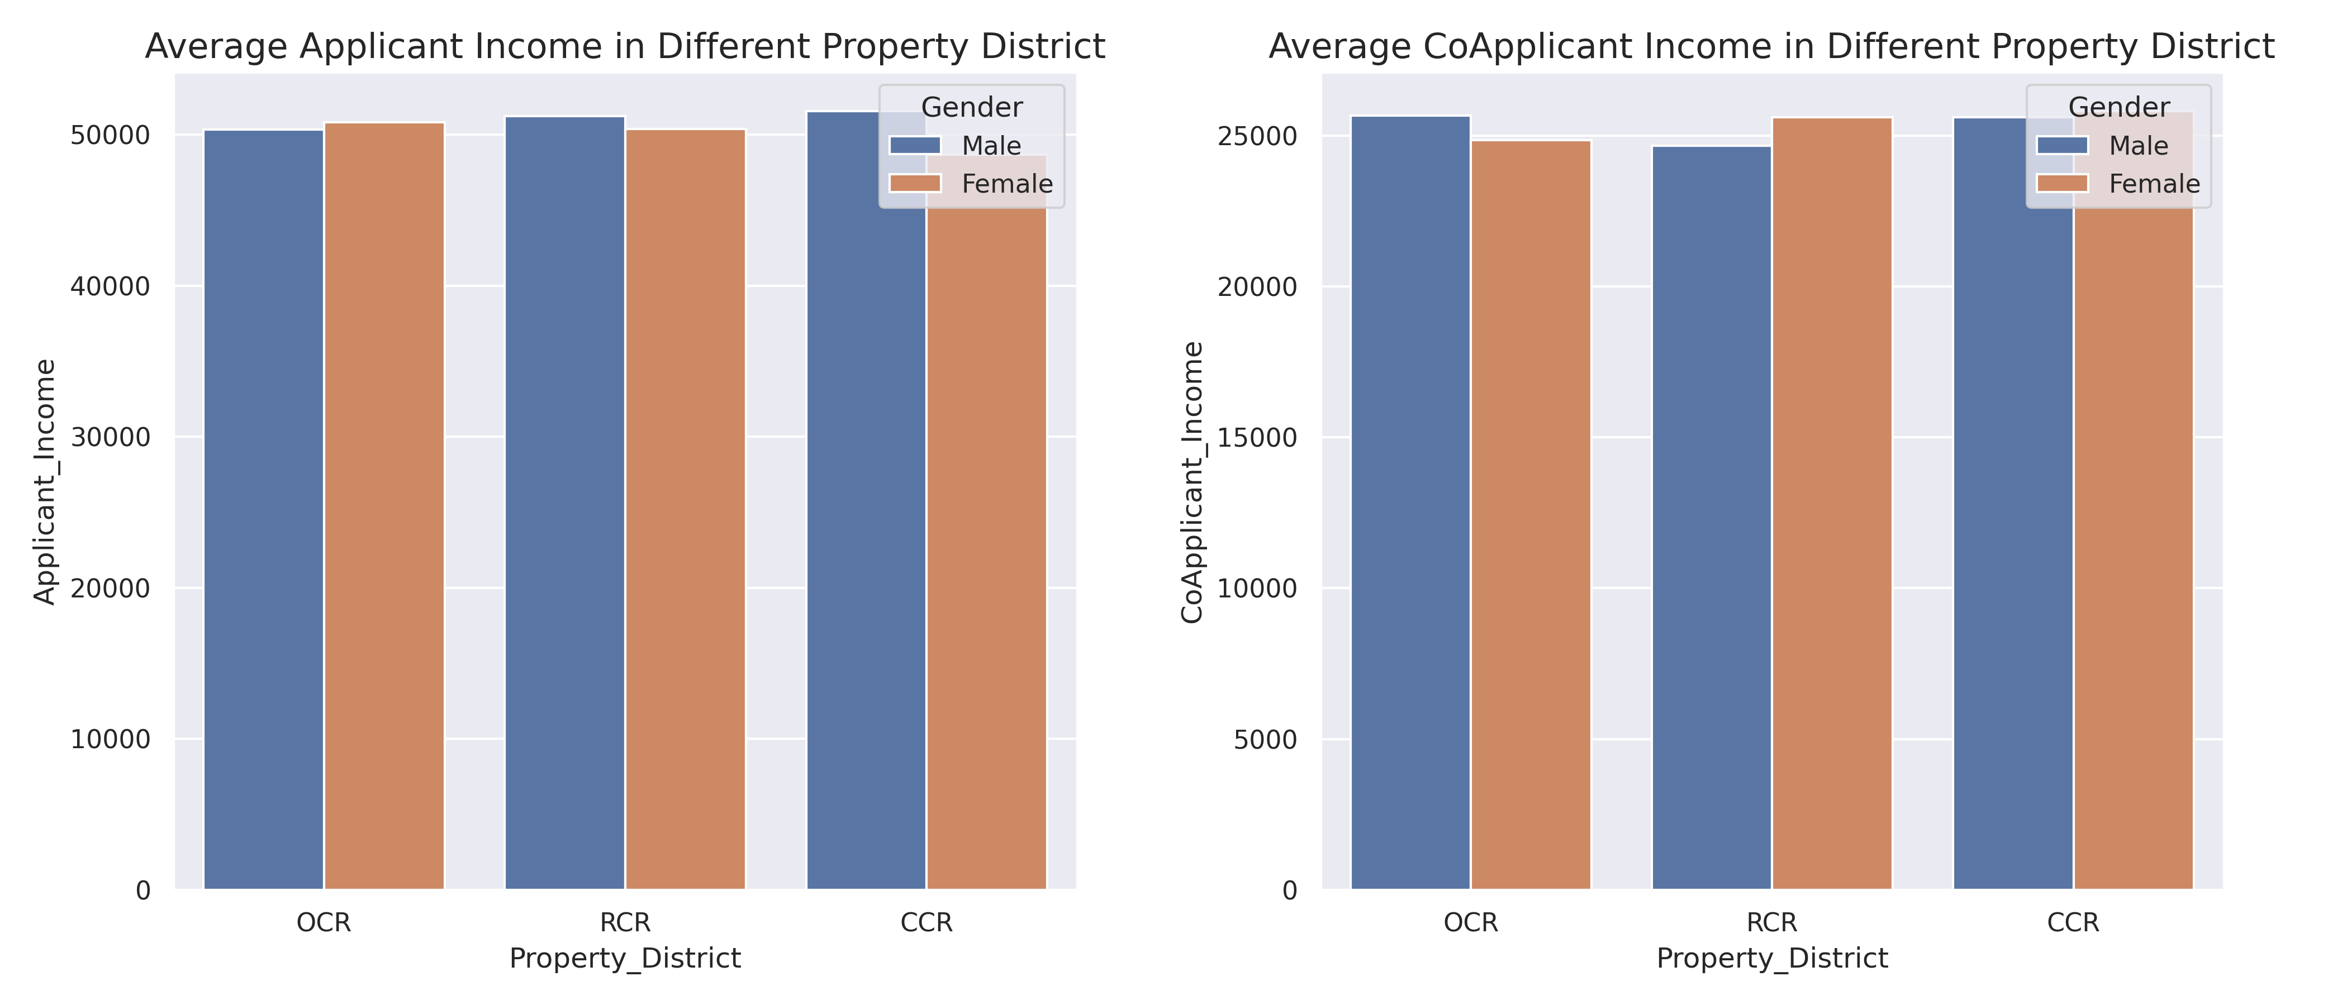
Average Applicant and co-applicant income in different Districts

Slide 7
Models used for predictions
KNN
Random Forest
LGBM Classifier
SMOTE with Logistic Regression
SMOTE with Random Forest

Slide 8
Evaluation Of Models for Test Data
Model | Accuracy | Precision |  | Recall |  | F1
 |  | Class 0 | Class 1 | Class 0 | Class 1 | Class 0 | Class 1
KNN | 0.65 | 0.33 | 0.67 | 0.06 | 0.94 | 0.1 | 0.78
Random Forest | 0.58 | 0.34 | 0.67 | 0.28 | 0.73 | 0.31 | 0.7
LGBM Classifier | 0.63 | 0.3 | 0.66 | 0.09 | 0.9 | 0.14 | 0.76
SMOTE with Logistic Regression | 0.49 | 0.32 | 0.66 | 0.49 | 0.49 | 0.39 | 0.56
SMOTE with Random Forest | 0.61 | 0.33 | 0.67 | 0.18 | 0.82 | 0.23 | 0.74
Class 0 – Loan will be disapproved
Class 1 – Loan will be approved

Slide 9
Recommendations
Re-consider the application process in order to eliminate the lack of critical data required for adjudication by making certain fields as mandatory
Extend the application to include additional information about:
purpose of the loan
debt-to-income ratio

Slide 10
Thank you

