Slide 1

EN.580.428 Genomic Data Visualization Lesson 0 Welcome and Introductions
If you would like to download these slides and take notes:
https://jef.works/genomic-data-visualization-2024/course/0-welcome-and-introductions/
Prof. Jean Fan

Slide 2
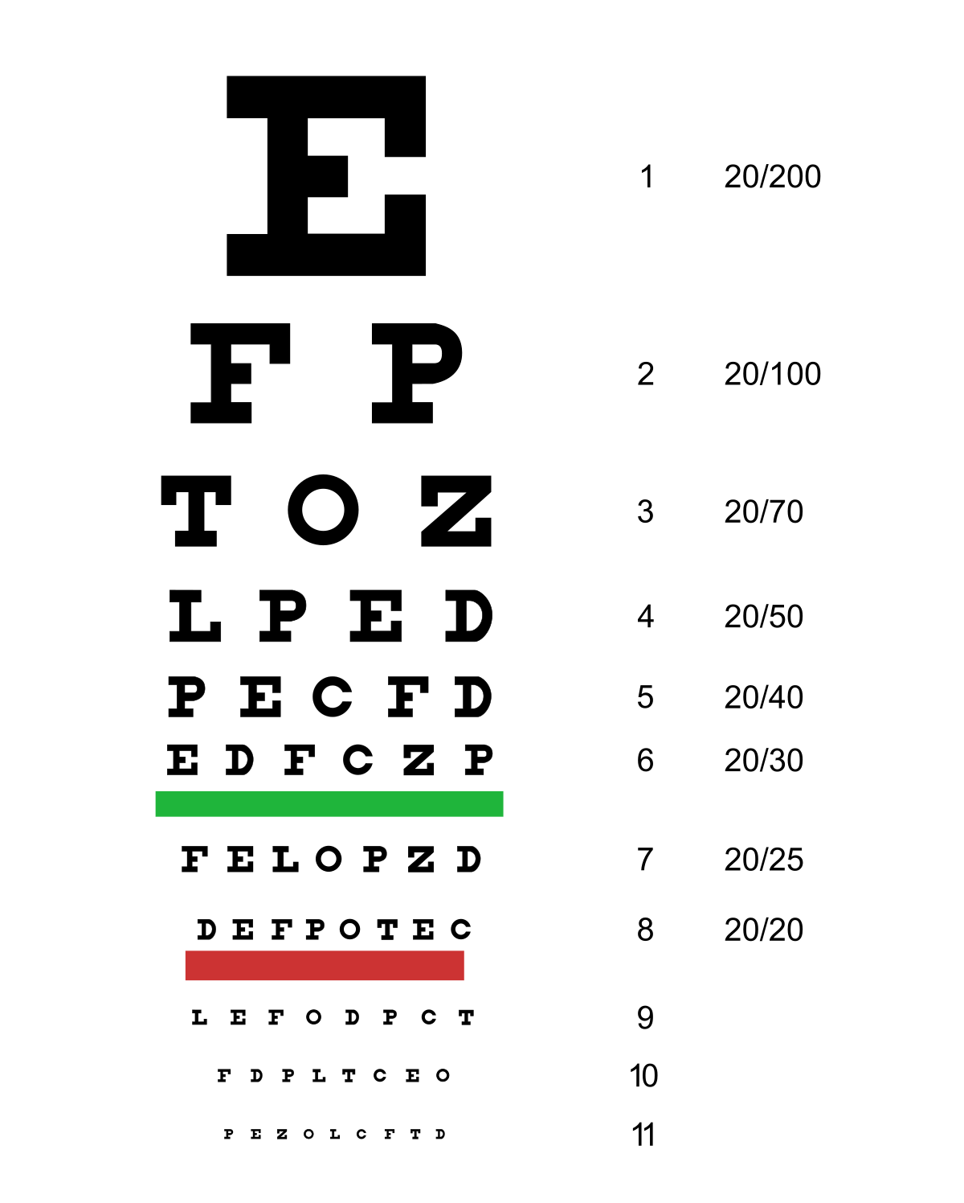
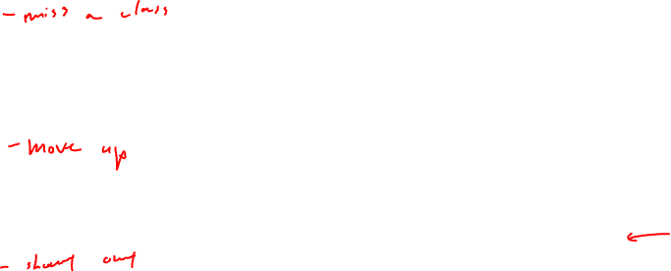
Announcements
Recording
Eyesight check
Ground rules

Slide 3
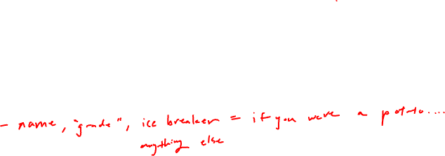
Lesson learning objectives
Introduce ourselves
Set expectations
Make sure you know how to submit your HW

Slide 4
Course website
https://jef.works/genomic-data-visualization-2024

Slide 5

Pre-survey
https://bit.ly/GDV24_presurvey

Slide 6

Reflection card
https://bit.ly/GDV24_rc

