Slide 1
EN.580.428 Genomic Data Visualization Lesson 5 Non-linear Dimensionality Reduction: T-distributed Stochastic Neighbor Embedding
Prof. Jean Fan

Slide 2
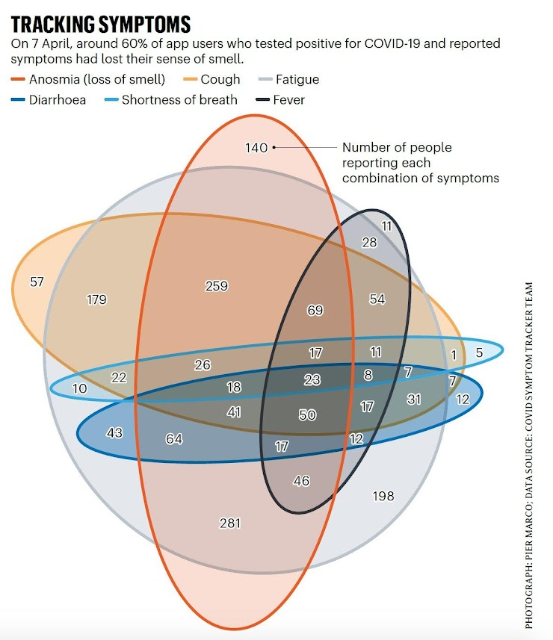

Quiz review
Even though there are lines,
is the data really being encoded by lines?

Slide 3
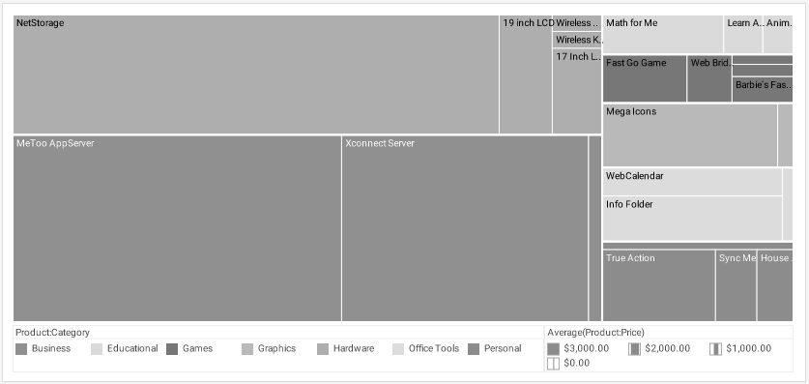
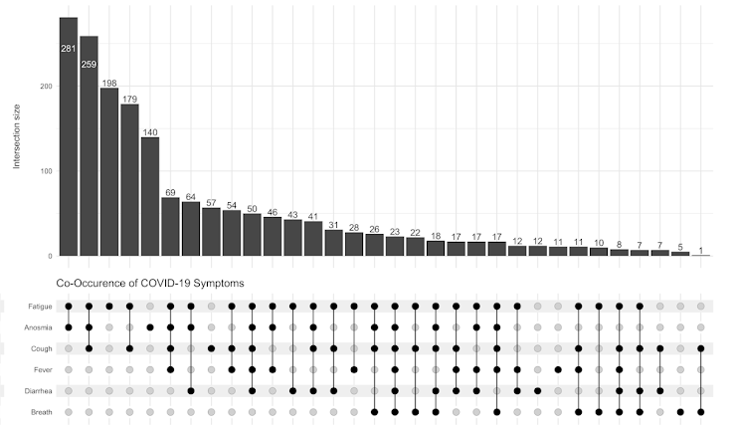
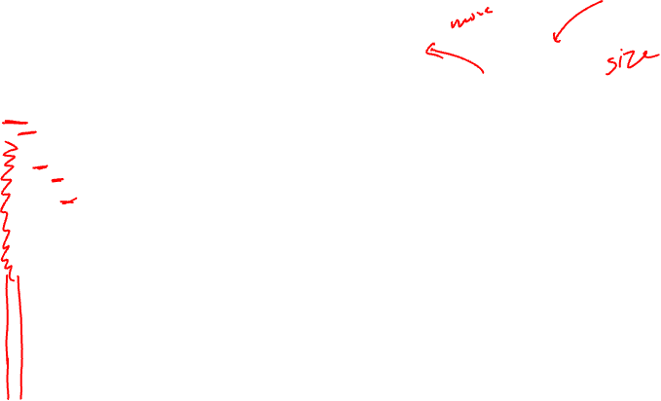
Size or position?
Position
Change position, change data
Change size, can keep data same

Slide 4
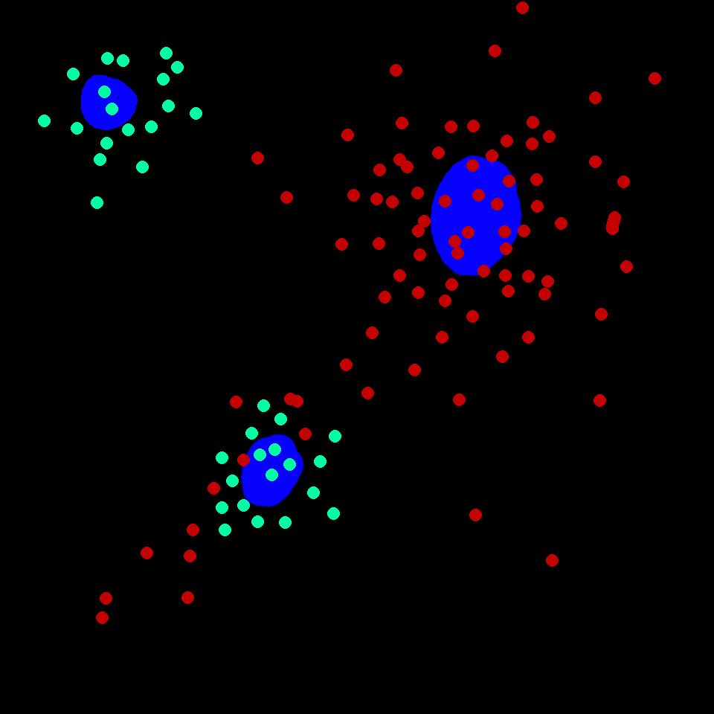
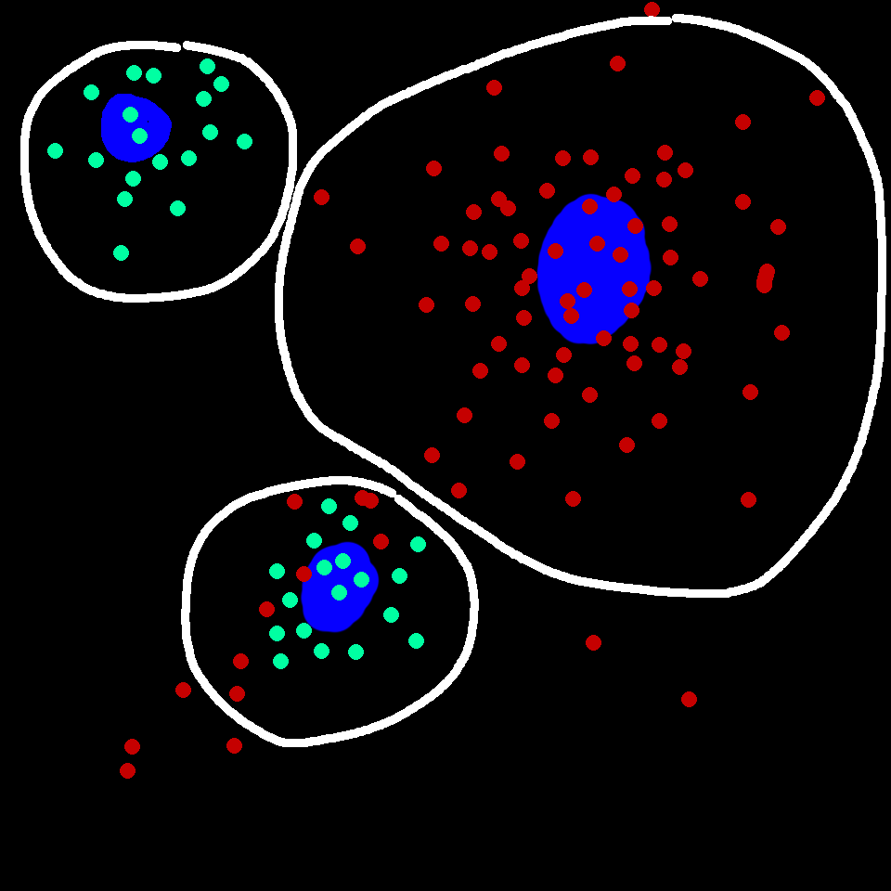
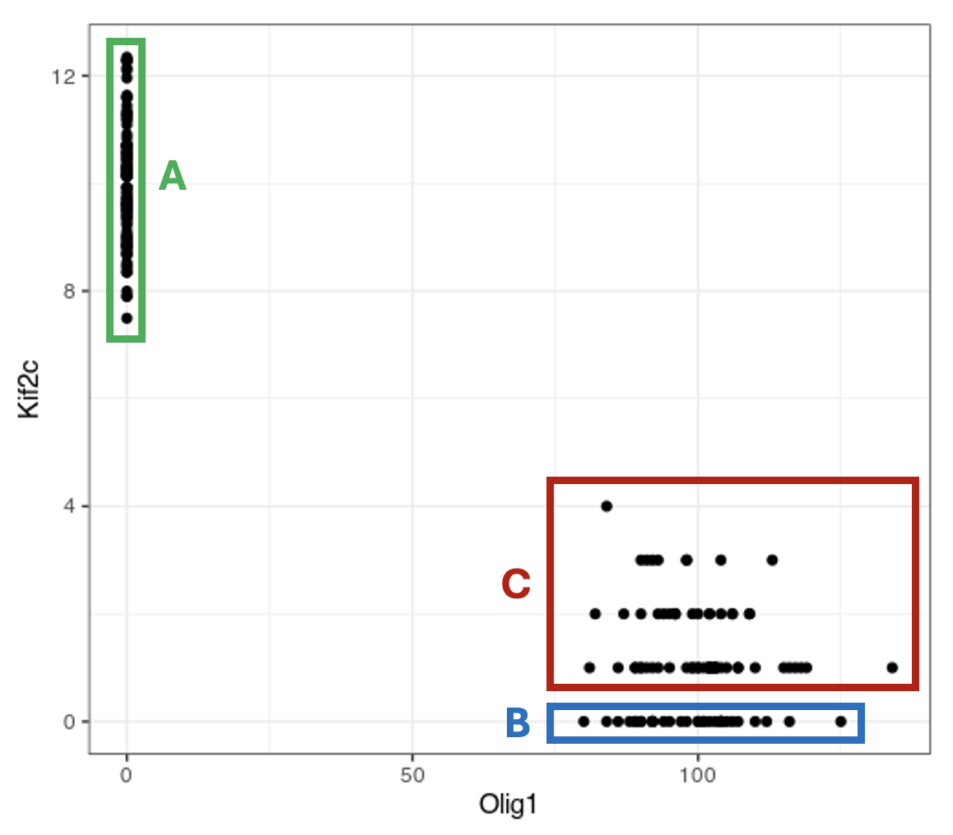
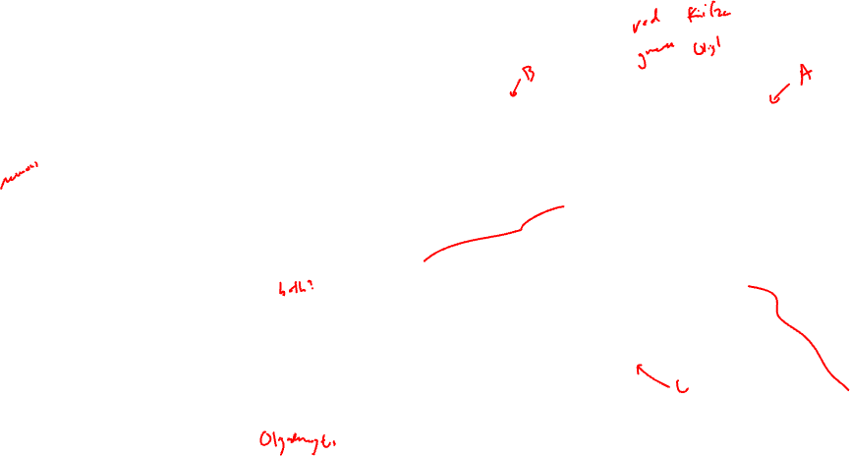
Multiplexed smFISH

Slide 5

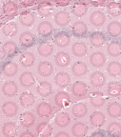
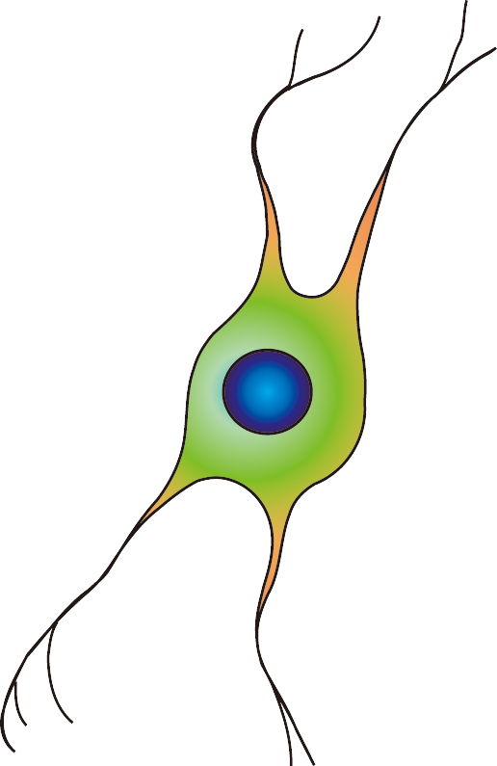
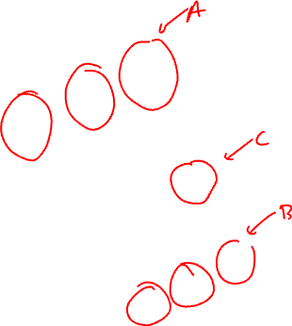
Spot-based capture + sequencing

Slide 6
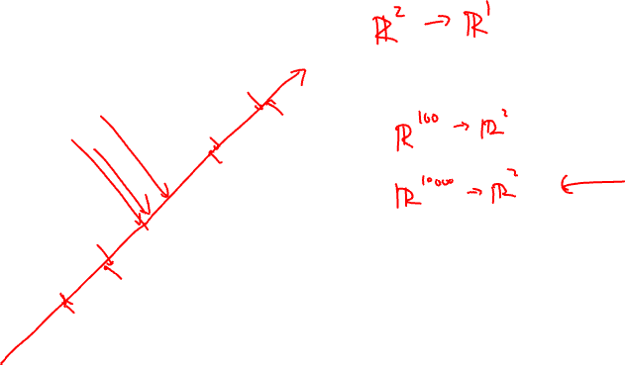
Remotivating Dimensionality Reduction
Gene B
Gene A

Slide 7
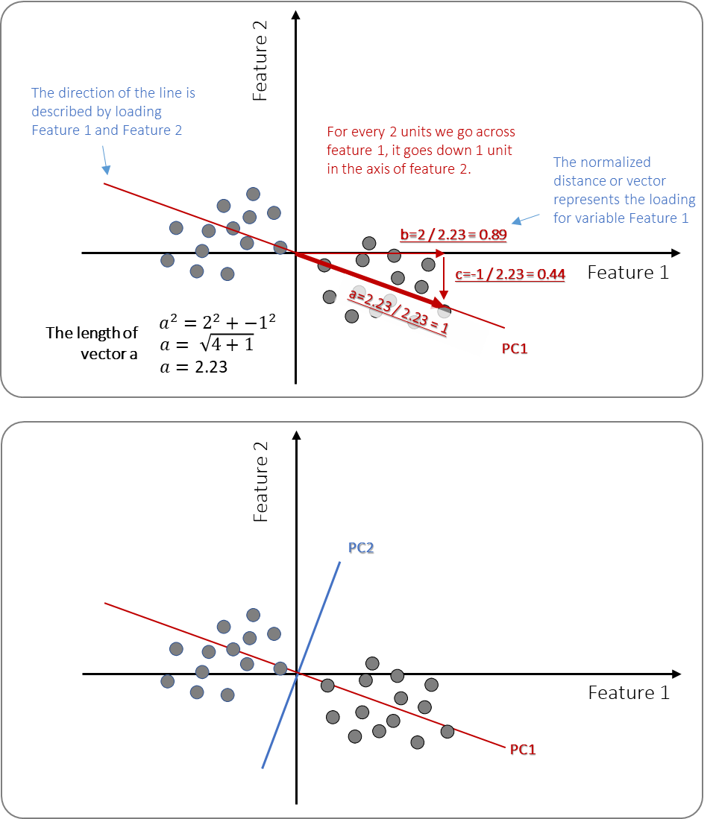
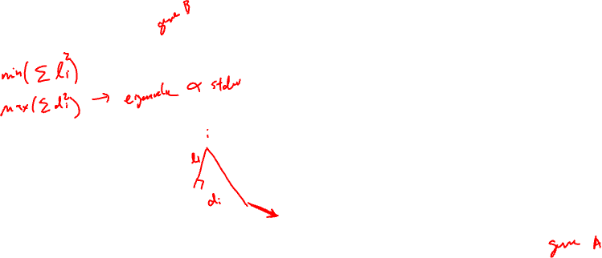
PCA review

Slide 8

PCA review

Slide 9
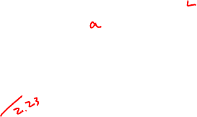
PCA review

Slide 10
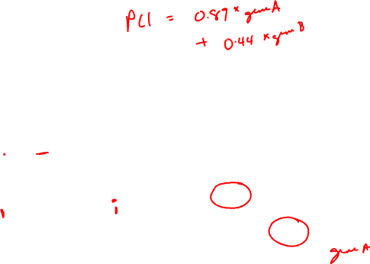
PCA review

Slide 11
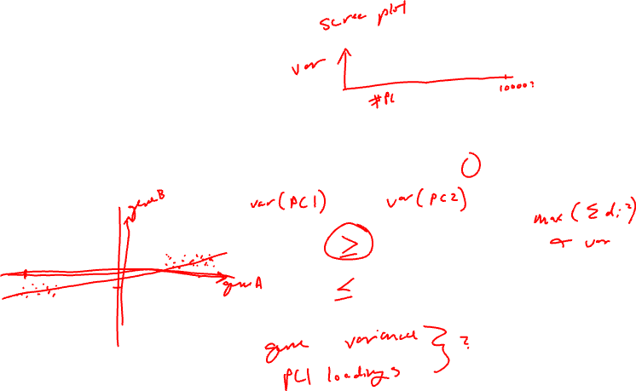
PCA review
Practice
The loading value of geneA on PC1 is 1
What is the loading value of all other genes on PC1?

Slide 12
Lesson learning objectives
Learn about and apply t-SNE

Slide 13
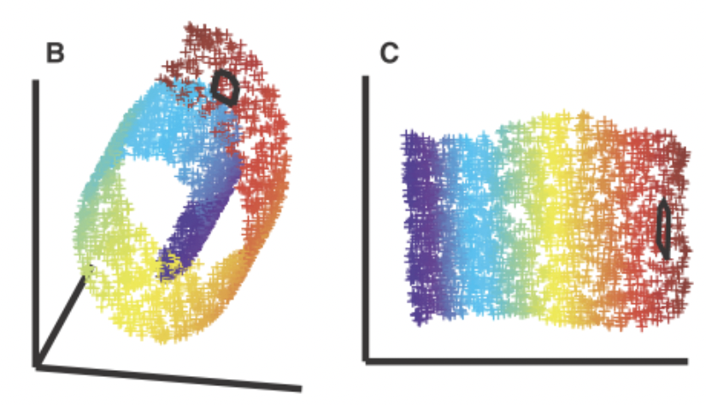
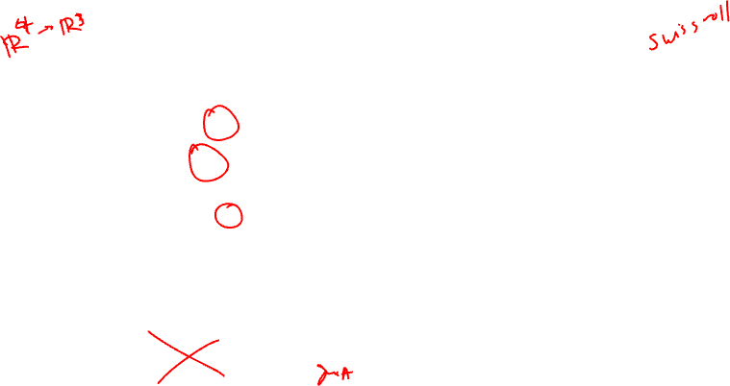
Motivating non-linear dimensionality reduction → linear dimensionality reduction insufficient
3D
Nonlinear 2D

Slide 14
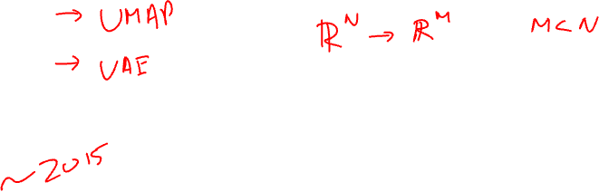
T-distributed Stochastic Neighbor Embedding

Slide 15
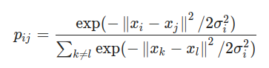
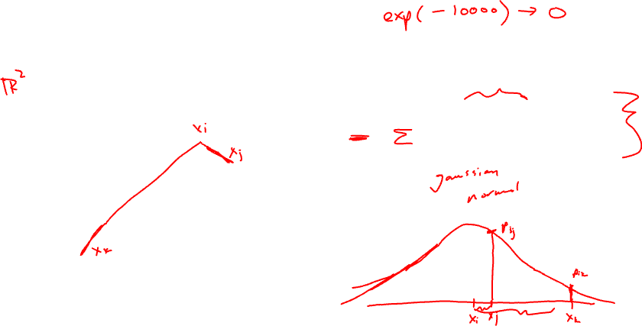
Step 1: compute scaled similarity P in high-dimensional space
Gene B
Gene A

Slide 16

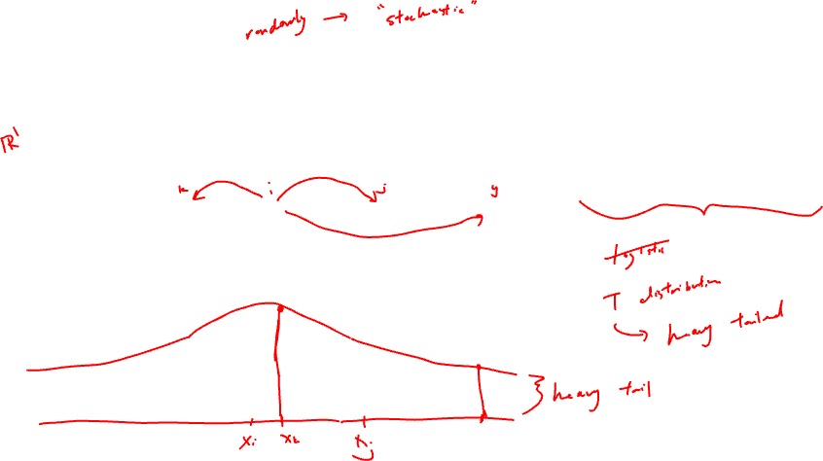
Step 2: place cells into low dimensional space and compute another scaled similarity metric Q
tSNE-1

Slide 17

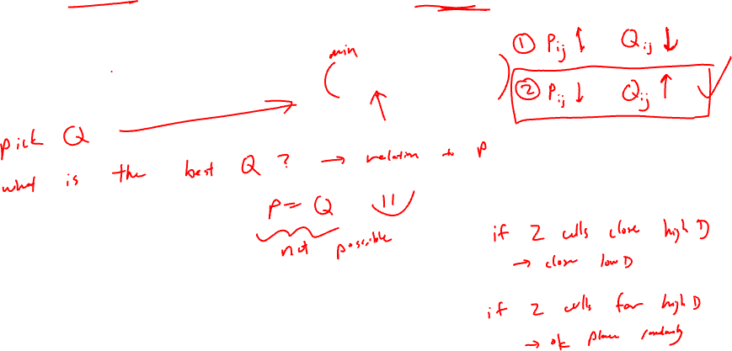
Step 3: P is fixed. Iteratively find a Q to minimize the KL divergence between P and Q

Slide 18
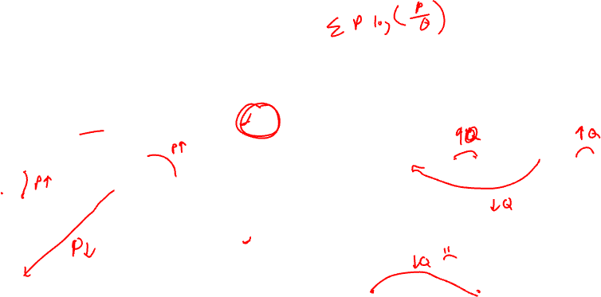
Given P, which Q has a smaller KL divergence?
Practice
P
Q₁
Gene B
tSNE-1
Q₂
tSNE-1
Gene A

Slide 19
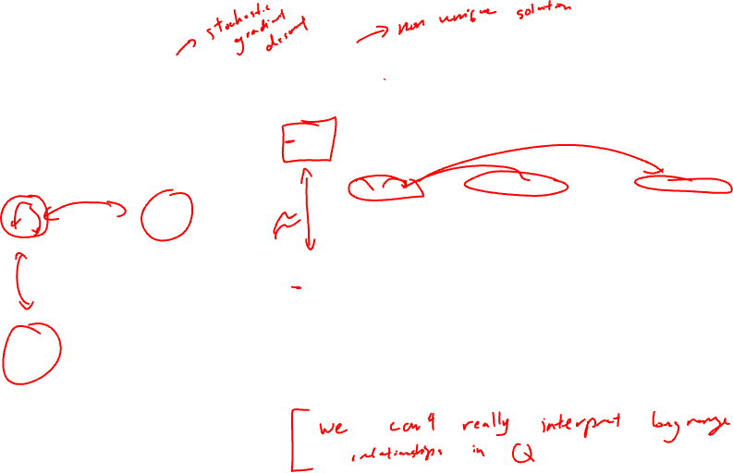
Given P, which Q has a smaller KL divergence?
Practice
P
Q₁
Gene B
tSNE-1
Q₂
tSNE-1
Gene A

Slide 20
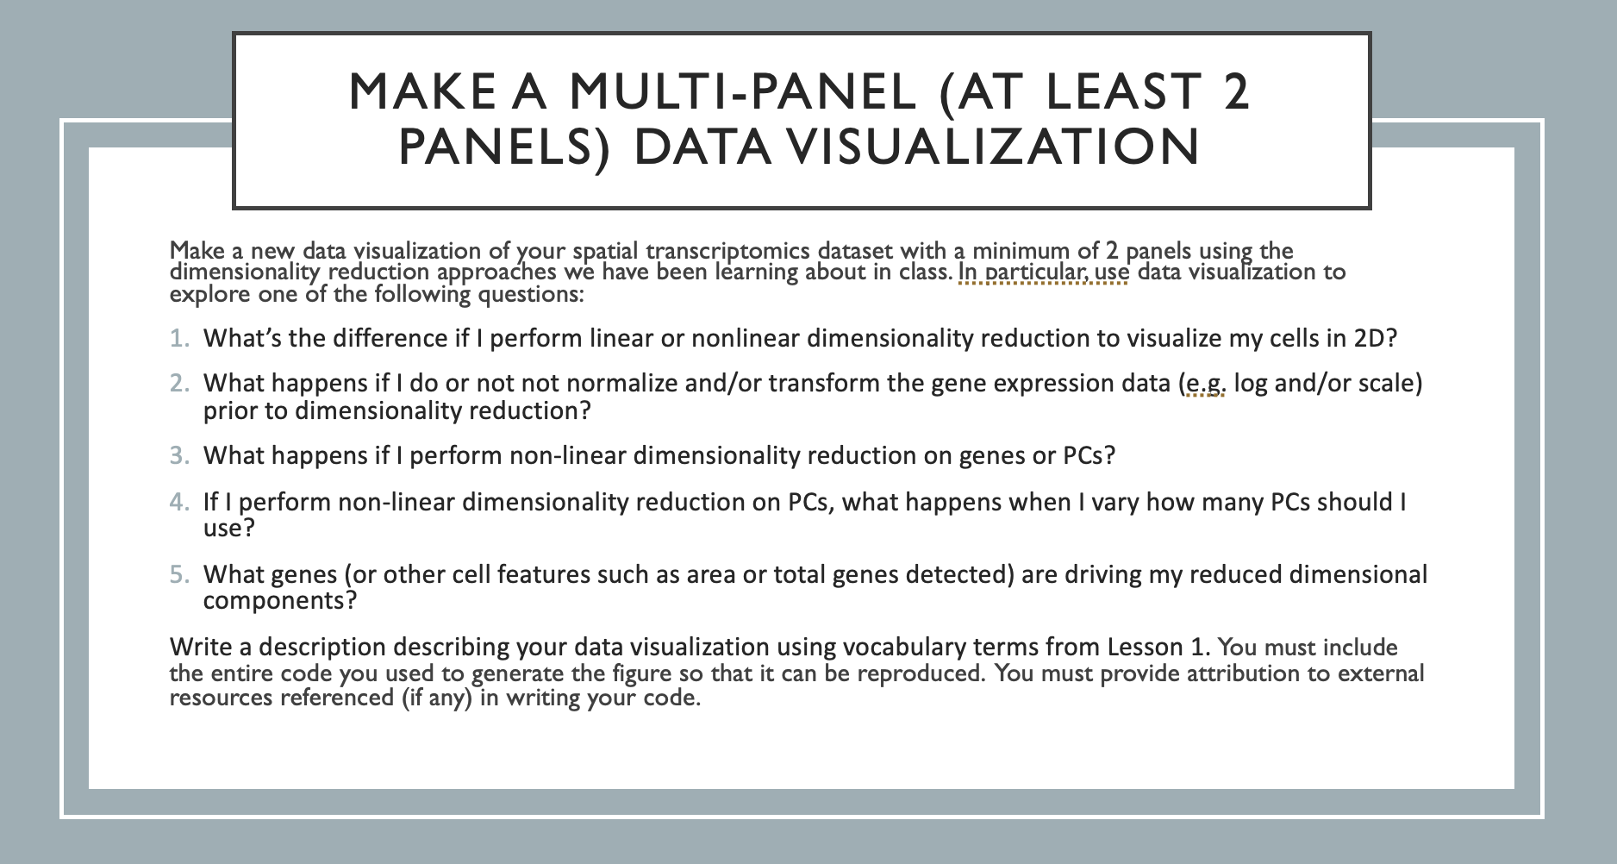
Homework 3 – due Monday midnight

Slide 21
Reflection card
https://bit.ly/GDV24_rc

