Slide 1
EN.580.428 Genomic Data Visualization Lesson 6 K-means clustering
Prof. Jean Fan

Slide 2
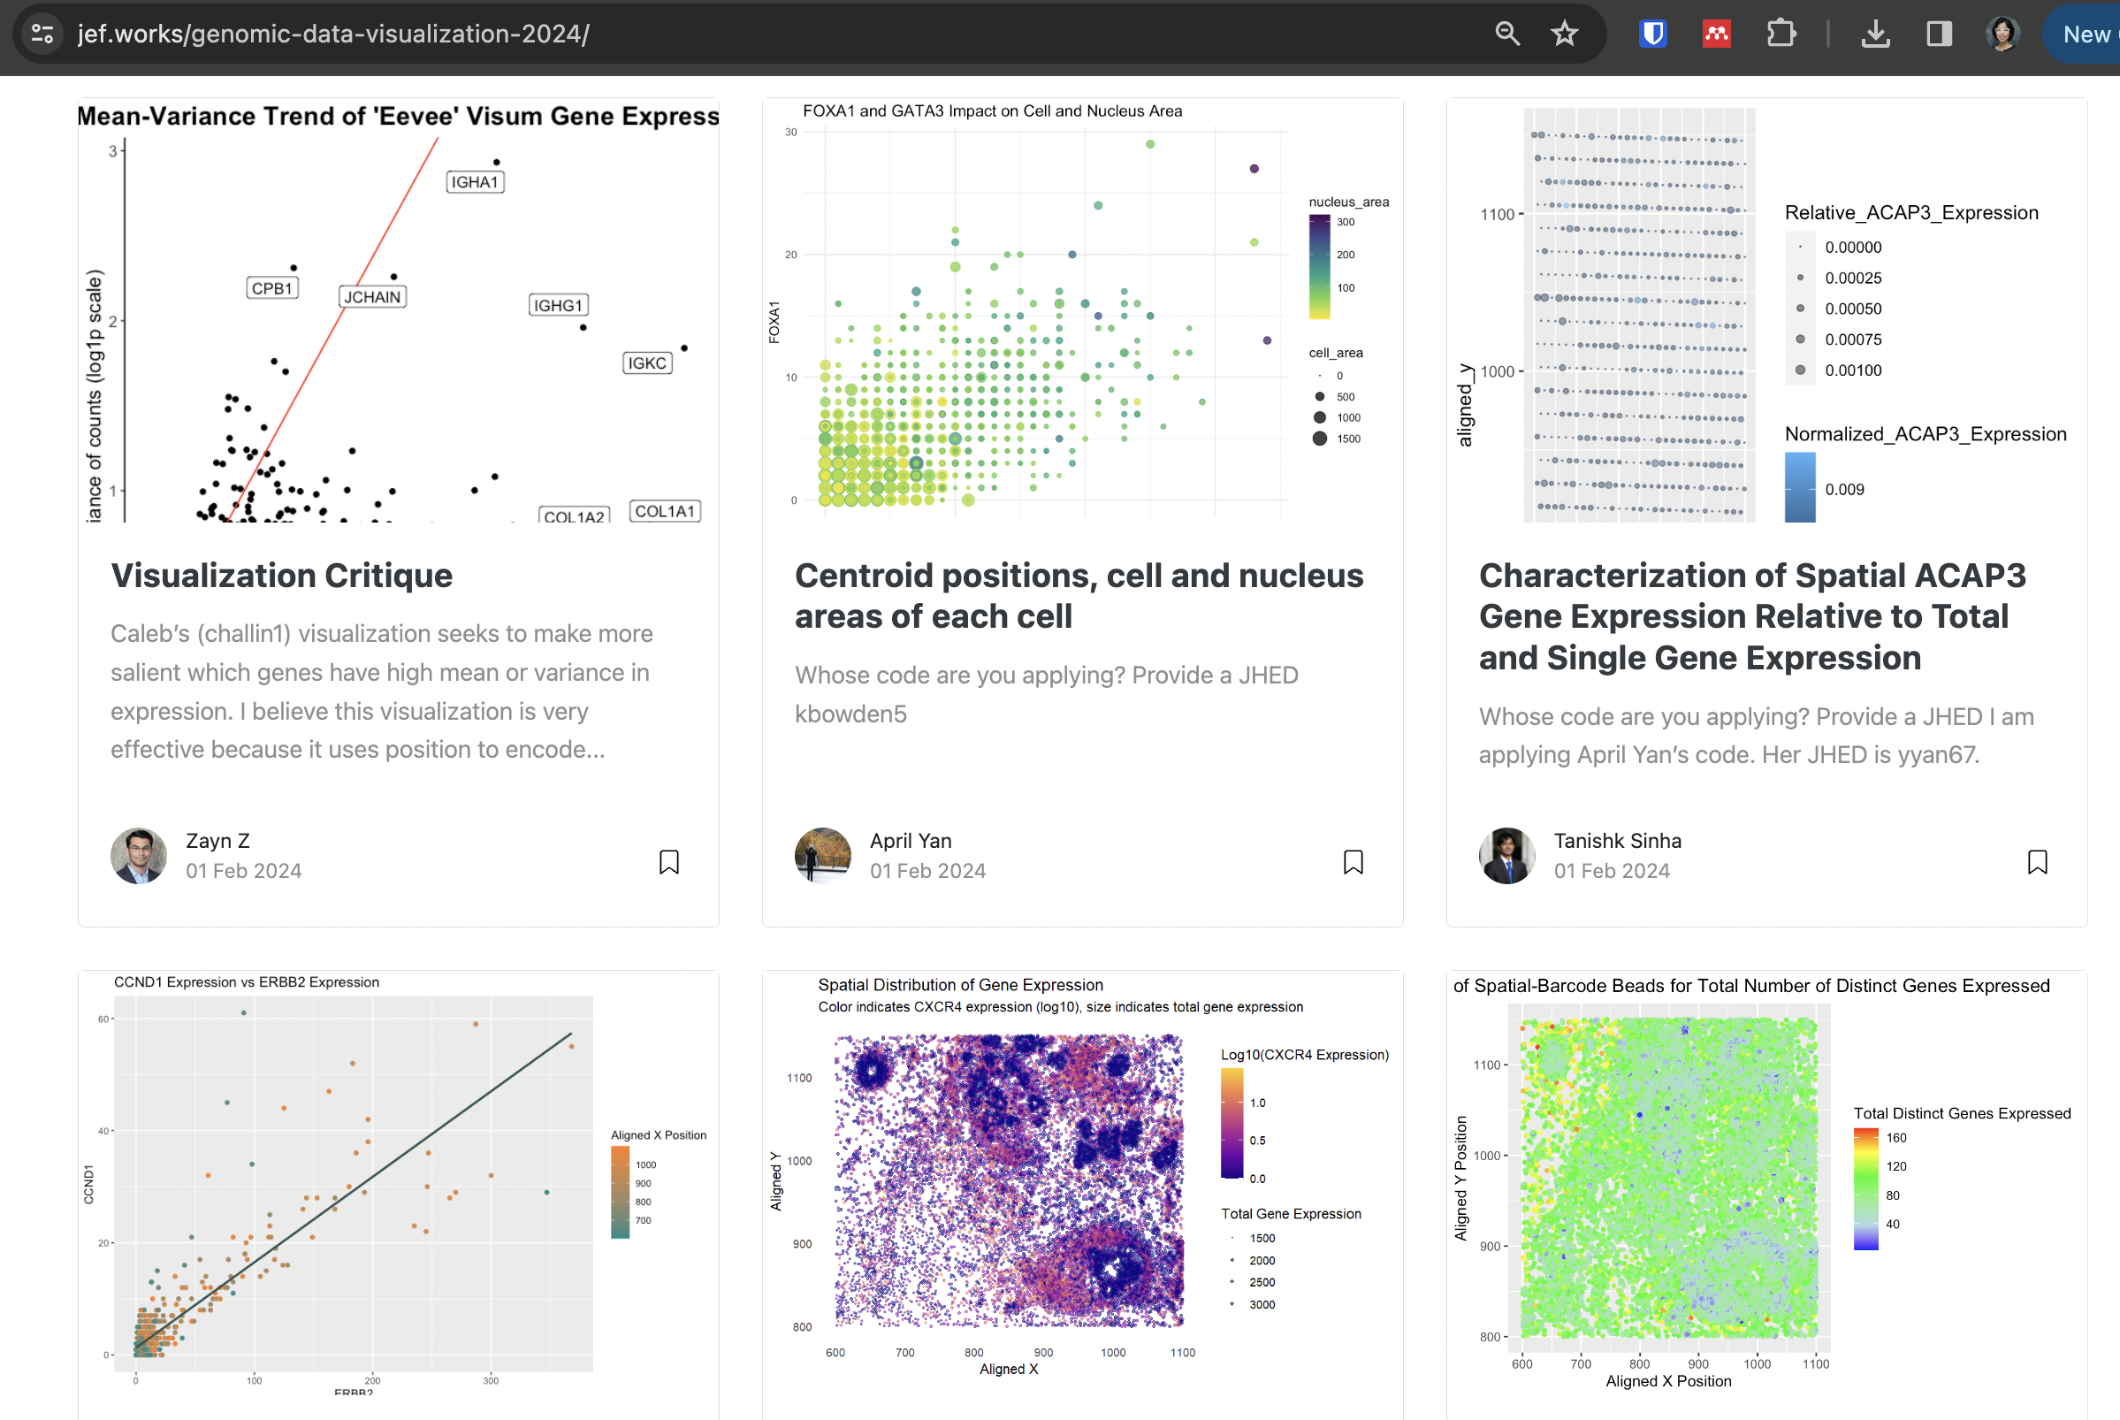
Peer review (HW2)

Slide 3
Lesson learning objectives
Learn about and apply k-means clustering
Practice interpreting data visualizations integrating normalization, dimensionality reduction, and k-means as review for Friday’s quiz

Slide 4
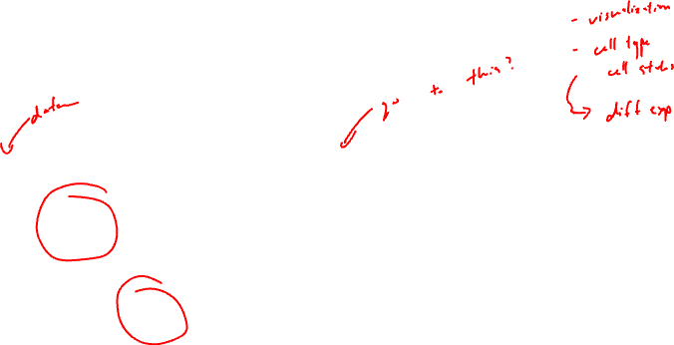
Why cluster?
Gene B
Gene B
Gene A
Gene A

Slide 5

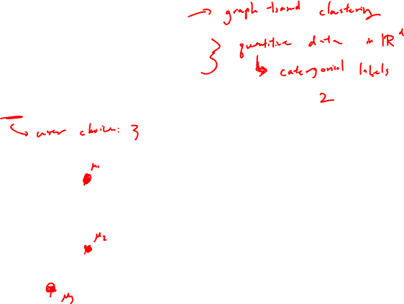
K-means clustering algorithm
Step 1: randomly place k centroids
Gene B
Gene A

Slide 6
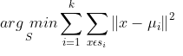
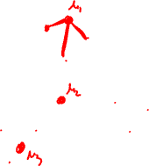
K-means clustering algorithm
Step 2: for each observation (x), find the nearest centroid
Gene B
Gene A

Slide 7

K-means clustering algorithm
Step 3: assign the observation (x) to that cluster
1
Gene B
2
3
Gene A

Slide 8

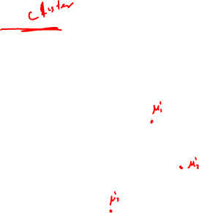
K-means clustering algorithm
Step 4: for each centroid, recompute to find a new centroid based on the observations in that cluster
Gene B
Gene A

Slide 9
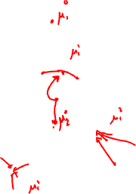
K-means clustering algorithm
Step 5: repeat steps 2 through 4 until cluster assignments no longer change
1
Gene B
2
3
Gene A

Slide 10
K-means clustering algorithm
Step 5: repeat steps 2 through 4 until cluster assignments no longer change
1
Gene B
2
3
Gene A

Slide 11
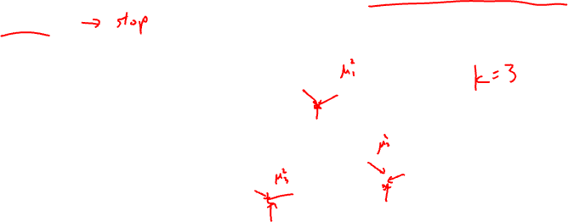
K-means clustering algorithm
Step 5: repeat steps 2 through 4 until cluster assignments no longer change
1
Gene B
2
3
Gene A

Slide 12

How to pick an appropriate k?
What if I had picked k = 2?
Gene B
Gene A

Slide 13
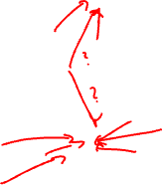
How to pick an appropriate k?
What if I had picked k = 2?
1
Gene B
2
Gene A

Slide 14
How to pick an appropriate k?
What if I had picked k = 2?
1
Gene B
2
Gene A

Slide 15
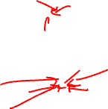
How to pick an appropriate k?
What if I had picked k = 2?
1
Gene B
2
Gene A

Slide 16
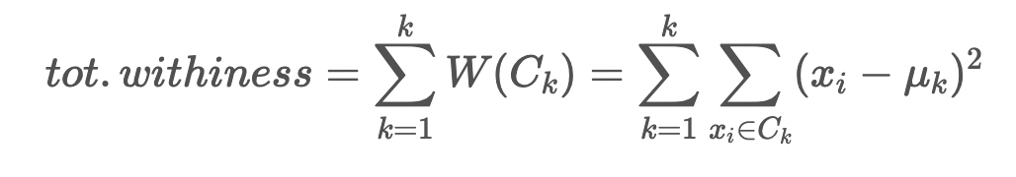
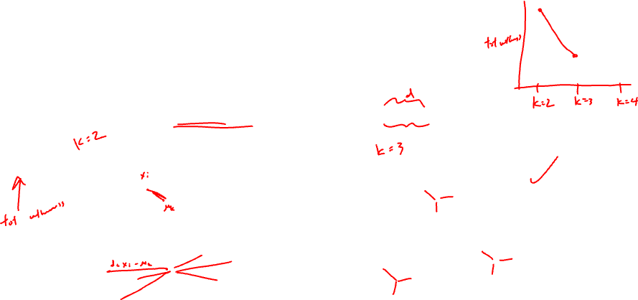
How to pick an appropriate k?
How does the within cluster sum of squares compare?
1
1
Gene B
Gene B
2
2
3
Gene A
Gene A

Slide 17
How to pick an appropriate k?
What if I had picked k = 4?
Gene B
Gene A

Slide 18
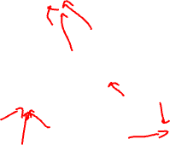
How to pick an appropriate k?
What if I had picked k = 4?
1
Gene B
3
2
4
Gene A

Slide 19
How to pick an appropriate k?
What if I had picked k = 4?
1
Gene B
3
2
4
Gene A

Slide 20
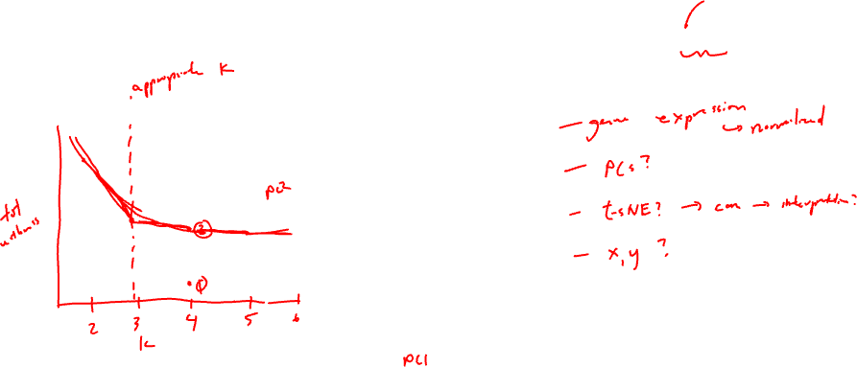
How to pick an appropriate k?
What if I had picked k = 4?
1
Gene B
3
4
2
Gene A

Slide 21
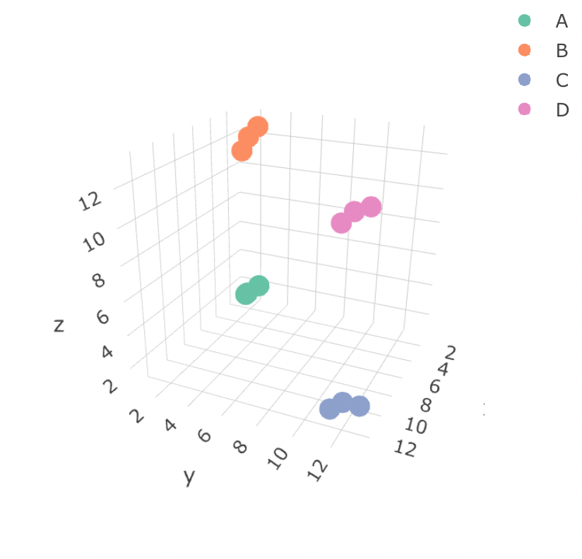
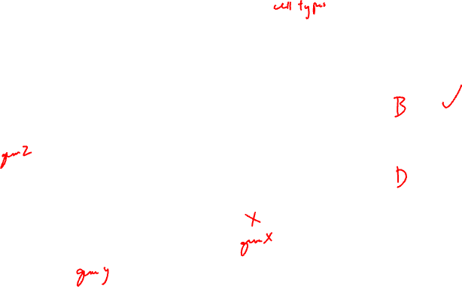
Based on this visualizations, which cell-type expresses more gene Z: cell-type B or cell-type D?
Practice

Slide 22
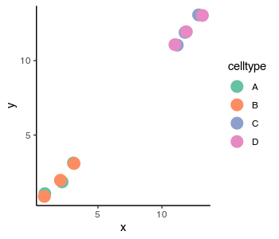
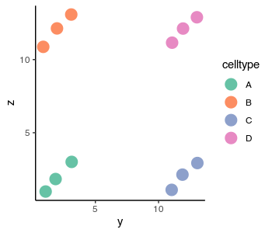

Based on this visualizations, which cell-type expresses more gene Z: cell-type B or cell-type D?
Practice

Slide 23
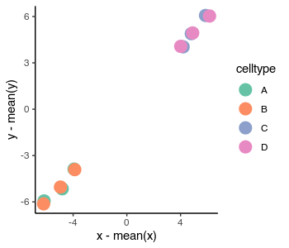
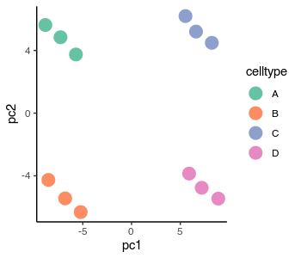
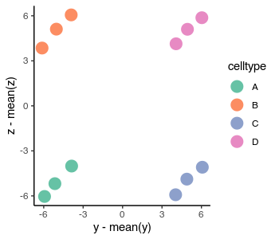
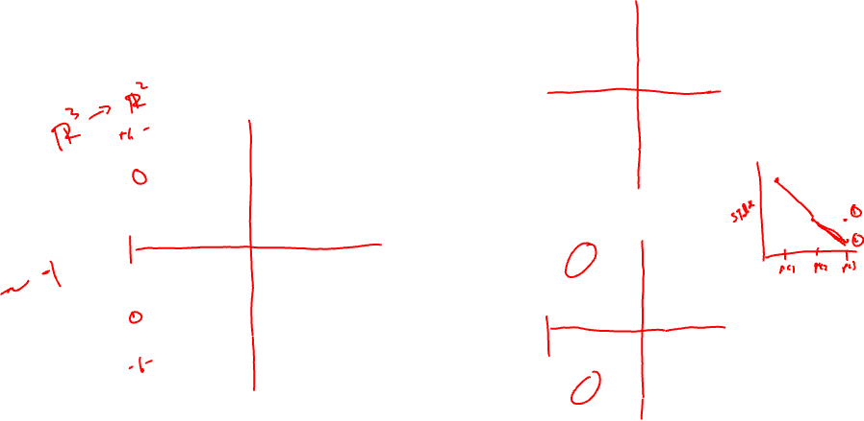
Based on these visualizations, what is the loading value of gene Z on PC2?
Practice

Slide 24
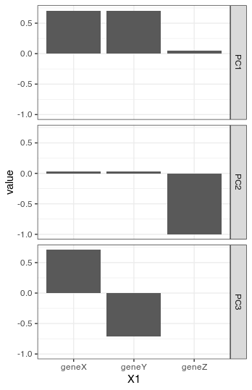
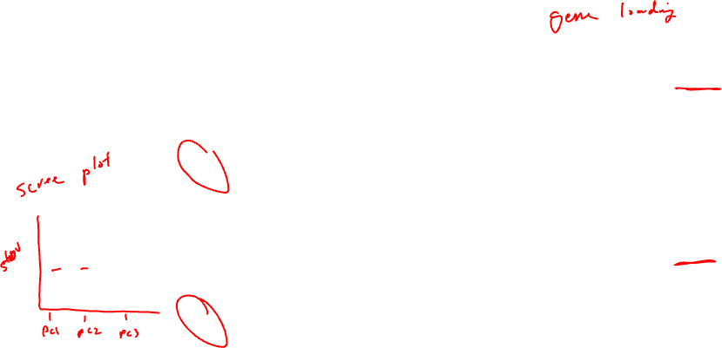
Based on these visualizations, which population expresses more gene Z: cell-type A or B?
Practice

Slide 25
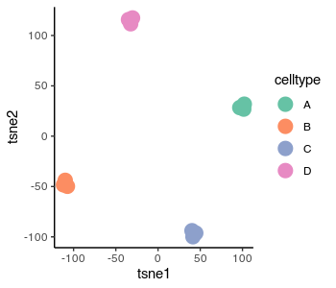
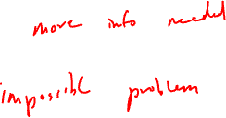
Based on this t-SNE plot, which population expresses more gene Z: cell-type A or B? What other information do you need to answer this question?
Practice

Slide 26
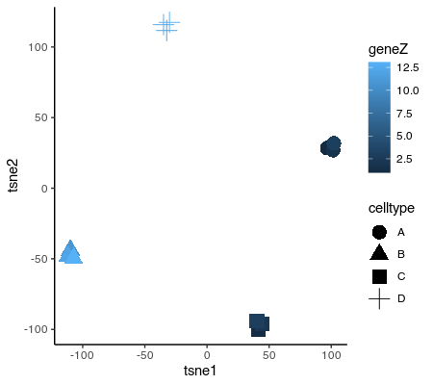
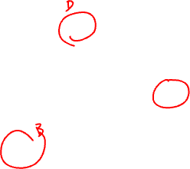
Based on this t-SNE plot, which population expresses more gene Z: cell-type A or B? What other information do you need to answer this question?
Practice

Slide 27

What can we run k-means clustering on? Will the clusters we get be similar?
Practice
Gene expression?
PCs?
tSNE?

Slide 28
Reflection card
https://bit.ly/GDV24_rc

