Slide 1

EN.580.428 Genomic Data Visualization Lesson 4 Linear Dimensionality Reduction: Principal Components Analysis
Prof. Jean Fan

Slide 2
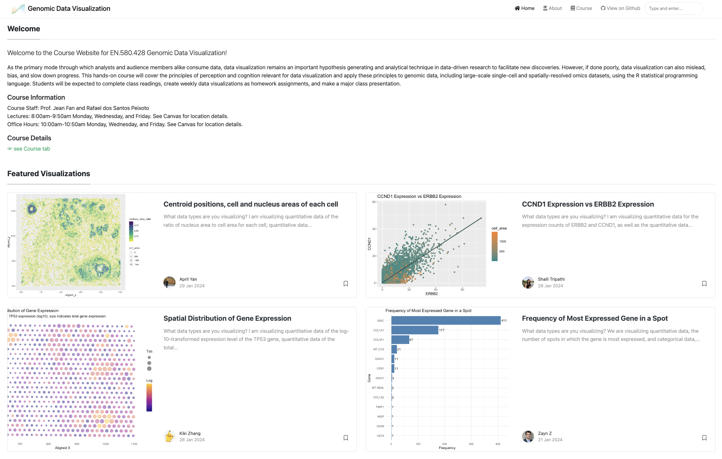

Announcements
Quiz1 will be returned on Friday
HW1 integrated into class website

Slide 3
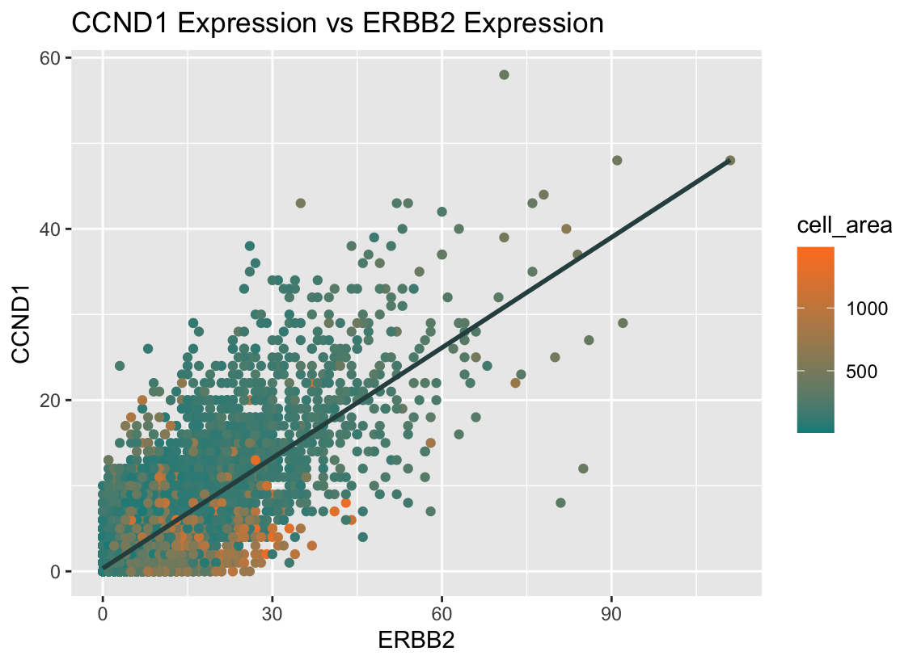

Features

Slide 4
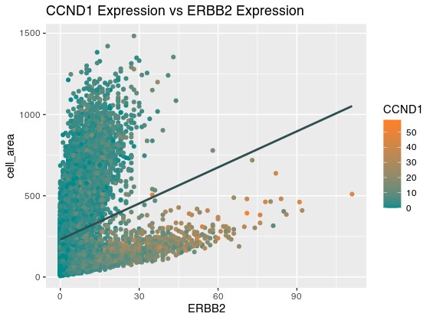

Features

Slide 5
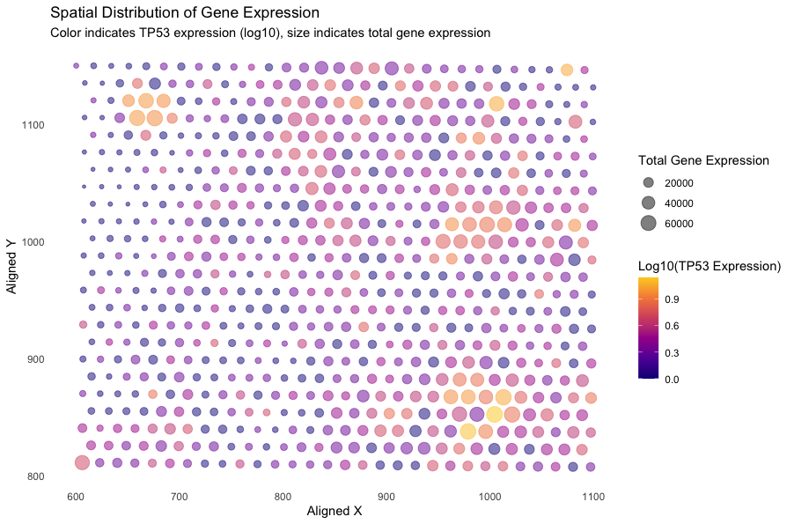

Features

Slide 6
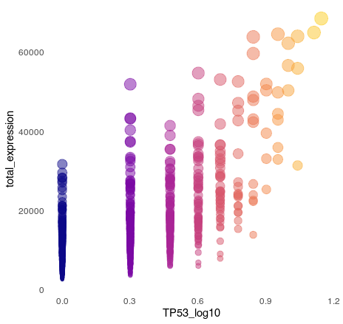
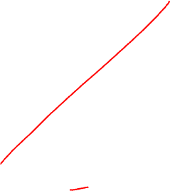
Features

Slide 7

HW2 – learn from your classmates (due Thursday midnight)
Choose another classmate’s data visualization from the class website. Apply their code to your data.
Critique the resulting visualization when applied to your data. Do you think the author was effective in making salient the point they said they wanted to make? How could you improve the data visualization in making salient the point they said they wanted to make? If you don’t think the data visualization can be improved, explain why the data visualization is already effective.
If they visualize a gene that’s not in your dataset, feel free to pick another
If they visualize a feature like cell-area that’s not in your dataset, feel free to use total number of genes as an alternative

Slide 8
Lesson learning objectives
Learn about and apply linear dimensionality reduction via principal components analysis

Slide 9
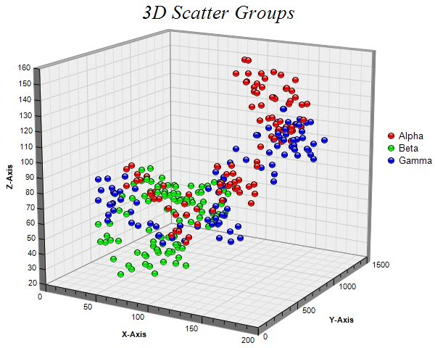
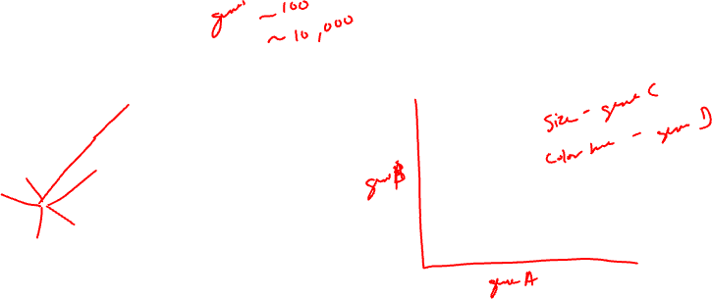
Why do we need dimensionality reduction?
4D?

Slide 10
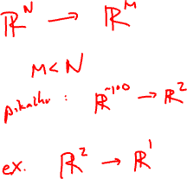
Linear dimensionality reduction: principal components analysis
Gene B
Gene A

Slide 11
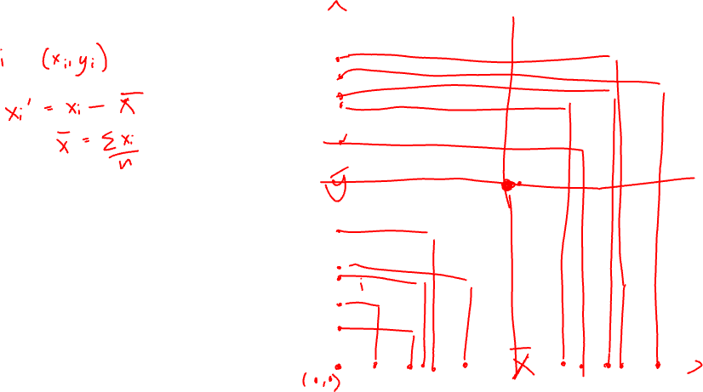
Step 1: center the data
Gene B
Gene A

Slide 12
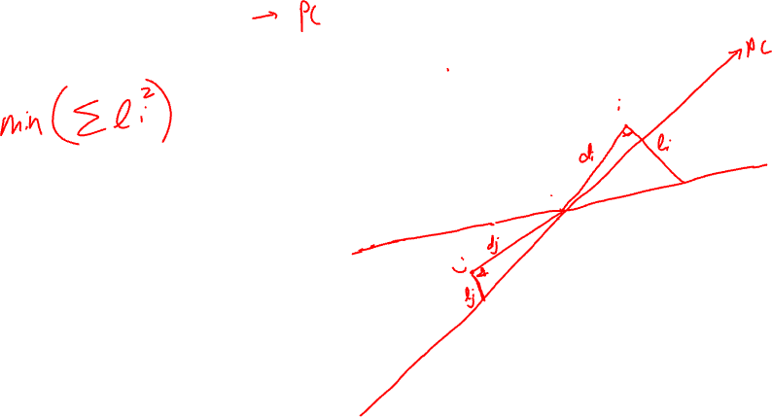
Step 2: find the of best fit
Gene B
Gene A

Slide 13
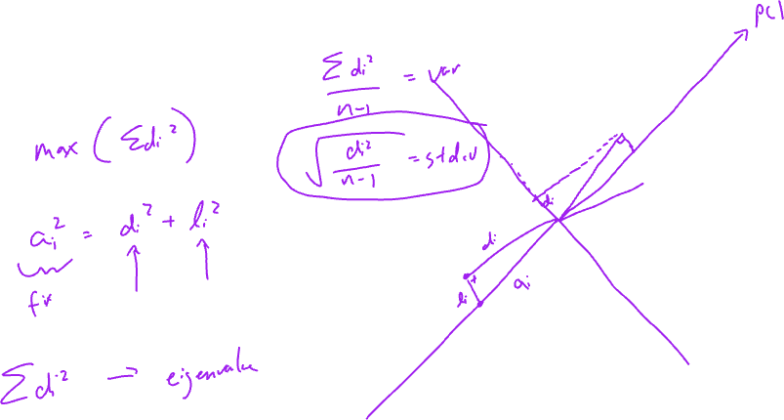
Equivalent Step 2: find the line of best fit
Gene B
Gene A

Slide 14
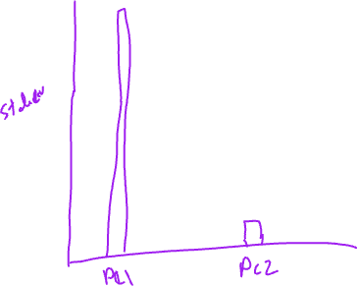
Scree plot: PC# vs stdev

Slide 15
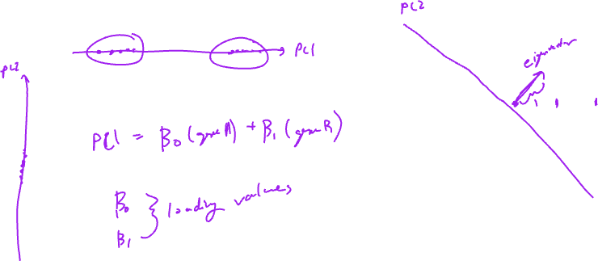
PCs are linear combinations of genes (why this is linear dimensionality reduction)
PC1
Gene B
Gene A

Slide 16
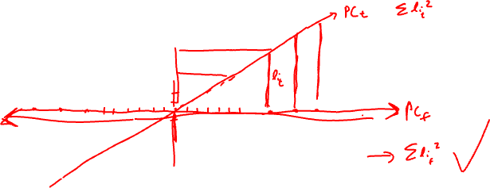
Consider the following centered gene expression
Practice
Are solutions unique?
Gene B
Gene A

Slide 17
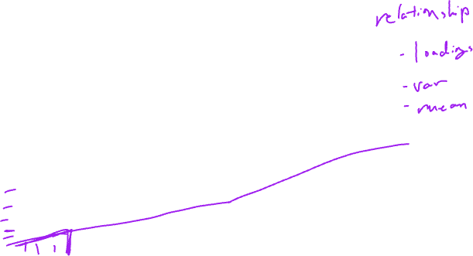
Genes that are more highly expressed tend to be more variable. How does this impact our PCs?
Practice
Gene B
Gene A

Slide 18
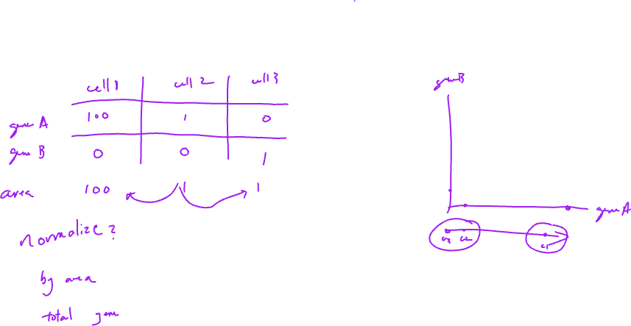
Gene expression is correlated with cell size (for imaging-based ST) or number of cells per spot (for sequencing-based ST). How does this impact our PCs?
Practice

Slide 19
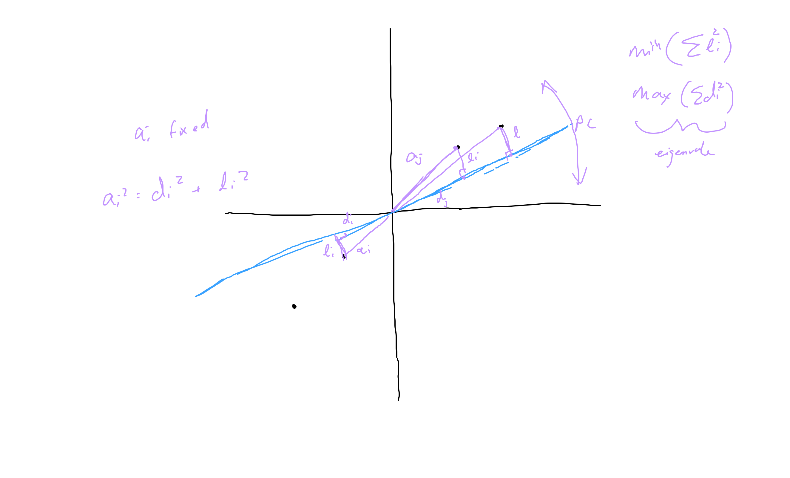
error from previous slides: a and d swapped

Slide 20
For next class, please install these R packages
Rtsne
install.packages('Rtsne’)
patchwork
https://patchwork.data-imaginist.com/

Slide 21
Reflection card
https://bit.ly/GDV24_rc

